Slide 1
CS 341: Algorithms
Lecture 7: finishing greedy
Readings: see website
Trevor Brown
https://student.cs.uwaterloo.ca/~cs341
trevor.brown@uwaterloo.ca

Slide 2
Assumed: profit / weight ratios are distinct
Last time: exchange argument for interval selection

Slide 3
What if profit/weight ratios are not distinct?
Or, more generally,
What if there are many opt solutions?

Slide 4
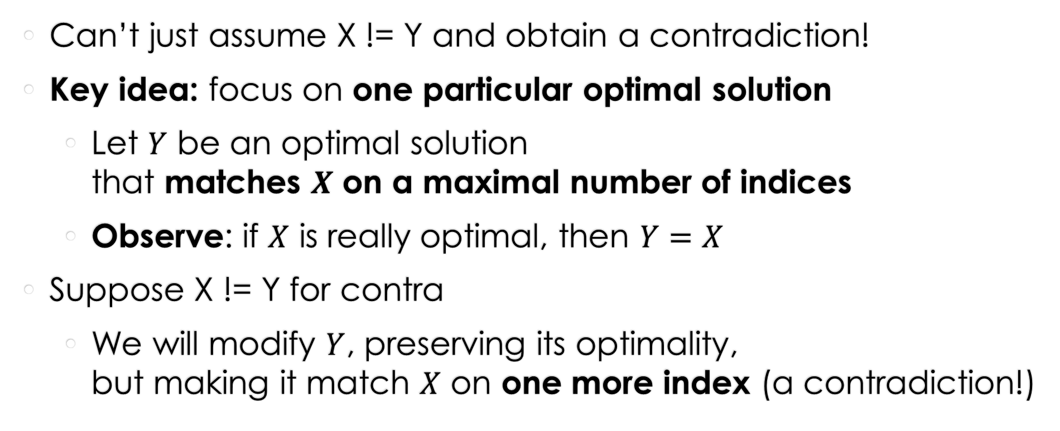
What if there are many optimal solutions
Can’t just assume X != Y and obtain a contradiction!
Key idea: focus on one particular optimal solution
  Let $Y$ be an optimal solution
  that matches $X$ on a maximal number of indices
  Observe: if $X$ is really optimal, then $Y=X$
Suppose X != Y for contra
  We will modify $Y$, preserving its optimality,
  but making it match $X$ on one more index (a contradiction!)

Slide 5
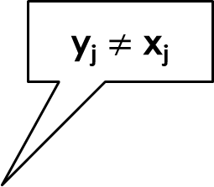
j = first index where the solutions differ
Greedy solution X
Optimal solution Y
1
1
x₁
x₂
x_{j-1}
x_{j}
y₁
y₂
y_{j-1}
y_{j} $≠$ x_{j}
fraction of item in knapsack
…
…
0
0
Item 1
Item j
Item n
Item 1
Item j
Item n
Item 2
Item 2

Slide 6
Greedy solution X
Optimal solution Y
1
1
x₁
x₂
x_{j-1}
x_{j}
y₁
y₂
y_{j-1}
fraction of item in knapsack
…
…
Must have
y_{j} < x_{j}
y_{j}
0
0
Item 1
Item j
Item n
Item 1
Item j
Item n
Item 2
Item 2

Slide 7
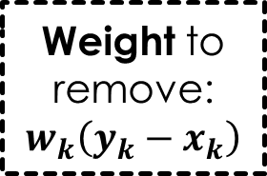

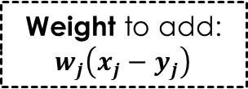

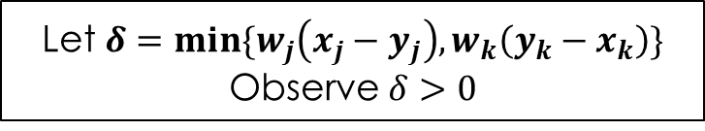
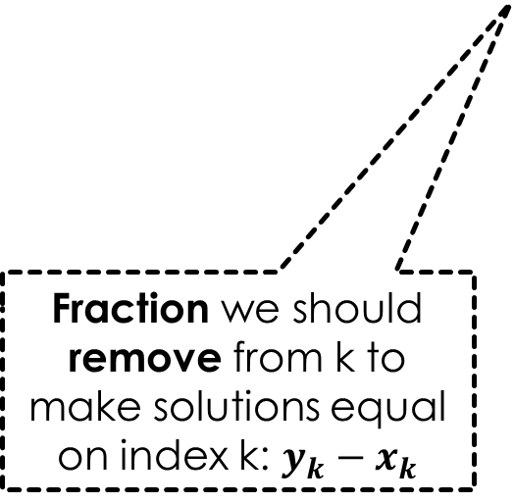
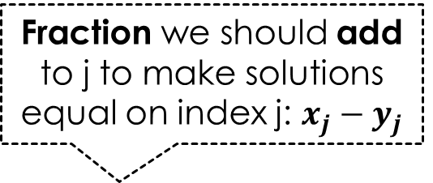
Optimal solution Y
Fraction we should add to j to make solutions equal on index j: $x_{j}−y_{j}$
Greedy solution X
1
1
Weight to add: $w_{j}\left(x_{j}−y_{j}\right)$
x₁
x₂
x_{j-1}
x_{j}
y₁
y₂
y_{j-1}
fraction of item in knapsack
…
…
y_{k}
x_{k}
y_{j}
0
0
Item 1
Item j
Item k
Item n
Item 1
Item j
Item k
Item n
Item 2
Item 2
Must exist k > j such that y_{k} > x_{k} because weight of $X$ and $Y$ must be the same
Fraction we should remove from k to make solutions equal on index k: $y_{k}−x_{k}$
Weight to remove: $w_{k}\left(y_{k}−x_{k}\right)$
Remove some weight $δ$ of item k and
add the same weight of item j
With the goal of making the solutions equal on index k or index j
Let $δ=min\{w_{j}\left(x_{j}−y_{j}\right),w_{k}\left(y_{k}−x_{k}\right)\}$
Observe $δ>0$

Slide 8
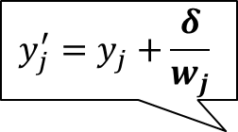
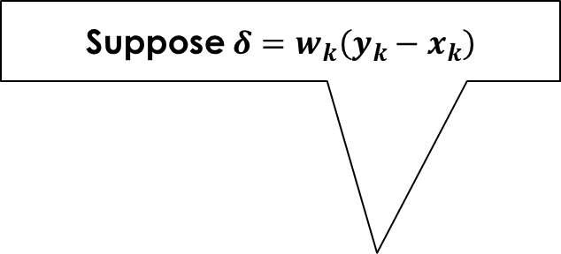
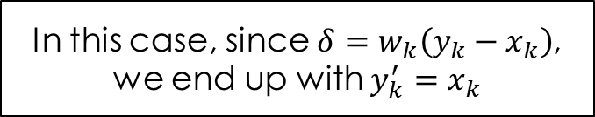
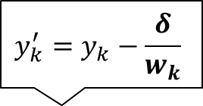
Optimal solution Y
Greedy solution X
Suppose $δ=w_{k}\left(y_{k}−x_{k}\right)$
1
1
x₁
x₂
x_{j-1}
x_{j}
y₁
y₂
y_{j-1}
fraction of item in knapsack
…
…
y_{k}
x_{k}
y_{j}
0
0
Item 1
Item j
Item k
Item n
Item 1
Item j
Item k
Item n
Item 2
Item 2
1
$$y_{j}^{′}=y_{j}+\frac{δ}{w_{j}}$$
y₁
y₂
y_{j-1}
$$y_{k}^{′}=y_{k}−\frac{δ}{w_{k}}$$
Modified optimal solution Y’
…
y_{j}’
In this case, since $δ=w_{k}\left(y_{k}−x_{k}\right)$,
we end up with $y_{k}^{′}=x_{k}$
y_{k}’
0
If $δ$ were $w_{j}\left(x_{j}−y_{j}\right)$, we would have $y_{j}^{′}=$ $x_{j}$

Slide 9
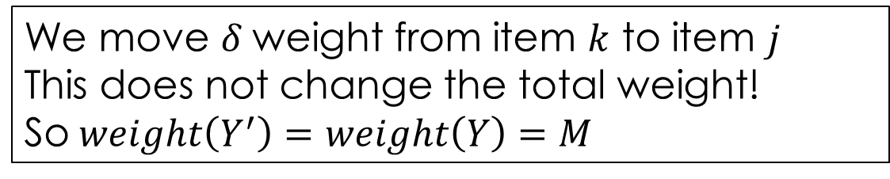

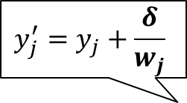
1
$$y_{j}^{′}=y_{j}+\frac{δ}{w_{j}}$$
y₁
y₂
y_{j-1}
$$y_{k}^{′}=y_{k}−\frac{δ}{w_{k}}$$
Modified optimal solution Y’
…
y_{j}’
y_{k}’
0
To show $Y^{′}$ is feasible, we show $weight\left(Y^{′}\right)≤M$ and $y_{k}^{′}≥0, y_{j}^{′}≤1$
Weight
We move $δ$ weight from item $k$ to item $j$
This does not change the total weight!
So $weight\left(Y^{′}\right)=weight\left(Y\right)=M$

Slide 10
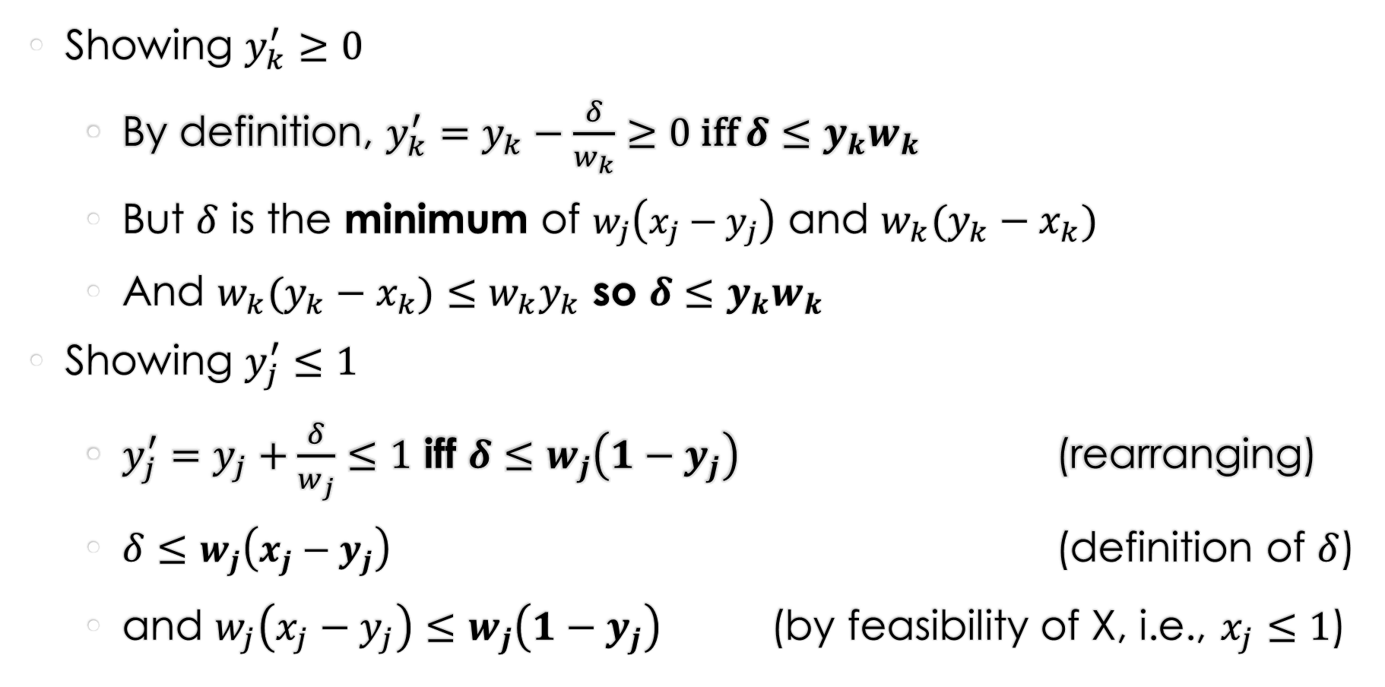

Feasibility of $Y′$
Showing $y_{k}^{′}≥0$
  By definition, $y_{k}^{′}=y_{k}−\frac{δ}{w_{k}}≥0$ iff $δ≤y_{k}w_{k}$
  But $δ$ is the minimum of $w_{j}\left(x_{j}−y_{j}\right)$ and $w_{k}(y_{k}−x_{k})$
  And $w_{k}(y_{k}−x_{k})≤{w_{k}y}_{k}$ so $δ≤y_{k}w_{k}$
Showing $y_{j}^{′}≤1$
  $y_{j}^{′}=y_{j}+\frac{δ}{w_{j}}≤1$ iff $δ≤w_{j}\left(1−y_{j}\right)$ (rearranging)
  $δ≤w_{j}\left(x_{j}−y_{j}\right)$ (definition of $δ$)
  and $w_{j}\left(x_{j}−y_{j}\right)≤w_{j}\left(1−y_{j}\right)$ (by feasibility of X, i.e., $x_{j}≤1$)

Slide 11
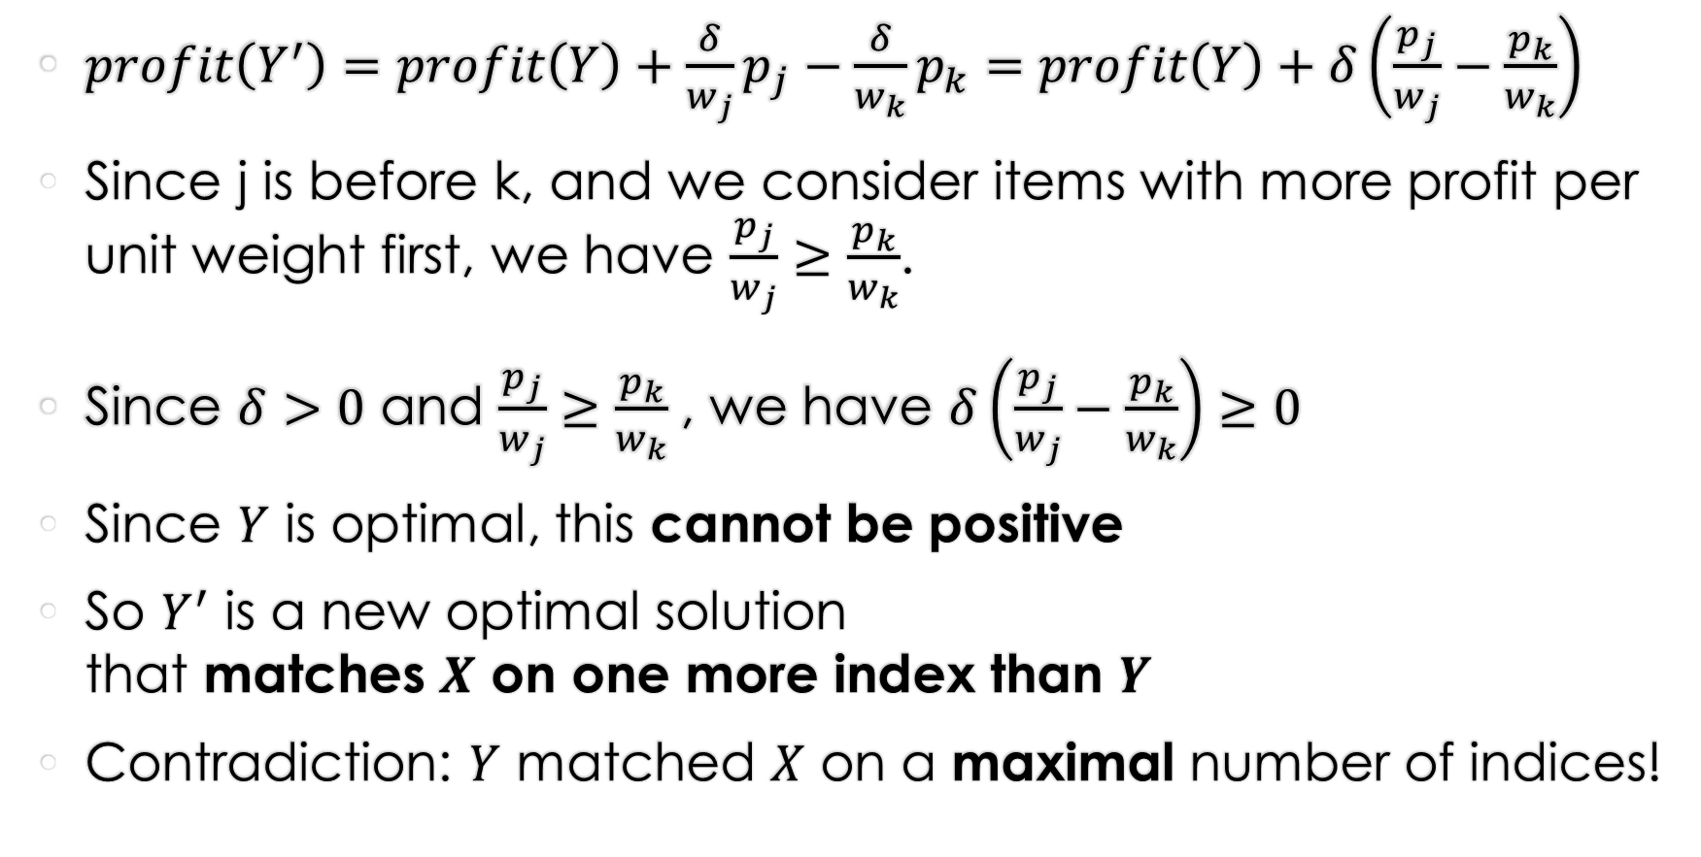

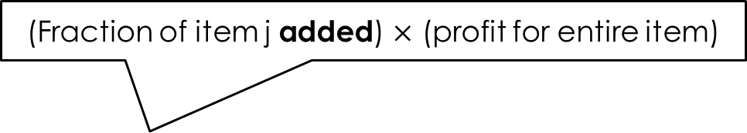
Profit of $Y′$
(Fraction of item j added) $×$ (profit for entire item)
$profit\left(Y^{′}\right)=profit\left(Y\right)+\frac{δ}{w_{j}}p_{j}−\frac{δ}{w_{k}}p_{k}=profit\left(Y\right)+δ\left(\frac{p_{j}}{w_{j}}−\frac{p_{k}}{w_{k}}\right)$
Since j is before k, and we consider items with more profit per unit weight first, we have $\frac{p_{j}}{w_{j}}≥\frac{p_{k}}{w_{k}}$.
Since $δ>0$ and $\frac{p_{j}}{w_{j}}≥\frac{p_{k}}{w_{k}}$, we have $δ\left(\frac{p_{j}}{w_{j}}−\frac{p_{k}}{w_{k}}\right)≥0$
Since $Y$ is optimal, this cannot be positive
So $Y^{′}$ is a new optimal solution
that matches $X$ on one more index than $Y$
Contradiction: $Y$ matched $X$ on a maximal number of indices!

Slide 12
Summarizing exchange arguments
If there is a unique optimal solution
  Let O != G be an optimal solution that beats greedy
  Show how to change O to obtain a better solution
If there is more than one optimal solution
  Let O != G be an optimal solution that matches greedy on as many choices as possible
  Show how to change O to obtain an optimal solution O’ that matches greedy for even more choice(s)

Slide 13
Finishing up greedy

Slide 14
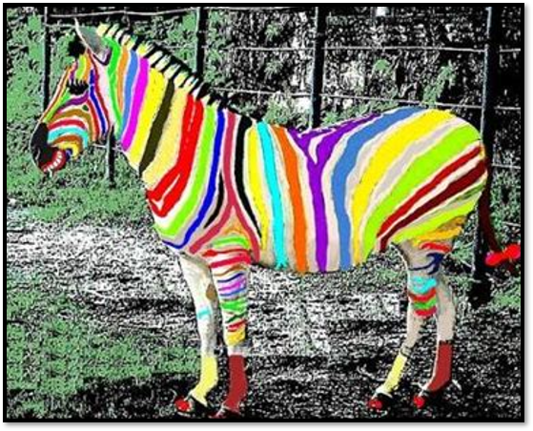
Interval Colouring

Slide 15
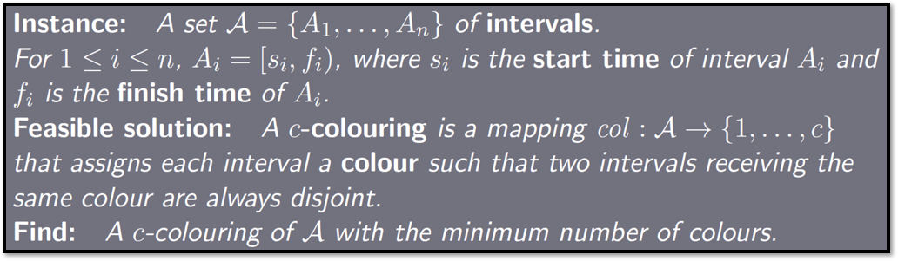
Problem: Interval colouring
Example
7 intervals,
7 colours.
Feasible, but
not optimal

Slide 16
More examples
Same color,
but not disjoint…
Example
Not feasible!
Example
7 intervals,
6 colours.
Feasible, but
not optimal
Same color,
but disjoint. OK!
Same color,
but disjoint. OK!
Example
7 intervals,
2 colours.
Optimal

Slide 17
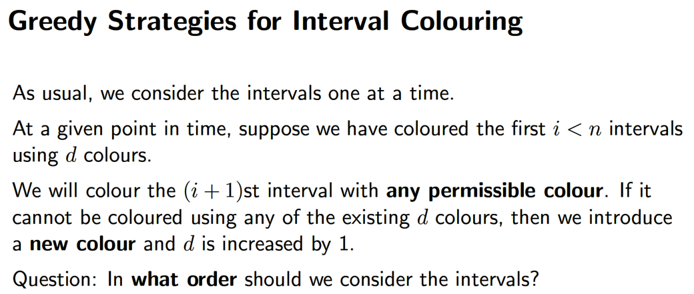

Slide 18
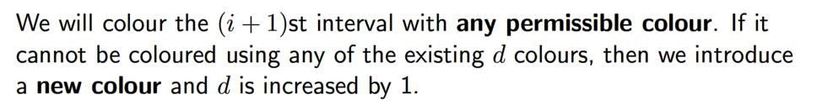
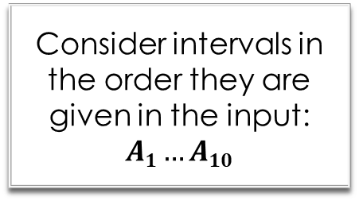
Example: order matters!
A₁
A₂
A₃
A₄
A₅
A₆
A₇
A₈
A₉
A₁₀
Consider intervals in the order they are given in the input: $A1…A10$
0
2
4
6
8
10
12
14
16
18
20
x-axis

Slide 19
Example: order matters!
A₁ | 1
A₂ |  |  |  |  |  |  |  |  | 1
A₃ |  |  |  |  |  |  |  |  |  |  |  |  |  |  | 1
A₄ |  |  |  | 2
A₅
A₆
A₇
A₈
A₉
A₁₀
0
2
4
6
8
10
12
14
16
18
20
x-axis

Slide 20
Example: order matters!
A₁ | 1
A₂ |  |  |  |  |  |  |  |  | 1
A₃ |  |  |  |  |  |  |  |  |  |  |  |  |  |  | 1
A₄ |  |  |  | 2
A₅
A₆
A₇
A₈
A₉
A₁₀
0
2
4
6
8
10
12
14
16
18
20
x-axis

Slide 21
Example: order matters!
A₁ | 1
A₂ |  |  |  |  |  |  |  |  | 1
A₃ |  |  |  |  |  |  |  |  |  |  |  |  |  |  | 1
A₄ |  |  |  | 2
A₅
A₆
A₇
A₈
A₉
A₁₀
0
2
4
6
8
10
12
14
16
18
20
x-axis

Slide 22
Example: order matters!
A₁ | 1
A₂ |  |  |  |  |  |  |  |  | 1
A₃ |  |  |  |  |  |  |  |  |  |  |  |  |  |  | 1
A₄ |  |  |  | 2
A₅
A₆
A₇
A₈
A₉
A₁₀
0
2
4
6
8
10
12
14
16
18
20
x-axis

Slide 23
Example: order matters!
A₁ | 1
A₂ |  |  |  |  |  |  |  |  | 1
A₃ |  |  |  |  |  |  |  |  |  |  |  |  |  |  | 1
A₄ |  |  |  | 2
A₅ |  |  |  |  |  |  |  |  |  |  |  |  |  |  |  |  | 2
A₆
A₇
A₈
A₉
A₁₀
0
2
4
6
8
10
12
14
16
18
20
x-axis

Slide 24
Example: order matters!
A₁ | 1
A₂ |  |  |  |  |  |  |  |  | 1
A₃ |  |  |  |  |  |  |  |  |  |  |  |  |  |  | 1
A₄ |  |  |  | 2
A₅ |  |  |  |  |  |  |  |  |  |  |  |  |  |  |  |  | 2
A₆ |  |  |  |  |  |  | 3
A₇
A₈
A₉
A₁₀
0
2
4
6
8
10
12
14
16
18
20
x-axis

Slide 25
Example: order matters!
A₁ | 1
A₂ |  |  |  |  |  |  |  |  | 1
A₃ |  |  |  |  |  |  |  |  |  |  |  |  |  |  | 1
A₄ |  |  |  | 2
A₅ |  |  |  |  |  |  |  |  |  |  |  |  |  |  |  |  | 2
A₆ |  |  |  |  |  |  | 3
A₇ |  |  |  |  |  |  |  |  |  |  | 2
A₈
A₉
A₁₀
0
2
4
6
8
10
12
14
16
18
20
x-axis

Slide 26
Example: order matters!
A₁ | 1
A₂ |  |  |  |  |  |  |  |  | 1
A₃ |  |  |  |  |  |  |  |  |  |  |  |  |  |  | 1
A₄ |  |  |  | 2
A₅ |  |  |  |  |  |  |  |  |  |  |  |  |  |  |  |  | 2
A₆ |  |  |  |  |  |  | 3
A₇ |  |  |  |  |  |  |  |  |  |  | 2
A₈ | 4
A₉
A₁₀
0
2
4
6
8
10
12
14
16
18
20
x-axis

Slide 27
Example: order matters!
A₁ | 1
A₂ |  |  |  |  |  |  |  |  | 1
A₃ |  |  |  |  |  |  |  |  |  |  |  |  |  |  | 1
A₄ |  |  |  | 2
A₅ |  |  |  |  |  |  |  |  |  |  |  |  |  |  |  |  | 2
A₆ |  |  |  |  |  |  | 3
A₇ |  |  |  |  |  |  |  |  |  |  | 2
A₈ | 4
A₉ |  |  |  |  |  |  |  |  |  |  |  |  | 4
A₁₀
0
2
4
6
8
10
12
14
16
18
20
x-axis

Slide 28
Example: order matters!
A₁ | 1
A₂ |  |  |  |  |  |  |  |  | 1
A₃ |  |  |  |  |  |  |  |  |  |  |  |  |  |  | 1
A₄ |  |  |  | 2
A₅ |  |  |  |  |  |  |  |  |  |  |  |  |  |  |  |  | 2
A₆ |  |  |  |  |  |  | 3
A₇ |  |  |  |  |  |  |  |  |  |  | 2
A₈ | 4
A₉ |  |  |  |  |  |  |  |  |  |  |  |  | 4
A₁₀ | 3
Used 4 colours
Can we do better?
0
2
4
6
8
10
12
14
16
18
20
x-axis

Slide 29
Example: order matters!
A₁
A₂
A₃
A₄
A₅
A₆
A₇
A₈
A₉
A₁₀
Pre-sort intervals by increasing start time!
0
2
4
6
8
10
12
14
16
18
20
x-axis

Slide 30
Example: order matters!
A₁
A₂
A₃
A₄
A₅
A₆
A₇
A₈
A₉
A₁₀
Pre-sort intervals by increasing start time!
0
2
4
6
8
10
12
14
16
18
20
x-axis

Slide 31
Example: order matters!
A₁ | 1
A₂
A₃
A₄
A₅
A₆
A₇
A₈
A₉
A₁₀
0
2
4
6
8
10
12
14
16
18
20
x-axis

Slide 32
Example: order matters!
A₁ | 1
A₂ | 2
A₃
A₄
A₅
A₆
A₇
A₈
A₉
A₁₀
0
2
4
6
8
10
12
14
16
18
20
x-axis

Slide 33
Example: order matters!
A₁ | 1
A₂ | 2
A₃ | 3
A₄
A₅
A₆
A₇
A₈
A₉
A₁₀
0
2
4
6
8
10
12
14
16
18
20
x-axis

Slide 34
Example: order matters!
A₁ | 1
A₂ | 2
A₃ | 3
A₄
A₅
A₆
A₇
A₈
A₉
A₁₀
0
2
4
6
8
10
12
14
16
18
20
x-axis

Slide 35
Example: order matters!
A₁ | 1
A₂ | 2
A₃ | 3
A₄
A₅
A₆
A₇
A₈
A₉
A₁₀
0
2
4
6
8
10
12
14
16
18
20
x-axis

Slide 36
Example: order matters!
A₁ | 1
A₂ | 2
A₃ | 3
A₄
A₅
A₆
A₇
A₈
A₉
A₁₀
0
2
4
6
8
10
12
14
16
18
20
x-axis

Slide 37
Example: order matters!
A₁ | 1
A₂ | 2
A₃ | 3
A₄
A₅
A₆
A₇
A₈
A₉
A₁₀
0
2
4
6
8
10
12
14
16
18
20
x-axis

Slide 38
Example: order matters!
A₁ | 1
A₂ | 2
A₃ | 3
A₄
A₅
A₆
A₇
A₈
A₉
A₁₀
0
2
4
6
8
10
12
14
16
18
20
x-axis

Slide 39
Example: order matters!
A₁ | 1
A₂ | 2
A₃ | 3
A₄
A₅
A₆
A₇
A₈
A₉
A₁₀
0
2
4
6
8
10
12
14
16
18
20
x-axis

Slide 40
Example: order matters!
A₁ | 1
A₂ | 2
A₃ | 3
A₄
A₅
A₆
A₇
A₈
A₉
A₁₀
Used 3 colours
0
2
4
6
8
10
12
14
16
18
20
Turns out to be optimal…
x-axis

Slide 41
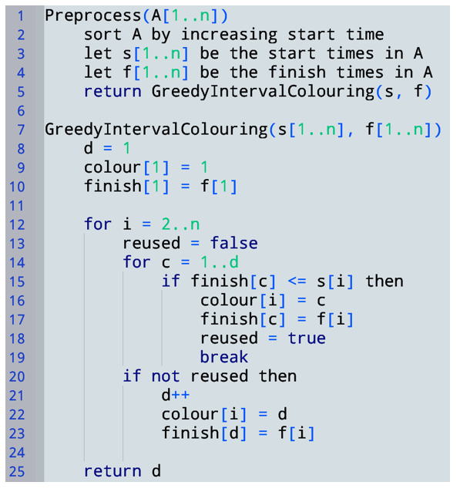

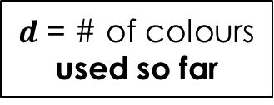
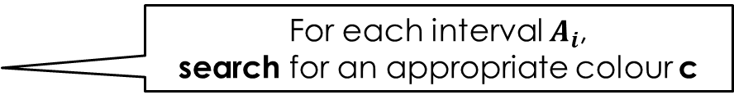
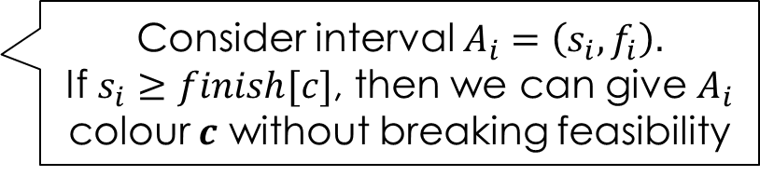
$d$ = # of colours used so far
$finish[c] =$ finish time of last interval to receive colour $c$
Interval 1 gets colour 1
For each interval $A_{i}$,
search for an appropriate colour c
Check if we can reuse any colour c in 1..d
Consider interval $A_{i}=\left(s_{i},f_{i}\right).$
If $s_{i}≥finish[c]$, then we can give $A_{i}$ colour $c$ without breaking feasibility
we reused a colour
If we didn’t reuse a colour,
use a new colour

Slide 42
Example: running greedy
Initial state
A₁
A₂
A₃
A₄
A₅
A₆
A₇
A₈
A₉
A₁₀
0
2
4
6
8
10
12
14
16
18
20
x-axis

Slide 43
Example: running greedy
i=1
d=1
finish[1]=
Code before the loop: just assign colour 1
A₁ | 1
A₂
A₃
A₄
A₅
A₆
A₇
A₈
A₉
A₁₀
0
2
4
6
8
10
12
14
16
18
20
x-axis

Slide 44

Example: running greedy
Is $finish\left[1\right]≤s2$?
i=2
d=1
finish[1]=
d=2
No. We cannot reuse colour 1.
While loop over c.
Check if we can reuse a color in 1..d
A₁ | 1
A₂
A₃
A₄
A₅
A₆
A₇
A₈
A₉
A₁₀
Cannot reuse any colour. Create a new one!
0
2
4
6
8
10
12
14
16
18
20
x-axis

Slide 45
Example: running greedy
Is $finish\left[1\right]≤s2$?
i=2
d=2
finish[1]=
finish[2]=
No. We cannot reuse colour 1.
While loop over c.
Check if we can reuse a color in 1..d
A₁ | 1
A₂ | 2
A₃
A₄
A₅
A₆
A₇
A₈
A₉
A₁₀
Cannot reuse any colour. Create a new one!
0
2
4
6
8
10
12
14
16
18
20
x-axis

Slide 46


Example: running greedy
Is $finish\left[1\right]≤s3$?
i=3
d=2
finish[1]=
finish[2]=
No. We cannot reuse colour 1.
While loop over c.
Check if we can reuse a color in 1..d
A₁ | 1
A₂ | 2
A₃
A₄
A₅
A₆
A₇
A₈
A₉
A₁₀
Is $finish\left[2\right]≤s3$?
No. We cannot reuse colour 2.
Cannot reuse any colour. Create new one.
0
2
4
6
8
10
12
14
16
18
20
x-axis

Slide 47
Example: running greedy
Is $finish\left[1\right]≤s3$?
i=3
d=3
finish[1]=
finish[2]=
finish[3]=
No. We cannot reuse colour 1.
While loop over c.
Check if we can reuse a color in 1..d
A₁ | 1
A₂ | 2
A₃ | 3
A₄
A₅
A₆
A₇
A₈
A₉
A₁₀
Is $finish\left[2\right]≤s3$?
No. We cannot reuse colour 2.
Cannot reuse any colour. Create new one.
0
2
4
6
8
10
12
14
16
18
20
x-axis

Slide 48

Example: running greedy
Is $finish\left[1\right]≤s4$?
i=4
d=3
finish[1]=
finish[2]=
finish[3]=
Yes. We can
reuse colour 1.
While loop over c.
Check if we can reuse a color in 1..d
A₁ | 1
A₂ | 2
A₃ | 3
A₄
A₅
A₆
A₇
A₈
A₉
A₁₀
0
2
4
6
8
10
12
14
16
18
20
x-axis

Slide 49
Example: running greedy
Is $finish\left[1\right]≤s4$?
i=4
d=3
finish[1]=
finish[2]=
finish[3]=
Yes. We can
reuse colour 1.
While loop over c.
Check if we can reuse a color in 1..d
A₁ | 1
A₂ | 2
A₃ | 3
A₄
A₅
A₆
A₇
A₈
A₉
A₁₀
0
2
4
6
8
10
12
14
16
18
20
x-axis

Slide 50



Example: running greedy
Is $finish\left[1\right]≤s5$?
i=5
d=3
finish[1]=
finish[2]=
finish[3]=
No. We cannot
reuse colour 1.
While loop over c.
Check if we can reuse a color in 1..d
A₁ | 1
A₂ | 2
A₃ | 3
A₄
A₅
A₆
A₇
A₈
A₉
A₁₀
Is $finish\left[2\right]≤s5$?
No. We cannot
reuse colour 2.
Is $finish\left[3\right]≤s5$?
Yes. We can
reuse colour 3.
0
2
4
6
8
10
12
14
16
18
20
x-axis

Slide 51
Example: running greedy
Is $finish\left[1\right]≤s5$?
i=5
d=3
finish[1]=
finish[2]=
finish[3]=
No. We cannot
reuse colour 1.
While loop over c.
Check if we can reuse a color in 1..d
A₁ | 1
A₂ | 2
A₃ | 3
A₄
A₅
A₆
A₇
A₈
A₉
A₁₀
Is $finish\left[2\right]≤s5$?
No. We cannot
reuse colour 2.
Is $finish\left[3\right]≤s5$?
Yes. We can
reuse colour 3.
And so on,
and so forth…
0
2
4
6
8
10
12
14
16
18
20
x-axis

Slide 52
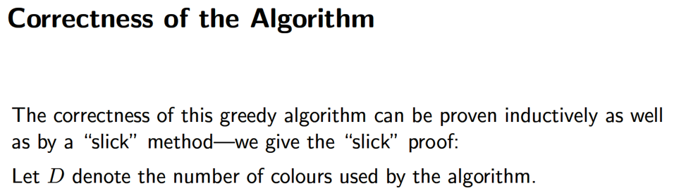

Slide 53

Let $F_{D}$ be the first interval that has colour $D$
$$F_{D}$$
 |  |  |  |  |  |  |  |  |  |  |  |  |  |  |  |  | D
x-axis
0
2
4
6
8
10
12
14
16
18
20

Slide 54
Let $F_{D}$ be the first interval that has colour $D$
We prove $F_{D}$ overlaps D-1 other intervals at a single point in time
$$F_{D}$$
 |  |  |  |  |  |  |  |  |  |  |  |  |  |  |  |  | D
x-axis
0
2
4
6
8
10
12
14
16
18
20

Slide 55
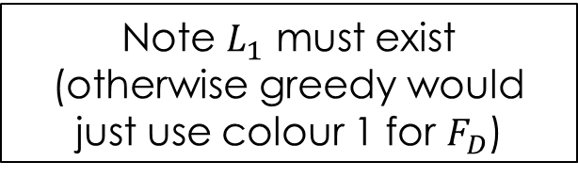
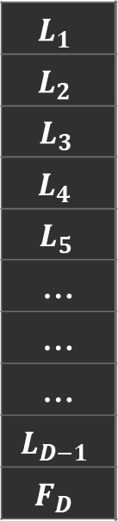


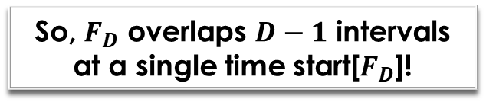

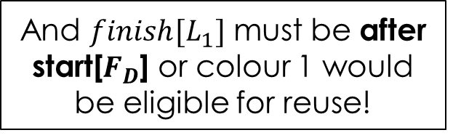
Let $F_{D}$ be the first interval that has colour $D$
Let’s argue this for $L_{1}$
Let $L_{c}$ be the last interval that has colour $c$ and starts before $F_{D}$
Note $L_{1}$ must exist
(otherwise greedy would
just use colour 1 for $F_{D}$)
We prove start[$F_{D}$] is properly contained in every such interval $L_{c}$
And $finish[L_{1}]$ must be after start[$F_{D}$] or colour 1 would be eligible for reuse!
$$L_{1}$$
$$L_{2}$$
$$L_{3}$$
$$L_{4}$$
$$L_{5}$$
…
…
…
$$L_{D−1}$$
$$F_{D}$$
 | 1
 | 2
 |  |  | 3
 |  |  |  | 4
 |  |  |  | 5
 |  |  |  |  |  |  |  |  | …
 |  |  |  |  |  |  |  |  |  |  | …
 |  |  |  |  |  |  |  |  |  |  |  |  | …
 |  |  |  |  |  |  |  |  |  |  |  |  |  |  | D-1
 |  |  |  |  |  |  |  |  |  |  |  |  |  |  |  |  | D
Same argument applies to $L_{2},…,L_{D−1}$
So, $F_{D}$ overlaps $D−1$ intervals at a single time start[$F_{D}$]!
So, we must use $D$ colours!
x-axis
0
2
4
6
8
10
12
14
16
18
20
Notes:
Note to self: I think finish time sorting also works, but you lose the ability to say that the intervals that justify the existence of colour D must have started BEFORE F_D (as they could start in the middle of F_D), and consequently you lose the ability to explicitly state at which single time the intervals that justify D’s existence all overlap. (I believe it becomes an existence proof rather than a constructive proof. With start times all intervals overlap at the start time of F_D, but with finish times they may only overlap at some time in the middle of F_D. And, it’s much harder to reason about all intervals overlapping at the *same* point if you can’t point constructively to that point.)

Slide 56
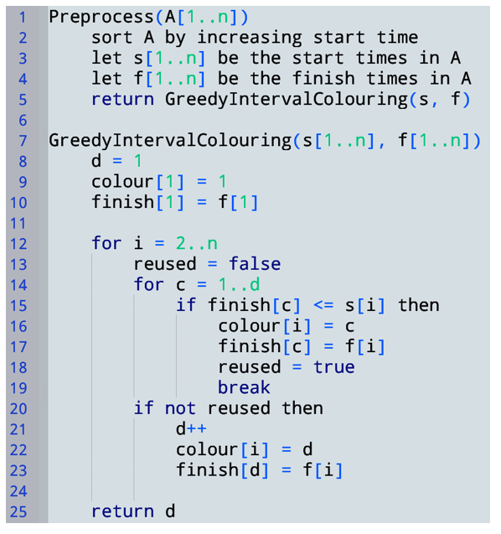


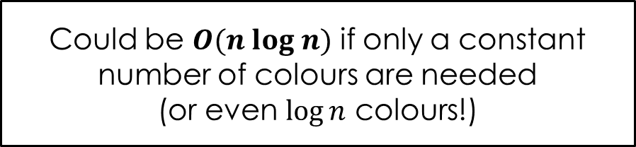



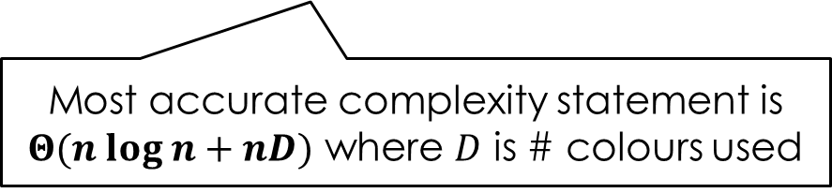
Time Complexity?
$$O(n\log{n)}$$
Total $O(n log n+ nd)$
Could be $O(n log n)$ if only a constant number of colours are needed
(or even $\log{n}$ colours!)
$O(n)$ iterations
Could be $O(n^{2})$ if $n$ colours are needed
$O(d)$ iterations…
Most accurate complexity statement is $Θ(n log n+nD)$ where $D$ is # colours used
What inefficiencies exist in this algorithm? Could we make it faster with clever data structure usage?

Slide 57
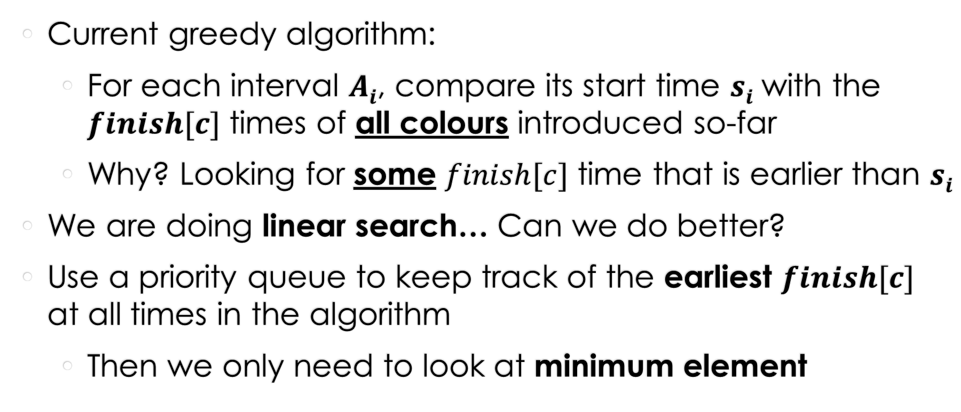
Improving this algorithm
Current greedy algorithm:
  For each interval $Ai$, compare its start time $si$ with the $finish[c]$ times of all colours introduced so-far
  Why? Looking for some $finish[c]$ time that is earlier than $si$
We are doing linear search… Can we do better?
Use a priority queue to keep track of the earliest $finish[c]$ at all times in the algorithm
  Then we only need to look at minimum element

Slide 58
Example: Heap-based algorithm
Initial state
A₁
A₂
A₃
A₄
A₅
A₆
A₇
A₈
A₉
A₁₀
Min element: NULL
Heap
0
2
4
6
8
10
12
14
16
18
20
x-axis

Slide 59
Example: Heap-based algorithm
Iteration i=1
Check heap minimum
Empty, so a new colour is needed
A₁
A₂
A₃
A₄
A₅
A₆
A₇
A₈
A₉
A₁₀
Min element: NULL
Heap
0
2
4
6
8
10
12
14
16
18
20
x-axis

Slide 60
Example: Heap-based algorithm
Iteration i=1
Check heap minimum
Empty, so a new colour is needed
A₁ | 1
A₂
A₃
A₄
A₅
A₆
A₇
A₈
A₉
A₁₀
Min element: NULL
finish at time 3
Heap
finish at time 3
0
2
4
6
8
10
12
14
16
18
20
x-axis

Slide 61
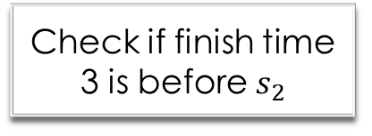
Example: Heap-based algorithm
Iteration i=2
Check heap minimum
Check if finish time 3 is before $s_{2}$
No. New colour!
A₁ | 1
A₂
A₃
A₄
A₅
A₆
A₇
A₈
A₉
A₁₀
Min element: NULL
finish at time 3
Heap
finish at time 3
0
2
4
6
8
10
12
14
16
18
20
x-axis

Slide 62
Example: Heap-based algorithm
Iteration i=2
Check heap minimum
Check if finish time 3 is before $s_{2}$
No. New colour!
A₁ | 1
A₂ | 2
A₃
A₄
A₅
A₆
A₇
A₈
A₉
A₁₀
Min element: NULL
finish at time 3
Heap
finish at time 3
finish at time 7
0
2
4
6
8
10
12
14
16
18
20
x-axis

Slide 63
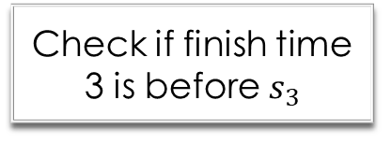
Example: Heap-based algorithm
Iteration i=3
Check heap minimum
Check if finish time 3 is before $s_{3}$
No. New colour!
A₁ | 1
A₂ | 2
A₃
A₄
A₅
A₆
A₇
A₈
A₉
A₁₀
Min element: NULL
finish at time 3
Heap
finish at time 3
finish at time 7
0
2
4
6
8
10
12
14
16
18
20
x-axis

Slide 64
Example: Heap-based algorithm
Iteration i=3
Check heap minimum
Check if finish time 3 is before $s_{3}$
No. New colour!
A₁ | 1
A₂ | 2
A₃ | 3
A₄
A₅
A₆
A₇
A₈
A₉
A₁₀
Min element: NULL
finish at time 3
Heap
finish at time 3
finish at time 7
finish at time 5
0
2
4
6
8
10
12
14
16
18
20
x-axis

Slide 65

Example: Heap-based algorithm
Iteration i=4
Check heap minimum
Check if finish time 3 is before $s_{4}$
Yes. Reuse colour, deleteMin and insert new finish time into heap!
A₁ | 1
A₂ | 2
A₃ | 3
A₄
A₅
A₆
A₇
A₈
A₉
A₁₀
Min element: NULL
finish at time 3
Heap
finish at time 3
finish at time 7
finish at time 5
0
2
4
6
8
10
12
14
16
18
20
x-axis

Slide 66
Example: Heap-based algorithm
Iteration i=4
Check heap minimum
Check if finish time 3 is before $s_{4}$
Yes. Reuse colour, deleteMin and insert new finish time into heap!
A₁ | 1
A₂ | 2
A₃ | 3
A₄
A₅
A₆
A₇
A₈
A₉
A₁₀
Min element: NULL
finish at time 5
Heap
finish at time 5
finish at time 7
0
2
4
6
8
10
12
14
16
18
20
x-axis

Slide 67
Example: Heap-based algorithm
Iteration i=4
Check heap minimum
Check if finish time 3 is before $s_{4}$
Yes. Reuse colour, deleteMin and insert new finish time into heap!
A₁ | 1
A₂ | 2
A₃ | 3
A₄
A₅
A₆
A₇
A₈
A₉
A₁₀
Min element: NULL
finish at time 5
Heap
finish at time 5
finish at time 7
finish at time 9
0
2
4
6
8
10
12
14
16
18
20
x-axis

Slide 68
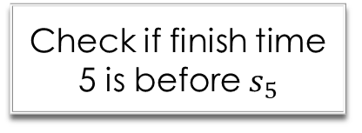
Example: Heap-based algorithm
Iteration i=5
Check heap minimum
Check if finish time 5 is before $s_{5}$
Yes. Reuse colour, deleteMin and insert new finish time into heap!
A₁ | 1
A₂ | 2
A₃ | 3
A₄
A₅
A₆
A₇
A₈
A₉
A₁₀
Min element: NULL
finish at time 5
Heap
finish at time 5
finish at time 7
finish at time 9
0
2
4
6
8
10
12
14
16
18
20
x-axis

Slide 69
Example: Heap-based algorithm
Iteration i=5
Check heap minimum
Check if finish time 5 is before $s_{5}$
Yes. Reuse colour, deleteMin and insert new finish time into heap!
A₁ | 1
A₂ | 2
A₃ | 3
A₄
A₅
A₆
A₇
A₈
A₉
A₁₀
Min element: NULL
finish at time 7
Heap
finish at time 7
And so on,
and so forth…
finish at time 13
finish at time 9
0
2
4
6
8
10
12
14
16
18
20
x-axis

Slide 70
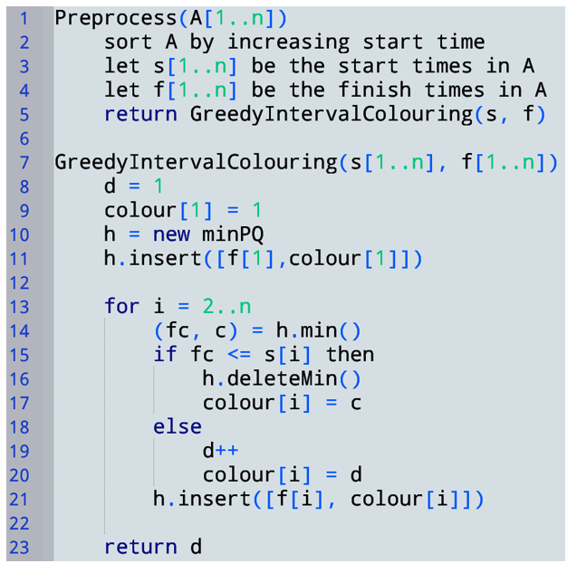



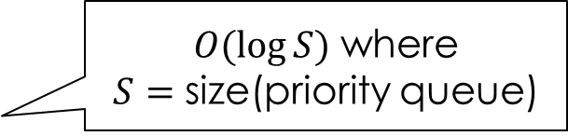



$O(log⁡S)$ where
$S=$ size(priority queue)
$$O(1)$$
$$O(1)$$
$$O(log⁡D)$$
Total $Θ\left(n\log{n}\right)+Θ(n\log{D})$
Since $n≥D$, $Θ(n\log{n})$
$$O(log⁡D)$$

Slide 71
Dynamic Programming
What?

Slide 72

— Richard Bellman, Eye of the Hurricane: An Autobiography
(1984, excerpts from page 159)
“Bottom-up recursion” might also a reasonable name, as we’ll see…
Where did the name, dynamic programming, come from? The 1950s were not good years for mathematical research.
We had a very interesting gentleman in Washington named Wilson. He was Secretary of Defense, and he actually had a pathological fear and hatred of the word "research”… He would turn red, and he would get violent if people used the term research in his presence. You can imagine how he felt, then, about the term mathematical.
I felt I had to do something to shield Wilson … from the fact that I was really doing mathematics… What title, what name, could I choose? In the first place I was interested in planning, in decision making, in thinking. But planning, is not a good word for various reasons. I decided therefore to use the word "programming." I wanted to get across the idea that this was “dynamic,” this was multistage, this was time-varying. I thought, let's kill two birds with one stone.
I thought dynamic programming was a good name.
It was something not even a Congressman could object to.
Notes:
I spent the Fall quarter (of 1950) at RAND. My first task was to find a name for multistage decision processes. An interesting question is, "Where did the name, dynamic programming, come from?" The 1950s were not good years for mathematical research. We had a very interesting gentleman in Washington named Wilson. He was Secretary of Defense, and he actually had a pathological fear and hatred of the word "research". I'm not using the term lightly; I'm using it precisely. His face would suffuse, he would turn red, and he would get violent if people used the term research in his presence. You can imagine how he felt, then, about the term mathematical. The RAND Corporation was employed by the Air Force, and the Air Force had Wilson as its boss, essentially. Hence, I felt I had to do something to shield Wilson and the Air Force from the fact that I was really doing mathematics inside the RAND Corporation. What title, what name, could I choose? In the first place I was interested in planning, in decision making, in thinking. But planning, is not a good word for various reasons. I decided therefore to use the word "programming". I wanted to get across the idea that this was dynamic, this was multistage, this was time-varying. I thought, let's kill two birds with one stone. Let's take a word that has an absolutely precise meaning, namely dynamic, in the classical physical sense. It also has a very interesting property as an adjective, and that is it's impossible to use the word dynamic in a pejorative sense. Try thinking of some combination that will possibly give it a pejorative meaning. It's impossible. Thus, I thought dynamic programming was a good name. It was something not even a Congressman could object to. So I used it as an umbrella for my activities.
— Richard Bellman, Eye of the Hurricane: An Autobiography (1984, page 159)

Slide 73
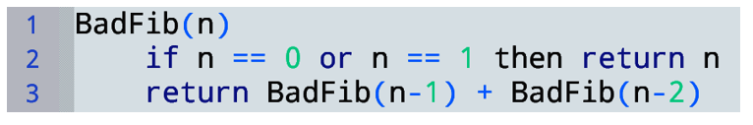
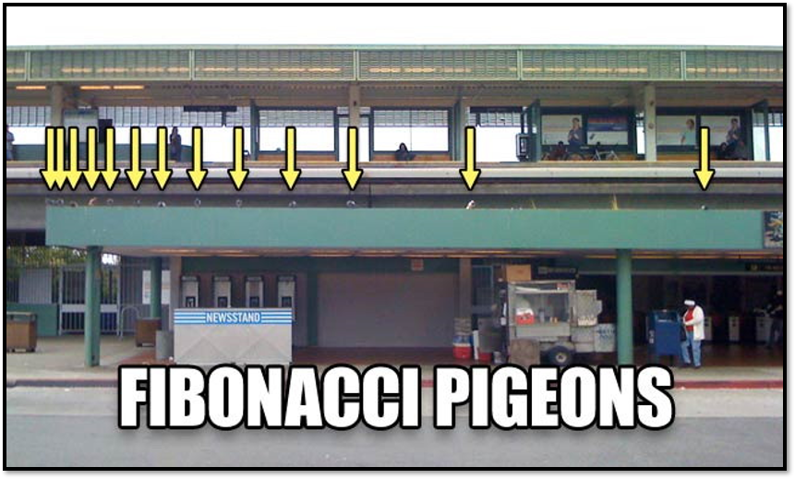
Computing Fibonacci numbers inefficiently
A Toy example to compare D&C to dynamic programming

Slide 74

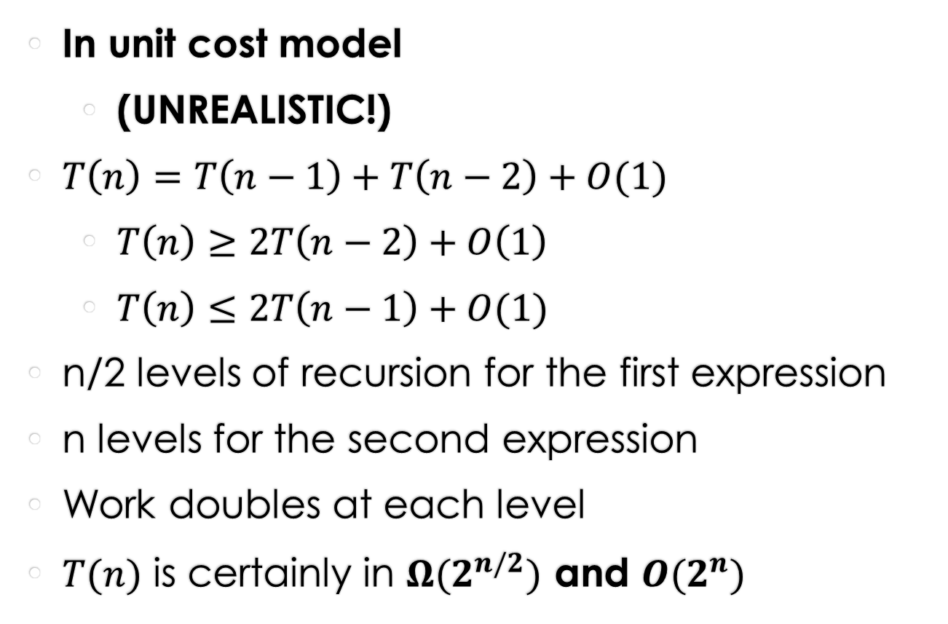
Runtime
In unit cost model
  (UNREALISTIC!)
$T\left(n\right)=T\left(n−1\right)+T\left(n−2\right)+O(1)$
  $T\left(n\right)≥2T\left(n−2\right)+O\left(1\right)$
  $T\left(n\right)≤2T\left(n−1\right)+O(1)$
n/2 levels of recursion for the first expression
n levels for the second expression
Work doubles at each level
$T(n)$ is certainly in $Ω(2^{n/2})$ and $O(2^{n})$
This O(1) would change in the bit complexity model

Slide 75
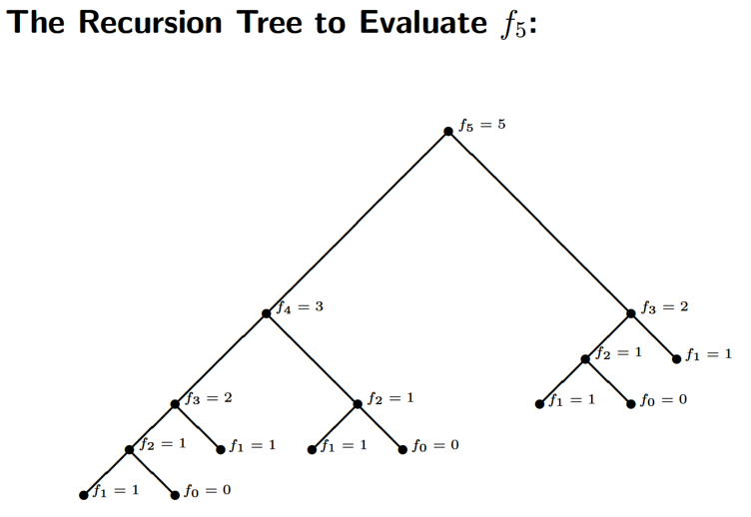
Why is this SO slow?
Subproblems have LOTS of overlap!
Every subtree on the right appears on the left
… recursively …
Each subtree is computed exponentially often in its depth
This overlap suggests dynamic programming may be able to help!

Slide 76
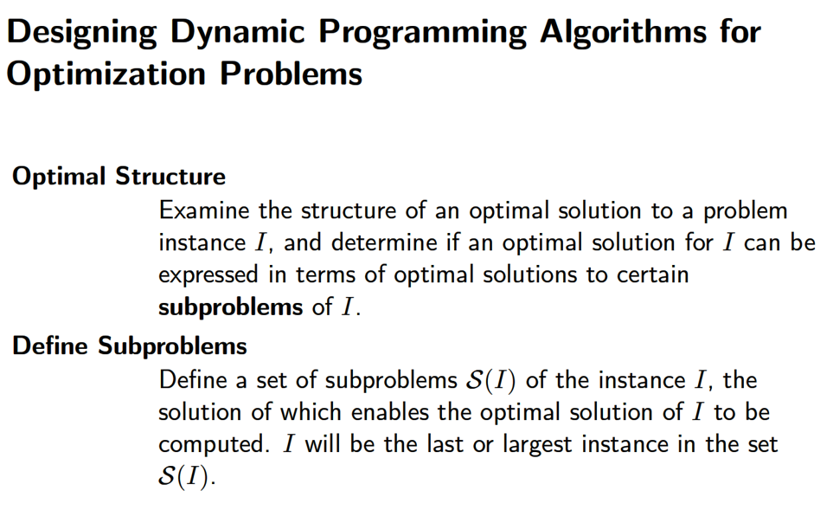
(Optimal) Recursive Structure

Slide 77
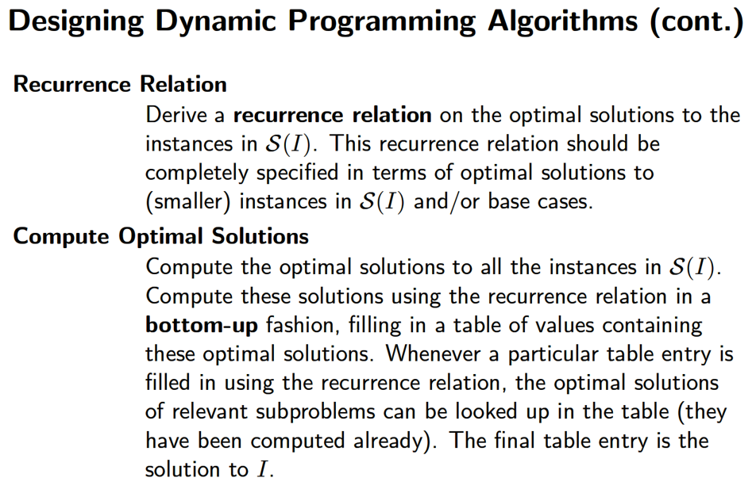

Slide 78
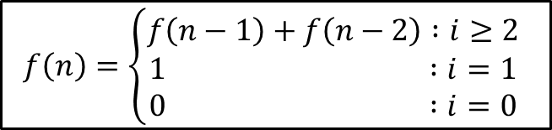
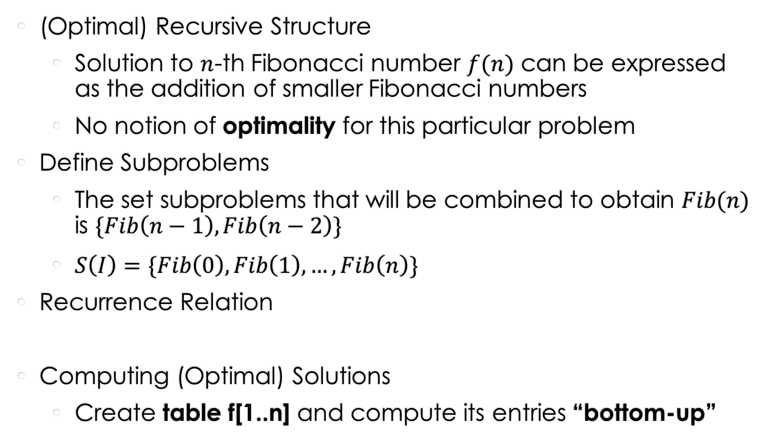
Solving Fib using Dynamic Programming
(Optimal) Recursive Structure
  Solution to $n$-th Fibonacci number $f(n)$ can be expressed
  as the addition of smaller Fibonacci numbers
  No notion of optimality for this particular problem
Define Subproblems
  The set subproblems that will be combined to obtain $Fib(n)$ is $\{Fib\left(n−1\right),Fib\left(n−2\right)\}$
  $S\left(I\right)=\{Fib\left(0\right), Fib\left(1\right), …, Fib\left(n\right)\}$
Recurrence Relation
Computing (Optimal) Solutions
  Create table f[1..n] and compute its entries “bottom-up”
$$f\left(n\right)=\left\{\begin{aligned}f\left(n−1\right)+f\left(n−2\right) :i≥2 \\ 1 :i=1 \\ 0 :i=0\end{aligned}\right.$$

Slide 79
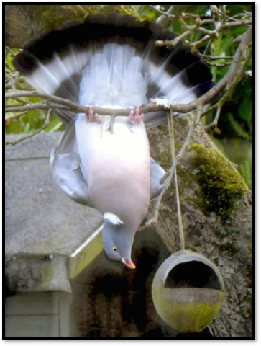
Filling the table “Bottom-up”
Key idea:
  When computing a table entry
  Must have already computed
  the entries it depends on!
Dependencies
  Extract directly from recurrence
  Entry n depends on n-1 and n-2
Computing entries in order 1..n
guarantees n-1 and n-2 are already computed when we compute n

Slide 80
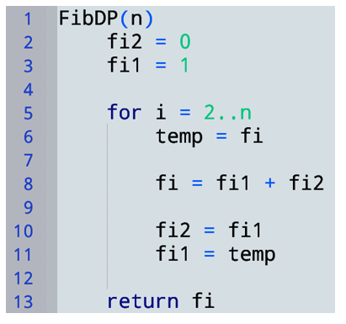
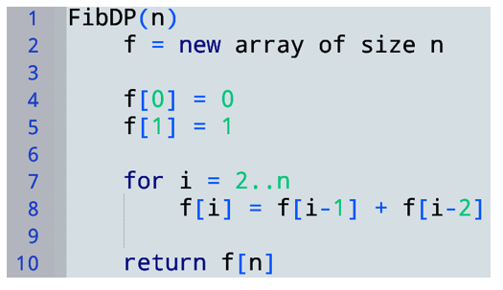
DP Solution
represents f[i-2]
represents f[i-1]
Save f[i] before overwriting it (so its value can be stored in f[i-1] later)
Space saving optimization:
  We never look at f[i-3] or earlier
  Can make do with a few variables instead of a table
Contains f[n]
This is still considered to be dynamic programming…
We’ve just optimized out the table.

Slide 81
Correctness
Order 0..n means i-1 and i-2 are already computed when we compute i
Step 1
  Prove that when computing a table entry,
  dependent entries are already computed
Suppose f[i-1] and f[i-2] are the (i-1)th and (i-2)th Fib #s
Then prove f[i] = the n-th Fib #
Step 2 (similar to D&C)
  Suppose subproblems are
  solved correctly (optimally)
  Prove these (optimal)
  subsolutions are combined
  into a(n optimal) solution

Slide 82

Model of computation for runtime
Unit cost model is not very realistic for this problem,
because Fibonacci numbers grow quickly
  F[10]=55
  F[100]=354224848179261915075
  F[300]=222232244629420445529739893461909967206666939096499764990979600
  Value of F[n] is exponential in n: $f_{n}∈Θ\left(φ^{n}\right)$ where $φ≅1.6$
  $φ^{n}$ needs $\log\left(φ^{n}\right)$ bits to store it
  So F[n] needs $Θ\left(n\right)$ bits to store!
But let’s use unit cost anyway for simplicity

Slide 83


Running time (unit cost)
$T\left(n\right)∈Θ\left(n\right)$

Slide 84



A brief Aside
Express T(n) as a function
of the input size S (in bits)
Is this linear runtime?
NO! This is “a linear function of n”
When we say “linear runtime” we mean
“a linear function of the input size”
What is the input size $S$?
  The input is the number $n$.
  How many bits does it take to store n? $O(\log{n)}$
  So $S=\log{n}$ bits
$$T\left(n\right)∈Θ\left(n\right)$$
$$2^{S}=2^{\log{n}}=n$$
So $T\left(n\right)∈Θ\left(2^{S}\right)$
This algorithm is exponential in the input size!
… but still exponentially faster than $2^{n}$

Slide 85
Unlikely that we get here

Slide 86





Rod cutting
A “real” Dynamic Programming example
Input:
  $n$: length of rod
  $p_{1},…,p_{n}$: $p_{i}=$ price of a rod of length $i$
Output:
  Max income possible by cutting the rod of length $n$
  into any number of integer pieces (maybe no cuts)
$$n=4$$
All ways of cutting a rod of length 4
Example output: 10

Slide 87


Dynamic programming approach
High level idea (can just think recursively to start)
  Given a rod of length n
  Either make no cuts,
  or make a cut and recurse on the remaining parts
  Where should we cut?
$$Income p_{n}$$
$$Income\left(Left\right)+Income(Right)$$

Slide 88








Dynamic programming approach
Try all ways of making that cut
  I.e., try a cut at positions $1, 2, …, n−1$
  In each case, recurse on two rods $[0,i]$ and $[i,n]$
Take the max income over all possibilities (each $i$ / no cut)
$$i=1$$
Optimal substructure:
Max income from two rods w/sizes $i$ and $n−i$
$$i=2$$
$$i=3$$
…
… is max income we can get from the rod size $i$
$$i=n−1$$
+ max income we can get from the rod size $n−i$

Slide 89





Recurrence relation
Critical step! Must define what M(k) means, semantically!
Define $M(k)=$ maximum income for rod of length $k$
If we do not cut the rod, max income is $p_{k}$
If we do cut a rod at $i$
  max income is $M\left(i\right)+M(k−i)$
  Want to maximize this over all $i$
    $max_{i}\left\{M\left(i\right)+M\left(k−i\right)\right\}$ (for $0<i<k$)
$M\left(k\right)=\max\left\{p_{k}, max_{1≤i≤k−1}\left\{M\left(i\right)+M\left(k−i\right)\right\}\right\}$
$$i$$
$$k$$
Length $i$
Length $k−i$

Slide 90





Computing solutions bottom-up
Recurrence: $M\left(k\right)=\max\left\{p_{k}, max_{1≤i≤k−1}\left\{M\left(i\right)+M\left(k−i\right)\right\}\right\}$
Compute table of solutions: $M[1..n]$
Dependencies: entry $k$ depends on
    $M[i]$ → $M[1..\left(k−1\right)]$
    $M[k−i]$ → $M[1..\left(k−1\right)]$
  All of these dependencies are $<k$
So we can fill in the table entries in order $1..n$
$$M$$
$$1$$
$$k$$
$$n$$

Slide 91


Recall, semantically, $M(k)=$ maximum income for rod of length $k$
Recurrence:$M\left(k\right)=\max\left\{p_{k}, max_{1≤i≤k−1}\left\{M\left(i\right)+M\left(k−i\right)\right\}\right\}$
Time complexity (unit cost)?
$$Θ\left(n^{2}\right)$$
Aside: Is this a “quadratic time” algorithm?
Exercise: devise an even simpler DP solution (hint: try “recursing” only once)

Slide 92
miscellaneous tips
Building a table of results bottom-up
is what makes an algorithm DP
There is a similar concept called memoization
  But, for the purposes of this course,
  we want to see bottom-up table filling!
Base cases are critical
  They often completely
  determine the answer
  Try setting f[0]=f[1]=0 in FibDP…

