Slide 1

Introduction to databases
Chapter 01
Collin Roberts
University of Waterloo

Slide 2
Chapter Outline
Motivation for databases
Characteristics of the Database Approach
Database basics
Data independence
How to access a database
When Not to Use a DBMS

Slide 3
Suggested Readings
Textbook Chapter 01 and Chapter 02

Slide 4
Early Data Management
Data hardcoded inside the program. One program, one data set
Program1
Data
int Revenue( )
{
int sales[ ] = [80, 81, 60, 99, 77];
… …
}
Notes:
Before computer is invented, we managed data by hand, on paper.
This is tedious for large amounts of data.
In the early days of computing, things were not much better.
How did we use computers to manage data in the early days? We stored data as part of the program.
This works great for a while, but only works for small dataset, and is difficult to change (change to data requires change to the program)

Slide 5
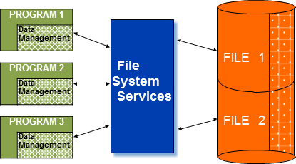
File Processing
Data are stored in files with interface between programs and files. One file corresponds to one or several programs
int Revenue( )
{
int sales[ ] = Read data from sales file;
… …
}
Notes:
As computers go faster and faster, more data needs to be processed, and we need a better way to manage data.
Decouple the data from the program as data might be gathered by someone else.
So put the program in one file and the data in another file
Works great until one day, someone has the epiphany: what if we share the file? Excellent idea, let’s do it.
Problem:
First how can you be sure all use the same program?
The problem does not stop here, what if want to see it differently … …
Another much bigger problem for sharing data file: lost update
********************
Food for thoughts:
The word "file" was used publicly in the context of computer storage as early as February, 1950. In an RCA (Radio Corporation of America) advertisement in Popular Science Magazine^{[1]} describing a new "memory" vacuum tube it had developed, RCA stated:
"...the results of countless computations can be kept "on file" and taken out again. Such a "file" now exists in a "memory" tube developed at RCA Laboratories. Electronically it retains figures fed into calculating machines, holds them in storage while it memorizes new ones - speeds intelligent solutions through mazes of mathematics."In 1952, "file" was used in referring to information stored on punched cards.^{[2]}
In early usage, people regarded the underlying hardware (rather than the contents) as a file. For example, the IBM 350 disk drives were called "disk files".^{[3]} In about 1961 the Burroughs MCP and the MIT Compatible Time-Sharing System introduced the concept of a "file system", which managed several virtual "files" on one storage device, giving the term its present-day meaning. Although the current term "register file" shows the early concept of files, it has largely disappeared.
The word ultimately comes from the Latin filum "a thread".^{[4]}

Slide 6
Problems with Storing Data in a File
Can a file do the following?
  Opened by many different applications
  Displayed in different formats to different people
  Part of the file is invisible/accessible to certain people but visible to others
    Redundancy: store the same data in different places
    Inconsistency: different values to the same attribute
  Can two or more people modify the same file at the same time?
  Do you know who accessed the file recently?
Notes:
What are the problems of storing data in a file? Problems arise when data is being shared
Consider this scenario in the next two slides
Another scenario: make the price disappear when shown to supplier
Another problem with file: it has no accountability, you don’t know who access the file lately and what changes they make (you know when the file is last updated, but don’t know who and what changes made)
File is ok for Personal use: only you, your app, your preference and your access. None of the above problems exists. So we do still use files to store personal data. But not for business data.
*******************
Can a file be opened by many different applications: Not quite! Typically, each app has its own file format and it is often not compatible with other app. Excel file cannot be opened by Word, Word cannot be open by Adobe Reader, PDF cannot be open by Photoshop, a picture cannot be opened by a movie player.
This means for the same data/business report to be accessible by different apps, it must be copied into different file formats. One copy for accounting, one copy for HR, one copy for production … … (for example, the slides I post … …)
Even you use the same app in your company, different people might have different preference about how data is displayed for example … … how to accommodate this? You make copies … …
Moreover, depending who is reading the report, certain data should be visible to some but invisible to others. Can you do that with a file? No. You make copies again.
So what is wrong with copies? Redundancy, leads to inconsistency when changes are made because we often don’t keep track how many copies out there. Redundancy: store the same data in different places; what is wrong with redundancy? Waste of space, but more importantly, it leads to inconsistency!
Inconsistency: different values to the same attribute
What is worst is that how to correct it?
One more problem:
Can two or more people modify the same file at the same time? No. Why not?
Recall: everything must be copied into memory before being accessed by CPU!
Need for concurrency control
(assume no concurrency control/nothing is in place, what could be the balance after both transactions are completed?)
Could it be 0, 100 or 200?
This is why we need … … what is the easiest way to fix it? Can multiple users open the same file on a computer?
Traditionally to avoid this problem: one file can be opened by one user, obviously not efficient because this suggests only customer can place order at any given moment. Or, for several people to modify the same files, you need to make copies of the file, adds to redundancy problem.
Another problem: do you know who accessed the file recently? No you cannot. Because of these problems with files, we prefer storing data in database instead files.

Slide 7

Scenario: Same Data Different Apps
How do they share the same sales report?
  John uses Adobe product
  Jane uses MS Word
  Joe uses Lotus Notes
  Jess uses WPS
Image Source: http://www.theawl.com/2011/03/how-to-share-big-files
Notes:
File is closely tied to specific app
A file to be shared by 4 group members each using different office suit.
Common solution: Make 4 copies, one in PDF, one in doc etc.

Slide 8
Scenario: Same Data Different Displays
How do you produce these reports?
  CFO wants sales data sorted according to region
  CIO wants sales data sorted according to product
  CEO wants sales data sorted according to quarter
  VP production wants a sales report about binders
  VP R&D wants a sales report for the past 3 months
Later realized there is a mistake about the price of pencil, how many files/places do you need to make changes?
Notes:
Some might say, this is crazy, they are in the same company, we can demand them they must use the same app!
Even they all use the same app: say Excel, but they might prefer different way to view the data. How do you meet the demands from these people?
Common solution: make a copy to each of them and re-format it accordingly

Slide 9
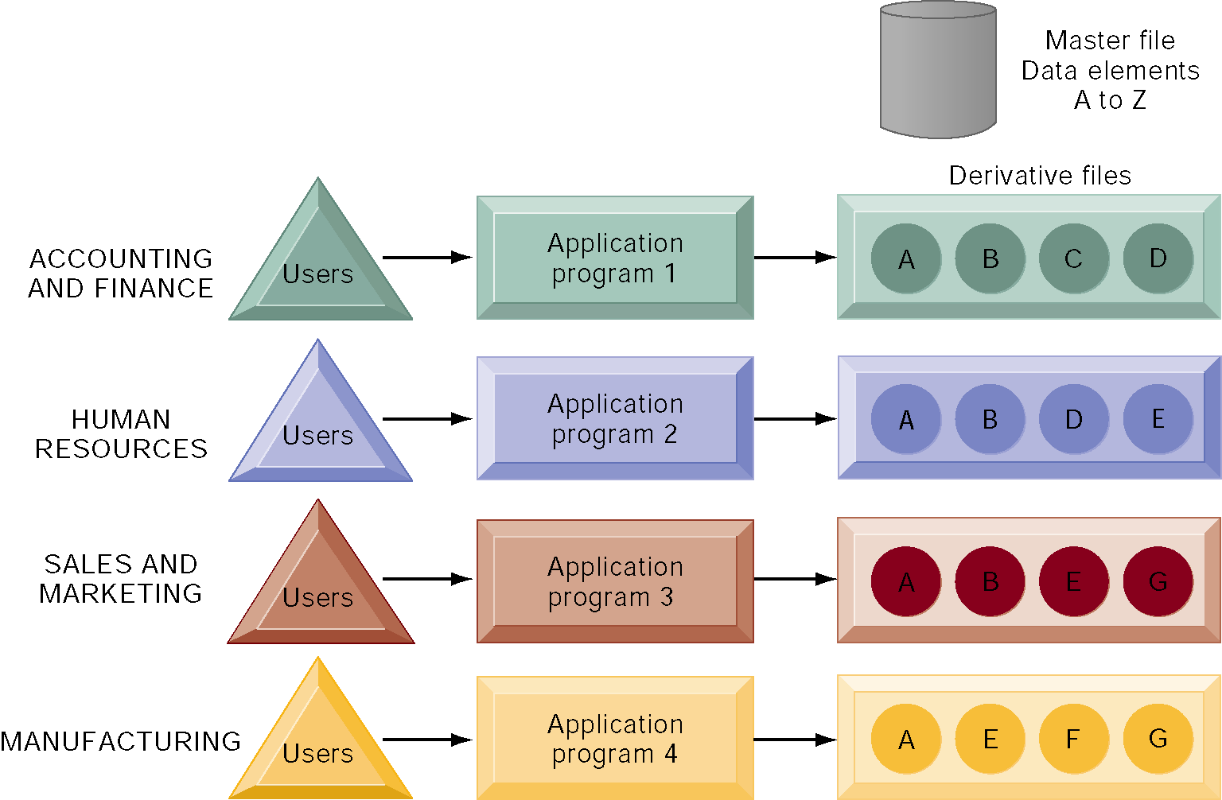
Traditional File Processing
Figure 6-2
Notes:
Because each application has its own file format and different people prefers different view, you need to copy the same report into different formats to fit the need of each application and each individual! (What is wrong with this approach?) What is wrong with copies?
It leads to redundancy! Redundancy: store the same data in different places

Slide 10
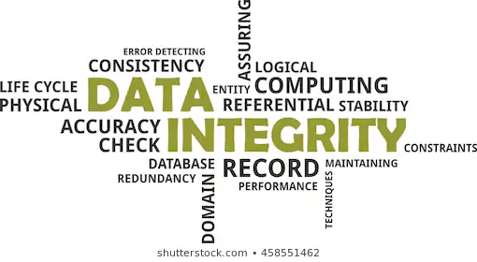
Data Redundancy
Data redundancy: The presence of duplicate data in multiple data files so that the same data are stored in more than one place or location
  Data inconsistency: The same attribute may have different values.
Image Source: https://www.shutterstock.com/image-vector/word-cloud-data-integrity-related-items-199701359
Notes:
What is the problem with redundancy? Waste of storage, but this is a very small problem; the big problem is that leads to data inconsistency: The same attribute may have different values.
Say, after making copies and sharing the sales with senior management, you later realized there is a mistake about the price of pencil, how many files/places do you need to make changes? do you even remember how many copies are out there? What happens if you forget to change in one file? This is called inconsistency. An even bigger problem with inconsistency: you don’t know which one is correct and how to fix it? There are 5 values for the price of pencil, which one is correct? Moreover, how do you change it? Not by yourself, but need to rely on someone else (send them an e-mail to ask them to make the changes on their copies).

Slide 11

Scenario: what if several users access the same file at the same time
Assumption: no DB used, everything stored in files
You have an account with TD and the balance is $100.
It is your birthday.
You are withdrawing $50 in Waterloo to celebrate with your friends.
At the same time, your grandpa in Toronto is depositing $90 into your account as your birthday gift.
What could be your balance after both transactions are completed?
Notes:
Some might say, you know what, I am going to force people use and view the data in the same app and in the same format. And put the file online, only one copy is needed. Problem solved, right? No, there is another big problem. Consider the scenario above.

Slide 12


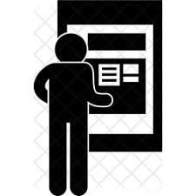
Scenario: Deposit and Withdrawal in Details
Bank server in Montreal
Your balance Z = $100
Withdraw at ATM1 in Waterloo
X = Read your balance from server
X = X – 50
Store the new balance X to server
Deposit at ATM2 in Toronto
Y = Read your balance from server
Y = Y + 90
Store the new balance Y to server
Notes:
We could simplify withdraw as:
1. X = Z
2. X = X-50
3. Z = X
We could simplify deposit as:
a. Y= Z
b. Y = Y+90
c. Z = Y
Although in ATM1: instructors 1, 2, 3 execute in order and in AMT2: instruction a, b, c execute in order,
The two sets of instructions could run interleave:
1, 2, 3, a, b, c: what is the balance?
1, a, b, c, 2, 3: what is the balance?
a, 1, 2, 3, b, c: what is the balance?
1, a, 2, b, 3, c: what is the balance?
Please share your answers on Piazza!
This problem is called lost update.

Slide 13
Why Databases and DBMS?
Provide data integrity
Reduce data redundancy and inconsistency
Provide data independence
Separate program and data
Provide security, concurrent access and crash recovery
Enable data sharing and high availability
Centralized data administration
Back up and access
Reduce application development time
Standard software packages readily available in the market
Enforce policies
Notes:
Because of these problems with storing data in files, we choose to store data in database instead. Benefits of using DB include:
It reduces redundancy and inconsistency
It separates program from data, which same data to be accessed by different apps.
Provide security
Centralized ad makes it easy to backup and access the data.
Reduce development time as standard s/w packages are widely available, some are even free.
Applications don’t need to worry about how to manage the data. Also off the shell package to help develop DB applications.
DB interface and development are pretty much standardized like SQL99 etc. Many library and packages available out there and no need to start from scratch. And because all follow some of standard, one app written for one DB can easily migrate to manage another DB

Slide 14
Databases and DBMS
Database: a collection of related information stored in a structured form
  The structure of information is described by data model that is expressed in schema
Database Management System (DBMS): a collection of programs that manipulate a database
  Set up the storage structures
  Perform updates on data
  Process queries (requests for data retrieval) from applications and users
The DBMS provides a central point of access to the data
Access 2010: Introduction to Databases
Notes:
So what is a database?
Database :- database is a collection of related information stored in a structured form in terms of table so that It makes easier insertion, deletion and manipulation of data. database consist of tables with rows and columns. Related: collectively represent a real world subject or concept; structured: formatted by schema. The most popular DB structure is relational structure that is , data is stored as tables.
A Database Management System (DBMS) is a set of computer programs that controls the creation, maintenance, and the use of a database.

Slide 15
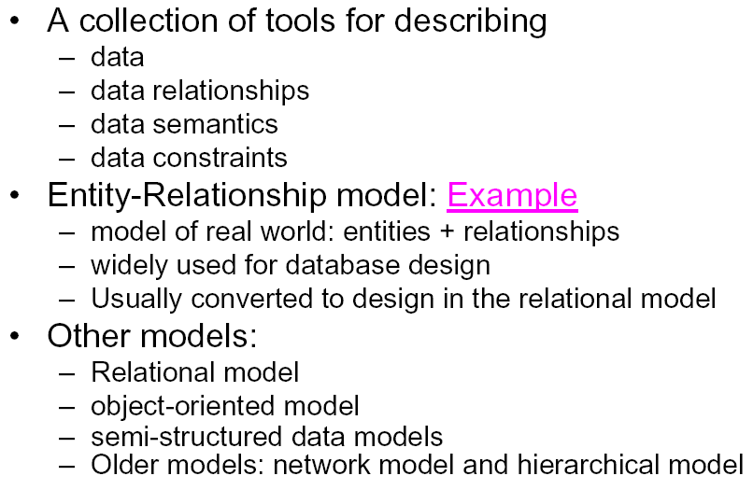
Data Model
Notes:
After collect all the requirements, we need to put them into some kinds of model known as data model …
Schema is a description of a database using a particular data model
Data: what objects, tables and attributes, their association
Also describes Semantics and constraint: one department must have one and only manager; a student can register up to 6 courses; SID must unique etc. How many objects can participate in a relationship
Data Model: A set of concepts to describe the structure of a database, and certain constraints that the database should obey.

Slide 16
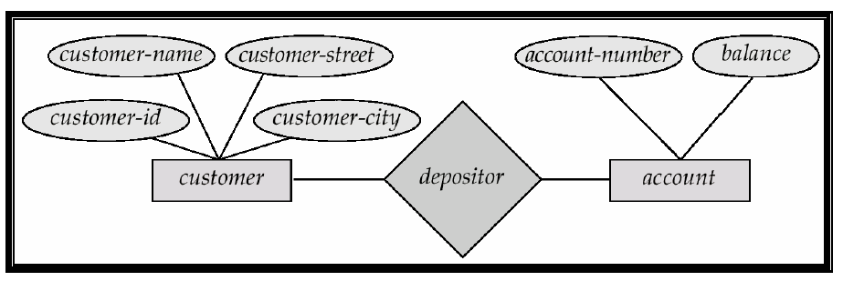
Example:
- Entity-Relationship Model
Notes:
Example of schema in the ER model. We will explore further in later chapters.

Slide 17
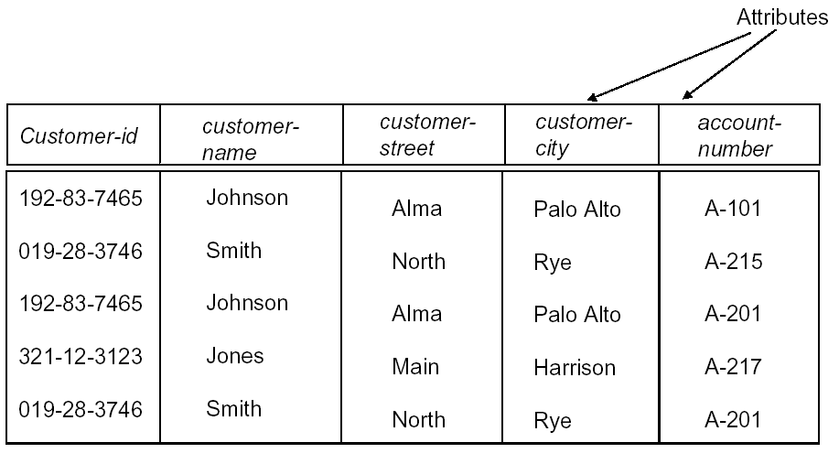
Example:
- Relational Model
Notes:
Example of tabular data in the relational model. We will explore this further in later chapters.

Slide 18
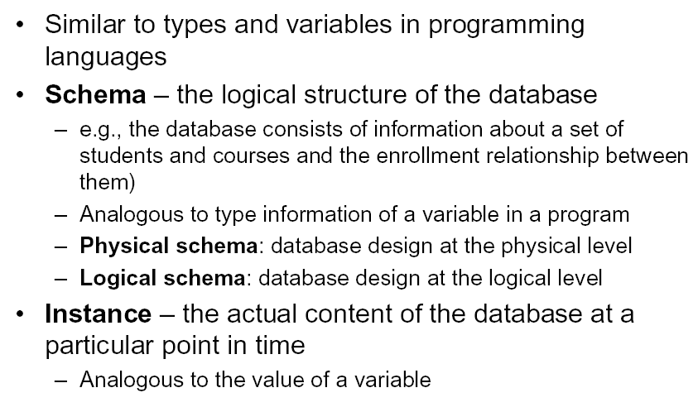
Instance and Schema
Notes:
Schema a description of a particular data model, rarely changed, must follow a data model
DBMS uses it to interpret the data (instance)
Instance: change frequently. Each time doing update, add, delete, instance changes;
Schema and instance are physically stored in different places.

Slide 19
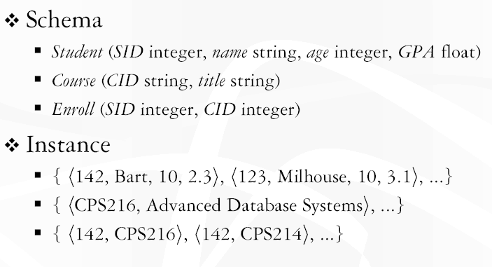
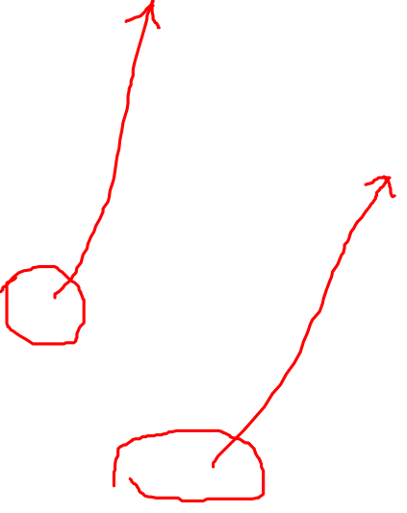
Examples of Instance and Schema
Notes:
In relational model: DB is a table, column headers are schema and contents are instance.

Slide 20
Three Layers of Schema
Table only describes one layer of a relational database:
Logical layer: what data to store, and its meaning
Physical layer: how data is physically stored in storage units
  Both physical and logical layers are invisible to users
External view: how data is displayed
  Only layer visible users
    This is what you see when accessing a database
    Often computed at runtime based on search criteria and access right of the user
Notes:
Table only describes one layer of structure of a relational database: logical layer – what data to store and their meanings
Physical layer: define how data is physically stored (1s and 0s, what media is used, what RAID etc., its index etc.)
External layer: how data is displayed
Both physical and logical layers are invisible to users
External is the only layer visible users. It is often computed at runtime based on search criteria and access right of the user
Every time you are doing a search on Watiam, Quest or Amazon or ebay, you are NOT accessing the actual database, you are only seeing the external layer of the database.

Slide 21
Example: 3 Layers of University Database
Logical schema (middle layer):
  Students(sid: string, name: string, login: string,
  birthday: date, gpa:real, phone: string)
  Courses(cid: string, cname:string, credits:integer)
  Enrolled(sid:string, cid:string, grade:string)
Physical schema:
  Data stored as bits and bytes on the disk.
  How do we store this optimally for the storage medium: Spinning Hard Disk, SSD, Tape? DBMS does that for you
  Stored in RAID 1 and indexing based primary keys
External Schema (View):
  StudentView(name: string, phone: string)
  Course_info(cid: string, enrollment:integer)
Notes:
7
Here is the 3 layers of schema for a university database.
Students can only access the last layer: external

Slide 22
Example: 3 Layers of Birthday Attribute
Consider the attribute “birthday” in a table and an entry: June 20th 1990
  At the middle layer (internal schema) of the 3 schema layer hierarchy (i.e tables). It is the easiest to understand
However there is a layer below (the 0s and 1s on a disk) where data manifests itself physically!
Above the table there is the external layer where different people/users can “view” the data differently
  Different display formats for date
  For example Age is derived from Date of Birth
    Age is function of date of birth and “today”
    Can be calculated as needed, thus people who only want to view the age can interpret the logical value of date of birth as needed according to a specified function
    Age is an application specific concept in this scenario
Notes:
To further understand the 3 layers of schema. Consider the attribute birthday.
This is defined at the logical layer.
Beneath it is the physical: physical stored as a binary integer (19900620), maybe as text in ASCII code, or three integers (1990, 6, 20). We actually don’t know which one is used.
We can view the data differently: (dd, mn, year) or (mn dd year); two digit or 4 digit year; or we are not interested at the date of birth, but age instead (Enter as june 20th 1990, display as age 23)
3 layers of schema lead to one of the most important features of DB: data independence

Slide 23
Why have these three layers?
Answer: Data independence!
  Separation of logic, storage and presentation
What happens if you change where or how your database is stored?
  You don’t have to change any applications that use it
  Just like file systems (regardless of where the file is stored you can open it, who know how its stored physically?)
Different people can view the data differently
  Easier to write software
  Easier to manage and control (e.g want some users to only see age but not exact date of birth)
Change software without changing the data and vice versa
  Make applications independent of data storage and make display independent of data logic
Notes:
All 3 layers represent the same real world subject, but the meaning of the subject, its physical storage and how is displayed are separated from each other. This is called Data independence!
Benefits?
Allows us to view the data differently and make changes to the app or database without impacting the other.

Slide 24
How to Access a Database: Structured Query Language (SQL)
The most commonly used database programming language for accessing and managing database in DBMS
  SQL statements can be embedded in other programming languages (C/C++, Java, Python etc) to enable them to access database
To create, manage and query a database.
It is pronounced “ess cue ell”, not SEQUEL
  SEQUEL is the ancestor of SQL introduced by IBM
Notes:
What is SQL? It is a programming language used to communicate with a database. You can use SQL to create, manage and query a database. All modern databases understand SQL.
SQL statements can be embedded in other programming languages (C/C++, Java, Python etc) to enable them to access database
How do you pronounce it? What does it stand for?
Clarification of common misconceptions
It is pronounced “ess cue ell”, not SEQUEL
SEQUEL is the ancestor of SQL introduced by IBM
It is a name, not a acronym for “Structured Query Language” as there are other types of s … q … l outhere.
**************************
How do we access a database? Need to learn to speak a DB programming language … …
Unify three important database functions … …
Its scope includes data insert, query, update and delete, schema creation and modification, and data access control.
Control: access control (who can access what and how to share), data integrity control
*******************
QBE is another popular choice.
SEQUEL is an ancestor of SQL, developped by IBM
Is "SQL" sometimes pronounced "sequel"? What is the preferred way to refer to SQL? Also, does SQL imply a specific type or brand of database, or do many databases support SQL as a command language?
Yes, SQL is sometimes pronounced "sequel," but mostly by people who have experience only with Microsoft's database system SQL Server, usually pronounced "sequel-server," which is one of the most commonly used database systems today. The more accepted pronunciation is "ess cue ell," in which each letter is spoken separately. A few people, for whatever reason, pronounce it "squeal" or "squirrel" but this is rare. If you're feeling adventurous, do an Internet search on google or alltheweb using "pronounce SQL" or similar search terms.
SQL dates back to IBM's development of relational databases in the early 1970's with a language called SEQUEL (Structured English QUery Language). Due to copyright problems, IBM had to change the name, so they chose SQL. Since that time, SQL has evolved considerably. Several versions of standard SQL have been published, including SQL-86, SQL-92, and SQL-99.
So SQL by itself should refer only to the language. You will often see the letters SQL embedded right in the name of a relational database system, such as SQL Server, MySQL, Mimer SQL, and PostgreSQL. Even if the database system name does not mention SQL, such as DB2, Oracle, Sybase, Access, and so on, the database system almost certainly supports the SQL language -- more or less. Many relational database systems have extensions and additional capabilities over and above (and, sadly, sometimes in place of) the specifications in the SQL standard.
I totally agree with you. I pronounce it as sequel as well when talking causally. I make sure that I pronounce it as S Q L when I am speaking formally or talking in meetings.
The reason, I posted this as I have received this question too many times, I decided to write about it.
I am interested to see what other readers have to suggest.

Slide 25
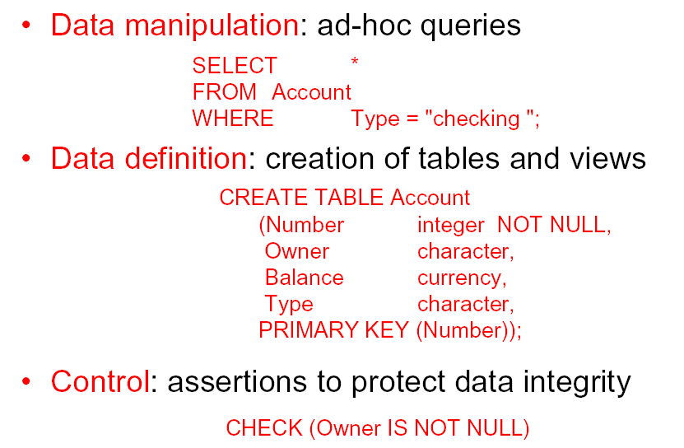
SQL Examples
Notes:
Use SQL to retrieve data;
To define new table;
To manage DB. Here we implement a management function to ensure each account must have an owner
The last one, a SQL command that rejects the request to create an account where the name of owner is not provided.
To ensure each account created must have an owner.
Unify three important database functions into one language

Slide 26
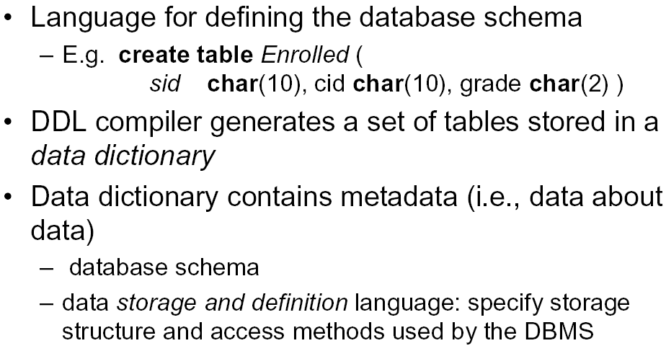
Data Definition Language (DDL)
Notes:
We can interact with a database through the following channels.
DDL create schema for a database, stored in a catalog or data dictionary.
Data Definition Language (DDL): Used by the DBA and database designers to specify the conceptual schema of a database. In many DBMSs, the DDL is also used to define internal and external schemas (views).
In some DBMSs, separate storage definition language (SDL) and view definition language (VDL) are used to define internal and external schemas.

Slide 27
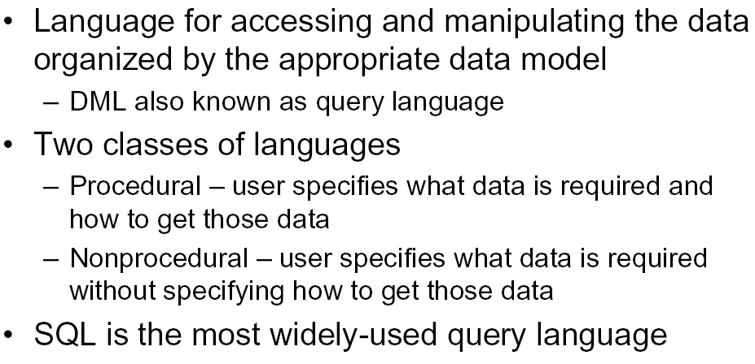
Data Manipulation Language (DML)
Notes:
High Level or Non-procedural Languages: e.g., SQL, are set-oriented and specify what data to retrieve than how to retrieve. Also called declarative languages.
Low Level or Procedural Languages: record-at-a-time; they specify how to retrieve data and include constructs such as looping. Oracle Pro C, PSQL
SQL can do both DDL and DML … … it can be embedded in … or run as standalone
Data Manipulation Language (DML): Used to specify database retrievals and updates.
DML commands (data sublanguage) can be embedded in a general-purpose programming language (host language), such as COBOL, C or an Assembly Language.
Alternatively, stand-alone DML commands can be applied directly (query language).
Procedural vs. Non-procedural: GH student DB, find out male, CS, 3rd year students. Different ways to do it … … In procedural, you need to specify the order … … not so in non-procedural

Slide 28
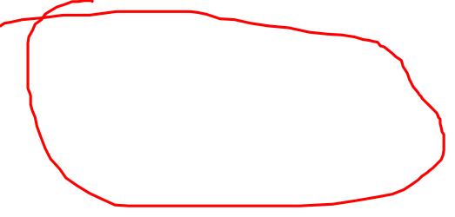
Example: SQL Embedded in Java (FYI)
class JDBCTest {
public static void main (String args [ ]) throws Exception {
Class.forName("com.mysql.jdbc.Driver").newInstance();
System.out.println ("Connecting...");
Connection conn =
DriverManager.getConnection ("jdbc:mysql://localhost/ML");
System.out.println ("connected.");
// Create a statement
Statement stmt = conn.createStatement ();
// List all the checking accounts
ResultSet rset = stmt.executeQuery (“SEECT * FROM Account
WHERE Type = “Checking”");
… …
}
}
Notes:
This SQL statement embedded in this Java program allows this Java application to retrieve all the checking account information.
FYI only. No need to worry the codes.

Slide 29
Database Development
Requirement analysis
  What data need to be stored
  What operations performed on the data
Design
  Conceptual: ER/EER or UML, DBMS independent
  Logical: mapping to a logical data model, DBMS dependent
  Physical: data structure, DBMS dependent
Implementation
  Language/DBMS dependent
  C/C++, Java, SQL interact with DBMS to create table/object/query etc.
Notes:
3 steps involved in developing a database system
In design stage: descript the data item and their relationship using some sort of schema, 3 level of design schema, C, L, P
ER modeling is done on the conceptual level, system independent, can be easily mapped into relational or OO model without any complication.
L: mapped to one of the Data model: network, relational, OO etc, operation is described in relational algebra or calculus; normalization also done here, process used to evaluate whether design is good or not
P: define data structure and indexing structure.
In the final step, the design plan is carried out by using SQL and some programming language like … …

Slide 30
When NOT to Use Databases
More desirable to use flat files for:
  Small variety of data and/or small amount of data
  Simple, well-defined applications with no expected changes at all
  Only single (personal) access to data
  Stringent, real-time requirements that cannot afford DBMS overhead
Unlikely that any of these apply to corporate data management.
  In fact, corporations often maintain many databases across many database systems.
Notes:
So DB is perfect, we must use it all the time. Not quite! There are some limitations to DB.
Typically in DB: ata comes in, stored in DB, app accesses the data through DBMS and process them. As such, data processing in DB could be slower than simple data processing in file because DBMS serves as the middle man between data and the application, adding overhead into the process.
Examples of real time system: computer system that controls the car engine. It take various inputs form sensors and driver to determine engine output. A delay in processing the signal might result in engine failure. Another one: (auto pilot program)) software the computes and updates the flight plan for commercial plane. It constantly takes information like longitude, latitude, temp, wind speed, weather, to adjust flight plan and these data must be processed as quickly as possible.
***************************
Food for thoughts (FYI):
A system is said to be real-time if the total correctness of an operation depends not only upon its logical correctness, but also upon the time in which it is performed.^{[5]} Real-time systems, as well as their deadlines, are classified by the consequence of missing a deadline:
Hard – missing a deadline is a total system failure.
Firm – infrequent deadline misses are tolerable, but may degrade the system's quality of service. The usefulness of a result is zero after its deadline.
Soft – the usefulness of a result degrades after its deadline, thereby degrading the system's quality of service.
Thus, the goal of a hard real-time system is to ensure that all deadlines are met, but for soft real-time systems the goal becomes meeting a certain subset of deadlines in order to optimize some application-specific criteria. The particular criteria optimized depend on the application, but some typical examples include maximizing the number of deadlines met, minimizing the lateness of tasks and maximizing the number of high priority tasks meeting their deadlines.
Hard real-time systems are used when it is imperative that an event be reacted to within a strict deadline. Such strong guarantees are required of systems for which not reacting in a certain interval of time would cause great loss in some manner, especially damaging the surroundings physically or threatening human lives (although the strict definition is simply that missing the deadline constitutes failure of the system). For example, a car engine control system is a hard real-time system because a delayed signal may cause engine failure or damage. Other examples of hard real-time embedded systems include medical systems such as heart pacemakers and industrial process controllers. Hard real-time systems are typically found interacting at a low level with physical hardware, in embedded systems. Early video game systems such as the Atari 2600 and Cinematronicsvector graphics had hard real-time requirements because of the nature of the graphics and timing hardware.
In the context of multitasking systems the scheduling policy is normally priority driven (pre-emptive schedulers). Other scheduling algorithms include earliest deadline first, which, ignoring the overhead of context switching, is sufficient for system loads of less than 100%.^{[6]} New overlay scheduling systems, such as an adaptive partition scheduler assist in managing large systems with a mixture of hard real-time and non real-time applications.
Soft real-time systems are typically used to solve issues of concurrent access and the need to keep a number of connected systems up-to-date through changing situations. An example can be software that maintains and updates the flight plans for commercial airliners: the flight plans must be kept reasonably current, but they can operate with the latency of a few seconds. Live audio-video systems are also usually soft real-time; violation of constraints results in degraded quality, but the system can continue to operate and also recover in the future using workload prediction and reconfiguration methodologies.^{[7]}

Slide 31
Summary of This Week’s Lectures
Course logistics
Motivation for databases
Databases
  Collection of related data (recorded facts)
  Data independence
DBMS
  Generalized software package for implementing and maintaining a computerized database
  Provides many services to manage data resources
Limitations of DB and DBMS

