Slide 1

Review of Lecture 1-1
Course logistics
Motivation to DB
  Redundancy and inconsistency, concurrent access
Database and DBMS
Schema and instance
  3 level of abstraction
  Data independence
DDL and DML
  SQL: both and control
Limitation of DB

Slide 2
Lecture 2-1: Today’s Plan
Relational data model
  Set, simple attribute
  Order of row vs. order of column
Integrity constraints in relational data model
  Domain
  Primary Key
  Foreign Key

Slide 3
Relational Data Model
Chapter 02
Collin Roberts
University of Waterloo
Notes:
Structure of DB defined by its data model, the most popular one is relational model

Slide 4
Chapter Outline
Relational Model Concepts
Relational Model Constraints and Relational Database Schemas
Update Operations and Dealing with Constraint Violations

Slide 5
Suggested Readings
Textbook Chapter 05

Slide 6
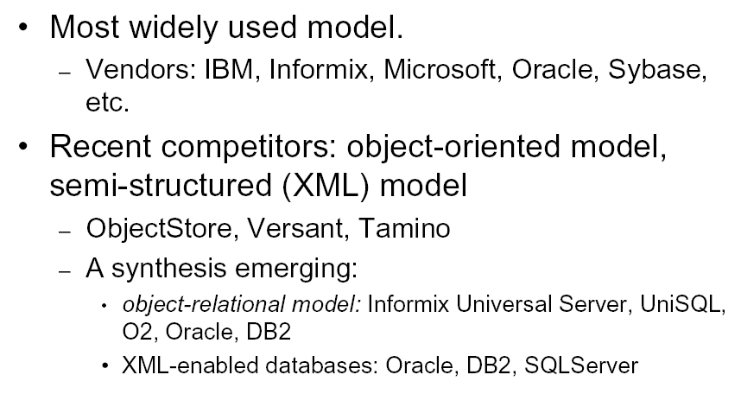
Why Relational Data Model?
Notes:
Most widely used model in logical design
Its query language is powerful and well supported in SQL
It is simple to understand and often match how we think about data
Recent competitor: OO and OR
A collection/list …
The model underlies SQL the most popular/important database language today
A synthesis:
Interesting question: it is popular, so we study it. But why is it popular in the first place.
Be aware: that is DBMS dependent!!

Slide 7
Relation – Informal Definition
RELATION: A table of values
  A relation may be thought of as a set of rows with several columns.
  Each row represents a real-world entity or relationship.
  Each column typically is called by its column name or column header
    Called attribute
  The values for each attribute must come from a domain (all possible values)
  Each row has a set of values that uniquely identifies that row in the table.
    Called primary key or simply key
    Sometimes row-ids or sequential numbers are (automatically) assigned to identify the rows in the table.
Notes:
A relation is similar to a table with a twists. Each row represents one real-world E. Each col represent the attribute of the entity. Possible values for an attribute is called a domain.
What is a set? No order and no duplicates! So a relation is a table with NO duplicate rows.
How can you make sure no duplicate row? It means that each row must have something unique. This is called a primary key (sometimes just called a key) and each table must have a primary key.

Slide 8
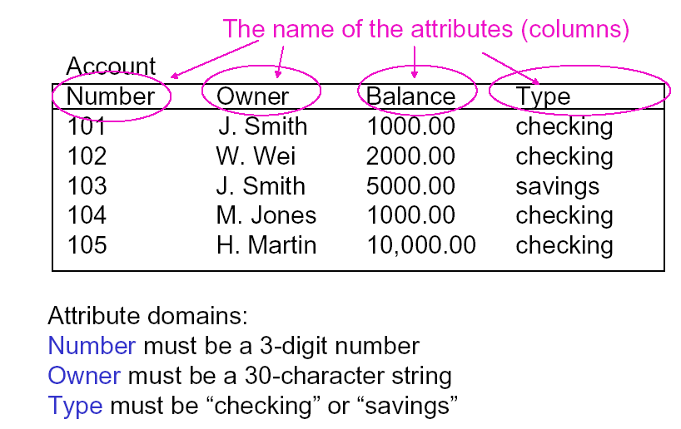
Example: A Relation
Notes:
This relation is called account.
The column headers are the attributes. The domain for each attribute? Integer, string, real, enumeration with two possible values.
We switch the whole columns (whether the header/schema is included makes no difference).
1. If we just switch the instance columns (101 with 1000.00) but headers remain the same, it is obvious that the result table is not the same table as the original. Schema is the same, but content is different.
2. If we switch the whole columns (including the headers), the new table is (Balance, Number, Owner, Number, Type). Is the new table the same as the original? Not automatically.
3. But if we switch row 101 with row 105, the result table is considered identical to the original.
Going back to the basics, a row is a tuple. Mathematically, (1,a) != (a,1). Order of the members (columns in tabular form) is important.
However, table/relation is a set of rows. Mathematically, {(1,a), (1,b)} = {(1,b), (1,a)}. Order of the members (rows in tabular form) is irrelevant.

Slide 9
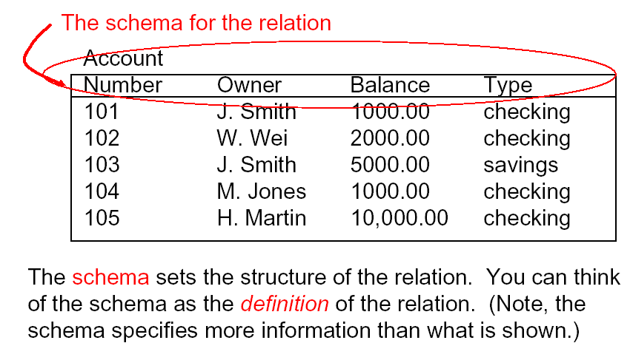
Example: Relational Schema
Notes:
The union of all attributes is the schema of the relation, which defines the structure of the relation.

Slide 10
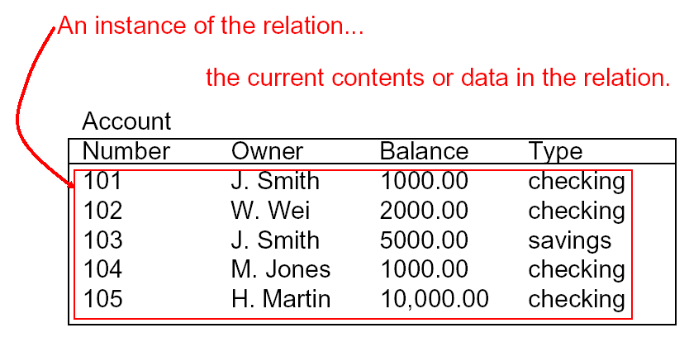
Example: Instance
Notes:
The content of the relation is called the instance.
Instance: change frequently, each add, delete, update changes the instance.
Schema: not so much

Slide 11
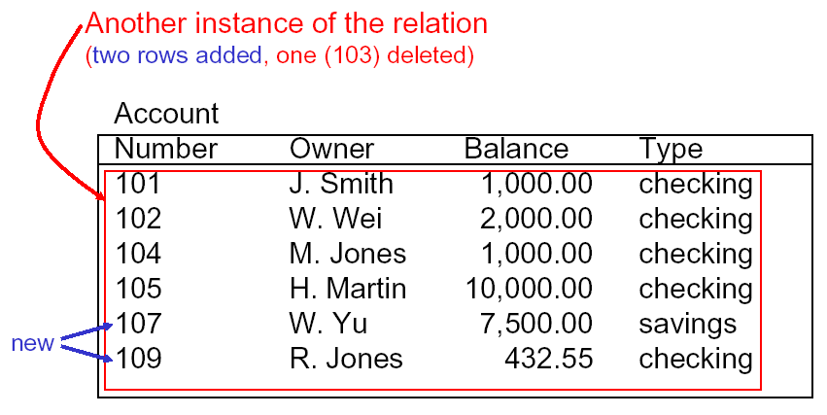
Example: Another Instance
Notes:
Is (Michael, Jordan) = (Jordan, Michael)?
DBMS uses schema to interpret the instance (each is stored in a different place). So using (FN, LN) to interpret (Michael, Jordan) gives you different information from using the same schema to interpret (Jordan, Michael).
I should clarify the order of rows/columns: when you shuffle the rows in the instance, the same schema gives you the exact same information as before the shuffle. But if you shuffle the columns in the instance, the schema will interpret it differently. Hence the order of the rows in the instance is irrelevant, but the order of the columns matters a lot.

Slide 12
Important Note
We can only run a query over an instance to check whether the query is wrong, but not whether it is correct.
  If the result is wrong, the query must be wrong
  If the result is correct, the query might be correct, but might be wrong as well
A correct query MUST return the right answers in all instances
Notes:
Analogy:
Prove that A+A=A*A
When A = 2, it is correct. So the equation is correct? Obviously NOT. We can try A = 1 and it does not hold
A = 2 is like an instance and A =1 is another instance, the equitation is correct for one instance does not mean it is correct.
However, if the equation is wrong for one instance, it MUST be wrong.
So we can use instance to prove something is wrong but never to prove something is correct.

Slide 13
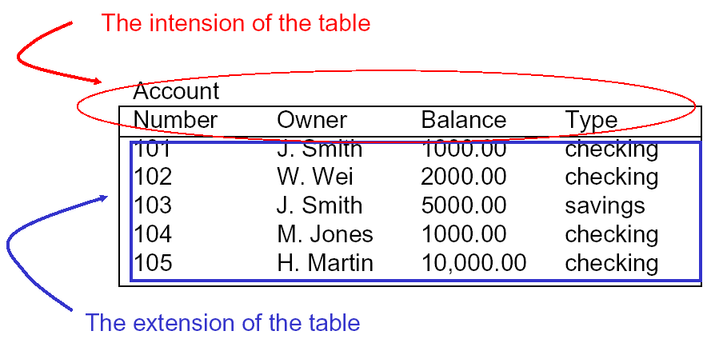
Alternative Terminology (FYI)

Slide 14
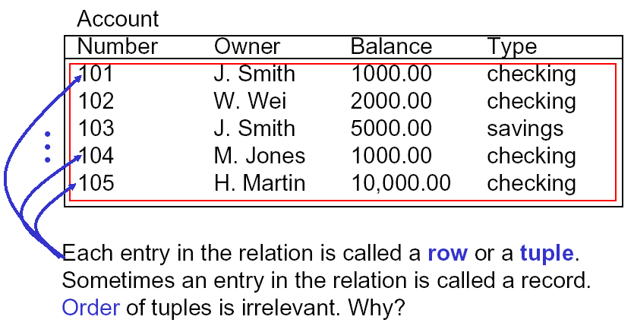
Row/Tuple
Notes:
Each row inside the table is also called tuple or record. Order of the tuples/rows is not important
By definition, relation is a set of tuples, no order among row. In terms of semantics, relation represents real world facts at a logical or abstract level. Many logical orders can specified on a relation, By Last Name or SID etc. But this is not part of the relation definition: there is no preference for one logical tuple over another. It is the user who might have preference over certain displaying order.
However, order of the attributes (columns) does play an important part. Remember that DBMS uses schema to interpret the data. So the order of attributes in schema and in the table must match!
Change the order of rows, still the same table; but change the order of columns => different table!
Implementation and performance issue …
As you can see, logical schema and physical are separated (you can have many logical orders, index, over one physical database; of courses, need different physical index file, but user transparent; accessing the same file from user point of veiw). Not like in legacy system (hierarchical or network, logical order and physical order are the same)
++++++++++++++++++++++++++++++
A tuple is an ordered set of values
Each value is derived from an appropriate domain.
Each row in the CUSTOMER table may be referred to as a tuple in the table and would consist of four values.
<632895, "John Smith", "101 Main St. Atlanta, GA 30332", "(404) 894-2000">
is a tuple belonging to the CUSTOMER relation.
A relation may be regarded as a set of tuples (rows).
Columns in a table are also called attributes of the relation.
Each Tuple represetns one entity in ER or real world
How about order of attributes? Some do, some don’t (n-tuple, is ordered …) Physically they are stored in order as fields within a record. We follow the former here, unless say otherwise
Ordering of tuples in a relation r(R): The tuples are not considered to be ordered, even though they appear to be in the tabular form.
Ordering of attributes in a relation schema R (and of values within each tuple): We will consider the attributes in R(A₁, A₂, ..., A_{n}) and the values in t=<v₁, v₂, ..., v_{n}> to be ordered .
(However, a more general alternative definition of relation does not require this ordering).
Values in a tuple: All values are considered atomic (indivisible). A special null value is used to represent values that are unknown or inapplicable to certain tuples.

Slide 15
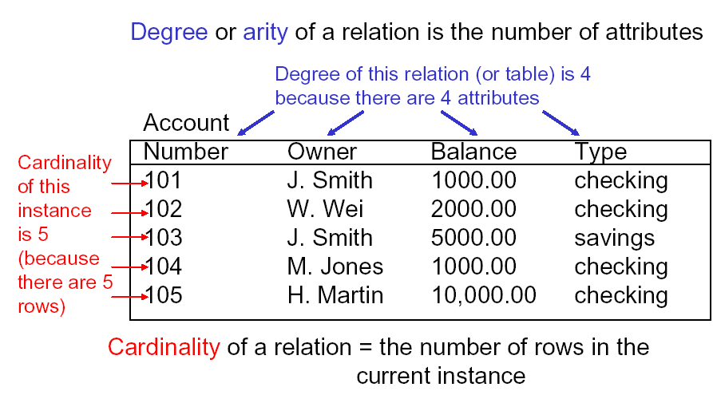
Degree and Cardinality
Notes:
Be aware degree of relation vs. degree of relationship!

Slide 16
Terminology Summary
Informal Terms |  | Formal Terms
Table |  | Relation
Column Header/Field |  | Attribute
Row/Record |  | Tuple
Possible Values in a column |  | Domain
Table Definition |  | Schema of a Relation/Intension
Table Content |  | Instance/Extension
Notes:
Use the terms interchangeably.
Note that every time we say table, we mean table as set of rows.

Slide 17
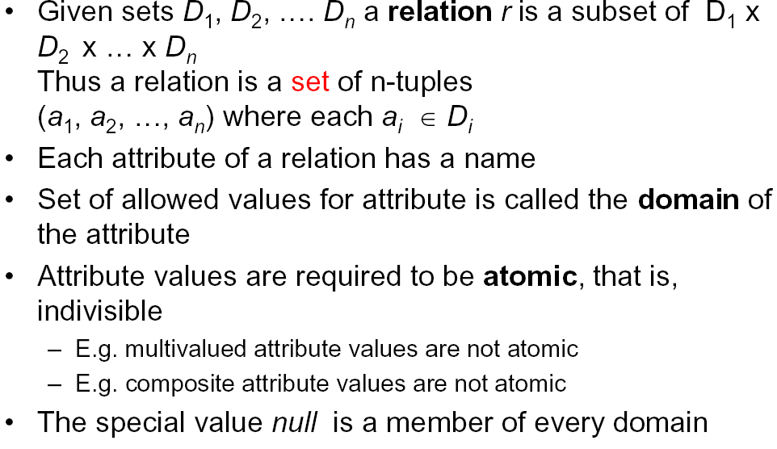
Relation – Formal Definition
Notes:
Formally relation is a set of n-tuples, a1, a2 are the attributes, and D1, D2 are the domains of the attributes. each value of the tuple come from a domain.
Two very important facts:
Regardless of the domain of the attribute (int, char, string etc.), the value of an attribute could always be null.
A domain has a logical definition: e.g.,
“USA_phone_numbers” are the set of 10 digit phone numbers valid in the U.S.
A domain may have a data-type or a format defined for it. The USA_phone_numbers may have a format: (ddd)-ddd-dddd where each d is a decimal digit. E.g., Dates have various formats such as monthname, date, year or yyyy-mm-dd, or dd mm,yyyy etc.
An attribute designates the role played by the domain. E.g., the domain Date may be used to define attributes “Invoice-date” and “Payment-date”.

Slide 18
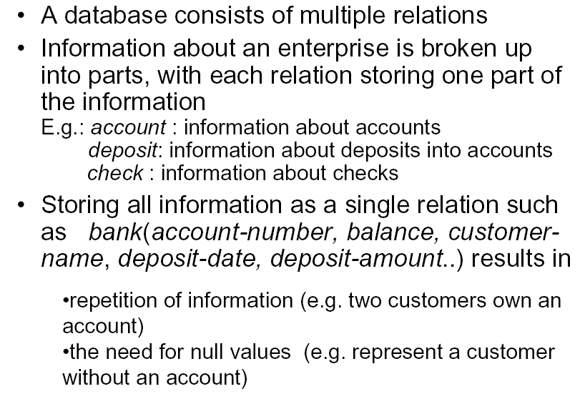
Relational Database
Notes:
A relation database is a collection of data broken into relations.
Not a good idea to keep everything in one single table:
Redundancy: For example, two customer share the same account … store the account info twice
Null: customer has no check will have null for check information

Slide 19
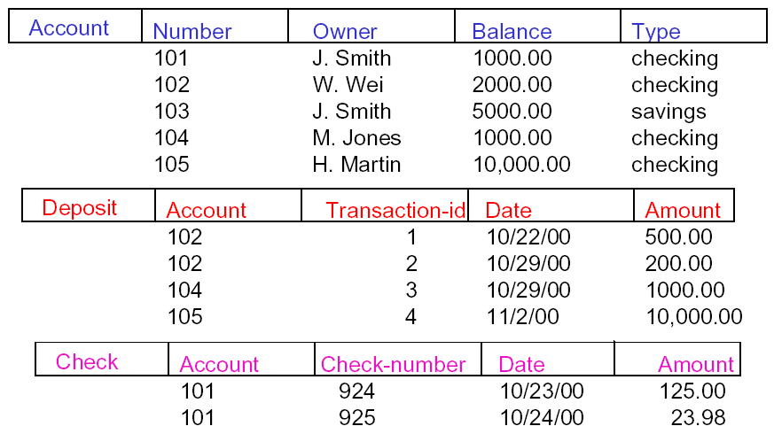
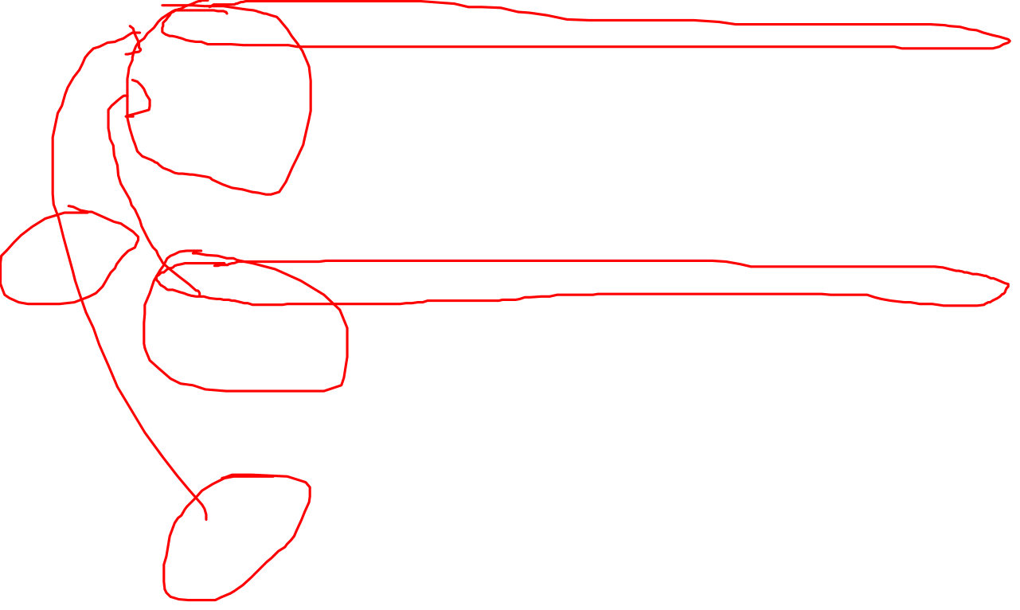
Example: Relational Database
Notes:
Example of a relation database, with 3 populated tables.
Related information stored in a structure format:
Structure here are tables.
How the information is connected to each together?

Slide 20
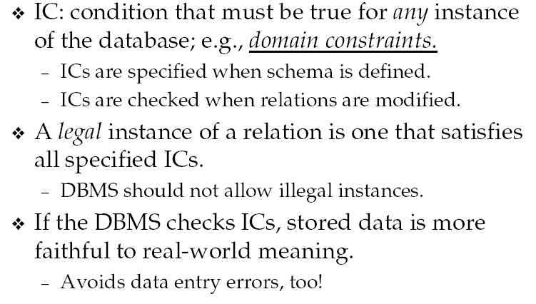
Integrity Constraints (IC)
Notes:
Every instance of a DB must satisfy some rules called all ICs. In other words, each time you add, delete or update the DB, all IC must be checked by the DBMS to see whether the action is legal.
Constraints are specified the developer during database development, but enforced automatically by DBMS

Slide 21
ICs in Relational Database
Domain constraints
Primary key constraints
Foreign key constraints

Slide 22
Domain constraints
Value for an attribute must be atomic
  For example, phone number
Value for an attribute must come from the domain of the attribute
  For example, int for int, float for float, string for string etc.

Slide 23
Primary Key Constraints
Primary key constraints: each relation must have a primary key
  Value for primary key must be unique and non-null (not empty)
Review question: why PK?
Notes:
Set: unique row!

Slide 24
Primary Keys
Primary key – minimum set of attributes that is a unique identifier for a tuple/row
  sid is primary key for Students
  cid is primary key for Courses
  A table might have several possible PKs. Each is called a candidate key and one of them is designated as PK.
  PK is often underlined
If a table has multiple possible PKs, each is called a candidate keys and one will be designated as PK
Notes:
Why PK? Having two more rows that are identical does not make sense! So every row must be unique. So there must exist a minimal set of attributes making each row unique.

Slide 25
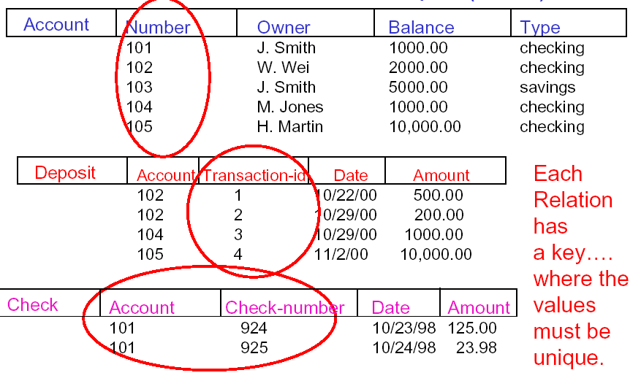
Example: Primary Keys
Notes:
If you are looking for account 102 in the Account table because of possible money laundering, I can uniquely identify one and only one row that you are looking for. So Number is a PK in Account.
However, if you say you want to put $100 to account belong to J Smith in the Account able, I cannot tell which specific account you are depositing. So Owner can NOT be a PK in Account.
Can Check-number alone be sufficient as the PK in the Check table?

Slide 26
Exercise: Candidate Key?
Student(SID, E-mail, Address, Phone, Birthday)
  SID?
  E-mail?
  Phone?
  (SID, Address)
F20Courses (CID, Title, Time, Location, Cap)

Slide 27
Why Minimal in PK?
PK: “Minimal” set of attributes whose values are unique for each row
  Its value must be unique and not empty
Why minimal?
  SID is the PK in the Student table
  Why can’t we make (SID, Name) as the PK?

Slide 28
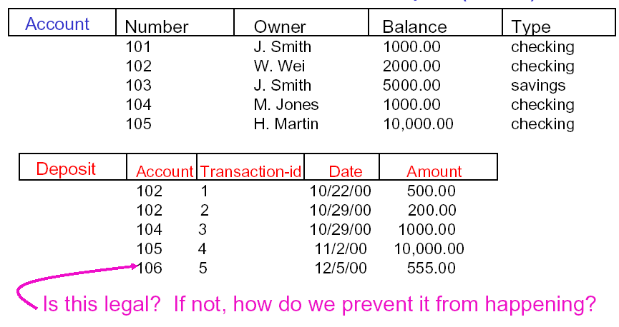
Discussion: What is Wrong?
Notes:
Let’s take a look at this example. Primary key and domain constraints are all satisfied but what is wrong? We deposit something to an account that does not exist! How can we prevent it?

Slide 29
Foreign Key and Referential Integrity
Foreign Key: set of fields in one relation that is used to refer to a tuple in another relation
  Often (but NOT always) corresponds to the primary key of the second relation like a “logical pointer”.
  The second relation could be the same relation, that is, pointing to itself (Ex. the supervisor FK in the employee table).
E.g. sid is a foreign key referring to Students:
Enrolled (sid: string, cid: string, grade: string)
If all foreign key constraints are enforced, re ferential integrity is achieved, i.e., no dangling references.
Can you name a data model w/o referential integrity ?
  Links in HTML!
Notes:
Recall: DB stores related data, how to data in different tables? How do they relate to each other? FK!

Slide 30
Definitions of FK Constraints
Referencing relation (R1): points to (refers to) other relation
  For example, the Enrolled relation
Referenced relation (R2): pointed to (referred to) by other relation
  For example, the Students relation
If FK exists, the value in the foreign key column (or columns) of the referencing relation R1 must be either:
  a unique value in the referenced relation R2, or.
  null.
Note: PK is mandatory but FK is optional
Notes:
Unique (what if not unique?, That is candidate key) or null (customer just want to cash a check?)
PK is mandatory for every table in DB but FK is optional. However, if you do have FK, it must follow the rules.
A constraint involving two relations (the previous constraints involve a single relation).
Used to specify a relationship among tuples in two relations: the referencing relation and the referenced relation.
Tuples in the referencing relation R₁ have attributes FK (called foreign key attributes) that reference the primary key attributes PK of the referenced relation R₂. A tuple t₁ in R₁ is said to reference a tuple t₂ in R₂ if t₁[FK] = t₂[PK].
A referential integrity constraint can be displayed in a relational database schema as a directed arc from R₁.FK to R₂.
A way to represent relationship in relational model
Statement of the constraint
The value in the foreign key column (or columns) FK of the the referencing relation R₁ can be either:
(1) a value of an existing primary key value of the corresponding primary key PK in the referenced relation R_{2,}, or..
(2) a null.
In case (2), the FK in R₁ should not be a part of its own primary key.

Slide 31
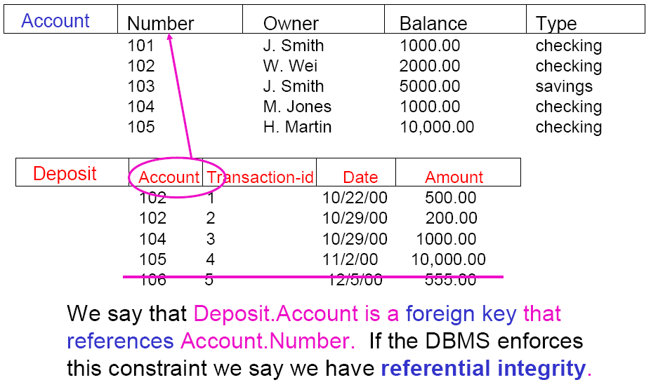

Example: Foreign Key
NULL 6 9/10/20 100
Notes:
If we establish Deposit.Account is a FK references Aaccount.Number in our design, then DBMS will check whether account exist in Account table when deposit to an account … …

Slide 32
Exercise: Foreign Key
NULL 6 9/10/20 100
Notes:
Deposit.Amount references Account.Balance.
Transactions #3 will be rejected because 1000.00 is NOT unique in Account.Balance. The system will be confused which 1000.00 is being referenced.
Transaction #1, 2, and 6 will be rejected as well because the corresponding values do not exist in Account.Balance.
#5 already been rejected

Slide 33
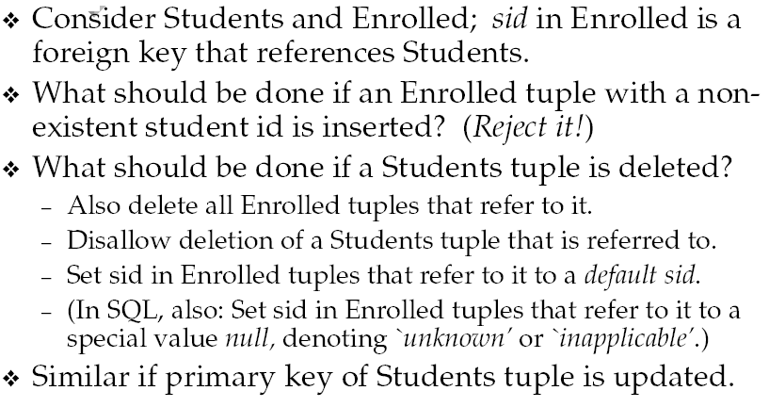
Enforcing Referential Integrity
Notes:
The impact of add, delete and update when having FK: you cannot perform these casucally. DBMS will check whether they violate FK.
Integrity constraints should not be violated by the update operations.
Updates may propagate to cause other updates automatically. This may be necessary to maintain integrity constraints.
In case of integrity violation, several actions can be taken:
Cancel the operation that causes the violation (REJECT option)
Perform the operation but inform the user of the violation
Trigger additional updates so the violation is corrected (CASCADE option, SET NULL option)
Execute a user-specified error-correction routine

Slide 34

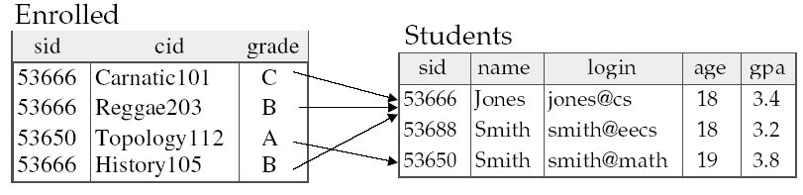
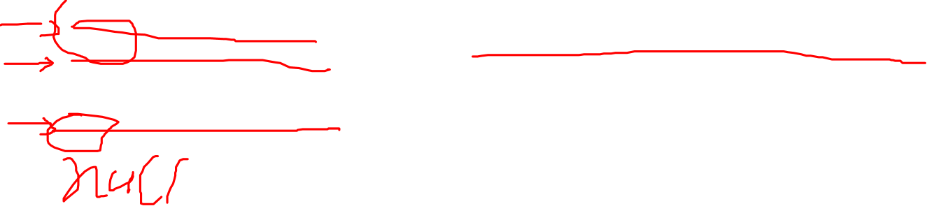
Example: Enforcing FK
What if Jones is deleted from Students table?

Slide 35

Example: Enforcing FK
What if Jones’s SID is changed to 111111?

Slide 36
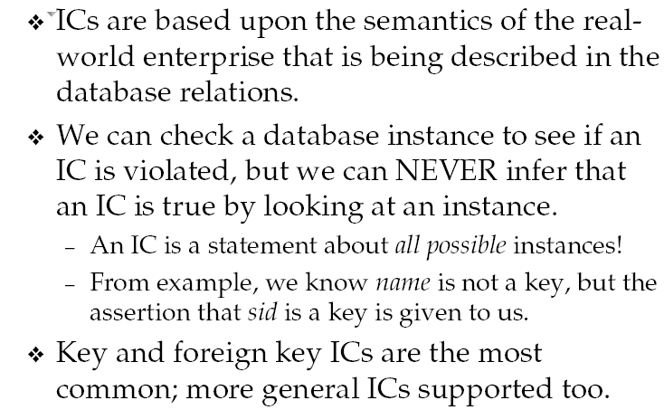
Where Does IC Come From?
Notes:
Designer are responsible for IC

Slide 37
Other Types of Constraints
Semantic Integrity Constraints:
  based on application semantics and cannot be expressed by the data model, but at the application level (you need to write code to describe it)
    E.g., “the max. no. of hours per employee for all projects he or she works on is 56 hrs per week”
    Or, “manager salary must be higher than regular worker salary”
    Or, “A student with average below 80 cannot take more than 5 courses”
  A constraint specification language may have to be used to express these
    SQL-99 allows triggers and ASSERTIONS to allow for some of these
Notes:
All three ICs introduced here can be achieved by a good design.
If not by design, we have to program it.

Slide 38
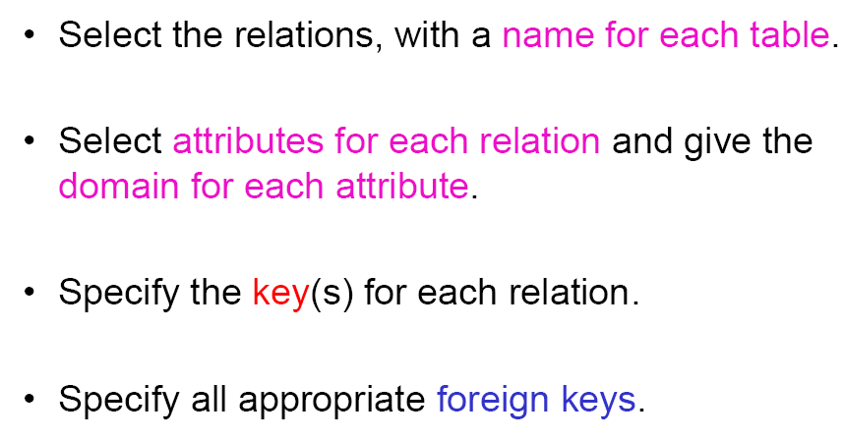
Specifying a Relation Schema

Slide 39
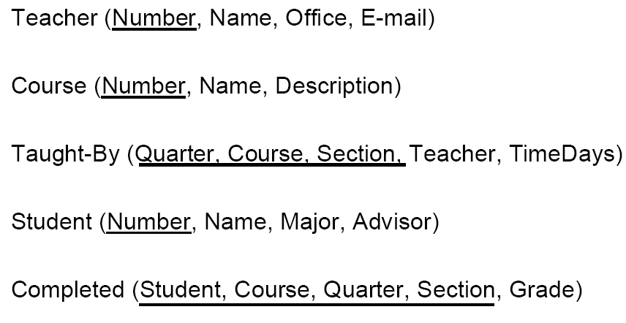
Exercise - FK
Notes:
Exercise: identify the PK, FK, referencing table and referenced table in the following example.

Slide 40
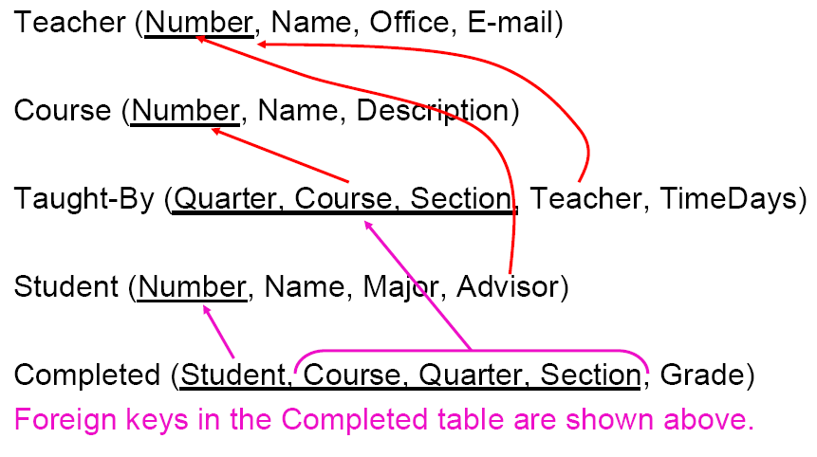
Exercise – FK (Answer)
Notes:
You can also specify FK as: Taught-By.Teacher references Teacher.Number.
Same attributescould have different names in different tables:
Taught-By.Course references Course.Number
Taught-By.Teacher references Teacher.Number
Student.Advisor references Teacher.Number
Completed.Student references Student.Number
Completed.(Course. Quarter, Section) references Taught-By.(Course. Quarter, Section)

Slide 41
Exercise – PK and FK
(Consider the following relations for a database that keeps track of student enrollment in courses and the books adopted for each course:
STUDENT(SID, Name, Major, Bdate)
COURSE(Course#, Cname, Dept)
ENROLL(SID, Course#, Quarter, Grade)
BOOK_ADOPTION(Course#, Quarter, Book_ISBN)
TEXT(Book_ISBN, Book_Title, Publisher, Author)
Identify the primary keys and foreign keys for this schema.
Notes:
If you want to know the answers, please post your answers on the discussion and we will comment on them.

Slide 42
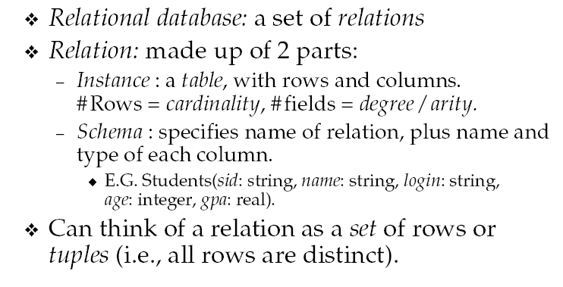
Summary of Relational Model I

Slide 43
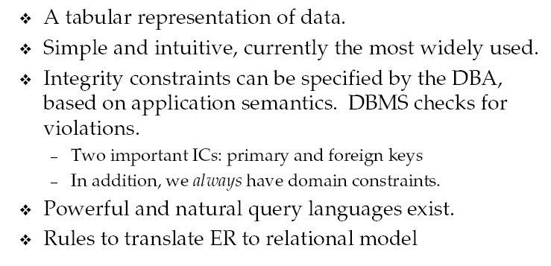
Summary of Relational Model II

Slide 44
Summary of 2-1
Relational data model
Integrity constraints in relational data model

