Slide 1
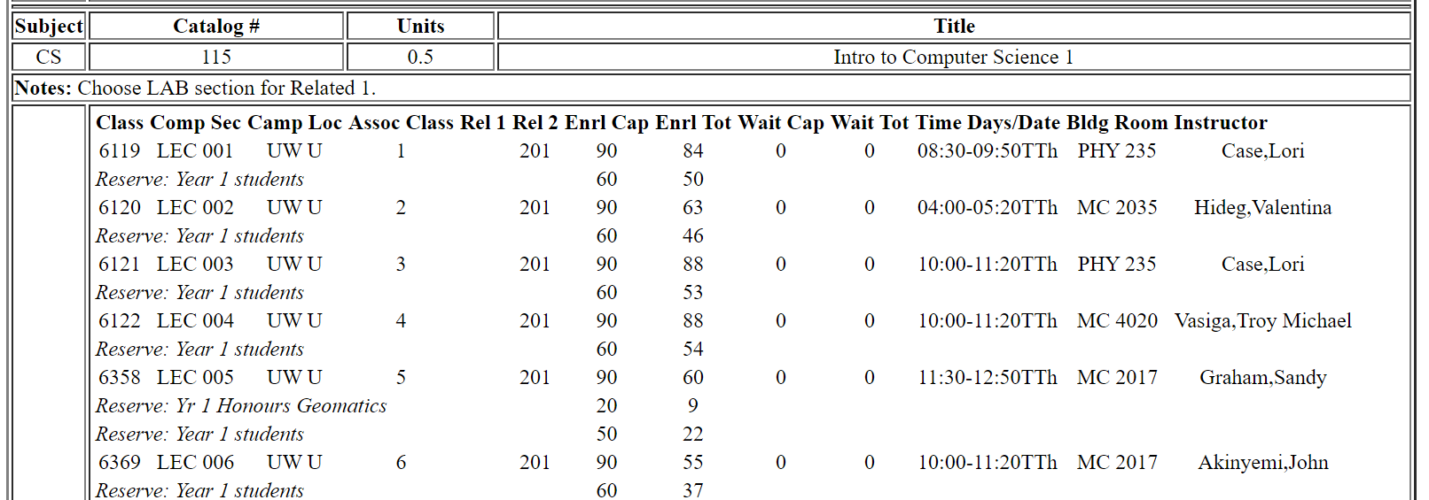
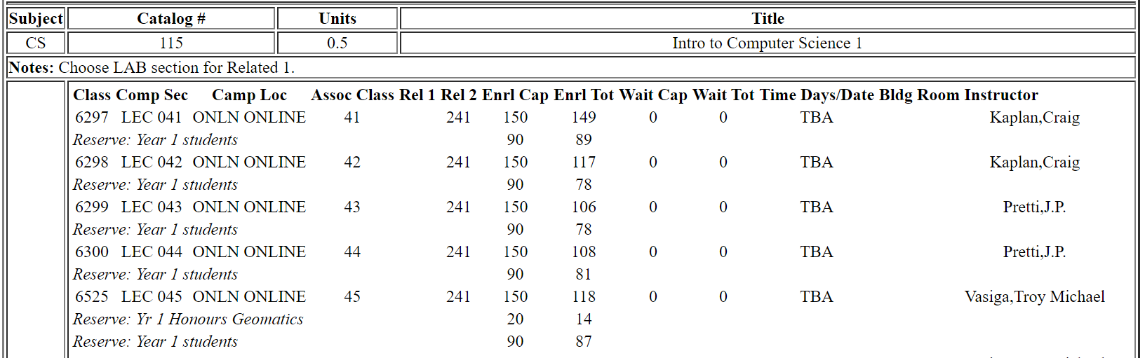


What would be the proper Candidate Key/Primary Key?
F19Courses (CID, Title, Time, Location, Cap)
F20Courses (CID, Title, Time, Location, Cap)
Notes:
Lots of responses and good answers. The table is intentionally ambiguous to make a point: 99% of the time, finding the PK is trivial. But some times not.
Let’s start with F19 where courses were on campus.
Now F20, courses are online. Would (CID, Time, Location) work? Three problems.
All T and L are the same, TBA or NULL! For CS 115, all the sections are (CS 115, TBA, TBA).
If using NULL for T and L, it violates PK constraints where PK can have NULL values.
If using TBA, the domain for T is time, NOT string. How can we use TBA? (They must have made some changes to allow special values for T)
How to solve it? Man-made PK: primary class meet# (just class#)

Slide 2
Review of Lecture 2-1
Relational database: tables
  Set, simple attribute
  Order of row vs. order of column
ICs
  Domain
  PK
  FK
    Used to associate table with table
    Referencing table and referenced table
Notes:
More costly and time consuming to use DB
Processed quickly in real time

Slide 3
Lecture 2-2: Today’s Plan
Introduction to Relational Algebra
  Select
  Project
  Assignment
  Union
  Intersect
  Minus
Exercise

Slide 4
Relational Algebra and Calculus
Chapter 03
Collin Roberts
University of Waterloo
Notes:
Relational Algebra (RA) and Relational Calculus (RC) are formal languages for the database relational model while SQL is the practical language in the database relational model. In these formal languages a conceptual database model is expressed in mathematical terms and notations while in the practical language – SQL, the mathematical expressions of the functionality and transaction of the database operations are implemented physically. Formal languages provide a medium through which to optimize and implement queries in database transactions.
Of course the first notable differences between these languages in the syntax and notation used in the expressions. Each language, that RA, RC, and SQL have their own notations to express their notations.

Slide 5
Recommended Readings
Textbook Chapter 06

Slide 6
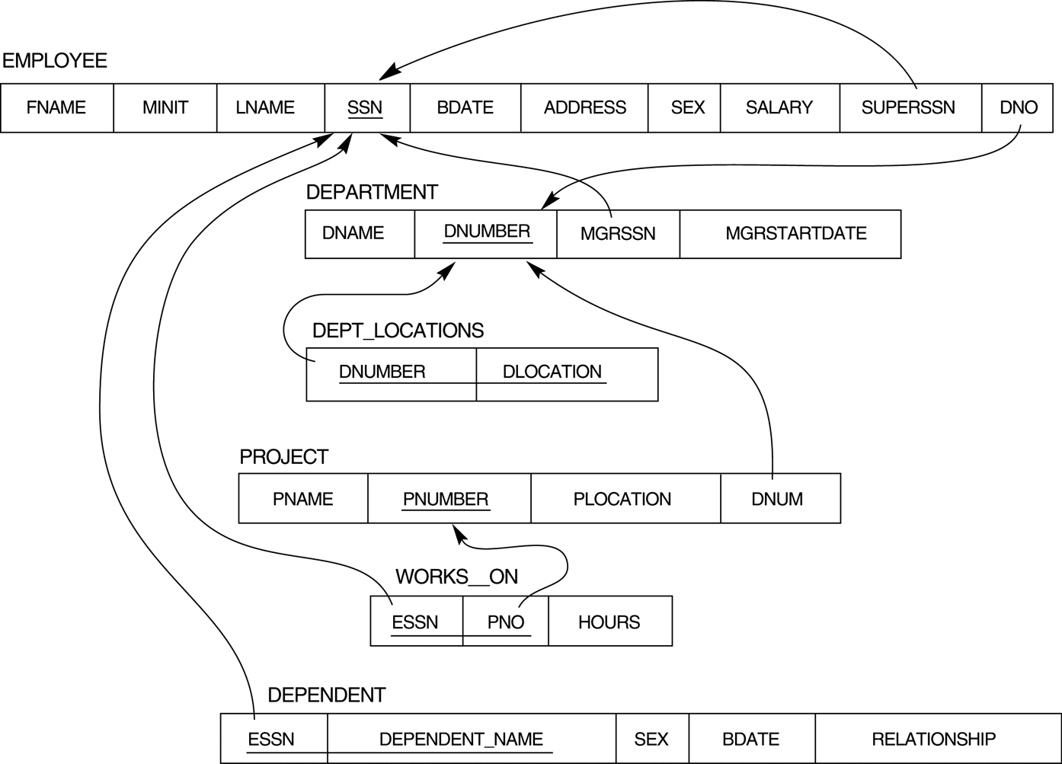
Company Relational Schema
Union
Join
Natural
Exercise
Review
Optimize
Notes:
Most examples discussed in this and next couple chapters refer to the COMPANY database shown here. So get familiar with this database.

Slide 7
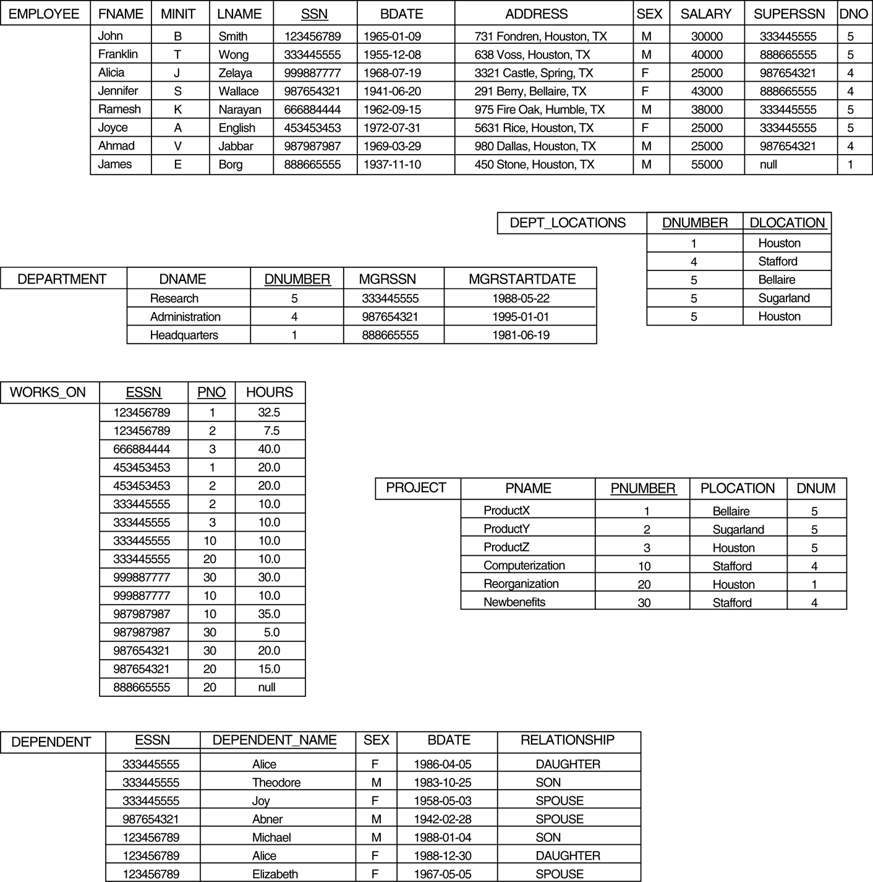
Populated Database--Fig.5.6

Slide 8
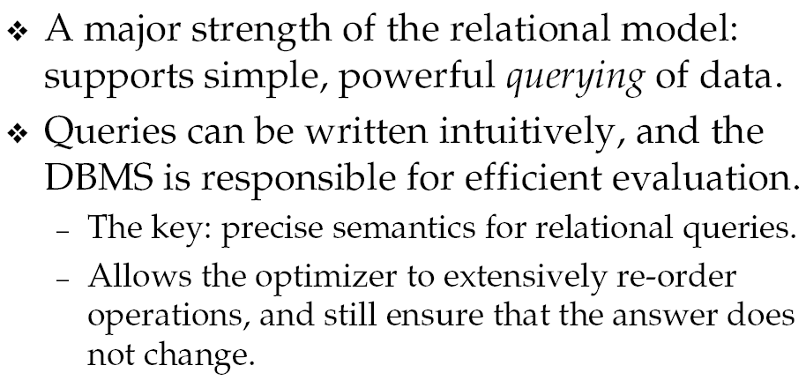
Relational Query Language
Notes:
Simple data type, but supports very powerful query language

Slide 9
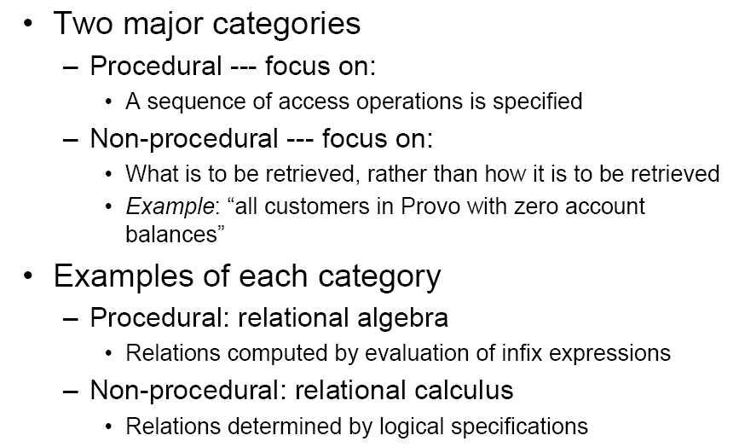
Procedural vs. Non-procedural

Slide 10
Relational Query Language
Relational Algebra: procedural, focus on a sequence of actions to access the data
Relational Calculus: declarative, let users specify what they want rather than how to compute it
Query language is NOT a programming language!
Notes:
RA: useful for representing execution plan
RC: Not use directly, but provide foundation for SQL and query processing
DBMS internally uses RA and externally uses RC (SQL is based on RC and RA)
Query is not a programming language (compute whatever that can be computed): no control structure like looping and decision making, no array, function etc.

Slide 11
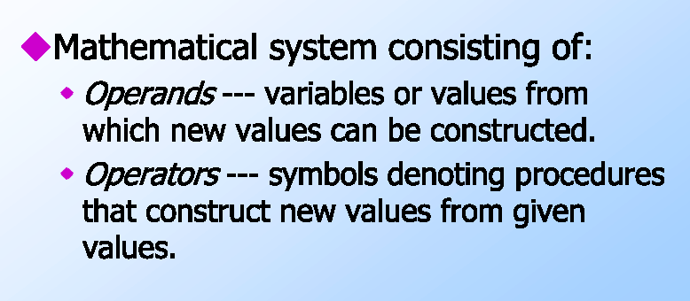
What is Algebra?
Notes:
We will discuss RA in detail in this chapter and study SQL in later chapter.

Slide 12
Relational Algebra
Use to specify retrieval request
  Operand: Relation treated as set
  Operator: Set operators
The result of a retrieval is a new relation
  Each relational operator takes in relations and produces a new relation
A sequence of relational algebra operations forms a relational algebra expression
Part of the model for SQL
  Explain semantics formally
  Basis for implementations
  Fundamental to query optimization
8 – 9 / (3 * 2)
Notes:
The basic set of operations for the relational model is known as the relational algebra. These operations enable a user to specify basic retrieval requests.
Relational algebra is the basic set of operations for the relational model
Similar to algebra that operates on numbers, but operands and results are relations instead of numbers
The algebra operations produce new relations, which can be further manipulated using operations of the same algebra. The new table is a table, could be empty, one record or several; could be one col or several
Operand: relation or attributes, treated as set of tuples and elements in a set;
SET: duplicate always removed in relational algebra!!!!!!!!!!!!

Slide 13
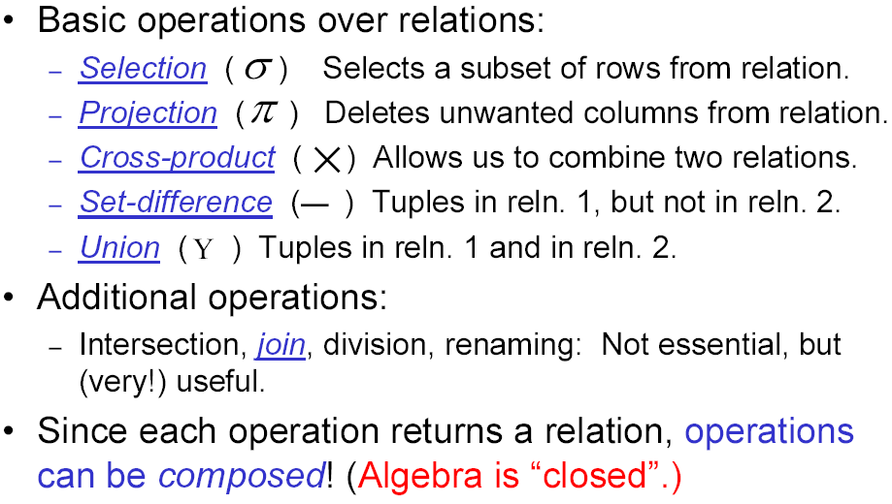
Relational Algebra Operators
Notes:
All of them operate on tables and produce new table

Slide 14
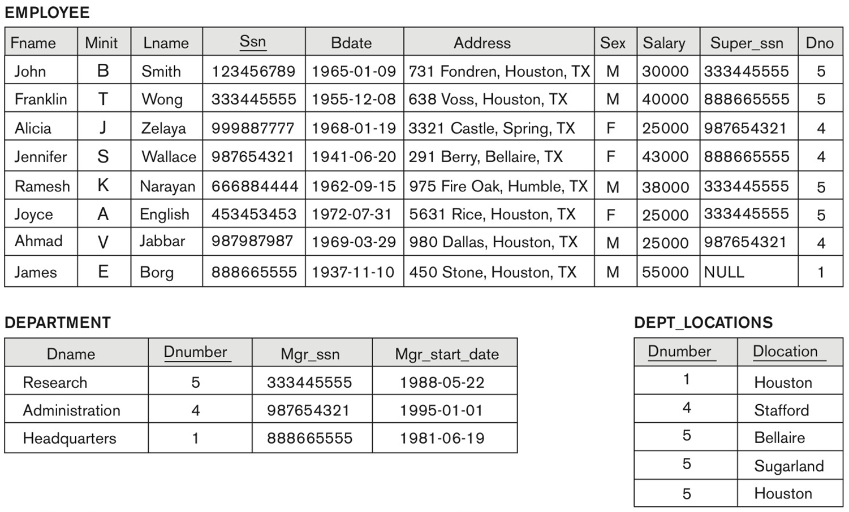

How would you do this manually?
Find employees who work in department #4?

Slide 15

Select Operation
A unary relational operations
Used to select a subset of the tuples from a relation that satisfy a selection condition.
  Boolean expression
_{σ <selection condition>}(R)
Notes:
This is a unary operation: takes in one operand, a relation
It is a filter that keeps only those tuples that satisfy a qualifying condition – those satisfying the condition are selected while others are discarded.
Select rows that satisfy the condition(s)
Note that in select, the Input and output have the same schema.
Duplicate: a relation is a set, no duplicate, subset of a relation is also a relation, obviously no duplicate

Slide 16
Boolean Condition
A statement that can be true or false depending on the input
Typical form: some value compare with other value (>, <, =, !=, >=, <=)
  Example: Balance > 1000
Can be combined using AND, OR, NOT
  Example: (Balance >= 1000) AND (Owner != ‘J Smith’)
Other forms will be introduced later in SQL

Slide 17
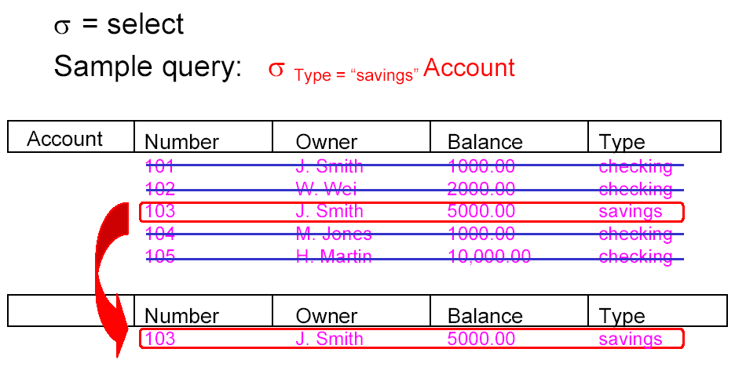

Select: Example
Notes:
From the account table, select all tuples satisfy this condition

Slide 18
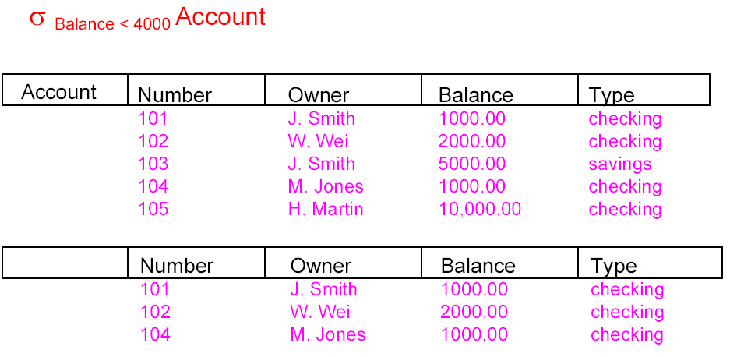
Select: Another Example
Notes:
Produce a set of tuples, a new relation

Slide 19
Select Operation Properties
  Produces a relation S that has the same schema as R
  Commutative:
  σ _{<condition1>}(σ _{< condition2>} ( R)) = σ _{<condition2>} (σ _{< condition1>} ( R))
  A cascaded SELECT operation may be applied in any order:
  σ _{<condition1>}(σ _{< condition2>} (σ _{<condition3>} ( R))
  = σ _{<condition2>} (σ _{< condition3>} (σ _{< condition1>} ( R)))
  Compound condition:
  σ _{<condition1>}(σ _{< condition2>} (σ _{<condition3>} ( R))
  = σ <condition1> AND < condition2> AND < condition3> ( R)
  Operation composition: Output of SELECT can be fed to another operation
Notes:
A cascaded SELECT operation may be replaced by a single selection with a conjunction of all the conditions;

Slide 20

How would you do this manually?
List the last name and first name of all employees.

Slide 21
Project Operation
A unary relational operations
This operation selects certain columns from the table and discards the other columns.
π_{<attribute list>}(R)
Duplicate?
  Eliminate in RA (based on set)
  Not so in practice (when using SQL)
Notes:
The PROJECT creates a vertical partitioning – one with the needed columns (attributes) containing results of the operation and other containing the discarded Columns.
(pi) is the symbol used to represent the project operation and <attribute list> is the desired list of attributes from the attributes of relation R.
The project operation removes any duplicate tuples, so the result of the project operation is a set of tuples and hence a valid relation.

Slide 22
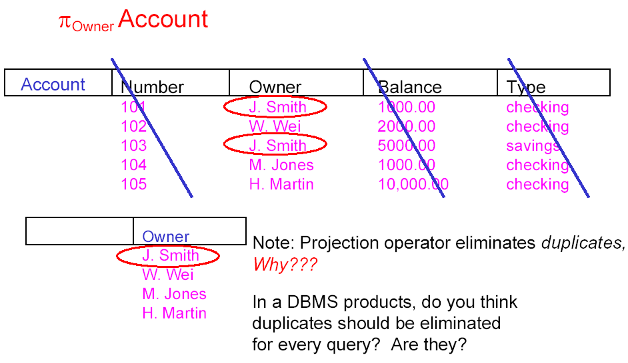

Project: Example

Slide 23
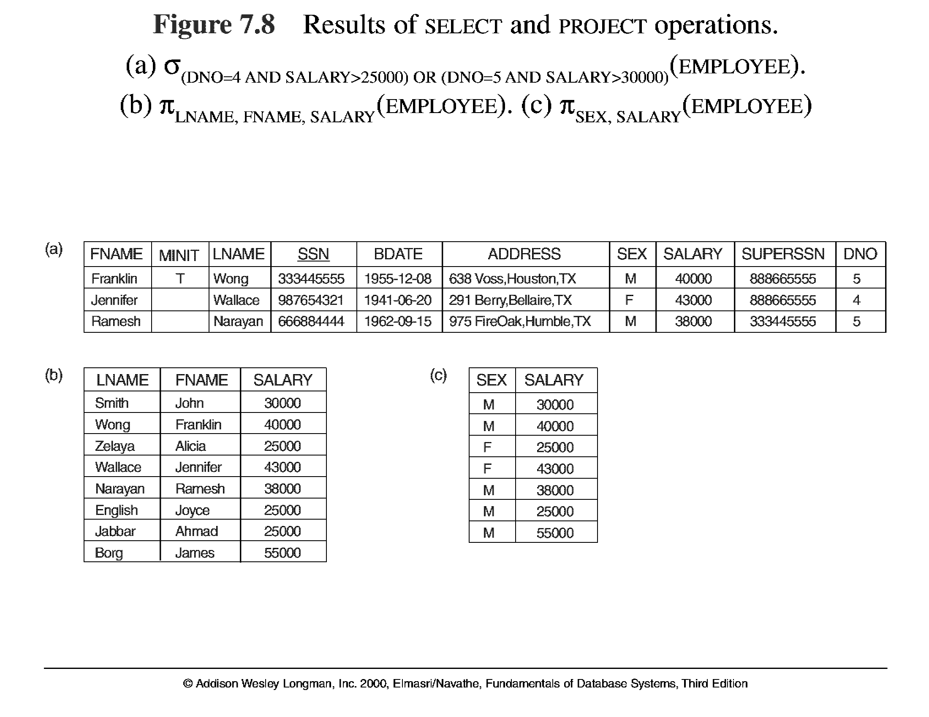

Example
Notes:
What does each expression mean?

Slide 24
Assignment Operation - Motivation
Example: To retrieve the first name, last name, and salary of all employees who work in department number 5, we must apply a select and a project operation. We can write a single relational algebra expression as follows:
π_{FNAME, LNAME, SALARY}(σ _{DNO=5}(EMPLOYEE))
OR we can do it step by step using the assignment operator:
DEP5_EMPS ← σ _{DNO=5}(EMPLOYEE)
RESULT ← π _{FNAME, LNAME, SALARY} (DEP5_EMPS)
Notes:
We may want to apply several relational algebra operations one after the other. Either we can write the operations as a single relational algebra expression by nesting the operations, or we can apply one operation at a time and create intermediate result relations. In the latter case, we must give names to the relations that hold the intermediate results.
Recommended for exam and assignments. So that partial marks are possible even get it wrong. Also easier to understand

Slide 25
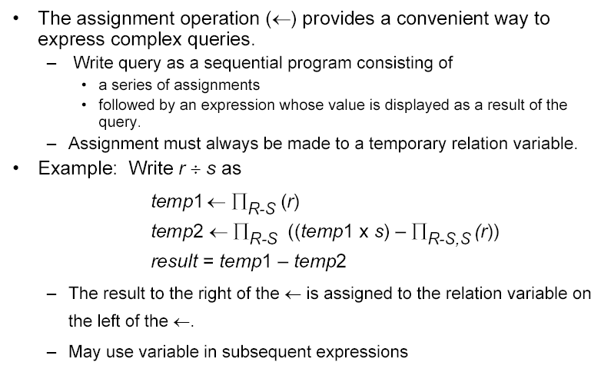
Assignment Operation
Notes:
More precisely, assignment operator allows us to given a name to the intermediate result produced by a query.
Also a very good idea after each assignment, write down the schema of each R (intermediate table)

Slide 26
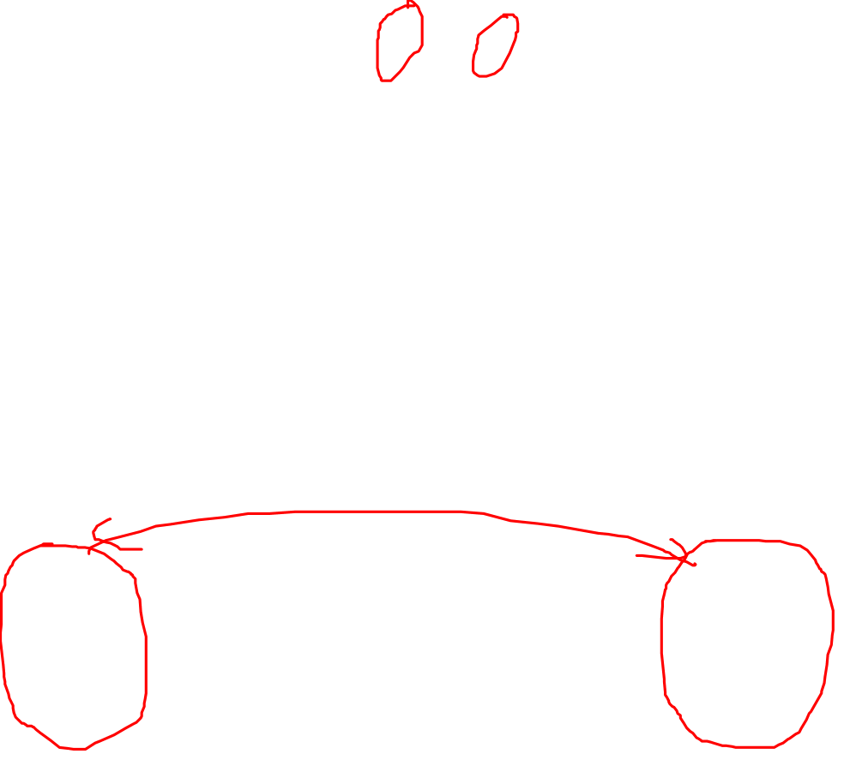
Union Operation
The result of this operation, denoted by R ∪ S, is a relation that includes all tuples that are either in R or in S or in both R and S. Duplicate tuples are eliminated.
Example: To retrieve the SSNs of all employees who either work in department 5 or directly supervise an employee who works in department 5, we can use the union operation as follows:
R1 ← σ_{DNO=5} (EMPLOYEE)
RESULT1 ← π _{SSN}(R1)
RESULT2 ← π _{SUPERSSN}(R1)
RESULT ← RESULT1 ∪ RESULT2
Company
R1 | Fname | Mini! | Lname | Ssn | Bdate | Address | Sex | Salary | Super_ssn | Ono
 | John | B | Smith | 123 456789 | 1965-01-09 | 73 1 Fondren, Houston, TX | M | 30000 | 333445555 | 5
 | Franklin | T | Wong | 333445555 | 1955-12-08 | 638 Voss, Houston, TX | M | 40000 | 888665555 | 5
 | Ramesh | K | Narayan | 666884444 | 1962-09-15 | 975 Fire Oak, Humble, TX | M | 38000 | 333445555 | 5
 | Joyce | A | English | 453453453 | 1972-07-31 | 563 1 Rice, Houston, TX | F | 25000 | 333445555 | 5
Notes:
This is a binary operation.
The union operation produces the tuples that are in either RESULT1 or RESULT2 or both. The two operands must be “type compatible”.
The resulting relation for R1 UNION R2 has the same attribute names as the first operand relation R1 (by convention).

Slide 27
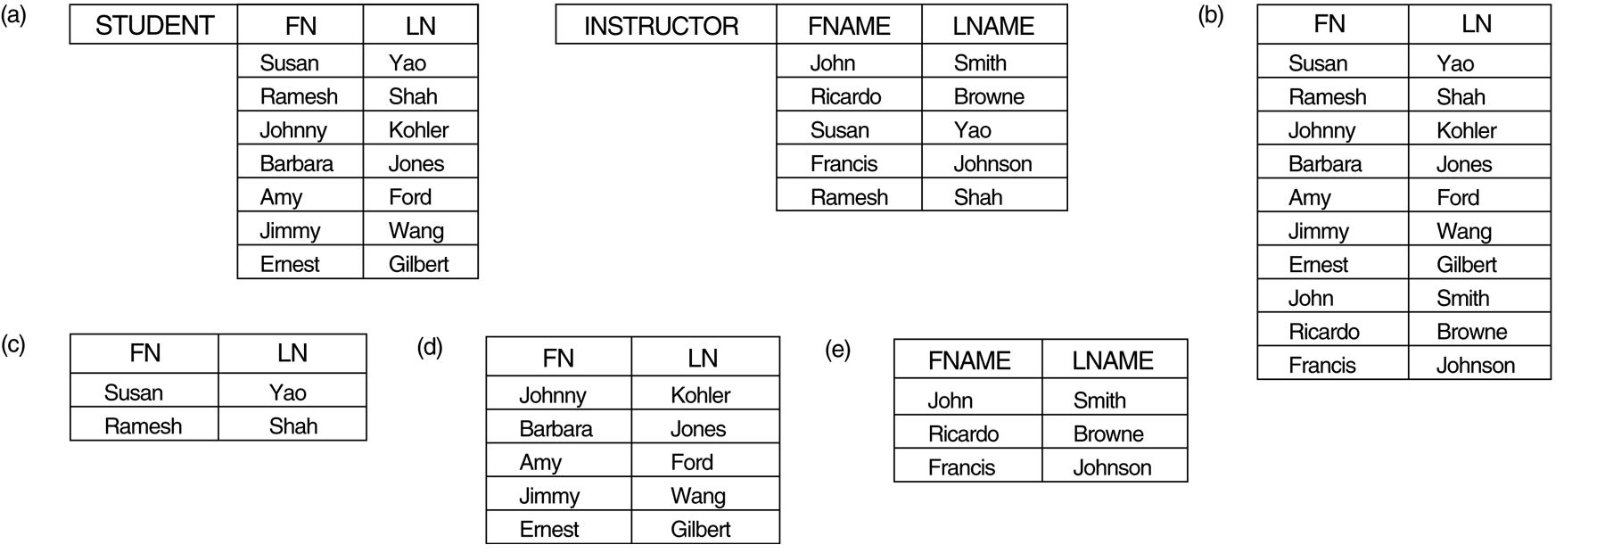
Union: Example
STUDENT ∪ INSTRUCTOR
Notes:
List all the people that is either a student or Instructor or both.
10
Say in the company DB, what if we union E and D? Can we?

Slide 28
Union: Requirement
What if we do a union between department and Employee:
Department ∪ Employee

Slide 29
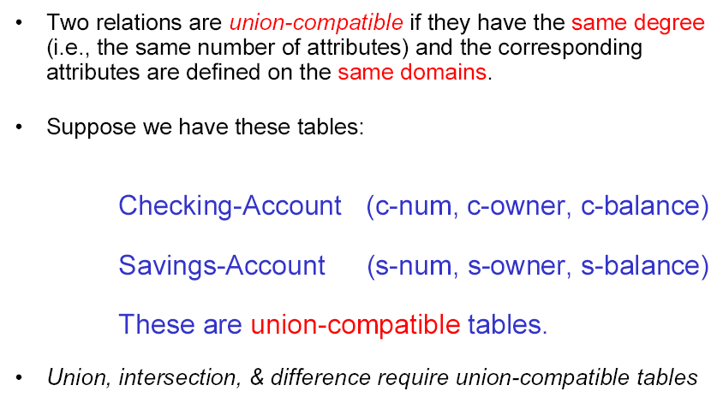
Union Compatible
Notes:
Type compatible (textbook term) or union compatible
The operand relations R₁(A₁, A₂, ..., A_{n}) and R₂(B₁, B₂, ..., B_{n}) must have the same number of attributes, and the domains of corresponding attributes must be compatible; that is, dom(A_{i})=dom(B_{i}) for i=1, 2, ..., n.

Slide 30
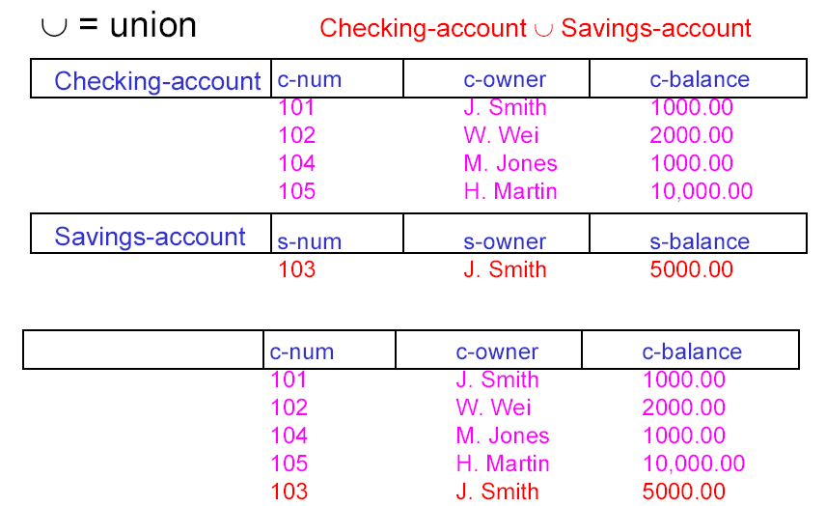

Union Compatible: Example
Notes:
Returns a table showing people with C or S or both account.
What if we want to find people with both account?

Slide 31
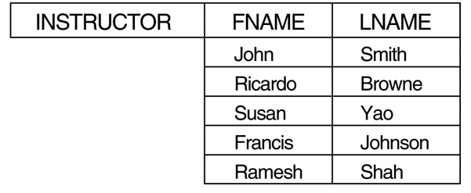
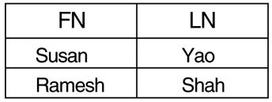
Intersection Operation
The result of this operation, denoted by R ∩ S, is a relation that includes all tuples that appear in both R and S. The two operands must be “union compatible"
Example: Find those who are both students and instructors.
STUDENT ∩ INSTRUCTOR
Notes:
Also binary
The resulting relation for R1 INTERSECT R2 has the same attribute names as the first operand relation R1 (by convention).

Slide 32
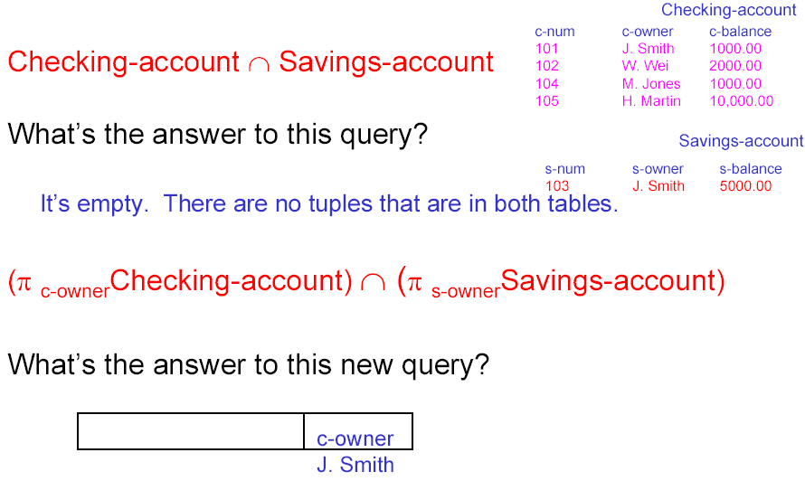
Exercise: Intersection
Notes:
Find people with both C and S accounts. Which one is correct?
The second query returns table showing people with both accounts, assuming owner name is unique.
+++++++++++++
What if we want to find people with only C account?

Slide 33
Difference (or Minus) Operation
The result of this operation, denoted by R - S, is a relation that includes all tuples that are in R but not in S. The two operands must be “union compatible”.
Example: The figure shows the names of students who are not instructors.
STUDENT-INSTRUCTOR
INSTRUCTOR-STUDENT
Notes:
First one lists who is a student but not an instructor;
Second one list who is an instructor but not a student
The resulting relation for R1 - R2 has the same attribute names as the first operand relation R1 (by convention).

Slide 34
Properties of Set Operators
Notice that both union and intersection are commutative operations; that is
R ∪ S = S ∪ R, and R ∩ S = S ∩ R
Both union and intersection can be treated as n-ary operations applicable to any number of relations as both are associative operations; that is
R ∪ (S ∪ T) = (R ∪ S) ∪ T, and (R ∩ S) ∩ T = R ∩ (S ∩ T)
The minus operation is not commutative; that is, in general
R - S ≠ S – R
SI Example
Notes:
Example: Student - Instructor is not the same as Instructor-Student

Slide 35
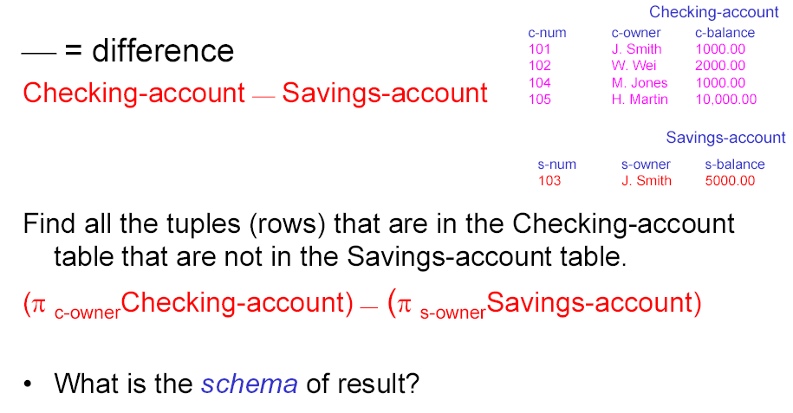
In-class Exercise #1
Find all the owners who have only checking account.
Find all the owners who have only saving account.
Find all the owners who have both accounts.
Find all the owners who have an account with us. (maybe ambiguous?)
Find all the owners who have some account with us.
Assumption: owner name is unique
Notes:
Write RA queries to answer the following questions.
From past students of the class, this is how they interpreted it:
An account: one and only account
Some account: one or more accounts

Slide 36
Summary of Lecture 2-2
Some basic RA operations
  Select, Project, Assignment, Union, Intersect, Minus
Make sure you understand the schema of the result for each operation

