Slide 1

FK Clarification
R1(ABC), R2(EFG). There is a FK: R1.A references R2.G.
The value of R1.A must be
  NULL, or
  A unique value in R2
That is, R2.G must be unique or NULL.
R2.G might or might not be a PK!
  R2.G could be NULL. while the value of PK can never be NULL.
Notes:
Based on the postings, there is a common mistake defining FK. You cannot just say: R1(ABC), R2(CXY), in this example, R1.C is the FK. It does not make sense. Where does it point to? R2.C, R1.A, R2.X? Any of them is possible. You need to state it like FK: R1.C references R2.C, or R1.C references R1.A. Although it is a convention to name them the same (R1.C to R2.C), but it is NOT a must.

Slide 2

Exercise – FK (Why it is wrong)
STUDENT(SID, Name, Major, Bdate)
COURSE(Course#, Cname, Dept)
ENROLL(SID, Course#, Quarter, Grade)
BOOK_ADOPTION(Course#, Quarter, Book_ISBN)
TEXT(Book_ISBN, Book_Title, Publisher, Author)
FK: BOOK_ADOPTION.(Course#, Quarter)
references ENROLL.(Course#, Quarter)
ENROLL
BOOK_ADOPTION
SID | Course# | Quarter | Grade
12 | CS 338 | W21
23 | CS 338 | W21
34 | CS 136 | W21
Course# | Quarter | Book_ISBN
CS 338 | W21 | B22
CS 330 | W21 | B35
CS 136 | W21 | B99
Notes:
If you want to know the answers, please post your answers on the discussion and we will comment on them.

Slide 3

Exercise – FK (Why it is right)
STUDENT(SID, Name, Major, Bdate)
COURSE(Course#, Cname, Dept)
ENROLL(SID, Course#, Quarter, Grade)
BOOK_ADOPTION(Course#, Quarter, Book_ISBN)
TEXT(Book_ISBN, Book_Title, Publisher, Author)
FK: ENROLL.(Course#, Quarter)
references BOOK_ADOPTION.(Course#, Quarter)
ENROLL
BOOK_ADOPTION
SID | Course# | Quarter | Grade
12 | CS 338 | W21
23 | CS 338 | W21
34 | CS 136 | W21
Course# | Quarter | Book_ISBN
CS 338 | W21 | B22
CS 330 | W21 | B35
CS 136 | W21 | B99
Notes:
Under the assumption: one course has one and only textbook.
If the assumption does not hold, there is no FK between the two tables (the issue here is that there is a missing table called Offering(Course#, Quarter, Cap, Time, Location, Instructor)). We did not include section.

Slide 4
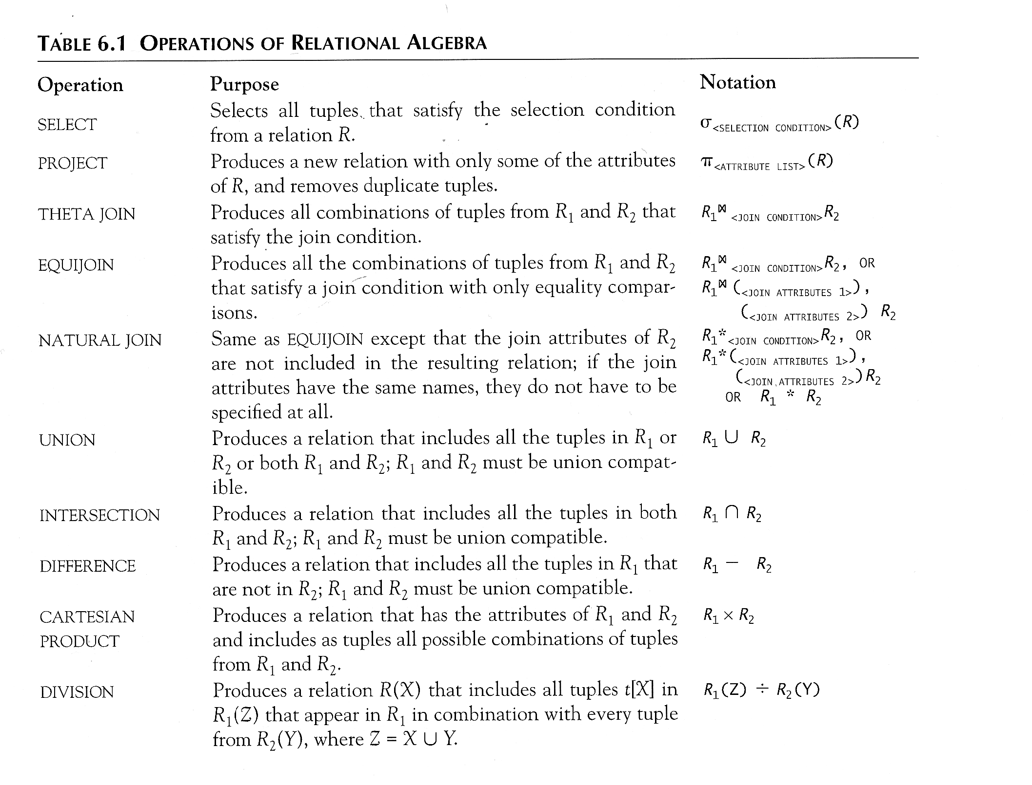
Recap of Relational Algebra
Review of Last Lecture
Notes:
Select, Project, Assignment
Symbols?
Unary
Union, Intersect, Minus
Requirement?
Binary

Slide 5
Today’s Plan
More advanced RA operators
  Rename (ρ)
  Cross Product (X)
  Join (⋈)
    EquiJoin
    Natural Join (*)
Exercises

Slide 6
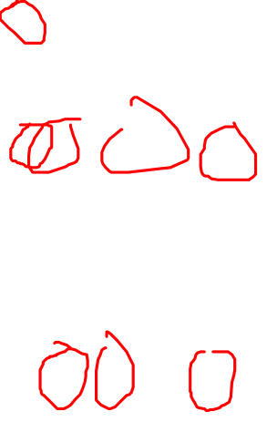
Rename Operation (ρ)
The rename operator is ρ
ρ _{S} ( R) is a renamed relation S based on R
ρ _{S (B1, B2, …, Bn )} ( R) is a renamed relation S based on R with column names B₁, B₁, ….. B_{n}.
ρ _{(B1, B2, …, Bn )} ( R) is a renamed relation with column names B₁, B₁, …..B_{n} which does not specify a new relation name.
Notes:
The Rename operation can be used to change the name of attributes, name of the relation, or both.

Slide 7

Be Aware!
Rename is in fact a copy!
  It returns a new relation with the same schema and content of the original, just different name (for the relation, attributes or both)
  The original relation is unchanged!
For convenience, when the assignment operator is used, we can do rename like this:
DEP5_EMPS ← σ _{DNO=5}(EMPLOYEE)
RESULT(FN, LN, S) ← π _{FNAME, LNAME, SALARY} (DEP5_EMPS)
Notes:
This query retrieves the first name, last name, and salary of all employees who work in department number 5.
In the result table, Fname, Lname and Salary are now named FN, LN, S.

Slide 8
In-class Exercise #2
Company
Retrieve the names of the department managers.
Find all the employees (SSN) who do not work on any project.
Retrieve the SSN of employees who are not a supervisor nor a manager.
Notes:
Here we will discuss Q1 in detail. The key is to understand the thought process!
Please try Q2 and Q3 by yourself. They lead us toward Outer Joins, which will be the topic of a future lecture.

Slide 9
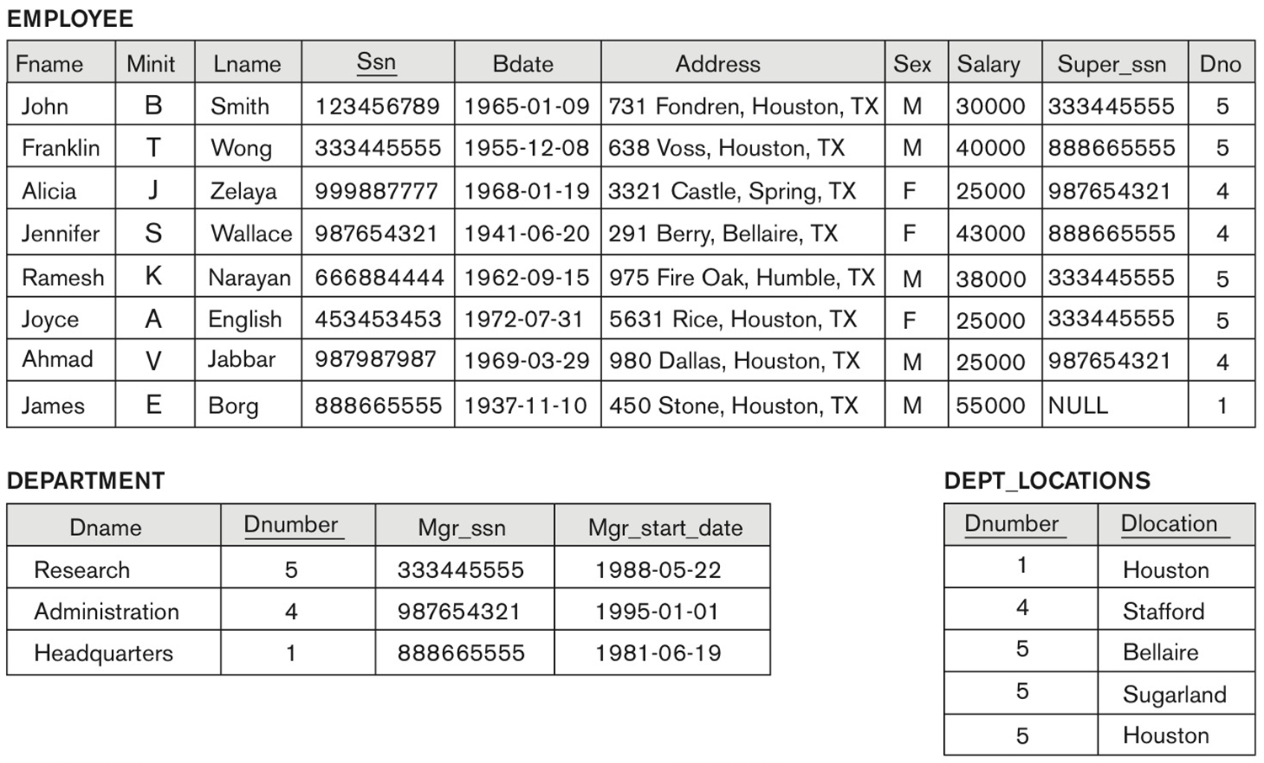

How would you do this manually?
Retrieve the names of the department managers.
Notes:
We need to access the name attribute from Employee and manager attribute in Department: each in different table, need to combine, so join or Cross Product
How do you do it systematically and manually?
Pair the first employee with the first department and check whether he/she is the manager of the department. How? Check whether SSN and manager SSN matches. If matches, the put the pair in the result.
Then check the first employee with second department, same process
Then first employee with the third department … …
Then the second employee with the first department … …
In effect, check every combo of E and D (paring every E with every D). What RA operation produces all combinations? This is what Cross Product does. … …

Slide 10
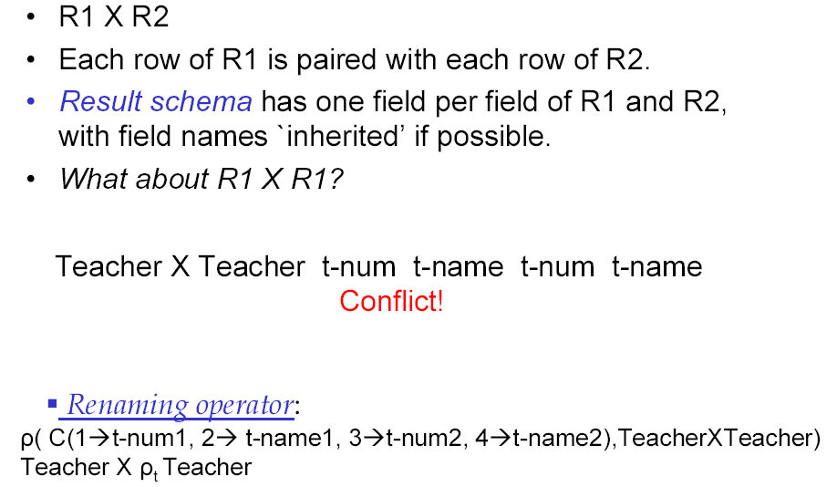
Cartesian (cross product) Operation
Solution: use Rename operation
Rename
Notes:
No type compatibility problem in cross product!!!!!!!!!!!!
This operation is used to combine tuples from two relations in a combinatorial fashion. In general, the result of R(A₁, A₂, . . ., A_{n}) x S(B₁, B₂, . . ., B_{m}) is a relation Q with degree n + m attributes Q(A₁, A₂, . . ., A_{n}, B₁, B₂, . . ., B_{m}), in that order. The resulting relation Q has one tuple for each combination of tuples—one from R and one from S.
Hence, if R has n_{R} tuples (denoted as |R| = n_{R} ), and S has n_{S} tuples, then
| R x S | will have n_{R} * n_{S} tuples.
The two operands do NOT have to be "type compatible”

Slide 11
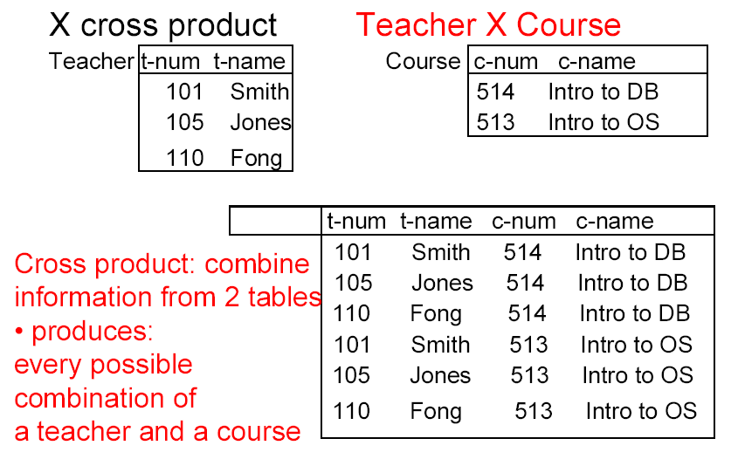
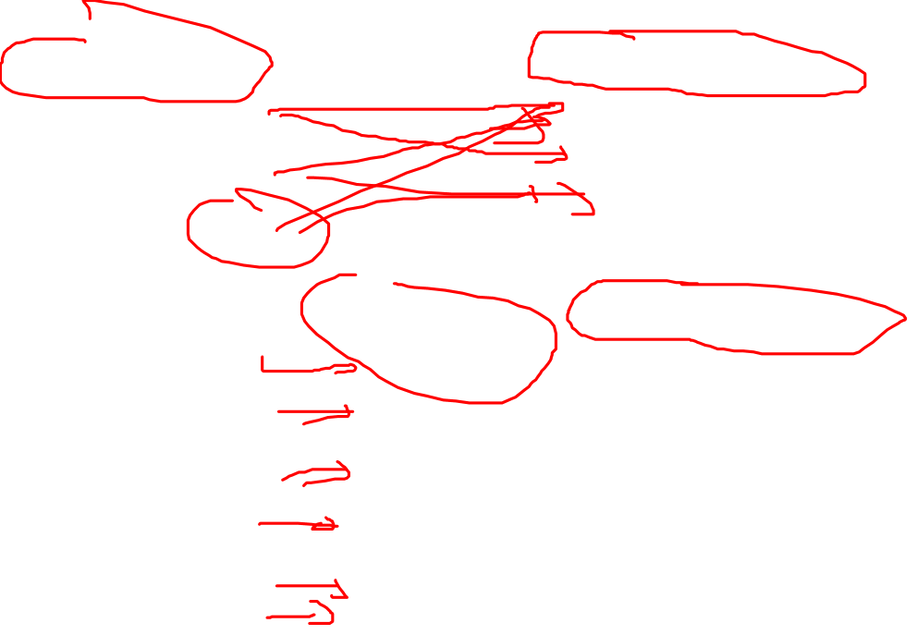
Cross Product: Example
Notes:
The result includes all the attributes from both tables, and the result list all the combinations of Teacher and Course.

Slide 12

In-class Exercise #2
Company
Retrieve the names of the department managers.
E_Dept ← Employee Х Department
Fname | Lname | … | SSN | … | DNO | … | DName | DNumber | MGRSSN | …
John | Smith | … | 123456789 | … | 5 | … | Research | 5 | 333445555 | …
John | Smith | … | 123456789 | … | 5 | … | Administration | 4 | 987654321 | …
John | Smith | … | 123456789 | … | 5 | … | Headquarters | 1 | 333445555 | …
Franklin | Wong | … | 333445555 | … |  | … | Research | 5 | 333445555 | …
Franklin | Wong | … | 333445555 | … |  | … | Administration | 4 | 987654321 | …
Franklin | Wong | … | 333445555 | … |  | … | Headquarters | 1 | 888665555 | …
. . . | . . . | . . . | . . . | . . . | . . . | . . . | . . . | . . . | . . . | . . .
Fname | Lname | … | SSN | … | DNO | … | DName | DNumber | MGRSSN | …
Franklin | Wong | … | 333445555 | … |  | … | Research | 5 | 333445555 | …
Jennifer | Wallace | … | 987654321 | … |  | … | Administration | 4 | 987654321 | …
James | Borg | … | 888665555 | … |  | … | Headquarters | 1 | 888665555 | …
Dept_MGR ← Ϭ_{MGRSSN = SSN} (E_Dept)
Result ← π _{Fname, Lname} (Dept_MGR)
Notes:
Going back to Q3 in E2: first we need to come up with all the employee and department combinations. Cross product will accomplish this.
Next, for each employee and department pair, filter it where SSN and MSGSSN matches. (check whether E is a manager of the department by comparing SSN with MGRSSN. Do this row by row -> this is selection)

Slide 13
Join: Motivation
Company
Example: Suppose that we want to retrieve the name of the manager of each department. To get the manager’s name, we need to combine each DEPARTMENT tuple with the EMPLOYEE tuple whose SSN value matches the MGRSSN value in the department tuple. We can do this by using the join operation.
E_Dept ← Employee Х Department
Dept_MGR ← Ϭ_{SSN = MGRSSN} (E_Dept)
DEPT_MGR ← Employee _{MGRSSN=SSN} Department
Fname | Lname | … | SSN | … | DNO | … | DName | DNumber | MGRSSN | …
Franklin | Wong | … | 333445555 | … |  | … | Research | 5 | 333445555 | …
Jennifer | Wallace | … | 987654321 | … |  | … | Administration | 4 | 987654321 | …
James | Borg | … | 888665555 | … |  | … | Headquarters | 1 | 888665555 | …
Notes:
Cross product followed by selection is extremely common and probably the most important operation combinations in RA. Because of its importance, we give the combinations a new name called join. So the answer for Q1 in in-class exercise #2 could (and should) be written using a join.

Slide 14

Join Operation: General
  The sequence of Cartesian product followed by select is used quite commonly to identify and select related tuples from two relations, a special operation, called JOIN.
R _{<join condition>}S
where R and S can be any relations that result from general relational algebra expressions
Notes:
Join is a Binary Relational Operations
This operation is very important for any relational database with more than a single relation, because it allows us to process relationships among relations.
Note that if the information you need to retrieve is distributed in more than one tables, your query will likely use join somewhere.

Slide 15
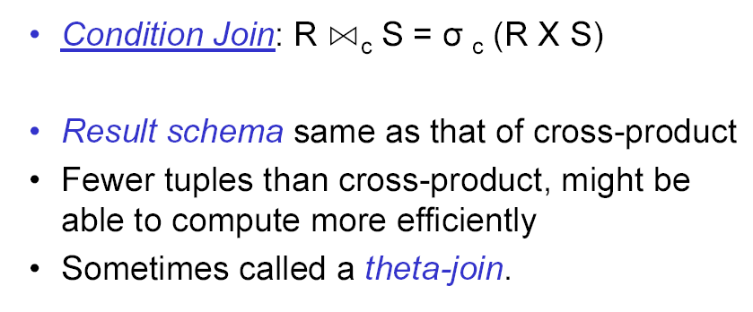
Basic Join Operation
Notes:
The most basic form of Join is condition join.
Condition: any Boolean condition

Slide 16
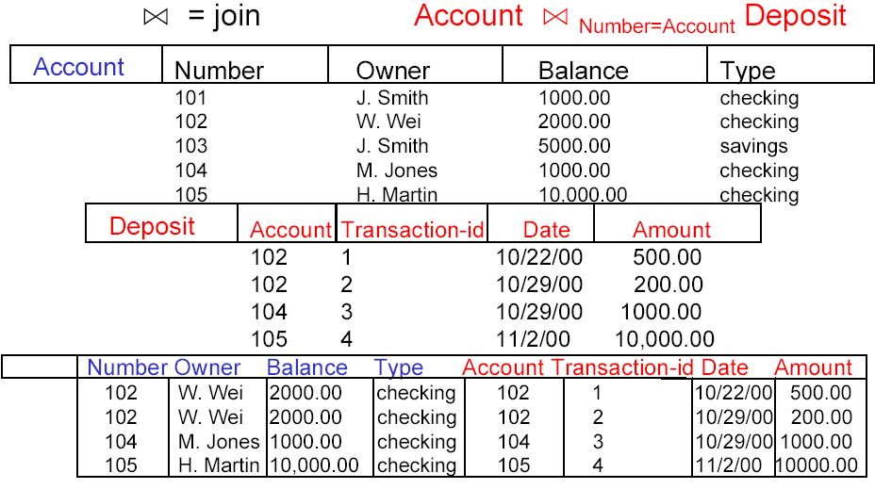

Join: Example
Div
Notes:
List all the deposit and its associated account info.

Slide 17

In-class Exercise #3
The following query does not produce meaningful information. It is created to test your understanding of the join operator.
What is its result?
π_{Number}( )
Number > Account
Notes:
How many columns (attributes) are in the result table right after the join operation? 8
How many rows are in the result table right after the join operation? 7
Result:
103
104
105
Keep in mind that any duplicates are removed in RA!

Slide 18

In-class Exercise #4
The following query does not produce meaningful information. It is created to test your understanding of the join operator.
What is its result?
π_{Number}( )
Balance=Amount
Notes:
How many columns (attributes) are in the result table right after the join operation? 8
How many rows are in the result table right after the join operation? 3
Result:
101
104
105

Slide 19
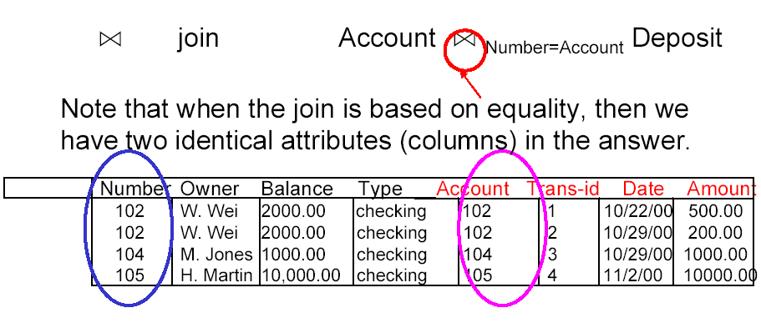

EquiJoin Problem: Example
Problem: join with equal
  Some call it EquiJoin
Notes:
When the join condition is equality, we end up with two identical columns in the result.
EQUIJOIN Operation
The most common use of join involves join conditions with equality comparisons only. Such a join, where the only comparison operator used is =, is called an EQUIJOIN. In the result of an EQUIJOIN we always have one or more pairs of attributes (whose names need not be identical) that have identical values in every tuple. The JOIN seen in this example was EQUIJOIN.

Slide 20
Natural Join Operation
Definition: join on the equality of the common attribute(s), only one copy of the common attribute(s) survives
  “Common”: attribute(s) with same name(s)
  Denoted by “*”
Assume R(ABC), S(AD)
Result ← R * S
R1 ← R X S
R2 ← Ϭ _{R.A = S.A} (R1)
Result: one copy of column A removed
Result(ABCD)
Notes:
Say we have two tables: R and S; R has 3 attributes ABC, S has AD. Both have an attribute A. We can natural join them.
This is almost the same as Cross Product followed by select based on R.A=S.A, but there is a catch, only one copy of A survives. The result has only 4 attributes, NOT 5.
NATURAL JOIN Operation (*)
Because one of each pair of attributes with identical values is superfluous, a new operation called natural join—denoted by *—was created to get rid of the second (superfluous) attribute in an EQUIJOIN condition.
The standard definition of natural join requires that the two join attributes, or each pair of corresponding join attributes, have the same name in both relations. If this is not the case, a renaming operation is applied first.
*****************************
Some literature allows natural join on equality of FK if there is a FK between the two tables being join (say Employee and Work_ON). Note this could create confusion if the two tables have multiple FKs between them like Employee and Department.
However, we do recommend that you use common attribute in natural join to avoid confusion (people might not be aware there is a FK between the two tables).

Slide 21
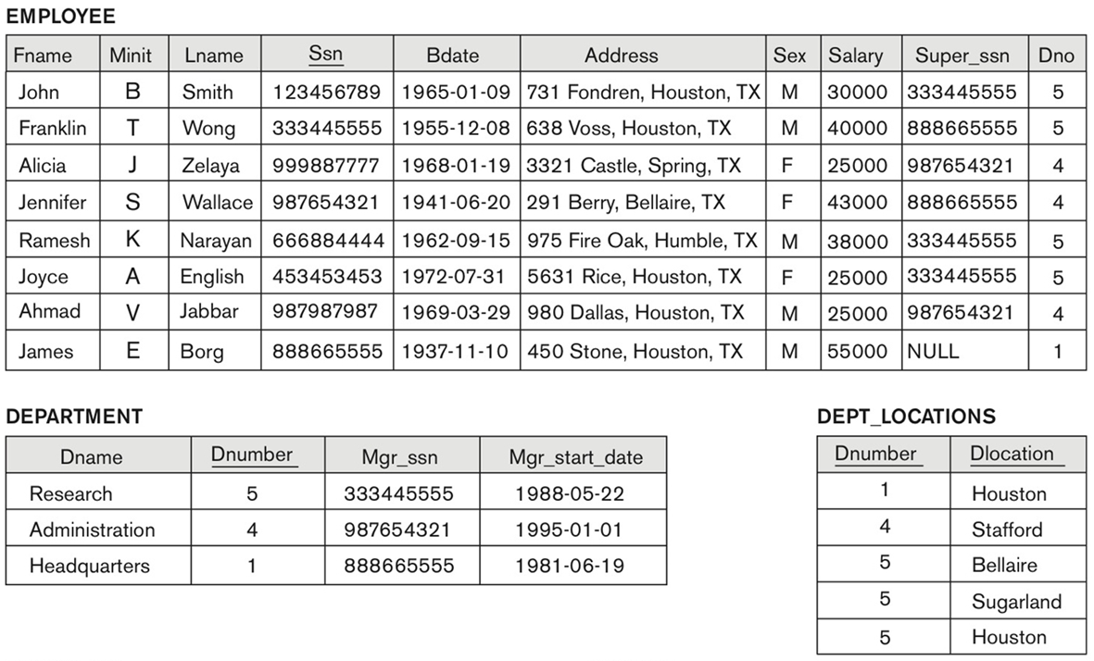
Natural Join: Example
Example: To apply a natural join on the DNUMBER attributes of DEPARTMENT and DEPT_LOCATIONS, it is sufficient to write:
DEPT_LOCS ← DEPARTMENT * DEPT_LOCATIONS
Notes:
This query lists department and its locations info.
Q: How many rows and columns in Dept_Locs?
A: 5 rows and 5 columns.

Slide 22
In-Class Exercises #5
What is the result?
AB | A | B
 | a1 | b1
 | a2 | b2
CD1 | C | D | X
 | c1 | d1 | x1
 | d2 | d2 | x2
AB _{A=a1}CD1
AB _{A=a1}CD2
AB*CD1
AB*CD2
AB*CD3
AB*CD4
AB*CD5
CD4 | AA1 | BB1 | X
 | a1 | b1 | x1
 | a2 | b2 | x2
CD2 | A | D | X
 | a2 | d2 | x1
 | a1 | d1 | x2
CD5 | A | B | X
 | a1 | d1 | x1
 | a2 | d2 | x2
CD3 | A | B | X
 | a1 | b1 | x1
 | a2 | b2 | x2
Notes:
Try by yourself! This is a very good exercise testing your understanding of the join operator, the most useful, the most used and a tricky operator.
1. Return a table with 5 columns and 2 rows.
2. This is invalid due to duplicate column names.
3. This is indeed valid! Return a table with 5 columns and 4 rows! (function like a CX).
4. Return a table with 4 columns and 2 rows.
5. Return a table with 3 columns and 2 rows.
6. This is indeed valid! Return a table with 5 columns and 4 rows! (function like a CX).
7. Return a table with 3 columns and 0 rows (empty table).

Slide 23
Summary of Today’s Lecture
More advanced RA operations:
  Rename (ρ)
  Cross Product (X)
  Join (⋈)
    EquiJoin
    Natural Join (*)
Exercises

