Slide 1

Review of Last Lecture
More advanced RA operations:
  Rename (ρ)
  Cross Product (X)
  Join (⋈)
    EquiJoin
    Natural Join (*)
Exercises

Slide 2
Today’s Plan
More advanced RA operations:
  Division
Exercises

Slide 3
In-class Exercise #6
Retrieve the names of employees who are neither a supervisor nor a manager
Find the names of employees who do not work on any project.
Notes:
As an exercise to remind you the material covered in last class, try them by yourself. If you are not sure, ask on the message board.

Slide 4
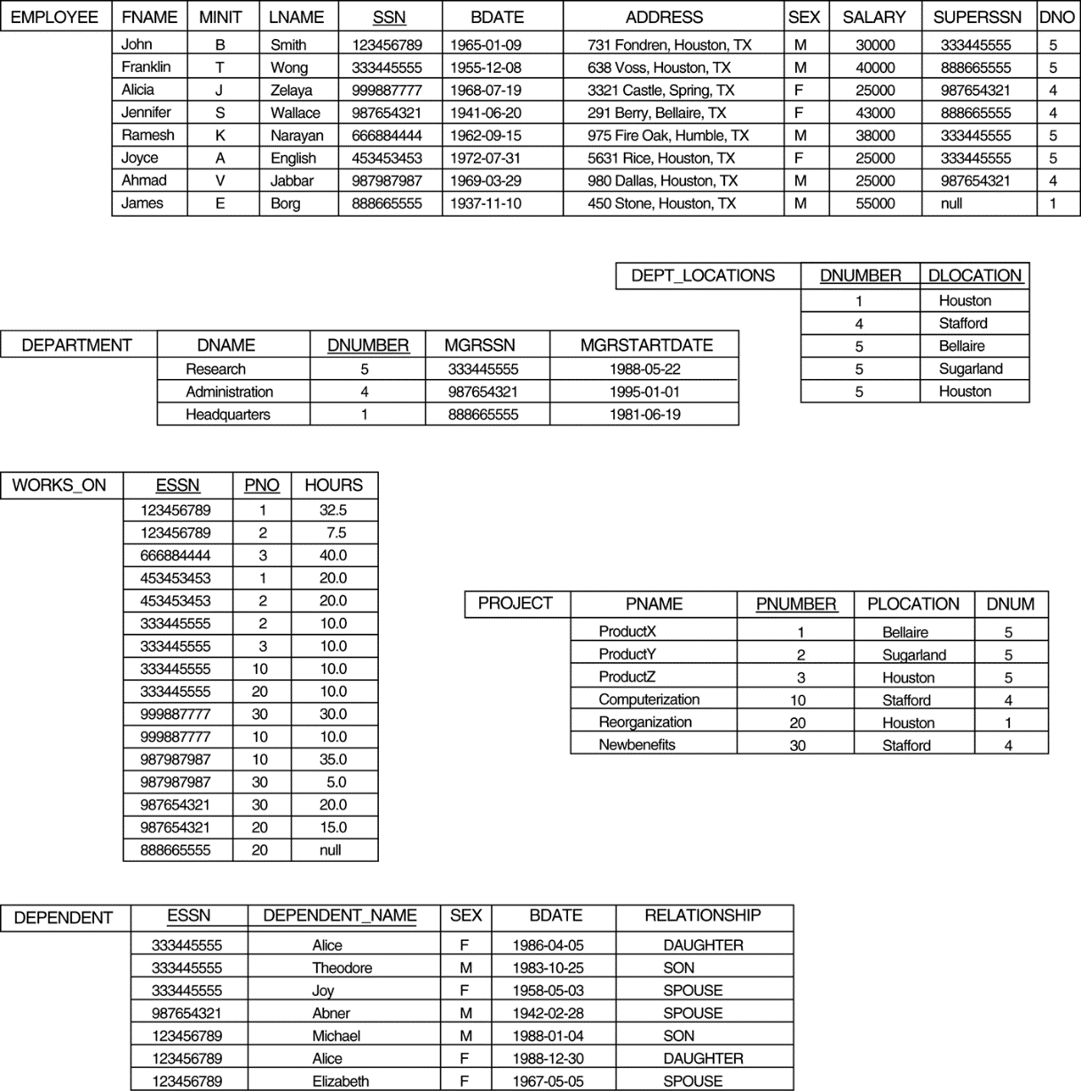
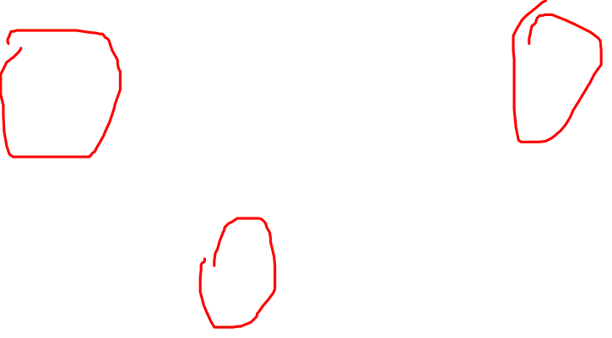
In-class Exercise #6 – Thoughts
Retrieve the names of employees who are neither a supervisor nor a manager
Notes:
Steps:
What data to access
Who are NOT managers
Who are NOT supervisors
Get their names
What tables do we need to access?
Before we start building the query, we need to narrow down what tables/data to access. The company DB has 6 tables, which ones do we need?
We names -> employee table
We need supervisor information -> employee table
We need manager information -> department table
So only need employee and department table.

Slide 5
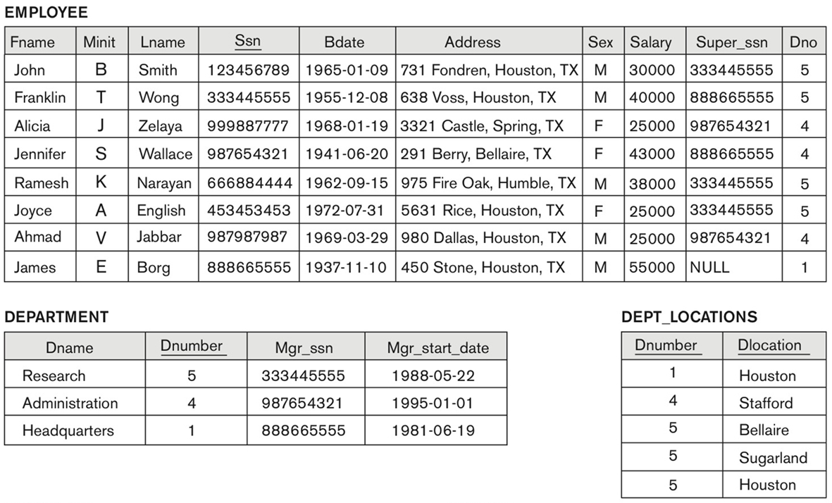
In-class Exercise #6 – Common Mistake
Retrieve the names of employees who are not a supervisor nor a manager
  Who are NOT managers?
R1 ← Employee _{MGR_SSN != SSN} Department
Notes:
Based on past experience, to find out who are NOT managers, some students will do this. Does it work?
What would be the output? How many rows are in R1? 21!
There are 8 employees in Employee table. We can eye-ball and see the correct answers should be 5 (5 employees are not managers).
Note that join is a CX followed by a selection. CX produces 24 rows and 3 rows have (MGR_SSN = SSN). So 24-3=21.

Slide 6
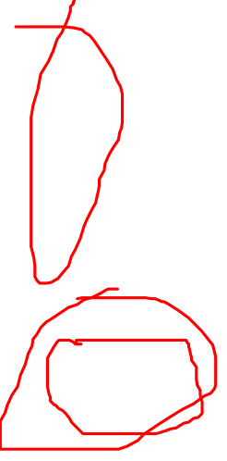
In-class Exercise #6 – Step 1
Retrieve the names of employees who are not a supervisor nor a manager
  Who are NOT managers?
M ← π_{MGR_SSN} (Department)
E ← π_{SSN} (Employee)
NM ← E - M
Notes:
Who are NOT managers?
Maybe we can think it differently: find out who are managers first. This is given in MGR_SSN in the Department table, Projection!
So who are NOT managers? We need to find employee in the employee table but NOT in the M table -> rows in one table but not in the other table, this is a minus operation!
However, to perform minus, the two tables MUST be union-compatible, that is same number of columns and same domain for corresponding column.
So do a projection on employee table first before doing minus.

Slide 7

In-class Exercise #6 – Step 2
Retrieve the names of employees who are not a supervisor nor a manager
  Who are NOT supervisors?
S ← π_{Super_SSN} (Employee)
NS ← E - S
Notes:
Who are NOT supervisors?
To find who are NOT supervisors, we can use the same approach: find the supervisors, this is given in the super_ssn column in employee then do a minus.

Slide 8
In-class Exercise #6 – Step 3
Retrieve the names of employees who are not a supervisor nor a manager
NSM ← NS ∩ NM
EN ← NSM * Employee
Result ← π_{Fname, Lname} (EN)
Notes:
Now we need to find who are not supervisor nor manager. Well, we need to find employees not appear in M table nor S table, this is a intersection operation. Note NSM has the same schema as the first table NS which has an attribute called SSN.
Get their names
Now we know the SSNs of employees who are neither M nor S. How to get their names? Combine information distributed two tables -> join, in this case natural join because of equality on common attributes.

Slide 9
In-class Exercise #6 – Your Turn
Retrieve the names of employees who are neither a supervisor nor a manager.
Find the names of employees who does not work on any project.
M ← π_{MGR_SSN} (Department)
E ← π_{SSN} (Employee)
NM ← E – M
S ← π_{Super_SSN} (Employee)
NS ← E - S
NSM ← NS ∩ NM
EN ← NSM * Employee
Result ← π_{Fname, Lname} (EN)
Notes:
Try by yourself. If you are not sure, ask on the message board.

Slide 10
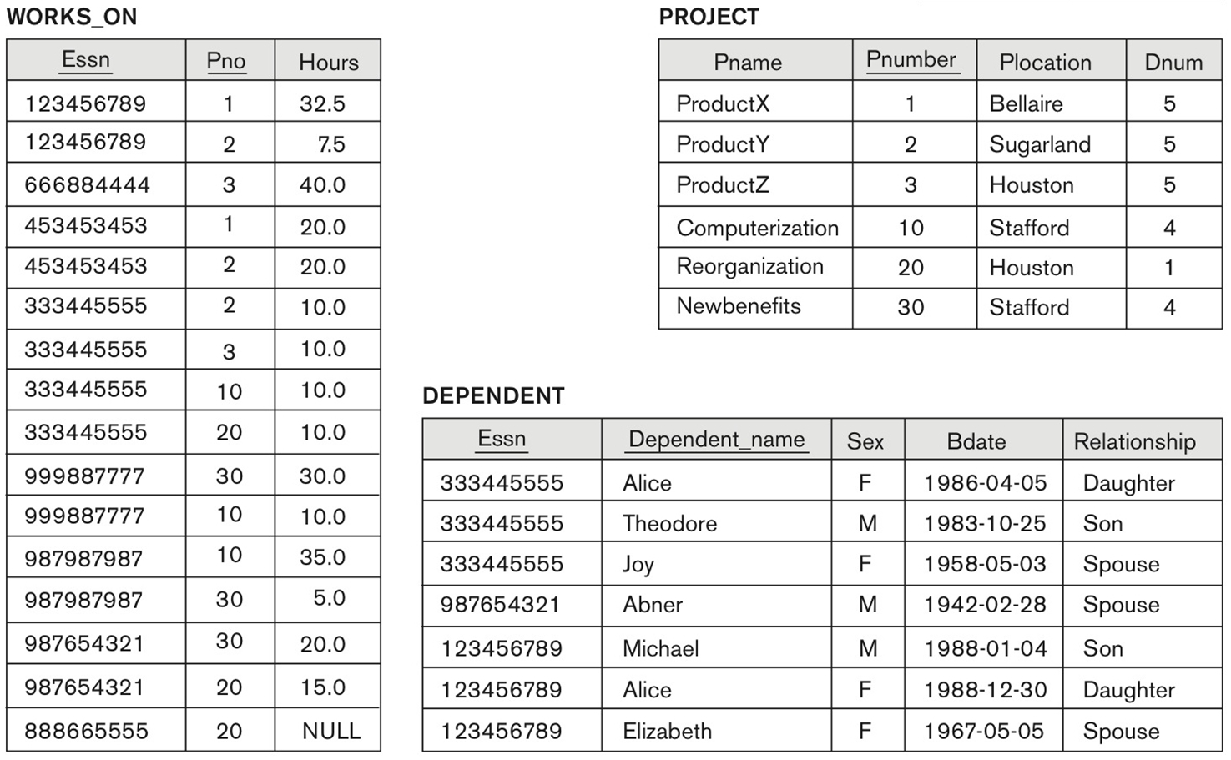
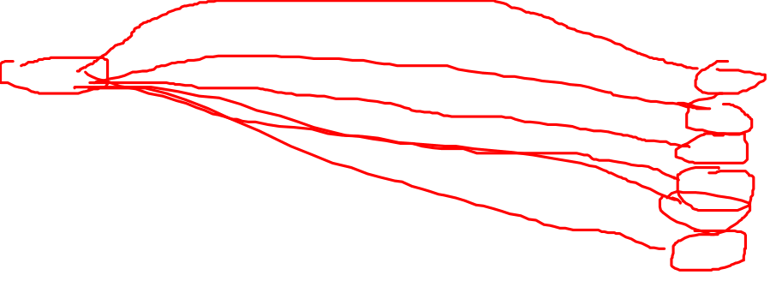
Division: Motivation
Find employees who work on all the projects
Notes:
How do you know employee 123456789 works on all the projects? Check whether (123456789, P1) in WK_ON, (123456789, P2) in WK_ON … … (123456789, P30) in WK_ON.
In short, to verify whether employee Ex works all projects we need to check to see every E and project combo appears in WK_ON. If so, then Ex works on all project; otherwise no. There is an operator in RA does this: division.

Slide 11
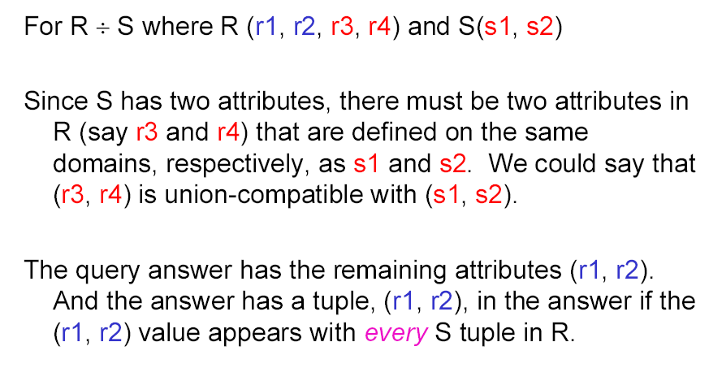
Division Operator
Notes:
Common attributes: attributes with same names!
Attributes in S must be a sub-set of R
Division is a Binary Relational Operation
The division operation is applied to two relations: R(Z) / S(X), where X is a subset of Z. Let Y = Z - X (and hence Z = X / Y); that is, let Y be the set of attributes of R that are not attributes of S. The result of DIVISION is a relation T(Y) that includes a tuple t if tuples t_{R} appear in R with t_{R} [Y] = t, and with t_{R} [X] = t_{s} for every tuple t_{s} in S. That is, for a tuple t to appear in the result T of the DIVISION, the values in t must appear in R in combination with every tuple in S.

Slide 12
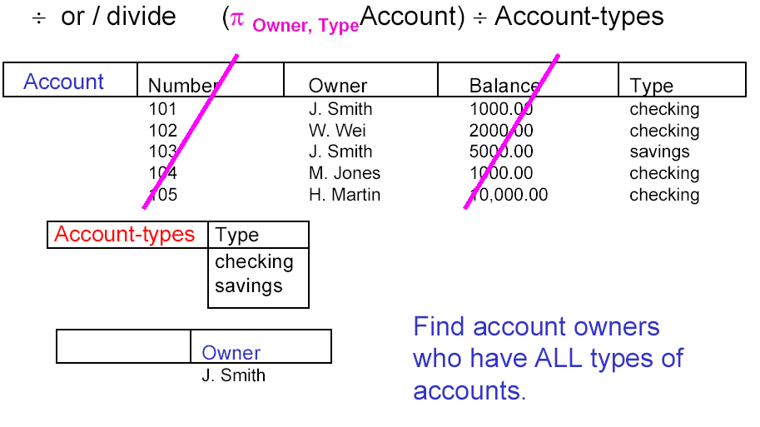
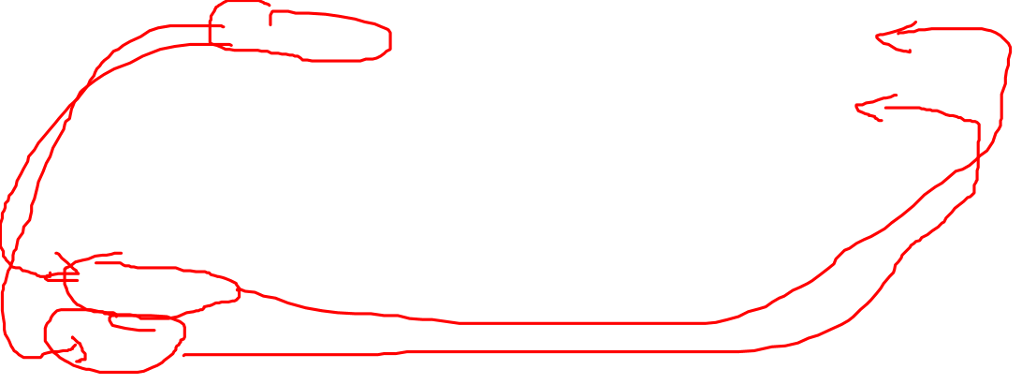
Division: Example
Find customers who have all the accounts that the bank offers

Slide 13
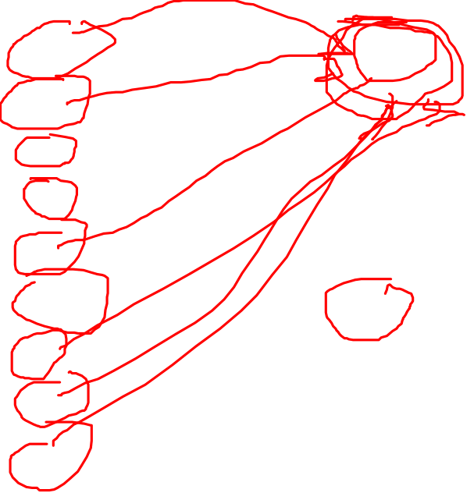
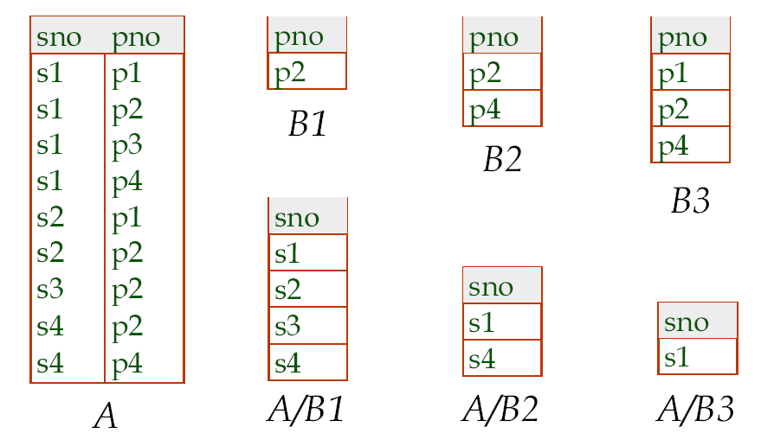
Division: Examples

Slide 14
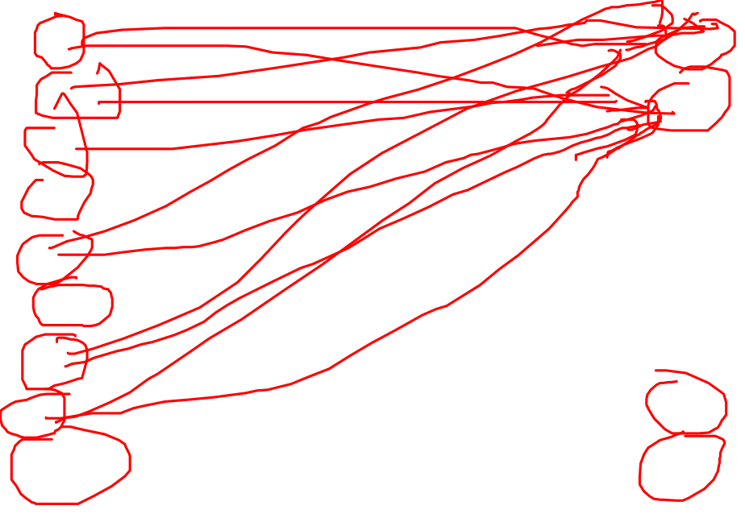
Division: Examples

Slide 15
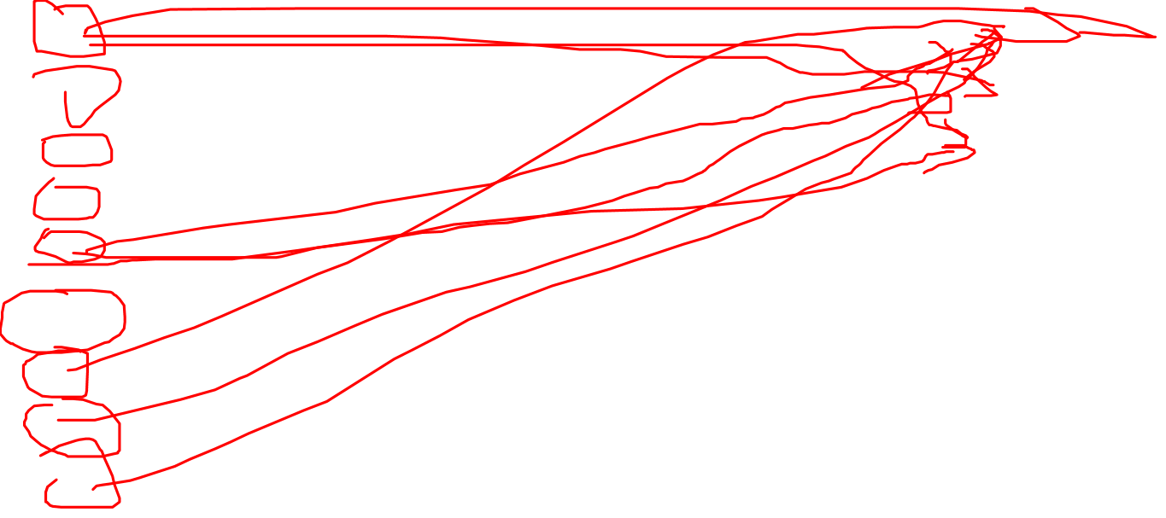
Division: Examples

Slide 16
Exercise: A / B4 = ?
SNO | PNO | Qty
S1 | P1 | 1
S1 | P2 | 2
S1 | P3 | 3
S1 | P4 | 4
S2 | P1 | 5
S2 | P2 | 5
S2 | P3 | 4
PNO
P1
P2
B4
A

Slide 17
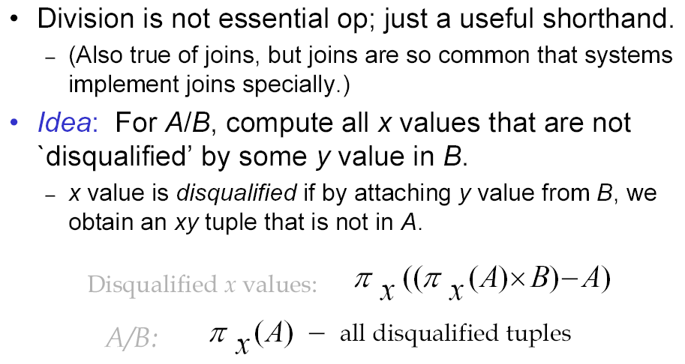
Expressing A/B Using Basic Opts (FYI)
Notes:
Join and Div are not essential, they can be expressed by using basic RA operations … … But they do simplify the RA expression.

Slide 18
Summary of Today’s Lecture
More advanced RA operations:
  Division
Exercises
Notes:
Join: useful to collect info distributed in several tables; condition usually about FK.
Division: one col must be common – same name

