Slide 1

Review of Last Lecture
More advanced RA operations:
  Division
Exercises
Notes:
Join: useful to collect info distributed in several tables; condition usually about FK.
Division: one col must be common – same name

Slide 2
Today’s Plan
Aggregation function
Outer join
Exercises

Slide 3
In-class Exercise #7
Retrieve the name and address of all employees who work for the ‘Research’ department.
Retrieve the names of employees who have no dependents.
Find the names of the departments that have employees who work on all the projects.
Company
Notes:
Q3: try it With division and try it Without division (you need learn the aggregation function first).

Slide 4

Aggregation: Motivation
Find the number of employees in each department
  How do you do this manually?
Employee
Fname | Minit | Lname | Ssn | Bdate | Address | Sex | Salary | Super_ssn | Dno
John | B | Smith | 123456789 | 1965-01-09 | 731 Fondren, Houston, TX | M | 30000 | 333445555 | 5
Franklin | T | Wong | 333445555 | 1955-12-08 | 638 Voss, Houston, TX | M | 40000 | 888665555 | 5
Alicia | J | Zelaya | 999887777 | 1968-01-19 | 3321 Castle, Spring,TX | F | 25000 | 987654321 | 4
Jennifer | s | Wallace | 987654321 | 1941-06-20 | 291 Berry, Bellaire, TX | F | 43000 | 888665555 | 4
Ramesh | K | Narayan | 666884444 | 1962-09-15 | 975 Fire Oak, Humble, TX | M | 38000 | 333445555 | 5
Joyce | A | English | 453453453 | 1972-07-31 | 5631 Rice, Houston, TX | F | 25000 | 333445555 | 5
Ahmad | V | Jabbar | 987987987 | 1969-03-29 | 980 Dallas, Houston, TX | M | 25000 | 987654321 | 4
James | E | Borg | 888665555 | 1937-11-10 | 450 Stone, Houston, TX | M | 55000 | NULL | 1
Employee
Fname | Minit | Lname | Ssn | Bdate | Address | Sex | Salary | Super_ssn | Dno
James | E | Borg | 888665555 | 1937-11-10 | 450 Stone, Houston, TX | M | 55000 | NULL | 1
Alicia | J | Zelaya | 999887777 | 1968-01-19 | 3321 Castle, Spring,TX | F | 25000 | 987654321 | 4
Jennifer | s | Wallace | 987654321 | 1941-06-20 | 291 Berry, Bellaire, TX | F | 43000 | 888665555 | 4
Ahmad | V | Jabbar | 987987987 | 1969-03-29 | 980 Dallas, Houston, TX | M | 25000 | 987654321 | 4
John | B | Smith | 123456789 | 1965-01-09 | 731 Fondren, Houston, TX | M | 30000 | 333445555 | 5
Franklin | T | Wong | 333445555 | 1955-12-08 | 638 Voss, Houston, TX | M | 40000 | 888665555 | 5
Ramesh | K | Narayan | 666884444 | 1962-09-15 | 975 Fire Oak, Humble, TX | M | 38000 | 333445555 | 5
Joyce | A | English | 453453453 | 1972-07-31 | 5631 Rice, Houston, TX | F | 25000 | 333445555 | 5

Slide 5
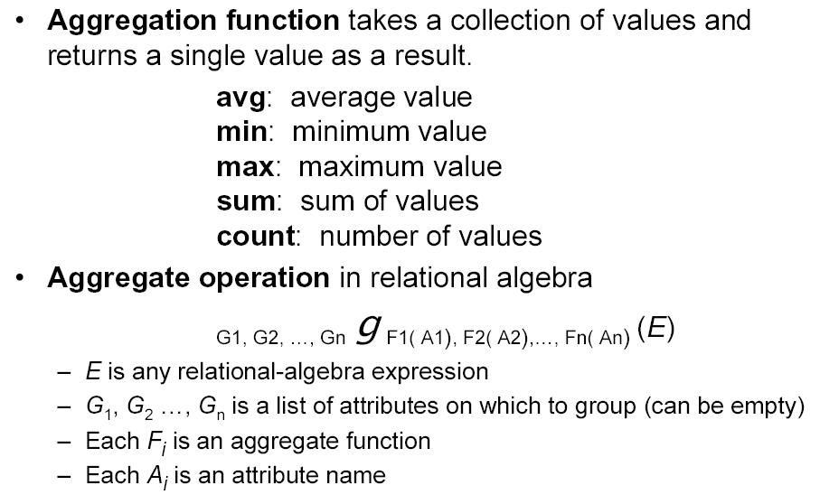

Aggregation Functions
Notes:
Aggregation is an unary operator and always operate on groups
It produces a relation!
If no grouping attribute is listed, the whole table is treated as one group.
Be aware: what table, which function on what attributes, what are the inputs to the function; one group one value; F apply to each group!.
How it works: first it groups the tuples in the given table according to the grouping attribute(s) (rows with the same values for the grouping attribute belong to the same group), apply aggregation function to the attribute in each group, one group produce one tuple in the result table! Only grouping attribute(s) and aggregated attribute(s) appear in the result table.
Note that, several aggregation functions can be applied at the same time!
Use of the Functional operator ℱ
ℱ_{MAX Salary} (Employee) retrieves the maximum salary value from the Employee relation
ℱ_{MIN Salary} (Employee) retrieves the minimum Salary value from the Employee relation
ℱ_{SUM Salary} (Employee) retrieves the sum of the Salary from the Employee relation
_{DNO} ℱ_{COUNT SSN, AVERAGE Salary} (Employee) groups employees by DNO (department number) and computes the count of employees and average salary per department.[ Note: count just counts the number of rows, without removing duplicates]

Slide 6
Aggregation Function: Important Note
The aggregation function g will be applied on the attributes in each group
  One group produces one tuple in the result
Grouping attribute could be one, several or none
  Tuples with the same value for the grouping attribute belong to the same group
  If no grouping attribute is specified, the whole table is treated as one group
Only grouping attributes and aggregated attribute survive in the result!
Notes:
Keep this in mind at all the time when using F!
It operates on groups.
NULL values will be ignored. So COUNT on (5, 32, 5, NULL) will be 3.
COUNT-UNIQUE on (5, 32, 5, NULL) will return 2.
Some literatures use COUNT-DISTINCT instead.

Slide 7
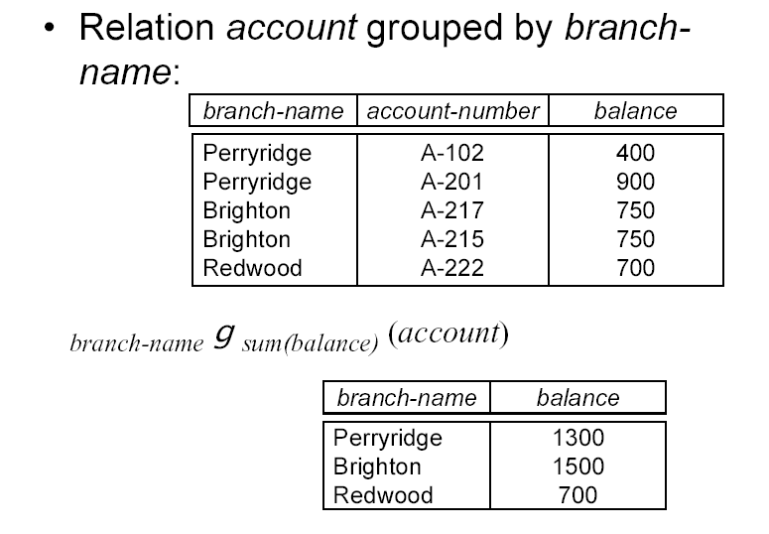
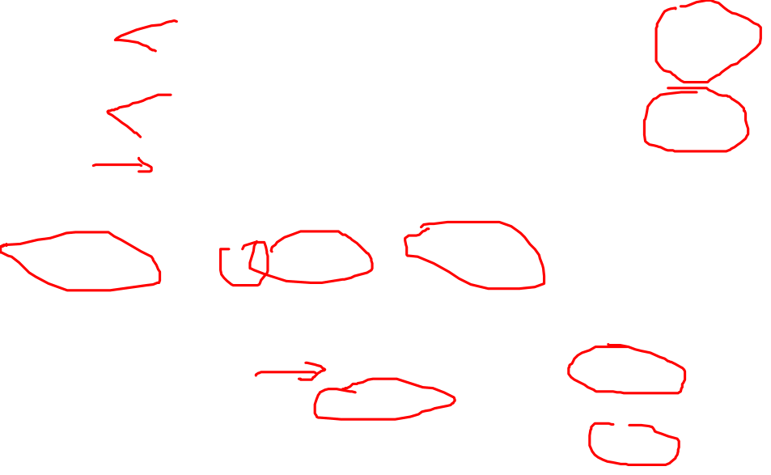
Aggregation Functions: Example

Slide 8
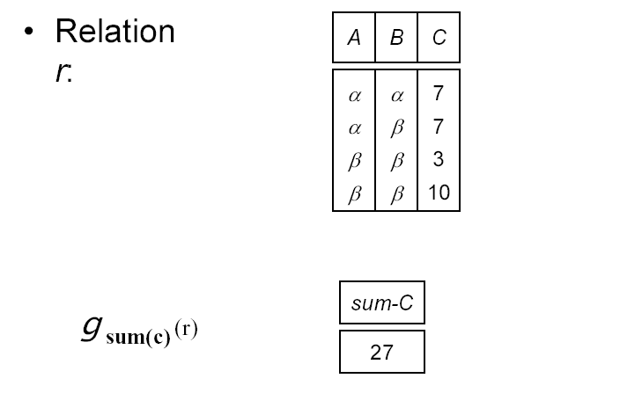
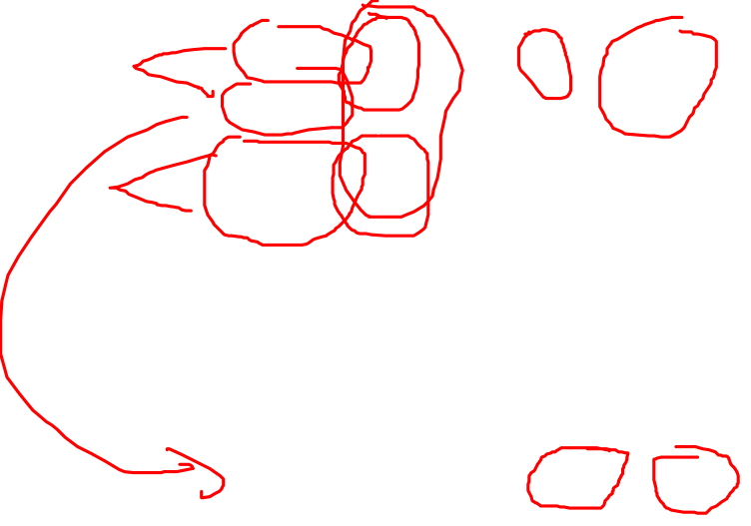
Aggregation Functions: Examples
Example:
1. _{A} g _{sum(c)} (r) =
Example:
2. _{A,B} g _{sum(c)} (r) =
Notes:
What are the outputs for these two aggregations?
Attribute ABC are gone, because they are not aggregated or grouping!

Slide 9
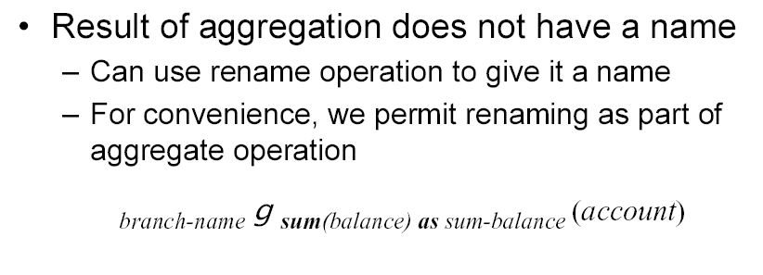

Aggregation Functions: Naming
Notes:
The attribute in the result is now called sum-balance.

Slide 10
In-class Exercise #8: Aggregation
Find the average account balance of each branch
Find how many accounts in each branch
Find how many accounts in all branches
Find the number of branches the bank has
What is the output of
g _{count(branch-name)} (Account)?
Notes:
Use avg(balance), group by branch-name.
Use count(account-number), group by branch-name.
Use count(account-number), no grouping needed.
Project on branch-name first, then use count(branch-name) without grouping
It produces one row with value 5 instead of 3. Count the number of values regardless of duplicates.

Slide 11
In-class Exercise #7 – Mod Version
Find the names of the departments that have employees who work on all the projects (but could be different employees working on different projects)
  Projects: p1, p2, p3
  Employees: e1, e4, e10 all from D5
  Work_on: e1 on p1, e4 on p2 and p1, e10 on p3
Notes:
Find the names of the department that has employees who work on all the projects (but could be different E on different P, e1 on p1, e2 on p2 etc. and all belong to D1)

Slide 12
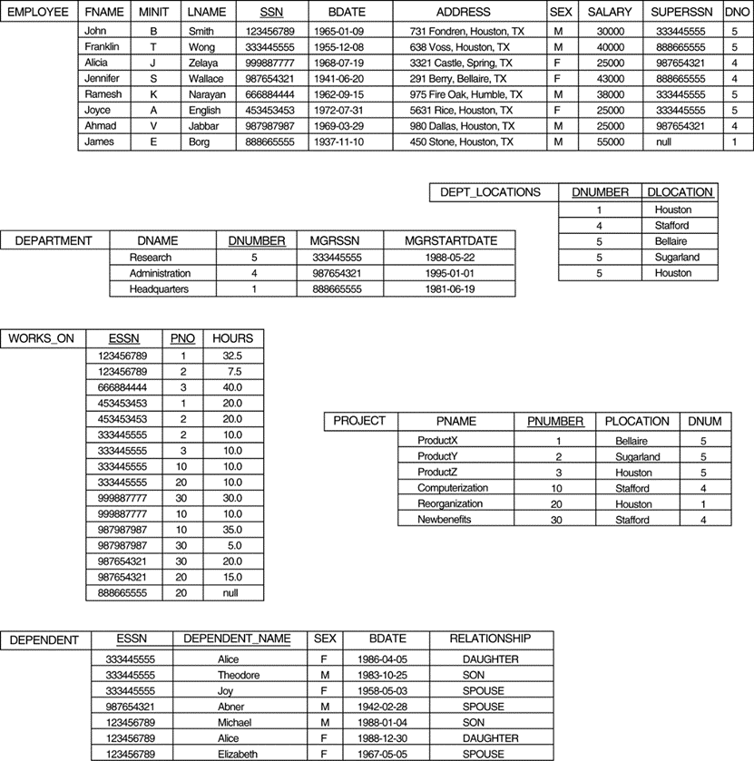

In-class Exercise #7 – Thoughts
Find the names of the departments that have employees who work on all the projects (but could be different employees working on different projects)
Notes:
What tables to access?
How many projects in total are in the DB?
How many projects does a department have employees working on them?
If the two numbers match, then the department is included in the result
Get the department names.

Slide 13

In-class Exercise #7 – Step 1
Find the names of the departments that have employees who work on all the projects (but could be different employees working on different projects)
  Total number of projects in the DB
T ← g_{count(PNUMBER) AS TP} (Project)
T | TP
 | 6
Notes:
How many projects in total are in the DB?

Slide 14

In-class Exercise #7 – Step 2
Find the names of the departments that have employees who work on all the projects (but could be different employees working on different projects)
  Number of projects each department having someone works on
E(ESSN, DNUMBER) ← π_{SSN, DNO} (Employee)
DP ← E * Works_ON
DPP ← π _{DNUMBER, PNO} (DP)
NPD1 ← _{DNUMBER}g_{count(PNO) AS TPD} (DPP)
DP | ESSN | PNO | Hours | DNUMBER
 | 123456789 | 1 | 32.5 | 5
 | 453453453 | 1 | 20 | 5
 | . | . | . | .
 | . | . | . | .
 | . | . | . | .
NPD ← _{DNUMBER}g_{count(PNO) AS TPD} (DP)
NPD | DNUMBER | TPD
 | 5 | 9
 | . | .
 | . | .
 | . | .
DPP | DNUMBER | PNO
 | 5 | 1
 | 5 | 2
 | . | .
 | . | .
NPD1 | DNUMBER | TPD
 | 5 | 5
 | . | .
 | . | .
 | . | .
Notes:
How many projects does a department have employees working on them?
Needs the DNUMBER of each E. Rename so that we can use natural join later. Make sure you understand the schema of DP and NPD.
NPD ← _{DNUMBER}g_{count(PNO) AS TPD} (DP)
The problem with this query is that the same department might have different employees working on the same project. In this instance, D5 has 2 employees working on P1, so P1 will be counted 2 times for D5 under this query, which is wrong. In fact, the table produces by this will have D5 having 9 projects but there are only 6 projects in total in the DB!
But if we do the projection first, after the project of (DNUMBER, PNO), duplicates of (D5, P1) will be removed. Now we can start counting properly.

Slide 15

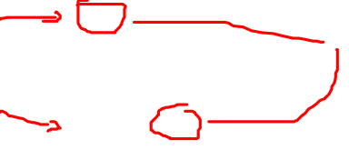
In-class Exercise #7 – Step 3
Find the names of the departments that have employees who work on all the projects (but could be different employees working on different projects)
  Do the two numbers match?
DAP ← T _{TP = TPD} NPD1
T | TP
 | 6
NPD1 | DNUMBER | TPD
 | 5 | 5
 | . | .
 | . | .
 | . | .
DAP | DNUMBER | TP | TPD
 | . | . | .
 | . | . | .
 | . | . | .
Notes:
If the two numbers match, then the department is included in the result
It is possible to use division (renaming is needed) instead of join here. But logically, join makes better sense.
*************
A common mistake from the past: students realize that there are 6 projects in the Project table. So they say if TPD = 6 in NPD table, the department works on all projects:
So they do a select on the NPD table based on the condition TPD = 6.
This works in this particular instance. But if the instance changes (say a new project is inserted), the above query will produce the wrong result.
Again, you can use an instance to verify whether it is wrong but NOT whether it is right. A query MUST work in all instances of the DB!

Slide 16

In-class Exercise #7 – Step 4
Find the names of the departments that have employees who work on all the projects (but could be different employees working on different projects)
  Department names?
DN ← DAP * Department
Result ← π _{DNAME} (DN)
DAP | DNUMBER | TP | TPD
 | . | . | .
 | . | . | .
 | . | . | .
Notes:
Get the department names.
Need to match the rows in DAP with the rows in Department -> Join. Because they have a common attribute, DNUMBER, we use natural join instead.
*****************************************
Now, you might think understand how to solve this problem. Grab a piece of paper and try to solve it without any help.
Some of you would still struggle. This is the difference between knowing and understanding.
You think you know the material but understand how to apply them would take lots exercises, particularly for subject like DB that has a strong applied nature.

Slide 17
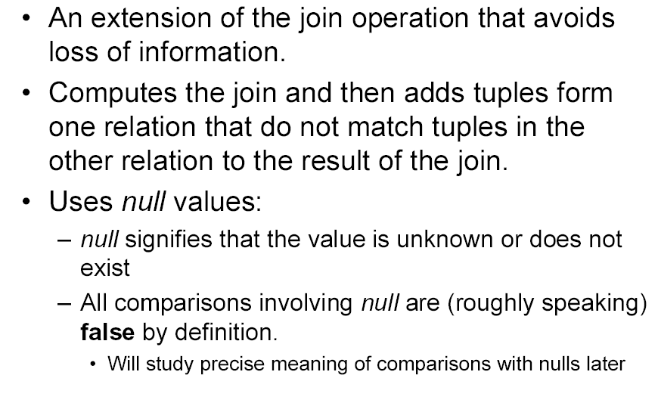
Outer Join
from
Notes:
In general, outer join first performs a natural join; then add tuples without a match, then add null if needed
The OUTER JOIN Operation
In NATURAL JOIN tuples without a matching (or related) tuple are eliminated from the join result. Tuples with null in the join attributes are also eliminated. This amounts to loss of information.
A set of operations, called outer joins, can be used when we want to keep all the tuples in R, or all those in S, or all those in both relations in the result of the join, regardless of whether or not they have matching tuples in the other relation.
The left outer join operation keeps every tuple in the first or left relation R: in R left-ut-join S, if no matching tuple is found in S, then the attributes of S in the join result are filled or “padded” with null values.
A similar operation, right outer join, keeps every tuple in the second or right relation S in the result of R right-outer-join S.
A third operation, full outer join, keeps all tuples in both the left and the right relations when no matching tuples are found, padding them with null values as needed.

Slide 18
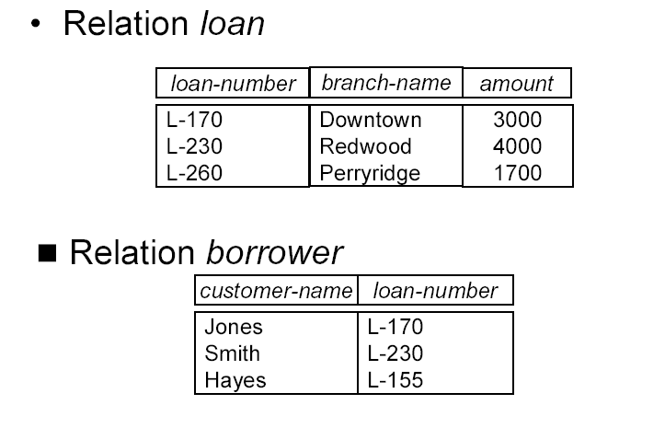
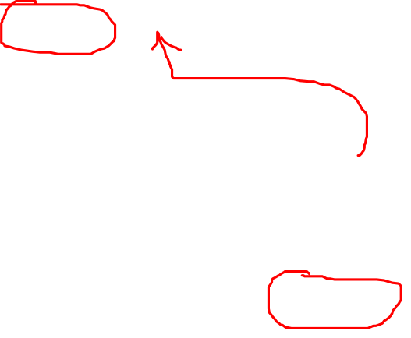
Loan and Borrower Tables
Notes:
We want info on loan and the borrower, natural join will do. But What if there is loan without borrower and you want to catch that. (no borrower? Trouble! No Loan for borrower? What does it mean?). Or borrower no loan, pay off, in the process of approval etc. FK can not prevent that, because NULL is possible for FK and it is from B to L. What operation will allow us to do that?
OUTER JOIN Operations (also called OUTER UNION)
The outer union operation was developed to take the union of tuples from two relations if the relations are not union compatible. This operation will take the union of tuples in two relations R(X, Y) and S(X, Z) that are partially compatible, meaning that only some of their attributes, say X, are union compatible.
The attributes that are union compatible are represented only once in the result, and those attributes that are not union compatible from either relation are also kept in the result relation T(X, Y, Z).
Example: An outer union can be applied to two relations whose schemas are STUDENT(Name, SSN, Department, Advisor) and INSTRUCTOR(Name, SSN, Department, Rank). Tuples from the two relations are matched based on having the same combination of values of the shared attributes—Name, SSN, Department. If a student is also an instructor, both Advisor and Rank will have a value; otherwise, one of these two attributes will be null.
The result relation STUDENT_OR_INSTRUCTOR will have the following attributes:
STUDENT_OR_INSTRUCTOR (Name, SSN, Department, Advisor, Rank)

Slide 19
Outer Join: Example I
Natural join: Loan * Borrower
loan-number | branch-name | amount | customer-name
L-170 | Downtown | 3000 | Jones
L-230 | Redwood | 4000 | Smith
Left Outer Join: Loan Borrower
loan-number | branch-name | amount | customer-name
L-170 | Downtown | 3000 | Jones
L-230 | Redwood | 4000 | Smith
L-260 | Perryridge | 1700 | null
Notes:
Natural join returns information about loan and its borrower.
Left outer join returns the same information plus loan without borrower, filled with null
Why outer join is useful? It keeps full details of all loads, including dead loans! Or Someone is stealing money!
For example, L-260, no borrower? Why? Dead or error or someone stealing
All info about loan survives! Perform a natural join; add unmatched; them fill with null where appropriate.

Slide 20
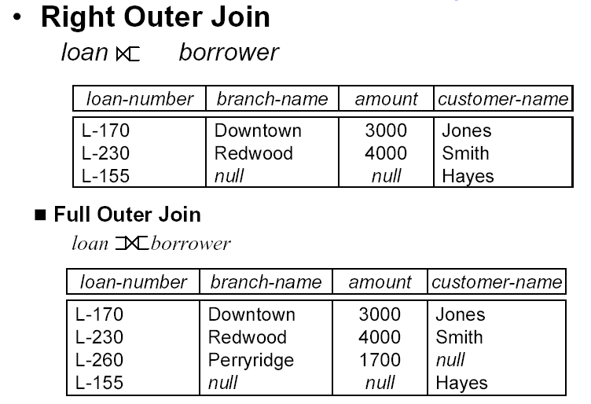
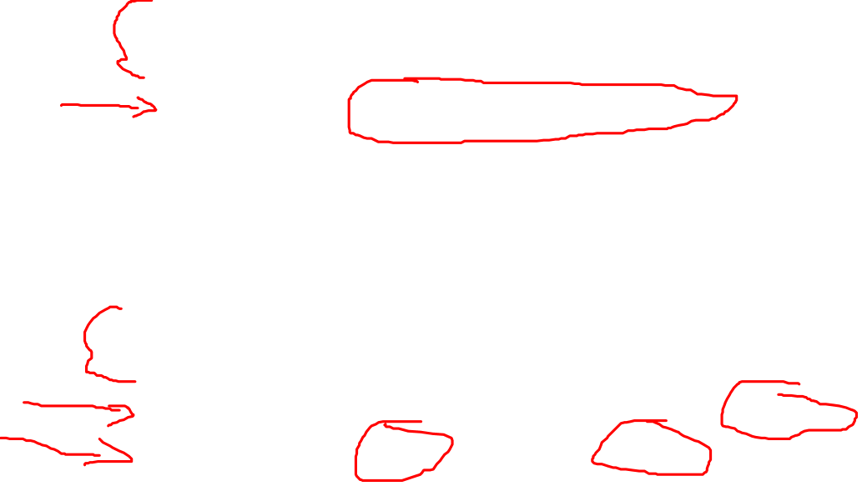
Outer Join: Example II
Right Outer Join
Notes:
Right outer join returns the same information plus borrower without loan, all info about borrower survives, if no load for the borrower, fill in null
Borrower has no loan? Why? Might still be processing loan application
Full outer join: all are kept => loan with borrower, loan without borrower, borrower without loan

Slide 21
Summary of Today’s Lecture
Aggregation function
Outer join
Exercises

