Slide 1

In-Class Exercises #5
What is the result?
AB | A | B
 | a1 | b1
 | a2 | b2
CD1 | C | D | X
 | c1 | d1 | x1
 | d2 | d2 | x2
AB _{A=a1}CD1
AB _{A=a1}CD2
AB*CD1
AB*CD2
AB*CD3
AB*CD4
AB*CD5
CD4 | AA1 | BB1 | X
 | a1 | b1 | x1
 | a2 | b2 | x2
CD2 | A | D | X
 | a2 | d2 | x1
 | a1 | d1 | x2
CD5 | A | B | X
 | a1 | d1 | x1
 | a2 | d2 | x2
CD3 | A | B | X
 | a1 | b1 | x1
 | a2 | b2 | x2
Notes:
3. This is indeed valid! There are nothing common between AB and CD2, so the system treats it as the same as AB X CD1
A B C D X
a1 b1 c1 d1 x1
a1 b1 d2 d2 x2
a2 b2 c1 d1 x1
a2 b2 d2 d2 x2
4. Return a table with 4 columns and 2 rows.
AB and CD2 both have A, the common attribute. Join them based on AB.A = CD2.A but only one copy of A will be in the result
A B D X
a1 b1 d1 x2
a2 b2 d2 x1
5. Return a table with 3 columns and 2 rows.
AB and CD3 both have A and B, two common attributes. Join them based on AB.A = CD3.A AND AB.B = CD3.Bbut only one copy of A and B will be in the result
A B X
a1 b1 x1
a2 b2 x2
6. This is indeed valid! Return a table with 5 columns and 4 rows! (function like a CX).
Nothing common here!. Similar to 3, treat it like AB X CD4
A B AA1 BB X
a1 b1 a1 b1 x1
a1 b1 a2 b2 x2
a2 b2 a1 b1 x1
a2 b2 a2 b2 x2
7. Return a table with 3 columns and 0 rows (empty table).
Similar to 5, AB and CD5 both have A and B, two common attributes. Join them based on AB.A = CD3.A AND AB.B = CD3.Bbut only one copy of A and B will be in the result. But none of the combinations meets the condition. So the table is empty.
A B X

Slide 2
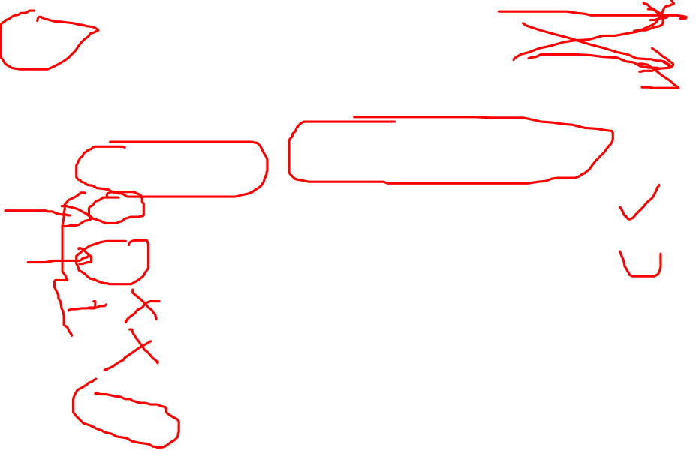
In-Class Exercises #5
What is the result?
AB | A | B
 | a1 | b1
 | a2 | b2
CD1 | C | D | X
 | c1 | d1 | x1
 | d2 | d2 | x2
AB _{A=a1}CD1
R1 ← AB X CD1
R1 | A | B | C | D | X
 | a1 | b1 | c1 | d1 | x1
 | a1 | b1 | d2 | d2 | x2
 | a2 | b2 | c1 | d1 | x1
 | a2 | b2 | d2 | d2 | x2
Result ← σ_{A=a1}(R1)
R1 | A | B | C | D | X
 | a1 | b1 | c1 | d1 | x1
 | a1 | b1 | d2 | d2 | x2

Slide 3

In-Class Exercises #5
What is the result?
AB | A | B
 | a1 | b1
 | a2 | b2
CD2 | A | D | X
 | a2 | d2 | x1
 | a1 | d1 | x2
2. AB _{A=a1}CD2
R1 ← AB X CD2
R1 | A | B | A | D | X
 | a1 | b1 | a2 | d2 | x1
 | a1 | b1 | a1 | d1 | x2
 | a2 | b2 | a2 | d2 | x1
 | a2 | b2 | a1 | d1 | x2
Result ← σ_{A=a1}(R1)
Invalid query due to joining two tables with identical attribute names.

Slide 4
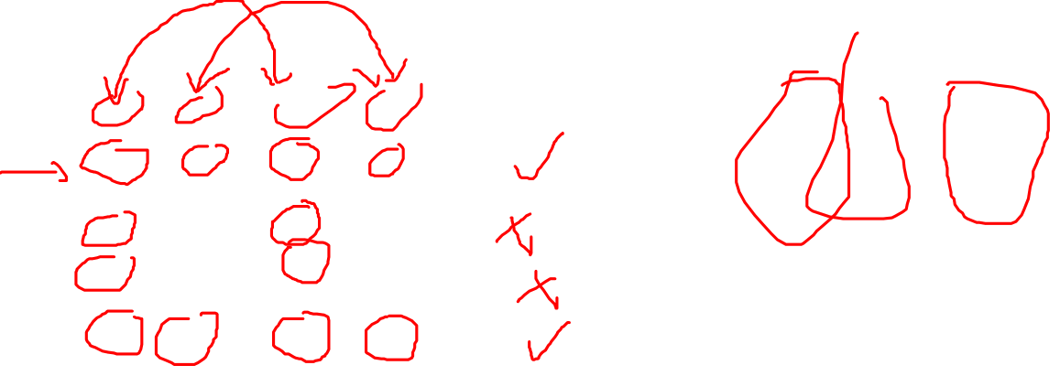
In-Class Exercises #5
What is the result?
AB | A | B
 | a1 | b1
 | a2 | b2
CD3 | A | B | X
 | a1 | b1 | x1
 | a2 | b2 | x2
5. AB * CD3
R1 ← AB X CD3
R2 ← σ_{Equality of common} (R1)
R1 | A | B | A | B | X
 | a1 | b1 | a1 | b1 | x1
 | a1 | b1 | a2 | b2 | x2
 | a2 | b2 | a1 | b1 | x1
 | a2 | b2 | a2 | b2 | x2
R2 | A | B | A | B | X
 | a1 | b1 | a1 | b1 | x1
 | a2 | b2 | a2 | b2 | x2
Result ← Remove one copy of common from R2
Result | A | B | X
 | a1 | b1 | x1
 | a2 | b2 | x2

Slide 5
Exercise: What is Wrong?
1. g _{Salary > avg(Salary)} (Employee)
2. π_{FNAME, LNAME} ( σ_{DNO = DNUMBER} (Employee, Department) )
3. π_{FNAME, LNAME} ( g _{max(Salary)} (Employee) )
4. Works_ON / Project.PNUMBER
5. π_{FNAME, LNAME, Project. HOURS} ( σ_{SSN = Project.ESSN} (Employee) )
6. σ _{Salary = min(Salary)} (Employee)
Notes:
Here are some mistakes students made in the past. Can you tell what is wrong with each of them syntactically?

Slide 6
Review of Lecture 4-1
Aggregation function
  Grouping attribute(s)
  Schema of output
Outer join
  3 forms (Left, Right, Full)

Slide 7
Lecture 4-2: Today’s Plan
Query tree
Query optimization
Relational calculus
RA exercises

Slide 8
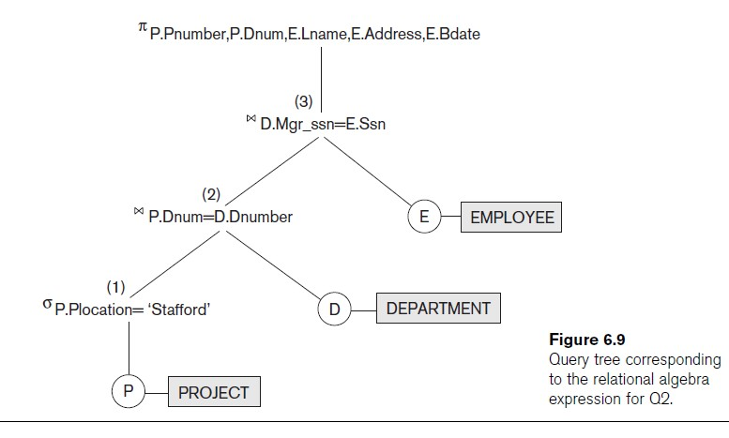
Query Tree
Representation for computation
  cf. arithmetic trees for arithmetic computations
  Leaf nodes are base relations
  Internal nodes are relational algebra operations
  Algebraic Query Optimization consists of rewriting the query or modifying the query tree into an equivalent tree. (see Chapter 15)
Notes:
DBMS covers User Query to RA to query tree, then use the query tree for query optimization.

Slide 9
Query Optimization: Example
Employee table has 8 tuples and Department table has 3 tuples.
Write a query to list the names of employees who work for the research department
  Which one runs faster?
R1 ← Employee X Department
R2 ← Ϭ_{DNO = DNUMBER} (R1)
R3 ← Ϭ_{DNAME = “Resarch”} (R2)
Result ← π _{Fname, Lname} (R3)
R1 ← Ϭ_{DNAME = “Resarch”} (Department)
R2 ← Employee X R1
R3 ← Ϭ_{DNO = DNUMBER} (R2)
Result ← π _{Fname, Lname} (R3)
Notes:
The query on the left: Project fname, lname ( Select dname = “research” ( Select dno=dnumber ((E)CX (D)) ) )
Number of rows of data accessed: 24 + 24 + 8 + 4 = 60 rows!
R1: Pair 8 employees with 3 departments, 24 combos
R2: go through all 24 combos to match employees with their departments, 24 rows to scan and produces 8 rows in the result.
R3: go through 8 rows to find who work for research, 4 rows produces.
Result: chop the names from a table with 4 rows.
The query on the right: Project fname, lname (Select dno = dnumber ( E CX (Select dname = “research” (D)) ) )
Number of rows of data accessed: 3 + 8 + 8 + 4 = 23 rows!
Basic idea: Delay join (CX) as late as possible (select and project first if possible)

Slide 10
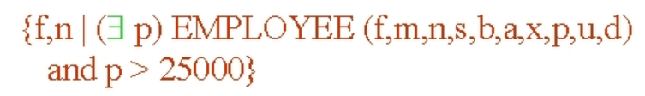
Relational Calculus
A relational calculus expression creates a new relation, which is specified in terms of variables:
  range over rows (in tuple calculus)
    Part of the model for SQL
  or over columns (in domain calculus)
    QBE (Query By Example)
Nonprocedural language.
  No order of operations to specify how to retrieve the query
Note that: RA, Tuple RC and Domain RC are equivalent
  Any one can always be converted to the other two
Notes:
In a calculus expression, there is no order of operations to specify how to retrieve the query result—a calculus expression specifies only what information the result should contain. This is the main distinguishing feature between relational algebra and relational calculus.
Relational calculus is considered to be a nonprocedural language. This differs from relational algebra, where we must write a sequence of operations to specify a retrieval request; hence relational algebra can be considered as a procedural way of stating a query.
Briefly discuss here, SQL uses calculus, so we study SQL in full details instead.

Slide 11
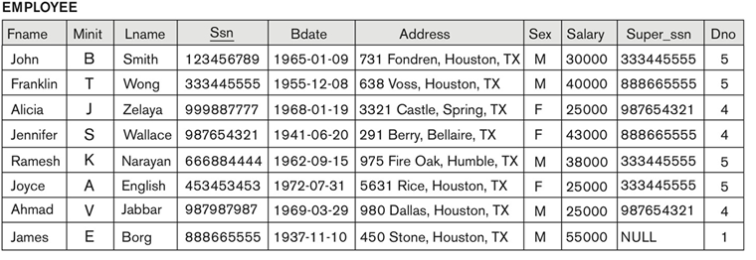
How many rows and columns in the results?
(_{lname, fname} g _{max(Salary) as Salary} (Employee))
(_{dno} g _{max(Salary) as Salary} (Employee))
Notes:
8 rows, 3 columns
3 rows, 2 columns

Slide 12
Can you help?
A couple of days after starting in the new position, Jane realized that she accidentally created two employee tables E1 and E2 and data has been randomly stored in either table. She is not sure whether the two tables have the same content. Can you help?
If the two tables are not same, what would you do to ensure no information is lost?
Will this work (E1 – E2)?
Notes:
Most exercises you have seen so far ask you for specific information. But in practice, the query you need to write or information needed to be retrieved are quite cryptic. Here are some examples

Slide 13
Can you help? - Solution
A couple of days after starting in the new position, Jane realized that she accidentally created two employee tables E1 and E2 and data has been randomly stored in either table. She is not sure whether the two tables have the same content. Can you help?
If the two tables are not same, what would you do to ensure no information is lost?
(E1 – E2) ∪ (E2 – E1). If this query returns an empty table, then the two are the same. Otherwise, not the same
E1 ∪ E2

Slide 14

Can you help? – Problem Statement
Kate (SSN=111000) is suspected of embezzling money from the company and she likely has an accomplice.
Can you help the company narrow down the pool of suspects?
  Maybe someone from the accounting department and worked with her in some project(s)
Image Source: https://mammothmemory.net/english/5000-new-words/vocabulary/word-list/i/accomplice.html
Notes:
Need to ID her accomplish. How do you specify the search criteria? What are we looking for?
Write a query to find all employees from accounting who have worked with Kate in some project(s)

Slide 15

Can you help? – Query Question
Find employees from the accounting department who worked with Kate (SSN=111000) in some project(s).
Image Source: https://www.learnaboutnature.com/how-can-i-help/

Slide 16
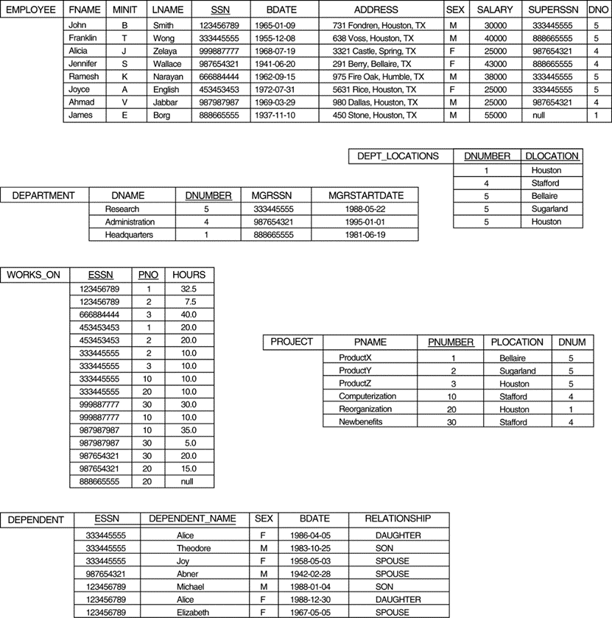

Can you help? – Thoughts
Find employees from the accounting department who worked with Kate (SSN=111000) in some project(s).
Notes:
Find all employees from accounting
Find the projects these employees work on
Find the projects Kate works on
Match the two lists.

Slide 17

Can you help? – Step 1
Find employees from the accounting department who worked with Kate (SSN=111000) in some project(s).
  Find all employees from accounting
A ← Employee (DNO = DNUMBER) AND (DNAME=“Accounting”) Department
AE(ESSN) ← π _{SSN} (A)
Notes:
Find all employees from accounting
Find the projects these employees work on
Find the projects Kate works on
Match the two lists.

Slide 18

Can you help? – Step 2
Find employees from the accounting department who worked with Kate (SSN=111000) in some project(s).
  Projects accounting employees work on
AEP ← Works_ON * AE
AE | ESSN
 | .
 | .
 | .
Notes:
Find all employees from accounting
Find the projects these employees work on
Find the projects Kate works on
Match the two lists.

Slide 19
Can you help? – Step 3
Find employees from the accounting department who worked with Kate (SSN=111000) in some project(s).
  Projects Kate works on.
K ← Ϭ _{(ESSN=111000)} (Works_ON)
KP ← π _{PNO} (K)
Notes:
Find all employees from accounting
Find the projects these employees work on
Find the projects Kate works on
Match the two lists.

Slide 20
Can you help? – Step 4
Find employees from the accounting department who worked with Kate (SSN=111000) in some project(s).
  Match the two project lists
M ← KP * AEP
Result ← π _{ESSN} (M)
KP | PNO
 | .
 | .
 | .
AEP | ESSN | PNO | HOURS
 | . | . | .
 | . | . | .
 | . | . | .
Notes:
You must used natural join instead of basic join due to the presence of common attributes (attribute with same name).
Would a division work? AEP / AP?

Slide 21
In Class Exercise #9
List the names of employees who have the highest salary
List the names of employees who have above average salary
List the names of employees who have higher salary than John
List the names of employees who have the lowest salary in research department
Notes:
Q1: Common mistake: manually go through the table, find John’s salary as $30K.

Slide 22
In Class Exercise #9 - Solution
π _{FName, LName} ( (g _{max(Salary) as Salary} (Employee) )* Employee) )
π _{FName, LName} ( (g _{avg(Salary) as A} (Employee) ) _{Salary>A} Employee) )
π _{FName, LName} ( Employee _{Salary>JS} (π _{Salary as} _{JS} (σ _{FName=‘John’} Employee) ) )
R1 ← σ _{DName=‘Research’} (Department)
R2 ← (Employee) _{DNO=DNumber} (R1)
R3 ← g _{min(Salary) as mins} (R2)
Result ← π _{FName, LName} ( (R3) _{Salary=mins} (R2))

Slide 23
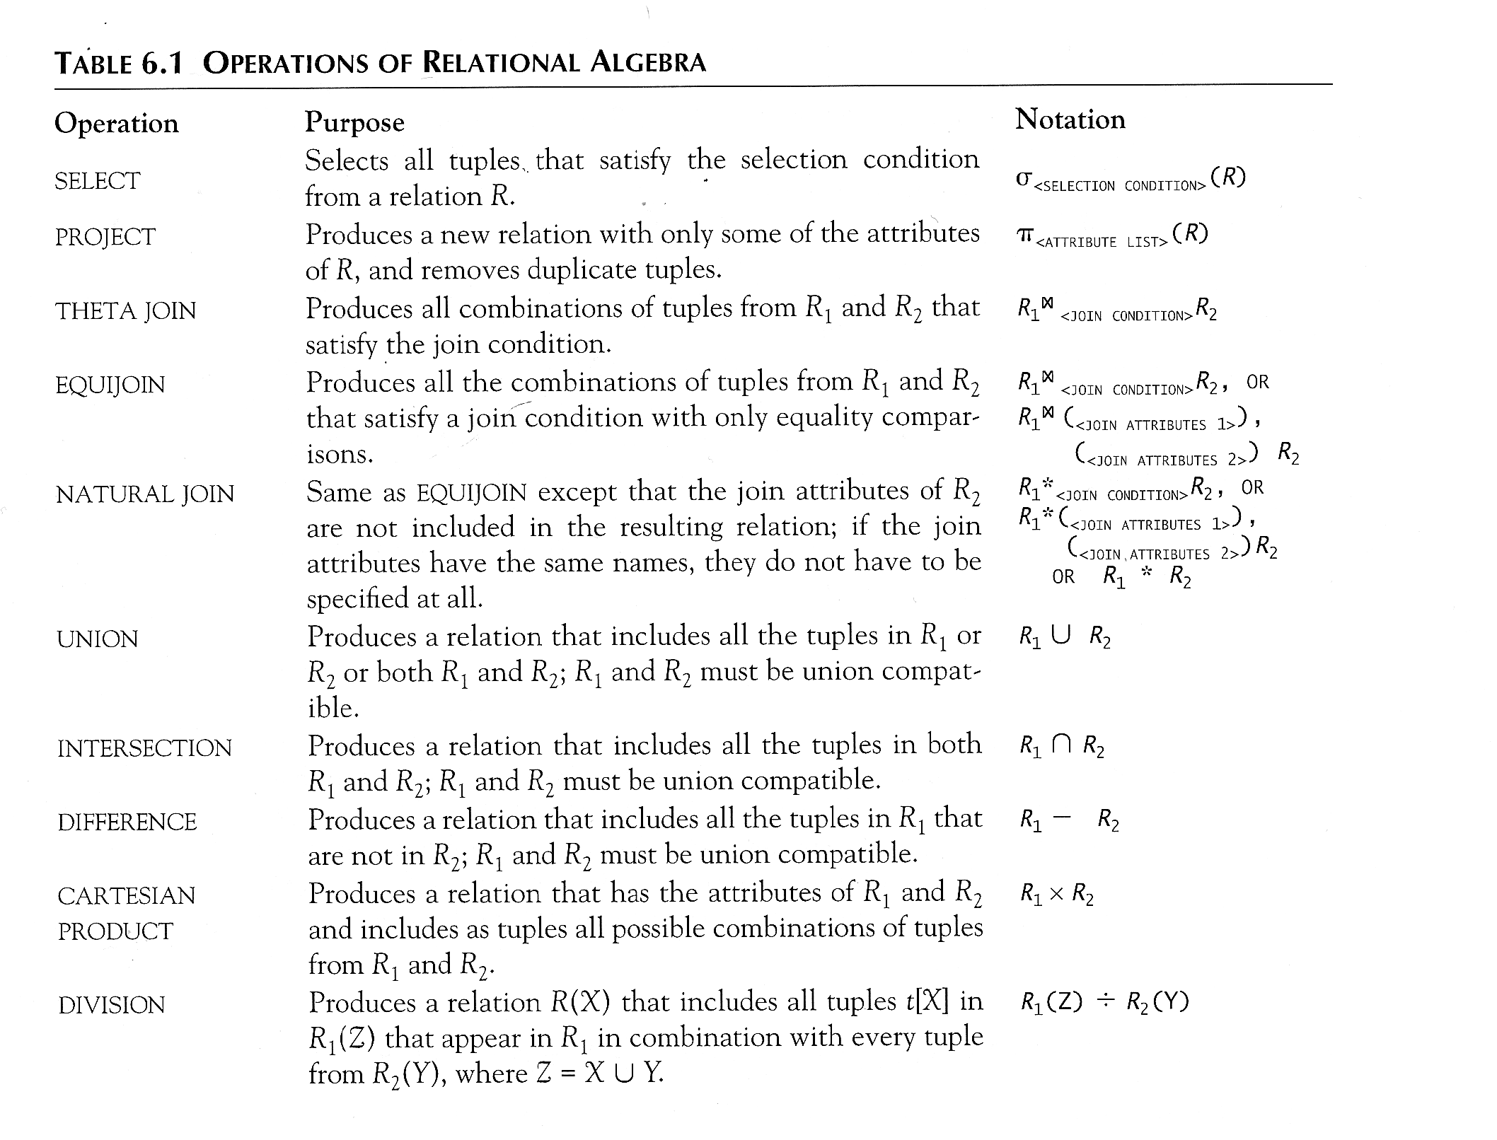
Recap of Relational Algebra
Aggregation Produces summary statistics on a table
R₁ * R₂

Slide 24
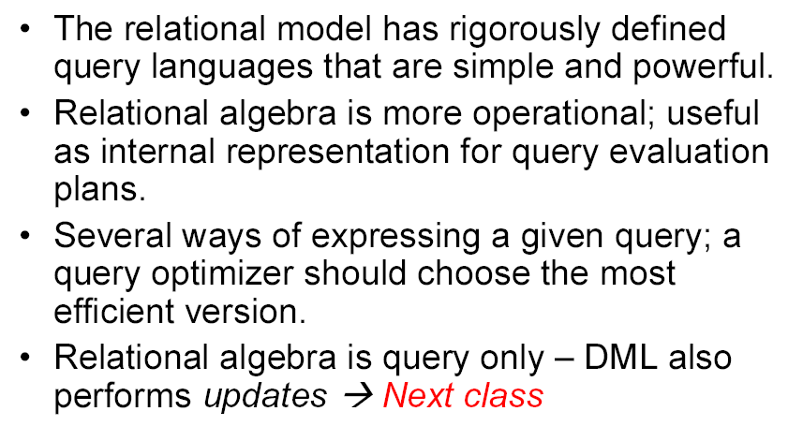
Benefits of Relational Algebra
Notes:
At the beginning, We did not mention the reason why algebra is needed. But now we have a better idea what algebra can do, we can answer the question

Slide 25
In Class Exercise #10
(Easy) List names of employees who work on more than one project.
(Tough) Find all the pairs of employees, where the first one has a higher salary than the second one.
(Tricky) Find out the supervisor of John’s Supervisor.
Find out the names of employees who work for any of the projects controlled by the Research department.
Find out the names of employees who work for all of the projects controlled by the Research department.

Slide 26
In Class Exercise #10 - Solution
a. R1 ← _{ESSN} g _{count(PNO) as np} (WORK_ON)
R2 ← σ _{np > 1} (R1)
Result ← π _{FName, LName} ( (Employee) _{SSN=ESSN} (R2) )
b. R1 (F, L, S) ← π _{FName, LName, Salary} ( Employee)
Result ← π _{FName, LName, F, L} ( (Employee) ) _{Salary > S} (R1) )
c. R1 (SJ) ← π _{SUPERSSN} ( σ _{FNAME=‘John’} (Employee) )
R2(SSJ) ← π _{SUPERSSN} ( (Employee) ) _{SSN=SJ} (R1) )
Result ← π _{FName, LName} ( (Employee) ) _{SSN=SSJ} (R2) )
d. R1 ← π _{DNUMBER} ( σ _{DNAME=‘Research’} (Department) )
R2(PNO) ← π _{PNUMBER} ( (Project) ) _{DNUM=DNUMBER} (R1) )
R3← π _{ESSN} ( (WORK_ON) * (R2) )
Result ← π _{FNAME, LNAME} ( (Employee) _{SSN=ESSN} (R3) )

Slide 27
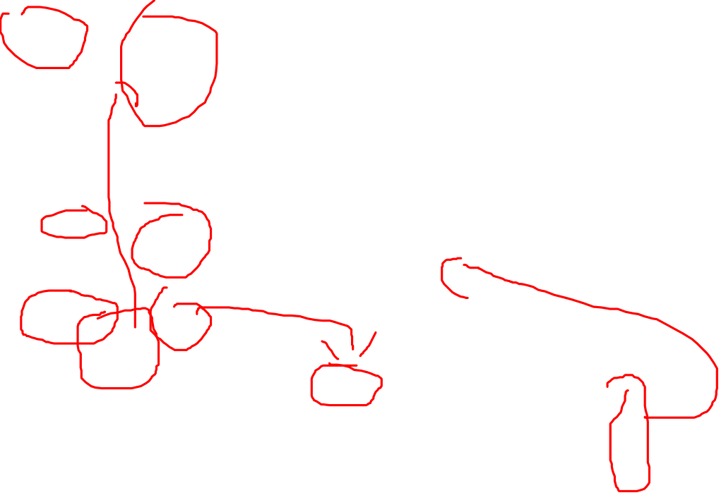
In Class Exercise #10 - Thoughts
e.) Find out the names of employees who work for all of the projects controlled by research department.

Slide 28

In Class Exercise #10 – Step 1
e.) Find out the names of employees who work for all of the projects controlled by research department.
  Find projects controlled by Research
R ← Project (DNUM = DNUMBER) AND (DNAME=“Research”) Department
RP(PNO) ← π _{PNUMBER} (R)

Slide 29

In Class Exercise #10 – Step 2
e.) Find out the names of employees who work for all of the projects controlled by research department.
  Find projects controlled by Research
WK ← π _{PNO, ESSN} (Works_ON)
ERP ← WK / RP
RP | PNO
 | 1
 | 2
 | 3
Notes:
Can we directly do Works_ON / RP? Why or why not?

Slide 30

In Class Exercise #10 – Step 3
e.) Find out the names of employees who work for all of the projects controlled by research department.
  Get the employee names.
R1 ← ERP _{(ESSN =SSN)} Employee
Result ← π _{FNAME, LNAME} (R1)
ERP | ESSN
 | . . .
Notes:
Join instead of natural join due to no common attributes (ESSN vs. SSN)

Slide 31
Summary of Lecture 4-2
Query tree
Query optimization
Relational calculus
RA exercises

