Slide 1

Review of Last Lecture
Query tree
Query optimization
Relational calculus
RA exercises

Slide 2
Today’s Plan
SQL: Data Manipulation Basics
  History and Features
  SELECT FROM WHERE

Slide 3
SQL Part I – Data manipulation
Chapter 04
Collin Roberts
University of Waterloo
Notes:
Show tables in sqlite: SELECT name FROM sqlite_master WHERE type='table';

Slide 4
Suggested Readings
Textbook Chapter 08

Slide 5
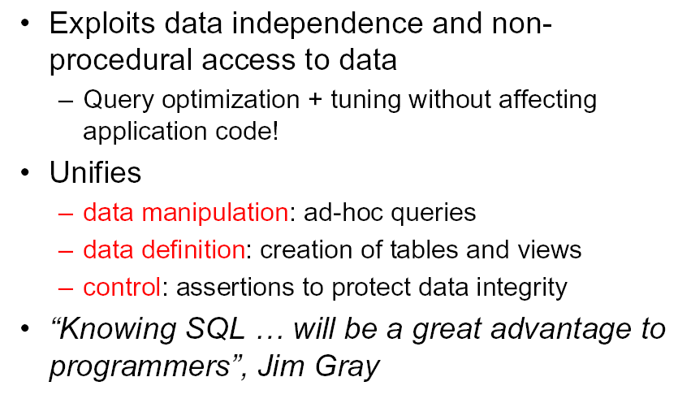
Why SQL?
Notes:
SQL user does not need to worry about performance. The DBMS will optimize it and the results will remain the same.
SQL is a very-high-level language.
Say “what to do” rather than “how to do it.”
Avoid a lot of data-manipulation details needed in procedural languages like C++ or Java.
Database management system figures out “best” way to execute query.
Called “query optimization.”

Slide 6
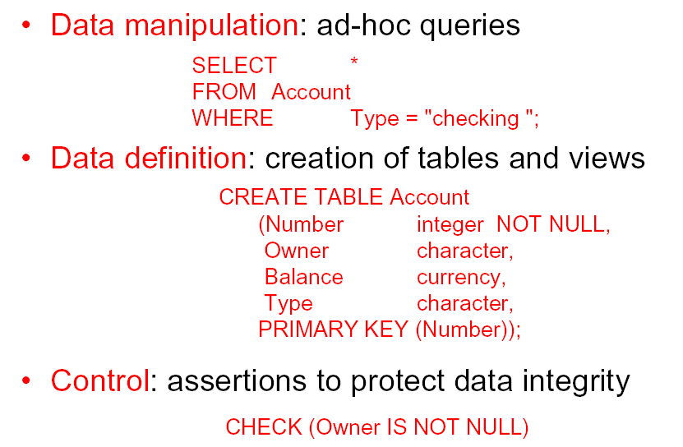
SQL: Examples
Notes:
DML and DDL, 3 components:

Slide 7
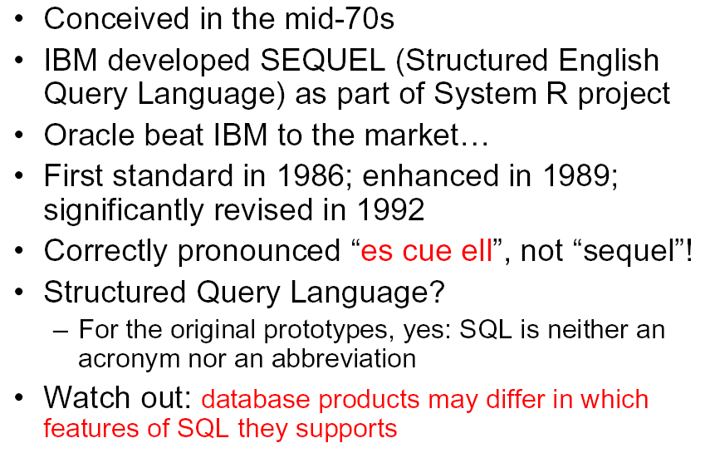
SQL History and Trivia
Notes:
SQL 2019 is the latest major revision

Slide 8
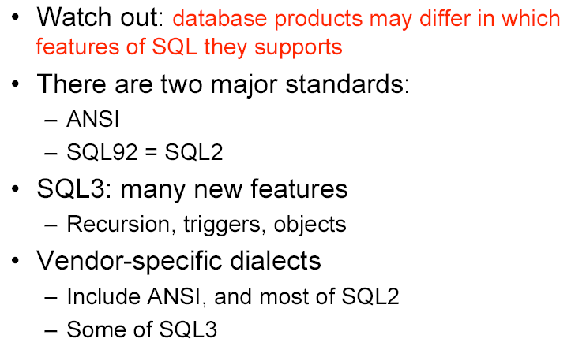
SQL: Many Versions
Notes:
Different SQL products offer different features.
What we have discussed are basic and standards.
Read the documentation before using any more advanced data type and features like triggers, view, assertions, PSM etc.

Slide 9
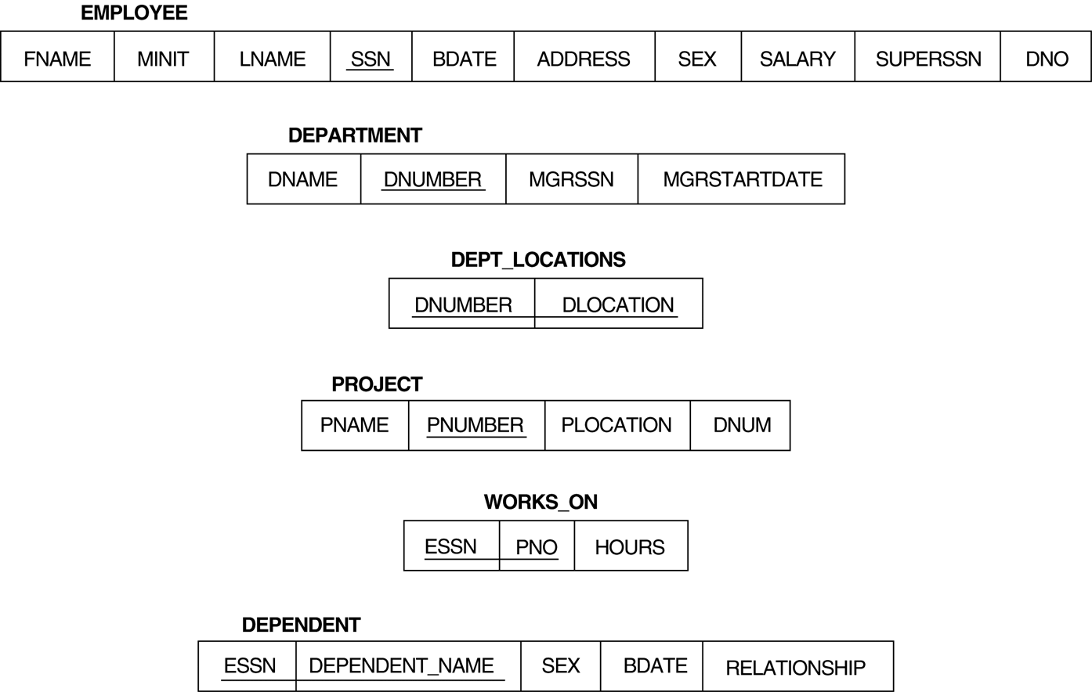
Company Database Schema

Slide 10
SQLite and Company Database
DB Browser for SQLite: https://sqlitebrowser.org/dl/
Company database: download from our Resources page
How to use the DB browser: https://datacarpentry.org/sql-socialsci/02-db-browser/index.html
There are also plenty of materials on YouTube about DB Browser for SQLite.
Table names and attribute names are CASE-INSENSITIVE in SQLite.
The company database can be downloaded from Learn. Note that its content is from the one in the slides

Slide 11
Part I: Data Manipulation
Notes:
Once table created and data added (discussed later), we can query them that is search them to find information needed

Slide 12
Retrieval Queries in SQL
Statement for retrieving information from a database: the SELECT statement
Important distinction between SQL and the formal relational model: SQL allows duplicate records, which means its relations need not be sets, as in the relational model.
SQL relations can be constrained to be sets by
  specifying PRIMARY KEY or UNIQUE attributes, or
  using the DISTINCT option in a query
Notes:
This is not the same as the SELECT operation of the relational algebra
SQL allows a table to have two or more tuples that are identical in all their attribute values
Hence, an SQL table is a multi-set (sometimes called a bag) of tuples; it is not a set of tuples
You can force SQL to be set-based, by using PK, unique or distinct

Slide 13
Select Statement
Basic form of the SQL SELECT statement:
  SELECT <attribute list>
  FROM <table list>
  WHERE <condition>
  <attribute list> is a list of attribute names whose values are to be retrieved by the query (like the Project in Relational Algebra)
  <table list> is a list of the relation names required to process the query
  <condition> is a conditional (Boolean) expression that identifies the tuples to be retrieved by the query (like the Select in Relational Algebra)
Notes:
SELECT in SQL is the same Project in RA
WHERE in SQL is the same as Select in RA
Also the order of processing: FROM, WHERE, SELECT (what table, what row and what column)
Similar to a SELECT-PROJECT pair of relational algebra operations; the SELECT-clause specifies the projection attributes and the WHERE-clause specifies the selection condition
However, the result of the query may contain duplicate tuples

Slide 14
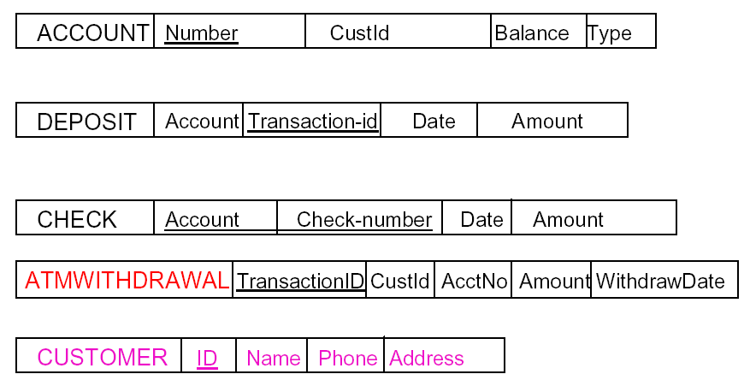
Bank Database Schema
Notes:
Examples based on these databases

Slide 15
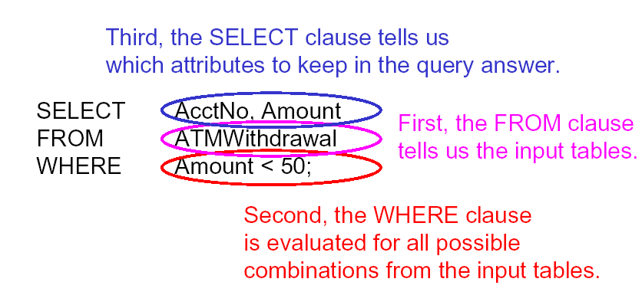
How Query Is Evaluated
Notes:
In RA: π_{AccNo, Amout} ( Ϭ _{Amount < 50} (ATMWithdrawal) ), with a twist: in SQL, duplicates are NOT removed in the projection!!!!

Slide 16
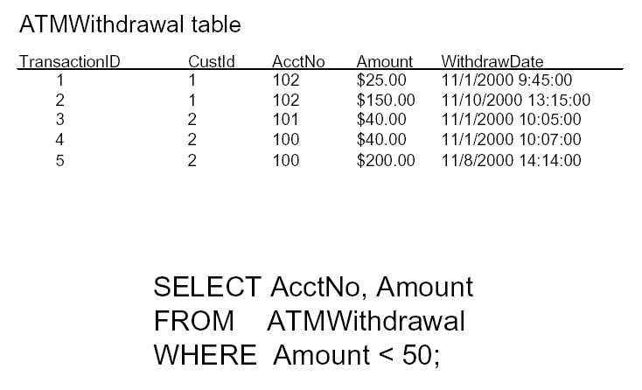
SQL in Action (1)
Notes:
Here is how it works: example here retrieves account number and amount for withdrawal less than 50.

Slide 17
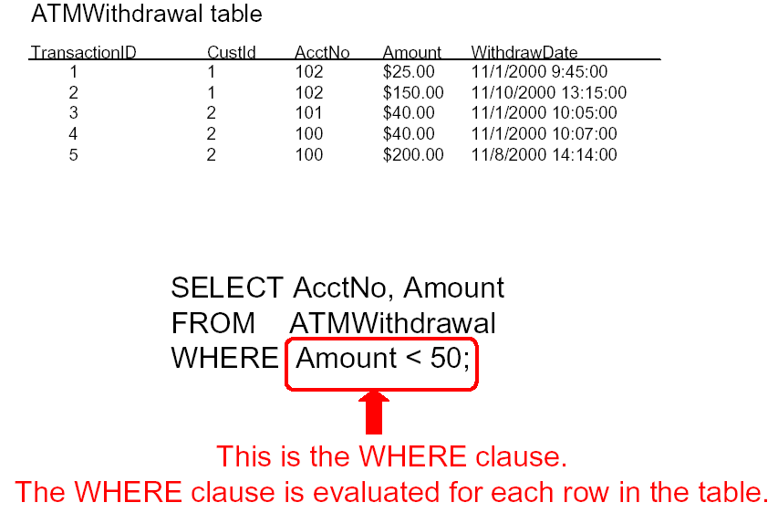
SQL in Action (2)

Slide 18
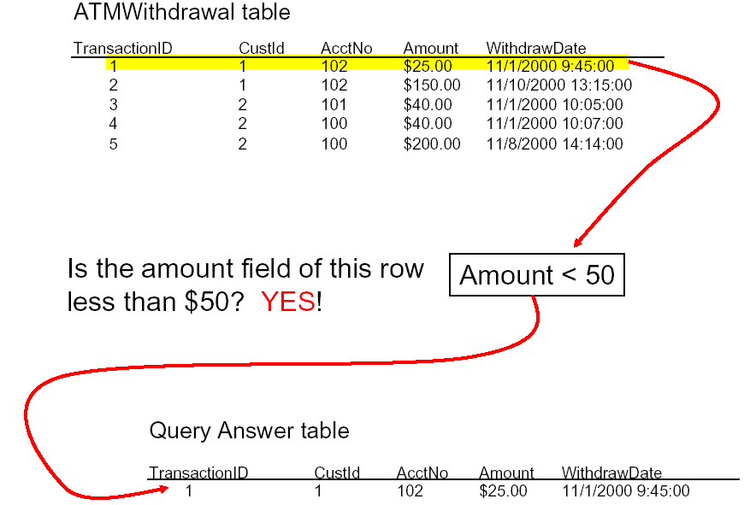
SQL in Action (3)

Slide 19
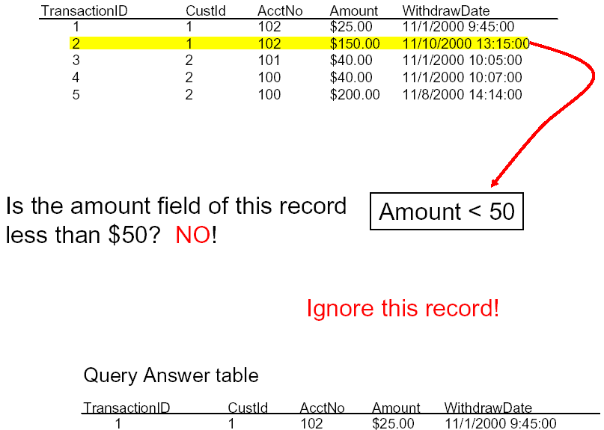
SQL in Action (4)

Slide 20
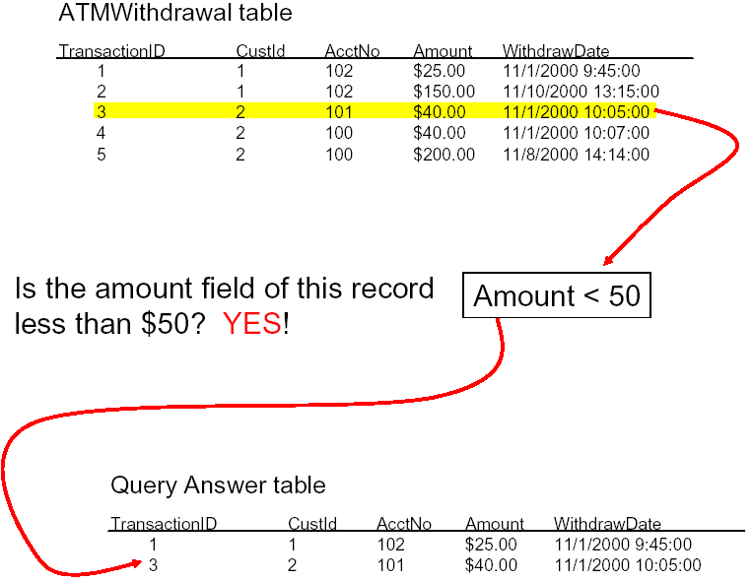
SQL in Action (5)

Slide 21
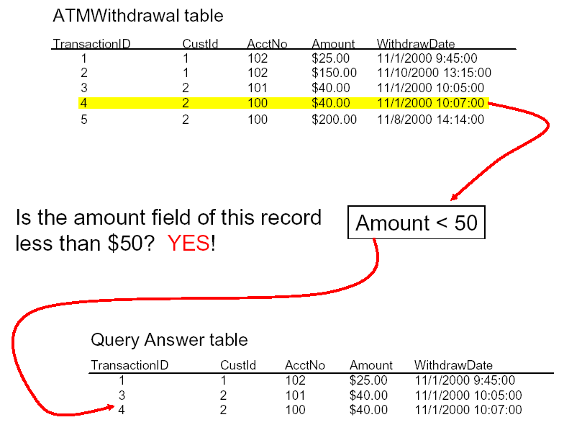
SQL in Action (6)

Slide 22
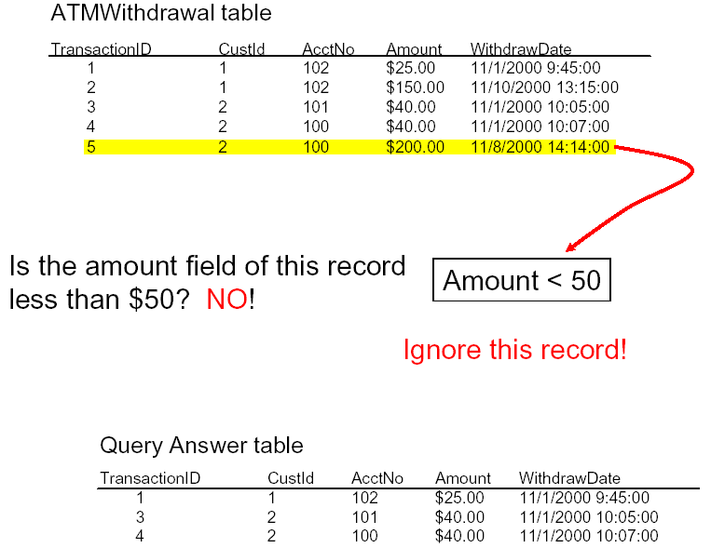
SQL in Action (7)

Slide 23
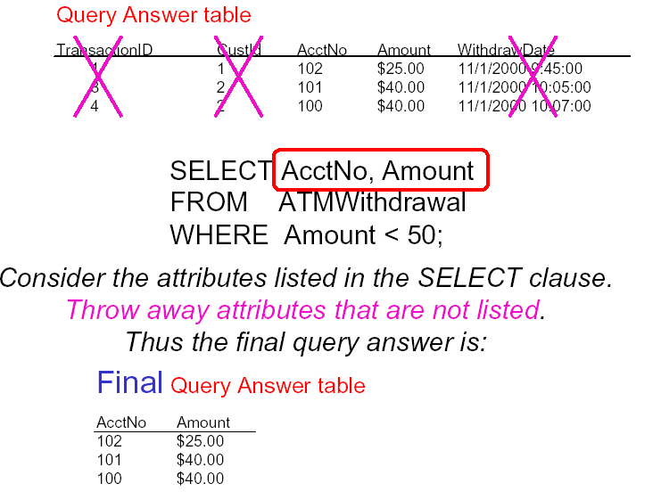
SQL in Action (8)

Slide 24
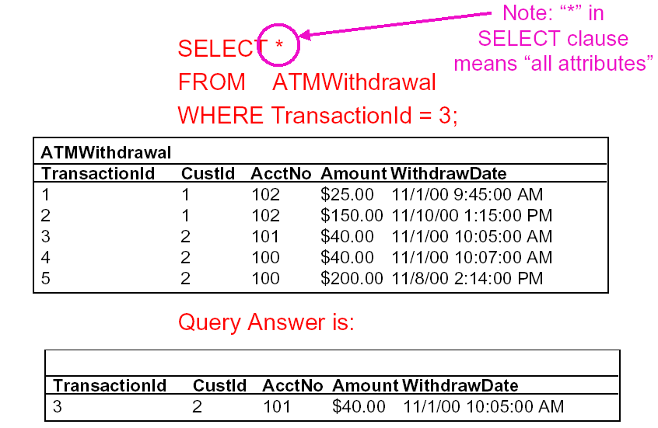
Use of * in Select
Notes:
All five rows are considered, one by one, to see if Transactionid = 3 is true
But be careful when using * invovling two tables, see later in cross join!!!!!!!!!!!!!!

Slide 25
Prefix
In SQL, the same name can be used for two (or more) attributes as long as the attributes are in different relations.
Prefix: TableName . AttributeName
Example:
EMPLOYEE.NAME, DEPARTMENT.NAME
Notes:
A query that refers to two or more attributes with the same name must qualify the attribute name with the relation name by prefixing the relation name to the attribute name.

Slide 26

SQL: Warm-up Example
Query 1: For each employee, retrieve the employee's name, and the SSN of his or her immediate supervisor.
Q1: SELECT FNAME, LNAME, SUPERSSN
FROM EMPLOYEE;
WHERE
Notes:
Let’s try an example.
Note that SQL statement in SQLite ends in semicolon. That is why is included. But it is fine if you don’t include the semicolon (in assignment or exams).
Missing WHERE is equivalent to WHERE TRUE. The condition is always TRUE. So all rows are chosen. But writing WHERE TRUE is tedious. So just skip the WHERE clause if it’s not needed.

Slide 27
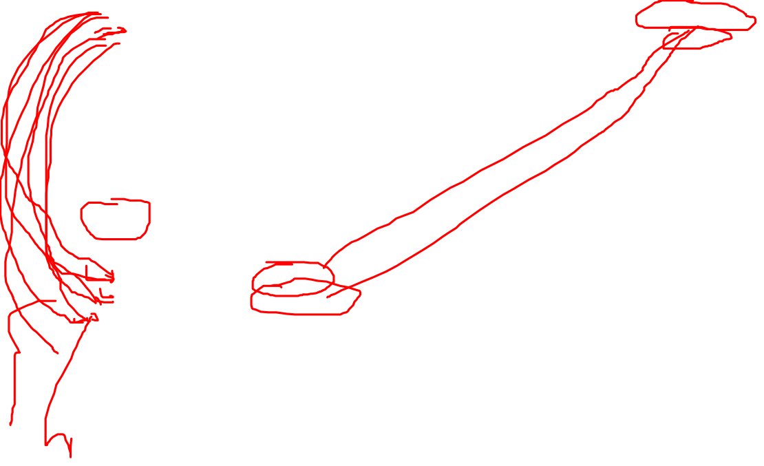
Aliases: Motivation
Query 2: For each employee, retrieve the employee's name, and the name of his or her immediate supervisor.
E
S
Notes:
What if we want the supervisor names instead?
Some may find it difficult to visualize the solution.
But what if we use two copies of the Employee table, one called E and one called S?

Slide 28
Aliases
Some queries need to refer to the same relation twice
  In this case, aliases are given to the relation name
Query 2: For each employee, retrieve the employee's name, and the name of his or her immediate supervisor.
Q2: SELECT E.FNAME, E.LNAME, S.FNAM, S.LNAME
FROM EMPLOYEE E, EMPLOYEE S
WHERE E.SUPERSSN = S.SSN;
E
S
Notes:
In Q2, the alternate relation names E and S are called aliases or tuple variables for the EMPLOYEE relation
We can think of E and S as two different copies of EMPLOYEE; E represents employees in role of supervisees and S represents employees in role of supervisors

Slide 29

How does it work with two tables?
Q2: SELECT E.FNAME, E.LNAME, S.FNAME, S.LNAME
FROM EMPLOYEE E, EMPLOYEE S
WHERE E.SUPERSSN = S.SSN;
E
S
Notes:
This looks awfully familiar: join in RA, except that duplicates are allowed.

Slide 30
Aliases: Alternative
  Aliasing can be used in any SQL query for convenience
  Can also use the AS keyword to specify aliases
  Q2: SELECT E.FNAME, E.LNAME, S.FNAME, S.LNAME
  FROM EMPLOYEE AS E, EMPLOYEE AS S
  WHERE E.SUPERSSN = S.SSN;
Notes:
For example, short name for less typing!!!

Slide 31
Query From Two Tables I
Notes:
We can also have queries involving several tables. For each deposit over 1000 (large amount deposit), list account information
This is similar to a join between the two tables (CX + SELECTION in RA) except that duplicates are allowed.

Slide 32
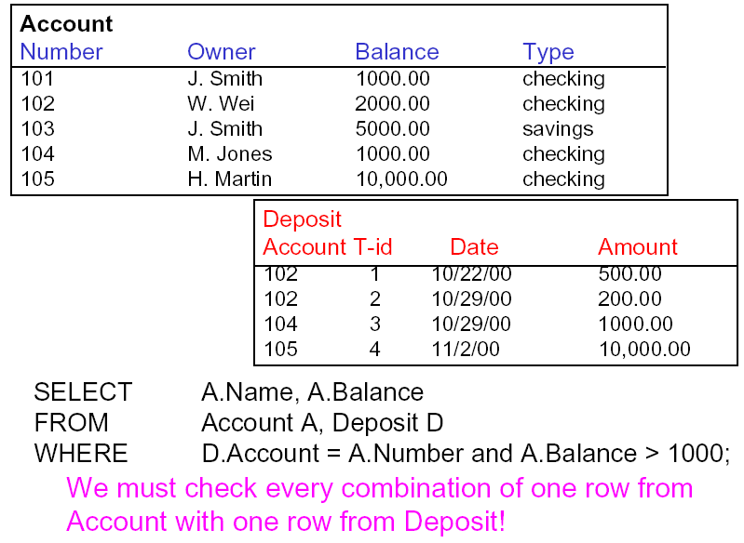
Query From Two Tables II
Notes:
Here are the tables. How does this query work?

Slide 33
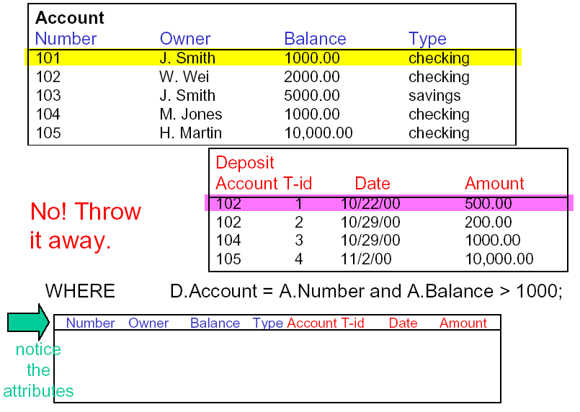

Example: Two Tables (1)
Notes:
We can also have queries from several tables

Slide 34
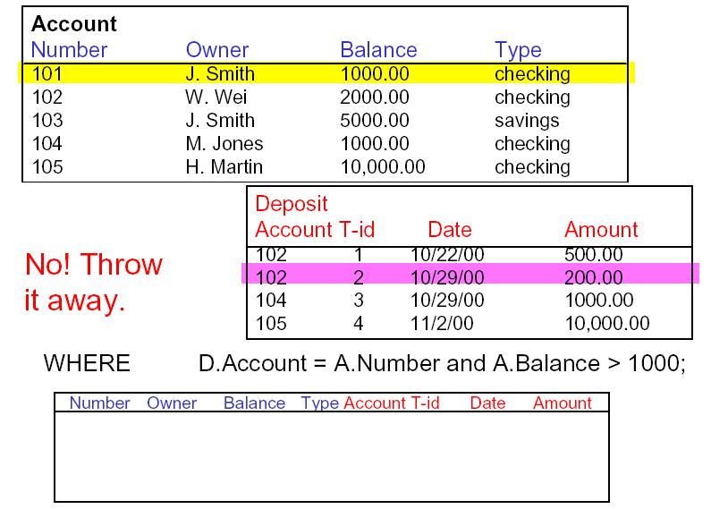
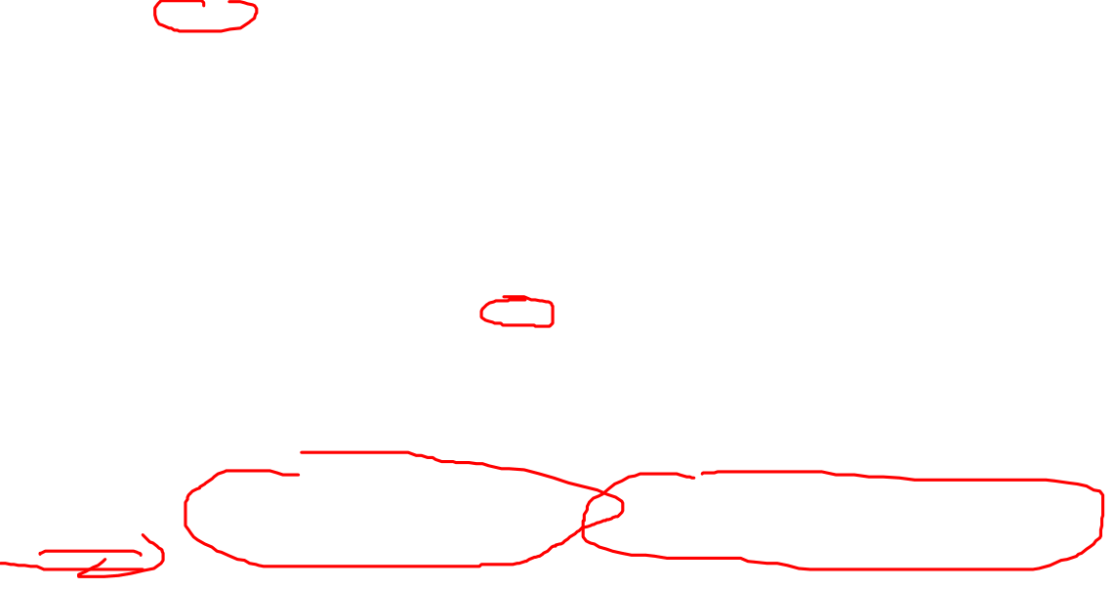
Example: Two Tables (2)
Notes:
We can also have queries from several tables

Slide 35
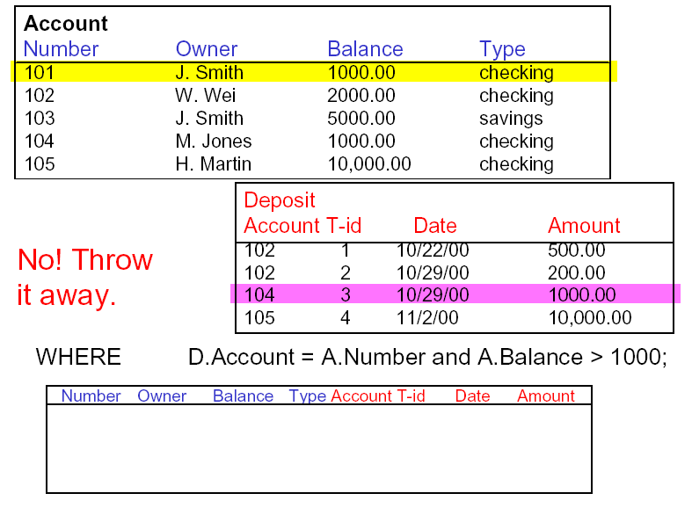
Example: Two Tables (3)
Notes:
We can also have queries from several tables

Slide 36
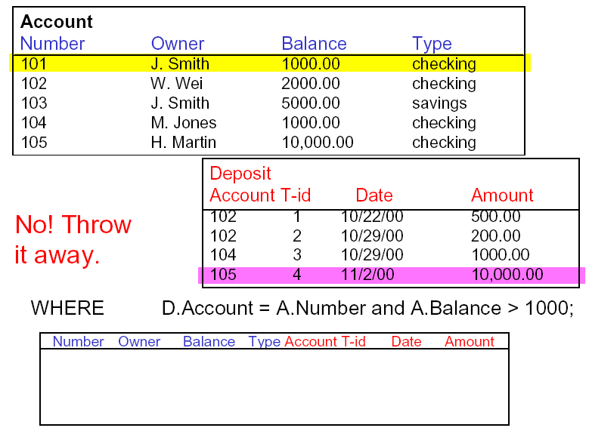
Example: Two Tables (4)
Notes:
Done, move to next row in account, and repeat the whole process: compare it with each row in Deposit!!
+++++++++++++++++++

Slide 37
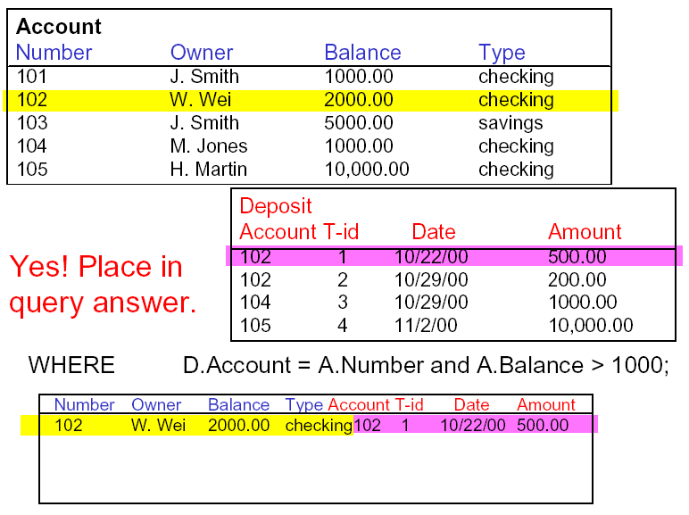

Example: Two Tables (5)
Notes:
We can also have queries from several tables

Slide 38
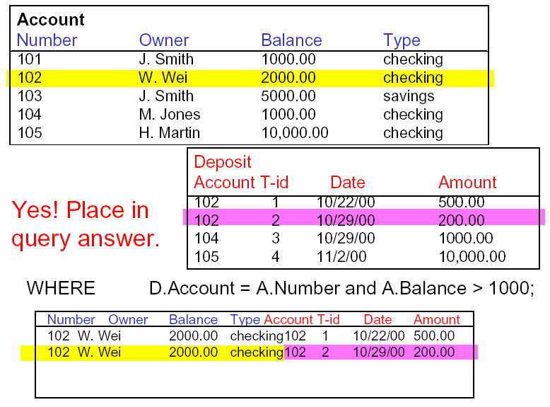
Example: Two Tables (6)
Notes:
We can also have queries from several tables

Slide 39
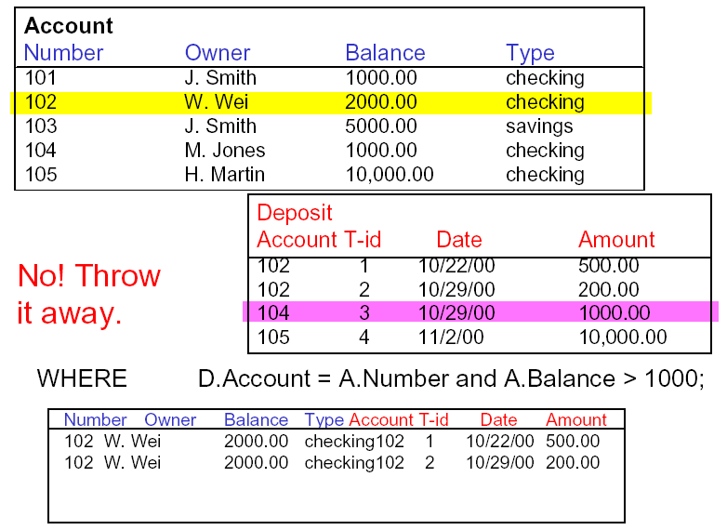
Example: Two Tables (7)
Notes:
We can also have queries from several tables

Slide 40
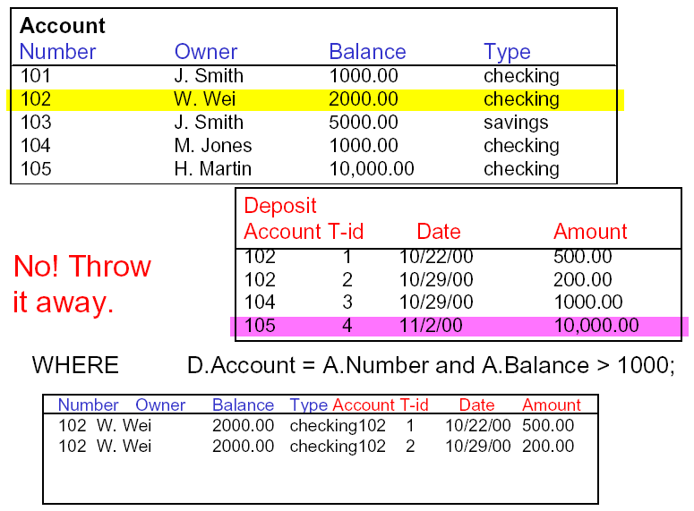
Example: Two Tables (8)
Notes:
We can also have queries from several tables

Slide 41
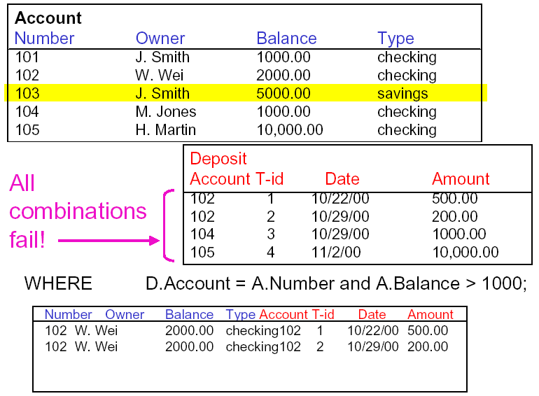
Example: Two Tables (9)
Notes:
Done, next row in Account, no match for all

Slide 42
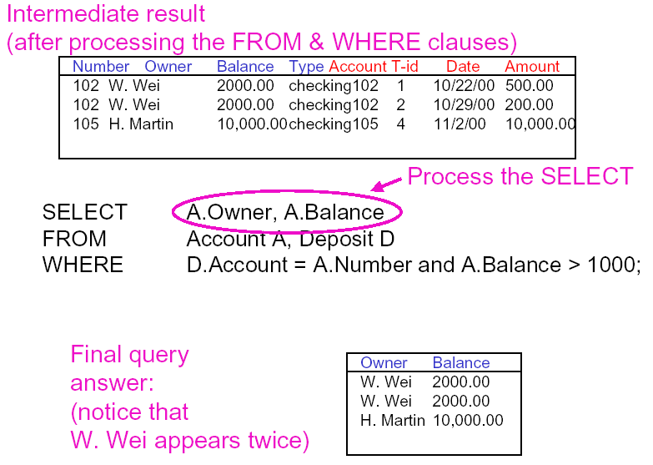

Example: Two Tables (11)
Notes:
Another way to visualize it: a cross produce between A and D, then a selection on the intermediate result relation, then a projection.

Slide 43
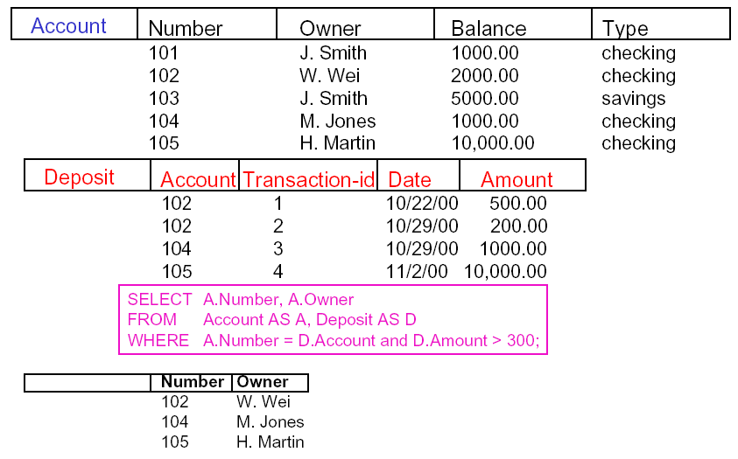
In-Class Exercise #1
Notes:
What is the output? Try it and remove the green box to verify your answer.

Slide 44
Discussion: Effect of multiple tables in the FROM clause
Do you think the following queries produce the same results?
SELECT FName
FROM Employee
WHERE LName = "Borg";
SELECT FName
FROM Employee, Department
WHERE LName = "Borg";
Notes:
Try them in SQLite and see yourself!

Slide 45
No WHERE-clause
A missing WHERE-clause indicates no condition; hence, all tuples of the relations in the FROM-clause are selected
This is equivalent to the condition WHERE TRUE
Query 7: Retrieve the first names for all employees.
  Q7: SELECT FNAME
  FROM EMPLOYEE
Notes:
What is the result of this query? No where clause is like a projection in RA but with a twist.
How about duplicate? Try it on SQLite (yes, it allows duplicates!).

Slide 46
Example: Missing Where
Example:
Q8: SELECT SSN, DNAME
FROM EMPLOYEE, DEPARTMENT
  It is extremely important not to overlook specifying any selection and join conditions in the WHERE-clause; otherwise, incorrect and very large relations may result
Notes:
This example shows us FROM clause with two tables is basically a CX
If more than one relation is specified in the FROM-clause and there is no join condition, then the CARTESIAN PRODUCT will be applied between the tables.
This is similar to π_{SSN, DNAME} (Employee X Department), but duplicates are NOT removed in the projection!!!!!

Slide 47

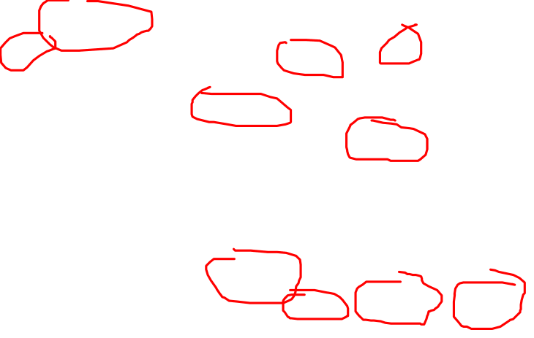
In-Class Exercise #2
Q6: For every project located in 'Stafford', list the project number, the controlling department number, and the department manager's last name, address, and birthdate.

Slide 48

In-Class Exercise #2
Q6: For every project located in 'Stafford', list the project number, the controlling department number, and the department manager's last name, address, and birthdate.
  Q6: SELECT PNUMBER, DNUM, LNAME, BDATE, ADDRESS
  FROM PROJECT, DEPARTMENT, EMPLOYEE
  WHERE PLOCATION = 'Stafford'
  AND DNUM = DNUMBER AND MGRSSN = SSN;
Notes:
In Q6, there are two join conditions
The join condition DNUM=DNUMBER relates a project to its controlling department.
The join condition MGRSSN=SSN relates the controlling department to the employee who manages that department.
PLOCATION='Stafford‘ is a selection to filter the projects.
Note that the sample company DB uses SUPERSSN and MGRSSN instead of SUPER_SSN and MGR_SSN

Slide 49
In-Class Exercise #3
Q3: Retrieve the birthdate and address of the employee whose name is 'John B. Smith'.
  Q3: SELECT BDate, Address
  FROM EMPLOYEE
  WHERE FName = "John" AND Minit = "B"
  AND LName = "Smith"
Q4: Retrieve the name and address of all employees who work for the 'Research' department.
  Q4: SELECT FNAME, LNAME, ADDRESS
  FROM EMPLOYEE, DEPARTMENT
  WHERE DNAME = "Research" AND DNumber = DNO
Q5: Retrieve the name of the manager of each department
  Q5: SELECT FNAME, LNAME
  FROM DEPARTMENT, EMPLOYEE
  WHERE MGRSSN=SSN
Notes:
Q3
Similar to a SELECT-PROJECT pair of relational algebra operations; the SELECT-clause specifies the projection attributes and the WHERE-clause specifies the selection condition
However, the result of the query may contain duplicate tuples
Q4
(DNAME='Research') is a selection condition (corresponds to a SELECT operation in relational algebra)
(DNUMBER=DNO) is a join condition (corresponds to a JOIN operation in relational algebra)
Q5
In the third one there is one join condition
The join condition MGRSSN=SSN relates the department to the employee who manages that department

Slide 50
Utmost Importance
Every RA operation produces a table with unique rows.
  Selection, projection, join etc.
Every SQL clause produces a table
  FROM clause produces a table
  WHERE clause produces a table
  SELECT clause produces a table
  But each table might contain duplicate rows!

Slide 51
Summary of Today’s Lecture
SQL basics
SQL Data Manipulation:
SELECT
FROM
WHERE

