Slide 1

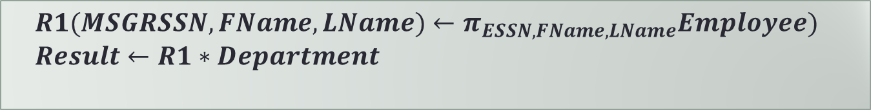
Some Comments about RA
Natural join
AS and renaming
$$Result←Employee∗Department$$
$$Result←(π_{ESSN AS MGRSSN, FName, LName}Employee)∗Department$$
$$R1(MSGRSSN, FName, LName)←π_{ESSN, FName, LName}Employee)$$
$$Result←R1∗Department$$
4.Works_ON / Project.PNUMBER
Notes:
Before opening today’s lecture, I would like to address a few things that I observed from the communication I received.
Natural join
You cannot natural join two tables if they don’t have common attributes. The DBMS has no idea which attribute should match which attribute (SSN with MGRSSN, DNO with DNUMBER, BDate with MGRSTART_Date?)
AS is only used in aggregation function to name aggregated attribute, no where else.
For renaming, I seldom use the rename operator, instead, use assignment.

Slide 2
Why PK Must Be Minimal
Student(SID, Name, GPA)
(SID)
  (01345, John, 67)
  (22234, Kate, 88)
  (01345, Jane, 78)
  … …
(SID, Name)
  (01345, John,67)
  (22234, Kate, 88)
  (01345, Jane, 78)
  … …
Notes:
PK must be minimal to enable that the DBMS can ensure/enforce its integrity. (the system cannot ensure the natural identifier of a table be unique.

Slide 3
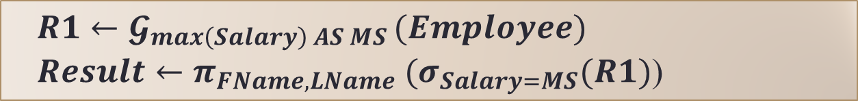
What is Wrong?
Find the name of the employee with the highest salary
$Result←π_{FName,LName}{(𝓖}_{max\left(Salary\right) }(Employee)$)
$$R1←𝓖_{max\left(Salary\right) AS MS }(Employee)$$
$Result←π_{FName,LName} (σ_{Salary=MS}(R1)$)
Notes:
This are very typical student responses. Both are wrong, but what is wrong with these answers? Please share your thoughts on the message board.
Please see the Additional Slides for a correct solution.

Slide 4
Review of Last Lecture
SQL basics
  IBM, pronunciation, features
SQL Data Manipulation:
SELECT
FROM
WHERE
Which one can be skipped?

Slide 5
Today’s Plan
Extension to Select
  DISTINCT, AS, expression, aggregated
Extension to From
  Nested query
  Join

Slide 6

In-class Exercise #1
Find the name of the supervisor of John Smith’ supervisor.
E
SELECT SS.FName, SS.LName
FROM Employee E, Employee S, Employee SS
WHERE (E.FName = ‘John’) AND
(E.LName = ‘Smith’) AND
(E.Super_SSN = S.SSN) AND
(S.Super_SSN = SS.SSN);
SS
S
Notes:
Note that this query is extremely inefficient! We will learn a better way to it later.
But in exams and in assignments, this solution is 100% fine.

Slide 7
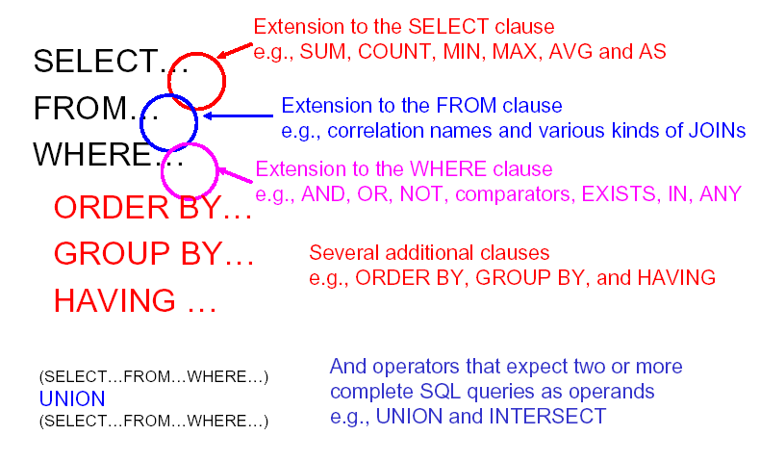
SQL Extension
Notes:
Operates on tables and result is a table, but result might contain duplicate rows.
For UNION in SQLite, do not use brackets!

Slide 8
Extension to SELECT
SELECT DISTINCT FName
FROM Employee;
SELECT SSN AS Sunshine_List
FROM Employee
WHERE Salary >= 100000;
SELECT SSN, (Salary * 1.05) AS Raise_Projection
FROM Employee;
SELECT MIN(Salary), MAX(Salary), AVG(Salary)
FROM Employee;
Notes:
Try it on the sample Company DB.

Slide 9
Distinct
SELECT DISTINCT FName
FROM Employee;
SELECT FName
FROM Employee;
Notes:
DISTINCT eliminates duplicate rows!
DISTINCT filters out duplicate values of your returned fields.
A really simplified way to look at it is:
It builds your overall result set (including duplicates) based on your FROM and WHERE clauses
It sorts that result set based on the fields you want to return
It removes any duplicate values in those fields
It's semantically equivalent to a GROUP BY where all returned fields are in the GROUP BY clause.

Slide 10
Distinct: Exercise
What is the output for the following query?
What is the output for the following query?
SELECT DISTINCT LName, Salary
FROM Emp
SELECT DISTINCT LName
FROM Emp
Emp
EID | FNAME | LNAME | Salary
1 | John | Liu | 80,000
2 | John | King | 90,000
3 | Kate | King | 80,000

Slide 11
AS
The following two queries are equivalent except for the attribute name used in query answer: “Sunshine_List” is used in the second query.
SELECT SSN
FROM Employee
WHERE Salary >= 100000;
SELECT SSN AS Sunshine_List
FROM Employee
WHERE Salary >= 100000;
We can assign new names to the attributes (columns) that appear in a query result with the AS <new attribute name> clause.
Notes:
Rename table, we can also rename attributes using AS clause
If you want the result to have different attribute names, use “AS <new name>” to rename an attribute.

Slide 12
Expression
SELECT SSN, (Salary * 1.05) AS Raise_Projection
FROM Employee;
Notes:
Any expression that makes sense can appear as an element of a SELECT clause.
What makes sense? Domain constraint …

Slide 13
Aggregation
SELECT MIN(Salary), MAX(Salary), AVG(Salary)
FROM Employee;
SELECT MIN(Salary), MAX(Salary), AVG(Salary)
FROM Employee
WHERE BDate < 1960
Notes:
SUM, AVG, COUNT, MIN, and MAX can be applied to a column in a SELECT clause to produce that aggregation on the column.
Also, COUNT(*) counts the number of rows.
More about aggregation and group by clause later.

Slide 14
Example: Aggregation
From Employee table, find the average salary in department #5
SELECT AVG(Salary)
FROM Employee
WHERE DNO = 5;
SELECT AVG(Salary) AS Average-salary
FROM Employee
WHERE DNO = 5;
Notes:
How many rows and columns? 1 and 1.

Slide 15
In-class Exercise #2
From Employee table, find the minimal salary and maximal salary in the Research department
Notes:
SELECT min(Salary), max(Salary)
FROM Employee, Department
WHERE (DNO = DNumber) AND (DName = ‘Research’);

Slide 16
DISTINCT Inside COUNT()
What is the difference between these two queries?
SELECT COUNT(FName)
FROM Emp
SELECT COUNT(DISTINCT FName)
FROM Emp
Emp
EID | FNAME | LNAME | Salary
1 | John | Liu | 80,000
2 | John | King | 90,000
3 | Kate | King | 80,000
Notes:
Use DISTINCT inside an aggregation.
Two employees with the same first name, count once or twice?
Distinct eliminate all duplicates from the set before computing the function
First query: 3
Second query: 2

Slide 17
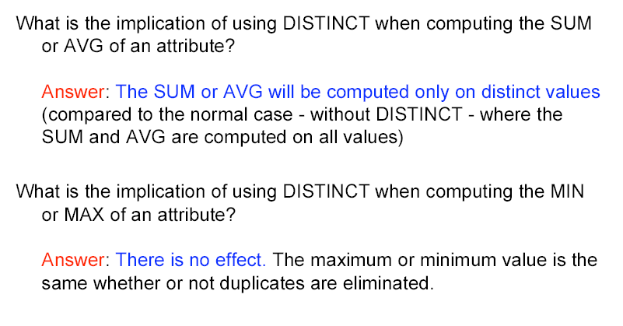
DISTINCT Inside Aggregation

Slide 18
In-class Exercise #3
Find the number of supervisors in the company.
Project the total cost if the company gives a 5% raise to all managers.
Notes:
Q1
SELECT COUNT(DISTINCT superssn)
FROM Employee;
Q2
SELECT SUM(Salary * 1.05)
FROM Department, Employee
WHERE mgrssn = SSN;

Slide 19
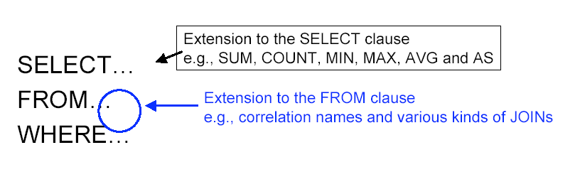
Extension to From
Notes:
1. Specify the source from one or more tables, or source from another query, or source from join operation on several tables
2. Correlation names => Alias, rename tables in From clause
rename these tables or temp tables

Slide 20

Nested SQL
The FROM clause takes a relation, but results from SOL queries are themselves relations, so we can use them in the FROM clause, too!
Customer (Number, Name, Address, CRating,
CAmount, CBalance,SalespersonNum)
SELECT (N.CRating+1) AS ClncrRating
FROM (SELECT *
FROM Customer
WHERE CRating = 0) AS N
WHERE N.CBalance = 0;
Notes:
We have seen examples of source come from more than one tables and how to use alias or correlation names to distinguish their name or attribute names.
Note that because each query produces a table and the FROM clause accepts table as source input, it means that the source could also come from another query.

Slide 21
Nested Query: Example
List the names of employees who have the lowest salary.
SELECT FName, LName, min(Salary)
FROM Employee;
SELECT FName, LName, Salary = min(Salary)
FROM Employee;
SELECT FName, LName
FROM Employee
WHERE Salary > min(Salary);
Notes:
Let’s try an example to show how to construct nested query.
Here are some common mistakes. All are WRONG.
First one WRONG because
If one attribute is aggregated, all the attributes in SELECT must be either aggregated or grouping attribute.
Second one WRONG because
If one attribute is aggregated, all the attributes in SELECT must be either aggregated or grouping attribute.
Moreover, Salary is an attribute and min(Salary) is a table of values. Checking a value equal a table of values does not make sense.
Third one WRONG because
Aggregation is an extension to the SELECT clause, not to the WHERE clause.
Moreover, Salary is an attribute and min(Salary) is a table of values. Checking a value greater than a table of values does not make sense.

Slide 22
Nested Query: Example
List the names of employees who have the lowest salary.
SELECT E.FName, E.LName
FROM Employee E, M
WHERE E.Salary = M.MinS;
Employee
M
MinS
25000
Notes:
So all the answers in the last slide are WRONG.

Slide 23
Nested Query: Example
List the names of employees who have the lowest salary
  .Find the lowest salary (produce M).
SELECT min(Salary) AS MinS
FROM Employee;
Employee
M
MinS
25000
Notes:
So all the answers in the last slide are WRONG.

Slide 24
Nested Query: Example
List the names of employees who have the lowest salary.
SELECT E.FName, E.LName
FROM Employee E,
(SELECT min(Salary) AS MinS
FROM Employee) AS M
WHERE E.Salary = M.MinS;
Employee
M
MinS
25000
Notes:
In the answer, we use alliance for employee table to avoid confusion as the employee table is used twice.

Slide 25

Typical Student Question
Why do we have to combine the two instead of step by step like in RA?
/* Find employees with the lowest salary */
(SELECT min(Salary) AS MinS
FROM Employee) AS M;
SELECT E.FName, E.LName
FROM Employee AS E, M
WHERE E.Salary = MinS;
M ← g_{min(Salary) AS MinS} (Employee)
EM ← M _{Salary = MinS} Employee
Result ← π _{FName, LName} (EM)
Notes:
This has been asked many times over the year.
Two problems:
1. Where can we use AS? In SELECT and in FROM clause, NOT outside of an entire query statement.
2. Each query is independent of each other. Query result is Not stored! After a query is executed, its result is showed to user and that is it. Subsequent queries cannot access them.

Slide 26
Join
There are a number of join that can be expressed in the FROM clause:
  Cross Join
  Join (AKA., inner join, basic join)
  Natural join
  Left outer join
  Right outer join
  Full outer join
Notes:
Data source could also come from join operation over several tables …
SQL provides several versions of (bag) joins.
These expressions can be stand-alone queries or used in place of relations in a FROM clause.
Very similar to the ones in RA!
Personally, I don’t think we should use join explicitly in query, it is not a efficient way to specify a query; we should let DBMS to figure out when and what join should be used.
Note that inner join, join and basic join are all the same!

Slide 27
Cross Join
A "CROSS JOIN" is simply a cross product
The following queries are equivalent:
SELECT *
FROM Employee, Department;
SELECT *
FROM Employee CROSS JOIN Department;
Notes:
Gives you all the attributes from both table as well as all combo of tuples from the two tables.

Slide 28

On Clause for Join
JOIN with ON: cross product followed by a selection
The selection condition is specified using ON
  SELECT LName, FName, DName
  FROM Employee JOIN Department ON DNO = DNumber;
Join condition in the ON clause vs. WHERE clause
These are the same:
  SELECT LName, FName, DName
  FROM Employee,Department
  WHERE DNO = DNumber;

Slide 29
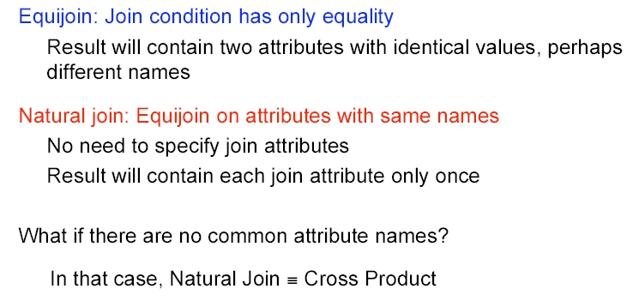
Equijoin and Natural Join
Notes:
Natural Join
With any join based on equality, there will always be pairs of identical columns in the answer (one for each column that is joined). The
NATURAL JOIN joins attributes with same name and eliminates one of them from the result.

Slide 30
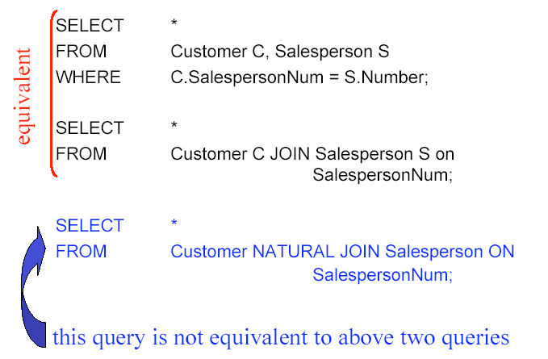
No Join, Join, Natural Join
Notes:
NATURAL JOIN requires equal values for all corresponding columns
from the two tables that have the same name (or you can list the
column name for the join) in the ON clause. Only one copy of common attribute survive!
Some students might be confused with the second FROM: Customer C JOIN Salesperson S on SalespersonNum. Shouldn't we have a selection condition after "on"? i.e. FROM: Customer C JOIN Salesperson S on SalespersonNum=Number.
Reason: If there is a FK from C.SalespersonNum references S.Number (this is the case here), Customer C JOIN Salesperson S on SalespersonNum is the same as Customer C JOIN Salesperson S on SalespersonNum=Number.
I don't like this style but it is allowed. So I show it in the slide. Frankly, I don't like join operation at all. I will just use the FROM (similar to CX) and WHERE (similar to join condition).

Slide 31
Natural Join Equivalence
Customer (Number, Name, Address, CRating,
CAmount, CBalance,SalespersonNum)
Salesperson (Number, Name, Address, Office)
SELECT *
FROM Customer NATURAL JOIN Salesperson;
Notes:
1.Which columns have the same name? Number, Name, and Address! These are the common attributes.
2.Result table has 8 columns
3.Equivalent query without natural join
SELECT C.Number, C.Name, C.Address, C.CRating,
C.CAmount, C. CBalance, C.SalespersonNum, S.Office
FROM Customer C JOIN Salesperson S ON
((C.Number = S.Number) AND
(C.Name = S.Name) AND
(C.Address = S.Address));
SELECT C.Number, C.Name, C.Address, C.CRating,
C.CAmount, C. CBalance, C.SalespersonNum, S.Office
FROM Customer C, Salesperson S
WHERE (C.Number = S.Number) AND
(C.Name = S.Name) AND
(C.Address = S.Address);

Slide 32
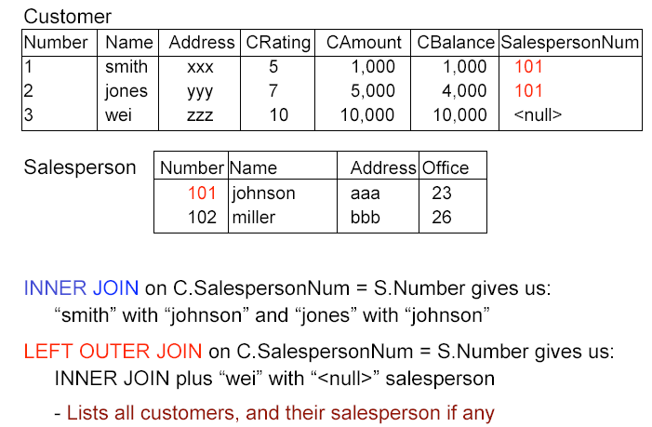
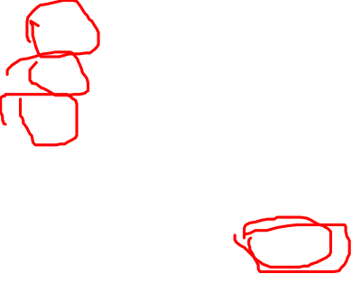
Left Outer Join
Notes:
Use to keep all info about the table on the left.
List all customers, plus their salesperson, if any.

Slide 33
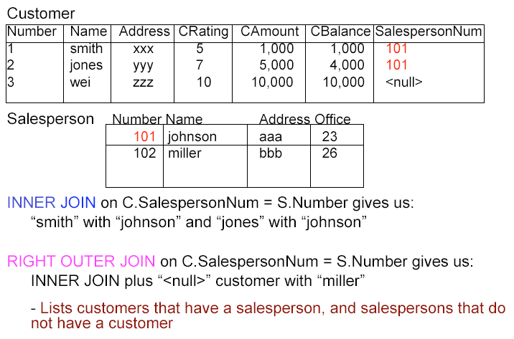

Right Outer Join
Notes:
Use to keep all info about the table on the right.
List all salespersons, and their customer, if any.

Slide 34
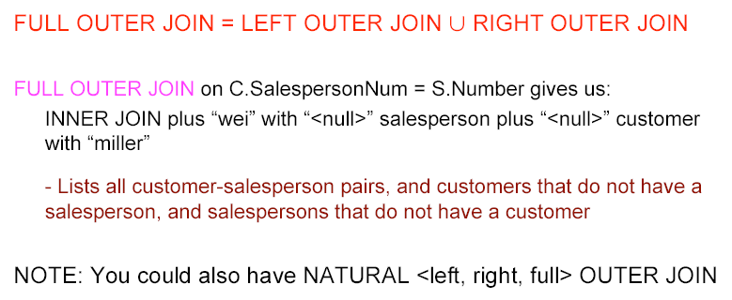
Full Outer Join
Notes:
List all salespersons and all customer, match them up if possible.

Slide 35
Summary of Today’s Lecture
Extension to Select
  DISTINCT, AS, expression, aggregated
Extension to From
  Nested query
  Join

