Slide 1

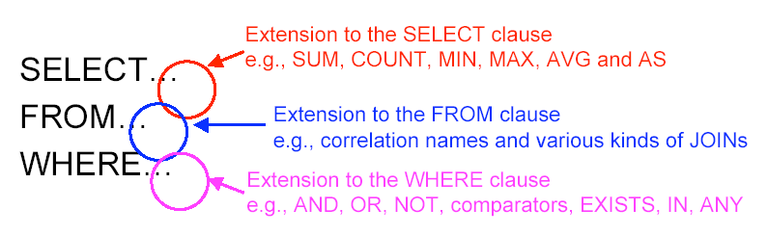
Review of Last Lecture

Slide 2
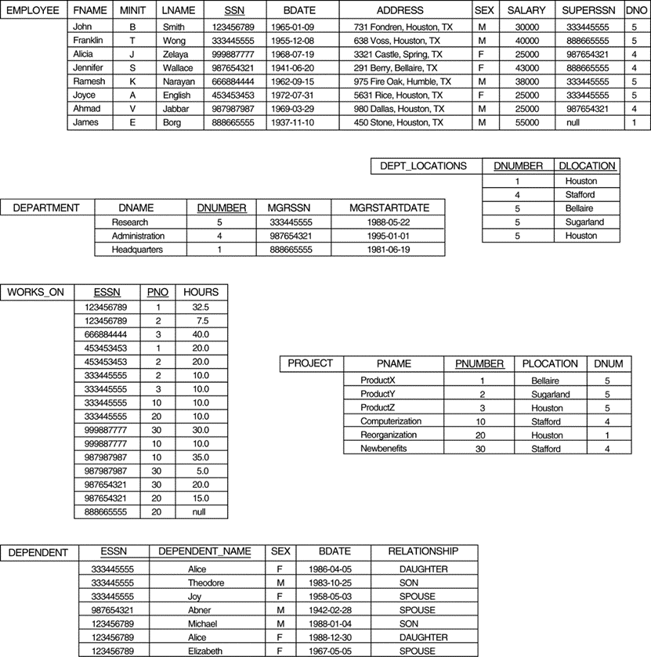
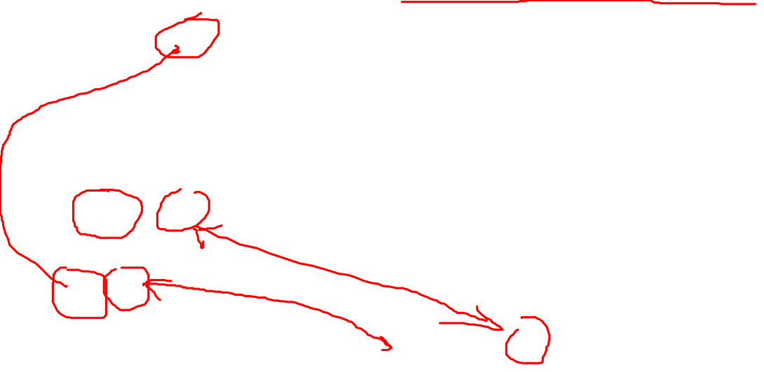
In-Class Exercise #1
Find the names of employees who work for some of the projects controlled by the research department
SELECT FName, LName
FROM Employee, Department,
Works_ON, Project
WHERE DName = "Research" AND
DNumber = DNum AND
PNO = PNumber AND
ESSN = SSN;

Slide 3
Today’s Plan
Extension to Where
  Boolean and comparator
  Subquery
SQL exercises

Slide 4
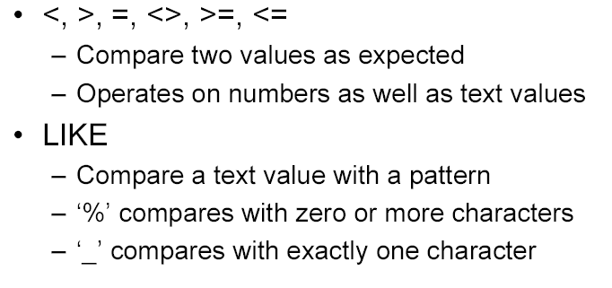
Comparator
Notes:
The WHERE clause ius Boolean, i.e. it always returns true or false for a tuple!

Slide 5
Patterns
WHERE clauses can have conditions in which a string is compared with a pattern, to see if it matches.
General form:
    <Attribute> LIKE <pattern> or
    <Attribute> NOT LIKE <pattern>
Pattern is a quoted string with % = “any string”; _ = “any single character.”
Select *
From Employee
Where LName LIKE "L%“;
Select *
From Employee
Where LName LIKE "L_";
Notes:
The LIKE comparison operator is used to compare partial strings
Two reserved characters are used:
'%' (or '*' in some implementations) replaces an arbitrary number of characters, and
'_' replaces a single arbitrary character

Slide 6
Pattern: Example
From Drinkers(name, addr, phone) find the drinkers with exchange 555:
  SELECT name
  FROM Drinkers
  WHERE phone LIKE "%555-_ _ _ _";
Match?
(555)123 5567
555-34344
(1)555-1134
5555-66BB
Notes:
Only 3 and 4 will be included in the result.

Slide 7
Review: Nested Query in FROM Clause
SELECT E.FName, E.LName
FROM Employee E,
(SELECT MIN(Salary) AS MinS
FROM Employee) AS M
WHERE E.Salary = M.MinS
Find employees with the lowest salary
Notes:
We can use a query as input to the FROM clause.
We can also include a query in the WHERE clause.

Slide 8

Subquery in WHERE Clause
SELECT E.FName, E.LName
FROM Employee AS E
WHERE E.Salary IN
(SELECT MIN(Salary)
FROM Employee)
Find employees with the lowest salary
You can think of a loop, where each employee tuple is checked against the qualification by computing the subquery
Notes:
We can use a query as input to the FROM clause.
We can also include query in WHERE clause.
A complete SELECT query, called a subquery (some also called this a nested query), can be specified within the WHERE-clause of another query, called the outer query
Many of the previous queries can be specified in an alternative form using a subquery
Because a query returns a table, when comparing a value (a tuple) with a table (set of tuples), need new operator called: IN or NOT IN
Think of the subquery as a table:
Be careful those, if it is correlated, need to compute the table for each tuple in the master query (outer query)
If it is not, only need to compute the subquery once.
The subquery is almost the same as a basic query
Start with the product of all the relations in the FROM clause.
Apply the selection condition from the WHERE clause.
Project onto the list of attributes and expressions in the SELECT clause.

Slide 9

IN and NOT IN
Use to compare a single value with a table of values
  This table must have only one attribute and the domain must be the same as well
  Typically associated with a subquery in the WHERE clause
SELECT E.FName, E.LName
FROM Employee AS E
WHERE E.Salary IN
(SELECT MIN(Salary)
FROM Employee)

Slide 10
Subquery: Exercise
Retrieve the name and address of all employees who work for the 'Research' department.
SELECT E.FName, E.LName, E.Address
FROM Employee AS E
WHERE E.DNO IN
(SELECT DNumber
FROM Department
WHERE DName = "Research");
Notes:
The subquery query selects the number of the 'Research' department and stores it in a table.
The outer query select an EMPLOYEE tuple if its DNO value is in the result of the subquery
The comparison operator IN compares a value v with a set (or multi-set) of values V, and evaluates to TRUE if v is one of the elements in V
In general, we can have several levels of nested queries
A reference to an unqualified attribute refers to the relation declared in the innermost nested query
In this example, the subquery is not correlated with the outer query

Slide 11
EXPLICIT SETS
It is also possible to use an explicit (enumerated) set of values in the WHERE-clause rather than a nested query
Retrieve the social security numbers of all employees who work on project number 1, 2, or 3.
  SELECT DISTINCT ESSN
  FROM WORKS_ON
  WHERE PNO IN (1, 2, 3)

Slide 12
Correlated Subquery: Example
Retrieve the name of each employee who has a dependent with the same first name as the employee.
SELECT E.FNAME, E.LNAME
FROM EMPLOYEE AS E
WHERE E.SSN IN
(SELECT ESSN
FROM DEPENDENT
WHERE ESSN=E.SSN AND
E.FNAME=DEPENDENT_NAME)
Correlated: because the subquery references two attributes from a table in the outer query
Notes:
If a condition in the WHERE-clause of a subquery query references an attribute of a relation declared in the outer query , the two queries are said to be correlated
The result of a correlated subquery is different for each tuple (or combination of tuples) of the relation(s) in the outer query
In correlated subquery, you can think of the subquery is a method in Python and might or might not take a parameter, the attribute from the outer are candidates for parameters. If no parameter, non-correlated, regardless who calls it, same result;
If there is a parameter, correlated, depends on what is the value of the parameter, the result differs. Different tuple pass different value to the parameter

Slide 13

Note on Correlated Subquery
It is very EXPENSIVE!
For every tuple in the outer query, the correlated subquery must be evaluated once!

Slide 14

Non-Correlated Subquery: Example
SELECT E.FName, E.LName
FROM Employee AS E
WHERE E.Salary IN
(SELECT MIN(Salary)
FROM Employee)
Find employees with the lowest salary
The subquery only uses attributes from its own table (table mentioned in the subquery)

Slide 15
Exists Clause
SELECT E.FName, E.LName
FROM Employee AS E
WHERE EXISTS
(SELECT ESSN
FROM Works_on
WHERE E.SSN = ESSN);
Find employees who work on any project
Notes:
EXISTS is used to check whether the result of a correlated subquery query is
empty (contains no tuples) or
non-empty

Slide 16
Exists: Example
Retrieve the name of each employee who has a dependent with the same first name as the employee.
SELECT FNAME, LNAME
FROM EMPLOYEE AS E
WHERE EXISTS (SELECT *
FROM DEPENDENT
WHERE E.SSN = ESSN AND
FNAME=DEPENDENT_NAME)
Correlated?

Slide 17
Not Exists: Example
Retrieve the names of employees who have no dependents.
SELECT FNAME, LNAME
FROM EMPLOYEE
WHERE NOT EXISTS (SELECT *
FROM DEPENDENT
WHERE SSN = ESSN)
Notes:
The correlated nested query retrieves all DEPENDENT tuples related to an EMPLOYEE tuple. If none exists, the EMPLOYEE tuple is selected
EXISTS is necessary for the expressive power of SQL

Slide 18
Exists and Unique

Slide 19
Unique/Not Unique: Exercise
Find employees who have more than one dependent.
SELECT E.FName, E.LName
FROM Employee AS E
WHERE NOT UNIQUE
(SELECT ESSN
FROM Dependant
WHERE E.SSN = ESSN);
Warning: using UNIQUE and NOT UNIQUE in the WHERE clause is NOT supported in SQLite. The example above will give you a syntax error in SQLite
Notes:
Because a null value is an unknown value, two null values aren’t considered equal to each other.
When the UNIQUE keyword is applied to a result table that contains only two null rows, the UNIQUE predicate evaluates to True.

Slide 20
In-Class Exercise #2
Find the names of employees who work for some of the projects controlled by the research department (use subquery)
Notes:
Use subquery.
SELECT FName, LName
FROM Employee, Works_ON
WHERE (SSN = ESSN) AND
(PNO IN
(SELECT PNumber
FROM Department, Project
WHERE DName = ‘Research’ AND DNumber = DNum));
***************
Food for thoughts (FYI):
SQLite output:
this query: Result: 8 rows returned in 3ms
the original one: Result: 8 rows returned in 5ms
This one using subquery is much more efficient!

Slide 21
ANY and ALL
Use to compare a single value with a table of values
  This table must have only one attribute and the domain must be the same as well
  Typically associated with a subquery, in the WHERE clause
Warning: using ANY or ALL in the WHERE clause is NOT supported in SQLite. The examples in the next couple slides will give you a syntax error in SQLite
Notes:
Another operator to compare a value with a table is … …

Slide 22
All or Any: Example
SELECT E.FName, E.LName
FROM Employee AS E
WHERE E.Salary <= ALL (SELECT Salary
FROM Employee)
Find employees with the lowest salary
This predicate must be true for all salaries returned by the subquery
Notes:
Use to compare a value with a set of values!
This query is not correlated.
x = ANY( <relation> ) is a boolean condition true if x equals at least one tuple in the relation.
Similarly, = can be replaced by any of the comparison operators.
Example: x >= ANY( <relation> ) means x is not the smallest tuple in the relation.
Note tuples must have one component only.

Slide 23
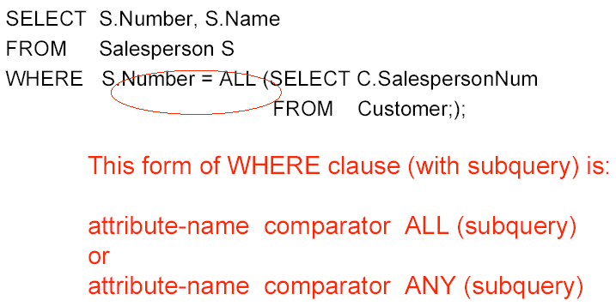
All or Any: General Form
SELECT E.FName, E.LName
FROM Employee AS E
WHERE E.Salary >= ALL (SELECT Salary
FROM Employee);
Notes:
Similarly, x <> ALL( <relation> ) is true if and only if for every tuple t in the relation, x is not equal to t. That is, x is not a member of the relation.
The <> can be replaced by any comparison operator.
Example: x >= ALL( <relation> ) means there is no tuple larger than x in the relation.

Slide 24
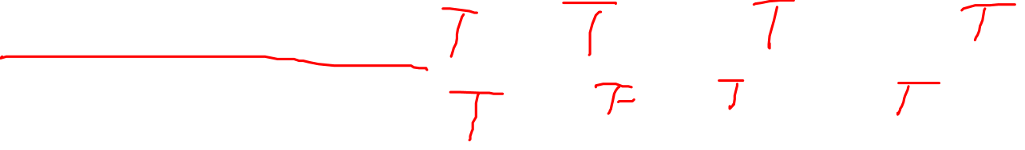
All or Any: Example and Exercises
A = 1, Subquery =
B
1
2
3
A <= All <Subquery>
A != Any <Subquery>
A != All <Subquery>
A >= Any <Subquery>
A < Any <Subquery>
(A + 1) > All<Subquery>
(A<=1) AND (A<=2) AND (A<=3)
(A!=1) OR (A!=2) OR (A!=3)
Notes:
3: F
4: T
5: T
6: F

Slide 25
Summary of Today’s Lecture
Extension to Where
  Boolean and comparator
  Subquery
SQL exercises

