Slide 1

Review of Last Lecture
Extension to Where
  Boolean and comparator
  Pattern and LIKE, NOT LIKE
    %, _
  Subquery
    How compare an attribute with a table of values generated by subquery?
      IN and NOT IN
      EXISTS, UNIQUE, NOT EXISTS, NOT UNIQUE
      Comparator ANY, ALL

Slide 2
Today’s Plan
Order By
  ASC
  DESC
Group By, Having
  Special requirements
Union, intersect, minus
  Special requirements
Effect of NULL

Slide 3
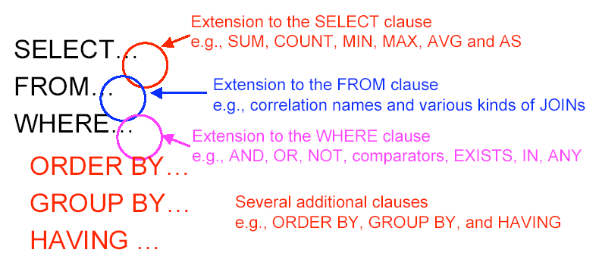
Today’s Plan

Slide 4
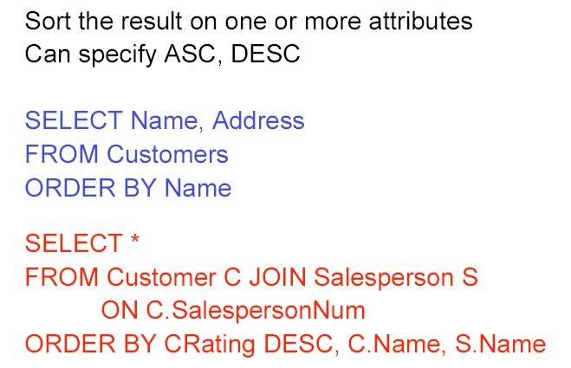
Order By
SELECT FName, LName
FROM Employee
ORDER BY LName /* The default is ASC */ /* Don’t be lazy! */
/* Specify it to avoid confusion */
SELECT FName, LName
FROM Employee
ORDER BY Salary DESC
Notes:
The ORDER BY clause is used to sort the tuples in a query result based on the values of some attribute(s)
The default order is in ascending order of values
We can specify the keyword DESC if we want a descending order; the keyword ASC can be used to explicitly specify ascending order, even though it is the default

Slide 5
Group By
SELECT DNO, COUNT(*) /* Count # of E in each D */
FROM Employee
GROUP BY DNO
SELECT Sex, COUNT(*) /* Find # of E in each gender */
FROM Employee
GROUP BY Sex
Any form of SQL query (e.g., with or without subqueries) can have the answer "grouped". When a query answer is grouped, there is one output row - for each group.
Notes:
We may follow a SELECT-FROM-WHERE expression by GROUP BY and a list of attributes.
The relation that results from the SELECT-FROM-WHERE is grouped according to the values of all those attributes, and any aggregation is applied only within each group.
In many cases, we want to apply the aggregate functions to subgroups of tuples in a relation
Each subgroup of tuples consists of the set of tuples that have the same value for the grouping attribute's)
The function is applied to each subgroup independently
SQL has a GROUP BY-clause for specifying the grouping attributes, which must also appear in the SELECT-clause
Having … … only groups satisfy having will be included; where => only tuples satisfy where will be group.

Slide 6
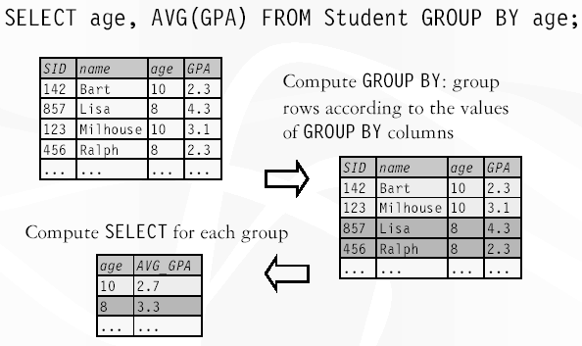
Example of Computing Group By

Slide 7
Restriction on SELECT With Aggregation/Group
If a query uses aggregation/group by, then every attribute referenced in SELECT MUST be either
  Grouping attribute or
  Aggregated
This restriction ensures that any SELECT expression produces only one value for each group

Slide 8
Illegal Query Example
You might think you could find the employees with the lowest salary:
SELECT SSN, MIN(Salary)
FROM Employee
But this query is illegal in SQL.
  SQLite allows it and selects the first row matches (the first employee in the table with the lowest salary). But what if there are more than employees with the same lowest salary? Only the first one will be shown!

Slide 9
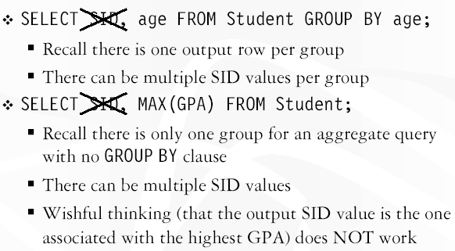
More Examples of Invalid Queries

Slide 10
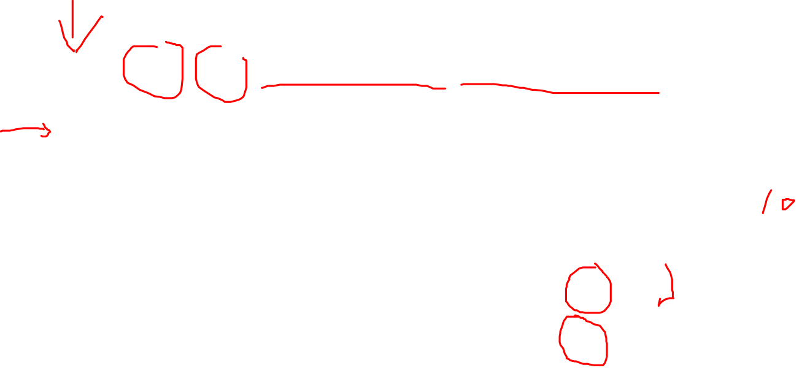
Why Wrong
SELECT SID, age FROM Student GROUP BY age
Notes:
Remember: one group one row
Which SID? There are two!
Age is fine. Only one value which does not matter
Same here, only one avg per group

Slide 11
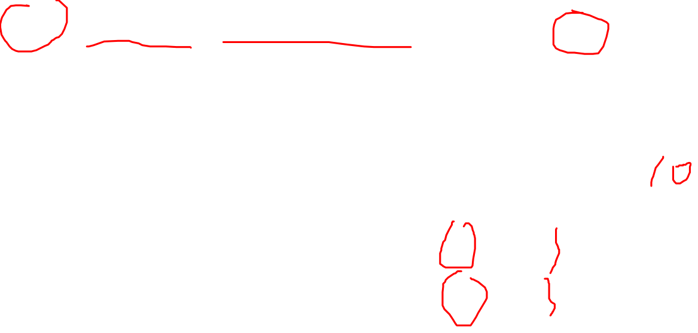
Why Right
Notes:
Age is fine. Only one value which does not matter
Same here, only one avg per group

Slide 12
Having
SELECT Sex /* Find gender group above */
FROM Employee /* minimal salary $25K */
GROUP BY Sex
HAVING avg(Salary) > 25000
Notes:
Sometimes we want to retrieve the values of these functions for only those groups that satisfy certain conditions
The HAVING-clause is used for specifying a selection condition on groups (rather than on individual tuples)
.
Find gender group with above avg salary
HAVING <condition> may follow a GROUP BY clause.
If so, the condition applies to each group, and groups not satisfying the condition are eliminated.
Use to filter groups based group properties (aggregation values based on group by )

Slide 13
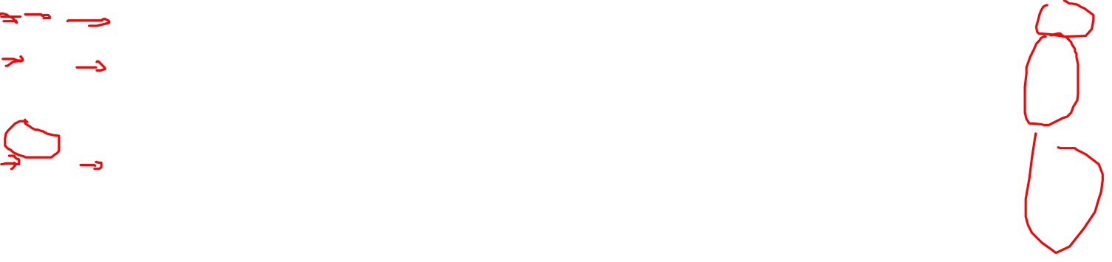
Having: Problem
SELECT DNO
FROM Employee
GROUP BY DNO
HAVING FName = “John”
HAVING DNO = 4
HAVING COUNT(*) > 3
Notes:
Run the query on SQLite and see the results for yourself.
The only attributes that can appear in a “grouped” query answer are aggregate operators (that are applied to the group) or the grouping
attribute(s).
Why is that? Having condition is true only if it is true for the whole group (for every member of the group) in order to be true, otherwise!
You can use DNO = 5; or COUNT(*)>2;
but if you use Fname = “John”, it will cause confusion:
First member named John?
Some member named John?
All members named John?

Slide 14
Requirements on HAVING Conditions
HAVING may refer to attributes of relations in the FROM clause, as long as the attribute makes sense within a group; i.e., it is either:
  A grouping attribute, or
  Aggregated
Recall: if GROUP BY is used or aggregation is used, all attributes in SELECT must be either grouping attributes or aggregated attributes.

Slide 15
HAVING: Exercise
From Sells(bar, beer, price) and Beers(name, manf), find the average price of those beers that are either served in at least three bars or are manufactured by Pete’s.

Slide 16
HAVING: Solution
Beer groups with at least
3 non-NULL bars and also
beer groups where the
manufacturer is Pete’s.
SELECT beer, AVG(price)
FROM Sells
GROUP BY beer
HAVING COUNT(bar) >= 3 OR
beer IN (SELECT name
FROM Beers
WHERE manf = ’Pete’’s’);
Beers manu-
factured by
Pete’s.

Slide 17
Group By and Having: Exercise
For each department, retrieve the department number, the number of employees who work in the department and their average salary.
SELECT DNO, COUNT(*), AVG(SALARY)
FROM EMPLOYEE
GROUP BY DNO
For each project on which more than one employee works, retrieve the project number, the project name, and the number of employees work on the project
SELECT PNUMBER, PNAME, COUNT(*) FROM PROJECT, WORK_ON
WHERE PNUMBER = PNO
GROUP BY PNUMBER, PNAME
HAVING COUNT(*) > 1
Notes:
For the second question, we group by PNUMBER and PNAME, instead of just PNUMBER. This is to follow the rule: if group/aggregation is used, attributes in SELECT must be either grouping attribute or aggregated attribute. If we use just PNUMBER in group by, then PNAME is neither a grouping attribute, nor an aggregated attribute, violating the rule. It still works fine. But we just want to be consistent and produce query that follows the rule.

Slide 18
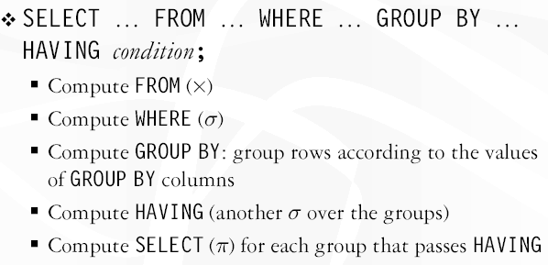
Evaluation Order

Slide 19
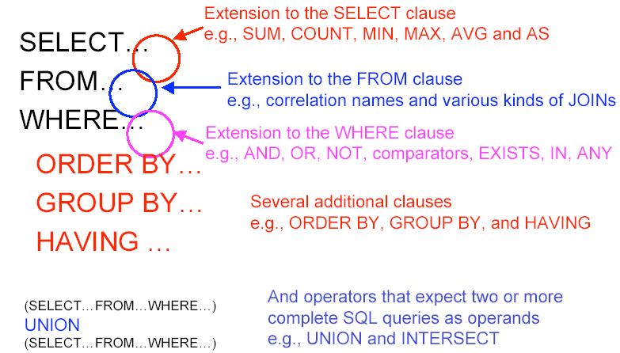
Combining Queries
Notes:
SQL has directly incorporated some set operations
There is a union operation (UNION), and in some versions of SQL there are set difference (MINUS) and intersection (INTERSECT) operations.
The resulting relations of these set operations are sets of tuples; duplicate tuples are eliminated from the result
The set operations apply only to union compatible relations ; the two relations must have the same attributes and the attributes must appear in the same order

Slide 20
Union
Query1
UNION [ALL]
Query2
SELECT SUPERSSN
FROM Employee
UNION
SELECT MGRSSN
FROM Department;
UNION eliminates duplicate rows, while UNION ALL does not
Notes:
Combine the tuples from two queries, not base tables.
So E UNION E does not work!!
For union in SQLite, do not use brackets!

Slide 21
Exercise: how many rows in the output?
SELECT FName
FROM Employee;
SELECT DISTINCT FName
FROM Employee;
SELECT FName
FROM Employee
UNION
SELECT FName
FROM Employee;

Slide 22
Union: Exercise
Make a list of all project numbers for projects that involve an employee whose last name is 'Smith' as a worker or as a manager of the department that controls the project.
SELECT PNUMBER
FROM PROJECT, DEPARTMENT, EMPLOYEE
WHERE DNUM=DNUMBER AND MGRSSN=SSN AND LNAME="Smith"
UNION
SELECT PNO
FROM WORKS_ON, EMPLOYEE
WHERE ESSN=SSN AND LNAME="Smith";

Slide 23
Intersect
Query1
INTERSECT
Query2
SELECT SUPERSSN
FROM Employee
INTERSECT
SELECT MGRSSN
FROM Department;
INTERSECT eliminates duplicate rows.
Notes:
Only tuples that appear in both table will be included in the result. Person as both supervisor and manager.

Slide 24
Minus (Difference, Except)
Query1
EXCEPT
Query2
SELECT SUPERSSN
FROM Employee
EXCEPT
SELECT MGRSSN
FROM Department;
In SQLite, the keyword is EXCEPT

Slide 25
Union Compatible
Just like in RA, queries combined by UNION, INTERSECT and MINUS must be union compatible (type compatible).
  Same number of attributes and same domain for corresponding attributes.

Slide 26
In-Class Exercise #1
For each department, retrieve the department number, name of the department manager, the number of employees who work in the department and their average salary.
Hint: imagine that there is an E table and a M table.
Notes:
This question is deceivingly similar to the first question in Slide 15.
/* There are many different ways to do this. But the following is the most straight-forward */
SELECT E.DNO, M.FName, M.LName, COUNT(E.SSN), avg(E.Salary)
FROM Department, Employee E, Employee M
WHERE (E.DNO = DNumber) AND (M.SSN = MGRSSN)
GROUP BY E.DNO, M.FName, M.LName; // This works even if just E.DNO
/* Again, we use E.DNO, M.FName and M.LName to comply with rule where only grouping or aggregated attributes should be used in SELECT if GROUP BY is used. */

Slide 27
What is the output?
/* The employee table has 40 employees. */
SELECT Count(*)
FROM Employee
SELECT Count(*)
FROM Employee
WHERE NULL = NULL
SELECT Count(*)
FROM Employee
WHERE NULL != NULL
Notes:
How many rows in the output table for each query
1. 40
2 and 3 both are 0!!!. The same!!!!
NULL is neither equal nor not equal to NULL! Just like infinite, one infinite does not equal or NOT-equal to another infinite.
Empty does not equal or NOT-equal to another empty.

Slide 28
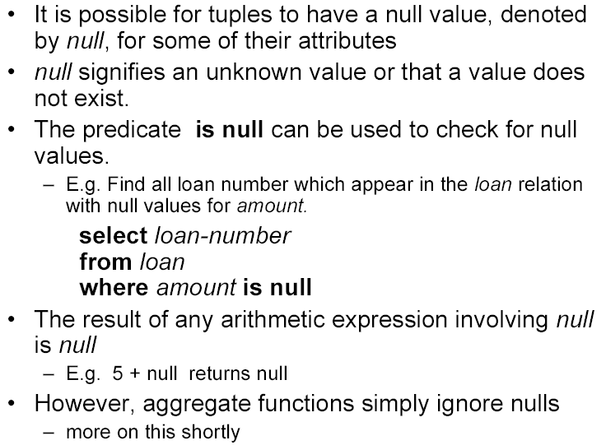

NULL Value
Notes:
Regardless what is the data type of an attribute, its value could be NULL. But null is bad news and we do our best to minimize it. Why?
Tuples in SQL relations can have NULL as a value for one or more components.
Meaning depends on context. Two common cases:
Missing value : e.g., we know Joe’s Bar has some address, but we don’t know what it is.
Inapplicable : e.g., the value of attribute spouse for an unmarried person.
SQL allows queries that check if a value is NULL (missing or undefined or not applicable)
SQL uses IS or IS NOT to compare NULLs because it considers each NULL value distinct from other NULL values, so equality comparison is not appropriate .

Slide 29
NULL: Example
Retrieve the names of all employees who do not have supervisors.
SELECT FNAME, LNAME
FROM EMPLOYEE
WHERE SUPERSSN IS NULL
Notes:
SQL allows queries that check if a value is NULL (missing or undefined or not applicable)
SQL uses IS or IS NOT to compare NULLs because it considers each NULL value distinct from other NULL values, so equality comparison is not appropriate .
But how Null is evaluated in Boolean? <>, >= etc?

Slide 30
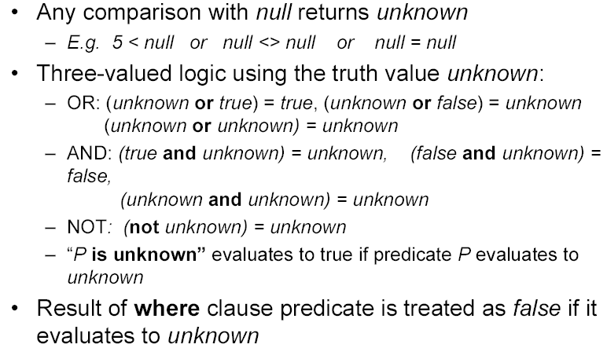
Three Valued Logic
Notes:
The logic of conditions in SQL is really 3-valued logic: TRUE, FALSE, UNKNOWN.
When any value is compared with NULL, the truth value is UNKNOWN.
But a query only produces a tuple in the answer if its truth value for the WHERE clause is TRUE (not FALSE or UNKNOWN).
If the final result for a where clause is unknown, it is treated as false! But unknown is not false!
NULL is not False! (NOT (NOT (Null) )) is evaluated to unknown; otherwise, if assume Null = false, this becomes True!
******************
Food for thoughts (FYI)
To understand how AND, OR, and NOT work in 3-valued logic, think of TRUE = 1, FALSE = 0, and UNKNOWN = ½.
AND = MIN; OR = MAX, NOT(x) = 1-x.
Example:
TRUE AND (FALSE OR NOT(UNKNOWN)) = MIN(1, MAX(0, (1 - ½ ))) =
MIN(1, MAX(0, ½ ) = MIN(1, ½ ) = ½.

Slide 31
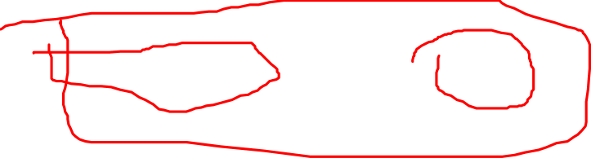
WHERE and UNKNOWN
If a Boolean expression is evaluated to UNKNOWN, WHERE treats it as FALSE.
But UNKNOWN is not the same as FALSE.
UNKOWN
WHERE
(NULL = NULL) AND (10 > 4)
Treated as FALSE

Slide 32
NULL and Aggregation
NULL never contributes to a sum, average, or count, and can never be the minimum or maximum of a column.
  NULL is simply ignored.
But if there are no non-NULL values in a column, then the result of the aggregation is NULL.
The only exception is count(*): count the number of rows regardless of NULL or not.

Slide 33
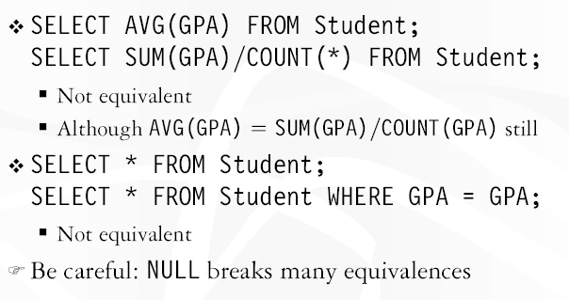
Unfortunate Consequence

Slide 34

Surprising Example
From the following Sells relation:
bar beer price
Joe’s Bar Bud NULL
SELECT bar
FROM Sells
WHERE price < 2.00 OR price >= 2.00;
SELECT bar
FROM Sells
UNKNOWN UNKNOWN
UNKNOWN
Notes:
You may assume the selection condition specified above is always TRUE. You will be wrong.
These two queries are not the same!!!!

Slide 35
Example: Effect of NULL’s
The number of bars
that sell Bud.
SELECT count(*)
FROM Sells
WHERE beer = ’Bud’;
SELECT count(price)
FROM Sells
WHERE beer = ’Bud’;
The number of bars
that sell Bud at a
known price.

Slide 36
SQL Example
Find name of employee who is a supervisor and a department manager.
SELECT DISTINCT E.FName, E.LName
FROM Employee E, Employee S, Department D
WHERE (E.SSN = S.Superssn)
AND (E.SSN = D.Mgrssn);
Notes:
Let’s try an example together. The most common solution using INTERSECT can be found.
Here I am going to introduce a different technique.
The main idea: create a copy of the employee table called E, you can visualize E contains all the employees.
Create another copy called S, you can visualize it contains all supervisors.
Then the Department table D.
So if an employee appears in supervisor table and in the department table as manger, then this employee is a super and manger.
This technique is quite useful in A2: create different copies of the same table visualize each stores different set of information.
The most common answer:
SELECT E.FName, E.LName
FROM Employee E
WHERE E.SSN IN (
SELECT SUPERSSN
FROM Employee
INTERSECT
SELECT MGRSSN
FROM Department);

Slide 37
In-class Exercise #2
Project the total cost if the company gives a 5% raise to all supervisors. (be careful with duplicates!)
SELECT SUM(S.Salary * 1.05)
FROM Employee S
WHERE S.SSN IN
(SELECT DISTINCT SUPERSSN
FROM Employee);
Notes:
There is a different approach to do this, using nested query.
The following query did not exclude duplicates supervisors (same super for different employees), hence WRONG!
SELECT SUM(S.Salary * 1.05)
FROM Employee AS E, Employee AS S
WHERE E.superssn = S.ssn
2097900.0
Duplicates are removed here (using nested query)
SELECT SUM(Salary * 1.05)
FROM (SELECT DISTINCT S.SSN, S.Salary
FROM Employee AS E, Employee AS S
WHERE E.superssn = S.SSN);
1057350.0

Slide 38
In-class Exercise #3
Project the total cost if the company gives a 5% raise to all managers and all supervisors. (be careful with duplicates!)
Notes:
SELECT SUM(E.Salary * 1.05)
FROM Employee E
WHERE E.SSN IN
(SELECT DISTINCT superssn
FROM Employee
UNION
SELECT mgrssn
FROM Department);

Slide 39
Summary of SQL Queries I
A query in SQL can consist of up to six clauses, but only the first two, SELECT and FROM, are mandatory. The clauses are specified in the following order:
SELECT <attribute list>
FROM <table list>
[WHERE <condition>]
[GROUP BY <grouping attribute(s)>]
[HAVING <group condition>]
[ORDER BY <attribute list>]

Slide 40
Summary of SQL Queries II
The SELECT-clause lists the attributes or functions to be retrieved
The FROM-clause specifies all relations (or aliases) needed in the query but not those needed in nested queries
The WHERE-clause specifies the conditions for selection and join of tuples from the relations specified in the FROM-clause
GROUP BY specifies grouping attributes
HAVING specifies a condition for selection of groups
ORDER BY specifies an order for displaying the result of a query
A query is evaluated by first looking up the tables in the FROM-clause, then applying the WHERE-clause, then GROUP BY and HAVING, and finally the SELECT-clause

Slide 41
Summary of Today’s Lecture
Order By
  ASC
  DESC
Group By, Having
  Special requirements
Union, intersect, minus
  Special requirements
Effect of NULL

