Slide 1

Review of Last Lecture
Lecture 6-2: Midterm
Order by
Group by, Having
  Special requirements
Union, intersect, minus
  Special requirements
How to process null
  Is null, is not null
  3 value logic
  Where clause treats unknown as false, but unknown is not equal to false.
  Aggregation with null
    COUNT(*)

Slide 2
In-class Exercise
Find the pair of employees who have worked together on any project (Bonus: a. get their names; b. remove duplicate like (e1, e2) and (e2, e1))
Notes:
This question is the same as the one in A1.
/* This works but lots of duplicates */
SELECT W1.ESSN, W2.ESSN
FROM Works_ON W1, Works_ON W2
WHERE (W1.ESSN != W2.ESSN) AND (W1.PNO = W2. PNO);
a) and b)
/* (e1, e2) and (e2, e1) are duplicates! */
/* No duplicates */
SELECT DISTINCT W1.FName, W1.LName, W2.FName, W2.LName
FROM (SELECT *
FROM Works_ON, Employee
WHERE ESSN = SSN) AS W1,
(SELECT *
FROM Works_ON, Employee
WHERE ESSN = SSN) AS W2
WHERE (W1.ESSN > W2.ESSN) AND (W1.PNO = W2.PNO);

Slide 3
Today’s Plan
Data definition
  Create, remove and change schema
Data modification
  Create, remove and change an instance
Notes:
Select takes attributes, from the original tables or rename, or caculated from expression or aggregated (careful)
From takes in tables, from table in DB or table generated from other query;
Where takes a Boolean expression: … …
You can think of the subquery is a method in java and might or might not take a parameter, the attribute from the outer are candiates for parameters. If no parameter, non-correlated, regardless who call it, same result;
If there is a parameter, correlated, depends on what is the value of the parameter, the result differs. Different tuple pass different value to the parameter
Project Part III: concentrate on search capability and update, insert, delete, fully utilize index, view, assertion or triggers if possible.

Slide 4
SQL Definition and Modification
Chapter 05
Michael Liu
University of Waterloo

Slide 5
Reading Assignment for This Chapter
Textbook Chapter 08 and 09

Slide 6
Part II: Data Definition

Slide 7
Data Definition
A database schema comprises declarations for the relations (“tables”) of the database.
Many other kinds of elements may also appear in the database schema, including views, indexes, and triggers, which we’ll introduce later.
Three basic operations
  Create, Drop and Alter
Notes:
SQL is DDL and DML. Before we can access/manipulate the table/data, let create a DB to store them. SQL allows us to use … … to create or modify tables, as well as views index etc.
Used to CREATE, DROP, and ALTER the descriptions of the tables (relations) of a database
Data Definition, Constraints, and Schema Changes
Data Definition Language (DDL)
Allows the specification of not only a set of relations but also
information about each relation, including:
• The schema for each relation.
• The domain of values associated with each
attribute.
• Integrity constraints
• The set of indices to be maintained for each
relations.
• Security and authorization information for each
relation.
• The physical storage structure of each relation
on disk.

Slide 8
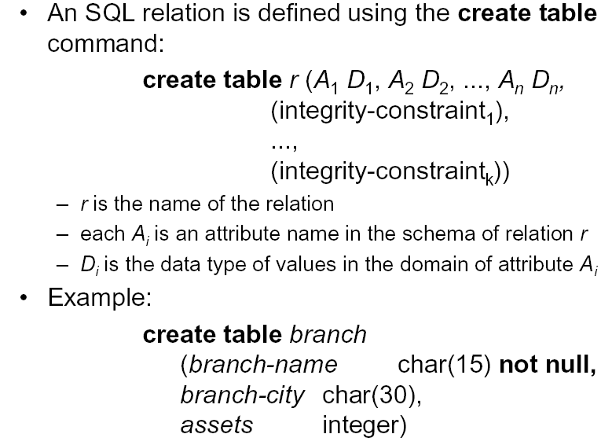
Create Table
Notes:
Ai is the attribute name followed by its domain and optional constraint.
In SQL2, can use the CREATE TABLE command for specifying the primary key attributes, secondary keys, and referential integrity constraints (foreign keys).
Key attributes can be specified via the PRIMARY KEY and UNIQUE phrases
The principal element is a pair consisting of an attribute and a type.
Example …
Domain could be …
Constraint …

Slide 9
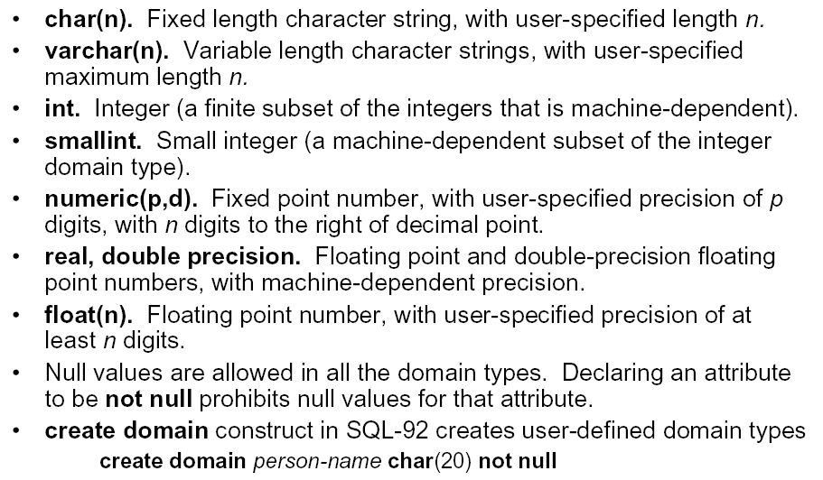
Domain Type (FYI)
d
Notes:
Data type for the attributes …
32 bit, 16 bit, float 32 bit, real 64
numeric(p,s)Where p is a precision value; s is a scale value. For example, numeric(6,2) is a number that has 4 digits before the decimal and 2 digits after the decimal.
The most common types are:
INT or INTEGER (synonyms).
REAL or FLOAT (synonyms).
CHAR(n ) = fixed-length string of n characters.
VARCHAR(n ) = variable-length string of up to n characters.
The CHAR and VARCHAR types are similar, but differ in the way they are stored and retrieved. They also differ in maximum length and in whether trailing spaces are retained.
The CHAR and VARCHAR types are declared with a length that indicates the maximum number of characters you want to store. For example, CHAR(30) can hold up to 30 characters.
The length of a CHAR column is fixed to the length that you declare when you create the table. The length can be any value from 0 to 255. When CHAR values are stored, they are right-padded with spaces to the specified length. When CHAR values are retrieved, trailing spaces are removed unless thePAD_CHAR_TO_FULL_LENGTH SQL mode is enabled.
Values in VARCHAR columns are variable-length strings. The length can be specified as a value from 0 to 65,535. The effective maximum length of a VARCHARis subject to the maximum row size (65,535 bytes, which is shared among all columns) and the character set used. See Section C.10.4, “Limits on Table Column Count and Row Size”.
In contrast to CHAR, VARCHAR values are stored as a 1-byte or 2-byte length prefix plus data. The length prefix indicates the number of bytes in the value. A column uses one length byte if values require no more than 255 bytes, two length bytes if values may require more than 255 bytes.

Slide 10
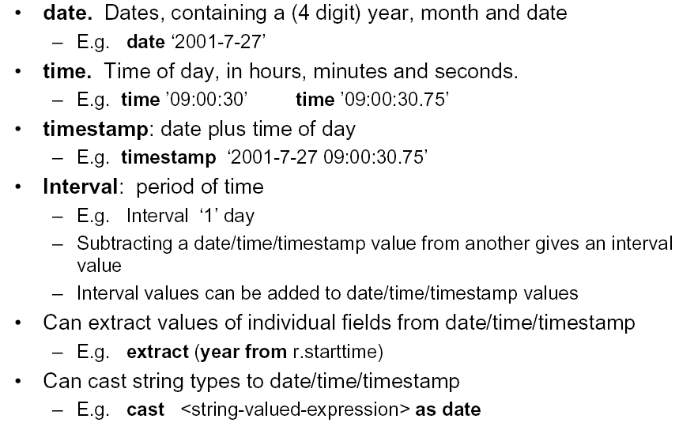
Date/Time Type (FYI)
Notes:
strftime('%Y', OrderDate) as Year
Introduced in SQL99, Has DATE, TIME, and TIMESTAMP data types
DATE:
Made up of year-month-day in the format yyyy-mm-dd
TIME:
Made up of hour:minute:second in the format hh:mm:ss
TIME(i):
Made up of hour:minute:second plus i additional digits specifying fractions of a second
format is hh:mm:ss:ii...i
TIMESTAMP:
Has both DATE and TIME components
INTERVAL:
Specifies a relative value rather than an absolute value
Can be DAY/TIME intervals or YEAR/MONTH intervals
Can be positive or negative when added to or subtracted from an absolute value, the result is an absolute value

Slide 11
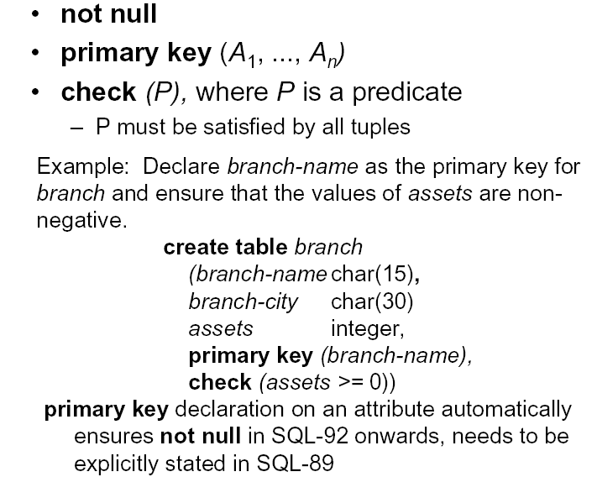
Integrity Constraint in SQL I
Notes:
When creating the table, we can specify additonal IC at the same time like … … P is any valid Boolean expression
A key declaration can also be another element in the list of elements of a CREATE TABLE statement.
This form is essential if the key consists of more than one attribute.
May be used even for one-attribute keys.
As far as I know (from last year), MySQL5.0 does not support check!

Slide 12
PRIMARY KEY vs. UNIQUE
There can be only one PRIMARY KEY for a relation, but several UNIQUE attributes.
No attribute of a PRIMARY KEY can ever be NULL in any tuple.
But attributes declared UNIQUE may have NULL’s, and there may be several tuples with NULL.
Notes:
You can also specify the value for an attribute to be unique.

Slide 13
Other Declarations for Attributes
Two other declarations we can make for an attribute are:
  NOT NULL means that the value for this attribute may never be NULL.
  DEFAULT <value> says that if there is no specific value known for this attribute’s component in some tuple, use the stated <value>.

Slide 14

Example: Default Values
CREATE TABLE Drinkers (
name CHAR(30) PRIMARY KEY,
addr CHAR(50)
DEFAULT ‘123 Sesame St.’,
phone CHAR(16)
);
INSERT INTO Drinkers(name)
VALUES(‘Sally’);
Notes:
If PK is single attribute, we can create them using this approach.

Slide 15

Effect of Defaults
Suppose we insert the fact that Sally is a drinker, but we know neither her address nor her phone.
An INSERT with a partial list of attributes makes the insertion possible:
INSERT INTO Drinkers(name)
VALUES(‘Sally’);
name | addr | Phone
‘Sally’ | ‘123 Sesame St’ | NULL
Notes:
Side note: we will discus how to insert, modify and delete data from a table later.

Slide 16
Integrity Constraint in SQL II - FK
foreign key (A1, A2 … …) REFERENCES R(B1, B2 .. …)
  CREATE TABLE EMP (
  ENAME VARCHAR(30) NOT NULL,
  ESSN CHAR(9),
  BDATE DATE,
  DNO INTEGER DEFAULT 1,
  SUPERSSN CHAR(9),
  PRIMARY KEY (ESSN),
  FOREIGN KEY (DNO) REFERENCES DEPT(DNUMBER)
  ON DELETE SET DEFAULT ON UPDATE CASCADE,
  CONSTRAINT FK1
  FOREIGN KEY (SUPERSSN) REFERENCES EMP
  ON DELETE SET NULL ON UPDATE CASCADE);
Notes:
We can also declare the FK. You can also assign a name for each IC, so that you can easily modify them later (delete or modify)
If no attribute is mentioned in the referenced table, it means reference its PK. I don’t like this as it causes confusion. Always list the attribute being referenced!
What if the master value in the referenced table is modified or deleted? You can specify what to do when declaring the FK.

Slide 17
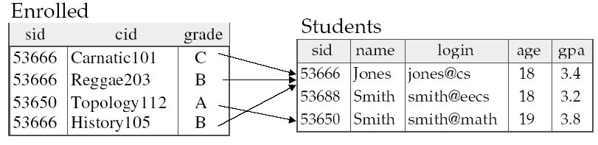
Integrity Constraint in SQL III
ON DELETE
CASCADE
ON UPDATE
SET NULL
SET DEFULT
foreign key (SID) REFERENCE Students(SID)
Notes:
A complete example … if no attributes mentioned in the referenced table, assume PK!

Slide 18
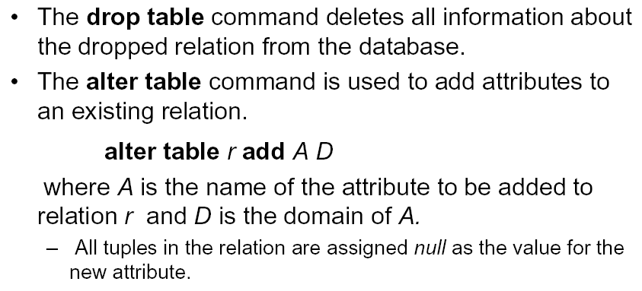
Alter and Drop Table I
Notes:
Once table created, add data, query, also remove or modify it.
Alter table add is used to add an attribute to one of the base relations
The new attribute will have NULLs in all the tuples of the relation right after the command is executed; hence, the NOT NULL constraint is not allowed for such an attribute

Slide 19
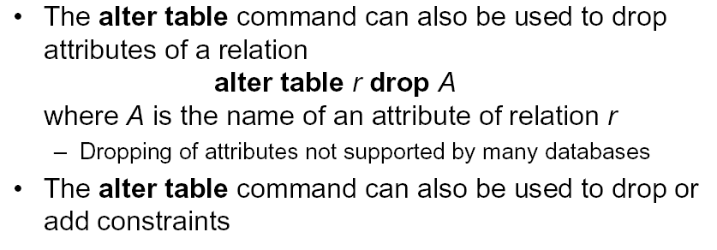
Alter and Drop Table II
Notes:
Besides add A, we can also add IC like FK, check etc.

Slide 20
Examples of Drop and Alter
ALTER TABLE Bars ADD phone CHAR(16) DEFAULT ‘unlisted’;
DROP TABLE Dependent;
ALTER TABLE Bars DROP license;
Notes:
Add and delete attributes, delete tables (both content and def are gone).

Slide 21
Part III Data Modifications
Notes:
Once DB created using create table, we can add data into it.

Slide 22
Database Modifications
A modification command does not return a result (as a query does), but changes the database in some way.
  Modify its content but not schema
Three kinds of modifications:
  Insert a tuple or tuples.
  Delete a tuple or tuples.
  Update the value(s) of an existing tuple or tuples.
Notes:
Note that all three commands can change one or more than one rows at a time.

Slide 23
Delete
Delete whole tuples, one relation at a time
Find all tuples t in R such that P(t) is true, then remove t from R.
DELETE FROM R
WHERE P;
Notes:
To delete tuples satisfying a condition from some relation:
DELETE FROM <relation>
WHERE <condition>;
Delete all tuples
Make the relation Project empty:
DELETE FROM Project;
Note no WHERE clause needed.
DELETE is different from drop, delete data and schema!!!!
Alter table drop account vs. Delete from account.

Slide 24
Delete: Example
Delete all employees in Department #2
Delete all employees working for the research department
DELETE FROM Employee
WHERE DNO = 2;
DELETE FROM Employee
WHERE DNO IN
(SELECT DNumber
FROM Department
WHERE DName = "Research");

Slide 25

Delete: Example
/* Delete student with the lowest grade */
DELETE FROM CS338Grades
WHERE grade in
(SELECT MIN(grade)
FROM CS338Grades)
Problem: as we delete tuples, the lowest grade changes
CS338Grades
SID | grade
001 | 70
002 | 80
003 | 90
Notes:
Simple enough. Let’s have some fun. What do you think will happen if we execute this deletion query?

Slide 26
Delete: 2 Step Process
Delete (for insert and update as well) is done in two steps
  First, identify the tuples to be deleted using the criteria and mark them
  Second, delete all the marked tuples (without re-computing the criteria).
/* Delete student with the lowest grade */
DELETE FROM CS338Grades
WHERE grade in
(SELECT MIN(grade)
FROM CS338Grades)
CS338Grades
SID | grade
001 | 70
002 | 80
003 | 90

Slide 27
Delete: Exercise
Delete from Works_ON entries where are more than one employee work on the project.
DELETE FROM Works_ON
WHERE PNO IN (
SELECT PNO FROM Works_ON
GROUP BY PNO
HAVING COUNT(ESSN) > 1);
Notes:
All rows are deleted. Empty table. No PNO left.
The reason is that deletion proceeds in two stages:
Mark all tuples for which the WHERE condition is satisfied.
Delete the marked tuples.

Slide 28
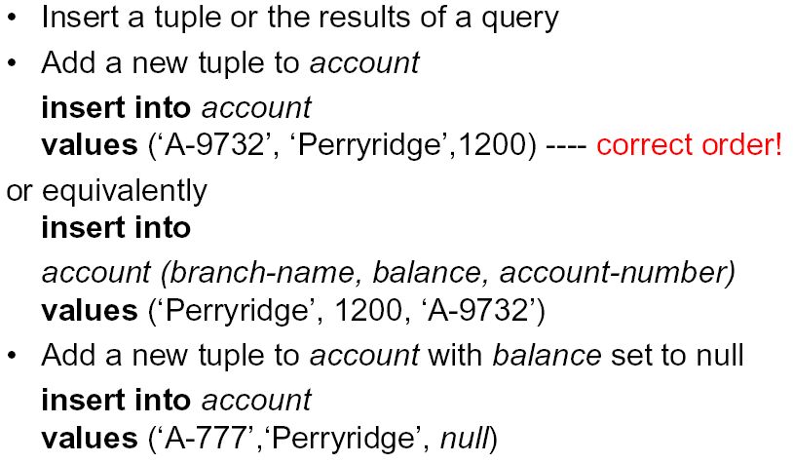
Insert
Notes:
We may add to the relation name a list of attributes.
Two reasons to do so:
We forget the standard order of attributes for the relation.
We don’t have values for all attributes, and we want the system to fill in missing components with NULL or a default value.
Another way to add the fact that Sally likes Bud to Likes(drinker, beer):
INSERT INTO Likes(beer, drinker)
VALUES(’Bud’, ’Sally’);

Slide 29
What if we don’t provide a value for a particular attribute during INSERT?
Use default value if there is one
If not, use NULL if no NOT NULL clause following the attribute definition
Otherwise, error
Works_ON(ESSN, PNO, Hours)
INSERT INTO Works_ON(ESSN, PNO)
VALUES(123456789, 40);

Slide 30
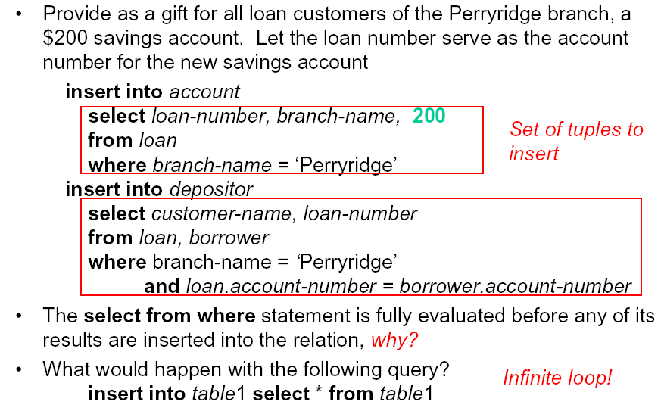
Insert: Example (FYI)
Notes:
We may insert the entire result of a query into a relation, using the form:
INSERT INTO <relation>
( <subquery> );
Another variation of INSERT allows insertion of multiple tuples resulting from a query into a relation

Slide 31
Update
UPDATE account
SET balance = balance * 1.05
WHERE balance > any (SELECT AVG(balance)
FROM account)

Slide 32
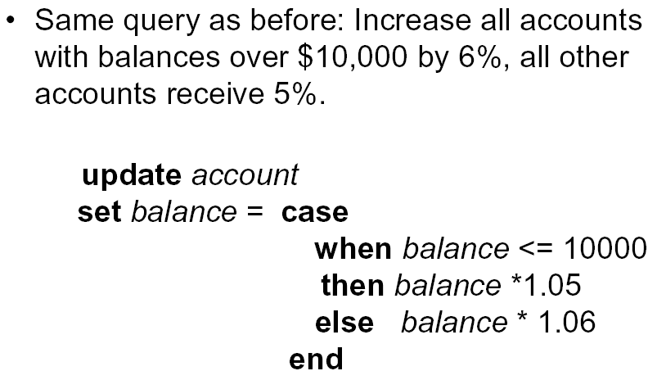
Conditional Update (FYI)
UPDATE Account
SET balance = 1.05 * balance
WHERE balance <= 10,000
UPDATE Account
SET balance = 1.06 * balance
WHERE balance > 10,000
Notes:
Good?

Slide 33
SQL Exercise
SQLite does not allow < ANY. Modify the query below so that it will work in SQLite
/* Given a 5% raise to employees with below-average salary */
UPDATE Employee
SET Salary = Salary * 1.05
WHERE Salary < ANY
(SELECT AVG(Salary)
FROM Employee)
Notes:
As the subquery has only one row, < ANY or < ALL makes no difference.
UPDATE Employee
SET Salary = Salary * 1.05
WHERE Salary IN
(SELECT E.Salary
FROM Employee E, (SELECT AVG(Salary) AS avs
FROM Employee)
WHERE E.Salary < avs)
You can also correlated subquery
UPDATE Employee AS E
SET Salary = Salary * 1.05
WHERE EXISTS
(SELECT *
FROM (SELECT AVG(Salary) AS avs
FROM Employee)
WHERE E.Salary < avs)

Slide 34
Database Modification: Exercise
Give a 10% raise to employee who works on more than 2 projects or whose total project hour exceeds the average (the average of total project hour per employee)
  E1: 10 hours in total on P1, P2
  E2: 20 hours in total on P10, P1
  Average total hour: 15 hours
Notes:
Average total hours per employee: Sum(hours) / count(distinct essn)

Slide 35
Database Modification: Exercise - 1
Give a 10% raise to employee who works on more than 2 projects or whose total project hour exceeds the average (the average of total project hour per employee)
UPDATE Employee
SET Salary = Salary 1.1
WHERE SSN IN (
);
Subquery1
UNION
Subquery2

Slide 36
Database Modification: Exercise - 2
Give a 10% raise to employee who works on more than 2 projects or whose total project hour exceeds the average (the average of total project hour per employee)
  Employee who works on more than 2 projects
/* Subquery1 */
SELECT ESSN
FROM Works_ON
GROUP BY ESSN
HAVING COUNT(PNO) > 2
Notes:
UPDATE Employee
SET Salary = Salary * 1.1
WHERE SSN IN(
SELECT ESSN
FROM Works_ON
GROUP BY ESSN
HAVING COUNT(PNO) > 2
UNION
Subquery2);

Slide 37

Database Modification: Exercise - 3
Give a 10% raise to employee who works on more than 2 projects or whose total project hour exceeds the average (the average of total project hour per employee)
  whose total project hour exceeds the average
    Total project hour for each employee
/* Subquery2 */
SELECT ESSN,
SUM(Hours) AS THours
FROM Works_ON
GROUP BY ESSN
Notes:
UPDATE Employee
SET Salary = Salary * 1.1
WHERE SSN IN(
SELECT ESSN
FROM Works_ON
GROUP BY ESSN
HAVING COUNT(PNO) > 2
UNION
Subquery2);

Slide 38

Database Modification: Exercise - 4
Give a 10% raise to employee who works on more than 2 projects or whose total project hour exceeds the average (the average of total project hour per employee)
  whose total project hour exceeds the average
    Average total project hour
/* Subquery2 */
SELECT avg(THours) AS ATH
FROM (SELECT ESSN,
SUM(Hours) AS THours
FROM Works_ON
GROUP BY ESSN)
ESSN | THours
123456789 | 42.0
222222200 | 40
222222201 | 48
222222202 | 40
222222203 | 40
222222204 | 40
222222205 | 40
… | …
Notes:
// The numbers are generated using the sample company DB.
UPDATE Employee
SET Salary = Salary * 1.1
WHERE SSN IN(
SELECT ESSN
FROM Works_ON
GROUP BY ESSN
HAVING COUNT(PNO) > 2
UNION
Subquery2);

Slide 39
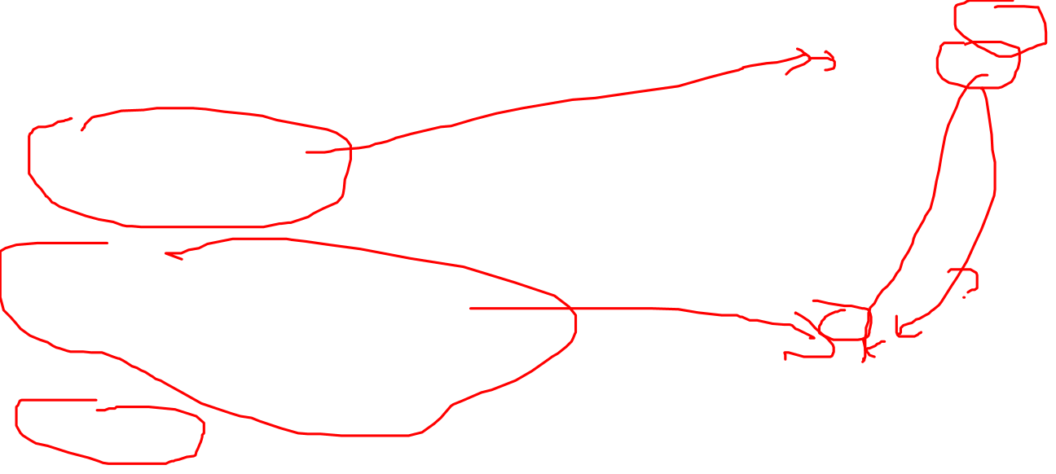
Database Modification: Exercise - 5
Give a 10% raise to employee who works on more than 2 projects or whose total project hour exceeds the average (the average of total project hour per employee)
  whose total project hour exceeds the average
ESSN | THours
123456789 | 42.0
222222200 | 40
222222201 | 48
222222202 | 40
222222203 | 40
222222204 | 40
222222205 | 40
… | …
/* Subquery2 */
SELECT ESSN
FROM (SELECT ESSN,
SUM(Hours) AS THours
FROM Works_ON
GROUP BY ESSN),
(SELECT avg(THours) AS ATH
FROM (SELECT ESSN,
SUM(Hours) AS THours
FROM Works_ON
GROUP BY ESSN))
WHERE THours > ATH
ATH
40.67
Notes:
// The numbers are generated using the sample company DB.
UPDATE Employee
SET Salary = Salary * 1.1
WHERE SSN IN(
SELECT ESSN
FROM Works_ON
GROUP BY ESSN
HAVING COUNT(PNO) > 2
UNION
Subquery2);

Slide 40
Database Modification: Exercise - 6
Give a 10% raise to employee who works on more than 2 projects or whose total project hour exceeds the average (the average of total project hour per employee)
  Put the pieces together
Notes:
UPDATE Employee
SET Salary = Salary * 1.1
WHERE SSN IN(
SELECT ESSN
FROM Works_ON
GROUP BY ESSN
HAVING COUNT(PNO) > 2
UNION
SELECT ESSN
FROM (SELECT ESSN,
SUM(Hours) AS THours
FROM Works_ON
GROUP BY ESSN),
(SELECT avg(THours) AS ATH
FROM (SELECT ESSN,
SUM(Hours) AS THours
FROM Works_ON
GROUP BY ESSN))
WHERE THours > ATH
);

Slide 41
Summary of Today’s Lecture
Data definition
  Create, remove and change schema
Data modification
  Create, remove and change an instance

