Slide 1
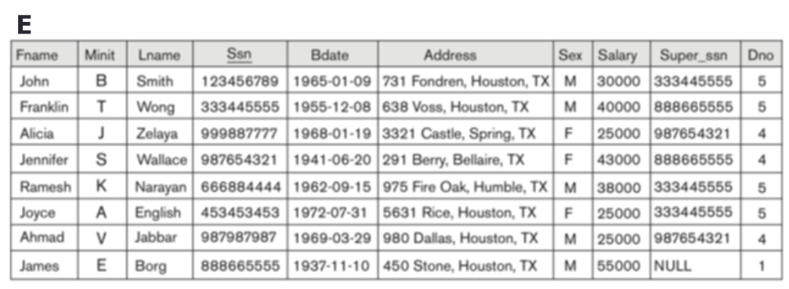

What is the result?
SELECT SSN, 0
FROM Employee E
WHERE FName = ‘John’;
Notes:
What is the output of this query?
Knowing this could be useful for answering A2Q1.

Slide 2
Review of Last Lecture
Data definition
  Create table
    Domain, FK, PK and other IC
    NOT NUL, UNIQUE, Check
  Drop and alter
Data modification
  Delete, Insert, Update
  2 step process

Slide 3
In-class Exercise #1
Find the names of employees who have dependent(s) and a cumulative > 100 total hours on projects.
SELECT FName, LName
FROM Employee
WHERE SSN IN (
);
Subquery1
INTERSECT
Subquery2

Slide 4
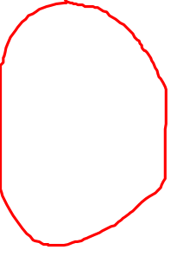
In-class Exercise #1 – Subquery1
Find the names of employees who have dependent(s) and cumulative > 100 total hours on projects.
  Employees with dependent
/* Subquery1 */
SELECT ESSN
FROM Dependent
Notes:
You can use SELECT DISTINCT as well to remove duplicates.

Slide 5
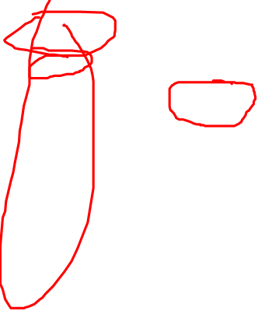
In-class Exercise #1 – Subquery2
Find the names of employees who have dependent(s) and cumulative > 100 total hours on projects.
  Employees with > 100 total hours on projects.
/* Subquery2 */
SELECT ESSN
FROM Works_ON
GROUP BY ESSN
HAVING SUM(Hours) > 100
Notes:
Hint: union

Slide 6
Today’s Plan
Advanced SQL
  View
  Assertion
  Trigger
SQL Exercises

Slide 7
Part VI Advanced Topics

Slide 8
Views
A view is a “virtual table,” a relation that is defined in terms of the contents of other tables and views.
Declare by:
CREATE VIEW <name> AS <query>;
In contrast, a relation whose value is really stored in the database is called a base table.
Notes:
Need to know select before introducing View, belong to part of the DDL, but derived from DML
Store only the definition, not the content of the query … but treated as a normal table (remember a query returns a table!!!!), compute on the fly … when needed
A view is a “virtual” table that is derived from other tables, its content is generated on the fly, never physically stored.
Allows for limited update operations (since the table may not physically be stored)
Allows full query operations
A convenience for expressing certain operations
Motivation:
–Protect (hide) information in relations
–Customize database to better match a user’s need
Any relation that is not part of the logical model but is made visible to a user as a virtual relation is called a view.
View Definition
. A view is defined using the create view statement
which has the form
create view v as <query expression>
where <query expression> is any legal relational
algebra query expression. The view name is
represented by v.
. Once a view is defined, the view name can be used to
refer to the virtual relation that the view generates.
. View definition is not the same as creating a new
relation by evaluating the query expression
Rather, a view definition causes the saving of an expression;
the expression is substituted into queries using the view.

Slide 9
SQL Views: An Example
Specify a different WORKS_ON table
CREATE VIEW WORKS_ON_NEW AS
SELECT FNAME, LNAME, PNAME, HOURS
FROM EMPLOYEE, PROJECT, WORKS_ON
WHERE SSN=ESSN AND PNO=PNUMBER
GROUP BY PNAME;
Notes:
How to create a view? Use the create view keywords followed by the name of the view and then the query that generates the view.
Base tables: E, P and WK …

Slide 10
Accessing a View
We can specify SQL queries on a newly create table (view):
SELECT FNAME, LNAME
FROM WORKS_ON_NEW
WHERE PNAME=‘Seena’;
When no longer needed, a view can be dropped:
DROP WORKS_ON_NEW;
In SQLite, use DROP VIEW instead.
drop view WORKS_ON_NEW;
Notes:
Once the view is defined, we can access it as if it is normal table

Slide 11
What Happens When a View Is Accessed?
The DBMS replaces the view with its query definition.
  Typical DBMS turns the query into relational algebra.
The queries defining any views used by the query are also replaced by their algebraic equivalents, and “spliced into” the expression tree for the query.
SELECT FNAME, LNAME
FROM WORKS_ON_NEW
WHERE PNAME=‘Seena’;
(SELECT FNAME, LNAME, PNAME, HOURS
FROM EMPLOYEE, PROJECT, WORKS_ON
WHERE SSN=ESSN AND PNO=PNUMBER
GROUP BY PNAME)
Notes:
What Happens When a View Is Accessed? View replace by its query definition. Use optimization involved. Because of the time constraint, skip this portion.
Push selections down the tree. (as early as possible)
Eliminate unnecessary projections or push up (as late as possible
The DBMS starts by interpreting the query as if the view were a base table.
Typical DBMS turns the query into something like relational algebra.
The queries defining any views used by the query are also replaced by their algebraic equivalents, and “spliced into” the expression tree for the query.

Slide 12
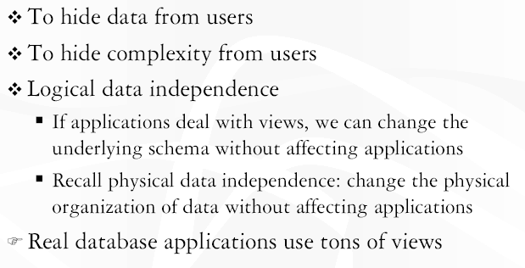
Why View?
Student(SID, FName, LName, GPA, Program, E-mail, BDate)
Notes:
Hide sensitive info from user. A query used to retrieve certain info might be quite complex but from user perspective, it is just a table. Most importantly, provides data independence. App only interacts with view not the actual base tables, allowing us to change … …
Real DB applications use tons of tons of views!
Say we want students be able to search other students but want to hide sensitive info like SID, GPA, birthday etc, but can we do that ? Access control works on table level not attribute level!

Slide 13
Scenario: Same Data Different Displays
People have their own display preference
  CEO wants to see employees with their department
  CFO wants to see employees with their salary in descending order
  HR manager wants to see employees with their number of dependents
These can be easily accomplished by queries
Problem: queries are not permanent
Solution: CREATE VIEW
Notes:
Create the illusions of different reports.

Slide 14
Scenario: Access Control of Sensitive Data
We want employees be able to search each other (like the white page on UW) but want to hide sensitive information like birthday and salary
Problem: Standard SQL can only control access at the table level
  GRANT you or NOT GRANT you the right to access the employee table
  It CANNOT control access to individual attribute within a table
Solution: CREATE VIEW

Slide 15
It is a CRIME punishable by being FIRED!
DO NOT USE VIEW AS INTERMIDEIATE STEPS WHEN WRITING A QUERY
  Use VIEW as intermediate results when writing a query. Similar to R1, R2 … … Result in RA.
YOU WILL GET ZERO IF YOU DO THAT IN EXAMS AND ASSINMENTS.
Why?
Analogy: counting fingers is OK for a 4 years old. But for a 20+ with a UW degree … …
Notes:
Why NOT? Performance!
You can do without VIEW. Just need to work a bit harder.
You will be laughed at and more important, I, as your database teacher, will be laughed at as well.

Slide 16
Assertion Motivation: Business Logic
We want to inject some business rule into our database:
  Say, employees with children should not work more than 100 hours on any project.
  Or manager should have the highest salary in the department
  Or students with average below 80 cannot take more than 5 courses.
Mechanism in SQL: CREATE ASSERTION
  Components include: a constraint name, followed by CHECK, followed by a condition
Notes:
We can use check in table definition but … … that is not good module design practice, also gets complicated when constraints involving multiple tables.
For example, constraints involving two or more tables …
Assertion allows us to specific complex constraints. Typically, to implement application level IC.
Each time DB is modified, assertions and triggers will be checked!

Slide 17
Using General Assertions
Specify a query that finds all the violations of the condition; include inside a NOT EXISTS clause
Query result must be empty
  If the query result is not empty, the assertion has been violated. An error message should pop up
Assertion (and later triggers) will be checked when a database is modified (insert, delete, update)

Slide 18
Assertions: Exercise
The salary of an employee must not be greater than the salary of the manager of the department that the employee works for.
CREATE ASSERTION SALARY_CONSTRAINT
CHECK NOT EXISTS
(
);
/* Query finds employee with salary greater than the manager */

Slide 19
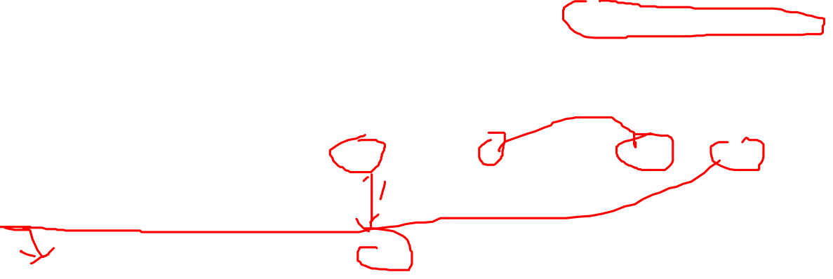
Assertions: Answer
The salary of an employee must not be greater than the salary of the manager of the department that the employee works for.
CREATE ASSERTION SALARY_CONSTRAINT
CHECK (NOT EXISTS
(
SELECT *
FROM EMPLOYEE E, EMPLOYEE M, DEPARTMENT D
WHERE (E.SALARY > M.SALARY) AND (E.SSN != M.SSN)
AND (E.DNO = D.DNUMBER)
AND (D.MGRSSN = M.SSN)
);
/* Query finds employee with salary greater than the manager */
E
M
Notes:
Query that violates the constraint: query looking for E.salary > M.salary for the same department
Many different ways.
Correlated subquery
Select M.SSN
From Department D, Employee M
Where D.MGRSSN = M.SSN AND M.Salary NOT IN
(SELECT max(E.Salary)
FROM Employee E
where E.DNO = D.DNumber);

Slide 20
SQL Triggers
Objective: to monitor a database and take action when a condition occurs
Triggers are expressed in a syntax similar to assertions and include the following:
  event (e.g., an update operation)
  condition
  action (to be taken when the condition is satisfied)
Notes:
Further improvement over assertion is trigger; not just check for violation but also allow us to do something when violation happens
MySQL supports triggers and assertion in 5.0 and above.

Slide 21
SQL Triggers: Example (FYI)
Transactions(TID, accNo, amount, type, date, status)
Account(accNo, balance, owner)
When a withdrawal is made, the balance in the account table should be updated accordingly
CREATE TRIGGER Update_balance
AFTER INSERT OF
TID, amount, status ON Transactions
FOR EACH ROW
WHEN
(new.status = “Success”) AND (type = “Withdrawal”)
UPDATE Account
SET balance = balance – new.amount

Slide 22
SQL Triggers: An Example (FYI)
A trigger to compare an employee’s salary to his/her supervisor during insert or update operations:
CREATE TRIGGER INFORM_SUPERVISOR
BEFORE INSERT OR UPDATE OF
SALARY, SUPERSSN ON EMPLOYEE
FOR EACH ROW
WHEN
(NEW.SALARY> (SELECT SALARY FROM EMPLOYEE
WHERE SSN=NEW.SUPERSSN))
INFORM_SUPERVISOR (NEW.SUPERVISOR_SSN,NEW.SSN);
Notes:
If the salary of new E is larger than its boss … …
For each row: each tuple, do the following, once for each modified tuple
For each statement: for the whole statement, execute once only regardless # of tuples modified
Use NEW and OLD to refer to the old value and new value of the tuple before and afterwards
When: execute only when this condition is true …
The CREATE TRIGGER statement requires the SUPER privilege. It was added in MySQL 5.0.2.

Slide 23
In-class Exercise #2
Write a view called Expert that includes all employees (name and SSN) that work on all the projects.
CREATE VIEW Expert AS
SELECT FName, LName, SSN
FROM Employee, Works_ON
WHERE SSN = ESSN
GROUP BY SSN, FName, LName
HAVING COUNT(PNO) IN
(SELECT COUNT(PNumber)
FROM Project);

Slide 24
In-class Exercise #3
Employee who works more than 1000 hours on projects should have salary more than $50,000
CREATE ASSERTION SALARY_CONSTRAINT
CHECK NOT EXISTS
(
SELECT SSN
FROM Employee
WHERE Salary <= 50000
AND SSN IN
(
SELECT ESSN
FROM Works_ON
GROUP BY ESSN
HAVING SUM(Hours) > 1000
)
);
/* Find E with salary $50k or less, and 1000+ hours on projects*/
Notes:
We can also write two subqueries, one to find employees with 1000 project hours, one to find employees with 50K or less, then INTERSECT.

Slide 25
In-class Exercise #4
Find the names of employees who work on all the projects controlled by department number 5 (if you want an even tougher challenge, replace D5 with “Research”).
Employee who has dependent should work no more than 200 total hours on projects.
Notes:
Q1 Steps:
Find employees wk on D5 projects
For each E wk on D5 projects, count the number of projects
Find number of projects controlled by D5;
Check whether they are equal
SELECT FName, LName
FROM Employee, Works_on, Project
WHERE DNUM = 5 AND ESSN = SSN AND PNO = PNumber
GROUP BY SSN, FName, LName
HAVING COUNT(PNO) IN
(SELECT COUNT(DISTINCT PNumber)
FROM Project
WHERE DNUM = 5)
Q2. One of the many possible approaches
CREATE ASSERTION SALARY_CONSTRAINT
CHECK NOT EXISTS
(
SELECT DISTINCT SSN
FROM Employee, Dependent /* E with dependant */
WHERE (SSN = ESSN) AND SSN IN /* E with over 200 project hours */
(
SELECT ESSN
FROM Works_ON
GROUP BY ESSN
HAVING SUM(Hours) > 200
)
);

Slide 26
Summary of Today’s Lecture
Advanced SQL
  View
  Assertion
  Trigger
SQL exercise
Notes:
Views are a convenient means for creating temporary (virtual) tables
Assertions provide a means to specify additional constraints
Triggers are a special kind of assertions; they define actions to be taken when certain conditions occur

