Slide 1

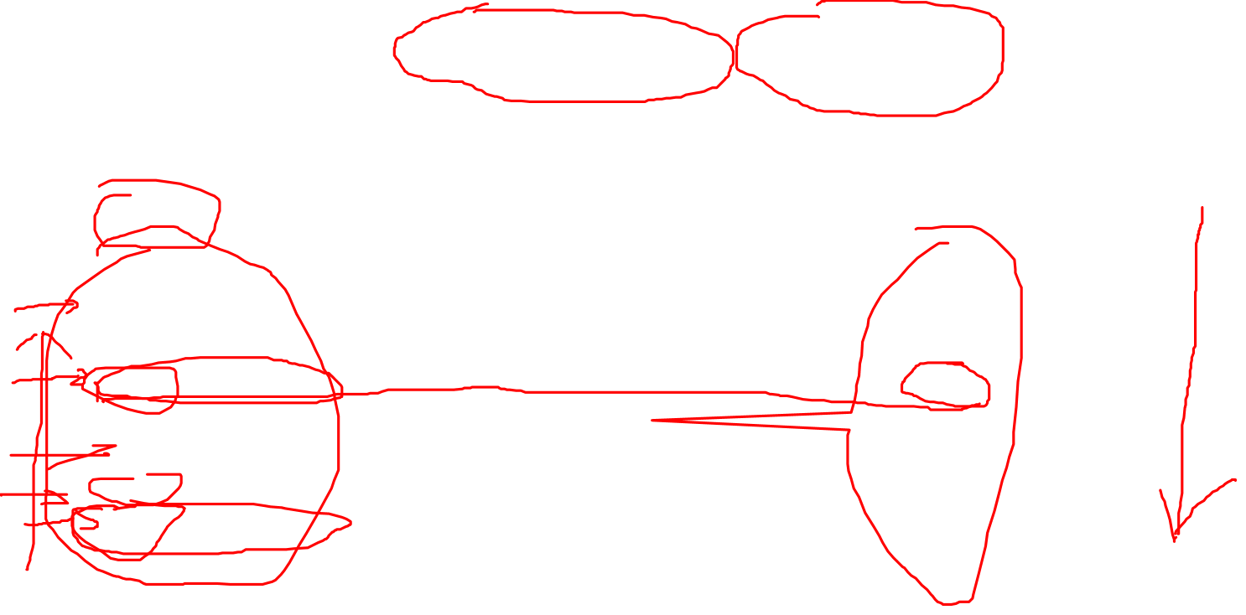
One of the Most Common Student Mistakes
Find the name of the employee(s) with the lowest salary
SELECT FName, LName, MIN(Salary)
FROM Employee;
Notes:
This slide is inspired by what we observed in A2. To simplify the discussion, we use the company DB instead. But the idea is the same.
What is wrong? The rules is that if aggregation is used in SELECT, all attributes in SELECT must be either grouping attribute or aggregated attribute.
Why does this rule exist? This what happens behind the scene: one group one row. The MIN for the group is 25K. But what are FN and LN for the group? There is NONE as employees have different names.
When the rules is NOT followed, what will happen is totally up to the individual DBMS to decide. You might observe different results when running this on different DBMSs. Some will return the first row (John Smith), some will return the first match (either Alicia or Ahamd depending on evaluation order using top down or bottom up).
Moreover, because one group one row, hence, no matter what DBMS you use, this query will produce only one tuple! But there are 3 employees qualified for the query.
So, what is the proper way to do this? Please share your thoughts on the message board.

Slide 2
SQL Exercise
Find the employee (SSN) who works on all project locations except Toronto.
  Say the company has
    P1 and P2 in Montreal,
    P10 in Waterloo,
    P12 in Toronto.
    Jane (SSN = 1111111) worked on P1 and P10,
    Peter worked on P1 and P2,
    Kate worked on P1, P10 and P12.
  Then
    Jane should be included in the result while
    Peter and Kate should not.
Notes:
// This solution assumes there is at least one project located in Toronto
SELECT DISTINCT W.ESSN
FROM Works_on W, Project P
WHERE (W.PNO = P.PNumber) AND (P.PLocation != "Toronto")
GROUP BY W.ESSN
/* Total number of worked on project locations outside of Toronto */
HAVING COUNT(DISTINCT P.PLocation) IN
/* Total number of project locations minus 1 (Toronto) */
(SELECT COUNT(DISTINCT PP.PLocation) -1
FROM Project PP)
EXCEPT
/* Everyone ever worked on any Toronto project */
/* Note that this is needed to weed out anyone who worked on all project locations, like Kate in the example. */
SELECT DISTINCT WW.ESSN
FROM Works_on WW, Project PPP
WHERE (WW.PNO = PPP.PNumber) AND (PPP.PLocation = "Toronto")

Slide 3
Review of Last Lecture
Advanced SQL
  View
  Assertion
  Trigger
SQL exercise

Slide 4
Today’s Plan
Entity
Weak entity
Attributes
Relationship
Structural constraints

Slide 5
Entity-Relationship DiagramS
Chapter 06
Collin Roberts
University of Waterloo
Notes:
I know that many of you come to this class to learn mainly SQL. But if you are serious about DB, DB design is really where the money is at.
Recall that the process of DB development involves requirement analysis, conceptual and logical design and then implementation. Requirement analysis is similar to the steps in software development, so we skip it and start with conceptual design using ER diagrams

Slide 6
Recommended Reading
Textbook Chapter 03

Slide 7
Overview of Database Design
Conceptual design
  Describe the data informally
Logical design
  Mapping
  Normalization
Physical design
  Storage, indexing, RAID
Notes:
Business analysis: interview users to gather information
The design phase is where the requirements identified in the previous phase are used as the basis to develop the new system.
Another way of putting it is that the business understanding of the data structures is converted to a technical understanding.
The what questions ("What data are required? What are the problems to be solved?") are replaced by the how questions ("How will the data be structured? How is the data to be accessed?")
This phase consists of three parts:
the conceptual design,
the logical design and
the physical design.
Some methodologies merge the logical design phase into the other two phases.
This section is not aimed at being a definitive discussion of database design methodologies (there are whole books written on that!); rather it aims to introduce you to the topic.

Slide 8
Benefits of ER Diagrams
Allow us to sketch the design informally
  Entity
  Attribute
  Relationship
  Constraint
Schemas in the ER model are entity-relationship diagrams
DBMS independent
There is a fairly mechanical way to convert ER diagrams to real implementations like relational databases.
Notes:
ERD is Not written in computer jargon, so it allows non-technical staff, including managers to participate in this process

Slide 9
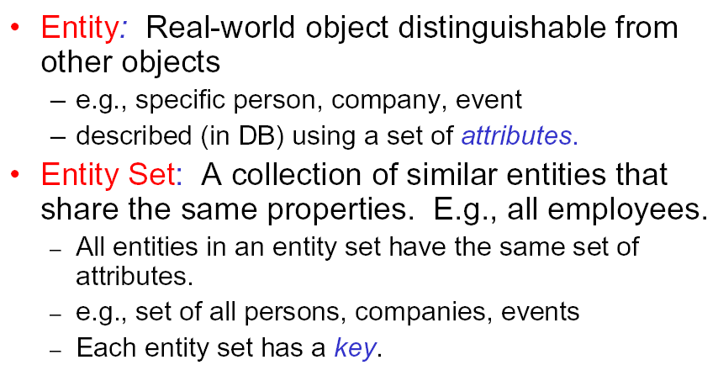
Entity
Notes:
Key: unique value used to identify an entity inside the entity set. More on this later
Entities are specific objects or things in the mini-world that are represented in the database.
For example
the EMPLOYEE John Smith,
the Research DEPARTMENT,
the ProductX PROJECT
Attributes are properties used to describe an entity. For example an EMPLOYEE entity may have a Name, SSN, Address, Sex, BirthDate
A specific entity will have a value for each of its attributes. For example a specific employee entity may have Name='John Smith', SSN='123456789', Address ='731, Fondren, Houston, TX', Sex='M', BirthDate='09-JAN-55‘
Each attribute has a value set (or data type) associated with it – e.g. integer, string, subrange, enumerated type, …

Slide 10
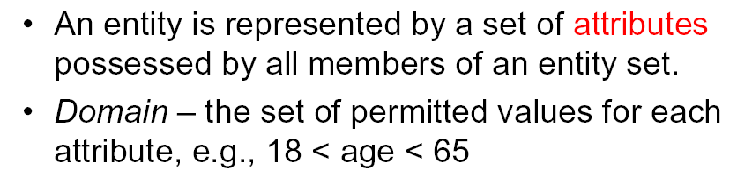
Attribute
Notes:
Represents some properties of the entity
Like a variable in programming language, it has a value.
Domain is the data type of the attribute

Slide 11
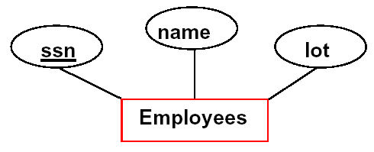
ER Diagram
In an ER diagram, each entity set is represented by a rectangle
Each attribute of an entity set is represented by an oval linked to the rectangle
Notes:
SSN underline indicates it is a key
Three attributes. Each employee entity has values for these attributes. And value for SSN must be unique

Slide 12
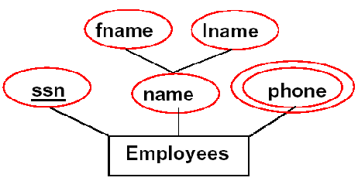
Types of Attributes
Simple
  Each entity has a single atomic value for the attribute
  Example: SSN or Sex.
Composite
  The attribute may be composed of several components.
  Example: Address (Apt#, House#, Street, City, State, ZipCode, Country) or Name (FirstName, MiddleName, LastName).
Multi-valued
  An entity may have multiple values for that attribute
  Example: Color of a CAR or PreviousDegrees of a STUDENT. Denoted as {Color} or {PreviousDegrees}.
Notes:
In general, composite and multi-valued attributes may be nested arbitrarily to any number of levels, although this is rare.
For example, PreviousDegrees of a STUDENT is a composite multi-valued attribute denoted by {PreviousDegrees (College, Year, Degree, Field)}.
Each component of the Composite is linked to the master name
Multi-valued is double-oval.
One more: derived attribute: e.g. age derived from given date of birth

Slide 13
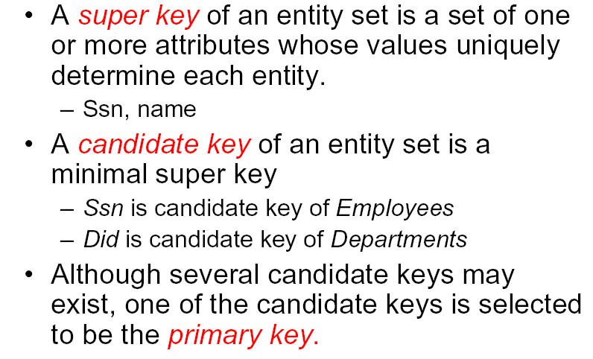
Keys
Notes:
Keys are used to identify the individual entity in an entity set.
So the value for the key must be unique
Candidate key: if Remove any attribute from it, it will no longer be a key.
Entities with the same basic attributes are grouped or typed into an entity type. For example, the EMPLOYEE entity type or the PROJECT entity type.
An attribute of an entity type for which each entity must have a unique value is called a key attribute of the entity type. For example, SSN of EMPLOYEE.
A key attribute may be composite. For example, VehicleTagNumber is a key of the CAR entity type with components (Number, State).
An entity type may have more than one key. For example, the CAR entity type may have two keys:
VehicleIdentificationNumber (popularly called VIN) and
VehicleTagNumber (Number, State), also known as license_plate number.
Primary key is underlined

Slide 14
Example: Multi-attribute key
(Location, Time) cannot be a key due to cross-list.
Notes:
Example: CS 338 01

Slide 15
Exercise: SK, CK and PK
Identify all the SK, CK and PK for the following entity:
SIN
SID
Name
Addr
Student

Slide 16
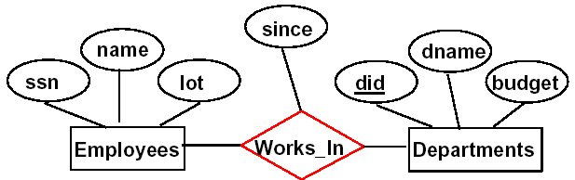
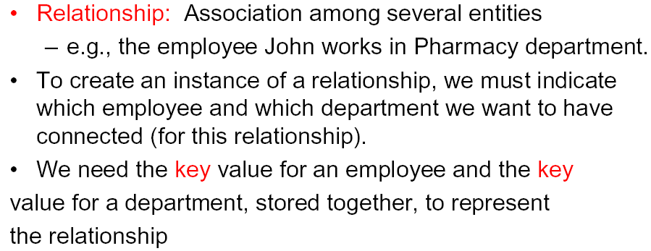
Relationship
Notes:
A relationship relates two or more distinct entities with a specific meaning. For example, EMPLOYEE John Smith works on the ProductX PROJECT or EMPLOYEE Franklin Wong manages the Research DEPARTMENT.
Relationships of the same type are grouped or typed into a relationship type. For example, the WORKS_ON relationship type in which EMPLOYEEs and PROJECTs participate, or the MANAGES relationship type in which EMPLOYEEs and DEPARTMENTs participate.
The degree of a relationship type is the number of participating entity types. Both MANAGES and WORKS_ON are binary relationships.

Slide 17
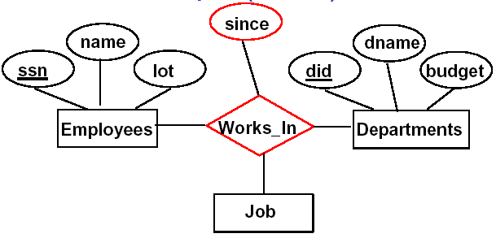
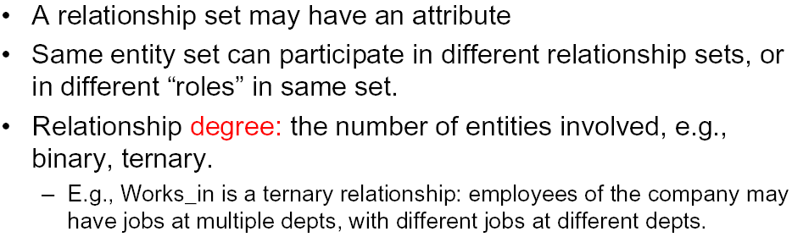
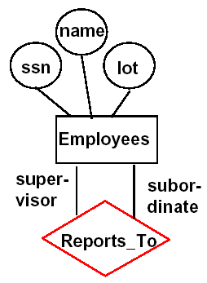
Relationship Property
Notes:
Relationship might be recursive, that is the two entities belong to the same entity set; they are distinguished by their roles.
Sometimes an entity set appears more than once in a relationship but play different role for example … one E reports to another E. This is sometimes called recursive relationship.
Label the edge between the relationship and the entity set with names called roles.
A relationship type can have attributes; for example, HoursPerWeek of WORKS_ON; its value for each relationship instance describes the number of hours per week that an EMPLOYEE works on a PROJECT.

Slide 18
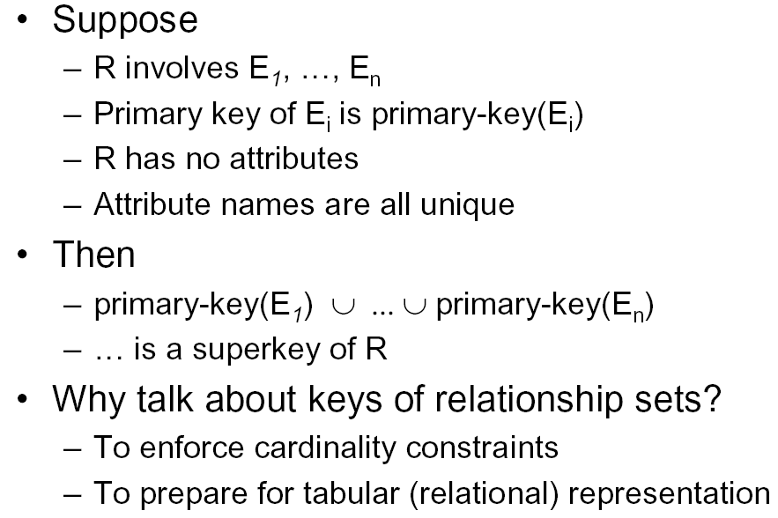
Relationship Key
Notes:
The key of an relationship, is the union of primary keys of all participants
Useful when converting to a relational model

Slide 19
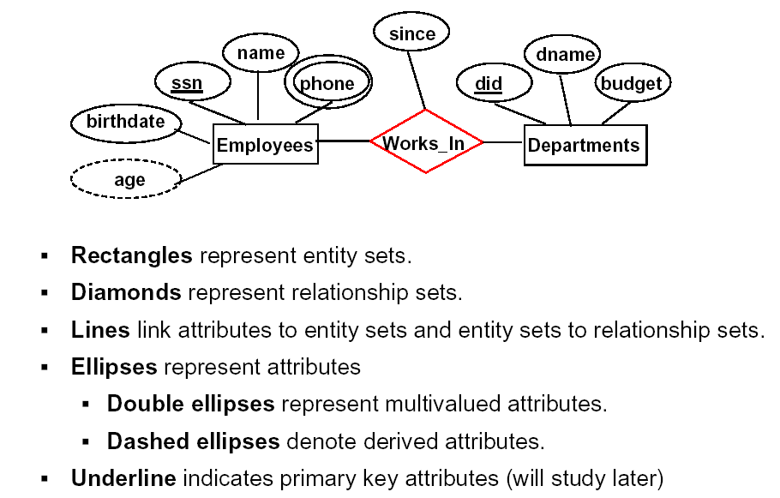
Quick Summary on ER Diagram

Slide 20
Structural Constraints
Structural constraints on relationships:
  Cardinality ratio (of a binary relationship): 1:1, 1:N, N:1, or M:N
    SHOWN BY PLACING APPROPRIATE NUMBER ON THE LINK.
  Participation constraint (on each participating entity type): total (called existence dependency) or partial.
    SHOWN BY DOUBLE LINING THE LINK
NOTE: These are easy to specify for Binary Relationship Types.
Notes:
We can also include some semantics in your design by using structural constraints. (for example, to represent E must work in a D; E can manage at most one department). There are two types of structural constraints in ER.
Constraints on Relationship Types
( Also known as ratio constraints )
Maximum Cardinality
One-to-one (1:1)
One-to-many (1:N) or Many-to-one (N:1)
Many-to-many
Minimum Cardinality (also called participation constraint or existence dependency constraints)
zero (optional participation, not existence-dependent)
one or more (mandatory, existence-dependent)
These constraints are used though mainly in binary. Can be extend to n-ary but careful with the meaning as you see later.

Slide 21
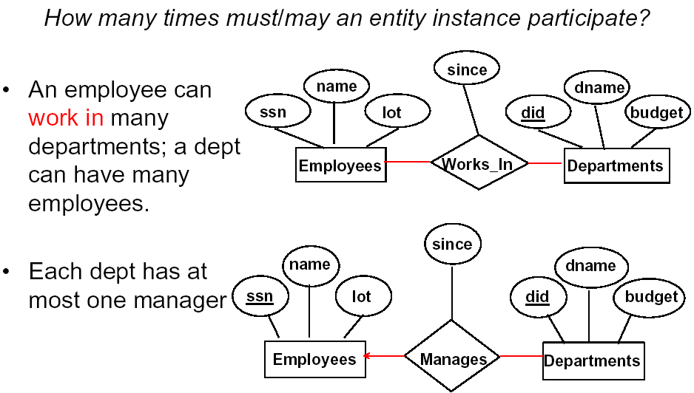
Cardinality/Key Constraint
N
M
1
1
Notes:
Place the number on the link

Slide 22
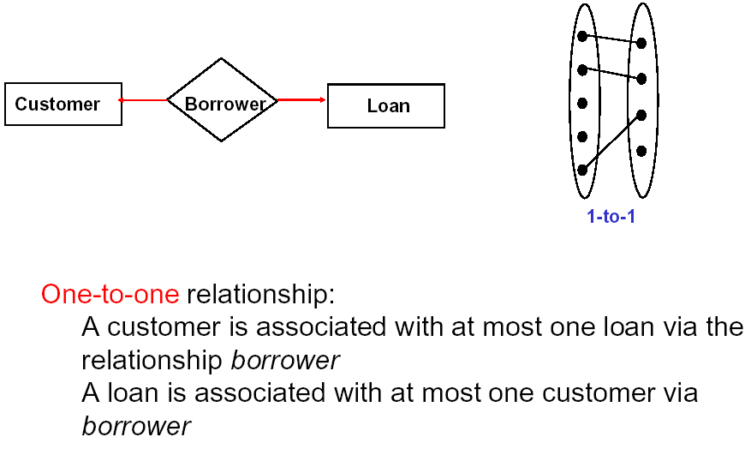
Cardinality: 1-1
1
1
Notes:
Why do we care about cardinality? Different C ratio carries different meaning in your design. Let’s look at some examples, same design but with different C ratio, see how they differ from each other.
What does it mean? One Client one loan, and he/she is solely responsible for paying it back

Slide 23
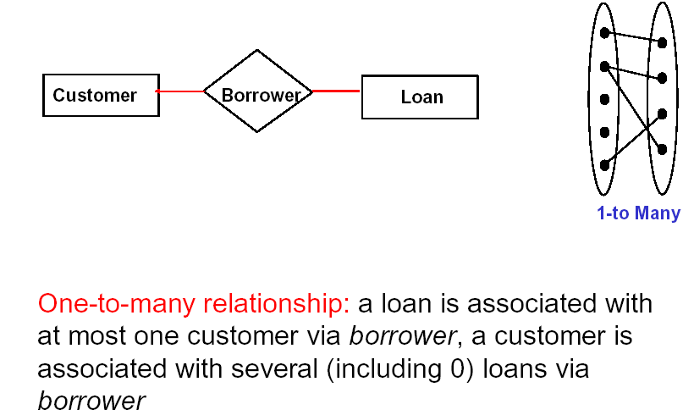
Cardinality: 1-Many
1
N
Notes:
Semantics: one client many load, solely responsible for each
Many to 1 the same?

Slide 24
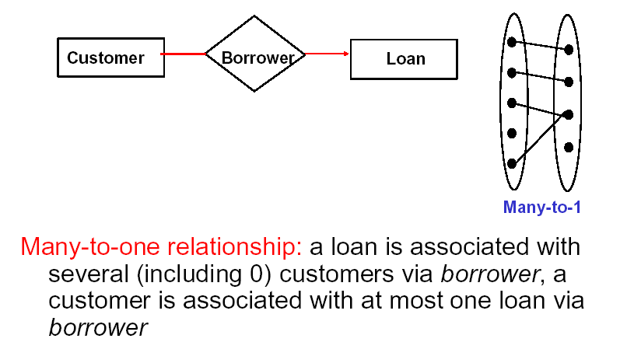
Cardinality: Many-1
N
1
1
1
Notes:
Many to 1 the same? Many client share the loan, each has one only

Slide 25
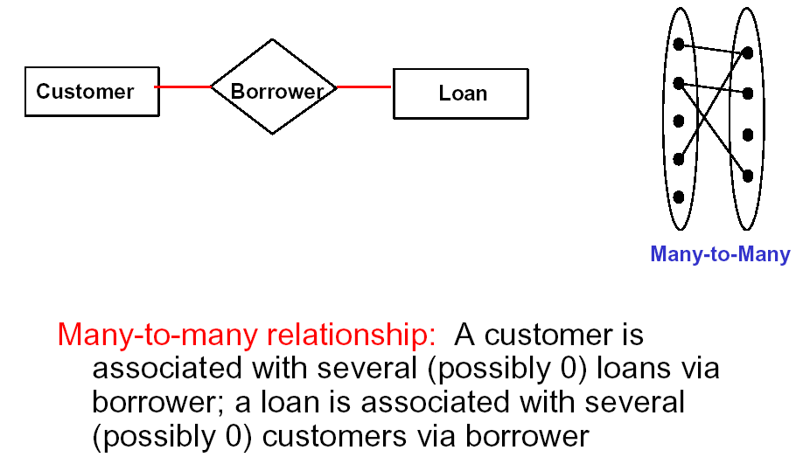
Cardinality: Many-Many
N
M
Notes:
Many client share the same loan, each can has different loans

Slide 26
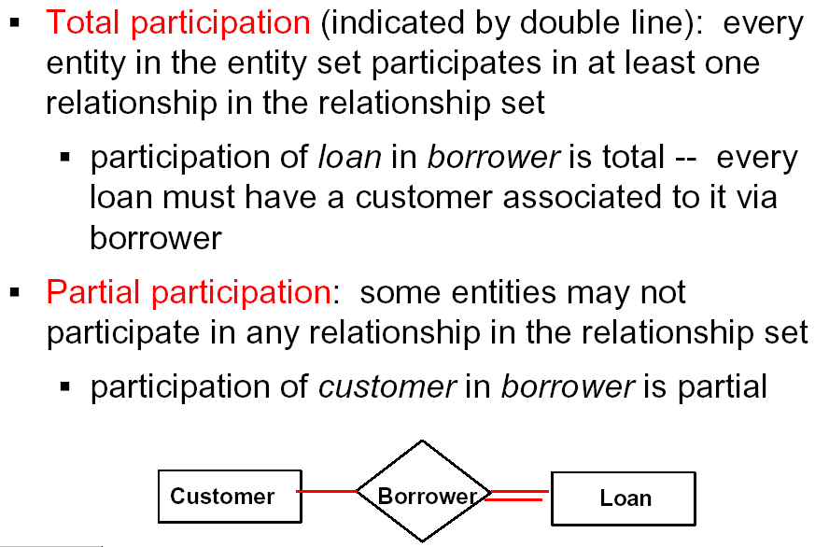
Participation Constraint
Notes:
The second constraint on a relationship is … it could be total or partial
Not everyone need to borrow money, rich fold don’t, so it is partial
But each loan is lent to particular client/clients, otherwise not a loan, it is total
Some use arrow to represent total participation (we don’t use it).

Slide 27
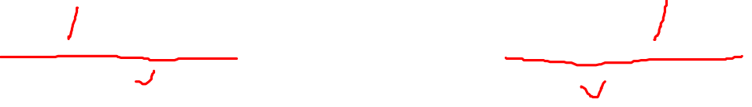
In-class Exercise #1: Structural Constraints
Marriage between two persons?
How about BG between two persons?
How about PC between adult and child?
Marry
Person
Husband
Wife
Person
Notes:
BG: boyfriend/girlfriend relationship
PC: parent/child

Slide 28
The (min,max) notation (FYI)
(0,1)
(1,1)
Employee
Manages
Department
(1,1)
(1,N)
Employee
Department
Works-for
Notes:
Alternative (min, max) notation for relationship structural constraints:
Specified on each participation of an entity type E in a relationship type R
Specifies that each entity e in E participates in at least min and at most max relationship instances in R
Default(no constraint): min=0, max=n
Must have min≤max, min≥0, max ≥1
Derived from the knowledge of mini-world constraints
Examples:
A department has exactly one manager and an employee can manage at most one department.
Specify (0,1) for participation of EMPLOYEE in MANAGES
Specify (1,1) for participation of DEPARTMENT in MANAGES
An employee can work for exactly one department but a department can have any number of employees.
Specify (1,1) for participation of EMPLOYEE in WORKS_FOR
Specify (0,n) for participation of DEPARTMENT in WORKS_FOR
Min>=1? Total
Min=0? Partial
Max=1? 1 to …
Max=N? Many to …
Max=0? None participated at all!

Slide 29
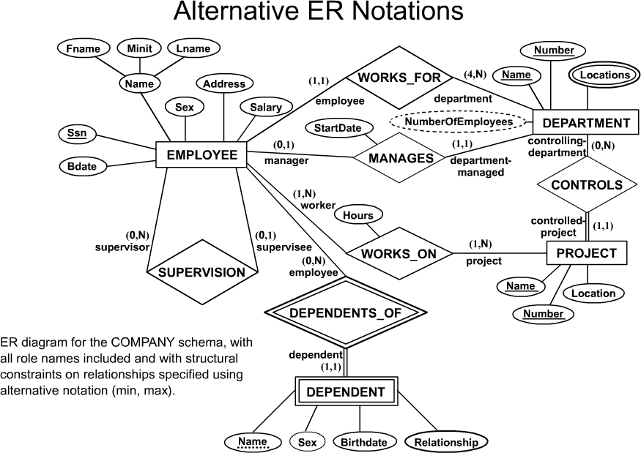
COMPANY ER Schema Diagram using (min, max) notation (FYI)
Notes:
Min>=1? Total
Min=0? Partial
Max=1? 1 to …
Max=N? Many to …
Max=0? None participated at all!

Slide 30
Weak Entity Types
Weak entity: an entity that does not have a primary key
  Identified by a double rectangle
  Naturally, the opposite is called strong entity
A weak entity must TOTALLY participate in an identifying relationship type with an owner or identifying entity type
  Identified by a double diamond
Weak entities are identified by the combination of:
  A partial key of the weak entity type (discriminator)
    Represented by a dash line
  The particular entity they are related to in the identifying entity type
Notes:
All E discussed so far have keys, called strong E. There are another type of E which has no key called weak E.
Need help to identify themselves, by jointing an identifying relationship, a must
The partial key in weak entity is called a discriminator attribute

Slide 31
Weak Entity Type Example
SSN
Employee
1
Name
Dependent_Of
Relationship
N
Name
Dependent
Birthday
Sex
Notes:
Example:
Suppose that a DEPENDENT entity is identified by the dependent’s first name, and the specific EMPLOYEE that the dependent is related to. DEPENDENT is a weak entity type with EMPLOYEE as its identifying entity type via the identifying relationship type DEPENDENT_OF
Weak: different employees might have children with same name.
Weak Entity Type is: DEPENDENT
Identifying Relationship is: DEPENDENTS_OF
Discriminator:{Name}
Each dependent is identified by {SSN, Name}

Slide 32
SUMMARY OF ER NOTATION
Symbol
Meaning
ENTITY TYPE
WEAK ENTITY TYPE
RELATIONSHIP TYPE
IDENTIFYING RELATIONSHIP TYPE
ATTRIBUTE
KEY ATTRIBUTE
MULTIVALUED ATTRIBUTE
COMPOSITE ATTRIBUTE
DERIVED ATTRIBUTE
TOTAL PARTICIPATION OF E₂ IN R
CARDINALITY RATIO 1:N FOR E₁:E₂ IN R
SOME USE ARROW TO REPRESENT TOTALPARTICIPATION
E₁
R
E₂
E₁
1
R
N
E₂

Slide 33
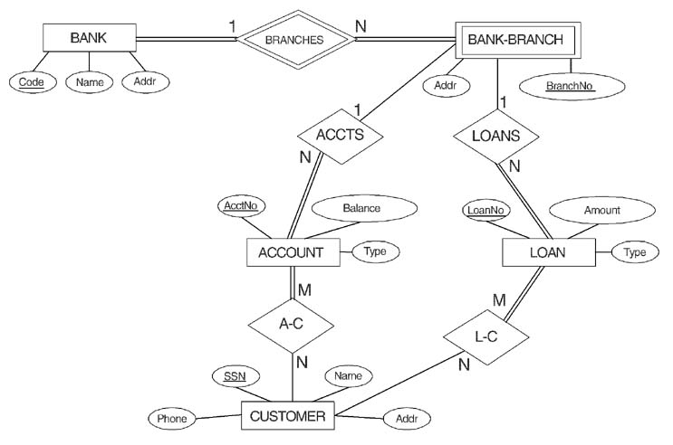
ER DIAGRAM FOR A BANK DATABASE
© The Benjamin/Cummings Publishing Company, Inc. 1994, Elmasri/Navathe, Fundamentals of Database Systems, Second Edition
Notes:
A simple ERD contains rich information.
Customer who cancels their account are still customers, want to keep their info around-> still possible to contact them for future business.
If using ternary, if account is closed, their info are gone.

Slide 34
In-class Exercise #2
In the following Company ER diagram, find out
  Example of weak entity?
    Identify the PK for this weak entity
  Example of identifying relationship?
  What is the primary key for DEPARTMENT?
  How many super keys for DEPARTMENT?
  What is the primary key for PROJECT?
  How many super keys for PROJECT?
  Modify the diagram so that an employee must have a supervisor.
  Explain the semantics (implied by the structural constraints) on the WORKS_ON relationship
Notes:
For structural constraints: 4 things, 2 links and 2 numbers, use 4 sentence to explain them.

Slide 35
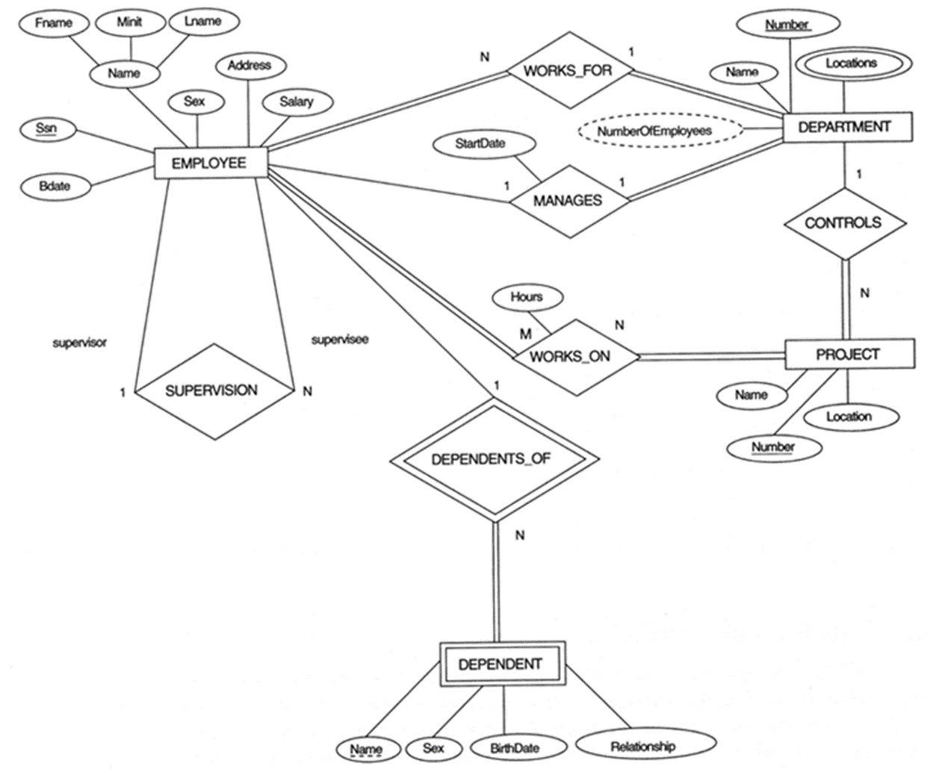
COMPANY ER Diagram
M
Notes:
At the end class exercises. Relationships, composite attributes, weak entity …
Recursive Relationship Type is: SUPERVISION
(participation role names are shown)
Attributes: … … simple, multivalued, composite …
Attribute of a Relationship Type is:
Hours of WORKS_ON
ER DIAGRAM – Relationship Types are:
WORKS_FOR, MANAGES, WORKS_ON, CONTROLS,
SUPERVISION, DEPENDENTS_OF
ER DIAGRAM – Entity Types are:
EMPLOYEE, DEPARTMENT, PROJECT, DEPENDENT
More than one relationship type can exist with the same participating entity types. For example, MANAGES and WORKS_FOR are distinct relationships between EMPLOYEE and DEPARTMENT, but with different meanings and different relationship instances.

Slide 36
In-class Exercise #3
Draw an ER diagram to represent:
  A customer can borrow at most 1 loan and a loan has at least one borrower.
    What is the cardinality for the relationship?
    What is the participation for Loan and the participation for Customer?

Slide 37
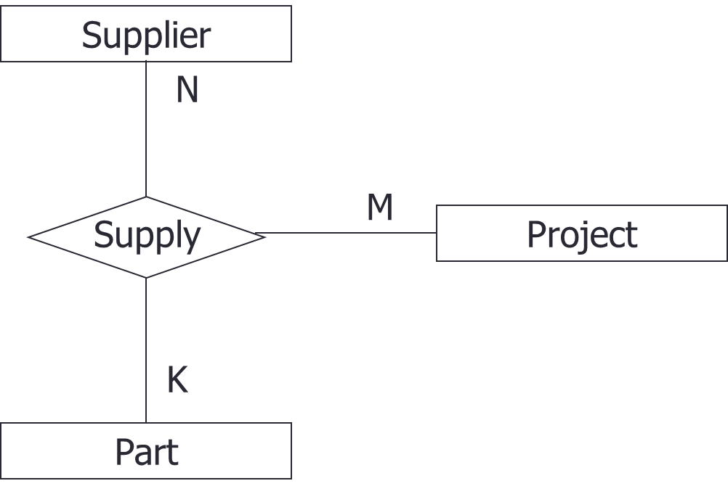
Relationships of Higher Degree
Relationship types of degree 2 are called binary
Relationship types of degree 3 are called ternary and of degree n are called n-ary
  AKA multiway relationship
Notes:
Most of the time, we deal with binary, involving two parties only. Sometimes we need a relationship that connects more than 2 entity sets called multiway relationship

Slide 38
Design Choice
How many attributes?
  Avoid redundancy
Attribute or Entity?
  Don’t use an entity when an attribute will do
Entity or relationship?
  Difficult to answer
  Depend on which one makes common sense
Binary relationship or n-ary?
  Use binary as often as possible
  Binary is simple but might not be adequate
Notes:
At first look, ER appears to be a simple, just diagrams, as long as you are high school graduate, you should be able to understand it. but not so in practice.
There are some hard choices to make.
Use E or R to represent certain piece of information?

Slide 39
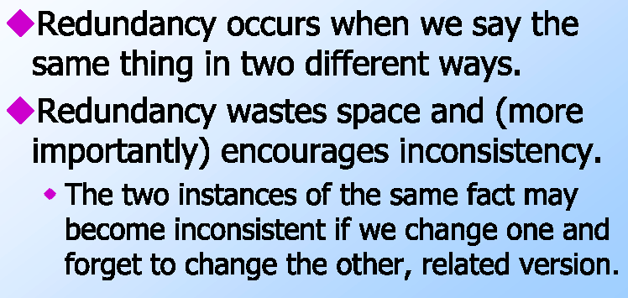
Avoid Redundancy

Slide 40
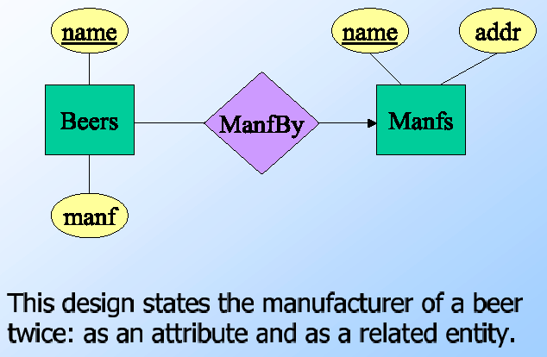
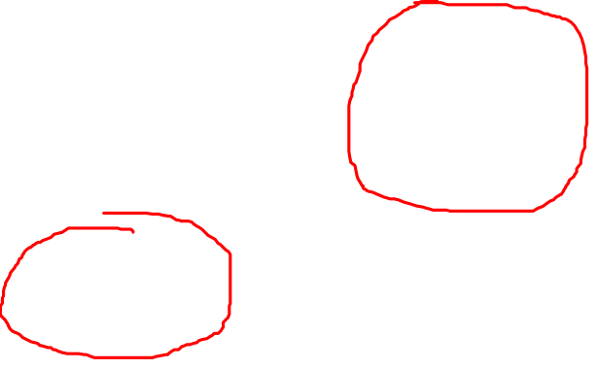
Good or Bad?
Notes:
A bad design

Slide 41
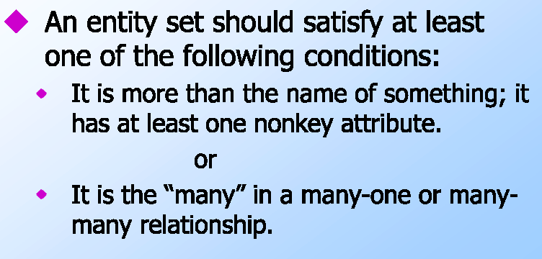
Attribute vs Entity
Notes:
Second Q in ER design: should we use A or E to represent certain value/object? Rule of thumb: E deserve to be E must … …

Slide 42
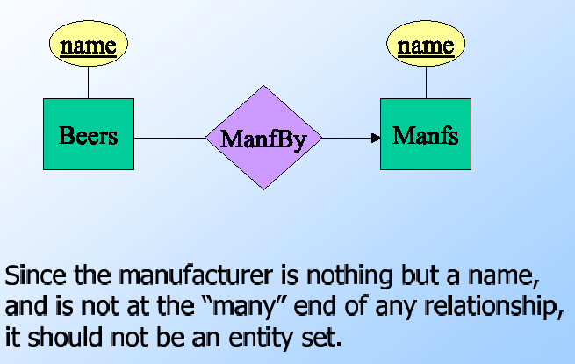
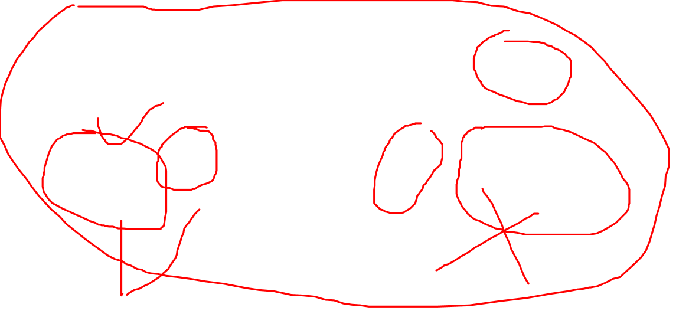
Good or Bad?
N
1
Notes:
A bad design here.
But how about Beers?

Slide 43
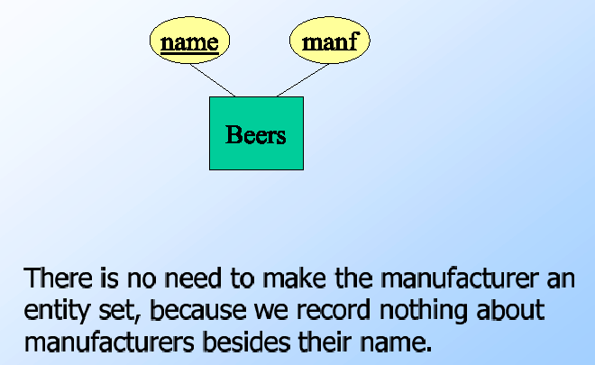
Good or Bad
Notes:
In that case, we use attribute instead.

Slide 44
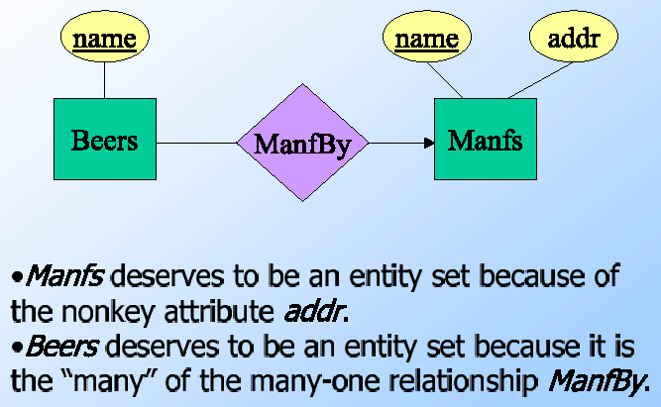
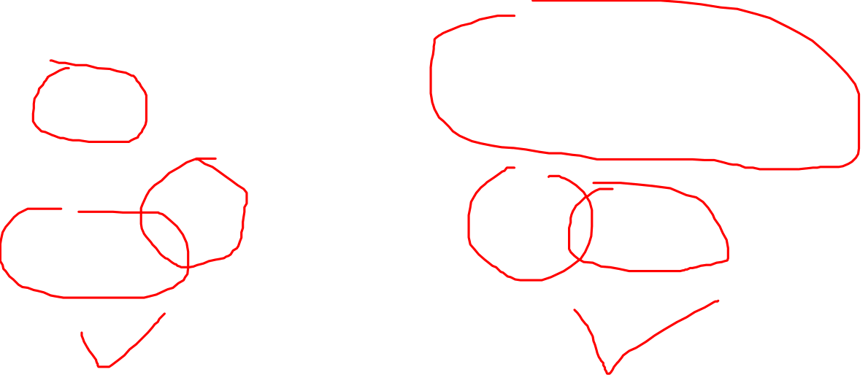
Good or Bad?
N
1
Notes:
Beers has only an attribute of name but defined as an entity because it is the many on the many to one relationship
How about replace R with E, say merge the two E: two options:
Keep Beer as entity, merge M into it
Keep Manf as entity, merge Beers into it

Slide 45
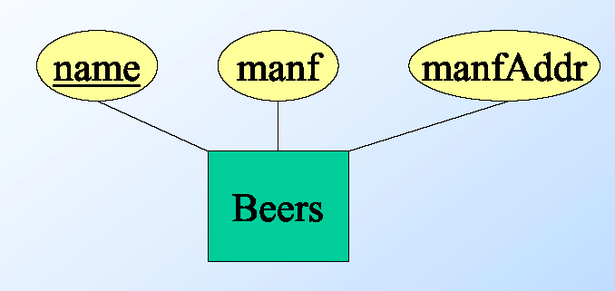
Entity or Relationship?
Good or bad? Why?
Notes:
Sometimes hard to decide to use entity or relationship. Previous example, let’s use an entity instead of relationship and include all information of the manf into Beers entity. Good or bad?
Bad
PK correct?
Two problems:
Redundancy: repeat manufacturer address for each beers they manufactured.
Lost manufacturer address if store temporarily run out of / no beer for the manufacturer.
No fix rules for this model, common senses and case by case … one possible guideline is to designate relationship as an action occurs between two entities

Slide 46
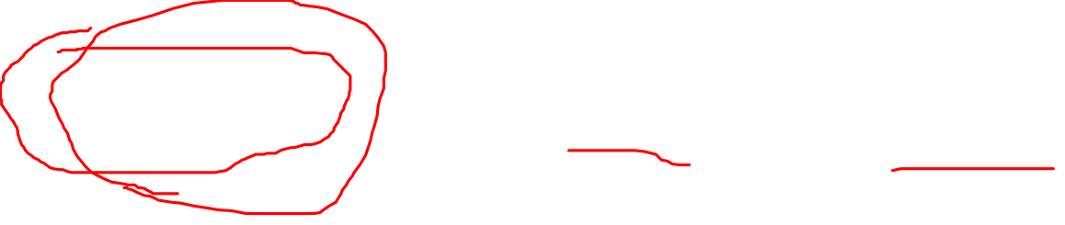
Entity or Relationship?
Good or bad? Why?
BeerName
Name
Addr
Manfs
Notes:
But how about this? Keep, M and merge Beers, we move beers to be part of the Manf entity?
Why in many to one, many should be an entity?
What is the PK?

Slide 47
ERD Exercise
Employees: Each employee has an employee number, a name, an address, and belongs to one department.
Departments: Each department has a name and a department code.
Projects: Each project has a project number. Some number of employees and a manager (also an employee) are associated with each project. For each employee it is necessary to record the amount of time he/she has worked on the project. It is possible for an employee to work on more than one project but each project only has one manager. Each project uses some parts that are explained below.
Parts: Each part has a part number and a description. In addition, it is necessary to represent the quantity and types of subcomponents (other parts), which make up each part as well as the parts of which it is a component.
Warehouses: Each warehouse has a number, an address, and contains an inventory of parts. The quantity of each in stock in each warehouse must be recorded.
Suppliers: Each supplier has a number, a name, and an address. It is necessary to record the parts that a supplier can potentially supply as well as the parts that he/she is currently supplying. It must also be possible to identify for each project, which supplier is supplying which parts and in what quantities.
Notes:
How many entities?
How many relationships?
How many one to one relationships? one to many? many to many?
How many weak entities?
How many total participations?

Slide 48
Free Diagraming Tool
Dia: http://dia-installer.de/download/index.html.en
If you want to draw ER diagram in Dia, make sure to choose ER from the drop down menu.

Slide 49
Review of Today’s Lecture
Entity
Weak entity
Attributes
Relationship
Structural constraints

