Slide 1

Review of Last Lecture
Symbol
Meaning
ENTITY TYPE
WEAK ENTITY TYPE
RELATIONSHIP TYPE
IDENTIFYING RELATIONSHIP TYPE
ATTRIBUTE
KEY ATTRIBUTE
MULTIVALUED ATTRIBUTE
COMPOSITE ATTRIBUTE
DERIVED ATTRIBUTE
TOTAL PARTICIPATION OF E₂ IN R
CARDINALITY RATIO 1:N FOR E₁:E₂ IN R
SOME USE ARROW TO REPRESENT TOTALPARTICIPATION
E₁
R
E₂
E₁
1
R
N
E₂
Notes:
Entity
Keys: SK, CK and PK
Attributes
Different types
Relationship
Degree of relationship
PK of a relationship
Structural constraints
Cardinality and participation
Weak entity
Identifying relationship
PK of a weak entity

Slide 2
Today’s Plan
How to map elements in ERD to a relational data model
Mapping of Regular Entity Types
Mapping of Multivalued attributes
Mapping of Weak Entity Types
Mapping 1:1
Mapping 1 to N
Mapping N to M
Mapping ternary and n-ary

Slide 3
MAPPING ERD TO RELATIONAL MODEL
CHAPTER 07
Collin Roberts
University of Waterloo

Slide 4
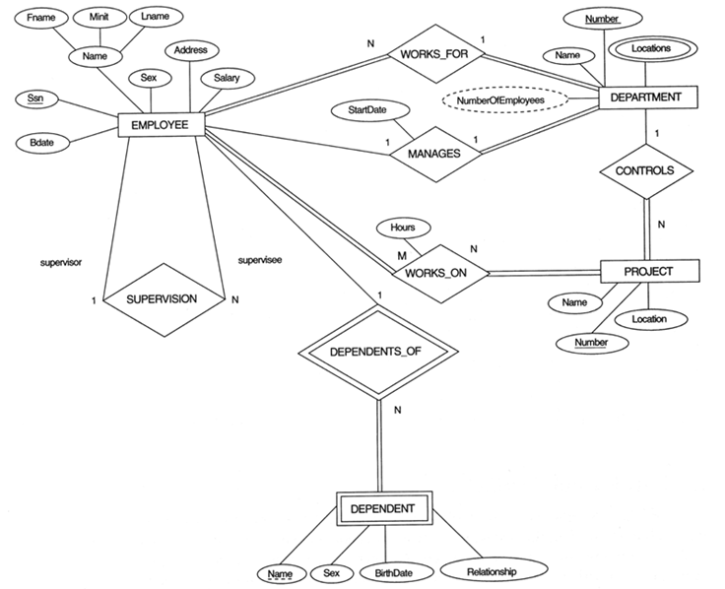
The ER schema diagram for the COMPANY database.
Notes:
Example: We create the relations EMPLOYEE, DEPARTMENT, and PROJECT in the relational schema corresponding to the regular entities in the ER diagram. SSN, DNUMBER, and PNUMBER are the primary keys for the relations EMPLOYEE, DEPARTMENT, and PROJECT as shown.
*******************************
Need this for several examples
Ask them to try WK_For and WK_on and supervison

Slide 5
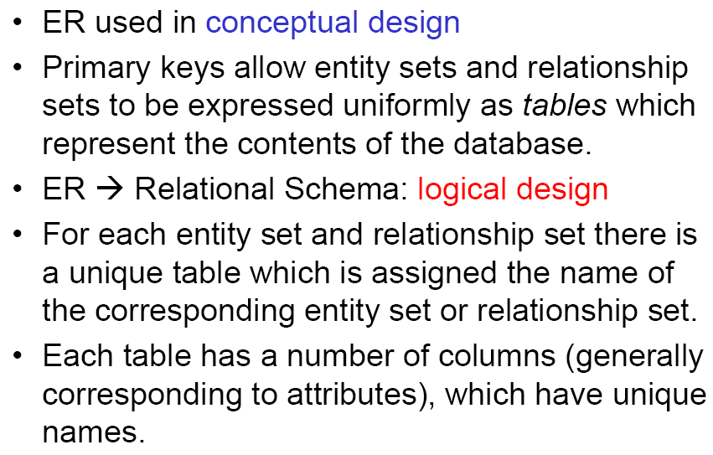
Logical Design
Notes:
Study ER and Relation model, how the two related? How to convert ER to relational model?

Slide 6
Basic Principles of Mapping ER/EER to Relational Model
Criteria:
  No loss of information
  Minimal redundancy
  Minimize the use of NULL
Basic rules:
  One table for each entity (optionally + FK)
    Same names, same attributes and same PK
  Relationship:
    FK
    Table + FK
Notes:
EER = enhanced entity relationship (adds OO concepts like inheritance). This will NOT be examinable for us.
We will use these criteria to evaluate whether your mapping is good or bad. Minimal redundancy: meaning no redundancy beyond FK
Criteria in preferred order … …
Minimal not NO redundancy, we will talk about this in the next chapter.
Two basic approaches: use a table or use FK; if FK will do, don’t use a table (of course must make sure the criteria hold)

Slide 7
Mapping Outline
ER-to-Relational Mapping Algorithm
Step 1: Mapping of Regular Entity Types
Step 2: Mapping of Multivalued attributes
Step 3: Mapping of Weak Entity Types
Step 4: Mapping of Binary 1:1 Relation Types
Step 5: Mapping of Binary 1:N Relationship Types.
Step 6: Mapping of Binary M:N Relationship Types.
Step 7: Mapping of N-ary Relationship Types.
Mapping EER Model Constructs to Relations (Not Covered)
Step 8: Options for Mapping Specialization or Generalization.
Step 9: Mapping of Union Types (Categories).
Notes:
How to convert ER diagrams into relations?
Following this order: strong, multivalued attribute, weak etc.

Slide 8
Step 1: Strong Entity
Step 1: Mapping of Regular Entity Types.
  For each regular (strong) entity type E, create a relation R that includes all the simple attributes of E.
    Same names
  Primary key (PK) of E becomes PK of R.
Notes:
Starting with strong/regular entity type, two things: the tables and key
Composite attributes: …
Simple A: one column for each simple A
Composite attribute: one column for each component
Composite key:
Choose one of the key attributes of E as the primary key for R. If the chosen key of E is composite, the set of simple attributes that form it will together form the primary key of R.
New R: A to A and K to K

Slide 9
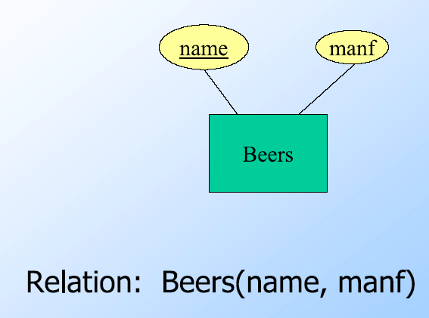
Example: Strong Entity Set
Notes:
Strong Entity Set As Table
Key in ER is till used as key in the relation/table
Name should be underlined as key.

Slide 10
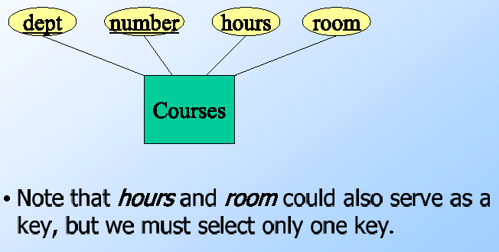
Example: Multi-attribute key
Notes:
If the chosen key of E is composite, the set of simple attributes that form it will together form the primary key of R.
ANS: Courses(dept, number, hours, room)

Slide 11
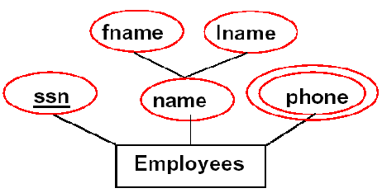
Example: Composite Attribute
Notes:
What about composite attribute in ER? Recall that in relational model, each attribute must be simple.
Composite attribute: one column for each component
ANS: Employees(ssn, fname, lname)

Slide 12
Step 2: Multivalue
Step 2: Mapping of Multivalued attributes.
  Suppose A is a multi-valued attribute, belonging to a relation (or attribute) named S.
  Create a new relation, R.
  R will include an attribute corresponding to A, plus PK attribute, K, of S.
  Make K a FK to S.K in R
  Make the PK of R = A + K
Notes:
What about multivalue attribute in ER? Recall that in relational model, each attribute must be simple.
Example: The relation DEPT_LOCATIONS is created. The attribute DLOCATION represents the multivalued attribute LOCATIONS of DEPARTMENT, while DNUMBER-as foreign key-represents the primary key of the DEPARTMENT relation. The primary key of R is the combination of {DNUMBER, DLOCATION}.

Slide 13
Example: Mapping Multivalue Attribute
Notes:
New table + FK: because borrow something from someone, need to make a note (use FK)
Employee(ssn, fname, lname)
Phone(phone, ssn), FK: phone.ssn reference Employee.ssn

Slide 14
Step 3: Weak Entity
Step 3: Mapping of Weak Entity Types
  For each weak entity type W with owner entity type E, create a relation R and include all simple attributes of W as attributes of R.
  Include the primary key of owner as foreign key of R
  PK of R = PK of the owner + the partial key of W
  The Identifying relationship is ignored!
Notes:
Example: Create the relation DEPENDENT in this step to correspond to the weak entity type DEPENDENT. Include the primary key SSN of the EMPLOYEE relation as a foreign key attribute of DEPENDENT (renamed to ESSN).
The primary key of the DEPENDENT relation is the combination {ESSN, DEPENDENT_NAME} because DEPENDENT_NAME is the partial key of DEPENDENT.
For each weak entity type W in the ER schema with owner entity type E, create a relation R and include all simple attributes (or simple components of composite attributes) of W as attributes of R.
Include as foreign key attributes of R the primary key attribute(s) of the relation(s) that correspond to the owner entity type(s).
The primary key of R is the combination of the primary key(s) of the owner(s) and the partial key of the weak entity type W, if any.
New R: A + PK from owner

Slide 15
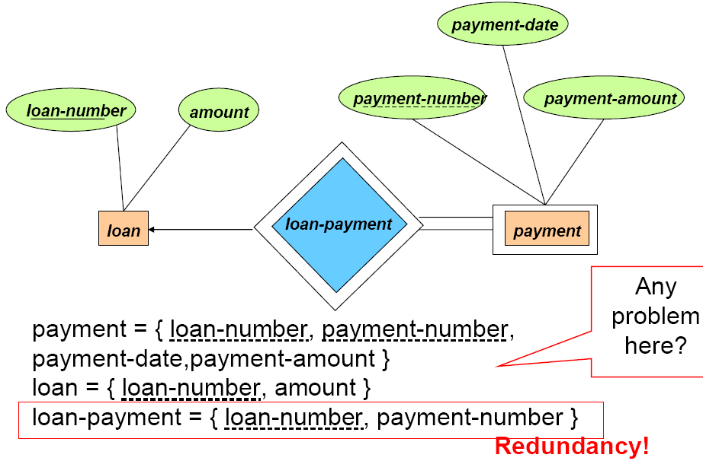

Example: Identifying Relationship
Notes:
The supporting relationship (identifying) is redundant and yields no relation
Why redundant? LP table is to store which payment pays which loan but this info is implied by the FK between P and L table. Hence not necessary.
Hint: one simple way to check relationship: see whether there is FK among the participants! If so, the extra table is redundant! If no, the relationship is lost in the process, error!

Slide 16
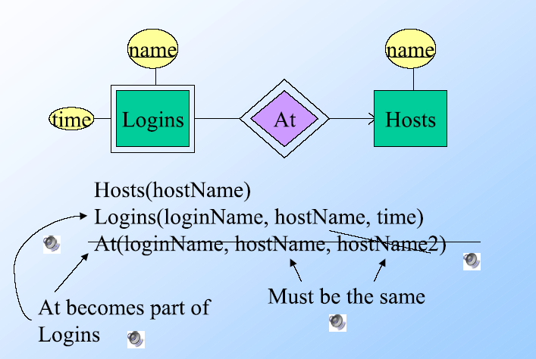
Exercise: Weak Entity Set
Notes:
The supporting relationship (identifying) is redundant and yields no relation
How about the key here?

Slide 17
Exercise: Weak Entity Set
SSN
Employee
1
Name
Dependent_Of
Relationship
N
Name
Dependent
Birthday
Sex
Notes:
Weak Entity Set As Table, What is the table for Dependent?
Now try yourself!
Example: Create the relation DEPENDENT in this step to correspond to the weak entity type DEPENDENT. Include the primary key SSN of the EMPLOYEE relation as a foreign key attribute of DEPENDENT (renamed to ESSN).
The primary key of the DEPENDENT relation is the combination {ESSN, DEPENDENT_NAME} because DEPENDENT_NAME is the partial key of DEPENDENT.
Go back to P.6 and P.7 …

Slide 18
Step 4: 1 to 1
Step 4: Mapping of Binary 1:1 Relation Types
For each 1:1 relationship R, identify the participating relations S and T. Three possible approaches:
  Foreign Key approach: If only the participation of S is total, include PK of T as FK in S.
  Merged relation option: If participations of S and T are both total, merging S and T and the relationship into a single relation.
      One of PK becomes PK of the new relation
  Cross-reference option: If none is total, set up a third relation C which includes PKs of S and T as FKs.
      One of the PKs will form the primary key of C.
Notes:
Relationship is done after entity mapping. So all participants are already represented as relations!!!!!!!!!!!!!
3 approaches for relationship: merging, FK, table+FK, in preferred order
Why not the other way around for FK? Use of NULL. Why not merge? Use of NULL
Why not FD? Too much redundancy!
3) Why third table, why not FK? Use of NULL, Note that only one row per pair.
+++++++++++++
One simple way to check whether there is redundant or whether relationship is not lost in the mapping, check whether there is FK among the participants!
+++++++++++++
Example in P.46 and P.47
Foreign Key approach: Choose one of the relations-S, say-and include a foreign key in S the primary key of T.
It is better to choose an entity type with total participation in R in the role of S. Why? Include attributes of R as attributes of S. If S is not total, NULL values need to be inserted for those not participated!!!!!!
In Total S: (FK = PK from T)+ A of relationship + A of S
Use FK to represent the R
E manages D: total for D, what if FK in E instead of D? Null used for non-manager E
(2) Merged relation option: An alternate mapping of a 1:1 relationship type is possible by merging the two entity types and the relationship into a single relation. Include attributes of R as attributes of S or T;
This may be appropriate when both participations are total
S+T+A
One to one and for all, one table is enough
(3) Cross-reference or relationship relation option: The third alternative is to set up a third relation R for the purpose of cross-referencing the primary keys of the two relations S and T representing the entity types. PK of S + PK of T + attributes of R
Appropriate when relationship has attributes as well?
New R = (FK=PK from S) + (FK=PK from T) + A
Why not FK? Null have to be used for non-participants.
Man married Woman,
Why not use tables for 1 and 2? No need, tables+FK, redundancy!
Example: 1:1 relation MANAGES is mapped by choosing the participating entity type DEPARTMENT to serve in the role of S, because its participation in the MANAGES relationship type is total.

Slide 19
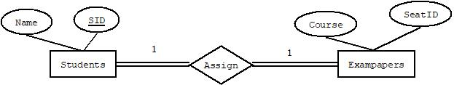
Example: Mapping 1:1 – Both Total
Exam seating: students, exampapers (both are total)
Before: Students(Name, SID)
Exampapers(Course, SeatID)
After: SE(Name, SID, Course, SeatID)

Slide 20
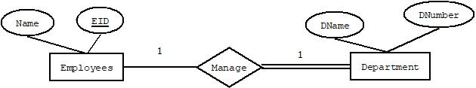

Example: Mapping 1:1 – One Total
Manage: employee, department (department is total)
Before: Employees(Name, EID)
Department(DName, DNumber)
After: Employees(Name, EID)
Department(DName, Dnumber, MgrEID)

Slide 21
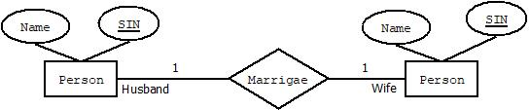
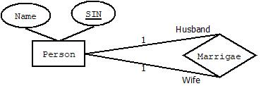

Example: Mapping 1:1 – No Total
Marriage: person, person (neither is total)
Before: Person(Name, SIN)
After: Person(Name, SIN)
Marriage(HusbandSIN, WifeSIN)
Notes:
Additional discussion if interested:
For Marriage, we can also use just FK approach
So FK vs. table : FK might have Null vs. Table without Null but more dependency
So if come down to: Null vs. some dependency via FK. We prefer the latter because FK are managed by DBMS, you don’t need to do anything to address them. But Null has to be managed by you as the developer, more work

Slide 22
Step 5: 1 to Many
Step 5: Mapping of Binary 1:N Relationship Types.
  Assume S and T are participants and relation S is at the N-side
  Include PK of T as FK in S
  Include any simple attributes of the relationship as attributes of S.
Notes:
This includes N to 1 … look from the other way around. Why not FK in minority? Can not set up FK. FK points to which value?
E WK_In D,
Why not table? More rows (many pairs), More FKs, a lot more redundancy
Side effect: possible use of NULL.
For each 1:N relationship type R, identify the relation S that represent the participating entity type at the N-side of the relationship type.
Include as foreign key in S the primary key of the relation T that represents the other entity type participating in R.
Include any simple attributes of the 1:N relation type as attributes of S.
For S at N: A of S + A of relationship + FK=PK of T
Example: 1:N relationship types WORKS_FOR, CONTROLS, and SUPERVISION in the figure. For WORKS_FOR we include the primary key DNUMBER of the DEPARTMENT relation as foreign key in the EMPLOYEE relation and call it DNO.
Example in P.6 and P.7

Slide 23

The ER schema diagram for the COMPANY database.
Notes:
Example: We create the relations EMPLOYEE, DEPARTMENT, and PROJECT in the relational schema corresponding to the regular entities in the ER diagram. SSN, DNUMBER, and PNUMBER are the primary keys for the relations EMPLOYEE, DEPARTMENT, and PROJECT as shown.
*******************************
Need this for several examples
Ask them to try WK_For and WK_on and supervison

Slide 24
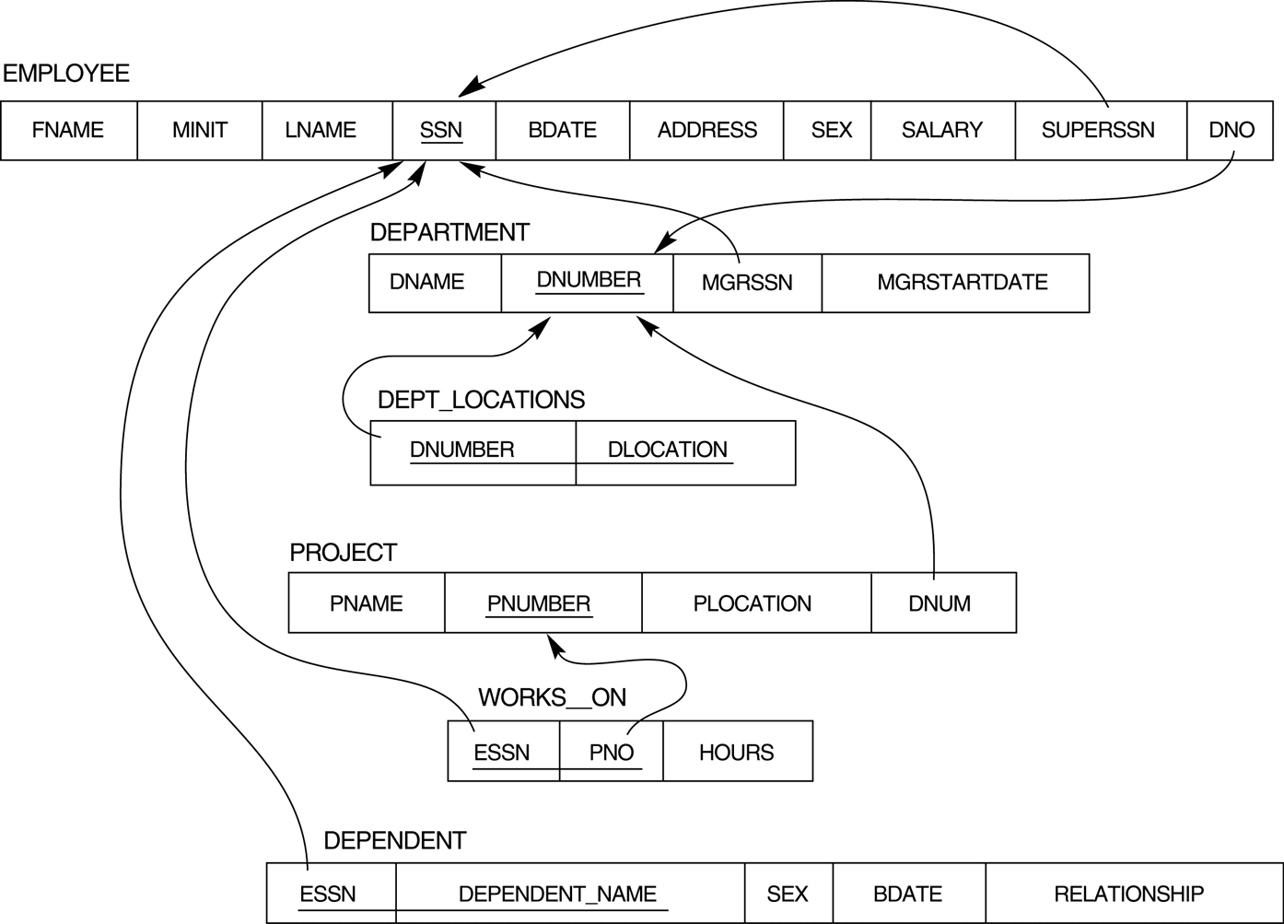
Mapping to Relations
--- A Complete Example
Notes:
Imagine that your DB design starts from Relational model. Many of the FKs will be lost! (association among tables are not very trivial/expressive)
FIGURE 7.2
Result of mapping the COMPANY ER schema into a relational schema.
Check whether info lost: E? (check for tables) R? (FK among tables). Not done yet no info lost does not mean it is good. What if the original ER is bad? Then mapping relation will be bad too!
++++++++++++++++++++++++++++++++++
Ignore the arrows now!
*******************************
Need this for several examples

Slide 25
Step 6: Many to Many
Step 6: Mapping of Binary M:N Relationship Types.
  For each M:N relationship type R, create a new relation C to represent R. (S and T are participants)
  Include PKs of S and T as FKs in C
    Their combination will form the primary key of C.
  Include any simple attributes of R as attributes of C.
Notes:
Why not FK? E Work_on Prj
For each M:N relationship type R, create a new relation C to represent R. (S and T are participants)
Include as foreign key attributes in S the primary keys of the relations that represent the participating entity types; their combination will form the primary key of S.
Also include any simple attributes of the M:N relationship type (or simple components of composite attributes) as attributes of S.
Example: The M:N relationship type WORKS_ON from the ER diagram is mapped by creating a relation WORKS_ON in the relational database schema. The primary keys of the PROJECT and EMPLOYEE relations are included as foreign keys in WORKS_ON and renamed PNO and ESSN, respectively.
Attribute HOURS in WORKS_ON represents the HOURS attribute of the relation type. The primary key of the WORKS_ON relation is the combination of the foreign key attributes {ESSN, PNO}.
Example in P.46 and P.47
New R = A of relationship + (FK=PK from T) + (FK=PK from S)

Slide 26

The ER schema diagram for the COMPANY database.
Notes:
Example: We create the relations EMPLOYEE, DEPARTMENT, and PROJECT in the relational schema corresponding to the regular entities in the ER diagram. SSN, DNUMBER, and PNUMBER are the primary keys for the relations EMPLOYEE, DEPARTMENT, and PROJECT as shown.
*******************************
Need this for several examples
Ask them to try WK_For and WK_on and supervison

Slide 27
Mapping to Relations
--- A Complete Example
Notes:
Imagine that your DB design starts from Relational model. Many of the FKs will be lost! (association among tables are not very trivial/expressive)
FIGURE 7.2
Result of mapping the COMPANY ER schema into a relational schema.
Check whether info lost: E? (check for tables) R? (FK among tables). Not done yet no info lost does not mean it is good. What if the original ER is bad? Then mapping relation will be bad too!
++++++++++++++++++++++++++++++++++
Ignore the arrows now!
*******************************
Need this for several examples

Slide 28
Exercise: Relationship to Relation
name
addr
name
manf
Drinkers
N
Likes
M
Beers
husband
N
1
N
M
1
Favorite
Buddies
1
wife
Married
Notes:
Make sure to follow the steps in order!
ANS:
Number of tables: 5
Number of FKs: 7

Slide 29
Step 7: N-ary
Step 7: Mapping of N-ary Relationship Types.
  For each n-ary relationship type R, create a new relation C to represent R
  Include PKs of all participants as FKs in C
    Their combination will form the primary key of C.
  Include any simple attributes of R as attributes of C
Notes:
Example: The relationship type SUPPY in the ER below. This can be mapped to the relation SUPPLY shown in the relational schema, whose primary key is the combination of the three primary keys {SNAME, PARTNO, PROJNAME}
For each n-ary relationship type R, where n>2, create a new relationship S to represent R.
Include as foreign key attributes in S the primary keys of the relations that represent the participating entity types.
Also include any simple attributes of the n-ary relationship type (or simple components of composite attributes) as attributes of S.
New R = A of relationship + (FK=PK from T) + (FK=PK from S) + …

Slide 30
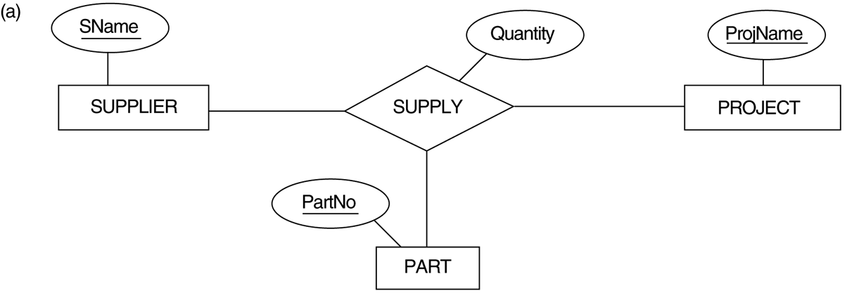

Example: Ternary

Slide 31
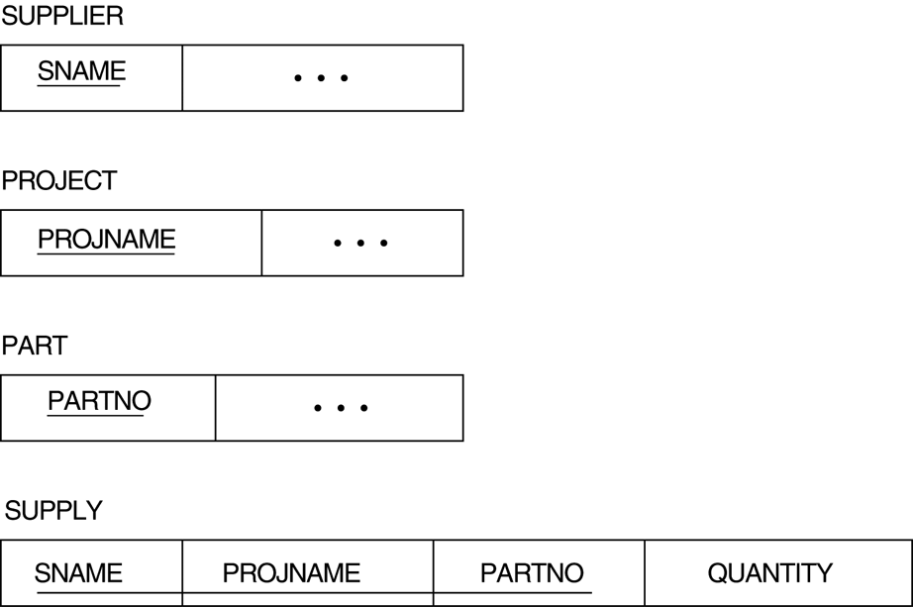
Example: Ternary Mapping

Slide 32
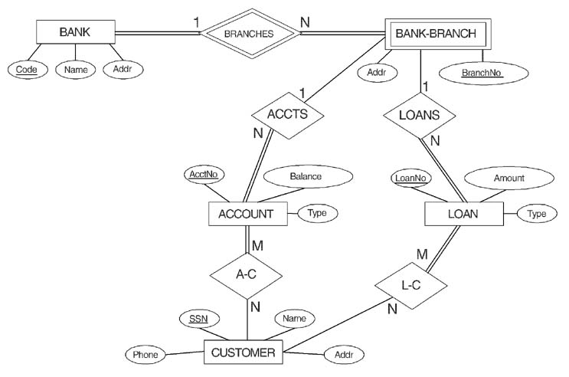
In Class Exercise: Mapping
© The Benjamin/Cummings Publishing Company, Inc. 1994, Elmasri/Navathe, Fundamentals of Database Systems, Second Edition
Notes:
Quick and dirty way to check your correctness
Number of tables? 7
Number of FKs? 7
******************************
Step 1: regular entity
Entity to table, attribute to attribute, PK to PK
Bank(Code, Name, Addr)
Account(AcctNo,Type, Balance)
Customer(Phone, SSN, Name, Addr)
Loan(LoanNo, Amount, Type)
Step 2: Multivalued attribute
None
Step 3: Weak Entity
Table and FK, create a new table for weak entity Bank-Branch and add the PK of the owner Bank table as FK.
Bank-Branch(Code, BranchNo, Addr), FK: Bank-Branch.Code references Bank.Code
Step 4: 1 to 1
None
Step 5: 1 to many
ACCTS -> FK approach, add PK of the Bank-Branch table into the Account table as FK. Need to modify Account table as:
Account(AcctNo,Type, Balance, Code, BranchNo), FK: Account.(Code, BranchNo) references Bank-Branch.(Code, BranchNo)
LOANS-> FK approach, add PK of the Bank-Branch table into the Loan table as FK. Need to modify Loan table as:
Loan(LoanNo,Type, Amount, Code, BranchNo), FK: Loan.(Code, BranchNo) references Bank-Branch.(Code, BranchNo)
Step 6: Many to many
Table + FKs
A-C-> create a new table including PKs of both participants as FKs:
A-C(AcctNo, SSN), FKs: A-C.AcctNo references Account.AcctNo, A-C.SSN references Cusomter.SSN
L-C-> create a new table including PKs of both participants as FKs:
L-C(LoanNo, SSN), FKs: L-C.LoanNo references Loan.LoanNo, L-C.SSN references Cusomter.SSN
Step 7: N-ary
None.
So final answer:
Bank(Code, Name, Addr)
Customer(Phone, SSN, Name, Addr)
Bank-Branch(Code, BranchNo, Addr), FK: Bank-Branch.Code references Bank.Code
Account(AcctNo,Type, Balance, Code, BranchNo), FK: Account.(Code, BranchNo) references Bank-Branch.(Code, BranchNo)
Loan(LoanNo,Type, Amount, Code, BranchNo), FK: Loan.(Code, BranchNo) references Bank-Branch.(Code, BranchNo)
A-C(AcctNo, SSN), FKs: A-C.AcctNo references Account.AcctNo, A-C.SSN references Cusomter.SSN
L-C(LoanNo, SSN), FKs: L-C.LoanNo references Loan.LoanNo, L-C.SSN references Cusomter.SSN

Slide 33
Summary of ER Mapping
ER Model Relational Model
Entity type “Entity” relation
1:1 or 1:N relationship type Foreign key (or “relationship” relation)
M:N relationship type “Relationship” relation and two foreign keys
n-ary relationship type “Relationship” relation and n foreign keys
Simple attribute Attribute
Composite attribute Set of simple attributes
Multivalued attribute Relation and foreign key
Value set Domain
Primary key Primary key
Notes:
Summary of Mapping ERD constructs and constraints

Slide 34
Summary of Today’s Lecture
Mapping of Regular Entity Types
Mapping of Multivalued attributes
Mapping of Weak Entity Types
Mapping 1:1
Mapping 1 to N
Mapping N to M
Mapping ternary and n-ary
Note: If the relationship has simple attributes, they should be included in the new table or in the FK table.

