Slide 1

Review of Last Lecture
Mapping of Regular Entity Types: table
Mapping of Multivalued attributes: new table + FK
Mapping of Weak Entity Types: table + FK
Mapping 1:1: merged, FK or new table + FKs
Mapping 1 to N: FK approach
Mapping N to M: new table + FKs
Mapping ternary and n-ary: new table + FKs
Note: If the relationship has simple attributes, they should be included in the new table or in the FK table.

Slide 2
Today’s Plan
Why redundancy is trouble
  Update anomaly and NULL
Functional Dependency
  How to use key and FD to decide whether a design is good
Decomposition
Three main goals of schema refinement
  How to check whether a decomposition is lossless
  How check for FD preserving
  How to check for minimal redundancy
Different normal forms and BCNF

Slide 3
NORMALIZATION
CHAPTER 08
Collin Roberts
University of Waterloo
Notes:
Mapping allows us to come up with a relational model matches the ERD.
But how do you know the original ERD is good?
What if it is defective?
The resulting ERD would be defective as well.
We need to add another checkpoint after the mapping is done.

Slide 4
Recommended Readings
Textbook Chapters 10 and 11

Slide 5
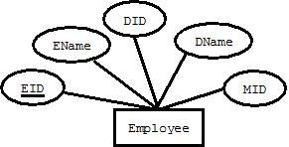
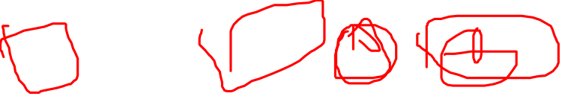
Motivation for Normalization
Interview: “We need a DB to store employee info along with their department and manager … …”
ERD
Mapping
Employee(EID, EName, DID, MID, DName)
Is this good?
Notes:
Recall that in DB design, gather user info, sketch it in ER, map ER to relations using some rules.
If we follow the rules to the letter, relation will be an exact match to ER.
But this approach relies on the ER being good! What if the origin ER is bad? Remember: ER is quite subjective. Might have Repetition or loss of information.
To help you understand this issue better: take a look at this example: Is this design good? Not good, why? Redundancy:
How do we detect and fix redundancy?
We need some well-defined process to help to decide. This is where normalization comes in.

Slide 6
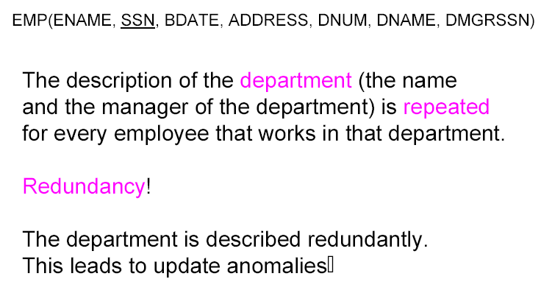
What is Wrong?
Notes:
What is wrong about redundancy other than waste space, disk is cheap!
Leads to a serious problem: update anomaly!
3 scenarios
-delete or insert new D or new E => use null => other problems

Slide 7

What is Wrong?
Modification anomaly: what if Karen becomes the new manager in Marketing?
Deletion anomaly: what if Jack resigns?
Insertion anomaly: what if we want to create a new department called Public Relations?
Insertion anomaly: what if Mike is hired but we have yet to decide what department to put him in?
ENAME | SSN | BDATE | ADDRESS | DNUM | DNAME | DMGRSSN
John | A1 | … | … | 1 | Marketing | A2
Kate | A2 | … | … | 1 | Marketing | A2
Karen | A3 | … | … | 1 | Marketing | A2
Jack | A4 | … | … | 2 | Sales | A4
NULL | NULL | NULL | NULL | 3 | PR | NULL
Mike | A5 | … | … | NULL | NULL | NULL
Notes:
Mod anomaly: what if Karen becomes the new manager in Marketing? All employee profiles in the department needs to be updated. If not, inconsistency might occur.
Del anomaly: what if Jack resigns? Delete Jack but also delete the department (Jack is the last one in the department)!
Ins anomaly: what if we want to create a new department called Public Relation? You can NOT! Because the primary key SSN is NULL which is ILLEGAL
Ins anomaly: what if Mike is hired but yet to decide what department to put him in? Need to used NULL values for the department columns.

Slide 8
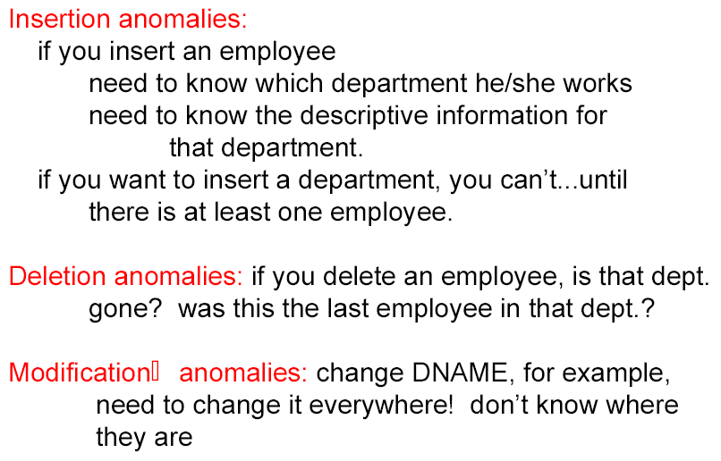
Update Anomaly
Notes:
All these are called update anomaly, all created by redundancy.
Delete D (dismantled), E is gone (fired) as well?
Some of these problems can be fixed using null. But that creates another problem … …

Slide 9
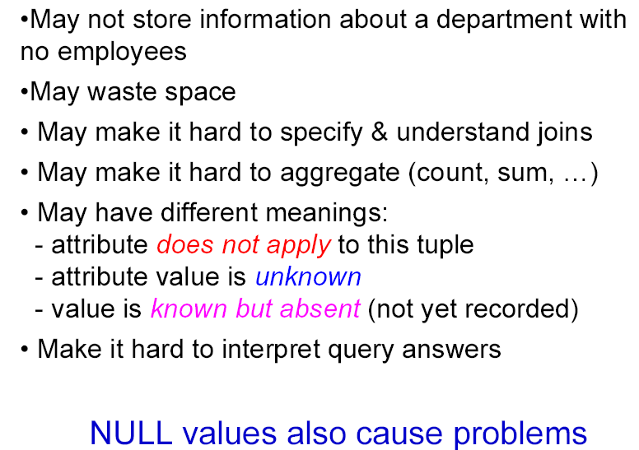
Using Null
Notes:
Summary of why NULL is bad news.
If E join D, and DNO is null for E how to join them? How about count, sum etc? Interpretations
Conclusions: null causes other problems!
How do we detect and fix these problems: two ways … …

Slide 10
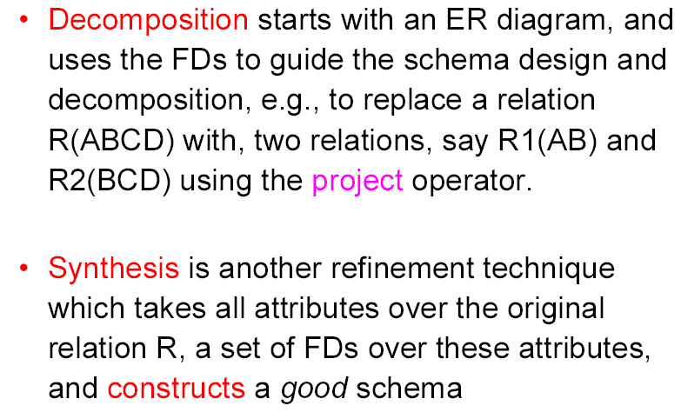
Schema Refinement Techniques
Notes:
Focus on the first one, more common, and easier, follow our ER to relations, we already have tables, just need to find which is good and how to convert bad to good.
Synthesis: no tables, only attributes.
Regardless which one, both based on FD, so take a detour to discuss FD, Functional Dependencies.

Slide 11
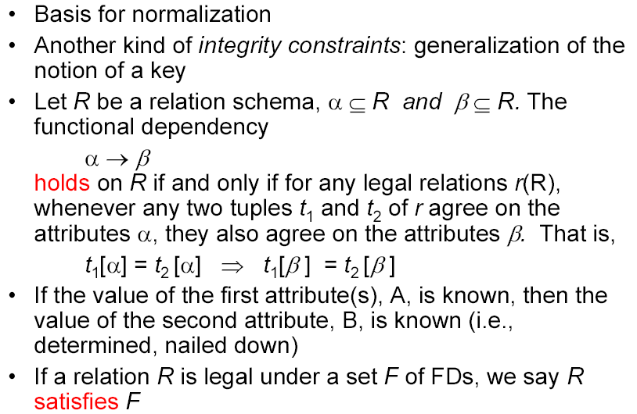
Functional Dependency (Formally)

Slide 12
Functional Dependency (Informally)
If attributes α and β come from the same relation R, and the value of α determines the value of β, we say β is functionally depends on α, denoted as
α → β
In other words, if we know the value for α, we know the value for β.
The dependency could be among more than two attributes, on both sides!
Notes:
In function Y = X+2, If value of X is known, then the value Y is known too. So X determines Y. Say concept applies here, instead of numbers, we use attributes.

Slide 13
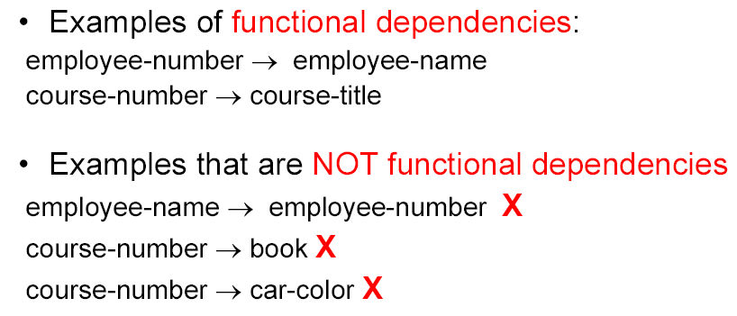
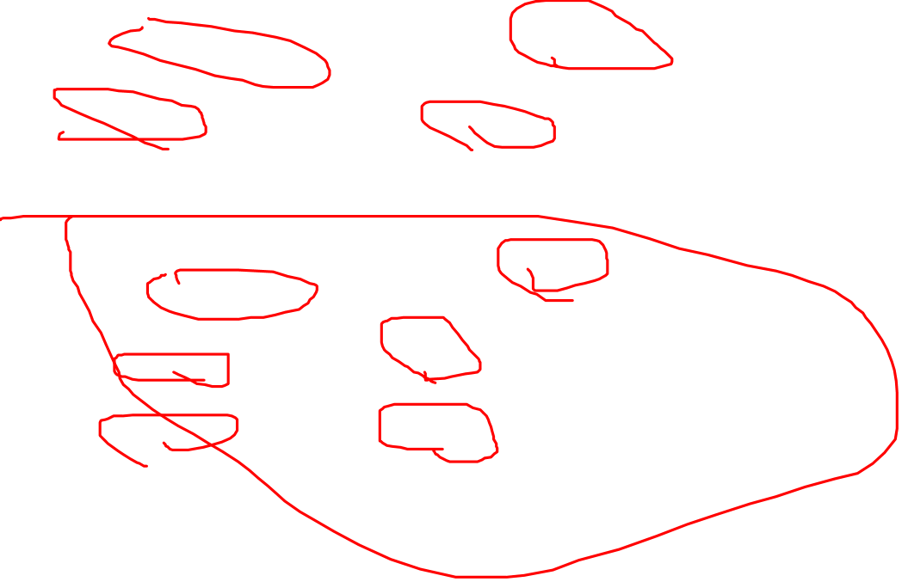
FD: Example

Slide 14
Basic Rules of FD
Note (A, B) is sometimes written as (AB)
A -> A
  Example: Name -> Name
  This is called a trivial FD
If A -> B, then (AC) -> B
  Example: SID -> SName, so (SID, GPA) -> SName
  This is also called a trivial FD
If A -> B and X -> B, then (AX) -> B.
  Example: SIN -> SName and Email -> SName, so (SIN, Email) -> SName
If A -> B and B -> C, then A -> C
  Example: SSN -> DNO and DNO -> DName, so SSN -> DName
Notes:
These rules are different from the rules provided in the text.

Slide 15

Good Design?
What are the CKs?
SIN
What are the FDs?
SIN -> Fname,Lname,Birthday,DNO,Salary,Phone, Address
Employee(SIN,Fname,Lname,Birthday,DNO,Salary,Phone, Address)
Is this a good design?
Notes:
Good because no redundancy.
Pay attention to CK and FDs: all FDs come from CK.
SIN
SIN -> fname, lname,
SIN -> SIN,Fname,Lname,Birthday,DNO,Salary,Phone, Address

Slide 16
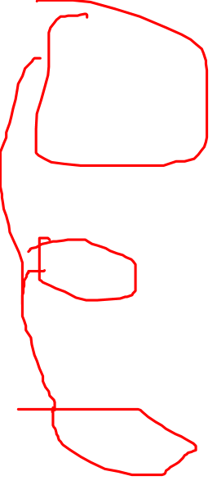
Good Design?
Student(SID,E-mail,Sname,Program,GPA,Standing,StartYear,Address)
What are the CKs?
SID
E-mail
What are the FDs?
SID -> E-mail,Sname,Program,GPA,Standing, StartYear,Address
E-mail -> SID, Sname,Program,GPA,Standing,StartYear,Address
Is this a good design?
Notes:
Good because no redundancy.
Pay attention to CK and FDs: all FDs come from CK.
SID
E-mail
SID -> any attribute combo
SID->E-mail,Sname,Program,GPA,Standing,StartYear,Address
E-mail->SID, Sname,Program,GPA,Standing,StartYear,Address

Slide 17
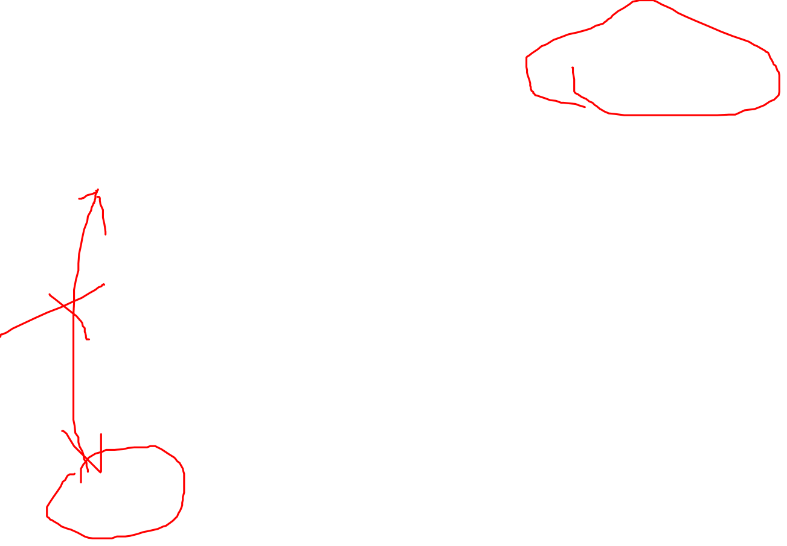
Good Design?
Employee(ENAME,SIN,BDATE,ADDRESS,DNUM,DNAME,MGRSIN)
What are the CKs?
SIN
What are the FDs?
SIN -> ENAME,BDATE,ADDRESS,DNUM,DNAME,MGRSIN
DNUM -> DNAME, MGRSIN
MGRSIN - > DNUM, DNAME
Is this a good design?
Notes:
Bad: because of redundancy. Department info repeated for every employee works for that department.
Pay attention to CK and FDs: NOT all FDs come from CK
SIN
SIN-> any (ENAME,BDATE,ADDRESS,DNUM,DNAME,MGRSIN)
DNUM->DNAME,MGRSIN

Slide 18
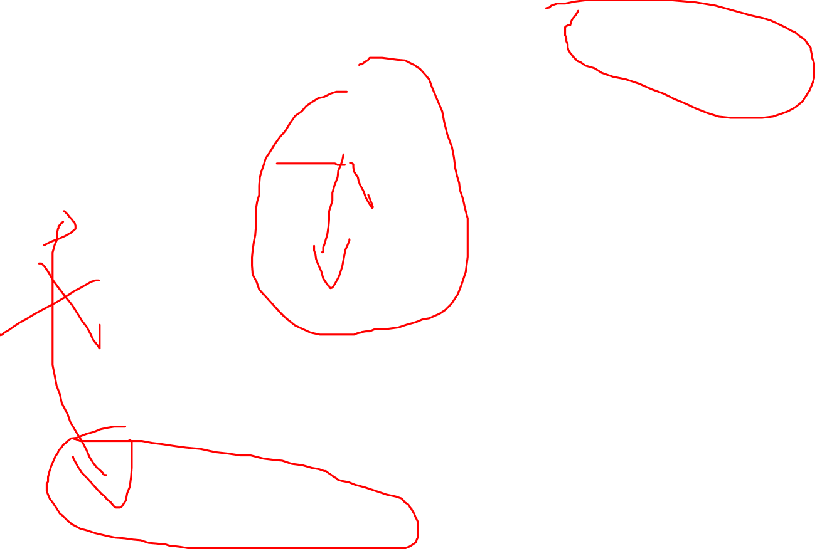
Good Design?
Std_Course(SID,E-mail,Sname, Cnum, Cname,Pre-req,Grade)
What are the CKs?
(SID, Cnum)
(E-mail, Cnum)
What are the FDs?
(SID, Cnum) - > Everything
(E-mail, Cnum) -> Everything
Cnum -> Cname, Pre-req
SID -> Email, Sname
E-mail -> SIDm, Sname
Is this a good design?
Notes:
Bad because of redundancy: course info repeated fro every student taking the same course.
Pay attention to CK and FDs: NOT all FDs come from CK
(SID, Cnum)
(E-mail, Cnum)
(SID, Cnum)-> E-mail,Sname, Cname,Pre-req,Grade
(E-mail, Cnum)-> SID,Sname,Cname,Pre-req,Grade
Cnum->Cname,Pre-req
SID->,E-mail,Sname
E-mail->SID, Sname

Slide 19
Do you see a pattern?
In all good designs, all FDs are based on CKs (left-hand side of the FD is always a CK)
In all bad designs, not all FDs are based on CKs (left-hand side of the FD is NOT always a CK)
Normalization approach
  Break up a table until all FDs are based on CKs.
    Say, T(ABCDEFG) becomes T1(ACD) and T2(BEFG)
  The next slide presents a complete example
Notes:
I think you now should have realized the pattern: bad design has FDs coming from NOT-CKs.
This give us idea how to decide whether a design is good or bad: in good design, all FDs come from CKs
and in bad design, NOT all FDs come from CKs.
So we can decide whether a design is good, but how do we fix it if it is bad?

Slide 20
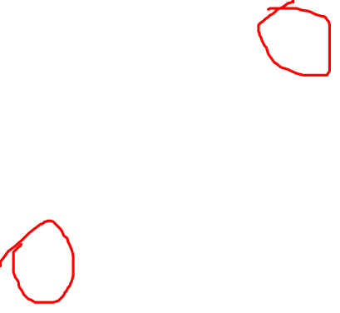
How to fix a bad design by decomposition
6
5
Employee(ENAME,SIN,BDATE,ADDRESS,DNUM,DNAME,MGRSIN)
2
4
1
3
Employee1(ENAME,SIN,BDATE,ADDRESS,DNUM)
2
4
1
3
6
5
X(DNUM,DNAME,MGRSIN)
What would be a good name for table X?
Notes:
Break up the bad design in such a way that the result tables only have FDs coming from CKs.

Slide 21
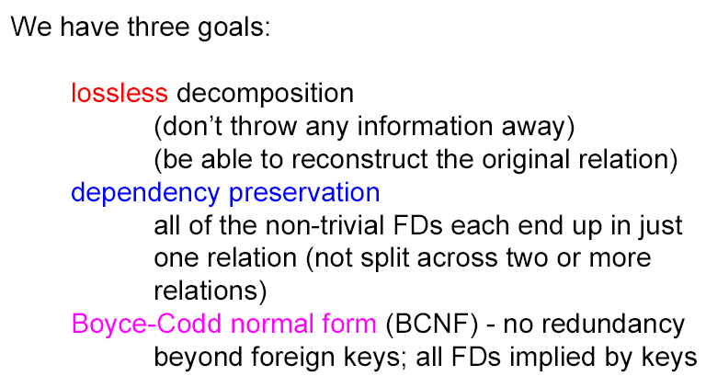
Goal of Decomposition
Notes:
To break a table properly, we need to (do our best) to meet three goals.
1. Because a relation T broken into T1 and T2, we need to ensure whatever stored in T is stored in T1 and T2, no less and no lmore
2. Preserve FDs
3. Minimize redundancy (not redundancy beyond FKs). Note that FKs are actually redundancy!!!! Because same attributes stored twice.
First one most important and must be obeyed.; last two are trade-off; can not achieve both in some occasions. Then one of them must be enforce at application level (for example, using SQL assertion and triggers).

Slide 22
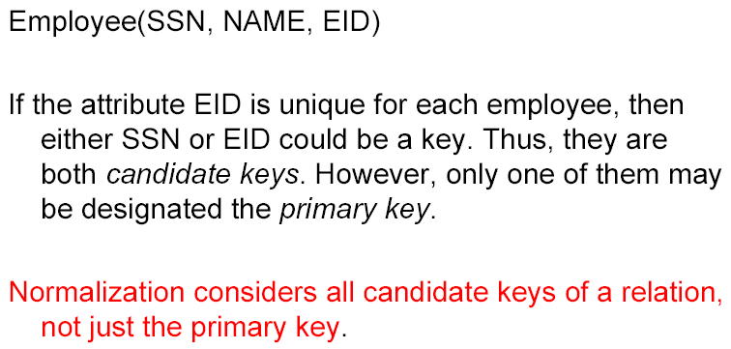
Candidate Key: Review
Notes:
Some concepts and review before moving on to normal form.
CK: a minimal set of attributes whose values are unique for each row in a table.
Also, superkey is a set of attributes whose values are unique for each row in a table.
So a primary key is a candidate key, a candidate key is a superkey.

Slide 23
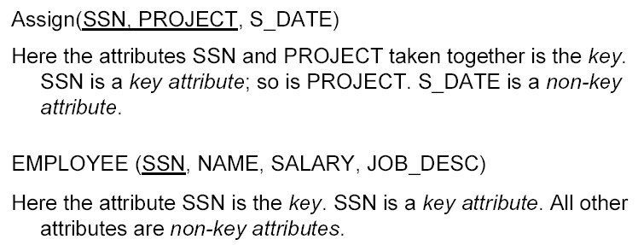
Keys and Key Attributes
Another way to view the key: there is a FD from the key to every attribute in the relation
Notes:
Key attribute: any attribute that is part of a candidate key is called a key attribute

Slide 24
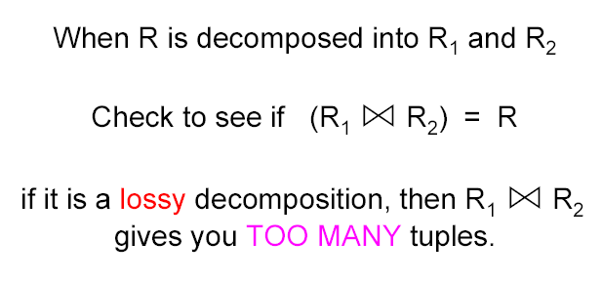
Lossless vs. Lossy Decomposition
*
*
Notes:
First and first most goal: How do we know the decomposition is correct, that is no information is lost?
More than the original!

Slide 25
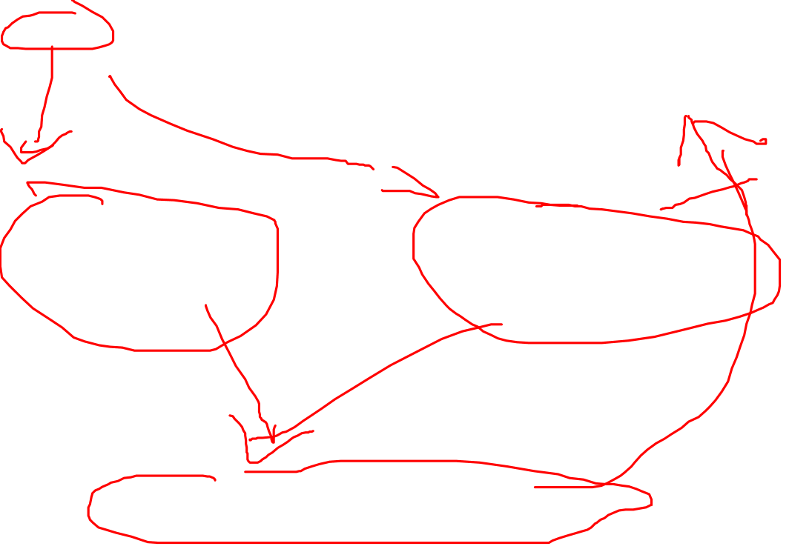
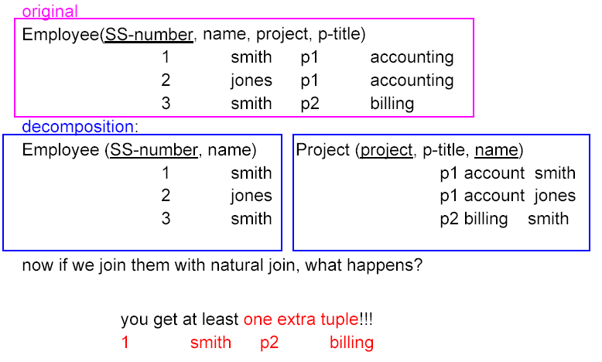
Example: Lossy Decomposition

Slide 26
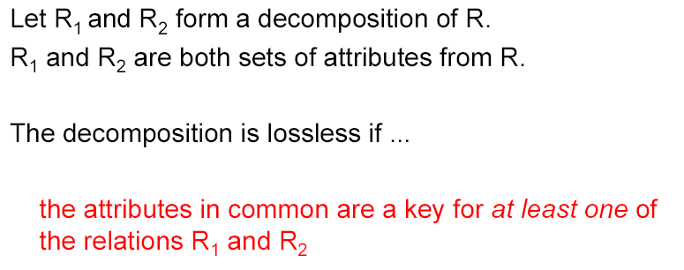
Test for Lossless Decomposition
Notes:
One simple way to check whether a decomposition is lossless or not
To keep it simple for now, decomposition is binary, that is splitting one table into two.

Slide 27
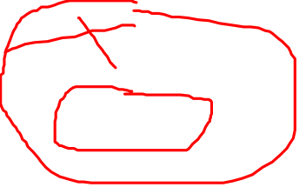
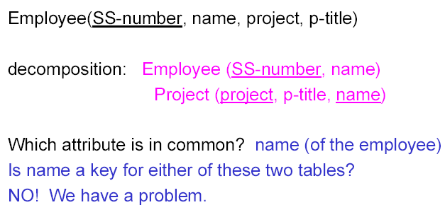
Example I: Lossless Test

Slide 28
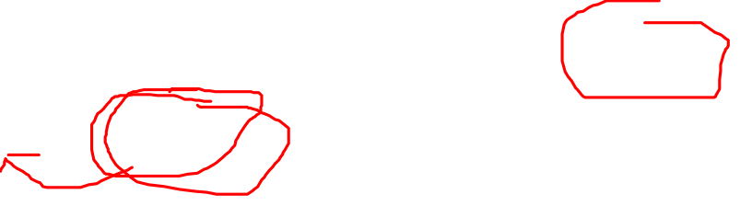
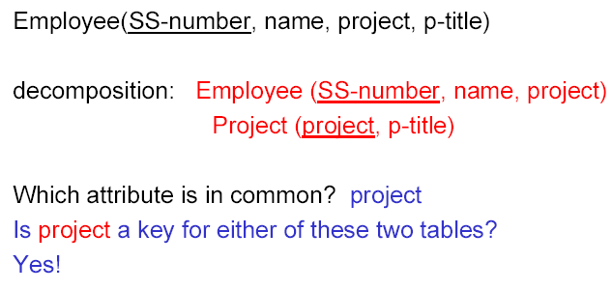
Example II: Lossless Test

Slide 29
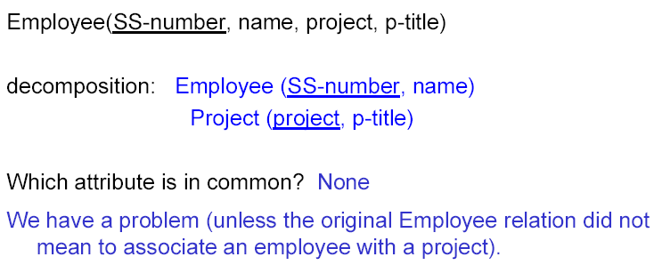
Example III: Lossless Test

Slide 30
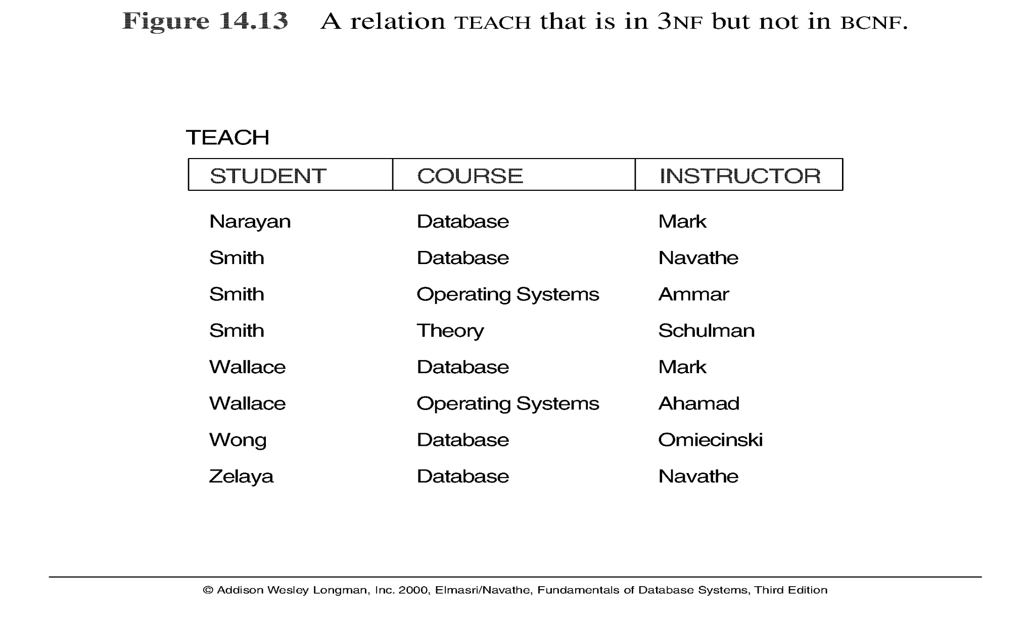
Lossless Exercise
Three possible decompositions for relation TEACH. Which one(s) is(are) lossless?
  {student, instructor} and {student, course}
  {course, instructor } and {course, student}
  {instructor, course } and {instructor, student}
Notes:
Only 3 is lossless.

Slide 31
Dependency Preserving
*We will discuss the concept of closure (F⁺) in the next lecture
Notes:
Second requirement of decomposition

Slide 32
Simple Way
One simple way to check whether a decomposition is FD preserving:
  After the decomposition, for each FD (A→B), check whether both A and B are in the same relation
    If yes, definitely yes
    If no, likely no
      Based on those FDs that are preserved, can you deduce the ones that were destroyed?

Slide 33
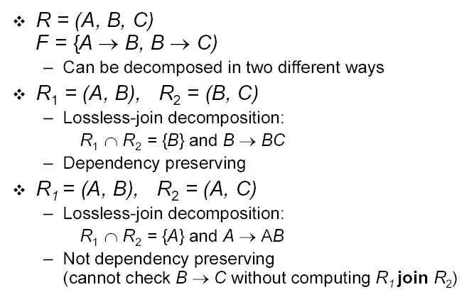
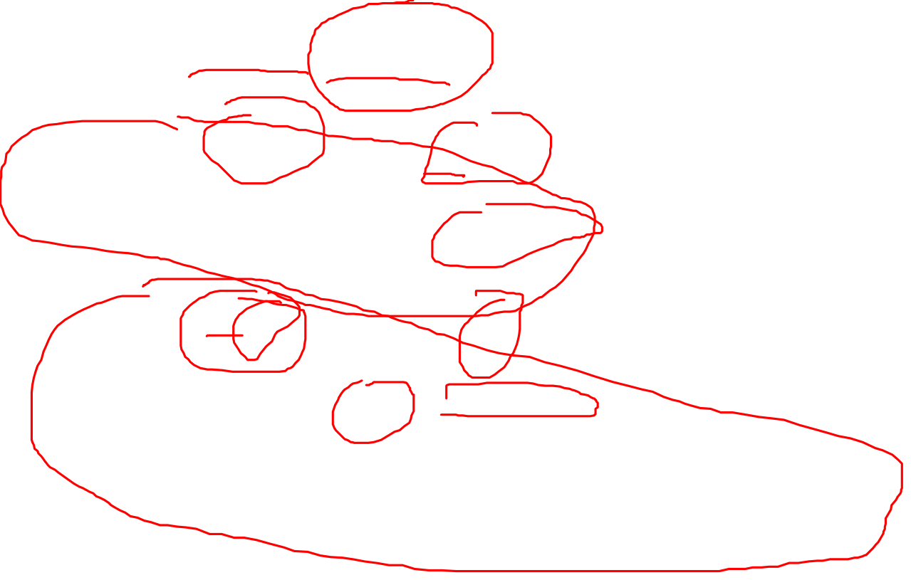
Decomposition: Example
Notes:
Say R magically split into R1 and R2 … …
First decomposition is good, but how can we achieve it? Special kind of decomposition called NF. But before we discuss NF, quick review of PK, CK, SK etc.

Slide 34
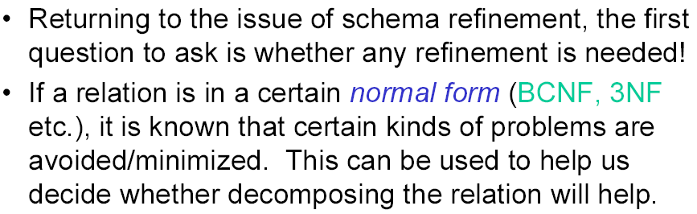
Normal Forms
Notes:
How to decompose a bad table (table with extra redundancy)?
We need to normalize it.

Slide 35
Normalization and Normal Form
Normalization: The process of decomposing unsatisfactory "bad" relations by breaking up their attributes into smaller relations which are in “certain” normal form
Normal form: Condition using keys and FDs of a relation to certify whether a relation schema is in a particular normal form
Notes:
Normalization is the process of splitting a bad table into smaller tables that are in some normal forms.
Once a table is in certain form, it is guaranteed to avoid /minimize certain redundancy problems.

Slide 36
Assumptions
During normalization, it is always assumed the following information is given:
  Relations with attributes, PKs, CKs, FKs and
  FDs!
Where do FDs come from? From the semantics of the problem!
  It is the responsibility of the user and DB developer to figure out together what the FDs are!
Notes:
Before we moving on to the actual decomposition, you must know that … …

Slide 37
Levels of Normal Form
2NF, 3NF, BCNF based on keys and FDs of a relation schema
4NF based on keys, multi-valued dependencies : MVDs; 5NF based on keys, join dependencies : JDs
  Additional properties may be needed to ensure a good relational design (lossless join, dependency preservation)
In this class, we only focus on BCNF as it is one of the most common NFs used in practice.
Notes:
6 levels of NF. In practice, only up BCNF or 3NF. Higher, becomes difficult to comprehend and more join

Slide 38
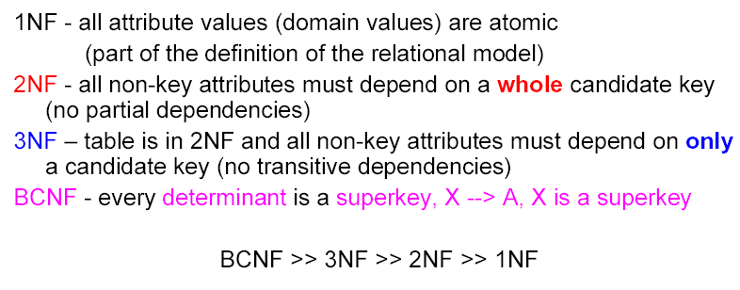
Important Normal Form
Notes:
There are at least 5 level of NF but usually only considered up to 3NF or BCNF, other two are for special cases.
For R to be in BCNF, every FD in R must meet the condition: where left hand side of every FD must be a superkey.
Also a CK or PK is also a superkey. So if the left side is a CK or PK in a FD, the FD meets the condition.

Slide 39
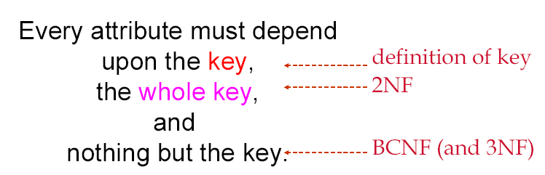
Normalization Made Easy (Ronald Fagin)

Slide 40
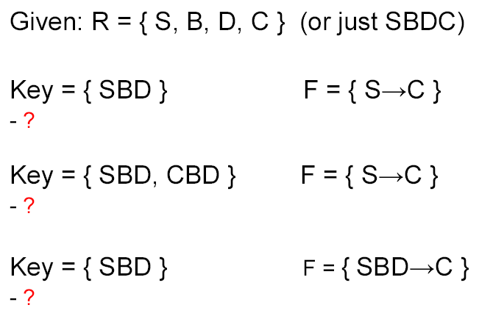
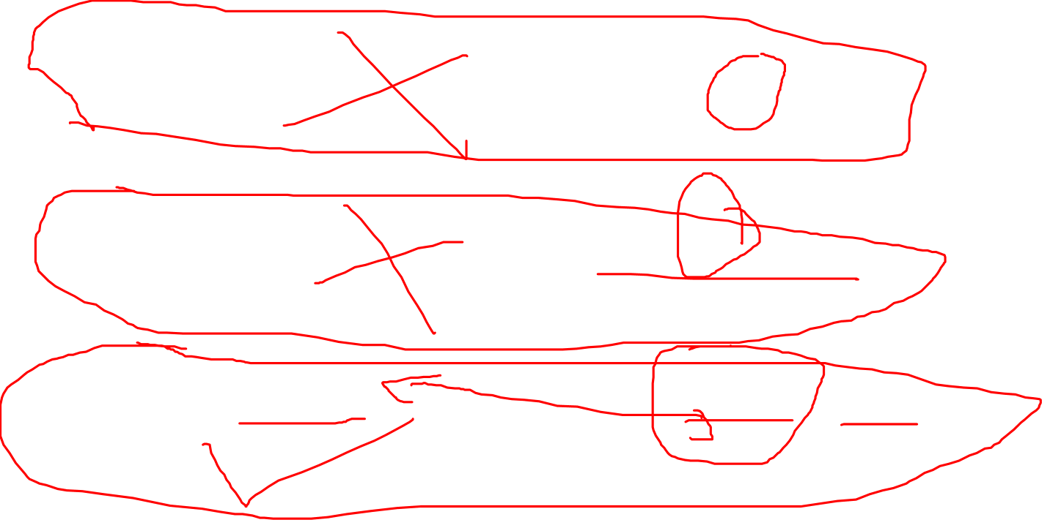
In-class Exercise: R in BCNF?
1
2
3
Notes:
Only the last one.

Slide 41
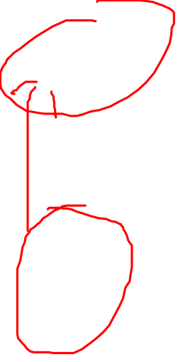
BCNF?
What are the CKs?
SIN
What are the FDs?
SIN -> Fname, Lname,
SIN -> SIN,Fname,Lname,Birthday,DNO,Salary,Phone, Address
Employee(SIN,Fname,Lname,Birthday,DNO,Salary,Phone, Address)
Notes:
Yes, good design

Slide 42
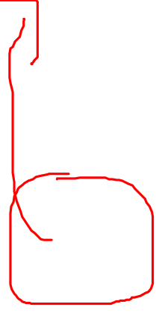
BCNF?
Student(SID,E-mail,Sname,Program,GPA,Standing,StartYear,Address)
What are the CKs?
SID
E-mail
What are the FDs?
SID->E-mail,Sname,Program,GPA,Standing,StartYear,Address
E-mail->SID, Sname,Program,GPA,Standing,StartYear,Address
Notes:
Yes, good design

Slide 43
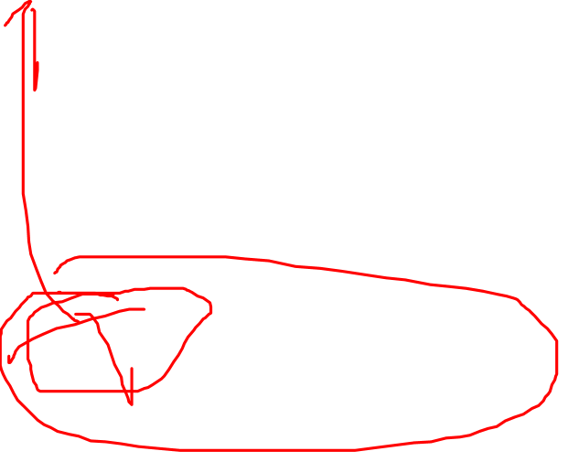
BCNF?
Employee(ENAME,SIN,BDATE,ADDRESS,DNUM,DNAME,MGRSIN)
What are the CKs?
SIN
What are the FDs?
SIN->ENAME,BDATE,ADDRESS,DNUM,DNAME,MGRSIN
DNUM->DNAME,MGRSIN
Notes:
No, bad design

Slide 44
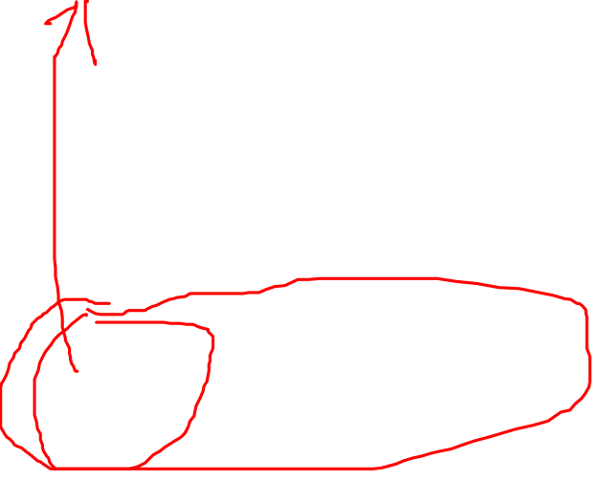
BCNF?
Std_Course(SID,E-mail,Sname, Cnum, Cname,Pre-req,Grade)
What are the CKs?
(SID, Cnum)
(E-mail, Cnum)
What are the FDs?
(SID, Cnum)-> E-mail,Sname,Cname,Pre-req,Grade
(E-mail, Cnum)-> SID,Sname,Cname,Pre-req,Grade
Cnum->Cname,Pre-req
SID->,E-mail,Sname
E-mail->SID, Sname
Notes:
No, bad design

Slide 45
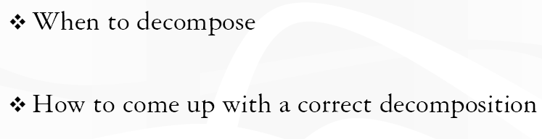
Questions About Decomposition
Notes:
Now we know normal forms, but when should we decompose a table?
And how make sure the decomposition is correct?
That is, no loss of info, minimize redundancy and FD preserving etc.

Slide 46
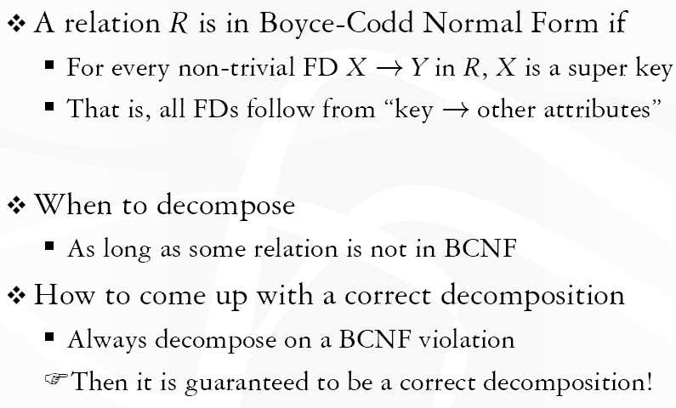
Answer: BCNF
For every non-trivial X → Y, X is a super key
Non-trivial: Y is not a member of X
Notes:
We say a relation R is in BCNF if whenever X ->A is a nontrivial FD that holds in R, X is a superkey.
Remember: nontrivial means A is not a member of set X.
Remember, a superkey is any superset of a key (not necessarily a proper superset).
No lost info!!!!

Slide 47
Summary of Today’s Lecture
Why redundancy is trouble
  Update anomaly and NULL
Functional Dependency
  How to use key and FD to decide whether a design is good
Decomposition
Three main goals of schema refinement
  How to check whether a decomposition is lossless
  How check for FD preserving
  How to check for minimal redundancy
Different normal forms and BCNF
Notes:
How to check whether a deposition is lossless: common attribute is a key in one of the decomposed tables.
How check for FD preserving: both sides (the left and right) in the same table for every FD.
How to check for minimal redundancy: no redundancy beyond foreign keys.
BCNF: for every FDs in a table, the left is a key then the table is in BCNF.

