Slide 1

Review of Last Lecture
Problems with redundancy
  Update anomaly and NULL
Functional Dependency
  How to use key and FD to decide whether a design is good
How to convert bad into good: Decomposition
  How to check whether a decomposition is lossless
  How check for FD preserving
  How to check for minimal redundancy
Normalization and different normal forms
BCNF: For every FD A -> B, A is a superkey
Notes:
How to check whether a deposition is lossless: common attribute is a key in one of the decomposed tables.
How check for FD preserving: both sides (the left and right) in the same table for every FD.
How to check for minimal redundancy: no redundancy beyond foreign keys.
BCNF: for every FDs in a table, the left is a key then the table is in BCNF.

Slide 2
Today’s Plan
BCNF exercises
How to decompose a table with redundancy into BCNF
  Attribute closure
BCNF decomposition exercises
Problem with BCNF
  Lossless and minimal redundancy
  But not FD preserving
The need for 3NF

Slide 3
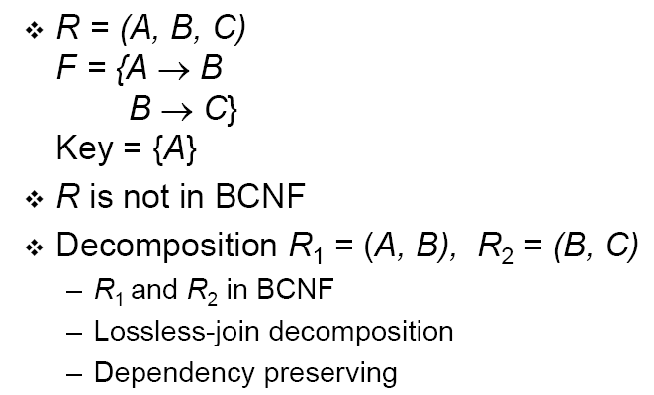
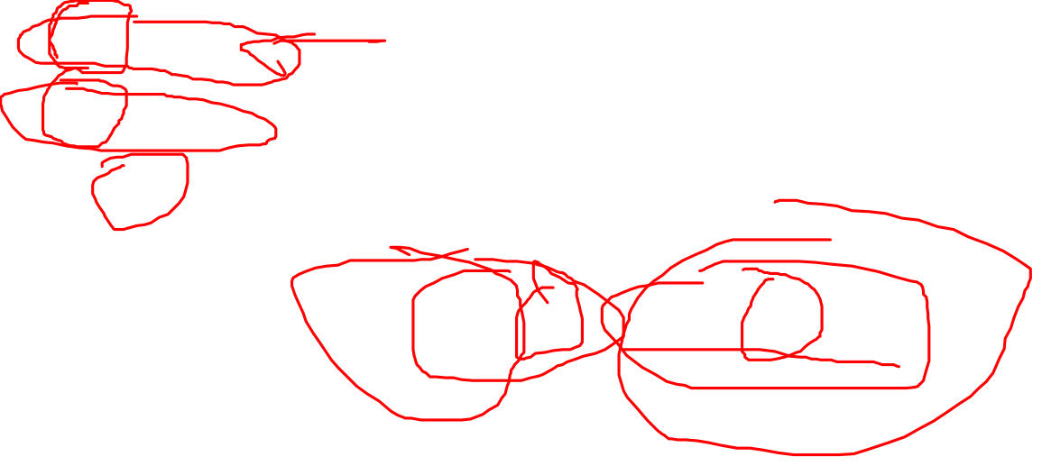
BCNF: Example I
Notes:
We say a relation R is in BCNF if whenever X ->A is a nontrivial FD that holds in R, X is a superkey.
Remember: nontrivial means A is not a member of set X.
Remember, a superkey is any superset of a candidate key
After the decomposition, B is a candidate key in R2 but why? Because B->C, then B->BC, So the value of B is unique for each row in B, therefore, B is a candidate key in R2.

Slide 4
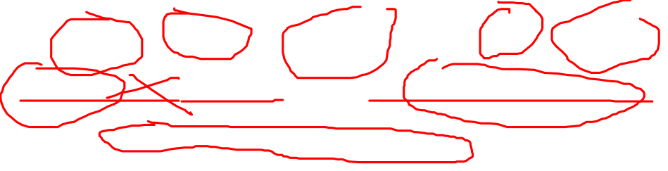
BCNF: Example II
Drinkers(name, addr, beersLiked, manf, favBeer)
FD’s: name->addr, favBeer beersLiked->manf
Only key is {name, beersLiked}.
In each FD, the left side is not a superkey.
Any one of these FD’s shows Drinkers is not in BCNF

Slide 5
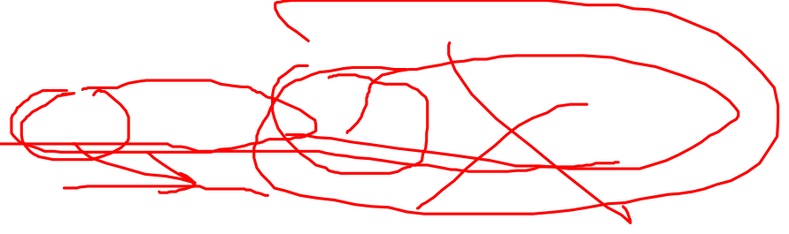
BCNF: Example III
Beers(name, manf, manfAddr)
FD’s: name->manf, manf->manfAddr
Only key is {name} .
name->manf does not violate BCNF, but manf->manfAddr does.
Notes:
A relation NOT in BCNF should be decomposed so as to meet this property, while possibly forgoing the preservation of all functional dependencies in the decomposed relations.
How to do this? Next slide

Slide 6
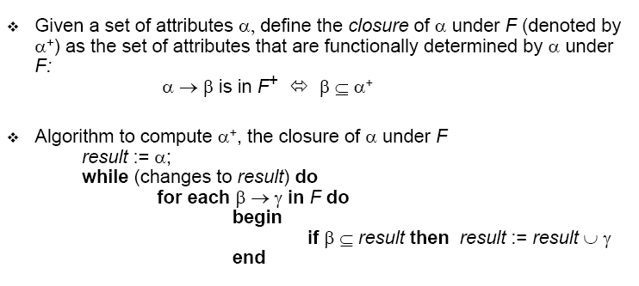
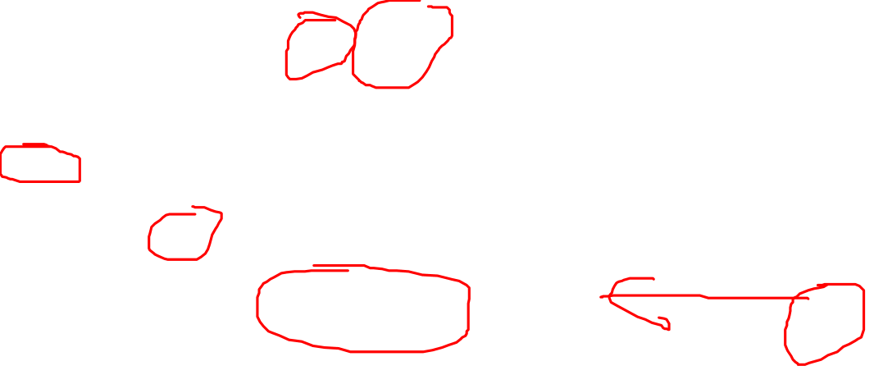
Compute Attribute Closure
Notes:
Attribute closure of {a} gives the list of attributes that are dependant of a.
Note attribute closure of {a} contains at least {a}, as an attribute determines at least itself. If you know someone’s name, then you know someone’s name, so Name -> Name, the value of Name determines the value of Name.
To compute {a}+, start with {a}, then for each FD, if the left is in {a}, then add the right hand side to the closure set. If there is change (something added to the set in the previous step), restart from the first FD. When all FDs are evaluated and there is no change to the set, the algorithm ends.

Slide 7
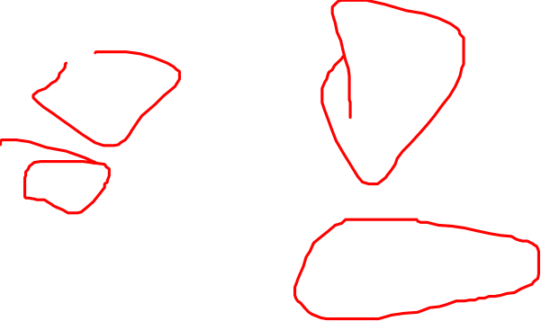
Compute Attribute Closure: Diagram
α
β
a⁺
new a⁺
Notes:
Here is a graphical representation of the algorithm. If the left in the closure set, add the right to the set.
Let’s try an example.

Slide 8
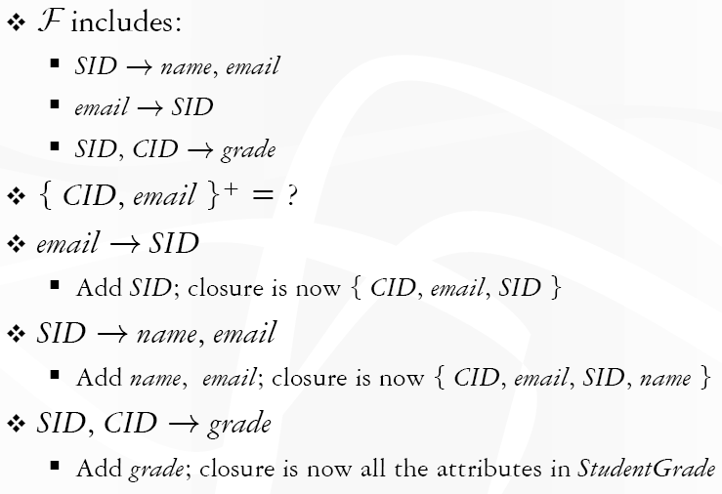
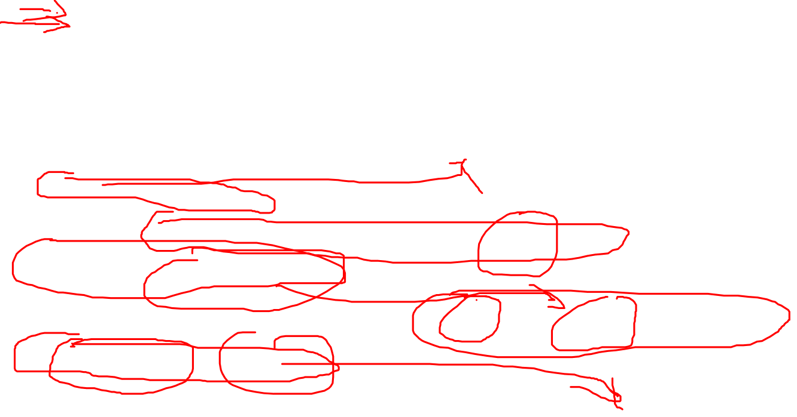
Attribute Closure: Example
{CID}⁺=?
{CID, email}
Notes:
ANS:
{CID}+ = {CID}
{CID,email}+ = all of StudentGrade

Slide 9
Little Trick to Check Superkey
If we know all the FD for a table, we can easily identify the SK
Trick: if the closure of attribute(s) include all the attributes in the table, then it is a super key
Example
  (SID, CID)+ = (SID, name, email, CID, grade)
  (email, CID)+ = (SID, name, email, CID, grade)
Notes:
Use previous slide as an example.

Slide 10
Closure Exercise
Let R = {ABCDE} and the set of FDs are:
FD1: AB → CD, FD2: C→ ED, FD3: AC → B
A⁺ = ?
C⁺ = ?
(AC)⁺ = ?
What are all the candidate keys for R?
Is R in BCNF?
Notes:
Note that we use {} and () interchangeably, same for (ABCDE) and (A, B, C, D, E)
A+
Start with A+= {A}
FD1: no change because (AB) is NOT in A+
FD2: no change
FD3: no change
So A+= {A} is the answer.
C+
1. C+={C}
2. FD1: no change
3. FD2: because the left hand side C is in C+={C}, we add the right ED into the set. We get C+={CED}
4. Because C+ is changed in the previous step, We need to go back to FD1: but no change
5. FD3: no change
6. So, C+={CED}
(AC)+ = {ABCDE}, meaning {AC} is a candidate key
All the candidate keys in R: {AB}, {AC}
R is NOT in BCNF, because FD2 violates BCNF. Note that if there is at least one FDs violates BCNF, a relation violates BCNF.

Slide 11
Lossless Decomposition into BCNF
Given: relation R with FD’s F.
Find the candidate keys of R
  A superkey is a superset of candidate keys
  For example, if {A} is a CK, then {AB} is a SK
Look among the given FD’s for a BCNF violation X → B.
Compute X ⁺.
  X ⁺ should not contain all attributes, or else X is a superkey.
Replace R by relations with schemas:
  R₁ = X ⁺
  R₂ = R – X ⁺ + (X)
X is the PK in R₁ and FK in R2 between R₁ and R₂
Project given FD’s F onto the two new relations.
Review whether R1 and R2 are in BCNF based on the projected FDs.
If not, repeat the steps for R1 and R2.
Notes:
Algorithm for Lossless Decomposition into BCNF
Also, not all FDs could be projected onto R1 and R2. Say we have Y -> J and I -> J in F, (YJ) are part of R1, but I is part of R1 and J is part of R2. Then Y->J is projected (preserved) in R1, but I->J is NOT preserved.

Slide 12
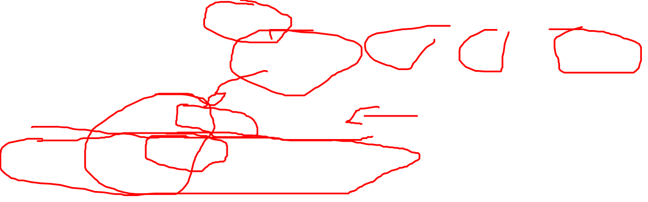
Example (1)
R=Drinkers(name, addr, beersLiked, manf, favBeer)
F = FD1: name → addr, FD2: name → favBeer,
FD3: beersLiked → manf
CKs: (name, beersLiked)
Pick BCNF violation name->addr.
Closure of the left side: (name)⁺ = (name, addr, favBeer)
Decomposed relations:
  R1=Drinkers1(name, addr, favBeer)
  R2=Drinkers2(name, beersLiked, manf)
Notes:
(name, beersLiked) is a CK because based on the FDs, the closure (name, beersLiked) +=R= (name, addr, beersLiked, manf, favBeer)
In other words, the value of (name, beersLiked) determines the value for each row, the definition of a key (you know the value of the key, you can identify which row you are referring to).

Slide 13

Example (2)
We are not done; we need to check Drinkers1 and Drinkers2 for BCNF.
Projecting FD’s is easy here.
For Drinkers1(name, addr, favBeer), relevant FD’s are name → addr and name → favBeer.
  Thus, {name} is the only key and Drinkers1 is in BCNF.
Notes:
FD1: name -> addr and FD2: name -> favBeer are projected (or you can say they are preserved) in Drinkers1 because attributes on the left and on the right of the FDs are present in Drinkers1.

Slide 14
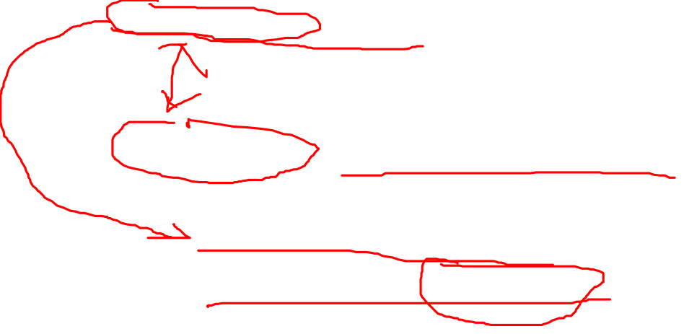
Example (3)
For Drinkers2(name, beersLiked, manf), the only FD is beersLiked->manf, and the only key is {name, beersLiked}.
  Violation of BCNF.
beersLiked⁺ = {beersLiked, manf}, so we decompose Drinkers2 into:
  Drinkers3(beersLiked, manf)
  Drinkers4(name, beersLiked)

Slide 15
Example (Concluded)
The resulting decomposition of Drinkers :
  Drinkers1(name, addr, favBeer)
  Drinkers3(beersLiked, manf)
  Drinkers4(name, beersLiked)
Notice: Drinkers1 tells us about drinkers, Drinkers3 tells us about beers, and Drinkers4 tells us the relationship between drinkers and the beers they like.
Question: lossless? FD preserving?
Notes:
Lossless? Yes
Common attribute between drinkers4 and drinkers3 is beersLiked which is a PK in drinker3. So the second decomposition is lossless
Common attribute between drinkers1 and drinkers4 is name which is a PK in drinker1. So the first decomposition is lossless
So yes, this is lossless. Note that BCNF decomposition is ALWAYS lossless.
FD preserving? Yes
FD1: name -> addr,
FD2: name -> favBeer,
FD3: beersLiked -> manf
FD preserving? Yes
FD1 and FD2 are preserved in Drinkers1
FD3 is preserved in Drinkers3
All FDs are preserved in the result. So FD preserving

Slide 16
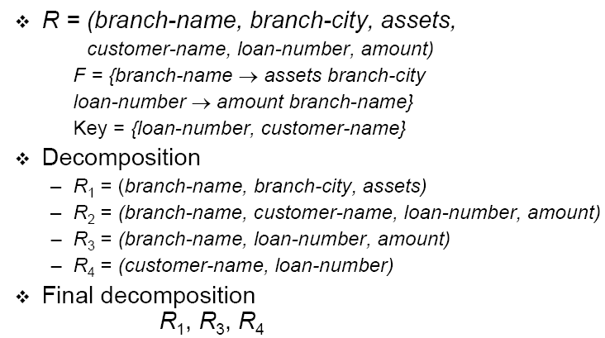
BCNF Decomposition: Another Example
Notes:
Lossless, minimal redundancy, and FD preserving

Slide 17
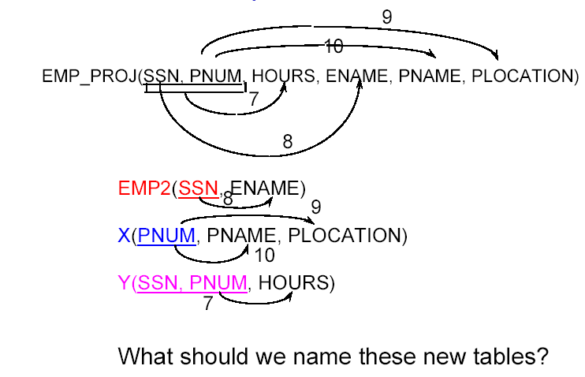
Exercise: Decomposition Using FD
Is the following relation in BCNF? If not, convert it into BCNF
Notes:
3 origins, 3 set of FD, each with different origin. Implying need 3 tables.

Slide 18
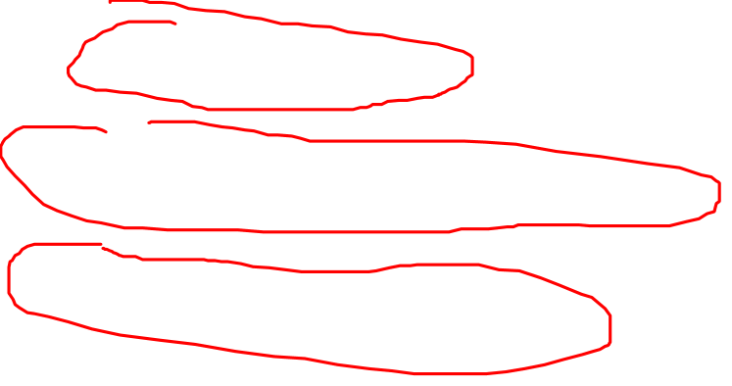
Answer: Decomposition Using FD
Notes:
X=Project
Y=WK_ON
Lossless, FD preserving and minimal dependency.

Slide 19
Note
BCNF decomposition is always lossless and minimizes redundancy
But does not always preserve all FDs!!!

Slide 20
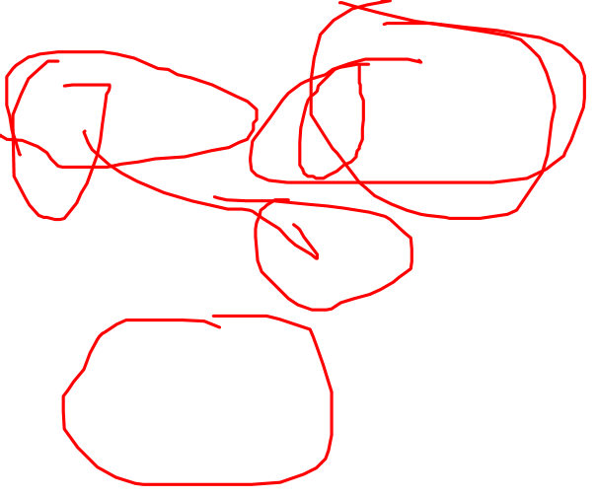
FD Preserving?
There is one structure of FD’s that causes trouble when we decompose.
R(SCZ), SC → Z and Z → C.
  Example: S = street address, C = city, Z = zip code.
There are two keys, {S,C} and {S,Z }.
Z → C is a BCNF violation, so we must decompose R into R1(SZ), R2(ZC).
Notes:
After the decomposition, SC->Z is gone and cannot be enforced automatically!!

Slide 21
We Cannot Enforce FD’s
The problem is that if we use R1(SZ) and R2(ZC) as our database schema, we cannot enforce the FD SC → Z by simply checking FD’s in these decomposed relations.
Example with S = street address, C = city, and Z = zip Code on the next slide.

Slide 22
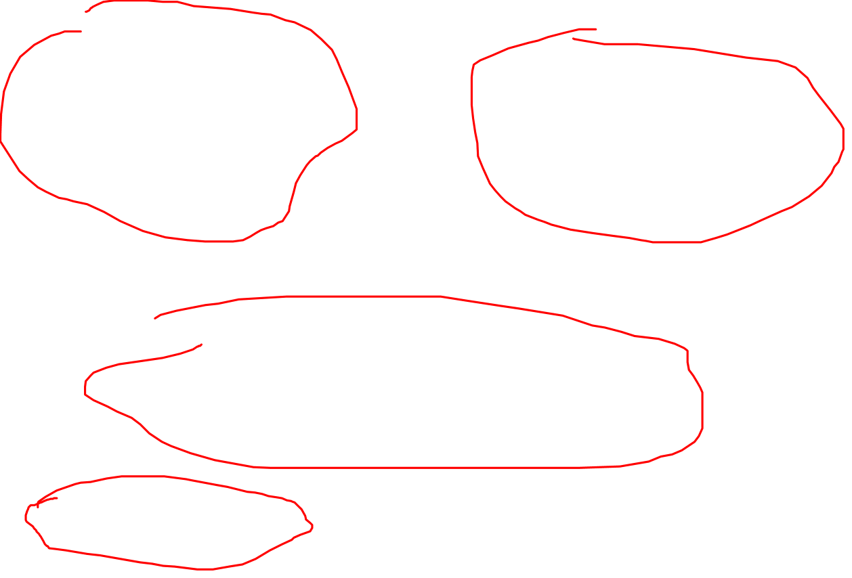
Example: An Unenforceable FD
street zip
545 Tech Sq. 02138
545 Tech Sq. 02139
city zip
Cambridge 02138
Cambridge 02139
Join tuples with equal zip codes.
street city zip
545 Tech Sq. Cambridge 02138
545 Tech Sq. Cambridge 02139
Although no FD’s were violated in the decomposed relations,
FD street, city -> zip is violated by the database as a whole.
Notes:
How can you have two zip code for the same address?
FD can be enforced in SQL (assertion) or programming in Java/C etc.
Creat assersion FD
Check (not exist s(
Select *
From R1, R2
Where R1.zip = R2.zip
Group by R1. street, R1.city
Having (count(distinct r1.zip) >1))

Slide 23
3NF Let Us Avoid This Problem
3rd Normal Form (3NF) modifies the BCNF condition so we do not have to decompose in this problem situation.
X → A violates 3NF if and only if X is not a superkey, and also A is not a key attribute.
  In other words, for every FD in R: X → A, if X is a either superkey or A is a key attribute, then R is in 3NF

Slide 24
This is fine in 3NF
R(SCZ), SC → Z and Z → C.
  Example: S = street address, C = city, Z = zip code.
There are two keys, {S,C } and {S,Z }.
Z → C is a NOT a 3NF violation, because C is a key attribute.
So R is in 3NF, no need to do anything here.

Slide 25
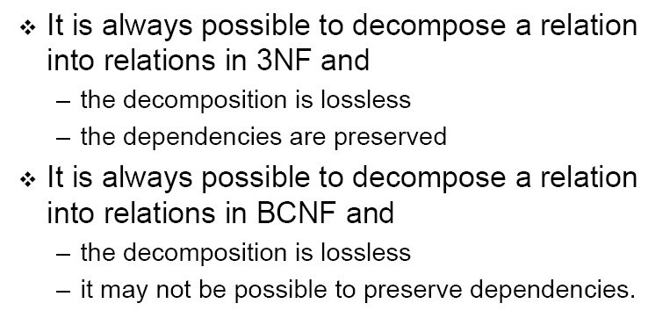
Comparing 3NF and BCNF
But not minimal redundancy!
But minimal redundancy!
Notes:
But 3NF, is not minimal redundancy (no redundancy beyond FK)

Slide 26
Which Form in Practice?
BCN F and Lossless and Minimal Redundancy
(first choice)
3N F and Lossless and Dependency-Preserving (second choice)
because sometimes we can't preserve all dependencies
Notes:
FD preserving is not as important because we can easily enforce them using trigger or assertion at app level and it is quite rare that BCNF is not FD preserving (only some special cases). But redundancy? Very difficult to reduce even at app level!
***********
FYI
R(ABC), AB → C and C → B.
R decomposed into R1(AC), R2(CB), C->B is preserved by R2 but AB->C is destroyed
How to enforced AB->C? We can write an assertion.
FD can be enforced in SQL (assertion) or programming in Java/C etc.
Creat assersion FD
Check (not exist s(
Select *
From R1, R2
Where R1.zip = R2.zip
Group by R1. street, R1.city
Having (count(distinct r1.zip) >1))

Slide 27
Assertion Exercise
BCNF does not enforce (preserve) all FDs but we can enforce the missing FD at the application level using assertion.
S(street, city), Z(city, zip)
Write an assertion to enforce:
street, city -> zip
Notes:
Write a query that violates the FD: there are tuples with the same street and city, and same zip.
Tips:
Join S and Z, check whether there are two tuples with same street and city but different zip.
Use group by street, city having count(distinct zip) > 1

Slide 28
General Steps of Normalization
Come up with the attributes, tables, CKs and FKs
  Use interviews, ERD, mapping
Figure out all the FDs for each table
  User interviews
Determine what NF is needed
Check each FD and see whether it violates the desired NF
If no violation, hurrah!
If there is violation, normalize it using the given algorithm for the desired NF decomposition.

Slide 29
In-Class Exercise: BCNF Decomposition
StudentGrade(SID, name, email, CID, grade)
CKs?
FDs?
BCNF?
Notes:
CKs:
(SID, CID)
(Email, CID)
FDs:
FD1: SID -> Name, email
FD2: Email -> Name, SID
FD3: SID, CID-> Grade
FD4: Email, CID -> Grade
BCNF?
No, FD1 and FD2 violate BCNF because SID is NOT a superkey neither is Email.

Slide 30
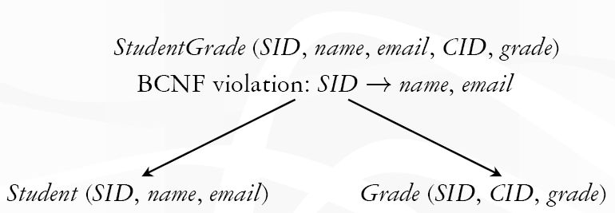
BCNF Decomposition
Notes:
Both FD1 and FD2 violates BCNF
We can decompose based on FD1 violation
(SID)+ = (SID, N=name, email)
So:
R1=(SID)+=(SID, name, email), PK is SID
R2=R-R1+(SID)=(SID, CID, grade), PK is (SID, CID), SID is a FK reference R1.SID
Note that this composition is lossless, minimal redundancy and FD preserving because (email, CID) -> grade can be derived from the preserved FDs..
The result above rename R1 to Student and R2 to Grade.
What if we decompose it based FD2? I will let you try it on your own.

Slide 31
In-Class Exercise: BCNF Decomposition
Let R = {ABCDE} and the set of FDs are:
FD1: AB → CD, FD2: C→ ED, FD3: AC → B
Is it in BCNF? Why or why not?
If not, decompose it into BCNF forms
Notes:
To determine BCNF, we need to figure out the candidates, we did that an earlier exercise
CKs: {AB}, {AC}
R is NOT because FD2: C->ED, C is not a superkey
Decompose R, we start with the FD that violates BCNF
C->ED
C+={CED}
R1=C+={CED}, PK is (C)
R2=R – C+ + {C} = {ABC}, PK is either (AB) or (AC), C is the FK between the two tables.
Project FDs:
R1={CED} contains FD2 C->ED because both left and right are in R1
R2={ABC} preserves FD3 AC->B
FD1 AB->CD can be looked at as AB->C and AB->D, AB->C is preserved in R2 and AB->D can be derived by AB -> C (in R1) and C -> D (in R2)
Based on the projected FDs, the candidate key in R1 is {C}, for R2 is {AB} and {AC}
Based on the FDs and CKs in each table
R1 is in BCNF and so is R2.
This is decomposition is lossless because the common attribute between R1 and R2 is C and C is a PK in R2.
In summary, this decomposition is lossless, minimal redundancy and FD preserving.

Slide 32
Summary
Each normal form is strictly stronger than the previous one
  Every 2NF relation is in 1NF
  Every 3NF relation is in 2NF
  Every BCNF relation is in 3NF
There exist relations that are in 3NF but not in BCNF
The goal is to have each relation in BCNF (or 3NF)

Slide 33
Summary of Today’s Lecture
BCNF exercises
How to decompose a table with redundancy into BCNF
  Attribute closure
BCNF decomposition exercises
Problem with BCNF
  Lossless and minimal redundancy
  But not FD preserving
The need for 3NF

