Slide 1

Review of Last Lecture
BCNF exercises
How to decompose a table with redundancy into BCNF
  Attribute closure
BCNF decomposition exercises
Problem with BCNF
  Lossless and minimal redundancy
  But not FD preserving
The need for 3NF

Slide 2
Today’s Plan
Transactions
  ACID properties
  5 states of transaction
Transactions in SQL
4 Isolation Levels in SQL

Slide 3
TransactionS
CHAPTER 09
Collin Roberts
University of Waterloo

Slide 4
Recommended Readings
Textbook Chapter 17

Slide 5
The Setting
Database systems are normally being accessed by many users or processes at the same time.
  Both inquiries and modifications.
Unlike operating systems, which support interaction of processes, a DBMS needs to keep processes from troublesome interactions.
Notes:
The DBMS itself is responsible to coordinate all interactions.

Slide 6
Example: Bad Interaction
Shared account between you and your mom with a starting Balance of $500.
You and your Mom each withdraw $100 from different ATMs at the EXACT same time.
At your ATM: Balance = Balance – $100 = $400
At your mom’s ATM: Balance = Balance – $100 = $400
Final Balance = $400!!!!
The DBMS better make sure one account deduction doesn’t get lost in this situation.
Notes:
Or for example, a power failure occurs during a withdrawal.

Slide 7
Transaction Concept
A transaction is a unit of program execution that accesses and possibly updates various data items.
  A transaction must produce a consistent database.
  During transaction execution, the database may be temporarily inconsistent.
  When the transaction completes successfully (is committed), the database must again be consistent.
  After a transaction commits, the changes it has made to the database persist, even if there are system failures.
Multiple transactions can execute in parallel.
Two main issues to handle:
  Concurrent execution of multiple transactions
  Failures of various kinds, such as hardware failures and system crashes
Notes:
Example of inconsistency: in the previous slides, only one withdrawal is recorded by the system.
Two major issues:
concurrency and
recovery from failures

Slide 8

ACID Properties
X=10
Y=11
… …
Atomicity. Either all operations of the transaction are properly reflected in the database, or none is.
Consistency. Database constraints are preserved.
Isolation. Although multiple transactions may execute concurrently, each transaction must be unaware of other concurrently executing transactions. Intermediate transaction results must be hidden from other concurrently executed transactions.
  That is, for every pair of transactions T_{i} and T_{j} (i <>j), it appears to T_{i} that, either T_{j} finished execution before T_{i} started, or T_{j} started execution after T_{i} finished.
Durability. After a transaction completes successfully, the changes it has made to the database persist, even if there are system failures.
Notes:
A transaction is a unit of program execution that accesses and possibly updates various data items.
To preserve the integrity of data the database system must ensure:
A DBMS is expected to support “ACID transactions,” processes that are:
Atomic : Either the whole process is done or nothing is.
Consistent : Database constraints are preserved.
Isolated : It appears to the user as if only one process executes at a time.
Durable : Effects of a process do not get lost if the system crashes.

Slide 9
Transaction States
Active – the initial state; the transaction stays in this state while it is executing
Partially committed – after the final statement has been executed.
Failed -- after the discovery that normal execution can no longer proceed.
Aborted – after the transaction has been rolled back and the database restored to its state prior to the start of the transaction. Two options after it has been aborted:
  restart the transaction; can be done only if no internal logical error
  kill the transaction
Committed – after successful completion.

Slide 10
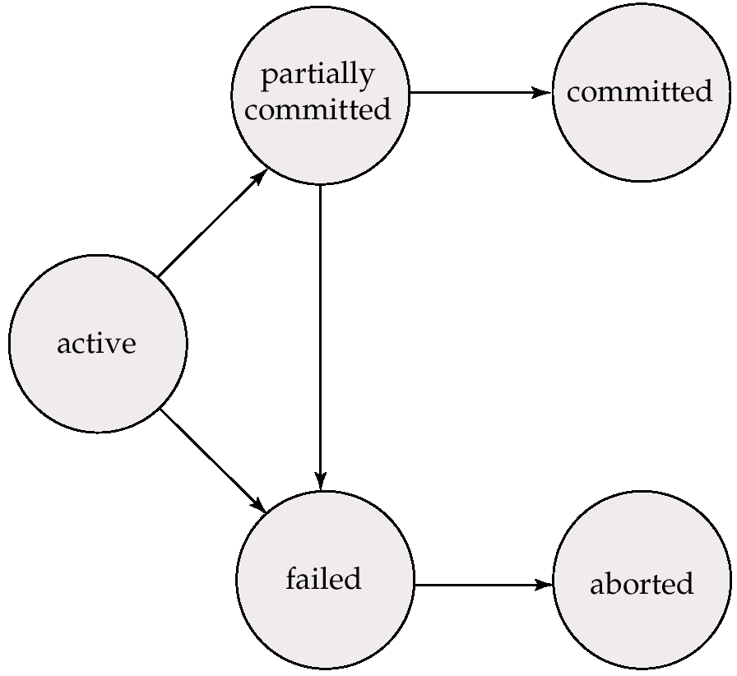
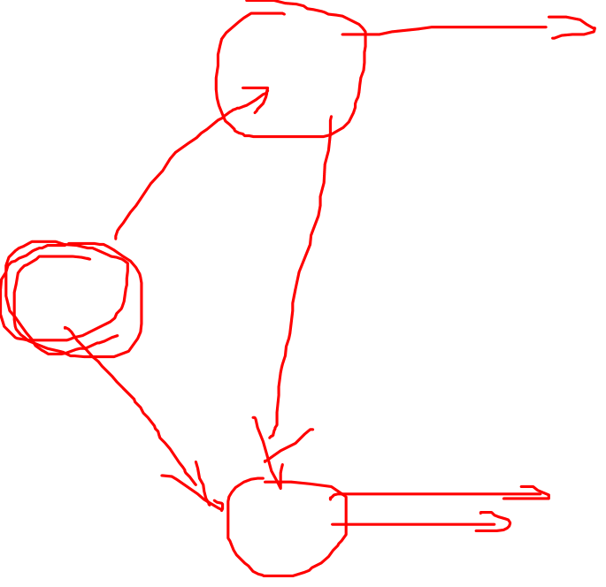
Transaction State Diagram
Notes:
During the lifetime of a transaction T, it jumps from state to state … …
All changes made to DB become permanent.
After failure, it attempts to rollback whatever changes it made.

Slide 11
Transactions in SQL
SQL supports transactions, often behind the scenes.
  Each statement issued at the generic query interface is a transaction unto itself.
  In programming interfaces like JDBC or PSM, a transaction begins the first time a SQL statement is executed and ends with the statement or an explicit transaction-end.
    That is, one statement is one transaction by default
Notes:
SQL Supports Transactions Implicitly … or Explicitly …
When a connection is created, it is in auto-commit mode.
This means that each individual SQL statement is treated as a transaction and is automatically committed right after it is executed.
(To be more precise, the default is for an SQL statement to be committed when it is completed, not when it is executed.
A statement is completed when all of its result sets and update counts have been retrieved. In almost all cases, however, a statement is completed, and therefore committed, right after it is executed.)
The way to allow two or more statements to be grouped into a transaction is to disable auto-commit mode.
This is demonstrated in the following line of code, where con is an active connection:
con.setAutoCommit(false);
Data manipulation language must include a construct for specifying the set of actions that constitute a transaction.
In SQL, a transaction begins implicitly.
A transaction in SQL ends by:
Commit work commits current transaction and begins a new one.
Rollback work causes current transaction to abort.
Levels of consistency specified by SQL-92:
Serializable — default
Repeatable read
Read committed
Read uncommitted

Slide 12

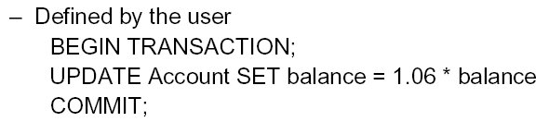
Example: Explicit Transaction in SQL
Notes:
If you want to group several statements into one Transaction, enclose them into Begin … …
Not necessary … each update statement by default is treated as a transaction. But if you have several update and insert etc, instead of treating each one as one Transaction, you can bundle them as one Transaction.

Slide 13
COMMIT
The SQL statement COMMIT causes a transaction to complete.
  Its database modifications are then permanent in the database.
Notes:
Two way to end a T in SQL:
either Commit or
Rollback … …

Slide 14
ROLLBACK
The SQL statement ROLLBACK also causes the transaction to end, but instead by aborting.
  No effects remain permanent on the database.
Failures like division by 0 or a constraint violation can also cause rollback, even if the programmer does not explicitly request it.

Slide 15
Example: Interacting Processes
Assume the usual Sells(bar,beer,price) relation, and suppose that Joe’s Bar sells only Bud for $2.50 and Miller for $3.00.
Joe decides to stop selling Bud and Miller, but to sell only Heineken at $3.50.
Sally is querying the Sells for the highest and lowest price Joe charges.
Notes:
Before we discuss how to use transaction in SQL to support different kind of interactions. Let’s take a look at an example of interacting processes.

Slide 16
Sally’s Program
Sally executes the following two SQL statements, which we call (min) and (max), to help remember what they do.
(max) SELECT MAX(price) FROM Sells
WHERE bar = ’Joe’’s Bar’;
(min) SELECT MIN(price) FROM Sells
WHERE bar = ’Joe’’s Bar’;

Slide 17
Joe’s Program
At about the same time, Joe executes the following steps, which have the mnemonic names (del) and (ins).
(del) DELETE FROM Sells
WHERE bar = ’Joe’’s Bar’;
(ins) INSERT INTO Sells
VALUES(’Joe’’s Bar’, ’Heineken’, 3.50);

Slide 18
Interleaving of Statements
Although (max) must come before (min), and (del) must come before (ins), there are no other constraints on the order of these statements, unless we group Sally’s and/or Joe’s statements into transactions.
(max)(del)(min)(ins)
(max)(del)(ins)(min)
… …
Notes:
Possible interleaving: max, del, min, ins; or del max, min ins.
What if the sequence of operations is: (max)(del)(ins)(min)?

Slide 19

Example: Strange Interleaving
Suppose the steps execute in the order (max)(del)(ins)(min).
Joe’s Prices:
Statement:
Result:
Sally sees MAX < MIN!
2.50, 3.00
2.50, 3.00
3.50
(max)
(del)
(ins)
(min)
3.00
3.50

Slide 20
Fixing the Problem by Using Transactions
If we group Sally’s statements (max)(min) into one transaction, then she cannot see this inconsistency.
  That is, max and min treated as one and nothing can be changed in the middle.
She sees Joe’s prices at some fixed time.
  Either before or after he changes prices, or in the middle, but the MAX and MIN are computed from the same prices.
  Only the following sequences would Sally observe.
    (max)(min)(del)(ins)
    (del)(max)(min)(ins)
    (del)(ins)(max)(min)
Notes:
Del max min ins or max min del ins; or del ins max min;
Max min as one; calculated based on the same set of values
But there is still other problems … …

Slide 21

Another Problem: Rollback
Suppose Joe executes (del)(ins), not as a transaction, but after executing these statements, thinks better of it and issues a ROLLBACK statement.
    If Sally executes her statements after (ins) but before the rollback, then she sees a value, 3.50, that never existed in the database.
    (del)(ins)(max)(min)(ROLLBACK)
Notes:
Del ins max min ROLLBACK

Slide 22
Solution
If Joe executes (del)(ins) as a transaction, its effect cannot be seen by others until the transaction executes COMMIT.
  If the transaction executes ROLLBACK instead, then its effects can never be seen.

Slide 23
Isolation Levels
SQL defines four isolation levels = choices about what interactions are allowed by transactions that execute at about the same time.
How a DBMS implements these isolation levels is highly complex, and a typical DBMS provides its own options.
Notes:
Serializable — default
Repeatable read — only committed records to be read, repeated reads of same record must return same value. However, a transaction may not be serializable – it may find some records inserted by a transaction but not find others.
Read committed — only committed records can be read, but successive reads of record may return different (but committed) values.
Read uncommitted — even uncommitted records may be read.
Not all 4 are supported by all DBMS! Most common is S …

Slide 24

Choosing the Isolation Level
Within a transaction, we can say:
SET TRANSACTION ISOLATION LEVEL X
where X =
  SERIALIZABLE
  REPEATABLE READ
  READ COMMITTED
  READ UNCOMMITTED
Notes:
InnoDB tables support all four SQL standard transaction isolation levels. Be careful when converting code from other DBMS's, as they do not all support all four levels, nor do they all default to the same level. MySQL supports all 4.
SQL SERVER - READ COMMITTED
Oracle - READ COMMITTED (supports only READ COMMITTED, SERIALIZABLE and the non-standard READ ONLY)
DB2 - REPEATABLE READ (supports REPEATABLE READ, UNCOMMITTED READ and 2 non-standard levels)
PostgreSQL - REPEATABLE READ (only supports REPEATABLE READ and SERIALIZABLE)

Slide 25
Serializable Transactions
If Sally = (max)(min) and Joe = (del)(ins) are each transactions, and Sally runs with isolation level SERIALIZABLE, then she will see the database either before or after Joe runs, but not in the middle.
It is up to the DBMS vendor to figure out how to do that, e.g.:
  True isolation in time.
  Keep Joe’s old prices around to answer Sally’s queries.
Notes:
Transaction executes one after another

Slide 26
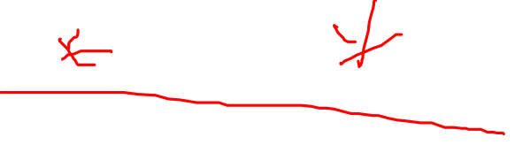
Read-Committed Transactions
If Sally runs with isolation level READ COMMITTED, then she can see only committed data, but not necessarily the same data each time.
Example: Under READ COMMITTED, the interleaving (max)(del)(ins)(min) is allowed, as long as Joe commits.
  Sally sees MAX < MIN.
Notes:
Why? All about the performance! Sally and Joe’s programs might not conflict with each other.

Slide 27
Repeatable-Read Transactions
Requirement is like read-committed, plus: if data is read again, then everything seen the first time will be seen the second time, the third time … …
  But the second and subsequent reads may see more tuples as well.
Notes:
Only committed records are shown.
Both old and new are available for newer operations.

Slide 28

Example: Repeatable Read
Suppose Sally runs under REPEATABLE READ, and the order of execution is (max)(del)(ins)(min).
  (max) sees prices 2.50 and 3.00.
  (min) can see 3.50, but must also see 2.50 and 3.00, because they were seen on the earlier read by (max).

Slide 29
Read Uncommitted
A transaction running under READ UNCOMMITTED can see data in the database, even if it was written by a transaction that has not committed (and may never commit).
Example: (del)(ins)(max)(min).
  If Sally runs under READ UNCOMMITTED, she could see a price 3.50 even if Joe later aborts.

Slide 30
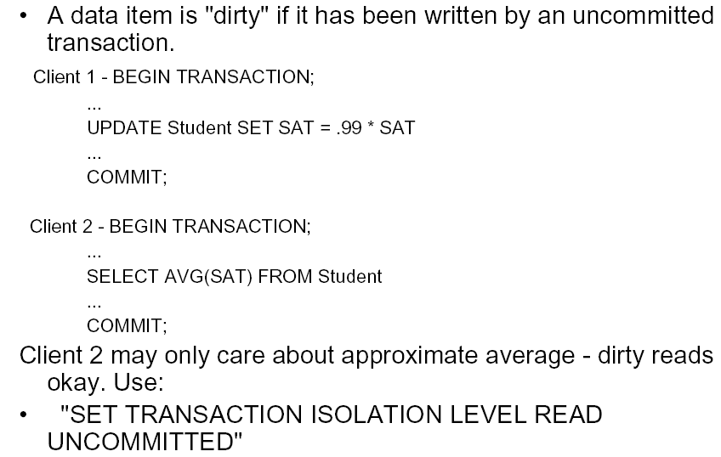
Dirty Read: Example
SID | SAT
S1 | 1000
S2 | 1000
1000
990
995
Notes:
Average changes as update progress from students to students; Dirty read will allow it to happen
Two students only, both GPA =100, what is the possible average you will see using the above commands?
S1: 100 average …
S2: 100 average …

Slide 31
Isolation Level Is Personal Choice
Your choice, e.g., run serializable, affects only how you see the database, not how others see it.
Example: If Joe Runs serializable, but Sally doesn’t, then Sally might see no prices for Joe’s Bar.
  i.e., it looks to Sally as if she ran in the middle of Joe’s transaction.
Notes:
Same query on the same table but with different isolation level setting, might see different results!

Slide 32
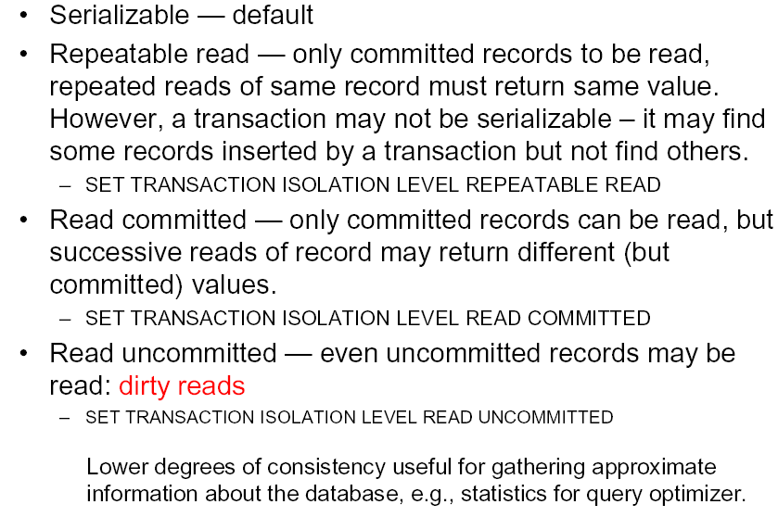
Summary: 4 Level of Isolation in SQL
Notes:
SERIALIZABLE: Updates are not permitted in other transactions if a transaction has run an ordinary SELECT query, i.e. queries are treated as if they had a LOCK IN SHARE MODE, which we saw in action last month.
REPEATABLE READ: The default isolation level for InnoDB tables. Within a transaction, all reads are consistent.
READ COMMITTED: Committed updates are visible within another transaction. This means identical queries within a transaction can return differing results. This is the default in some DBMS's.
READ UNCOMMITTED: Barely transactional, this setting allows for so-called 'dirty reads', where queries inside one transaction are affected by uncommitted changes in another transaction.

Slide 33
Summary of Today’s Lecture
Transactions
  ACID properties
  5 states of transaction
Transactions in SQL
4 Isolation Levels in SQL

