Slide 1

Review of Last Lecture
Transaction
  ACID
  States
Transaction in SQL
4 Isolation Levels in SQL

Slide 2
Today’s Plan
How data can be stored in database
  Unordered file
  Ordered file
  Hashing
  B+ Tree
Indexing

Slide 3
Storage and Indexing
CHAPTER 10
Collin Roberts
University of Waterloo
Notes:
We want to get data we need and get it fast! Performance is equally important!
Make no mistake: DB design and access are important, but for management, reliability and performance are much more important.
You might have the best DB design in the world and can query it whatever you want.
But if it is slow or unreliable, then what is the use?
***************

Slide 4
Recommended Readings
Textbook Chapters 13 and 14

Slide 5
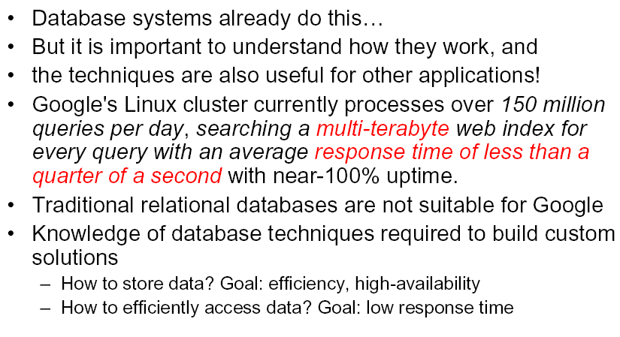
Why are we interested in Storage and Indexing?
Notes:
Simply accessing the data is often NOT enough, you need to access the data IN TIME.
Think about Google, the best search engine in the world.
If each search takes 1 minute, would you ever use it?
The efficiency Problem is magnified in DB: DB often manages large quantity of data and they are being accessed frequently by hundred of users.
Speed is equally important as any other performance factors.
Storage technologies contribute a huge factor into performance, not just the CPU.
How you organize the data on disk and how you access the data make a big difference in performance.

Slide 6
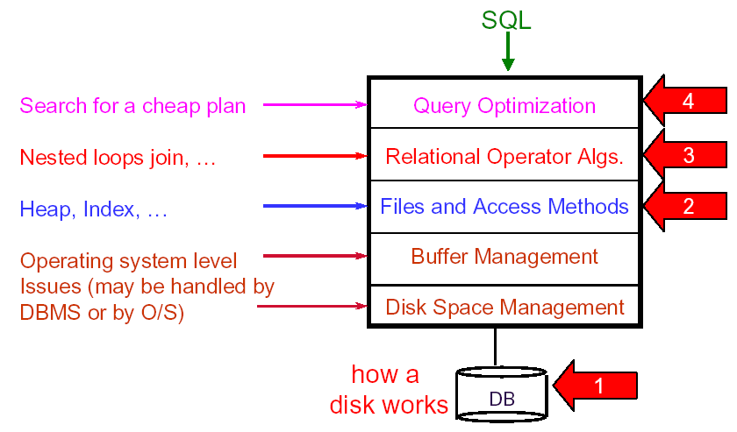
DBMS Structure
Notes:
How query is processed from DBMS point of view …
This gives us idea how to speed up data retrieval.

Slide 7
How to access data faster?
Come up with a better way to execute the query
  Query optimization, already discussed (briefly) in Chapter 03
Come up with a better way to logically organize the data
  Data structure of database and indexing
Come up with a better way to physically store the data on hard drive
  Storage technology e.g. RAID
Notes:
1. Query in such a way that it reduces the amount of data access to answer the question (e.g. retrieve 10 rows instead of 100)
2. Organize data in such away that it reduces the amount of data access to answer the question (e.g. 1MB instead of 100MB)
3. Make HD access faster (e.g. 1 ms instead of 100 ms)

Slide 8
How to access data faster?
Come up with a better way to answer the query
  Query optimization, already discussed in Chapter 03
Come up with a better way to logically organize the data
  Data structure of database and indexing
Come up with a better way to physically store the data on hard drive
  Storage technology and RAID
Notes:
1. Query in such a way that it reduces the amount of data access to answer the question (e.g. retrieve 10 rows instead of 100)
2. Organize data in such away that it reduces the amount of data access to answer the question (e.g. 1MB instead of 100MB)
3. Make HD access faster (e.g. 1 ms instead of 100 ms)

Slide 9
How to store and organize the data logically in a table?
Ontario has about 650,000 public employees. How many of them are in the sunshine list (salary $100K+)?
What if the employee records are randomly stored in the table? How many rows needs to be accessed?
σ _{Salary>=100,000} (Employee)
FName | LName | Sex | Dept | Rank | … | … | Address | SIN | Salary
John | Doe | M | Acct | L3 | … | … | Toronto | 111145 | 55,000
Jane | Jane | F | Tranp | L2 | … | … | Waterloo | 234435 | 45,000
Kate | Lo | F | IT | L10 | … | … | Guelph | 343999 | 110,00
. . . | . . . | . . . | . . . | . . . | . . . | . . . | . . . | . . . | . . .

Slide 10
Unordered Files
Rows are not sorted, also called a heap or a pile file.
New records are inserted at the end of the file. Hence, record insertion is quite efficient.
To search for a record, a linear search through the file records is necessary. This requires reading and searching half the file blocks on the average, and is hence quite expensive.
Worse yet: reading the records in order of a particular field requires sorting all file records.
Notes:
If the rows are not sorted in the table file, this is unordered file.
It is efficient to modify but quite expensive to search
For the sunshine list example: needs to search all 650K rows!
What if you want to sort list the employees alphabetically?
Very expensive!
Note that Sorting is expensive in general!

Slide 11
Ordered/Sorted Data: Motivation
Ontario has about 650,000 public employees. How many of them are in the sunshine list (salary $100K+)?
What if the employee records are sorted based on salary in the table? How many rows needs to be accessed?
σ _{Salary>=100,000} (Employee)
FName | LName | Sex | Dept | Rank | … | … | Address | SIN | Salary
Jane | Jane | F | Tranp | L2 | … | … | Waterloo | 234435 | 45,000
John | Doe | M | Acct | L3 | … | … | Toronto | 111145 | 55,000
Kate | Lo | F | IT | L10 | … | … | Guelph | 343999 | 110,00
. . . | . . . | . . . | . . . | . . . | . . . | . . . | . . . | . . . | . . .

Slide 12
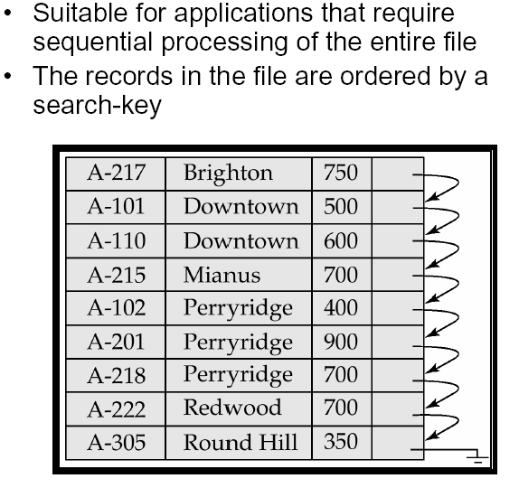
Ordered File Organization: Idea
Notes:
Also called sequential file …
Searching on the ordered field (search key) is very efficient.

Slide 13
Example: Performance Discrepancy
In a list of one million integers, check whether 123,456 is in the list. Say one row stores one integer.
Number of rows accessed: unordered file vs ordered file?
  Sequential search for unsorted list
  Binary search for sorted list: https://en.wikipedia.org/wiki/Binary_search_algorithm
Notes:
In the worst case scenario: 1 million rows vs. 20 rows!
In the average case scenario: 0.5 million rows vs. 20 rows!
How many rows need to be accessed in the sunshine list example where data is sorted according to salary?

Slide 14
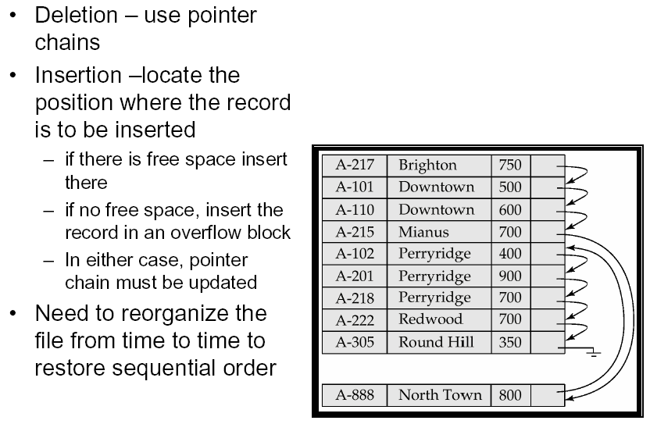
Ordered File Organization: Problem
Notes:
Unfortunately, ordered file has its own problem: it is easy to search but difficult to modify
Can we do both? This where Hash and B+ tree are introduced
Hashing: 100 students in a building with 10 rooms, each hold 10.
Simple but no free lunch, always a catch. If we update (insert, delete), …
Also called a sequential file.
File records are kept sorted by the values of an ordering field.
Insertion is expensive: records must be inserted in the correct order. It is common to keep a separate unordered overflow (or transaction ) file for new records to improve insertion efficiency; this is periodically merged with the main ordered file.
A binary search can be used to search for a record on its ordering field value. This requires reading and searching log₂ of the file blocks on the average, an improvement over linear search.
Reading the records in order of the ordering field is quite efficient.

Slide 15
Hash Files (FYI)
The file is divided into M equal-sized buckets, numbered bucket0, bucket1, ..., bucket M-1. Typically, a bucket corresponds to one (or a fixed positive number of) disk blocks.
A hash function h determines item K is stored in bucket i, where i=h(K)
  Search is very efficient on K.
  Inserting K is also very efficient.
Collisions occur when a new record hashes to a bucket that is already full.
  An overflow file is kept for storing such records. Overflow records that hash to each bucket can be linked together.
Notes:
To reduce overflow records, a hash file is typically kept 70-80% full.
The hash function h should distribute the records uniformly among the buckets; otherwise, search time will be increased because many overflow records will exist.
*************
Food for thought (FYI):
There are numerous methods for collision resolution, including the following:
Open addressing: Proceeding from the occupied position specified by the hash address, the program checks the subsequent positions in order until an unused (empty) position is found.
Chaining: For this method, various overflow locations are kept, usually by extending the array with a number of overflow positions.
In addition, a pointer field is added to each record location.
A collision is resolved by placing the new record in an unused overflow location and setting the pointer of the occupied hash address location to the address of that overflow location.
Multiple hashing: The program applies a second hash function if the first results in a collision.
If another collision results, the program uses open addressing or applies a third hash function and then uses open addressing if necessary.

Slide 16
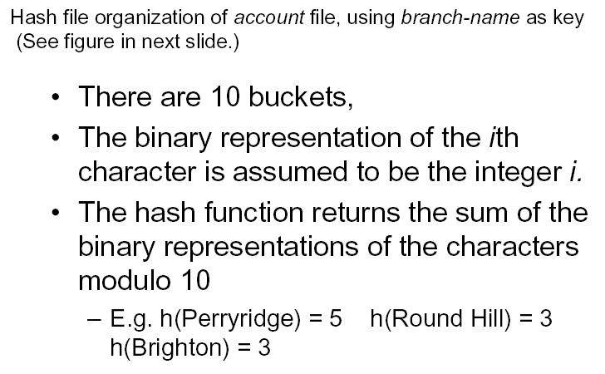
Hash File: Example I (FYI)

Slide 17
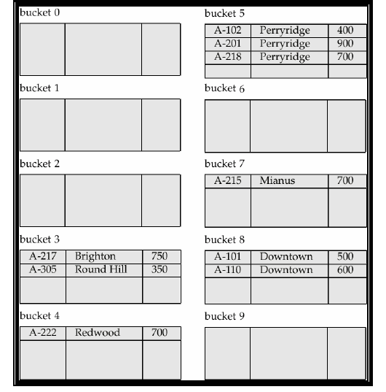
Hash File: Example I (Continued)

Slide 18
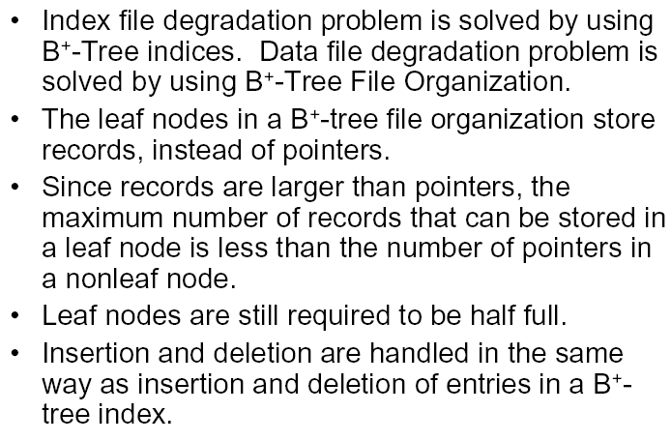
B⁺-tree File Organization (FYI)
Notes:
This is what you need to know:
data in database files are organized using B+ trees.

Slide 19
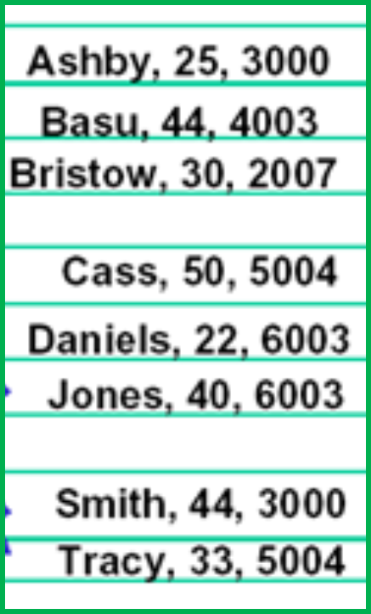
Index: Motivation
Sorted list significantly improve access performance for search
  Note that data stored in ordered file, hash table or B⁺-tree is all sorted in some way.
But file/data can only be stored physically in one order!
  Say sorted by customer names. Then search by name can be done using binary search
  But what if we want to search by age?

Slide 20
Example: Search by Name vs. by Age
Notes:
Find Michael: binary search
Find age 50: sequential search

Slide 21
Indexes as Access Paths
A single-level index is an auxiliary file that makes it more efficient to search for a record in the data file.
The index is usually specified on one attribute of the file (although it could be specified on several attributes)
One form of an index is a file of entries
<search key, pointer to record>,
which is ordered by the search key (attribute value). So search on the search key is quite efficient
Notes:
Index speeds up search on selective field.
The index file usually occupies considerably less disk blocks than the data file because its entries are much smaller
A binary search on the index yields a pointer to the file record
Pointer: think of it as the address of the data on the hard drive.

Slide 22
Index Example: Age
Search Key
Pointer to record
22 | 5
25 | 1
30 | 3
33 | 8
40 | 6
44 | 2
44 | 7
50 | 4
25 | 1
44 | 2
30 | 3
50 | 4
22 | 5
40 | 6
44 | 7
33 | 8
Notes:
Find age 50

Slide 23
How Index Help: Example (FYI)
Example: Given the following data file:
EMPLOYEE(NAME, SSN, ADDRESS, JOB, SAL, ... )
Suppose that:
record size R=150 bytes
block size B=512 bytes
r=30000 records
Then, we get:
blocking factor Bfr= B div R= 512 div 150= 3 records/block
number of file blocks b= (r/Bfr)= (30000/3)= 10000 blocks
For an index on the SSN field, assume the field size V_{SSN}=9 bytes,
assume the record pointer size P_{R}=7 bytes. Then:
index entry size R_{I}=(V_{SSN}+ P_{R})=(9+7)=16 bytes
index blocking factor Bfr_{I}= B div R_{I}= 512 div 16= 32 entries/block
number of index blocks b= (r/ Bfr_{I})= (30000/32)= 938 blocks
binary search needs log₂bI= log2938= 10 block accesses
This is compared to an average linear search cost of:
(b/2)= 30000/2= 15000 block accesses
If the file records are ordered, the binary search cost would be:
log₂b= log₂30000= 15 block accesses

Slide 24
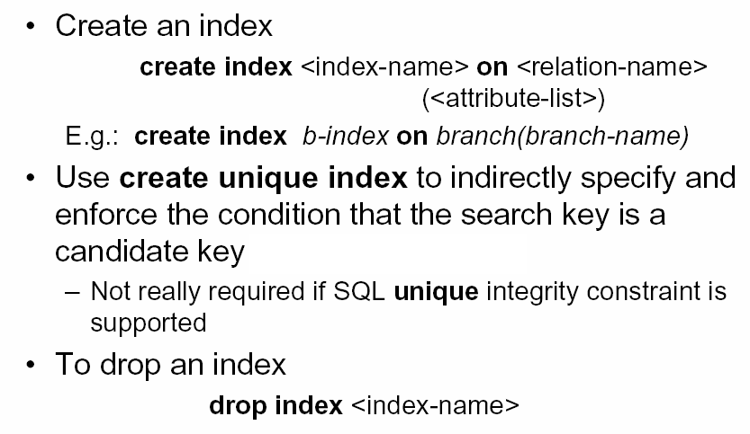
Index in SQL

Slide 25
Summery of Today’s Lecture
How data can be stored in database
  Unordered file
  Ordered file
  Hashing
  B+ Tree
Indexing

