Slide 1

Review of Last Lecture
How to improve database access via efficient data structure
  Unordered file
  Ordered file
  Hashing
  B+ Tree
  Indexing

Slide 2
Today’s Plan
RAID technologies
  Striping
  Mirroring
  Parity
RAID 0, 1, 5
  Access time
  Space efficiency
  Fault tolerance

Slide 3
How to access data faster?
Come up with a better way to answer the query
    Query optimization, already discussed in Chapter 03
Come up with a better way to logically organize the data
    Data structure of database and indexing
Come up with a better way to physically store the data on hard drive
    Storage technology and RAID
Notes:
1. Query in such a way that it reduces the amount of data access to answer the question (10 rows instead of 100 rows)
2. Organize the data in such away that it reduces the amount of data access to answer the question (1MB instead of 100MB)
3. Make HD access faster (1 millisecond instead of 100 ms)

Slide 4
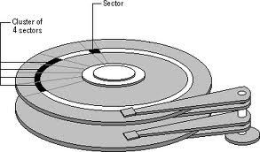
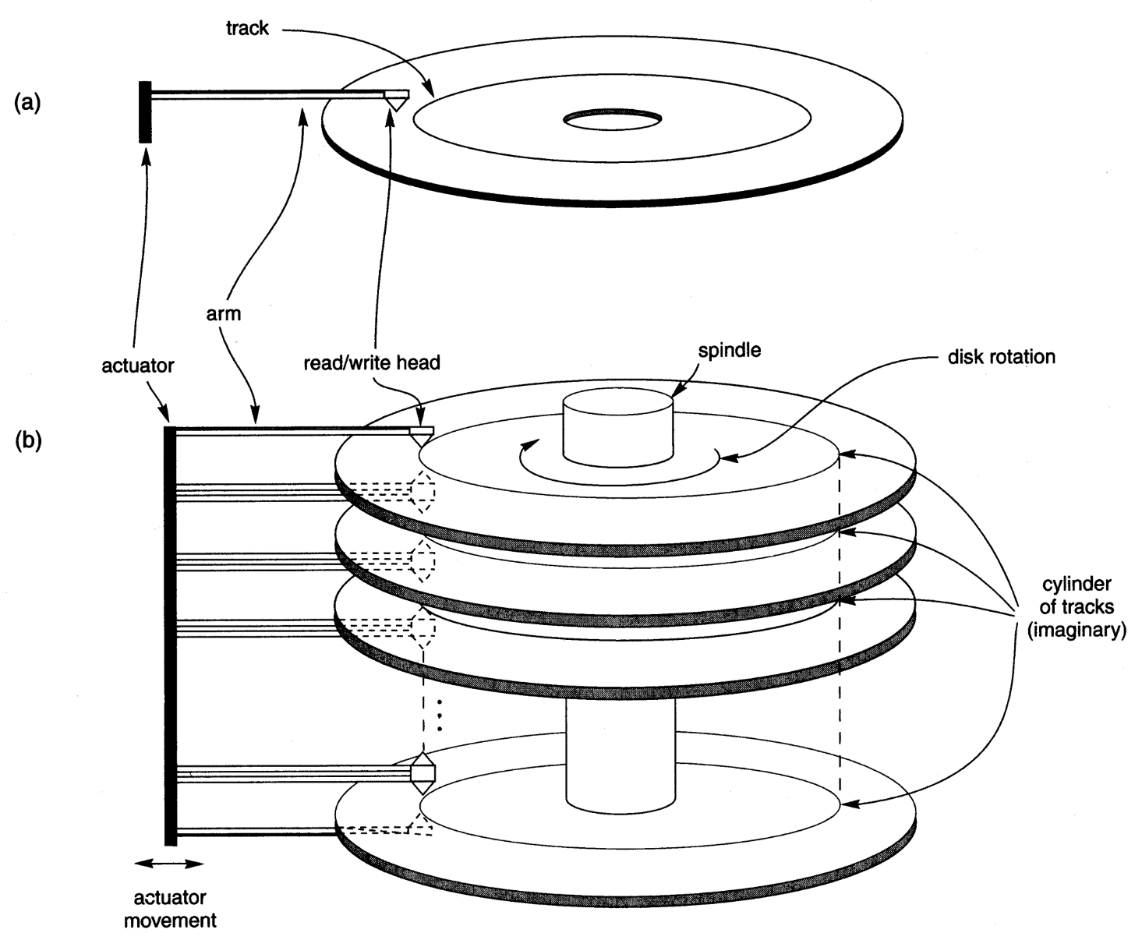
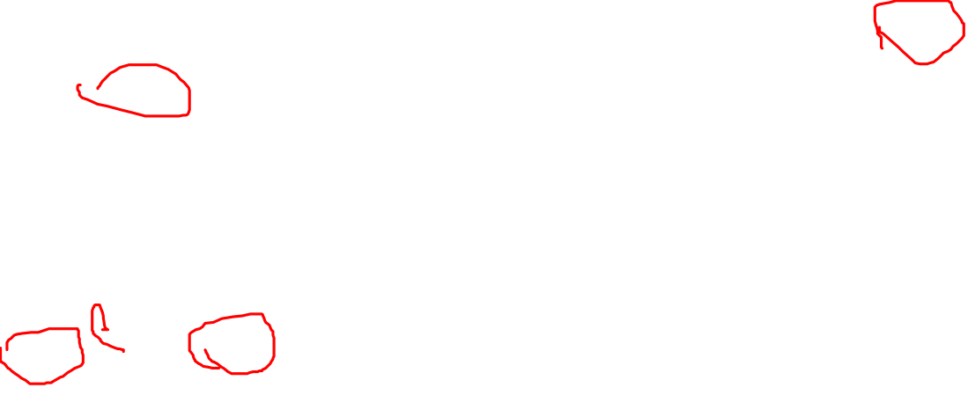
How Disk is Accessed
https://blogs.umass.edu/Techbytes/2017/04/04/hard-drives-how-do-they-work/
Notes:
Data in a database is typically stored in hard disks. (RAM is fast but too expensive; tape is cheap but too slow due to sequential later)
Complex method of organizing tracks and sectors on the disks formatted into marking tracks and sectors to prepare the disk to receive data
One, two, or more platters (CD like disks) are stacked together and spin in unison
Read/write heads, one head per surface, squeeze/contact the surface when at rest, but lift up when spinning
Controlled by an actuator
Move in unison across disk surfaces as disks rotate on a spindle
Require a hard drive controller
3 steps are involved when a disk is being accessed
Seek: move the head to the proper track
Rotate: the platter rotates to the proper vector
Transfer (Tx): a block a data from the sector transfer to memory. A block, not just a byte or word you are reading. Principle of locality. A byte, then those near it are likely to be access. Block size: 4k, 8k or 16k; DMA: block transfer to reduce overhead.

Slide 5
Cost of Accessing Disk
The time to Reading/Writing a disk is referred to as Input/output (I/O) cost
Broken down into 3 steps
  Seek time: time it takes to move the arm to the proper track
      4 – 10 milliseconds (ms), often specified by the manufacturer.
  Rotation time: time it takes to rotate the disk to put the right sector underneath the read/write head.
      Typical RPM is 7200, translated into 4 ms.
  Transfer time: time to move data between memory and disk
      Defined by its interface (S-ATA, USB etc.). Typically couple hundred Mbps to couple Gbps
      Compared to seek time and rotation time, transfer time is negligible.
Notes:
RPM: rotation per minute.
Rotation time = 1/RPM * 0.5 rotation
RPM = 7200, that is 7200/60 rotation per second.
On average, half of rotation to find the proper sector
1/7200 * 0.5 = 60/7200 rotation per second *0.5 = 0.004s = 4ms

Slide 6
A Mid-end HD (FYI)

Slide 7
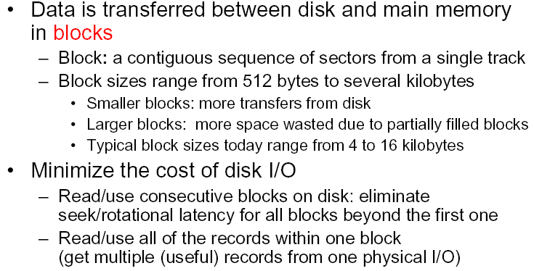
Optimize Disk Access
Notes:
Note that data transfer between HD and Memory is typically done in blocks. This minimizes seek and rotate overhead;
Reading 1 byte , 10 bytes or up to a block, the time spent almost s identical.

Slide 8
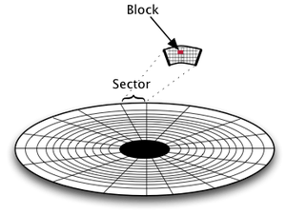
Block: Example
I want to store “0123456789” on HD (10 bytes)
I want to retrieve my SID “0123456789” from the HD
=4KB in Windows 10
Image Source: https://jmetz.com/2018/01/storage-hdd-and-ssd-partitioning-and-i-o-operations/
Notes:
HD Space is divided into blocks, which is located in a sector on a particular track.
*************************
Food for thought (FYI)
If you are really interested at HD storage, you should read this:
https://jmetz.com/2018/01/storage-hdd-and-ssd-partitioning-and-i-o-operations/

Slide 9
Example: How much time does it take to access a 1GB database(file)?
Using this hard drive: WD Black 4TB
  Seek time: 4ms
  Rotation: 7200RPM
  Transfer speed: 750MBps
  http://www.tomshardware.com/reviews/wd4001faex-4tb-review,3368-4.html
  Assume each block is 4KB and data randomly distributed
The amount of data FB stored increases by over 600TB everyday!
  https://code.facebook.com/posts/229861827208629/scaling-the-facebook-data-warehouse-to-300-pb/
Notes:
Assume data is randomly distributed on disk
Note that data access on HD is always in blocks. One HD access gives one block of data Assume one block is 4KB.
How many HD access needed (How may blocks for 1GB)? 1GB/4KB = 250,000 blocks
How long does it take to access one block?
Seek time: 4ms
Rotation: 60/7200*0.5 =4ms
Tx: 4KB/750MBps=0.005ms
8.005ms per block (per access), that is, actual HD speed: 8.005ms per 4KB, that is 4KB/8.005= 0.5MB/s=0.5MBps
So 8.005ms*250,000 = 2001 second = 33 mins (worst case). In short, it will take 33 mins to access 1GB of data!
In practice, HD uses various techniques and technologies like defragmentation (data not randomly distributed), pre-fetch etc. to make it faster, so 1GB is about several minutes.
This is ok for individual use. But for DB shared by hundreds, this is a problem!

Slide 10
Parallelizing Disk Access using RAID Technology
Secondary storage technology must take steps to keep up in performance and reliability with processor technology.
A major advance in secondary storage technology is represented by the development of RAID, which originally stood for Redundant Arrays of Inexpensive Disks.
The main goal of RAID is to even out the widely different rates of performance improvement of disks against those in memory and microprocessors. And to provide improved reliability as well.
Notes:
Accessing HD is time consuming and has become the performance bottleneck as computers (CPU) run faster and faster.
How can we improve it?
When you have several HDs, you can organize them using RAID
Besides improving speed, RAID also offers fault tolerance. More HD, better performance but higher failure rate as well.
In the fast-paced and highly-contaminated digital world, errors are unavoidable. (cosmic particle, power surge, radio interference etc).
In particular on a file server, where the disks are accessed constantly, we will experience a much higher failure rate.
To ensure data integrity, we need to implement some kind of fault tolerance.
That is where RAID comes to play.
Currently, there are seven standard RAID levels are defined by the RAID Advisory Board, called RAID 0–6.
RAID typically is implemented by a RAID controller board, although software-only implementations are also possible (but not recommended).
**********************
RAID0: increase capacity and speed
RAID Level 0—Striping. File data is written simultaneously to multiple drives in the array, which act as a single larger drive. Offers high read/write performance but very low reliability. Requires a minimum of two drives to implement.
RAID1: fully fault tolerated, but slow
RAID Level 1—Mirroring. Data written to one drive is duplicated on another, providing excellent fault tolerance (if one drive fails, the other is used and no data lost), but no real increase in per­formance as compared to a single drive. Requires a minimum of two drives to implement (same capacity as one drive).
RAID5: most common, improves fault tolerance and speed
Most ATA RAID implementations are much simpler than the professional SCSI RAID adapters used on network file servers. ATA RAID is designed more for the individual who is seeking performance or sim­ple drive mirroring for redundancy. When set up for performance, ATA RAID adapters run RAID Level 0, which incorporates data striping. Unfortunately, RAID 0 also sacrifices reliability such that if one drive fails, all data is lost.
When set up for reliability, ATA RAID adapters generally run RAID Level 1, which is simple drive mir­roring. All data written to one drive is written to the other. If one drive fails, the system can continue to work on the other drive. Unfortunately, this does not increase performance at all, and it also means you get to use only half of the available drive capacity. In other words, you must install two drives, but you get to use only one (the other is the mirror).
RAID is an acronym for redundant array of independent (or inexpensive) disks and was designed to improve the fault tolerance and performance of computer storage systems. RAID was first developed at the University of California at Berkeley in 1987,.
Initially, RAID was conceived to simply enable all the individual drives in the array to work together as a single, larger drive with the combined storage space of all the individual drives added up. However, this actually reduced reliability and didn’t do much for performance, either. For example, if you had four drives connected in an array acting as one drive, you would be four times as likely to experience a drive failure than if you used just a single larger drive. To improve the reliability and per­formance, the Berkeley scientists proposed six levels (corresponding to different methods) of RAID. These levels provide varying emphasis on either fault tolerance (reliability), storage capacity, perfor­mance, or a combination of the three.

Slide 11
Different Level of RAID
Different RAID organizations were defined based on different combinations of the two factors of granularity of data interleaving (striping) and pattern used to compute redundant information.
  Raid level 0 has no redundant data and hence has the best write performance.
  Raid level 1 uses mirrored disks.
  Raid level 2 uses memory-style redundancy by using Hamming codes, which contain parity bits for distinct overlapping subsets of components. Level 2 includes both error detection and correction.
  Raid level 3 uses a single parity disk relying on the disk controller to figure out which disk has failed.
  Raid Levels 4 and 5 use block-level data striping, with level 5 distributing data and parity information across all disks.
  Raid level 6 applies the so-called P + Q redundancy scheme using Reed-Soloman codes to protect against up to two disk failures by using just two redundant disks.
We only focus on 0, 1 and 5 as they are the most common
Notes:
Raid level 1 (mirrored disks)is the easiest for rebuild of a disk from other disks. It is used for critical applications like logs.
Most popular uses of the RAID technology currently are: Level 0 (with striping), Level 1 (with mirroring) and Level 5 with an extra drive for parity.
**************
Food for thought (FYI):
Raid level 2 uses memory-style redundancy by using Hamming codes, which contain parity bits for distinct overlapping subsets of components. Level 2 includes both error detection and correction.
Raid level 3 ( single parity disks relying on the disk controller to figure out which disk has failed) and level 5 (block-level data striping) are preferred for Large volume storage, with level 3 giving higher transfer rates.
Design Decisions for RAID include – level of RAID, number of disks, choice of parity schemes, and grouping of disks for block-level striping

Slide 12
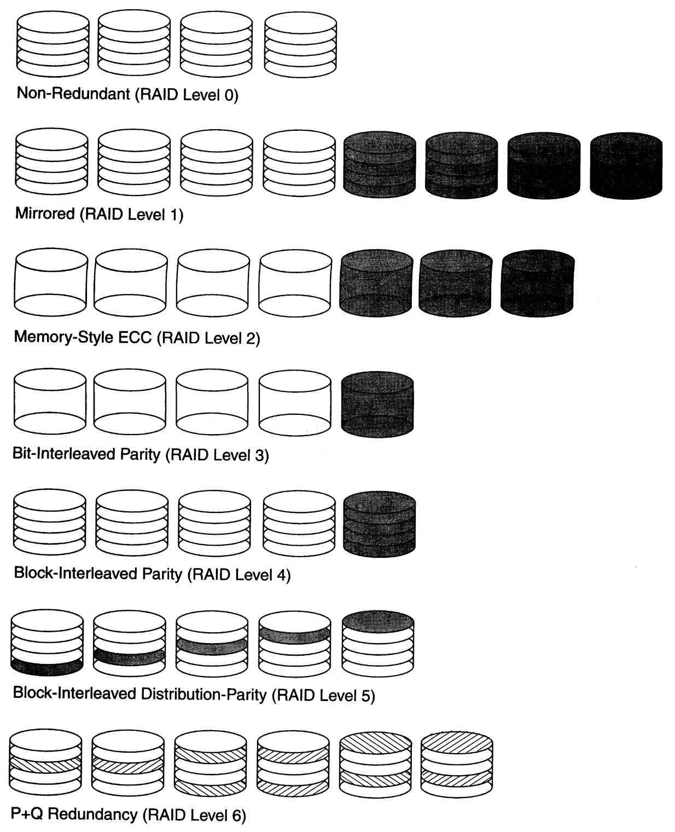
RAID: Diagram
Notes:
Only focus on 0, 1 and 5, explained in detail in the next few slides.

Slide 13
Key RAID Concepts
Striping
Mirroring
Parity
Performance matrix
  Read/write speed
  Space efficiency
  Fault tolerance
Good information source: https://en.wikipedia.org/wiki/Standard_RAID_levels

Slide 14

Data Striping
Data striping intentionally distributes data blocks of the same file over multiple disks to speed up access performance.
  It utilizes parallelism to improve disk performance as each disk can move and rotate independently. So each disk can access a data block simultaneously.
File
F1
F2
F3
Notes:
Speed performance improved based on a concept of striping.
S: Seek
R: Rotate
T: Transfer
File: F1, F2, F3
-----------------------------------------------------------------→ (Time line)
With striping:
F1,SRT
F2 SRT
F3 SRT
Without Striping:
SRT for F1, SRT for F2, SRT for F3
However, there is a problem with data striping: reliability (data loss due HD failure). As data is distributed over multiple drives, if one drive fails, the entire data/file will be corrupted.

Slide 15
RAID 0
Only striping is used
Performance
Problems?
The average failure rate of a HD is 1.84% (so the success rate of a HD is 98.16%
Source: https://www.backblaze.com/blog/hard-drive-reliability-stats-q1-2016/
With 5 drives, speed improve 5 times.
But chance of data loss due to HD failure?
Disk 0
Disk 1
Disk 2
Disk 3
Disk 4
Notes:
With 5 drives, speed improve 5 times
But data loss due to HD failure? Increase, decrease, or the same compare with no striping, with one HD?
This is a binomial distribution B(5, 98.16%)
P(X= 5) = 91%
If we have 4 HDs, B(4, 98.6%), P(4=6) = 93%.

Slide 16
RAID 1
Only use mirroring
Performance
RAID 1
A1
A1
A2
A2
B1
B1
B2
B2
C1
C1
C2
C2
D1
D1
D2
D2
Notes:
RAID1 aims at improving reliability. So no striping because it decreases reliability (in striping, if one HD fails, all files corrupted).
In RAID 0, If we have 4 HDs, B(4, 98.6%), P(X=4) = 93%.
In RAID 1, If we have 4 HDs, B(4, 98.6%), P(X>=3) = 99.8%.
************
Food for thought (FYI)
Some variations of RAID 1 also uses striping but we don’t consider them here. It is sometimes called RAID 1E.
Also, RAID 01 is NOT RAID 1. RAID 01 is actually RAID 0+1.

Slide 17
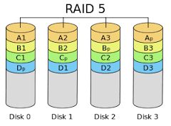
RAID 5
Striping and parity are used

Slide 18

Parity
A parity bit, or check bit, is a bit added to a string of binary code that indicates whether the number of 1-bits in the string (including the parity bit) is even or odd.
Source: https://en.wikipedia.org/wiki/Parity_bit
111X101
7 bits of data | (count of 1-bits) | 8 bits including parity
 |  | even | odd
0000000 | 0 | 00000000 | 00000001
1010001 | 3 | 10100011 | 10100010
1101001 | 4 | 11010010 | 11010011
1111111 | 7 | 11111111 | 11111110
Notes:
Even parity:
How about 111000000Y01? What is Y? Y=0
How about 111111X001Y? What is X and what is Y? No idea. Out of luck!

Slide 19
Parity at work: Example
5 data blocks, each block contains 4 bit, even parity.
4 bits of data
0 0 0 0
0 1 0 1
0 1 0 1
1 0 1 0
1 1 0 1
0 1 1 1
One block corrupted
4 bits of data
0 0 0 0
0 1 0 1
0 1 0 1
1 0 1 0
1 1 0 1
0 1 1 1
A B C D
B C D
C D
D
Notes:
If we have more than one block corrupted, then we are out of luck. So this approach can only recover one block of corrupted data.
What if the third block is corrupted instead of the first? Would it make any difference in terms of how to recover it? NOOOOOOOOOO. Apply the same process.

Slide 20
Striping + Parity
5 data blocks, each block contains 4 bit, even parity. Assume B2 is empty (0 0 0 0).
File A
0 0 0 0
0 1 0 1
0 1 0 1
1 0 1 0
1 1 0 1
F1
A1
F2
A2
F3
A3
F4
B3
F5
B1
Even Parity for F1(stored in A1), F2 (stored in A2) and F3 (stored in A3)
Even Parity for F4 (stored in B3), F5 (stored in B1) and B2 (0 0 0 0)
0 0 0 0
Ap
0 1 1 1
Bp
Notes:
With this arrangement, we can retrieve 4 blocks of data simultaneously.
If one HD say Disk 2 crashes, we can:
use A1, A2, Ap to recover data in A3,
use B1, B2, B3 to recover data in Bp,
use C1, Cp, C3 to recover data in C2,
… … till the whole drive data is fully recovered.

Slide 21

RAID 5
Performance
Fault Tolerance

Slide 22
Summary of Today’s Lecture
RAID technologies
  Striping
  Mirroring
  Parity
RAID 0, 1, 5
  Access time
  Space efficiency
  Fault tolerance
Notes:
A summary of key performance

