Slide 1

Review of Last Lecture
HD access: 3 steps, block access
RAID technologies
  Striping, mirroring, parity
  RAID 0, 1 and 5
Performance | 0 | 1 | 5
Access speed | Striping, N timers faster | Mirroring No improvement N must be even | Striping and parity N timers faster
Space Efficiency | 100% | 50% | (N-1/)N
Fault tolerance | None, data loss greatly increase | No problem for 1 HD failure, and up to N/2 if lucky | One and only one HD failure, no problem

Slide 2
Today’s Plan
Data backup
  Online vs. offline
  Full vs. incremental
SSD and tape drive
  SSD: used a primary storage, not as backup
  Tape: use only for offline backup

Slide 3
How to put this into practical use?
On Feb 1, 2004, 3 days before FB launches, Mark Zuckerberg asks his CIO (you) :“We spent $10 Million to build a data server with 10,000 HDs setup in RAID 5. Do you think it is fast enough to handle user demands?”
Answer #0:”Mark, you are asking the wrong person. My major from UW is NOT computer science … ....”.
Answer #1:”Yes, I think so. If not, we can always add more later on.”
Answer #2:”Let’s do some user testing.” Delay launch. After couple days, you might get some answers (simulating millions of concurrent access is not easy).
Answer #3:”Let me apply what I learned at UW and show you some math.”
Fired
replaced
Demoted

Slide 4
Is it enough?
One HD =50MBps
10,000HD=50MBps * 10,000=500GBps
Speed performance for RAID 5 with 10,000 HDs.
  How much user traffic can it handle?
Approach one: how many users do you expect daily?
ANS: 1M => 12 users per second!
Approach two: how many users can it handle at maximal?
How long can a user wait for a page?
How big is a page?
5MB in 3 second => 5MB/3s = 1.7MBps
500GBps / 1.7MBps = = 294,118 visitors every 3 seconds
Meaning: capacity is 8.4 billion users daily!
Notes:
10,000HD in RAID 5, each HD typically runs at 50MBps, so 50MBps*10K =500GBps total bandwidth (access speed). So, is this good enough?
Translation: speed wise, how many users can it support?
Approach one: How many users do you expect daily? 1M, 12 visitor per second, so 500GBps / 12 = … … way more than enough! A user can download like 5 4K movies per second!
Approach two: How fast a user need to access a FB page (how long will they wait)? One page 5MB (FB games home page). How long can you wait before losing patience? 3s. 5MB/3s = 1.7MBps for each user. So 500GBps / 1.7MBps = 294,118 visitors every 3 seconds (3s wait time). Roughly 100K users per second, that is 8.4 billion daily!
Fact: 1.62 billion users visit Facebook daily, as of 2020.
***************
Food for thought:
More realistic: download speed (web page access speed) = HD access + network delay (transmission), say it adds 10%, so 500KBps / 1.1 = 450KBps (500KB per 1.1 second).
More realistic: 1s: 12 new; 2s: 12 new … …, existing users (say 1s user) might not leave right away at 2s, 3s etc.!
So Need to use Poisson process/arrival process (with arrival rate of 12) and exponential residence time to estimate average number of users per second.

Slide 5
Data Backup
Online backup (hot backup)
  Instant real-time backup
  Example: RAID 1 and RAID 5
  Protect against one HD failure
Offline backup (archive)
  Done at the end of the day, copy and ship to a different location
  Example: backup to tape drive
  Protect against complete failure, but can only recover data from one day (some time) ago.
  Full vs. incremental backup
Notes:
Online/Hot backup: you can unplug the old drive and plug in the new one without interruption.
RAID 1 and 5 can protect against one HD failure.
What if there are two HD failures?
Or if a fire destroys everything, how do we protect our data against that?
RAID 1 and 5 can protect against one HD failure.
No interruption or data lost if one HD fails.
This is called online backup.
It provides instant backup while the system is up and running. (this does not sound much, just one failure, but for 100 HD, its reliability increases from 50% improved to 85%!)
However, more than 1 simultaneous HD failure could still happen.
What should we do?
In a business setting, besides RAID, you should also implement offline backup: say backup all your data at the end of the day.
So even if the whole system fails, you still can recover data from the day before.
Timing, type of failure, freshness of the data are up for discussion.
So you have RAID providing instant backup for one HD failure, you also have offline backup to prevent complete failure.
You also have SMART technology that can predict and warn you about possible HD failure.
Your data is reasonably safe.
It sounds simple, right?
Facebook generates 4 petabytes of data per day—a petabytes is a million gigabytes.
All that data is stored in what is known as the Hive, which contains about 300 petabytes of data in total.
Making a copy of the Hive regularly is not practical (too time-consuming) nor cost-effective (too expensive).
Alternative: incremental back-up – only maintain copy of changes regularly and make full copy occasionally.

Slide 6
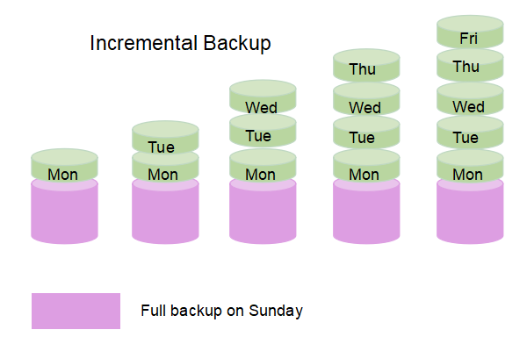
Incremental Backup
Image Source: https://www.easeus.com/backup-utility/differential-backup-vs-incremental-backup.html
Notes:
An incremental backup is a backup type that only copies data that has been changed or created since the previous backup activity was created.
An incremental backup approach is used when the amount of data that has to be protected is too voluminous to do a full backup of that data every day.
How many students access their bank account today? In W20, only 2%. It means only 2% of bank data needs to be backed up on a daily basis.
For example, suppose that you created a full backup on Monday and used incremental backups for the rest of the week. Tuesday's scheduled backup would only contain the data that has changed since Monday. Wednesday's backup files would only contain the data that has changed since Tuesday, and so on.
The primary disadvantage of incremental backups is that they can be time-consuming to restore. Going back to the previous example, suppose that you wanted to restore the backup from Wednesday. To do so, you would have to first restore Monday's full backup. After that, you would have to restore Tuesday's backup, followed by Wednesday's.
In addition, if any of the backup media happens to be missing or damaged, then you will experience incomplete data recovery.
********************
Food for thought (FYI):
https://searchdatabackup.techtarget.com/tip/Data-backup-types-explained-Full-incremental-differential-and-incremental-forever-backup
Data repository models
Any backup strategy starts with a concept of a data repository.
The backup data needs to be stored somehow and probably should be organized to a degree.
It can be as simple as a sheet of paper with a list of all backup tapes and the dates they were written or a more sophisticated setup with a computerized index, catalog, or even a relational database.
Different repository models have different advantages.
This is closely related to choosing a backup rotation scheme.
Unstructured
An unstructured repository may simply be a stack of floppy disks or CD-R/DVD-R media with minimal information about what was backed up and when.
This is the easiest to implement, but probably the least likely to achieve a high level of recoverability.
Full only / System imaging
A repository of this type contains complete system images from one or more specific points in time. This technology is frequently used by computer technicians to record known good configurations.
Imaging is generally more useful for deploying a standard configuration to many systems rather than as a tool for making ongoing backups of diverse systems.
Incremental / Differential
An incremental style repository aims to make it more feasible to store backups from more points in time by organizing the data into increments of change between points in time.
This eliminates the need to store duplicate copies of unchanged data.
Typically to start out, a full backup (of all files) is made.
After that, any number of incremental or differential backups can be made.
Restoring a whole system to a certain point in time would require locating the last full backup taken previous to that time and all the incremental / differential backups that cover the period of time between the full backup and the particular point in time to which the system is supposed to be restored.^{[4]}
Additionally, some backup systems can reorganize the repository to synthesize full backups from a series of incrementals.
Note: Different implementations of backup systems frequently use specialized or conflicting definitions of these terms.
The most relevant characteristic of a type of incremental backup is which reference point is it using to check for changes.
By a common definition, a differential backup copies files that have been created or changed since the last full backup, regardless of whether any other backups have been since then and an incremental backup refers only to a backup that includes just the changes made since the most recent backup of any type.
Other variations include multi-level incrementals and incremental backups that compare parts of files instead of just the whole file.
Reverse delta
A reverse delta type repository stores a recent "mirror" of the source data and a series of differences between the mirror in its current state and its previous states.
A reverse delta backup will start with a normal full backup.
After the full backup is performed, the system will periodically synchronize the full backup with the live copy, while storing the data necessary to reconstruct older versions.
This can either be done using hard links, or using binary diffs.
This system works particularly well for large, slowly changing, data sets.
Examples of programs that use this method are rdiff-backup and Time Machine.Continuous data protection
Instead of scheduling periodic backups, the system immediately logs every change on the host system.
This is generally done by saving byte or block-level differences rather than file-level differences.^{[5]}
It differs from simple disk mirroring in that it enables a roll-back of the log and thus restoration of old image of data.

Slide 7
Alternative Mass Storage Devices
Solid State Drive (SSD)
Tape drive
Optical drive
  Not modifiable (or too slow to modify), hence not considered here
Notes:
Optical drive: not useful in large scale applications.

Slide 8
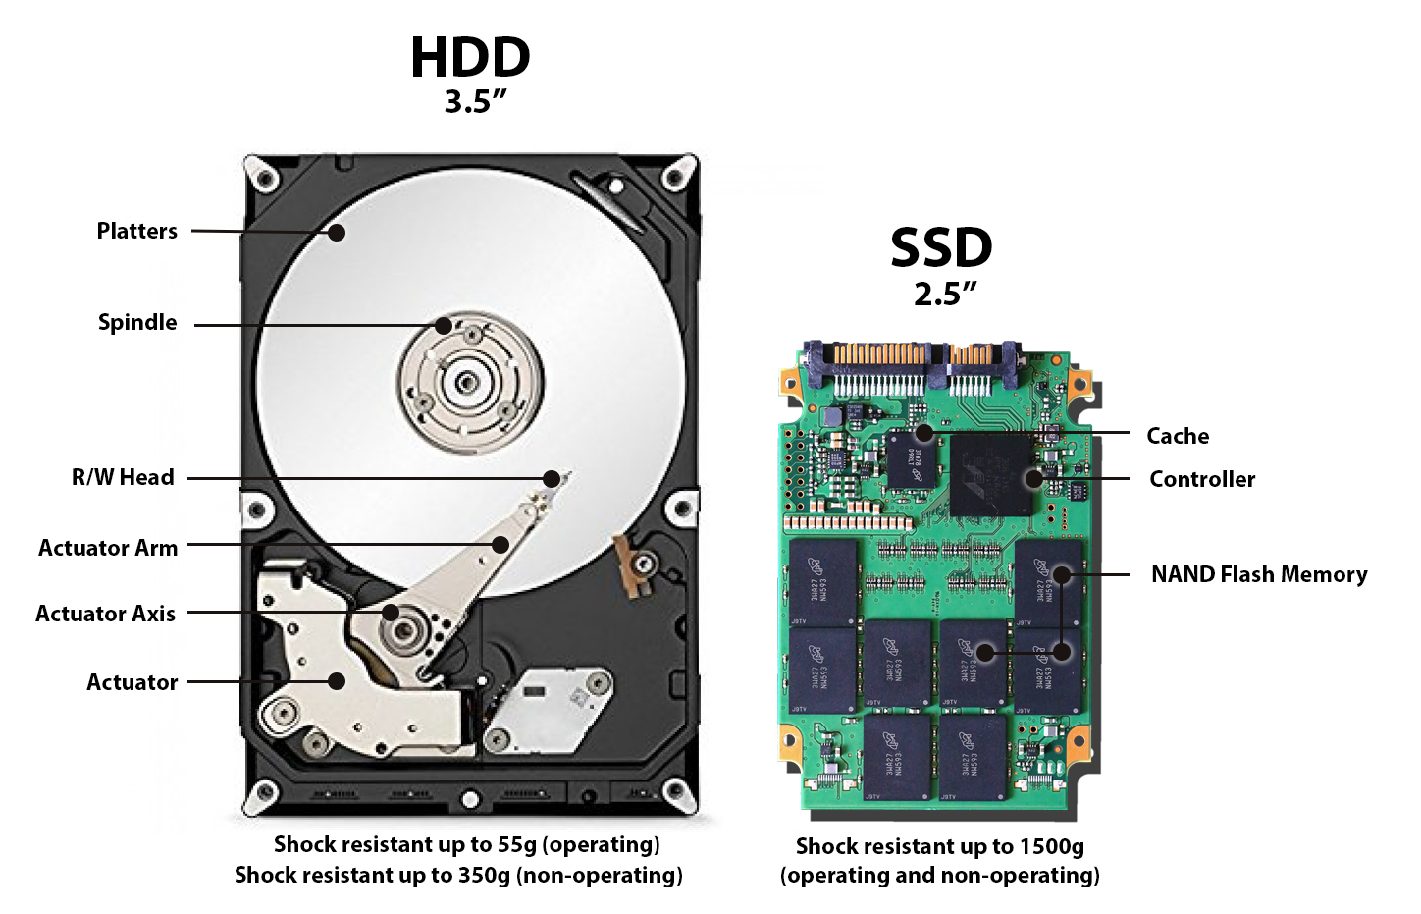
HDD vs. SSD
Image Source: https://www.backblaze.com/blog/ssd-vs-hdd-future-of-storage/
Notes:
SSD uses flash memory like SD card to store data!
SSD often uses main storage in computers, NOT as backup, because that would be too expensive!

Slide 9
Comparison: HDD vs. SSD
 | HDD | SSD
Failure Rate | Mean time between failure rate of 1.5 million hours | Mean time between failure rate of 2.0 million hours
File Copy / Write Speed | The range can be anywhere from 50–120MB/s | Generally above 200 MB/s and up to 550 MB/s for cutting edge drives
File Opening Speed | Slower than SSD | Up to 30% faster than HDD
Affected by Magnetism | Magnets can erase data | An SSD is safe from any effects of magnetism
Ruggedness | Vulnerable to physical jolts and movement | Not vulnerable to jolts and vibration
Source: https://www.backblaze.com/blog/hdd-vs-ssd-in-data-centers/
Notes:
Food for thought (FYI):
The HDD has an amazing history of improvement and innovation.
From its inception in 1956 the hard drive has decreased in size 57,000 times, increased storage 1 million times, and decreased cost 2,000 times.
In other words, the cost per gigabyte has decreased by 2 billion times in about 60 years.

Slide 10
Comparison: HDD vs. SSD
 | HDD | SSD
Power Draw/Battery Life | More power draw, averages 6–7 watts and therefore uses more battery | Less power draw, averages 2–3 watts, resulting in 30+ minute battery boost
Cost | Only around $0.03 per gigabyte, very cheap (buying a 4TB model) | Expensive, roughly $0.20- $0.30 per gigabyte (based on buying a 1TB drive)
Capacity | Typically around 500GB and 2TB maximum for notebook size drives; 10TB max for desktops | Typically not larger than 1TB for notebook size drives; 4TB for desktops
Operating System Boot Time | Around 30-40 seconds average bootup time | Around 8-13 seconds average bootup time
Noise | Audible clicks and spinning platters can be heard | There are no moving parts, hence no sound
Vibration | The spinning of the platters can sometimes result in vibration | No vibration as there are no moving parts
Notes:
SSD has many advantages over HDD but too expensive to be used as backup (online or offline).

Slide 11
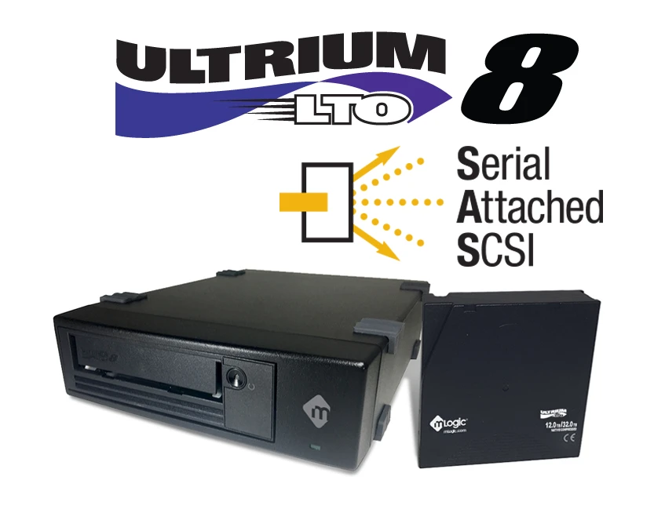
Tape Drive
Image Source: https://www.mlogic.com/products/desktop-sas-lto-8-tape-drive

Slide 12
Tape Drive
Pros (Compared to HDD) | Cons
3x cheaper than HDD for large system (50TB+) Cost-effective in terms of expenses, i.e. electricity, cooling, maintenance Hard drives require power to run - Tape requires no electrical power when not being actively used Faster than HDD for sequential access. Hence fast for full system recovery Less sensitive to mechanical damage and drop 30 year shelf life Tape can sit cold and unused for decades. Hard drives need to be spun up occasionally or they freeze up and/or errors build up. | High entry cost. Besides the tapes, need a special drive (it costs over $1,000) Not for random access Proper storage conditions (temperature/humidity) required to achieve 10+ year shelf life If re-used often (approx. 100x), tapes are prone to wear and tear. Therefore better suited for long-term archive. If used for recurring backup, tapes should be replaced in approx. 3-year cycles Not as plug-and-play like HDD. Technology requires proper/proprietary drivers and/or a technology-aware application for driving it.
Notes:
If you plug in a HDD but not reading or writing any data on it, it still draws power. But tape does not. It only draws power when being accessed.
Tape is fast when used sequentially. For backups (copying the entire drive from start to finish), it runs between 75 MB/s and 130 MB/s sustained per drive.

Slide 13
Comprehensive Exercise
For simplicity: each block is 2-bit
File F
4 HDs
How is F stored in RAID 0, RAID 1, RAID 5?
F1
F2
F3
F4
F5
01
11
10
00
11
xx
xx
xx
D0
xx
xx
xx
D1
xx
xx
xx
D2
xx
xx
xx
D3

Slide 14

Comprehensive Example – R0
For simplicity: each block is 2-bit
File F
4 HDs
F1
F2
F3
F4
F5
01
11
10
00
11
01
11
xx
D0
11
xx
xx
D1
10
xx
xx
D2
00
xx
xx
D3
Notes:
Striping: Data blocks of F spread out among all drives.
Note the data block can go to any block within the drive. We start from the top as a convention.

Slide 15

Comprehensive Example – R1
For simplicity: each block is 2-bit
File F
4 HDs
F1
F2
F3
F4
F5
01
11
10
00
11
01
11
10
D0
01
11
10
D1
00
11
xx
D2
00
11
xx
D3
Notes:
Mirroring: D0 is the data drive and D1 is its mirror; D2 is the data drive and D3 is its mirror.

Slide 16
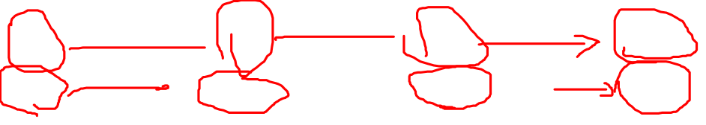
Comprehensive Example – R5
For simplicity: each block is 2-bit, assume odd parity
File F
4 HDs
F1
F2
F3
F4
F5
01
10
10
00
11
01
00
xx
D0
10
xx
xx
D1
10
xx
xx
D2
10
00
xx
D3
Ap
11
Bp
00
Notes:
Striping and parity.
Take first bits of every block and take the second bit of every block:
01
10
10
Odd: Ap = 10
XX is vacant spots with random data that we usually don’t care. But because we need compute the parity for F4 and F5, we need to know what is there. Assume all 00.
00
11
00
Odd: Bp = 00
Some might ask why don’t we compute the parity block for the last rows? You can but no need. If we need to restore a HD, the last row does not need to be restored, as it is vacant.

Slide 17
Summary of Today’s Lecture
Data backup
  Online vs. offline
  Full vs. incremental
SSD and tape drive
  SSD: used a primary storage, not as backup
  Tape: use only for offline backup

Slide 18
Recap of Our Journey
Database and DBMS
Relational data model
Relational algebra
SQL
ERD and mapping
Normalization
Transaction control
Storage technologies

