Slide 1
CS 341: Algorithms
Lecture 14: graph algorithms V – single source shortest path
Readings: see website
Trevor Brown
https://student.cs.uwaterloo.ca/~cs341
trevor.brown@uwaterloo.ca

Slide 2
Dijkstra’s algorithm
Single-source shortest path in a graph with non-negative edge weights

Slide 3
Problem: Single source Shortest paths (SSSP)
Let’s study directed G. Can also be defined for undirected G…
Input: graph $G=(V,E)$ and a non-negative weight function $w\left(e\right)$ defined for every edge $e$
Problem: for every node $v≠s$, output a path $s⇝v$ with the smallest total weight (among all paths $s⇝v$)
I.e., each path $P$ should minimize $w\left(P\right)=\sum_{e∈P}{w(e)}$
“Shortest” means minimum weight
Suppose this is 𝒔
Shortest path to $i$
l
18
19
6
a
a
a
a
7
h
14
10
h
5
j
f
j
f
c
4
k
c
b
8
c
21
9
16
12
2
3
1
15
22
i
d
i
d
e
e
20
g
Shortest path to $d$
11
17
13
Shortest path to $c$
And so on… one path for each node.
Notes:
Applications? Revisit BFS path applications… but describe where edge weights come into play…

Slide 4
Application: Driving distance to many possible destinations
Single source: from where you are
Shortest paths: to all destinations
Display a subset of destinations
Include the optimal distances computed using SSSP algorithm
Other heuristics… traffic? Lights?
Weights can combine many factors

Slide 5
Game AI: path finding with waypoints
Divide game world into linear paths, then send game characters in straight lines between waypoints
[video clip]
If some linear paths are much faster/slower, use weighted SSSP
Otherwise use BFS to find shortest sequence of waypoints (with fewest waypoints)

Slide 6
Dijkstra’s algorithm Illustrative example
$dist[e]$ is optimal
Done!
$dist[c]$ is optimal
$dist[f]$ is optimal
$dist[k]$ is optimal
$dist[b]$ is optimal
$dist[h]$ is optimal
$dist[ℓ]$ is optimal
Start node $s$ is here
Showing $dist$-values
$dist[d]$ is optimal
$dist[g]$ is optimal
$dist[i]$ is optimal
$dist[j]$ is optimal
l,$69$
l
l,$69$
l,$∞$
18
19
6
a,0
a
7
h
g,$41$
g,$41$
g,$∞$
5
14
10
g,$45$
j,$50$
j
j,$50$
f
j,$∞$
f,$∞$
f,$24$
f,$24$
4
k,$75$
c
k
k,$75$
c,$∞$
k,$∞$
c,$7$
This $dist$ is optimal!
b
8
c,$7$
21
b,$5$
b,$∞$
9
b,$5$
16
2
3
1
15
2
12
22
i
i,$62$
d,$2$
i,$62$
d,$∞$
i,$∞$
d,$2$
d
e
e,$23$
e,$∞$
e,$23$
20
g
h,$39$
h,$∞$
h,$39$
11
17
13
Can we use this optimal $dist$ to improve the $dist$ of neighbours
We call this relaxing the neighbours
Key insight: after relaxing all, the smallest $dist$ (that we didn’t already know was optimal) is now optimal

Slide 7
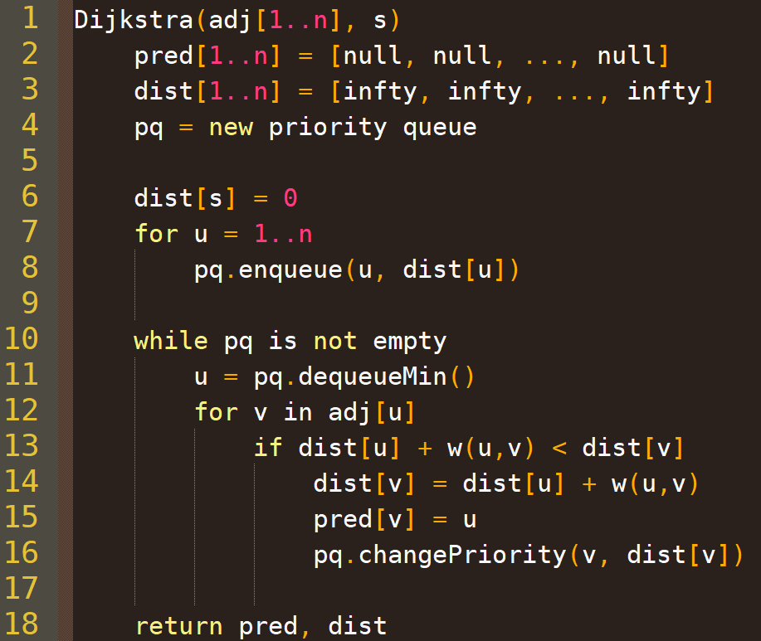
Maintain nodes in priority order, ordered by smallest distance
Enqueue all nodes with distance $∞$ except for $s$ with distance 0
Eventually dequeue all nodes (no more enqueues)
Each dequeued node $u$ has optimal $dist$
Relax neighbour $v$

Slide 8
Correctness: intuition
Dijkstra’s algorithm iteratively construct a set $OPT$ of nodes for which we know the shortest path from $s$ (initially $OPT=\{s\}$)
After each relaxation step, we grow $OPT$ by adding the node in $V\backslash OPT$ with the smallest $dist$
l
l,$∞$
Nodes in $OPT$ are coloured like this
18
19
6
a,0
a
7
h
14
10
g,$∞$
5
j
f
j,$∞$
f,$∞$
c
4
k
c,$∞$
k,$∞$
c,$7$
b
8
c,$7$
21
b,$5$
b,$∞$
9
b,$5$
16
2
3
1
15
2
12
22
d,$2$
i
d,$∞$
i,$∞$
d,$2$
d
e
e,$23$
e,$∞$
e,$23$
20
g
h,$∞$
11
17
13
And so on…

Slide 9
Proof
Theorem: At the end of the algorithm, for all $u$, $dist[u]$ is exactly the total weight of the shortest $s⇝u$ path
We prove this in two parts
$dist\left[u\right]≤$ the total weight of the shortest $s⇝u$ path (case $≤$)
$dist\left[u\right]≥\text{the} \text{total} \text{weight} \text{of} \text{the} \text{shortest} s⇝u \text{path}$ (case $≥$)

Slide 10
$\text{case} ≤$ [Erickson thm.8.5]
Let $P$ be any arbitrary $s⇝u$ path $v_{0}→v_{1}→…→v_{ℓ}$ where $v_{0}=s$ and $v_{ℓ}=u$
For any index $j$ let $L_{j}$ denote $w\left(v_{0}→v_{1}→…→v_{j}\right)$
We prove by induction: $dist\left[v_{j}\right]≤L_{j}$ for all $j$
$w($orange edges$)=L_{j}$
$$v_{j}$$
$$P$$
$$s,0$$
a
7
c
c,$∞$
b
8
$u$,$7$
b,$5$
b,$∞$
$$c,5$$
2
3
16
d,$2$
22
d,$∞$
d,$2$
d
e
11
e,$∞$

Slide 11
Prove by induction: $∀j : dist\left[v_{j}\right]≤L_{j}$
Base case: $dist\left[v_{0}\right]=dist\left[s\right]=0=L_{0}$
Ind. step: suppose $∀_{j>0} :dist\left[v_{j−1}\right]≤L_{j−1}$
When dequeueMin() returns $v_{j−1}$: we check if $dist\left[v_{j−1}\right]+w\left(v_{j−1},v_{j}\right)<dist[v_{j}]$
If so, we set $dist\left[v_{j}\right]=dist\left[v_{j−1}\right]+w\left(v_{j−1},v_{j}\right)$
If not, $dist\left[v_{j}\right]≤dist\left[v_{j−1}\right]+w\left(v_{j−1},v_{j}\right)$
In both cases, $dist\left[v_{j}\right]≤dist\left[v_{j−1}\right]+w\left(v_{j−1},v_{j}\right)$
By I.H. $dist\left[v_{j−1}\right]≤L_{j−1}$ so $dist\left[v_{j}\right]≤L_{j−1 }+w\left(v_{j−1},v_{j}\right)$
And $L_{j−1}+w\left(v_{j−1},v_{j}\right)=L_{j}$ by definition
So $dist\left[v_{j}\right]≤L_{j}$
$w($orange edges$)=L_{j}$
$$v_{j}$$
$$v_{j−1}$$
$$s,0$$
a
7
c
c,$∞$
b
8
$u$,$7$
b,$5$
b,$∞$
$$c,5$$
2
3
16
d,$2$
22
d,$∞$
d,$2$
d
e
11
e,$∞$
This proves $dist\left[u\right]≤L_{u}$, the weight of an arbitrary $s⇝u \text{path}$.
So $dist\left[u\right]≤$ the weight of EVERY $s⇝u \text{path}$.
Including the shortest $s⇝u \text{path}\text{!}$

Slide 12
case $≥$
Let $P′$ be the path $s→…→pred\left[pred\left[u\right]\right]→pred\left[u\right]→u$
I.e., the reverse of following $pred$ pointers from $u$ back to $s$
We show $dist[u]$ is as long as this path (and hence as long as the shortest path)
Denote the nodes in $P^{′}$ by $v_{0},v_{1},…,v_{ℓ}$ where $v_{0}=s$ and $v_{ℓ}=u$
Let $L_{j}=w\left(v_{0}→v_{1}→…→v_{j}\right)$
Prove by induction: $∀_{j>0} :dist\left[v_{j}\right]=L_{j}$
Base case: $dist\left[v_{0}\right]=dist\left[s\right]=0=L_{0}$

Slide 13
case $≥$
$P^{′}=v_{0}→…→v_{ℓ}=s→…→pred\left[pred\left[u\right]\right]→pred\left[u\right]→u$
$L_{j}=w\left(v_{0}→v_{1}→…→v_{j}\right)$
Inductive step: suppose $∀_{j>0} :dist\left[v_{j−1}\right]=L_{j−1}$
When we set $pred\left[v_{j}\right]=v_{j−1}$, we set $dist\left[v_{j}\right]=dist\left[v_{j−1}\right]+w\left(v_{j−1},v_{j}\right)$
By I.H., $dist\left[v_{j}\right]=L_{j−1}+w\left(v_{j−1},v_{j}\right)$
By definition $L_{j}=L_{j−1}+w\left(v_{j−1},v_{j}\right)$
So $dist\left[v_{j}\right]=$ $L_{j}$
Recall:
So $dist\left[u\right]=$ length of a particular path $P^{′}$in the graph
And length of $P^{′}$is $≥$ length of shortest path
So $dist\left[u\right]≥$ length of shortest path $s⇝u$
So $dist[u]$ is both $≤$ and $≥$ to the length of the shortest $s⇝u$path!
That means it’s equal to the length of the shortest path!

Slide 14
Runtime
$$O(n)$$
$$O(n)$$
$$O(n)$$
Each node enqueued and dequeueMin’d once
$O\left(n\log{n}\right)$
For each dequeueMin, do $O\left(\log{n}\right)$ per neighbour
$O\left(\log{n}\right)$ for each edge
$O\left(m\log{n}\right)$ w/adjacency lists
Total time $O\left(\left(n+m\right)\log{n}\right)$
$$O(\log{n})$$
$$O(n\log{n})$$
$$O(\log{n})$$
$$O(\log{n})$$
Space complexity?

Slide 15
Outputting actual shortest path(s)?
To compute the actual shortest path $s⇝t$
Inspect $pred[t]$
If it is NULL, there is no such path
Otherwise, follow $pred$ pointers back to $s$, and return the reverse of that path

Slide 16
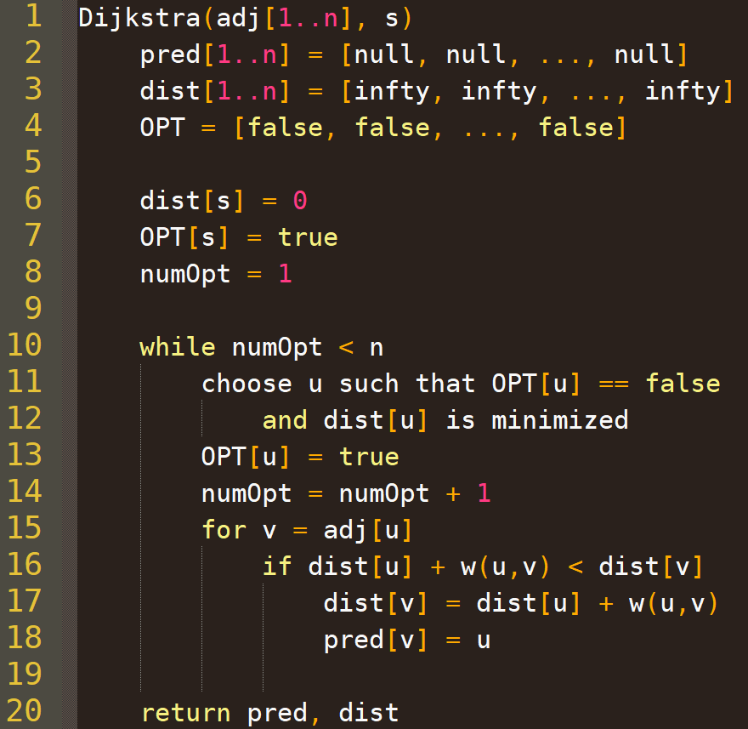
An alternative implementation
Instead of using a priority queue
Find the minimum dist[] node to add to OPT via linear search
Runtime?
$O(n^{2})$
Better or worse than $O\left(\left(n+m\right)\log{n}\right)$?
Notes:
ALTERNATIVE DIJKSTRA’S WITH V^2 TIME

Slide 17
Website demonstrating Dijkstra’s alg
https://www.cs.usfca.edu/~galles/visualization/Dijkstra.html

Slide 18
Bellman-Ford
Single-source shortest path in a graph with possibly negative edge weights but no negative cycles

Slide 20
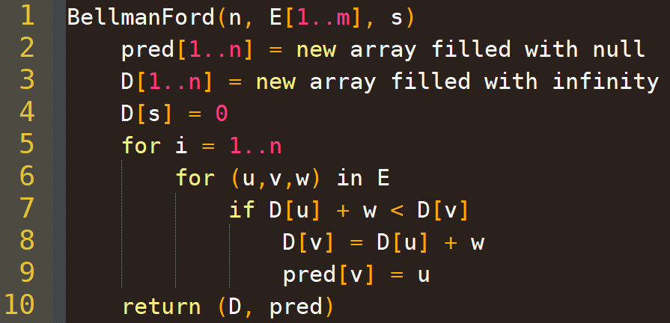
Bellman-Ford
$$O(n)$$
$$O(n)$$
$O(n)$ outer iterations
$$O(1)$$
$O(m)$ inner iterations per outer iteration
$O(1)$ work per inner iteration
Could be $O(n^{3})$
Total $O(nm)$

Slide 21
Best case execution
It technically suffices to do one iteration of the outer loop
Edges happen to be processed left to right by the inner loop

Slide 22
Worst case execution
Need $n$ iterations of outer loop
Edges happen to be processed right to left by the inner loop
Since the longest possible path without a cycle can be $n−1$ edges, the edges must be scanned $n−1$ times to ensure the shortest path has been found for all nodes.
Dijkstra’s is similar, but consistently achieves good ordering using its priority queue

Slide 23
Why Bellman-Ford works
Not going to prove this (by induction), but the crucial lemma is:
After $i$ iterations of the outer for-loop,
if $D\left[u\right]≠∞$, it is equal to the weight of some path $s⇝u$; and
if there is a path $P=(s⇝u)$ with at most $i$ edges, then $D\left[u\right]≤w(P)$
So, after $n−1$ iterations, if $∃$ path $P$ with at most $n−1$ edges, then $D\left[u\right]≤w(P)$. (Note: any more edges would create a cycle.)
So, if $u$ is reachable from $s$, then $D[u]$ is the length of the shortest simple path (no cycles) from $s$ to $u$
Of course every simple path has at most $n−1$ edges
So what if we do another iteration, and some $D[u]$ improves?
There is a negative cycle!

Slide 24
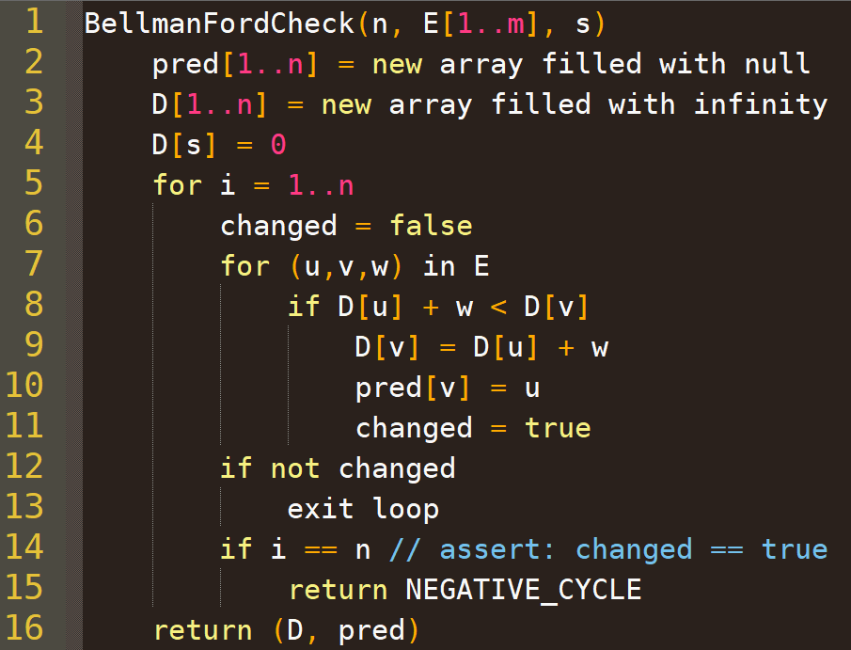
A More Detailed Implementation
With early stopping
and checking for negative cycles

Slide 25
Bonus slide
Why can’t you just modify a graph with negative weights by: finding the minimum edge weight Wmin, and adding that to each edge, so you no longer have negative edges and can run Dijkstra’s algorithm?
Exercise: can you find a graph for which this will cause Dijkstra’s algorithm to return the wrong answer?
Solution:
Consider a graph with 5 nodes: s, a, b, c, t
And edges s->a with weight -10, b->t with weight 10 s->b weight -1, b->c weight -1, c->t weight -1
What happens if you modify this graph as proposed, then run Dijkstra’s to find the shortest path from s to t?

