Slide 1
CS 341: Algorithms
Lecture 17: max flow
Readings: CLRS 26.2
Trevor Brown
https://student.cs.uwaterloo.ca/~cs341
trevor.brown@uwaterloo.ca

Slide 2
Quick review of last time

Slide 3
Recall: Max-Flow Min-Cut Theorem
Theorem 3: every max $s$-$t$ flow has value equal to the capacity of a min $s$-$t$ cut
We give an algorithmic proof of this theorem
(showing that one algorithm solves both max-flow and min-cut at the same time)

Slide 4
Ford-Fulkerson Method
Algorithm development (mixed together with proof of max-flow min-cut theorem)

Slide 5
Ford-Fulkerson Method
Same Ford as in Bellman-Ford :)
Can undo previous decisions to improve the flow
Can effectively “push back” some flow using an augmenting path through a residual graph
1/1
1/1
1/1
1/1
1/1
$$s$$
0/1
$$t$$
$$s$$
$$t$$
1/1
1/1
1/1
1/1
1/1
greedy flow
Pushes back the flow on this edge (negating its flow)
“augmenting path”
improved flow
So, what’s the residual graph, how do we find an augmenting path, and how do we improve the flow?

Slide 6
Residual graph
A residual graph $R_{f}$ is defined for a given flow $f$ and graph $G$
$R_{f}$ has the same vertices as $G$
For each edge $e=uv$ in $G$,
If $f\left(e\right)<c(e)$, then $R_{f}$ contains a forward edge $(u,v)$ with the remaining capacity $c\left(e\right)−f\left(e\right)$
If $f\left(e\right)>0$, then $R_{f}$ contains a backwards edge $\left(v,u\right)$ with capacity $f(e)$ representing flow that could be “pushed back”
0/1
0/1
0/1
1
1
1
1/1
0/1
1
1
$$s$$
1/1
$$t$$
$$s$$
1
$$t$$
0/1
1/1
1
1
0/1
0/1
0/1
1
1
1
greedy flow $f$
Forward edge: remaining capacity
residual graph for this flow
Backwards edge: can undo flow

Slide 7
Another example residual graph
Recall: for each edge $e=uv$ in $G$,
If $f\left(e\right)<c(e)$, then $R_{f}$ contains a forward edge $(u,v)$ with the remaining capacity $c\left(e\right)−f\left(e\right)$
If $f\left(e\right)>0$, then $R_{f}$ contains a backwards edge $\left(v,u\right)$ with capacity $f(e)$ representing flow that could be “pushed back”
0/1
0/1
0/1
1
1
1
2/2
0/1
2
1
$$s$$
2/3
$$t$$
$$s$$
1
2
$$t$$
0/1
2/2
1
2
0/1
0/1
0/1
1
1
1
flow $f$ with value 2
residual graph for this flow

Slide 8
Continuing with new material

Slide 9
Ford-Fulkerson Method
Find a shortest path P from $s$ to $t$ in the residual graph
If it improves the flow, we call it an augmenting path
And use it to update the flow
0/1
0/1
0/1
1
1
1
1/1
0/1
1
1
$$s$$
1/1
$$t$$
$$s$$
P
1
$$t$$
0/1
1/1
1
1
0/1
0/1
0/1
1
1
1
greedy flow $f$
residual graph for this flow
Forward edge: remaining capacity
Backwards edge: undo some flow

Slide 10
Ford-Fulkerson Method
Find a shortest path P from $s$ to $t$ in the residual graph
If it improves the flow, we call it an augmenting path
And use it to update the flow
For each forward edge in P, increase existing flow
0/1
0/1
0/1
1
1
1
1/1
0/1
1
1
$$s$$
1/1
$$t$$
$$s$$
P
1
$$t$$
0/1
1/1
1
1
0/1
0/1
0/1
1
1
1
greedy flow $f$
residual graph for this flow
Forward edge: remaining capacity
Backwards edge: undo some flow

Slide 11
Ford-Fulkerson Method
Find a shortest path P from $s$ to $t$ in the residual graph
If it improves the flow, we call it an augmenting path
And use it to update the flow
For each backwards edge in P, decrease existing flow
1/1
1/1
1/1
1
1
1
1/1
1/1
1
1
$$s$$
1/1
$$t$$
$$s$$
P
1
$$t$$
1/1
1/1
1
1
1/1
1/1
1/1
1
1
1
updated flow
residual graph for this flow
Forward edge: remaining capacity
Backwards edge: undo some flow

Slide 12
Ford-Fulkerson Method
Find a shortest path P from $s$ to $t$ in the residual graph
If it improves the flow, we call it an augmenting path
And use it to update the flow
1/1
1/1
1/1
1
1
1
1/1
1/1
1
1
$$s$$
0/1
$$t$$
$$s$$
P
1
$$t$$
1/1
1/1
1
1
1/1
1/1
1/1
1
1
1
updated flow
residual graph for this flow
Original greedy path no longer exists
Forward edge: remaining capacity
Backwards edge: undo some flow

Slide 13
Ford-Fulkerson Method
Find a shortest path P from $s$ to $t$ in the residual graph
If it improves the flow, we call it an augmenting path
And use it to update the flow
1/1
1/1
1/1
1
1
1
1/1
1/1
1
1
$$s$$
0/1
$$t$$
$$s$$
1
$$t$$
1/1
1/1
1
1
1/1
1/1
1/1
1
1
1
updated flow
new residual graph for this flow
No path from $s$ to $t$ in residual graph. Done!

Slide 14
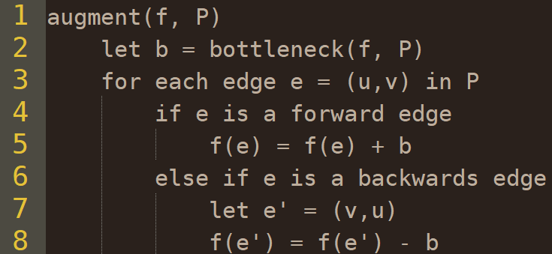
Improving a flow $f$ given an augmenting path $P$
no cycles!
An augmenting path w.r.t a flow $f$ is a simple $s$-$t$ path in $R_{f}$
Let $P$ be an augmenting path w.r.t $f$
Let $bottleneck(f, P)$ be the minimum capacity of an edge in $P$
We show this subroutine $augment(f, P)$ always improves the value of flow $f$

Slide 15
Lemma 4: augment() improves flow $f$
Let $f$ be a flow in $G$ with $f^{in}\left(s\right)=0$, and $P$ be an augmenting path w.r.t $f$
Let $f′$ be the resulting flow after running $augment(f, P)$
Then $f′$ is a flow with $value\left(f^{′}\right)=value\left(f\right)+bottleneck(f, P)$
That is, $augment(f, P)$increases the flow by $bottleneck(f, P)$

Slide 16
Proof
Claim: $augment(f, P)$increases the flow by $bottleneck(f, P)$
First check $f^{′}$ is a flow
Prove capacity and conservation constraints, and ${f^{′}}^{in}\left(s\right)=0$
Are capacity constraints satisfied?
We add/subtract $bottleneck(f, P)$ to/from each edge
And $bottleneck(f, P)$ is the minimum of the smallest remaining capacity, and the current flow
So capacity constraints are satisfied

Slide 17
Proof
Claim: $augment(f, P)$increases the flow by $bottleneck(f, P)$
How about conservation of flow?
Consider how the flow into and out of each vertex $u∉\{s,t\}$ changes as a result of running $augment(f, P)$
We show the change in $f^{in}\left(u\right)$ is the same as the change in $f^{out}\left(u\right)$
There are 4 cases, depending on whether the edges entering/leaving $u$ are forward or backward edges

Slide 18
Case 1: forward / forward
$$f^{in}\left(u\right)=5$$
$$f^{out}\left(u\right)=5$$
2/5
2
3
forward
forward
3
5
$$u$$
$$u$$
$$u$$
3/10
5/8
7
3
7
3
flow $f$
residual graph $R_{f}$
augmenting path $P$ in $R_{f}$
Let $bottleneck\left(f,P\right)=b$
Both $f^{in}(u)$ and $f^{out}(u)$ are increased by $bottleneck(f, P)$
2/5
$${f^{′}}^{in}\left(u\right)=5+b$$
$${f^{′}}^{out}\left(u\right)=5+b$$
$$u$$
3+b/10
5+b/8
Case 2: backwards / backwards is similar.
Both $f^{in}(u)$ and $f^{out}(u)$ are decreased by $b$
new flow $f^{′}$ (after augmenting)

Slide 19
Case 3: forward / backwards
$$f^{in}\left(u\right)=5$$
$$f^{out}\left(u\right)=5$$
5/6
5
1
2
forward
backwards
2
$$u$$
$$u$$
$$u$$
2/7
3/5
5
3
5
3
flow $f$
residual graph $R_{f}$
augmenting path $P$ in $R_{f}$
Let $bottleneck\left(f,P\right)=b$
Added and subtracted $b$ terms cancel out
$${f^{′}}^{in}\left(u\right)=5$$
$${f^{′}}^{out}\left(u\right)=5$$
5/6
$$u$$
Case 4: backwards / forwards is similar.
2+b/7
3-b/5
new flow $f^{′}$ (after augmenting)

Slide 20
Showing ${f^{′}}^{in}\left(s\right)=0$
0/1
0/1
0/1
2/2
0/1
Last step in showing $f^{′}$ is a flow
Prove: $s$ still has no flow into it
Since $f$ is a flow, $f^{in}\left(s\right)=0$
To get ${f^{′}}^{in}\left(s\right)>0$, an augmenting path must include an edge into $s$
But then an augmenting path starts at $s$, then returns to $s,$ forming a cycle -- contradiction!
$$s$$
2/3
$$t$$
0/1
2/2
0/1
0/1
0/1
flow $f$ with value 2
1
1
1
2
1
$$s$$
1
2
$$t$$
1
2
1
1
1
residual graph for this flow

Slide 21
Finishing Lemma 4: augment() improves flow
Finally we argue $value\left(f^{′}\right)=value\left(f\right)+bottleneck\left(f,P\right)$
$f$ and $f′$ are flows, so $value\left(f^{′}\right)={f^{′}}^{out}(s)$ and $value\left(f\right)=f^{out}(s)$
We thus show ${f^{′}}^{out}\left(s\right)=f^{out}\left(s\right)+bottleneck(f, P)$
The augmenting path $P$ is a simple path (leaving $s$ exactly once)
And there is no flow into $s$, so the edge $e∈P$leaving $s$ is a forward edge
This means $augment(f,P)$ adds $bottleneck(f, P)$ to $f(e)$
So ${f^{′}}^{out}\left(s\right)=f^{out}\left(s\right)+bottleneck(f, P)$

Slide 22
Ford-Fulkerson Method
By Lemma 4, starting from any flow $f$, if we can find an augmenting path $P$ w.r.t $f$ in $R_{f}$, then we can use $augment\left(f,P\right)$ to improve our flow
Ford-Fulkerson does this repeatedly starting from an empty flow

Slide 23
Max-Flow Min-Cut Theorem Proof
What we have proved so far: augmenting improves flow.
We don’t know yet if
we can actually obtain the max flow, or
2. whether max-flow = min-cut.

Slide 24
Proof strategy
Claim: when there is no augmenting path, there is a cut with capacity equal to the value of the current flow.
Proving this will simultaneously
prove the max-flow min-cut theorem,
prove correctness of the Ford-Fulkerson method,
solve the max flow problem, and
solve the min cut problem

Slide 25
Proving max flow = min cut
Two directions:
max flow $≤$ min cut and max flow $≥$ min cut
We actually proved the $≤$ direction already (Lemma 2 last time) when discussing upper bounds for max flow
It remains to prove the $≥$ direction.

Slide 26
Proving max flow $≥$ min cut
Proposition: if $f$ is an $s$-$t$ flow such that there is no $s$-$t$ path in the residual graph $R_{f}$, then there is an $s$-$t$ cut $S$ s.t. $value\left(f\right)=c^{out}\left(S\right)$
Understanding the proposition…
1/1
1/1
1/1
1
1
1
1/1
1/1
1
1
$$s$$
0/1
$$t$$
$$s$$
1
$$t$$
1/1
1/1
1
1
1/1
1/1
1/1
1
1
1
flow $f$
residual graph $R_{f}$
containing no $s$-$t$ paths
If flow value = 2
then cut exists with capacity 2 = flow value

Slide 27
Proving the proposition
Since there is no $s$-$t$ path in $R_{f}$, there is a subset $S$ of vertices with $s∈S$, $t∉S$ such that $S$ has no outgoing edges in $R_{f}$
What does this statement look like?
No outgoing edges in $R_{f}$ from $S$
$$S$$
0/10
0/1
0/1
0/1
10
1
1
1
$$s$$
0/10
0/1
1/1
0/1
0/1
$$s$$
10
1
1
1
1
0/1
1/1
1/30
9
1
1
29
1/10
1/1
1/1
1
1
1
1
0/1
$$t$$
1
$$t$$
flow $f$
want to prove: outgoing edges in $G$ from $S$ carry the flow
residual graph $R_{f}$

Slide 28
Proving the proposition
No outgoing edges in $R_{f}$ from $S$
Since there is no $s$-$t$ path in $R_{f}$, there is a subset $S$ of vertices with $s∈S$, $t∉S$ such that $S$ has no outgoing edges in $R_{f}$
Claim: $c^{out}\left(S\right)=value(f)$
Consider two types of edges. Type 1:
$uv$exiting $S$ in $G$ ($uv∈δ^{out}(S)$ in $G$, $u∈S,v∉S)$
Since $S$ has no outgoing edge in $R_{f}$, we know $uv∉R_{f}$
This implies $f\left(uv\right)=c\left(uv\right)$, as otherwise $uv$ would be a forward edge in $R_{f}$
$$s$$
residual graph $R_{f}$
$$v$$
$$s$$
$$u$$
flow $f$ in $G$

Slide 29
Proving the proposition
No outgoing edges in $R_{f}$ from $S$
Claim: $c^{out}\left(S\right)=value(f)$
Consider two types of edges. Type 2:
$uv$ entering $S$ in $G$ ($uv∈δ^{in}(S)$ in $G$, $u∉S,v∈S)$
Since $S$ has no outgoing edge in $R_{f}$, we know there is no edge $vu∉R_{f}$ (note $vu$ would be directed out of $S)$
This implies $f\left(uv\right)=0$, as otherwise $vu$ would be a backwards edge in $R_{f}$
$$s$$
residual graph $R_{f}$
$$v$$
$$u$$
$$s$$
flow $f$ in $G$

Slide 30
Proving the proposition
We just showed
For edge $uv$ directed out of $S$, $f\left(uv\right)=c\left(uv\right)$
For edge $uv$ directed into $S$, $f\left(uv\right)=0$
So $f^{out}\left(S\right)−f^{in}\left(S\right)=c^{out}\left(S\right)−0=c^{out}\left(S\right)$
This proves the proposition. I.e., given flow $f$, if there are no $s$-$t$ paths in $R_{f}$, then there is a cut matching the flow
$$v$$
$$s$$
$$u$$
$$v$$
$$u$$
$$s$$
Note this was the last thing remaining to prove the min-cut max-flow theorem, and the correctness of Ford-Fulkerson

Slide 31
Time complexity
of the Ford-Fulkerson method

Slide 32
Runtime of Ford-Fulkerson
Depends on the implementation
How do we find an augmenting path?
How many times do we need to augment before we terminate?

Slide 33
Runtime of Ford-Fulkerson
Assume we find any arbitrary augmenting path $P$, using any technique, in $O(n+m)$ time
Then every time $augment(f,P)$ is run, we know only that the flow increases
If capacities are integers, the increase is at least 1
In this case, if max flow is $k$ then runtime is $O(k\left(n+m\right))$
For max flow we assume a connected graph, so this is $O\left(km\right)$
Very bad if $k$ is large
If capacities are reals (and in particular some are irrational), this may never terminate!

Slide 34
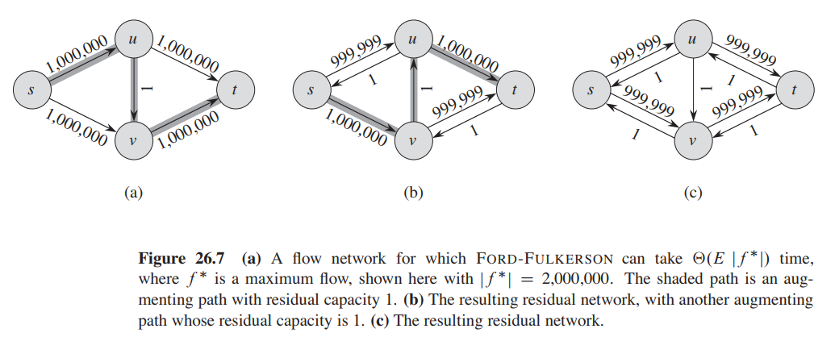
Worst case for this approach

Slide 35
Edmonds-Karp approach
Use BFS to find a shortest path (in terms of number of edges) and use that as an augmenting path
It turns out this always terminates after $O\left(nm\right)$ augmenting paths
(even with real capacities)
BFS takes $O(n+m)$ time; $O(m)$ since the graph is connected
So total runtime is $O\left(nm^{2}\right)$
There are more sophisticated algorithms with $O(V^{2}E)$ and even $O(V^{3})$ runtimes
(optional: CLRS 26.4, 26.5)
In 2022, researchers found an almost linear time algorithm, which leverages techniques from convex optimization and sophisticated data structures

