Slide 1
CS 341: Algorithms
Lecture 21: intractability III – complexity class NP, poly transformations
Readings: see website
Trevor Brown
https://student.cs.uwaterloo.ca/~cs341
trevor.brown@uwaterloo.ca

Slide 2
This time
Complexity class NP
Oracles, certificates, polytime verification algorithms
Two problems in NP
Subset sum
Hamiltonian Cycle
Relationship between P and NP
Polynomial transformations

Slide 3
Complexity class NP
NP: Non-deterministic polynomial time

Slide 4
Example: subset-sum problem
Suppose we are given some integers, -7, -3, -2, 5, 8
Does some subset of these sum to zero?
In this case, yes: (-3) + (-2) + 5 = 0
Finding such a subset can be extremely difficult
Suppose I give you a certificate consisting of an array of numbers, and claim it represents such a subset
Of course, I might lie and give you a subset that does not sum to zero…
I could even give you numbers that are not in the input…
If I’m telling the truth, then we call this a yes-certificate. It is is essentially a proof that “yes” is the correct output.
Can you determine whether I am lying in polynomial time?
Can you use a yes-certificate to solve the problem efficiently?

Slide 5
Subset-sum via non-deterministic oracle
Suppose there is a non-deterministic oracle, which returns a subset that sums to 0 if one exists and otherwise can return anything (even garbage)
We call the oracle’s output a certificate
Given a certificate, can you verify in polytime whether it describes a solution to the problem?
Otherwise, either C is not a subset of the input (return false), or C sums to a non-zero value (return false)
If there exists a subset that sums to 0, then C is one such subset, and we return true
Given such an oracle, this algorithm would solve subset-sum
“Non-deterministic” is the N in NP, and it is so named because of oracles
Here “non-deterministic” just means the oracle is magically guaranteed to return a yes-certificate if one exists

Slide 6
Subset-sum via non-deterministic oracle
Suppose there is a non-deterministic oracle, which returns a subset that sums to 0 if one exists and otherwise can return anything (even garbage)
We call the oracle’s output a certificate
Given a certificate, can you verify in polytime whether it describes a solution to the problem?
Given a certificate from the oracle, would verify solve the problem in poly-time?
Test whether C is a subset of I
For loop with $\left|C\right||I|$ time…
Test whether C sums to 0
For loop with $|C|$ time…
Input to verify is $\left(I,C\right)$. Runtime is $O(\left|C\right||I|)$, which is in $O(Size{\left(I\right)}^{2})=O({\left(\left|C\right|+\left|I\right|\right)}^{2})$

Slide 7
Dumb Subset-sum algorithm: Pretend you’re an oracle and make certs.
Generate every subset certificate S
Verify certificate S (valid + sums to zero)
If any certificate S sums to zero, it is a yes-certificate (a proof that the answer to the decision problem is “true”), and we return true
A certificates that does not sum to zero doesn’t really prove anything (would need to know that all certificates sum to non-zero)
Generating these certificates is expensive; exponential time!
But verifying one certificate is fast; runtime is $poly(\left|S\right|)$
If there was such a thing as a no-certificate, what would it look like?
How long would it take to verify it?
Notes:
From Wikipedia:
In order to explain the verifier-based definition of NP, let us consider the subset sum problem: Assume that we are given some integers, {−7, −3, −2, 5, 8}, and we wish to know whether some of these integers sum up to zero. Here, the answer is "yes", since the integers {−3, −2, 5} corresponds to the sum (−3) + (−2) + 5 = 0. The task of deciding whether such a subset with zero sum exists is called the subset sum problem.
To answer if some of the integers add to zero we can create an algorithm which obtains all the possible subsets. As the number of integers that we feed into the algorithm becomes larger, both the number of subsets and the computation time grows exponentially.
But notice that if we are given a particular subset we can efficiently verify whether the subset sum is zero, by summing the integers of the subset. If the sum is zero, that subset is a proof or witness for the answer is "yes". An algorithm that verifies whether a given subset has sum zero is a verifier. Clearly, summing the integers of a subset can be done in polynomial time and the subset sum problem is therefore in NP.

Slide 8
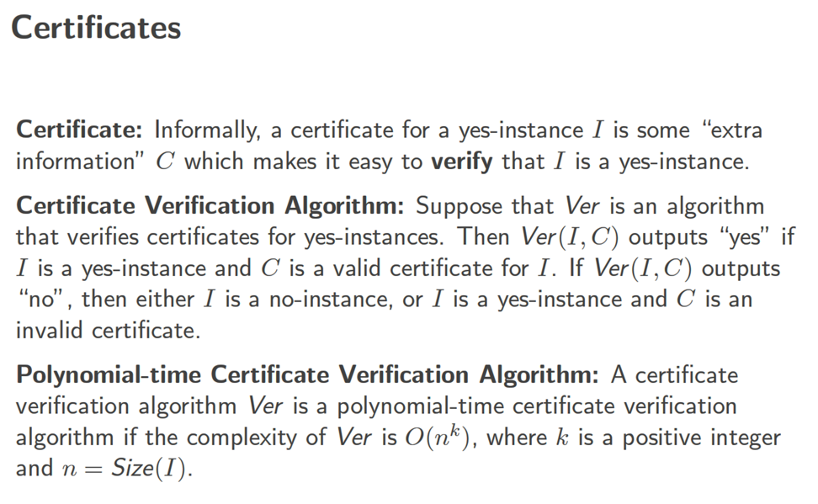

Slide 10
Generalizing beyond subset-sum
Our definition of NP will not explicitly involve non-deterministic oracles. But it is based on certificate verification, which makes more sense if you think of such oracles…
You can solve any decision problem in non-deterministic poly-time, given:
a poly-time non-deterministic oracle, and
a poly-time $verify$ algorithm
Such that:
If $I$ is a yes-instance, then the oracle returns a yes-certificate $C$ (i.e., a “proof” the answer is “yes”) and $verify(I,C)$ returns $true$
If $I$ is a no-instance, then $verify(I,C)$ returns $false$ for all $C$ (i.e., it must be impossible to fool $verify$ into returning true)
The algorithm:
Could you “fool” the subset-sum verify function?

Slide 11
Oracle
verify
Guesses solution in O(1) time
Verifies solution in poly-time
As we are about to see: existence of a poly-time verifier for a problem means problem is in NP
verify
Oracle

Slide 12
Defining NP
Intuition: For a yes-instance, there must exist some certificate that verify would accept (and, if one exists, the oracle would find it, solving the problem). For a no-instance, verify must always reject.
A decision problem $Π$ is solved by a poly-time $verify$ alg. iff:
for every yes-instance $I$, there exists a certificate $C$ such that $verify(I,C)$ returns true, and
for every no-instance $I$, $verify(I,C)$ returns $false$ for every $C$
The complexity class NP denotes the set of all decision problems that can be solved by poly-time $verify$ algorithms
No oracle needed! Note it is not necessary for an oracle to actually exist for a problem to be in NP. We can simply assume certificates come from an oracle, and show a poly-time $verify$ algorithm exists.
Crucial definition!

Slide 13
Mechanics of showing a problem is in NP
How to show $Π∈NP$
Define a yes-certificate
Design a poly-time $verify(I,C)$ algorithm
Correctness proof
Case 1: Let $I$ be any yes-instance; Find $C$ such that $verify\left(I,C\right)=true$
Case 2: Let $I$ be any no-instance, and $C$ be any certificate; Prove $verify\left(I,C\right)=false$
Subset-sum as an example:
A yes-certificate is a list of indices in the input array where the elements should sum to 0
How to verify a certificate $C$ is a subset of input $I$ with sum zero?
$∀c∈C,$ add $I[c]$ to sum, and return true iff sum=0
$O(\left|C\right|)$ time
This is certainly polytime…
Case 1: Let $I$ be a yes-instance. There is a subset in $I$ that sums to 0. For any such subset $C$, verify(I,C) will return true.
Case 2: Let $I$ be a no-instance & $C$be any certificate. No subset of $I$ sums to 0. So,$Σ_{c∈C} I\left[c\right]≠0$ and verify returns false.
So, subset-sum $∈NP$

Slide 14
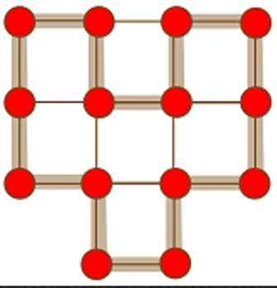
Another example: Hamiltonian Cycle problem
Let’s show that this problem is in NP!
Have to find a poly-time $verify$ algorithm…
Defining a yes-certificate: array of nodes representing a Hamiltonian cycle
How to verify that a given array of nodes represents a cycle?
How about a Hamiltonian cycle?

Slide 15
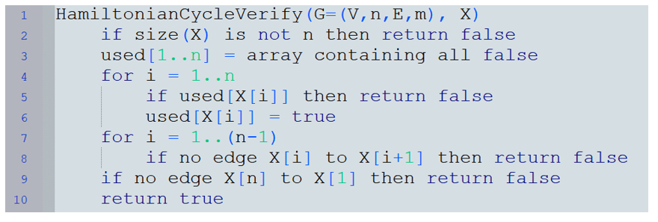
Example: Showing “Hamiltonian Cycle” is in NP
This is a $verify$ algorithm that we imagine being called on the certificate $X$ produced by $oracle(G)$
A certificate X consists of an array of node names (1…n), which might represent a Hamiltonian cycle
If $G$ is a yes-instance of the problem, then must show there exists some possible certificate $X$ for which this procedure returns will true
What would such a certificate look like?
Yes-instance implies there is a Hamiltonian cycle. Suppose $X$ is a sequence of $n$ consecutive nodes on that cycle. Then we return true!

Slide 16
Example: Showing “Hamiltonian Cycle” is in NP
This is a $verify$ algorithm that we imagine being called on the certificate $X$ produced by $oracle(G)$
A certificate X consists of an array of node names (1…n), which might represent a Hamiltonian cycle
If $G$ is a no-instance of the problem, then “every possible certificate should cause verify to return false”
Easier to prove the contrapositive: “if verify returns true, then $G$ is a yes-instance.”
If we return true, then the graph contains a cycle with $n$ distinct nodes…
So $G$ is a yes-instance
So, Hamiltonian Cycle is in NP

Slide 17
How are P and NP related?
$P⊆NP$
Consider a problem $Π∈P$
We show there exists a poly-time $verify(I,C)$ such that:
For every yes-instance $I$ of $Π$, $verify\left(I,C\right)=true$ for some $C$
For every no-instance $I$ of $Π$, $verify\left(I,C\right)=false$ for all $C$
By definition, there is a poly-time algorithm $A$ to solve $Π$
Implement $verify(I,C)$ by simply running $A(I)$ [ignoring $C$]
Regardless of what $C$ is, $verify(I,C)$ satisfies the above
How about $NP⊆P ?$
Million dollar question. We think not.

Slide 18
Polynomial transformations
A subclass of poly-time reductions
commonly used for NP-completeness and impossibility results

Slide 19
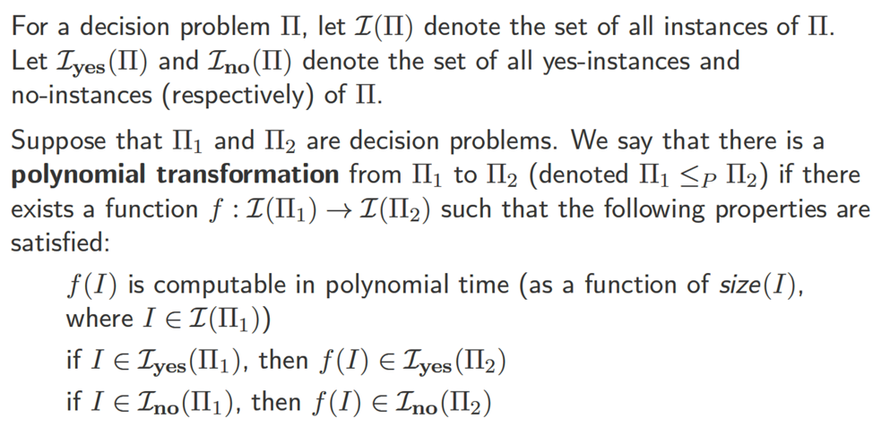
Polynomial transformations
[Mechanics] to give a polynomial transformation, you must:
1. specify $f(I)$, 2. show it runs in poly-time, and 3. show $I$ is a yes-instance of $Π_{1}$ IFF $f(I)$ is a yes-instance of $Π_{2}$.

Slide 20
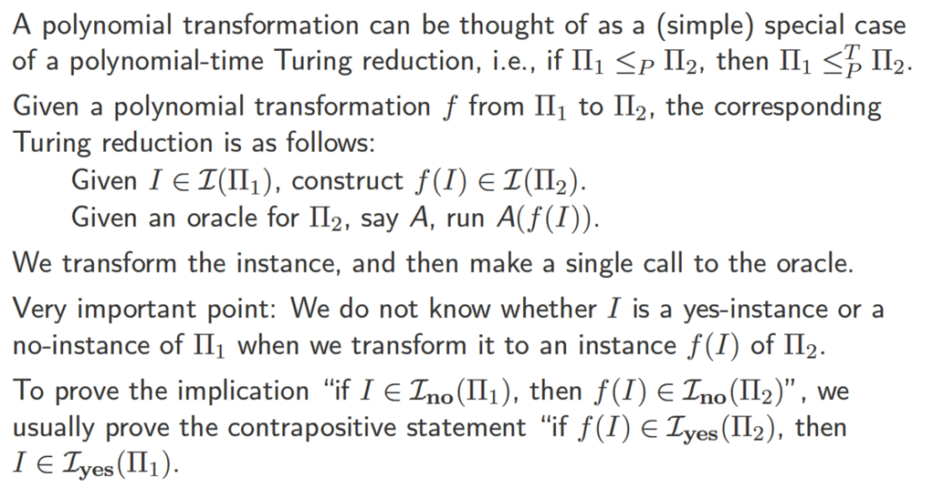
Polynomial transformations (cont.)
Also known as Karp reductions and many-one reductions
We saw one instance where a contrapositive was easier to prove when we discussed Hamiltonian cycles
The contrapositive can help when it is hard to precisely characterize certificates for no-instances (or when such certificates don’t prove much)

Slide 21
Summarizing the More convenient definition
Let $Π_{1}$ and $Π_{2}$ be decision problems
$Π_{1}≤_{P}Π_{2}$ iff there exists $f :ℐ\left(Π_{1}\right)→ℐ(Π_{2})$ such that:
$f(I)$ is computable in poly-time, for all $I∈ℐ(Π_{1})$
If $I∈ℐ_{yes}(Π_{1})$ then $f\left(I\right)∈ℐ_{yes}(Π_{2})$
If $f(I)∈𝓘_{yes}(Π_{2})$ then $I∈𝓘_{yes}(Π_{1})$
Note: this is the same as saying
$$(I∈𝓘_{yes}\left(Π_{1}\right))⇔(f\left(I\right)∈𝓘_{yes}\left(Π_{2}\right))$$
This property justifies correctness for the following generic poly-time Karp reduction:
P1toP2KarpReduction(I)
fI = f(I)
return OracleForP2(fI)
This is the contrapositive. Was previously (2 slides ago): If $I∈ℐ_{no}(Π_{1})$ then $f\left(I\right)∈ℐ_{no}\left(Π_{2}\right)$

Slide 22
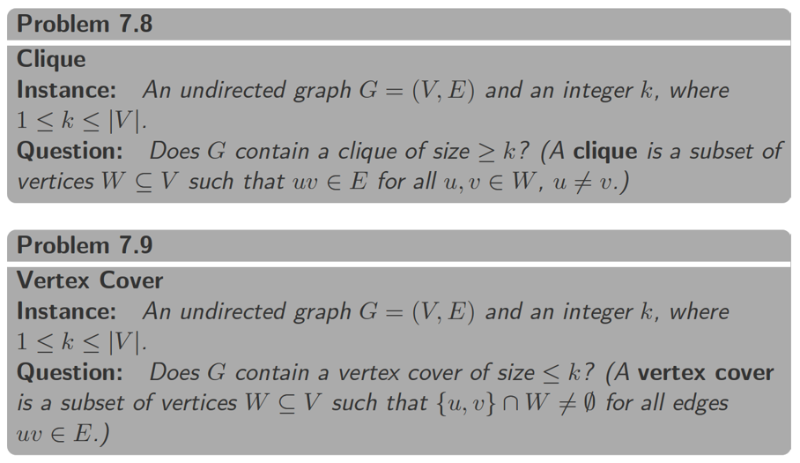
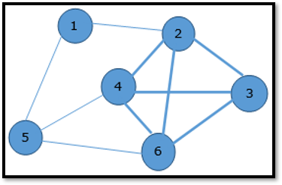
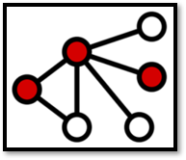
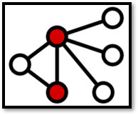
Example polynomial transformation
4-clique
3-vertex cover
2-vertex cover

Slide 23
Clique $≤_{P}$Vertex-Cover
Suppose $I=(G,k)$ is an instance of Clique where $G=\left(V,E\right)$, $V=\{v_{1},…, v_{n}\}$ and $1≤k≤n$
Construct instance $f\left(I\right)=(\overline{G},n−k)$ of Vertex-Cover, where $H=(V,\overline{E})$ and $v_{i}v_{j}∈\overline{E}⇔v_{i}v_{j}∉E$
Want to solve
$$Clique(G, k)$$
Claim: there is a $k$-clique in $G$ iff there is an $\left(n−k\right)$ Vertex-Cover in $\overline{G}$
Consider the complement graph $\overline{G}$ of $G$
Idea: reduce to
$$VertexCover(\overline{G}, n−k)$$
Every edge of $G$ is a non-edge of $\overline{G}$.
Every non-edge of $G$ is an edge of $\overline{G}$.
Given an adjacency matrix for $G$, get $\overline{G}$by flipping 0’s and 1’s.

Slide 24
Proving this is a Polynomial transformation
We denote Clique by $CL$ and Vertex-Cover by $VC$
$CL≤_{P}VC$ iff there exists $f :ℐ\left(CL\right)→ℐ(VC)$ such that:
$f(I)$ is computable in poly-time, for all $I∈𝓘(CL)$
If $I∈ℐ_{yes}(CL)$ then $f\left(I\right)∈ℐ_{yes}(VC)$
If $f(I)∈ℐ_{yes}(VC)$ then $I∈ℐ_{yes}(CL)$
First let’s show this

Slide 25
Complexity of the transformation
Assuming adjacency matrix,
$$Size\left(I\right)=Θ(n^{2}+\log_{2}{k})$$
Suppose $I=(G,k)$ is an instance of Clique where $G=\left(V,E\right)$, $V=\{v_{1},…, v_{n}\}$ and $1≤k≤n$
Construct instance $f\left(I\right)=(\overline{G},n−k)$ of Vertex-Cover, where $\overline{G}=(V,\overline{E})$ and $v_{i}v_{j}∈\overline{E}⇔v_{i}v_{j}∉E$
Time to compute $f(I)$?
Constructing $\overline{G}$ takes $O(n^{2})$ time, and computing $n−k$ takes $O(\log{n})$ time.
Want to solve
$$Clique(G, k)$$
So computing $f(I)$ takes $O(n^{2})$ time, which is polynomial in $Size\left(I\right)$.
Idea: reduce to
$$VertexCover(\overline{G}, n−k)$$

Slide 26
Proving this is a Polynomial transformation
We denote Clique by $CL$ and Vertex-Cover by $VC$
$CL≤_{P}VC$ iff there exists $f :ℐ\left(CL\right)→ℐ(VC)$ such that:
$f(I)$ is computable in poly-time, for all $I∈ℐ(CL)$
If $I∈𝓘_{yes}(CL)$ then $f\left(I\right)∈𝓘_{yes}(VC)$
If $f(I)∈ℐ_{yes}(VC)$ then $I∈ℐ_{yes}(CL)$
Now let’s show this, i.e., if $G$ contains a $k$-clique then $\overline{G}$ contains an $\left(n−k\right)$ vertex cover.

Slide 27
Proving: $I∈ℐ_{yes}\left(CL\right)⇒f(I)∈ℐ_{yes}(VC)$
Graph $G$
Suppose $I=(G,k)$ is a yes-instance of Clique
Then there is a set $W$ of $k$ vertices in a clique (with all-to-all edges)
Define $\overline{W}=V∖W$. Clearly $\left|\overline{W}\right|=n−k$.
We claim $\overline{W}$ is a vertex cover of $\overline{G}$
Consider any edge $\left(u,v\right)∈\overline{G}$
If either $u$ or $v$ is in $\overline{W}$, then we are done, so assume $u,v∉\overline{W}$ to obtain a contradiction
Then $u,v∈W$, and $W$ is a clique in $G$, so $\left(u,v\right)∈G$
But $\left(u,v\right)∈\overline{G}$ implies $\left(u,v\right)∉G$. Contradiction!
Example:
$$Clique(G, 4)$$
$$W$$
Graph $\overline{G}$
$$\overline{W}$$

Slide 28
Proving this is a Polynomial transformation
We denote Clique by $CL$ and Vertex-Cover by $VC$
$CL≤_{P}VC$ iff there exists $f :ℐ\left(CL\right)→ℐ(VC)$ such that:
$f(I)$ is computable in poly-time, for all $I∈ℐ(CL)$
If $I∈ℐ_{yes}(CL)$ then $f\left(I\right)∈ℐ_{yes}(VC)$
If $f(I)∈𝓘_{yes}(VC)$ then $I∈𝓘_{yes}(CL)$
Now let’s show this, i.e., if $\overline{G}$ contains an $\left(n−k\right)$ vertex cover, then $G$ contains a $k$-clique

Slide 29
Proving: $f(I)∈ℐ_{yes}\left(VC\right)⇒I∈ℐ_{yes}(CL)$
Graph $\overline{G}$
Suppose $f(I)=(\overline{G},n−k)$ is a yes-instance of $VC$
Then there is a set of $n−k$ vertices $\overline{W}$ that is a vertex cover of $\overline{G}$
Define $W=V∖\overline{W}$. Clearly $\left|W\right|=k$.
We claim $W$ is a clique in $G$
Since $\overline{W}$ is a vertex cover of $\overline{G}$, every edge in $\overline{G}$ has at least one endpoint in $\overline{W}$
Therefore, no edge in $\overline{G}$ has two endpoints in $W$
So, in $G$, there are edges between all pairs of nodes in $W$. So, $W$ is a clique in $G$.
$$\overline{W}$$
Graph $G$
$$W$$
So, we have demonstrated a polynomial transformation from CLIQUE to VERTEX-COVER

