Slide 1
CS 341: Algorithms
Lecture 24: intractability VI – Decidability, more NPC transformations
Readings: see website
Trevor Brown
https://student.cs.uwaterloo.ca/~cs341
trevor.brown@uwaterloo.ca

Slide 2
Complexity class EXPTIME
A very brief overview
(Non-core material)

Slide 3
EXPTIME is the set of all decision problems that can be solved in exponential time.
I.e., in time $O(2^{poly\left(n\right)})$ where $poly(n)$ is a polynomial in the input size.
Observe that $NP⊆EXPTIME$
$O\left(n!\right)⊆O\left(n^{n}\right)=O\left(2^{n\log{n}}\right)$ time

Slide 4
$t$ is exponential in $\log{t}$.
(And $\log{t}$ might be the largest term in the input size, in which case $O(t)$ would be exponential in the input size.)

Slide 5
Undecidability
Problems that are impossible to solve

Slide 6
decidable vs Undecidable Problems
We say an algorithm $A$ “solves” a decision problem if, for every instance $I$, $A(I)$ has finite runtime and returns the correct answer
If an algorithm $A$ solves decision problem $Π$, then we say $Π$ is decidable.
Formally, $Π$ is decidable IFF there exists some algorithm $A$ such that, for every instance $I$, $A(I)$ returns the correct answer in finite time.
If it is not possible to design an algorithm $A$ that solves decision problem $Π$, then we say $Π$ is undecidable.
Formally, $Π$ is undecidable IFF there cannot exist an algorithm $A$ such that, for every instance $I$, $A(I)$ returns the correct answer in finite time.
Equivalently, $Π$ is undecidable IFF, for every algorithm $A$, there exists some input $I$ such that$A(I)$ does not return the correct answer in finite time.
I.e., for some input, $A(I)$ either runs forever or returns the wrong answer

Slide 7
Halting: An Undecidable Problem
For example, you could run $Halt(BFS,G)$ to determine whether, $BFS(G)$ will halt in finite time, which it will, so $Halt(BFS,G)$ returns yes.
The Halting problem is decidable IFF there exists an algorithm $Halt(I)$ that, for every instance $I=(A,x)$, $Halt(I)$has finite runtime and correctly answers the question: “would a call to $A(x)$ halt in finite time?”

Slide 8
Undecidability of the Halting Problem
We suppose Halt exists, to obtain a contradiction…
Halt runs in finite time, and:
Since $A$ is a string (of code), and its input $x$ is also a string… we could pass $A$ as an argument to itself: $A(A)$
Weird… Let’s try to obtain a contradiction by doing this…
Then we could ask if $A(A)$ halts, by running $Halt(A,A)$…

Slide 9
If $not Halt(A,A)$, then $A(A)$ will run forever
but $Strange(A)$ terminates in finite time
Else if $Halt(A,A)$, then $A(A)$ will terminate in finite time
But $Strange(A)$ will run forever
Two cases: $Strange\left(Strange\right)$ either halts or does not halt
Both cases lead to a contradiction. So, our only assumption, that Halt exists, must be false!
Suppose $Strange\left(Strange\right)$ halts. Then, it must return. This means it sees $not Halt(A,A)$ just before returning.
But $A=Strange$, so it sees $not Halt(Strange,Strange)$.
Therefore, the Halting problem is undecidable.
So, $Strange\left(Strange\right)$ does not halt --- contradiction!
Suppose $Strange\left(Strange\right)$ does not halt. Then, it must spin in the while loop forever. This means $Halt\left(A,A\right)=true$.
But $A=Strange$, so $Halt\left(Strange,Strange\right)=true$.
So, $Strange\left(Strange\right)$ halts --- contradiction!

Slide 10
If we have HaltAllSolver then we have Halt, but this is impossible, so HaltAllSolver cannot exist, so the Halt-All problem is undecidable!

Slide 11
Finishing NPC transformations/reductions

Slide 12
Every problem in NP
SAT
transforms to
transforms to
3-SAT

Slide 13
Every problem in NP
SAT
transforms to
transforms to
3-SAT
(Target)
Let’s show this

Slide 14
Reduce Target Subset Sum to 0-1 Knapsack

Slide 15
Recall: 0-1 Knapsack Problem
Can I obtain profit $T$ (or better) by taking (whole) items with total weight $≤M$?

Slide 16
Target Subset Sum $≤_{P}$ 0-1 Knapsack
How should we poly-transform (Target) Subset-Sum input into (Target) 0-1 Knapsack input
Such that: $I$ contains a subset that sums to $T$ IFF $(≥T)$ profit can be obtained in knapsack input $f(I)$

Slide 17
ints
Claim: $I$ contains a subset that sums to $T$ IFF $(≥T)$ profit can be obtained in knapsack input $f(I)$

Slide 18
Every problem in NP
SAT
transforms to
transforms to
3-SAT

Slide 19
Every problem in NP
SAT
transforms to
transforms to
3-SAT
Erickson 12.11

Slide 20
Every problem in NP
SAT
transforms to
transforms to
3-SAT
Let’s show this

Slide 21
Reduce Hamiltonian Cycle to TSP-Decision

Slide 22
Exercise: Give a poly-transformation
This exercise: Show how to transform Hamiltonian Cycle input into TSP-Decision input (in poly time).
Such that: $I$ contains a Ham Cycle IFF $f(I)$ contains a Ham Cycle of weight at most $T$

Slide 24
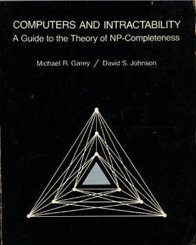
Every problem in NP
SAT
transforms to
transforms to
3-SAT
Any many, many more ☺… over 300 listed in this book

Slide 25
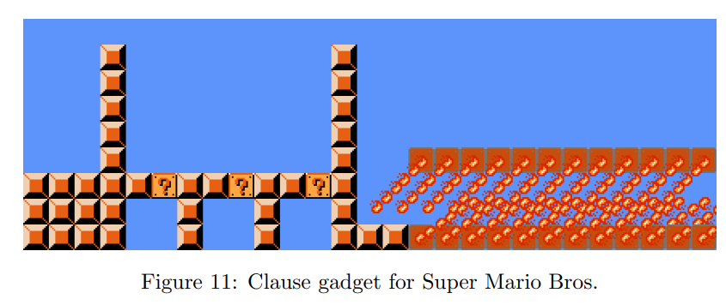
Fun and games
https://arxiv.org/pdf/1203.1895.pdf
3-SAT $≤_{P}^{T}$ Super Mario

Slide 26
(Factually incorrect) Memes
There’s also an old video meme about proving that Super Mario Bros is NP complete
(Long before it was legitimately proved NP hard ☺)
Whereas the stuff on the previous slide is real math, the stuff in this video is just a meme, and is very wrong. but you may find it funny…

Slide 27
Summary of complexity classes
See this slide’s notes
P (Poly-time)
Decision problems that can be solved by algorithms with runtime poly(input size)
NP (Non-deterministic poly-time)
Decision problems for which certificates can be verified in time poly(input size)
Equivalently: decision problems that can be solved in poly-time if you have access to a non-deterministic oracle that returns a yes-certificate if one exists
NPC (NP-complete)
Decision problems $Π∈NP$ s.t. every $Π^{′}∈NP$ can be transformed to $Π$ in poly-time
NP-hard (at least as hard as NPC)
problems $Π$ s.t. every $Π^{′}∈NP$ can be reduced to $Π$ in poly-time
Note: P, NP and NPC problems are decidable
E.g., (decision problem variants of:) BFS, Dijkstra’s, some DP algorithms
All of P, and e.g.,, vertex cover, clique, SAT, subset sum
E.g., vertex cover, clique, SAT, subset sum, TSP-decision
All of NPC, and e.g., TSP-optimization, TSP-optimal value
Notes:
Note: problems can be NP-hard even if they are NOT decision problems. (And in that case they are, of course, not in NP.)
P is a subset of NP. NPC is a subset of NP. NPC is a subset of NP-hard. Other relationships and other complexity classes can be studied in a complexity theory course. :)

Slide 28
Polytime 2-SAT (if we have time)

Slide 29
2-SAT examples
Logical refresher:
$p⇒q$ is equivalent to
$¬p∨q$.
$\left(p∨q\right)∧\left(¬p∨r\right)∧\left(¬r∨¬p\right)$
Satisfiable: $p=0,q=1,r∈\{0,1\}$
$\left(p∨q\right)∧\left(¬p∨r\right)∧\left(¬r∨¬p\right)∧\left(p∨¬q\right)$
Therefore, $p∨q$ is equivalent to $¬p⇒q$ and equivalent to $¬q⇒p$
Edges (implications of clauses)…
$$q$$
$$p$$
$$q$$
$$q$$
$$p$$
$$p$$
$$r$$
$$¬p⇒q$$
$$p⇒r$$
$$r⇒¬p$$
$$¬p⇒¬q$$
$$¬q⇒p$$
$$¬r⇒¬p$$
$$p⇒¬r$$
$$q⇒p$$
$q⇒p⇒¬r⇒¬p⇒¬q$ … so $q$ cannot be $true$
$$¬q$$
$$¬p$$
$$¬q$$
$$¬q$$
$$¬p$$
$$¬p$$
$$¬r$$
$$¬r$$
$$¬r$$
$¬q⇒p⇒¬r⇒¬p⇒q$ … so $q$ cannot be $false$
Therefore the formula cannot be satisfied!

Slide 30
(variable names are integers in 1..|X|)
2-SAT
2-SAT
$$X=\{1..\left|X\right|\}$$
Suppose no variable $x$ is in the same SCC as $\overline{x}$, then to get a satisfying assignment do the following:
For each $x$, if $∃$ path from $x$ to $\overline{x}$, then set $x=false$ else set $x=true$.

