Slide 1
CS 341: Algorithms
Lecture 3: divide & conquer II
Readings: see website
Trevor Brown
https://student.cs.uwaterloo.ca/~cs341
trevor.brown@uwaterloo.ca

Slide 2
Problem: Non-dominated points
A point dominates everything to the southwest
So, I am a non-dominated point
$$+y$$
No other point dominates me
$$+x$$

Slide 3
More formally
$$+y$$
Given two points $(x_{1},y_{1})$ and $(x_{2},y_{2})$, we say $(x_{1},y_{1})$dominates $(x_{2},y_{2})$ if $x_{1} > x_{2}$ and $y_{1} > y_{2}$
Input: a set S of n points with distinct x values
Output: all non-dominated points in S, i.e., all points in S that are not dominated by any point in S
$$+x$$
What’s an easy (brute force) algorithm for this?

Slide 4
Brute force algorithm
Running time? (unit cost)
$$O(n2)$$
Let’s come up with a better algorithm

Slide 5
$$+y$$
$$+x$$

Slide 6
Problem decomposition
$$+y$$
7
1
4
3
9
5
8
14
6
11
12
2
10
16
13
15
$$+x$$

Slide 7
Problem decomposition
$$+y$$
$$S_{1}$$
7
$$S_{2}$$
1
4
3
9
5
8
14
6
11
12
2
10
16
13
15
$$+x$$

Slide 8
Problem decomposition
$$+y$$
$$+y$$
7
1
4
3
9
5
8
13
6
11
2
10
16
$$+x$$
12
14
$$+x$$
$$S_{1}$$
$$S_{2}$$

Slide 9
Problem decomposition
$$+y$$
$$+y$$
7
1
4
3
9
5
8
13
6
11
2
10
16
$$+x$$
12
14
$$+x$$
$$S_{1}$$
$$S_{2}$$

Slide 10
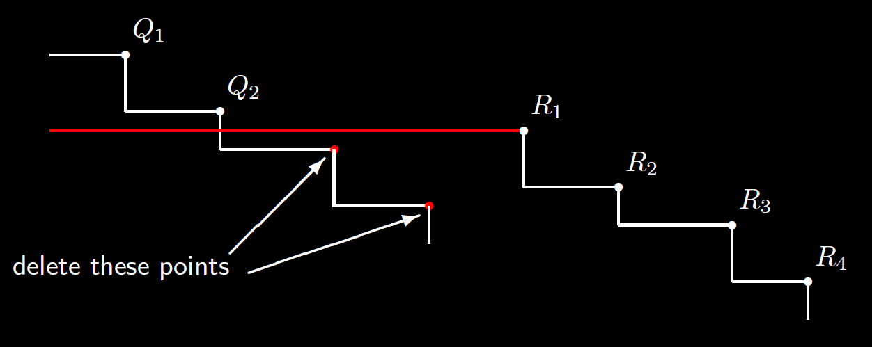
Combining to get Non-dominated points
Let $Q_{1}, Q_{2}, …, Q_{k}$ be the non-dominated points in $S_{1}$
Let $R_{1}, R_{2}, …, R_{m}$ be the non-dominated points in $S_{2}$
Just need to find rightmost $Q_{i}$ that is not dominated (that has $y$-coordinate $≥ R_{1}.y$)
$$S_{1}$$
$$S_{2}$$

Slide 11
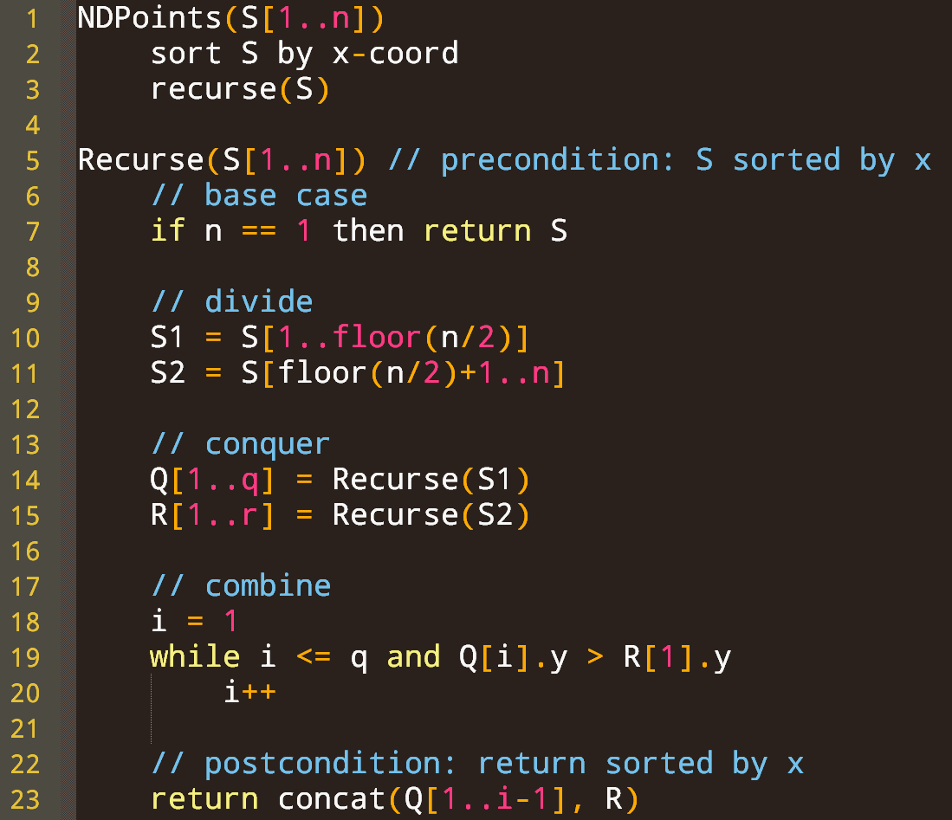

Slide 12
$$Θ(n\log{n})$$
Running time complexity? (unit cost model)
$$T(n)$$
$$Θ(1)$$
Assume $n=2^{j}$ for simplicity
$Θ(1)$ or $Θ\left(n\right)$
$$T\left(n\right)=2T\left(\frac{n}{2}\right)+Θ\left(n\right)$$
$$T\left(\left\lfloor \frac{n}{2}\right\rfloor \right)$$
Same as merge sort recurrence: $Θ\left(n\log{n}\right)$
$$T\left(\left\lceil \frac{n}{2}\right\rceil \right)$$
So total for sort & recursion is $Θ\left(n\log{n}+T(n)\right)=Θ(n\log{n})$
$$Θ(n)$$
$Θ(1)$ or $Θ(n)$ depending on data structures… either way doesn’t matter

Slide 13
Bonus slide: What if x values are not distinct?
R might contain multiple points with the same x value but with different y values
If there are points in Q with the same x as R[1], and a lower y, then the algorithm would say they are dominated by R[1]. Wrong!
We can find all of the points with the same x as R[1] in linear time
If there are multiple such points, and some are in Q, then they are not dominated by R[1], but might be dominated by the next element R[i] of R that has a different x
So, we compare them with R[i].y (in linear time) instead of R[1].y
All of the other points in Q with x different from R[1].x are compared with R[1].y as usual (in linear time)

Slide 14
Multiprecision multiplication
Input: two $k$-bit positive integers X and Y
With binary representations: $X=[X[k−1], …, X[0]]$ $Y=[Y[k−1], …, Y[0]]$
Output: The $2k$-bit positive integer $Z=XY$
With binary representation: $Z=[Z[2k−1], …, Z[0]]$

Slide 15
Brute force algorithm
$$X[3]$$
$$X[0]$$
$$X$$
1 | 0 | 1 | 0
$$Y$$
1 | 0 | 1 | 1
One row per digit of $Y$
For each row copy the $k$ bits of $X$
Add the $k$ rows together
$Θ(k)$ binary additions of $Θ(k)$ bit numbers
Total runtime is $Θ\left(k^{2}\right)$ bit operations
1 | 0 | 1 | 0
times
1 | 0 | 1 | 1
0 | 0 | 0 | 0 | 1 | 0 | 1 | 0
0 | 0 | 0 | 1 | 0 | 1 | 0 | 0
0 | 0 | 0 | 0 | 0 | 0 | 0 | 0
0 | 1 | 0 | 1 | 0 | 0 | 0 | 0
$$Z$$
0 | 1 | 1 | 0 | 1 | 1 | 1 | 0

Slide 16
A divide-and-conquer Approach
$$X$$
$$Y$$
1 | 0 | 1 | 1
1 | 0 | 1 | 0
$$X_{L}$$
1 | 0
$$X_{R}$$
1 | 0
$$Y_{L}$$
1 | 0
$$Y_{R}$$
1 | 1
k/2 bit shift!
$$2^{k/2}X_{L}$$
1 | 0 | 0 | 0
$$2^{k/2}Y_{L}$$
1 | 0 | 0 | 0
$$+X_{R}$$
1 | 0
$$+Y_{R}$$
1 | 1
=$X$
1 | 0 | 1 | 0
=$Y$
1 | 0 | 1 | 1

Slide 17
expressing $k$-bit mult. As $k/2$-bit mult.
$X=2^{k/2}X_{L}+X_{R}$ and $Y=2^{k/2}Y_{L}+Y_{R}$
So $XY=(2^{k/2}X_{L}+X_{R})(2^{k/2}Y_{L}+Y_{R})$
$=2^{k}X_{L}Y_{L}+2^{k/2}\left(X_{L}Y_{R}+X_{R}Y_{L}\right)+X_{R}Y_{R}$
Suggests a D&C approach…
Divide into four $k/2$-bit multiplication subproblems
Conquer with recursive calls
Combine with $k$-bit addition and bit shifting

Slide 18
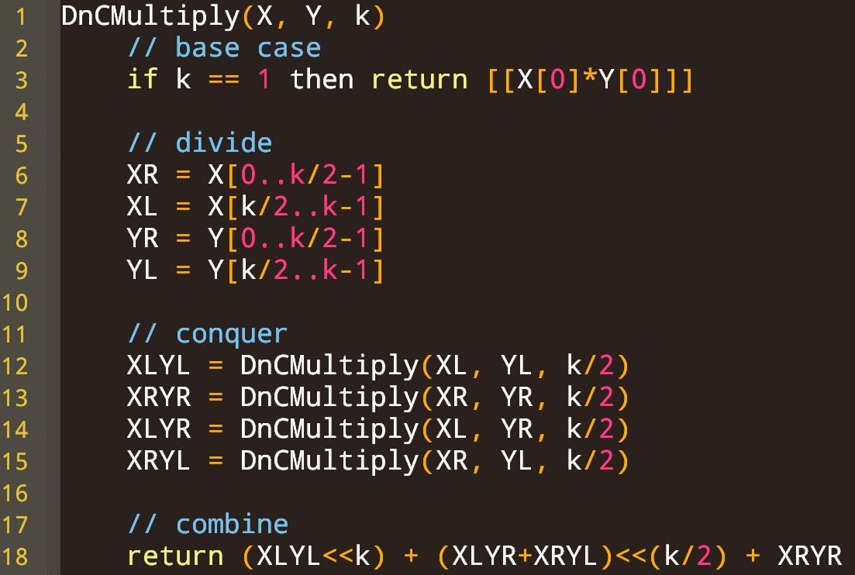
Runtime?
(bit complexity model)
Recall: $XY=2^{k}X_{L}Y_{L}+2^{k/2}\left(X_{L}Y_{R}+X_{R}Y_{L}\right)+X_{R}Y_{R}$

Slide 19
$$Θ(1)$$
Assume $k=2^{j}$ for ease
$T\left(k\right)=4T\left(\frac{k}{2}\right)+Θ(k)$
Master theorem says $T\left(k\right)∈Θ(k^{\log_{2}{4}})=Θ(k^{2})$
$Θ(\log{k})$ or $Θ\left(k\right)$
$$4T\left(\frac{k}{2}\right)$$
Same complexity as brute force!
$$Θ(k)$$
Intuition: to get speedup, must reduce the number of subproblems or their size

Slide 20
For millennia it was widely thought that $O(n^{2})$ multiplication was optimal.
Then in 1960, the 23-year-old Russian mathematician Anatoly Karatsuba took a seminar led by Andrey Kolmogorov, one of the great mathematicians of the 20th century.
Kolmogorov asserted that there was no general procedure for doing multiplication that required fewer than n² steps.
Karatsuba thought there was—and after a week of searching, he found it.
https://www.wired.com/story/mathematicians-discover-the-perfect-way-to-multiply/
Notes:
And, I found this nice quote giving a little bit on context on the algorithm’s development…

Slide 21
Karatsuba’s algorithm
Let’s optimize from four subproblems to three
Idea: compute $X_{L}Y_{R}+X_{R}Y_{L}$ with only one multiplication
Note $X_{L}Y_{R}+X_{R}Y_{L}$ appears in $(X_{L}+X_{R})(Y_{L}+Y_{R})$
$\left(X_{L}+X_{R}\right)\left(Y_{L}+Y_{R}\right)=X_{L}Y_{L}+X_{L}Y_{R}+X_{R}Y_{L}+X_{R}Y_{R}$
Let $X_{T}=X_{L}+X_{R}$ and $Y_{T}=Y_{L}+Y_{R}$
Then $X_{L}Y_{R}+X_{R}Y_{L}=X_{T}Y_{T}−X_{L}Y_{L}−X_{R}Y_{R}$
And the other two terms $X_{L}Y_{L}$ and $X_{R}Y_{R}$ are already in $XY$
So $XY=2^{k}X_{L}Y_{L}+2^{k/2}\left(X_{T}Y_{T}−X_{L}Y_{L}−X_{R}Y_{R}\right)+X_{R}Y_{R}$
Recall: $XY=2^{k}X_{L}Y_{L}+2^{k/2}\left(X_{L}Y_{R}+X_{R}Y_{L}\right)+X_{R}Y_{R}$
Only three unique multiplications!

Slide 22
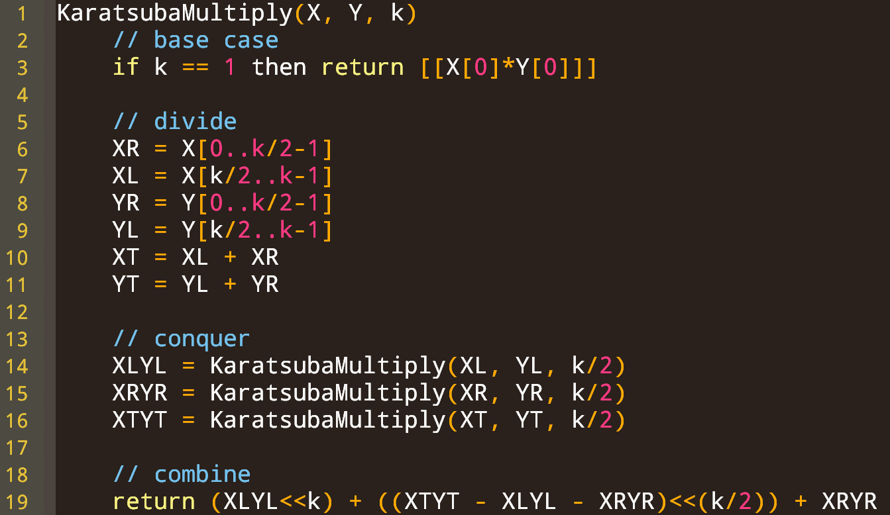
Running time complexity?
$$Θ(1)$$
$T\left(k\right)=3T\left(\frac{k}{2}\right)+Θ(k)$
Assume $k=2^{j}$ for ease
Master theorem:
$a=3,b=2,y=1$
$x=\log_{b}{a}=\log_{2}{3}$
$T\left(k\right)∈Θ\left(k^{\log_{2}{3}}\right)$
$≈Θ\left(k^{1.58}\right)$
$Θ(k)$ *
$$3T\left(\frac{k}{2}\right)$$
$$Θ(k)$$
Input size increase by 10x causes runtime to 38x
Compare to $Θ(k^{2})$ algo:
10x input causes 100x time

Slide 24
Quoting Fürer, author of the $O(n\log{n }2^{O\left(\log^{∗}{n}\right)})$ algorithm:
“It was kind of a general consensus that multiplication is such an important basic operation that, just from an aesthetic point of view, such an important operation requires a nice complexity bound…
From general experience the mathematics of basic things at the end always turns out to be elegant.”

Slide 25
And Harvey and van der Hoeven achieved O(n log n) in November 2020!
[https://hal.archives-ouvertes.fr/hal-02070778/document]
Their method is a refinement of the major work that came before them. It splits up digits, uses an improved version of the fast Fourier transform, and takes advantage of other advances made over the past 40 years.
Unfortunately, simple complexity doesn’t always mean simple algorithm…
Lower bound of $Ω(n\log{n})$ is conjectured.
A conditional proof is known… it holds if a central conjecture in the area of network coding turns out to be true. [https://arxiv.org/abs/1902.10935]

Slide 26
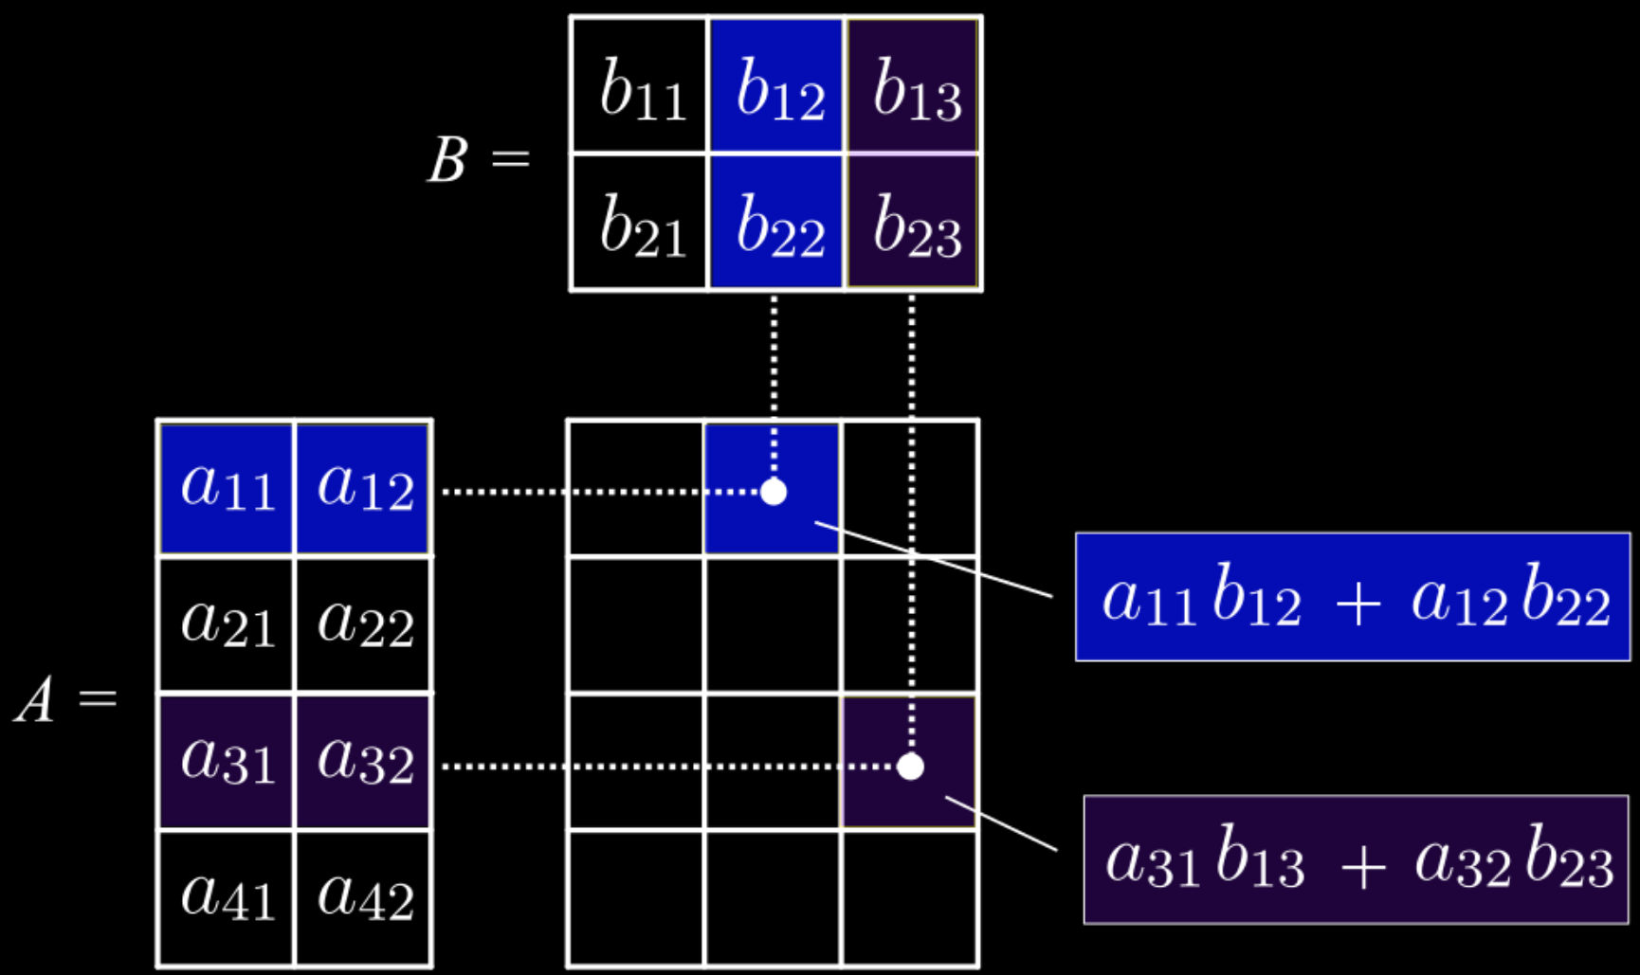
Matrix multiplication
Input: A and B
Output: their product C=AB
Naïve algorithm for $n×n$ matrices:
For each output cell $Cij$
$$C_{ij}=DotProd(row_{i}(A), col_{j}{\left(B\right)}^{T})$$
$$=\sum_{k=1}^{n}{A_{ik}B_{kj}}$$
Running time (unit cost)?

Slide 27
Attempting a better solution
What if we first partition the matrix into sub-matrices
Then divide and conquer on the sub-matrices
Example of partitioning: 4x4 matrix into four 2x2 matrices
$$\left[\begin{matrix}a & b \\ c & d\end{matrix}\right]=\left[\begin{matrix}\begin{matrix}a_{11} & a_{12} \\ a_{21} & a_{22}\end{matrix} & \begin{matrix}b_{11} & b_{12} \\ b_{21} & b_{22}\end{matrix} \\ \begin{matrix}c_{11} & c_{12} \\ c_{21} & c_{22}\end{matrix} & \begin{matrix}d_{11} & d_{12} \\ d_{21} & d_{22}\end{matrix}\end{matrix}\right]$$

Slide 28
Multiplying Partitioned matrices
Let $A=\left[\begin{matrix}a & b \\ c & d\end{matrix}\right]=\left[\begin{matrix}\begin{matrix}a_{11} & a_{12} \\ a_{21} & a_{22}\end{matrix} & \begin{matrix}b_{11} & b_{12} \\ b_{21} & b_{22}\end{matrix} \\ \begin{matrix}c_{11} & c_{12} \\ c_{21} & c_{22}\end{matrix} & \begin{matrix}d_{11} & d_{12} \\ d_{21} & d_{22}\end{matrix}\end{matrix}\right]$
Let $B=\left[\begin{matrix}e & f \\ g & h\end{matrix}\right]=\left[\begin{matrix}\begin{matrix}e_{11} & e_{12} \\ e_{21} & e_{22}\end{matrix} & \begin{matrix}f_{11} & f_{12} \\ f_{21} & f_{22}\end{matrix} \\ \begin{matrix}g_{11} & g_{12} \\ g_{21} & g_{22}\end{matrix} & \begin{matrix}h_{11} & h_{12} \\ h_{21} & h_{22}\end{matrix}\end{matrix}\right]$
Note $C=AB=$ $\left[\begin{matrix}a & b \\ c & d\end{matrix}\right]\left[\begin{matrix}e & f \\ g & h\end{matrix}\right]$ where $a,b,…,h$ are matrices

Slide 29
Identifying subproblems to solve
$C=AB=$ $\left[\begin{matrix}a & b \\ c & d\end{matrix}\right]\left[\begin{matrix}e & f \\ g & h\end{matrix}\right]$
$$=\left[\begin{matrix}ae+bg & af+bh \\ ce+dg & cf+dh\end{matrix}\right]$$
$C=AB=$ $\left[\begin{matrix}a & b \\ c & d\end{matrix}\right]\left[\begin{matrix}e & f \\ g & h\end{matrix}\right]$
$$=\left[\begin{matrix}ae+bg & af+bh \\ ce+dg & cf+dh\end{matrix}\right]$$
$C=AB=$ $\left[\begin{matrix}a & b \\ c & d\end{matrix}\right]\left[\begin{matrix}e & f \\ g & h\end{matrix}\right]$
$$=\left[\begin{matrix}ae+bg & af+bh \\ ce+dg & cf+dh\end{matrix}\right]$$
$C=AB=$ $\left[\begin{matrix}a & b \\ c & d\end{matrix}\right]\left[\begin{matrix}e & f \\ g & h\end{matrix}\right]$
$$=\left[\begin{matrix}ae+bg & af+bh \\ ce+dg & cf+dh\end{matrix}\right]$$
Recall $ae$, $bg$, etc., each represent matrix multiplication!
Can compute $C$ using 8 matrix multiplications

Slide 30
Size of subproblems & subsolutions
$AB=$ $\left[\begin{matrix}a & b \\ c & d\end{matrix}\right]\left[\begin{matrix}e & f \\ g & h\end{matrix}\right]=\left[\begin{matrix}ae+bg & af+bh \\ ce+dg & cf+dh\end{matrix}\right]=C=\left[\begin{matrix}r & s \\ t & u\end{matrix}\right]$
Suppose $A, B$ are $n×n$ matrices
For simplicity assume $n$ is a power of 2
Then $a,b,c,d,e,f,g,h,r,s,t,u$ are $\frac{n}{2}×\frac{n}{2}$ matrices
So we compute $C$ with 8 multiplications of $\frac{n}{2}×\frac{n}{2}$ matrices
(and 4 additions of such matrices)

Slide 31
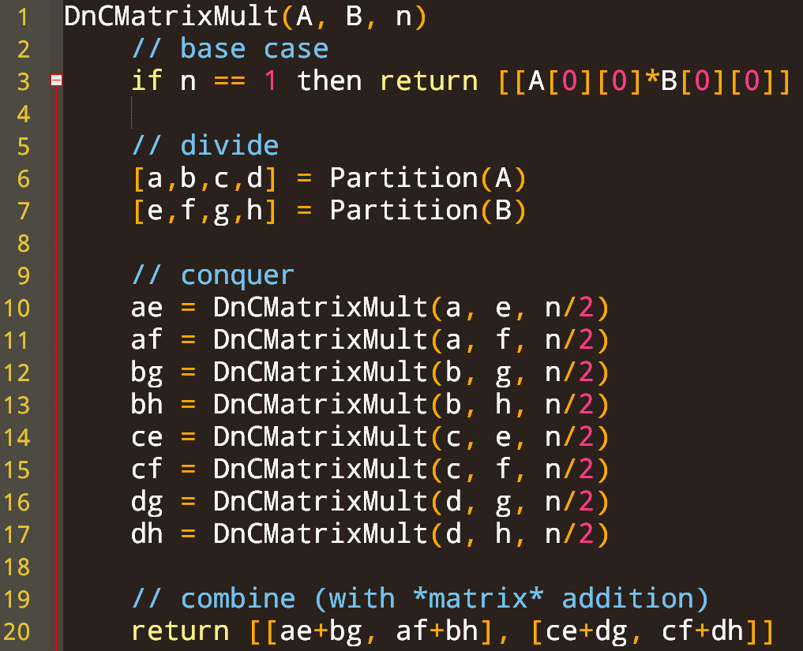
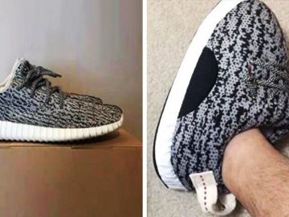
Time complexity (unit cost)?
$$Θ(1)$$
$T\left(n\right)=8T\left(\frac{n}{2}\right)+Θ(n^{2})$
Master theorem
$a=8,b=2,y=2$
$x=\log_{2}{8}=3$
$x>y$ so $T\left(n\right)∈Θ(n^{3})$
Same time as brute force!
$$Θ\left(1\right) or Θ(n^{2})$$
(recall A, B have $n^{2}$ entries)
$$8T\left(\frac{n}{2}\right)$$
$$Θ(n^{2})$$

Slide 32
Strassen fast matrix multiplication algorithm
$AB=$ $\left[\begin{matrix}a & b \\ c & d\end{matrix}\right]\left[\begin{matrix}e & f \\ g & h\end{matrix}\right]=\left[\begin{matrix}ae+bg & af+bh \\ ce+dg & cf+dh\end{matrix}\right]=C=\left[\begin{matrix}r & s \\ t & u\end{matrix}\right]$
Key idea: get rid of one multiplication!
Define
Each $P_{i}$ requires one multiplication
Can combine these $P_{i}$ terms with +/-
to compute $r,s,t,u$!

Slide 33
Strassen fast matrix multiplication algorithm
$AB=$ $\left[\begin{matrix}a & b \\ c & d\end{matrix}\right]\left[\begin{matrix}e & f \\ g & h\end{matrix}\right]=\left[\begin{matrix}ae+bg & af+bh \\ ce+dg & cf+dh\end{matrix}\right]=C=\left[\begin{matrix}r & s \\ t & u\end{matrix}\right]$
Define
Claim
As an example, according to Strassen, $t=P_{3}+P_{4}$
Plugging in $P_{3},P_{4},$ we get $t=\left(c+d\right)e+d(g−e)$
This simplifies to $t=ce+de+dg−de=ce+dg$

Slide 34
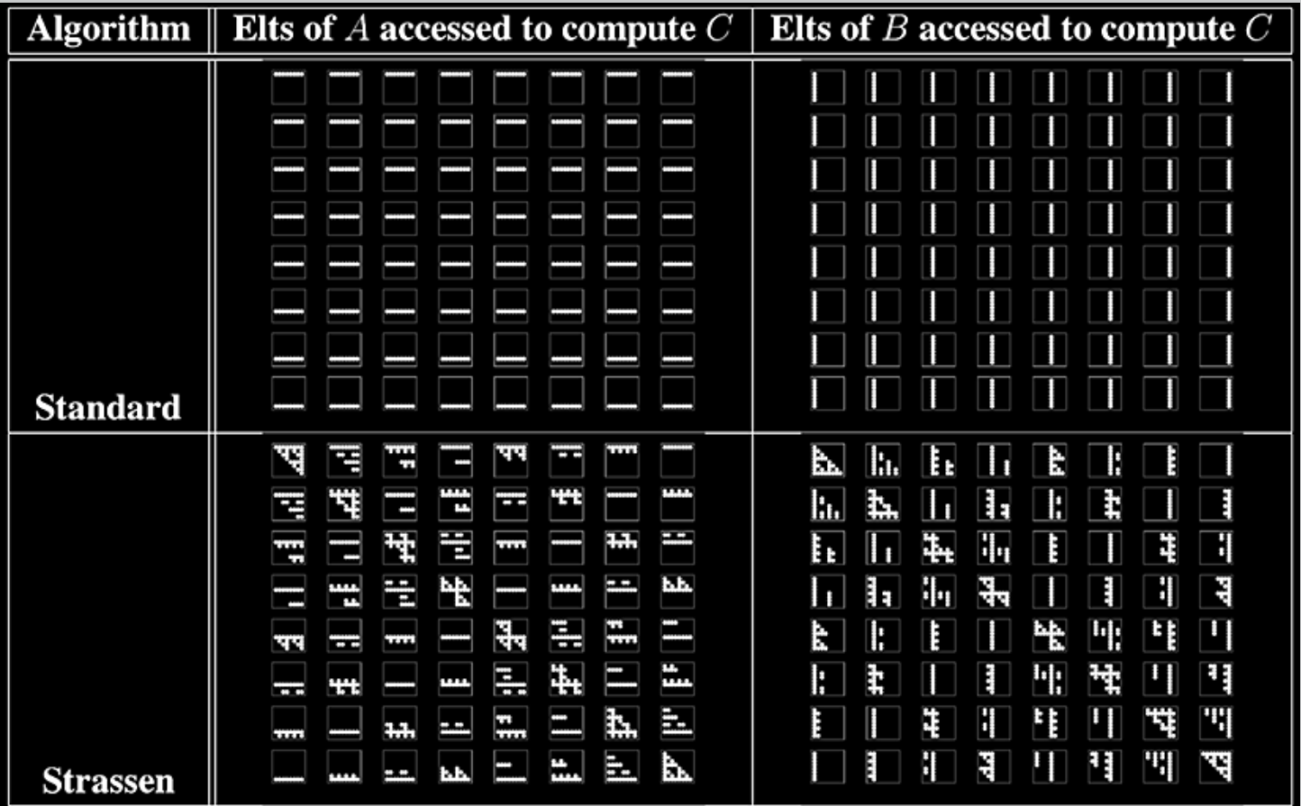
Source: https://www.computer.org/csdl/journal/td/2002/11/l1105/13rRUxAASVu

Slide 35
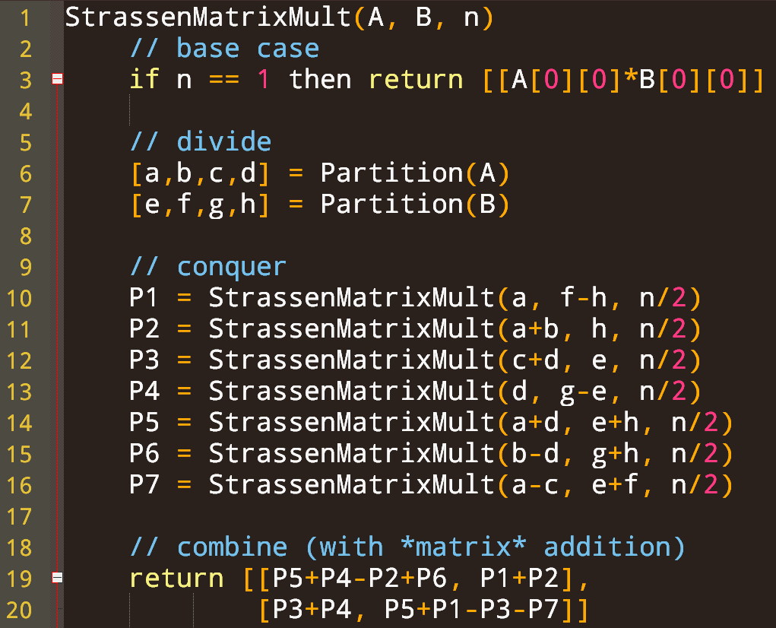

Slide 36
$$Θ(1)$$
Running time complexity?
$T\left(n\right)=7T\left(\frac{n}{2}\right)+Θ(n^{2})$
Master theorem
$a=7,b=2,y=2$
$x=\log_{2}{7}$
$x>y$ so $T\left(n\right)∈Θ\left(n^{x}\right)$
$T\left(n\right)∈Θ\left(n^{\log_{2}{7}}\right)≈Θ\left(n^{2.81}\right)$
$Θ(1)$ or $Θ\left(n^{2}\right)$
$$7T\left(\frac{n}{2}\right)$$
$$Θ(n^{2})$$

Slide 37
How much better is $Θ(n^{2.81})$ than $Θ(n^{3})$?
How much better is $Θ(n^{2.376})$ than $Θ(n^{3})$?
Let n=10,000
$n^{2.81}≈174$ billion
$n^{3}=1$ trillion (~6x more)
Let n=10,000
$n^{2.376}≈3.2$ billion
$n^{3}=1$ trillion (~312x)

