Slide 1
Lecture 15:
Indexing
CS348 Spring 2025:
Introduction to Database Management
Guest Lecture: Chao Zhang
Sections: 001, 002, 003

Slide 2
Announcements
Midterm exam tomorrow!
  Time: 4:30 PM – 6:00 PM
  Location: M3 1006 and STC 0040 (check your room)
  See the midterm-review lecture
No class on next Tue, July 1 (Canada day)!

Slide 3
Outline
Types of indexes:
  Dense v.s. sparse
  Clustering v.s. non-clustering
  Primary v.s. secondary
Indexing structure
  ISAM
  B+-tree
  Hashing
How to use index

Slide 4


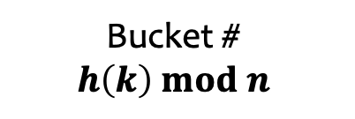
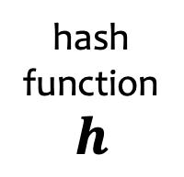
Static hashing
With record pointers
(shown below) or records
bucket 0
bucket i
k_{i1}
k_{i2}
k_{i3}
…
hash
function
$$h$$
bucket 1
Search key
$$k$$
Bucket #
$$h\left(k\right) mod n$$
bucket i
bucket i
overflow
bucket i
overflow
…
What if a bucket is full?
bucket
n-1

Slide 5
Performance of static hashing
Depends on the quality of the hash function
  Best (hopefully average) case: one I/O
  Worst case: all keys hashed into one bucket
  See Knuth vol. 3 for good hash functions
    Efficiency + uniformity (low collision)
Rule of thumb: keep utilization at 50%-80%
How do we cope with growth?

Slide 6
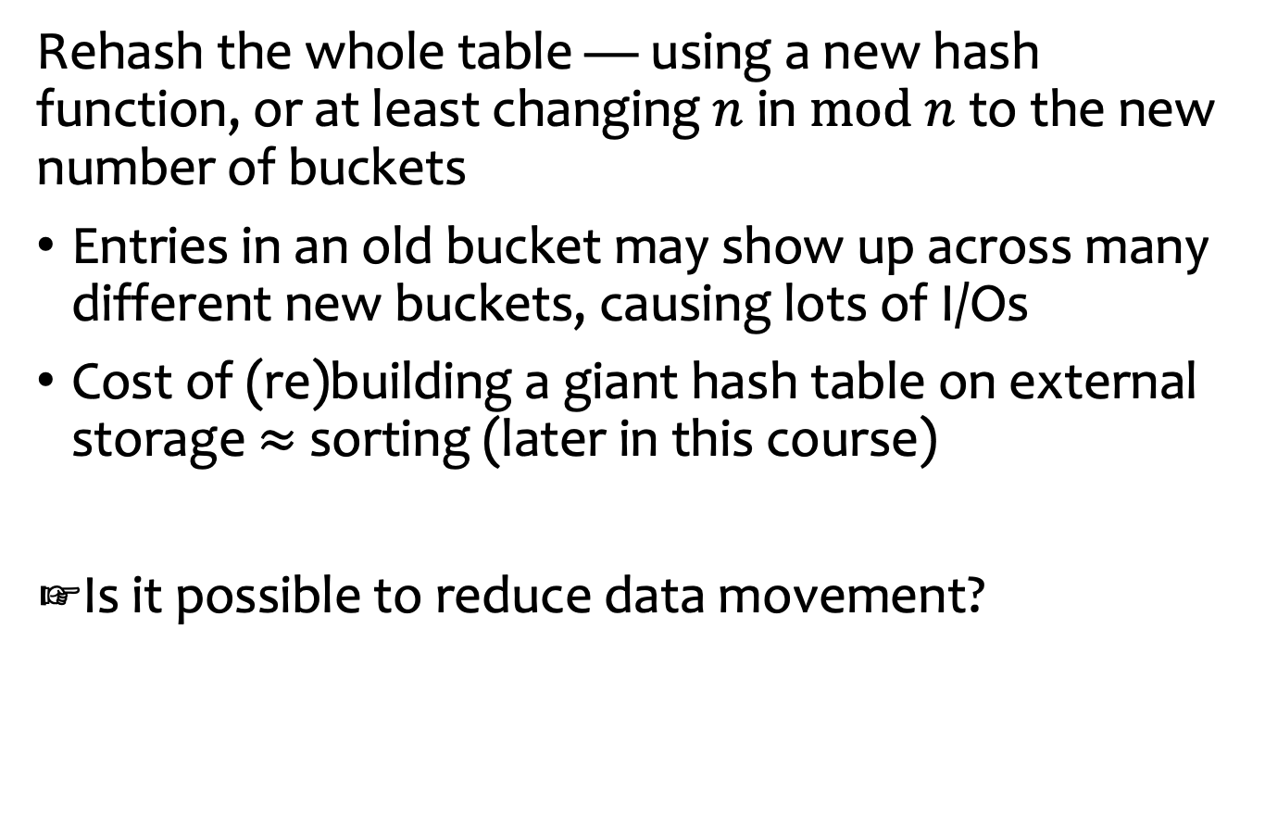
Strawman solution
Rehash the whole table — using a new hash function, or at least changing $n$ in $mod n$ to the new number of buckets
Entries in an old bucket may show up across many different new buckets, causing lots of I/Os
Cost of (re)building a giant hash table on external storage $≈$ sorting (later in this course)
Is it possible to reduce data movement?

Slide 7
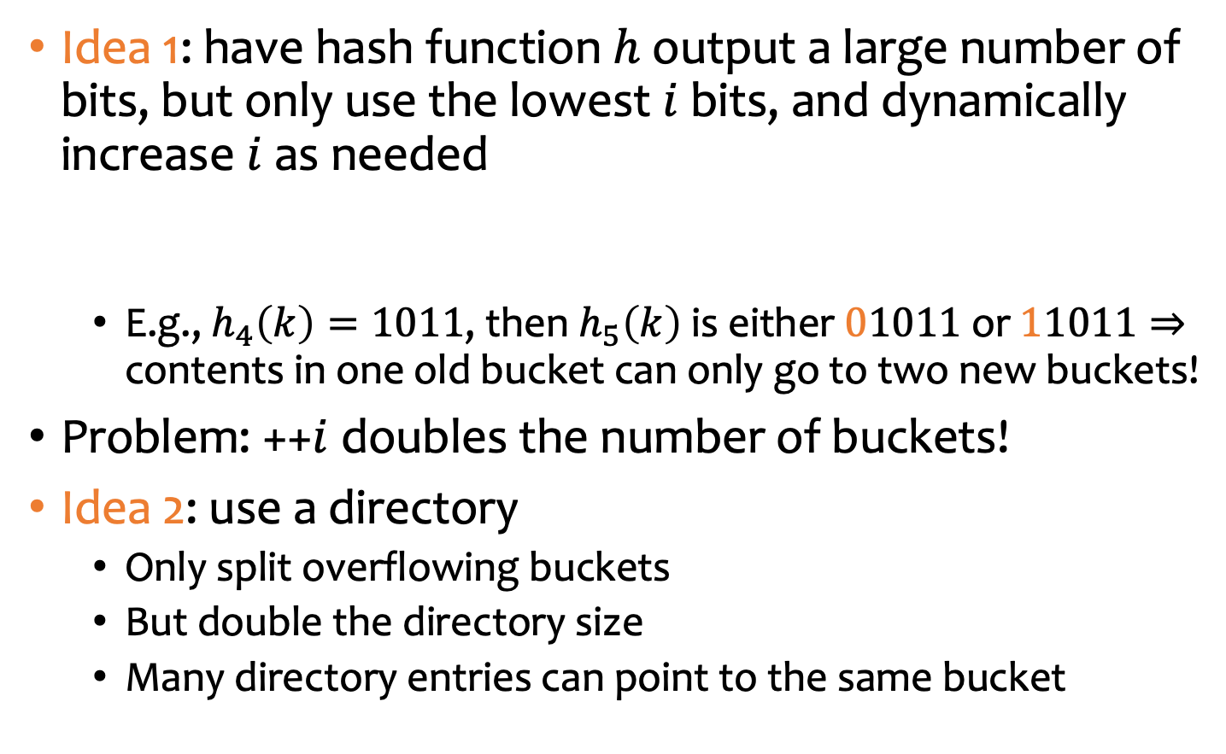


Extensible hashing
Idea 1: have hash function $h$ output a large number of bits, but only use the lowest $i$ bits, and dynamically increase $i$ as needed
  E.g., $h_{4}\left(k\right)=1011$, then $h_{5}\left(k\right)$ is either $01011$ or $11011⇒$ contents in one old bucket can only go to two new buckets!
Problem: ++$i$ doubles the number of buckets!
Idea 2: use a directory
  Only split overflowing buckets
  But double the directory size
  Many directory entries can point to the same bucket
$$h\left(k\right)$$
0
1
1
0
1
0
1
1
$$i$$

Slide 8
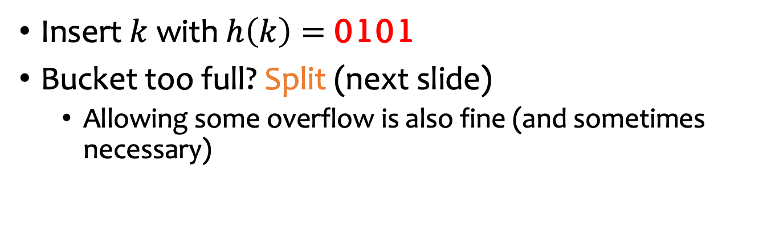
Extensible hashing example – 1
Showing hashed values here for ease of understanding, but in reality, we store original key values
Global
depth
(always the max
of local depths)
Directory
Buckets
0
1
1
1000
1
Local
depth
1001
0011
1
0101
Insert $k$ with $h\left(k\right)=$ 0101
Bucket too full? Split (next slide)
  Allowing some overflow is also fine (and sometimes necessary)

Slide 9

Extensible hashing example – 2
Global
depth
Directory
Local
depth
Buckets
0
1
1
1000
1
1001
0101
2
Each half = copy of the original directory,
except one entry in the second half points to the new bucket
00
01
10
11
2
0011
2
Upon split:
++local depth, redistribute contents, and ++global depth (double the directory size) if necessary

Slide 10
Extensible hashing example – 3
Insert 1110
(no split necessary)
Local
depth
Buckets
1000
1
1110
Global
depth
Directory
1001
0101
2
00
01
10
11
2
0011
2

Slide 11
Extensible hashing example – 4
1000
0000
Insert 0000
(split, but no
directory doubling)
2
Local
depth
1110
2
1000
1110
1
0000
Global
depth
Directory
1001
0101
2
00
01
10
11
2
0011
2
Buckets

Slide 12
Extensible hashing example - 5
Local
depth
Buckets
1000
0000
Insert 0001
(split +
directory doubling)
2
1110
2
Global
depth
Directory
1001
0001
3
1001
0101
2
000
001
010
011
100
101
110
111
3
00
01
10
11
2
0001
0011
2
0101
3
0011
2

Slide 13
Extensible hashing – deletions
Just the reverse of insertions
If the bucket becomes too empty:
  Merge with “sibling” (differing only on the leading bit)
    Adjust any pointer from the directory as needed
  – – local depth
  If possible, – – global depth and half the directory
    Invariant: global depth = max of all local depths

Slide 14
Summary of extensible hashing
Pros:
Handles growing/shrinking indexes
No full reorganization
Cons:
One more level of indirection through the directory
Directory size still doubles/halves
There are cases when doubling may not be enough
101100011
101100011
010000011
2

Slide 15
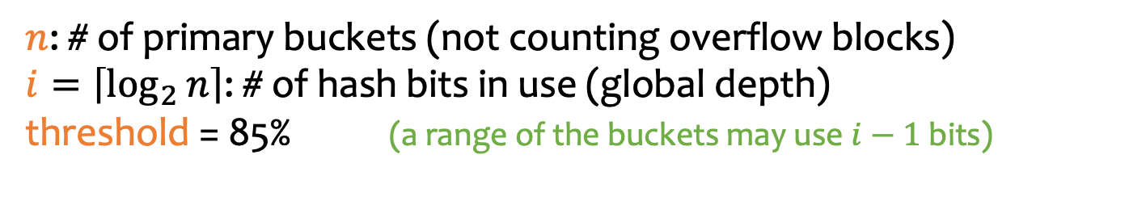

Linear hashing
No extra indirection through a directory
  Fix the splitting/growth order
  Use some extra math to figure out the right bucket
Grow only when utilization (avg. # entries per bucket / max # entries per block) exceeds a given threshold
$n$: # of primary buckets (not counting overflow blocks)
$i=\left\lceil \log_{2}{n}\right\rceil$: # of hash bits in use (global depth)
threshold = 85% (a range of the buckets may use $i−1$ bits)
$$n=2, i=1$$
bucket 0
bucket 1
0000
1010
1111
Local depth reflected by label, but no need to store explicitly

Slide 16


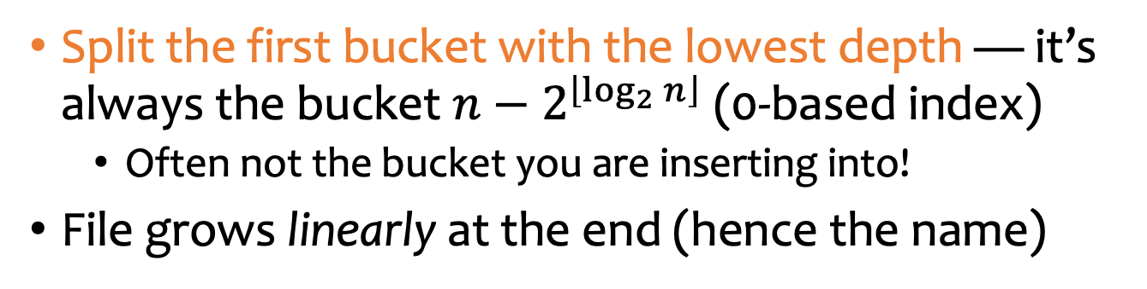
Linear hashing example – 1
$$n=2, i=1$$
bucket 0
bucket 1
0000
1010
1111
0101
Inserting 0101 exceeds threshold — grow
Split the first bucket with the lowest depth — it’s always the bucket $n−2^{\left\lfloor \log_{2}{n}\right\rfloor }$ (0-based index)
  Often not the bucket you are inserting into!
File grows linearly at the end (hence the name)
$$n=3, i=2$$
bucket 00
bucket 1
bucket 10
0000
1111
0101
1010

Slide 17


Linear hashing example – 2
$$n=3, i=2$$
bucket 00
bucket 1
bucket 10
0000
1111
0101
1010
1100
0001
1
Inserting 0001 doesn’t exceed threshold
Overflow is needed
2
Inserting 1100 exceeds threshold — grow
$$n=4, i=2$$
bucket 00
bucket 01
bucket 10
bucket 11
0000
1100
0101
0001
1010
1111

Slide 18

Linear hashing example – 3
$$n=4, i=2$$
bucket 00
bucket 01
bucket 10
bucket 11
0000
1100
0101
0001
1010
1110
1111
Inserting 1110 exceeds threshold — grow
$$n=5, i=3$$
bucket 000
bucket 01
bucket 10
bucket 11
bucket 100
0000
0101
0001
1010
1110
1111
1100
Look up 1110
Bucket 110 doesn’t exist, so go to bucket 10

Slide 19
Summary of linear hashing
Pros:
Handles growing/shrinking indexes
No full reorganization
No extra level of indirection (beats extensible hashing)
Cons:
Still has overflow chains, and may not split them right away because buckets must be split in sequence
empty
empty
empty
full
empty
empty
empty
full
full
full

Slide 20
Hash indexes vs. B⁺-trees
Hashing is faster on average, but the worst case can be bad
B⁺-tree’s worst-case performance guarantees rely on fewer assumptions, and in practice these trees are not very tall
Hashing destroys order, but B⁺-trees provide ordering and support range scans
We will come back to sorting vs. hashing again in query processing

Slide 21
Outline
Types of indexes:
  Dense v.s. sparse
  Clustering v.s. non-clustering
  Primary v.s. secondary
Indexing structure
  ISAM
  B+-tree
  Hashing
How to use index
Notes:
Last, we will see how we use index for database system.

Slide 22
Multi-attribute indices
Index on several attributes of the same relation.
  CREATE INDEX NameIndex ON User(LastName, FirstName);
This index would be useful for these queries:
  select * from User where Lastname = ‘Smith’
  select * from User where Lastname = ‘Smith’ and Firstname=‘John’
This index would be not useful at all for this query:
  select * from User where Firstname=‘John’
tuples (or tuple pointers) are organized first by Lastname. Tuples with a common lastname are then organized by Firstname.

Slide 23
Index-only plan
For example:
  SELECT firstname, pop FROM User WHERE pop > ‘0.8’ AND firstname = ‘Bob’;
  non-clustering index on (firstname, pop)
A (non-clustered) index contains all the columns needed to answer the query without having to access the tuples in the base relation.
  Avoid one disk I/O per tuple
  The index is much smaller than the base relation

Slide 24
Physical design guidelines for indices
Don’t index unless the performance increase outweighs the update overhead
Attributes mentioned in WHERE clauses are candidates for index search keys
Multi-attribute search keys should be considered when a WHERE clause contains several conditions; or it enables index-only plans

Slide 25
Physical design guidelines for indices
Choose indexes that benefit as many queries as possible
Each relation can have at most one clustering scheme; therefore choose it wisely
  Target important queries that would benefit the most
    Range queries benefit the most from clustering
  A multi-attribute index that enables an index-only plan does not benefit from being clustered

Slide 26
Case study
User (uid int, name string, age int, pop float)
Group (gid string, name string, date DATE)
Member (uid int, gid string)
Common queries
  List the name, pop of users in a particular age range
  List the uid, age, pop of users with a particular name
  List the average pop of each age
  List all the group info, ordered by their starting date
  List the average pop of a particular group given the group name
Pick a set of clustering/non-clustering indexes for these set of queries (without worrying too much about storage and update cost)

Slide 27
Case study
User (uid int, name string, age int, pop float)
Group (gid string, name string, date DATE)
Member (uid int, gid string)
A clustering index on User(age)
A non-clustering index on User(name)
Common queries
  List the name, pop of users in a particular age range
  List the uid, age, pop of users with a particular name
  List the average pop of each age
  List all the group info, ordered by their starting date
  List the average pop of a particular group given the group name

Slide 28
Case study
User (uid int, name string, age int, pop float)
Group (gid string, name string, date DATE)
Member (uid int, gid string)
A non-clustering index on User(age, pop)
→ index-only plan
A clustering index on User(age)
A non-clustering index on User(name)
Common queries
  List the name, pop of users in a particular age range
  List the uid, age, pop of users with a particular name
  List the average pop of each age
  List all the group info, ordered by their starting date
  List the average pop of a particular group given the group name

Slide 29
Case study
User (uid int, name string, age int, pop float)
Group (gid string, name string, date DATE)
Member (uid int, gid string)
A non-clustering index on User(age, pop)
→ index-only plan
A clustering index on User(age)
A non-clustering index on User(name)
Common queries
  List the name, pop of users in a particular age range
  List the uid, age, pop of users with a particular name
  List the average pop of each age
  List all the group info, ordered by their starting date
  List the average pop of a particular group given the group name
A clustering index on Group(date)

Slide 30
Case study
User (uid int, name string, age int, pop float)
Group (gid string, name string, date DATE)
Member (uid int, gid string)
A non-clustering index on User(age, pop)
→ index-only plan
A clustering index on User(age)
A non-clustering index on User(name)
Common queries
  List the name, pop of users in a particular age range
  List the uid, age, pop of users with a particular name
  List the average pop of each age
  List all the group info, ordered by their starting date
  List the average pop of a particular group given the group name
A join between User(uid, …,pop) , Member(uid,gid), Group(gid, name)
A clustering index on Group(date)
(i) Search gid by a particular name
Clustering/non-clustering index on Group(name)?
Non-clustering, as we already have a clustered index on Group(date)
(ii) Search uid by a particular gid
Clustering/non-clustering index on Member(gid)?
If many other queries need a clustering index on Group(name), we may reconsider!
(iii) Search pop by a particular uid
→ Clustering/non-clustering index on User(uid)?

Slide 31
Case study
User (uid int, name string, age int, pop float)
Group (gid string, name string, date DATE)
Member (uid int, gid string)
A non-clustering index on User(age, pop)
→ index-only plan
A clustering index on User(age)
A non-clustering index on User(name)
Common queries
  List the name, pop of users in a particular age range
  List the uid, age, pop of users with a particular name
  List the average pop of each age
  List all the group info, ordered by their starting date
  List the average pop of a particular group given the group name
A join between User(uid, …,pop) , Member(uid,gid), Group(gid, name)
A clustering index on Group(date)
(i) Search gid by a particular name
Non-clustering index on Group(name)
(ii) Search uid by a particular gid
Clustering/non-clustering index on Member(gid)?
Clustering -> all records of the same gid are clustered
(iii) Search pop by a particular uid
→ Clustering/non-clustering index on User(uid)?
Or clustering index on Member(gid,uid)

Slide 32
Case study
User (uid int, name string, age int, pop float)
Group (gid string, name string, date DATE)
Member (uid int, gid string)
A non-clustering index on User(age, pop)
→ index-only plan
A clustering index on User(age)
A non-clustering index on User(name)
Common queries
  List the name, pop of users in a particular age range
  List the uid, age, pop of users with a particular name
  List the average pop of each age
  List all the group info, ordered by their starting date
  List the average pop of a particular group given the group name
A join between User(uid, …,pop) , Member(uid,gid), Group(gid, name)
A clustering index on Group(date)
(i) Search gid by a particular name
Non-clustering index on Group(name)
Or non-clustering index on User(uid, pop) → index-only plan, if without worrying about storage/update cost
(ii) Search uid by a particular gid
Clustering index on Member(gid)
Non-clustering, as we already have a clustering index on User(age)
(iii) Search pop by a particular uid
→ Clustering/non-clustering index on User(uid)?

Slide 33
Summary
Types of indexes:
  Dense v.s. sparse
  Clustering v.s. non-clustering
  Primary v.s. secondary
Indexing structure
  ISAM
  B+-tree
  Hashing
How to use index
  Use multi-attribute indices
  Index-only plan
  General guideline

Slide 34
What is next?
DBMS Internals:
Storage: records, blocks, and files
Indexing
Query processing & optimization

