Slide 1
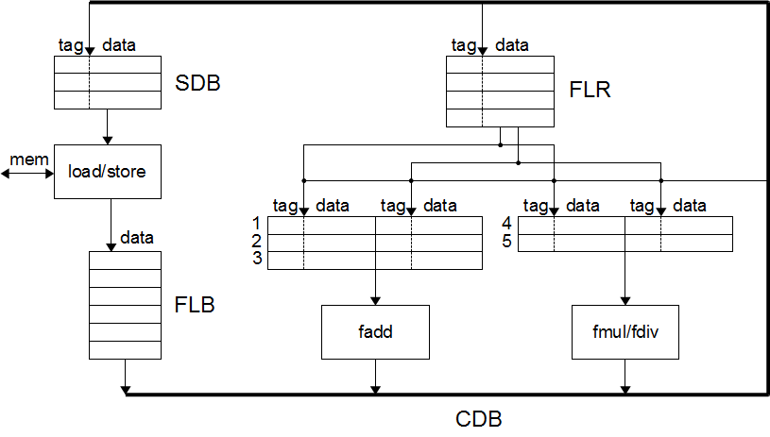
FPU structure

Slide 2
Example
Assumptions (to shorten execution trace)
2 instructions dispatched in order per cycle
execution begins in same cycle as dispatch
result broadcast on CDB in last cycle of execution
Instruction sequence
W: F4 <- F0 + F6
X: F2 <- F0 * F4
Y: F4 <- F4 + F6
Z: F6 <- F4 * F2
Initial register contents
FLR
 | tag | data
F0 |  | 6
F2 |  | 2
F4 |  | 10
F6 |  | 8

Slide 3
Cycle 1
 | FADD |  |  |  |  |  | FMUL/DIV |  |  |  |  | FLR
 | tag | data | tag | data |  |  | tag | data | tag | data |  |  | tag | data
1 |  |  |  |  |  | 4 |  |  |  |  |  | 0 |  | 6
2 |  |  |  |  |  | 5 |  |  |  |  |  | 2 |  | 2
3 |  |  |  |  |  |  |  |  |  |  |  | 4 |  | 10
 | Ex unit |  |  |  |  |  | Ex unit |  |  |  |  | 6 |  | 8
 | FADD |  |  |  |  |  | FMUL/DIV |  |  |  |  | FLR
 | tag | data | tag | data |  |  | tag | data | tag | data |  |  | tag | data
1 |  | 6 |  | 8 |  | 4 |  |  |  |  |  | 0 |  | 6
2 |  |  |  |  |  | 5 |  |  |  |  |  | 2 |  | 2
3 |  |  |  |  |  |  |  |  |  |  |  | 4 | 1 | 10
 | Ex unit |  | W |  |  |  | Ex unit |  |  |  |  | 6 |  | 8
 | FADD |  |  |  |  |  | FMUL/DIV |  |  |  |  | FLR
 | tag | data | tag | data |  |  | tag | data | tag | data |  |  | tag | data
1 |  | 6 |  | 8 |  | 4 |  | 6 | 1 |  |  | 0 |  | 6
2 |  |  |  |  |  | 5 |  |  |  |  |  | 2 | 4 | 2
3 |  |  |  |  |  |  |  |  |  |  |  | 4 | 1 | 10
 | Ex unit |  | W |  |  |  | Ex unit |  |  |  |  | 6 |  | 8
W: F4 <- F0 + F6
X: F2 <- F0 * F4
Y: F4 <- F4 + F6
Z: F6 <- F4 * F2

Slide 4
Cycle 2
 | FADD |  |  |  |  |  | FMUL/DIV |  |  |  |  | FLR
 | tag | data | tag | data |  |  | tag | data | tag | data |  |  | tag | data
1 |  | 6 |  | 8 |  | 4 |  | 6 | 1 |  |  | 0 |  | 6
2 |  |  |  |  |  | 5 |  |  |  |  |  | 2 | 4 | 2
3 |  |  |  |  |  |  |  |  |  |  |  | 4 | 1 | 10
 | Ex unit |  | W |  |  |  | Ex unit |  |  |  |  | 6 |  | 8
 | FADD |  |  |  |  |  | FMUL/DIV |  |  |  |  | FLR
 | tag | data | tag | data |  |  | tag | data | tag | data |  |  | tag | data
1 |  | 6 |  | 8 |  | 4 |  | 6 | 1 |  |  | 0 |  | 6
2 | 1 |  |  | 8 |  | 5 |  |  |  |  |  | 2 | 4 | 2
3 |  |  |  |  |  |  |  |  |  |  |  | 4 | 2 | 10
 | Ex unit |  | W |  |  |  | Ex unit |  |  |  |  | 6 |  | 8
 | FADD |  |  |  |  |  | FMUL/DIV |  |  |  |  | FLR
 | tag | data | tag | data |  |  | tag | data | tag | data |  |  | tag | data
1 |  | 6 |  | 8 |  | 4 |  | 6 | 1 |  |  | 0 |  | 6
2 | 1 |  |  | 8 |  | 5 | 2 |  | 4 |  |  | 2 | 4 | 2
3 |  |  |  |  |  |  |  |  |  |  |  | 4 | 2 | 10
 | Ex unit |  | W |  |  |  | Ex unit |  |  |  |  | 6 | 5 | 8
W: F4 <- F0 + F6
X: F2 <- F0 * F4
Y: F4 <- F4 + F6
Z: F6 <- F4 * F2

Slide 5
Cycle 3
 | FADD |  |  |  |  |  | FMUL/DIV |  |  |  |  | FLR
 | tag | data | tag | data |  |  | tag | data | tag | data |  |  | tag | data
1 |  |  |  |  |  | 4 |  | 6 |  | 14 |  | 0 |  | 6
2 |  | 14 |  | 8 |  | 5 | 2 |  | 4 |  |  | 2 | 4 | 2
3 |  |  |  |  |  |  |  |  |  |  |  | 4 | 2 | 10
 | Ex unit |  | Y |  |  |  | Ex unit |  | X |  |  | 6 | 5 | 8
W: F4 <- F0 + F6
X: F2 <- F0 * F4
Y: F4 <- F4 + F6
Z: F6 <- F4 * F2

Slide 6
Cycle 4
 | FADD |  |  |  |  |  | FMUL/DIV |  |  |  |  | FLR
 | tag | data | tag | data |  |  | tag | data | tag | data |  |  | tag | data
1 |  |  |  |  |  | 4 |  | 6 |  | 14 |  | 0 |  | 6
2 |  | 14 |  | 8 |  | 5 | 2 |  | 4 |  |  | 2 | 4 | 2
3 |  |  |  |  |  |  |  |  |  |  |  | 4 | 2 | 10
 | Ex unit |  | Y |  |  |  | Ex unit |  | X |  |  | 6 | 5 | 8
W: F4 <- F0 + F6
X: F2 <- F0 * F4
Y: F4 <- F4 + F6
Z: F6 <- F4 * F2

Slide 7
Cycle 5
 | FADD |  |  |  |  |  | FMUL/DIV |  |  |  |  | FLR
 | tag | data | tag | data |  |  | tag | data | tag | data |  |  | tag | data
1 |  |  |  |  |  | 4 |  | 6 |  | 14 |  | 0 |  | 6
2 |  |  |  |  |  | 5 |  | 22 | 4 |  |  | 2 | 4 | 2
3 |  |  |  |  |  |  |  |  |  |  |  | 4 |  | 22
 | Ex unit |  |  |  |  |  | Ex unit |  | X |  |  | 6 | 5 | 8
W: F4 <- F0 + F6
X: F2 <- F0 * F4
Y: F4 <- F4 + F6
Z: F6 <- F4 * F2

Slide 8
Cycle 6
 | FADD |  |  |  |  |  | FMUL/DIV |  |  |  |  | FLR
 | tag | data | tag | data |  |  | tag | data | tag | data |  |  | tag | data
1 |  |  |  |  |  | 4 |  |  |  |  |  | 0 |  | 6
2 |  |  |  |  |  | 5 |  | 22 |  | 84 |  | 2 |  | 84
3 |  |  |  |  |  |  |  |  |  |  |  | 4 |  | 22
 | Ex unit |  |  |  |  |  | Ex unit |  | Z |  |  | 6 | 5 | 8
W: F4 <- F0 + F6
X: F2 <- F0 * F4
Y: F4 <- F4 + F6
Z: F6 <- F4 * F2

Slide 9
Cycle 7
 | FADD |  |  |  |  |  | FMUL/DIV |  |  |  |  | FLR
 | tag | data | tag | data |  |  | tag | data | tag | data |  |  | tag | data
1 |  |  |  |  |  | 4 |  |  |  |  |  | 0 |  | 6
2 |  |  |  |  |  | 5 |  | 22 |  | 84 |  | 2 |  | 84
3 |  |  |  |  |  |  |  |  |  |  |  | 4 |  | 22
 | Ex unit |  |  |  |  |  | Ex unit |  | Z |  |  | 6 | 5 | 8
W: F4 <- F0 + F6
X: F2 <- F0 * F4
Y: F4 <- F4 + F6
Z: F6 <- F4 * F2

Slide 10
Cycle 8
 | FADD |  |  |  |  |  | FMUL/DIV |  |  |  |  | FLR
 | tag | data | tag | data |  |  | tag | data | tag | data |  |  | tag | data
1 |  |  |  |  |  | 4 |  |  |  |  |  | 0 |  | 6
2 |  |  |  |  |  | 5 |  | 22 |  | 84 |  | 2 |  | 84
3 |  |  |  |  |  |  |  |  |  |  |  | 4 |  | 22
 | Ex unit |  |  |  |  |  | Ex unit |  | Z |  |  | 6 | 5 | 8
W: F4 <- F0 + F6
X: F2 <- F0 * F4
Y: F4 <- F4 + F6
Z: F6 <- F4 * F2

Slide 11
Cycle 9
 | FADD |  |  |  |  |  | FMUL/DIV |  |  |  |  | FLR
 | tag | data | tag | data |  |  | tag | data | tag | data |  |  | tag | data
1 |  |  |  |  |  | 4 |  |  |  |  |  | 0 |  | 6
2 |  |  |  |  |  | 5 |  |  |  |  |  | 2 |  | 84
3 |  |  |  |  |  |  |  |  |  |  |  | 4 |  | 22
 | Ex unit |  |  |  |  |  | Ex unit |  |  |  |  | 6 |  | 1848
W: F4 <- F0 + F6
X: F2 <- F0 * F4
Y: F4 <- F4 + F6
Z: F6 <- F4 * F2

