Slide 1

Data-Intensive Distributed Computing
CS 431/631 451/651 (Fall 2019)
Part 1: MapReduce Algorithm Design (1/4)
Ali Abedi
These slides are available at https://www.student.cs.uwaterloo.ca/~cs451/
This work is licensed under a Creative Commons Attribution-Noncommercial-Share Alike 3.0 United States
See http://creativecommons.org/licenses/by-nc-sa/3.0/us/ for details

Slide 2
Agenda for Today
Who am I?
What is big data?
Why big data?
What is this course about?
Administrivia

Slide 3
Who am I?
PhD from Waterloo (2017)
Systems and Networking Research Group

Slide 4
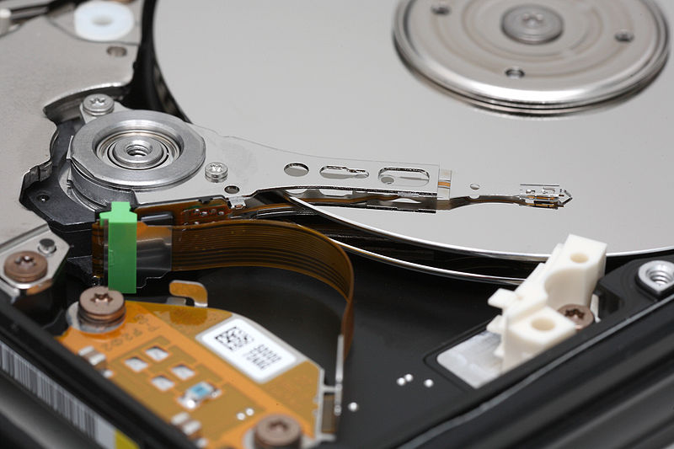
Big Data
Source: Wikipedia (Hard disk drive)

Slide 5
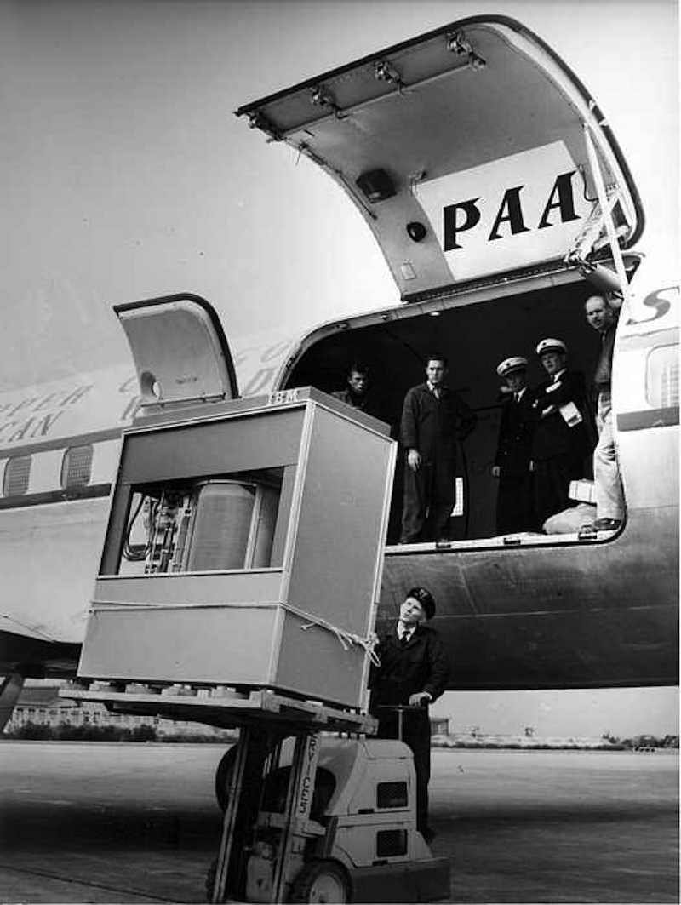
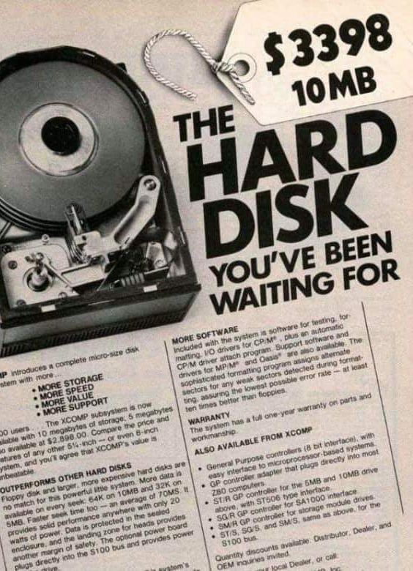
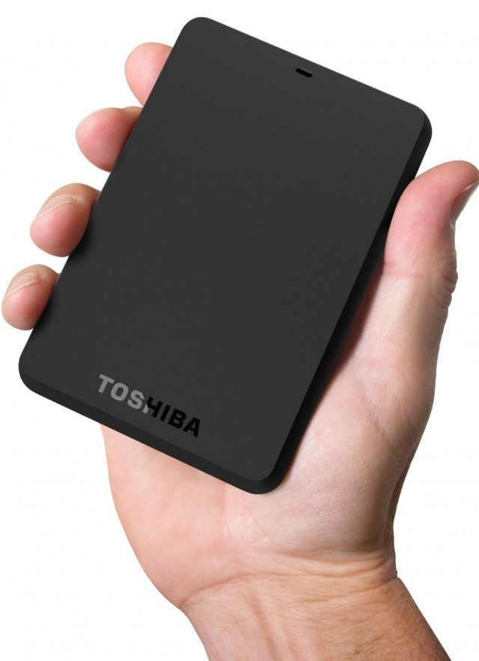
1950s
1980s
Today
Storage evolution over time

Slide 6
Storage cost over time

Slide 7








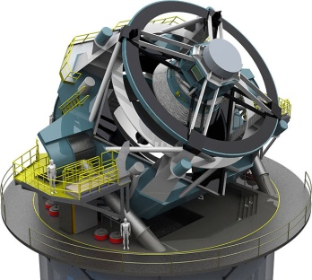
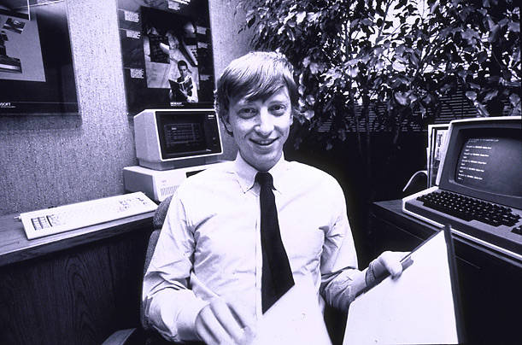
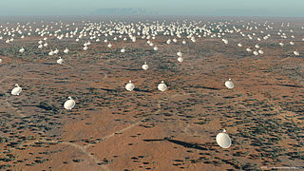
Processes 20 PB a day (2008)
Crawls 20B web pages a day (2012)
Search index is 100+ PB (5/2014)
Bigtable serves 2+ EB, 600M QPS (5/2014)
400B pages, 10+ PB (2/2014)
19 Hadoop clusters: 600 PB, 40k servers (9/2015)
Hadoop: 10K nodes, 150K cores, 150 PB (4/2014)
150 PB on 50k+ servers
running 15k apps (6/2011)
300 PB data in Hive +
600 TB/day (4/2014)
LHC: ~15 PB a year
S3: 2T objects, 1.1M request/second (4/2013)
640K ought to be enough for anybody.
LSST: 6-10 PB a year
(~2020)
SKA: 0.3 – 1.5 EB
per year (~2020)
How much data?

Slide 8
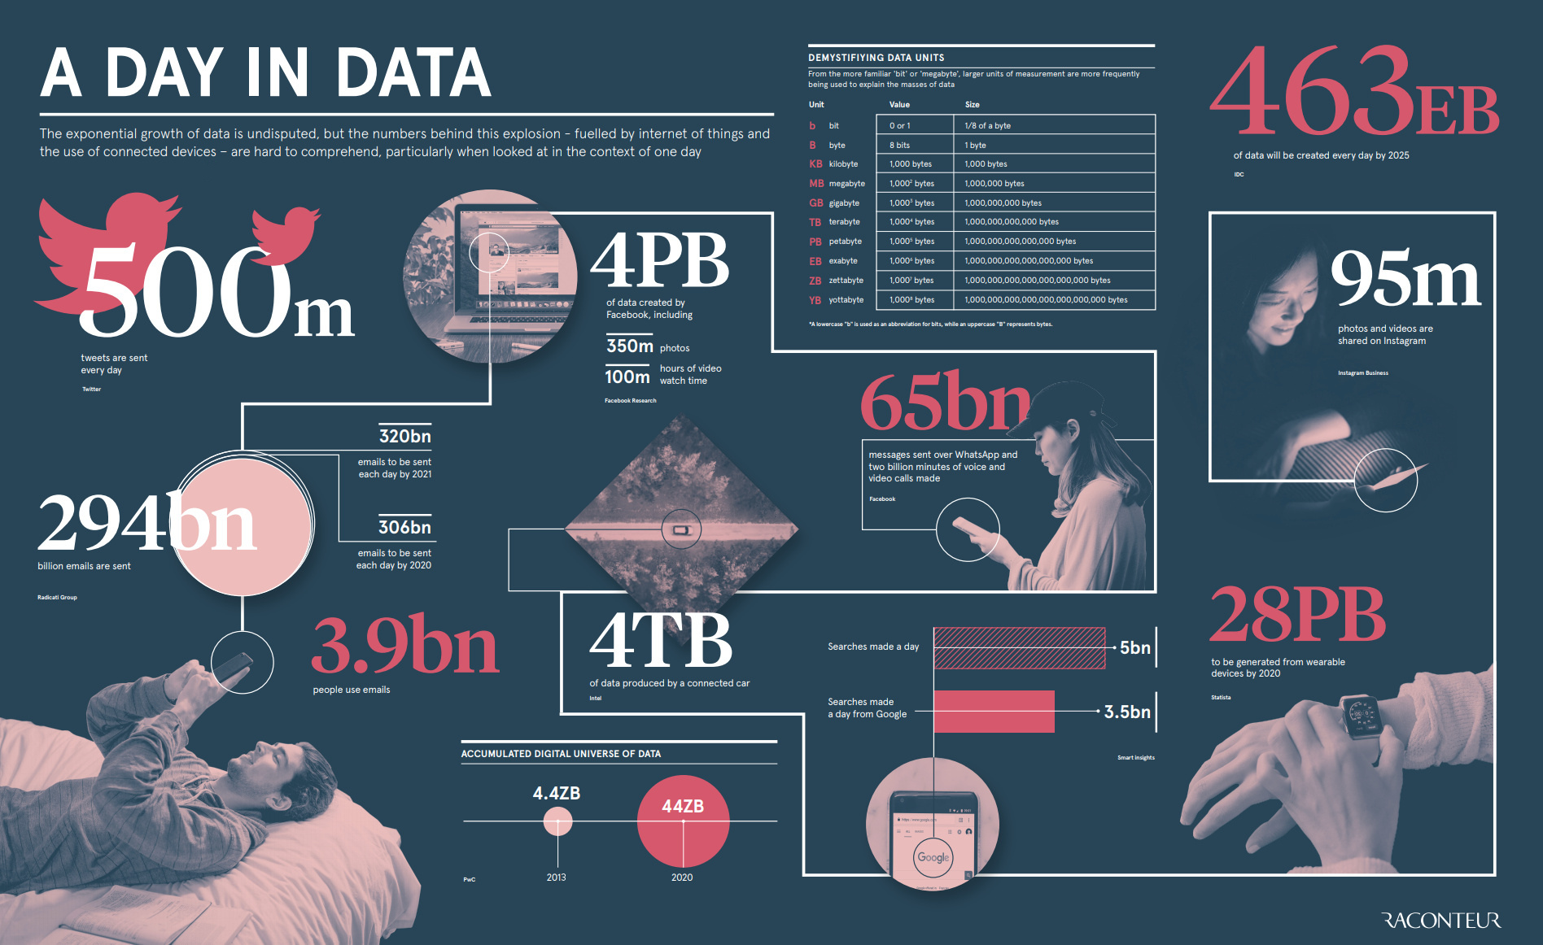

Slide 9
Storage cost
Big Data
Data generation

Slide 10
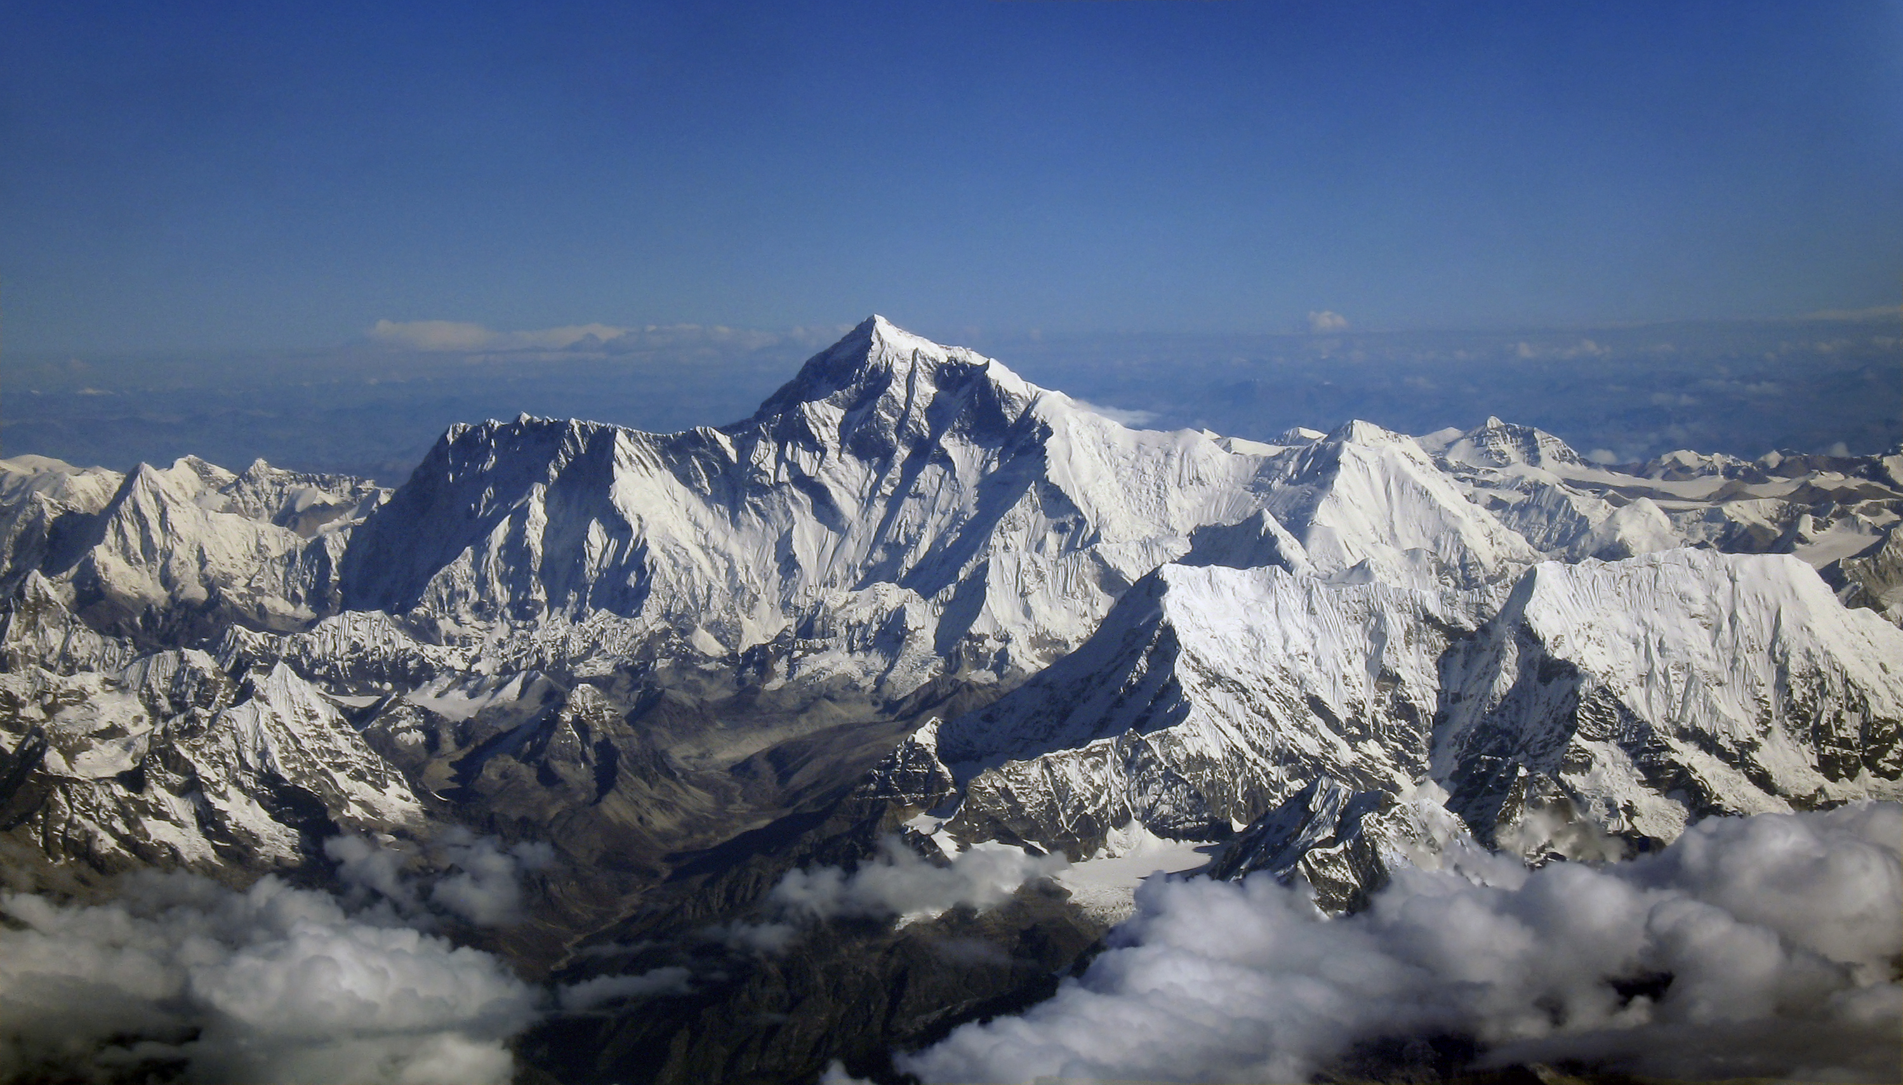
Why big data?
Science
Business
Society
Source: Wikipedia (Everest)

Slide 11
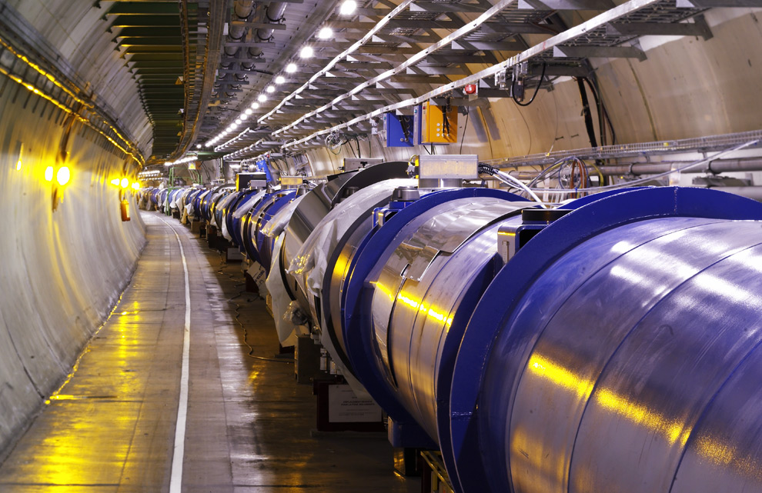
Science
Emergence of the 4th Paradigm
Data-intensive e-Science
Maximilien Brice, © CERN
Notes:
By the time it shuts down in 2011, the CERN collider should have amassed about 20 times as much data as it now has. (NYTimes article, “Trillions of Reasons to Be Excited”, 11/1/2010)

Slide 12
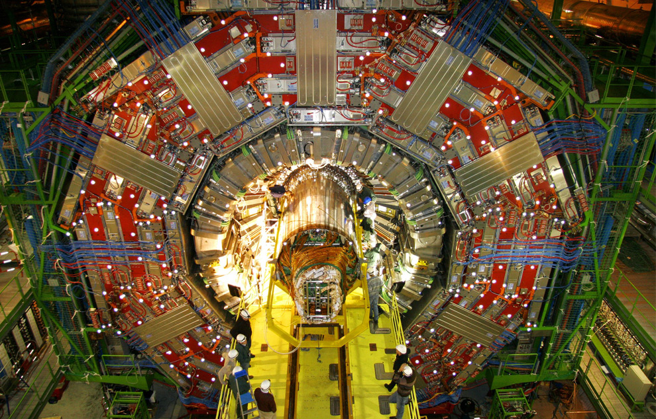
Maximilien Brice, © CERN

Slide 13
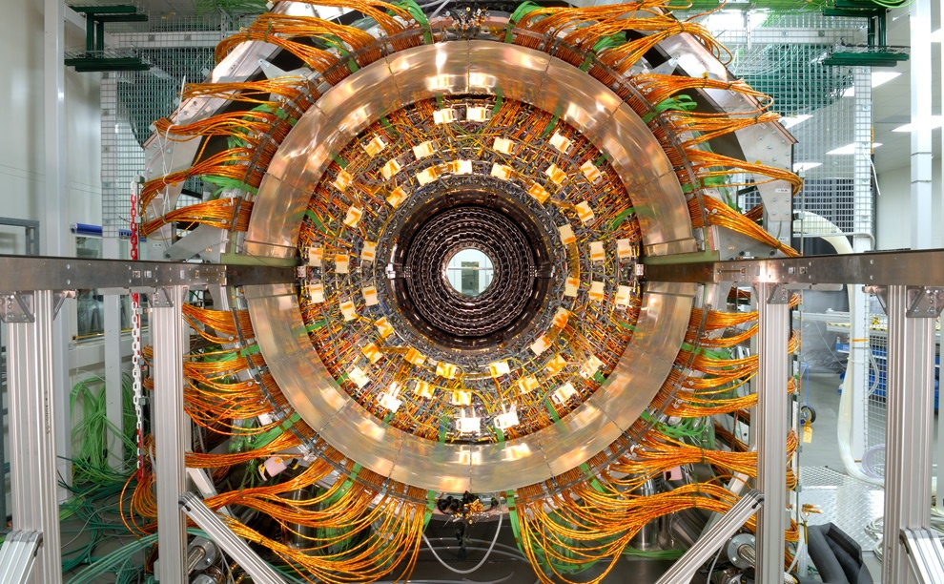
Maximilien Brice, © CERN

Slide 14
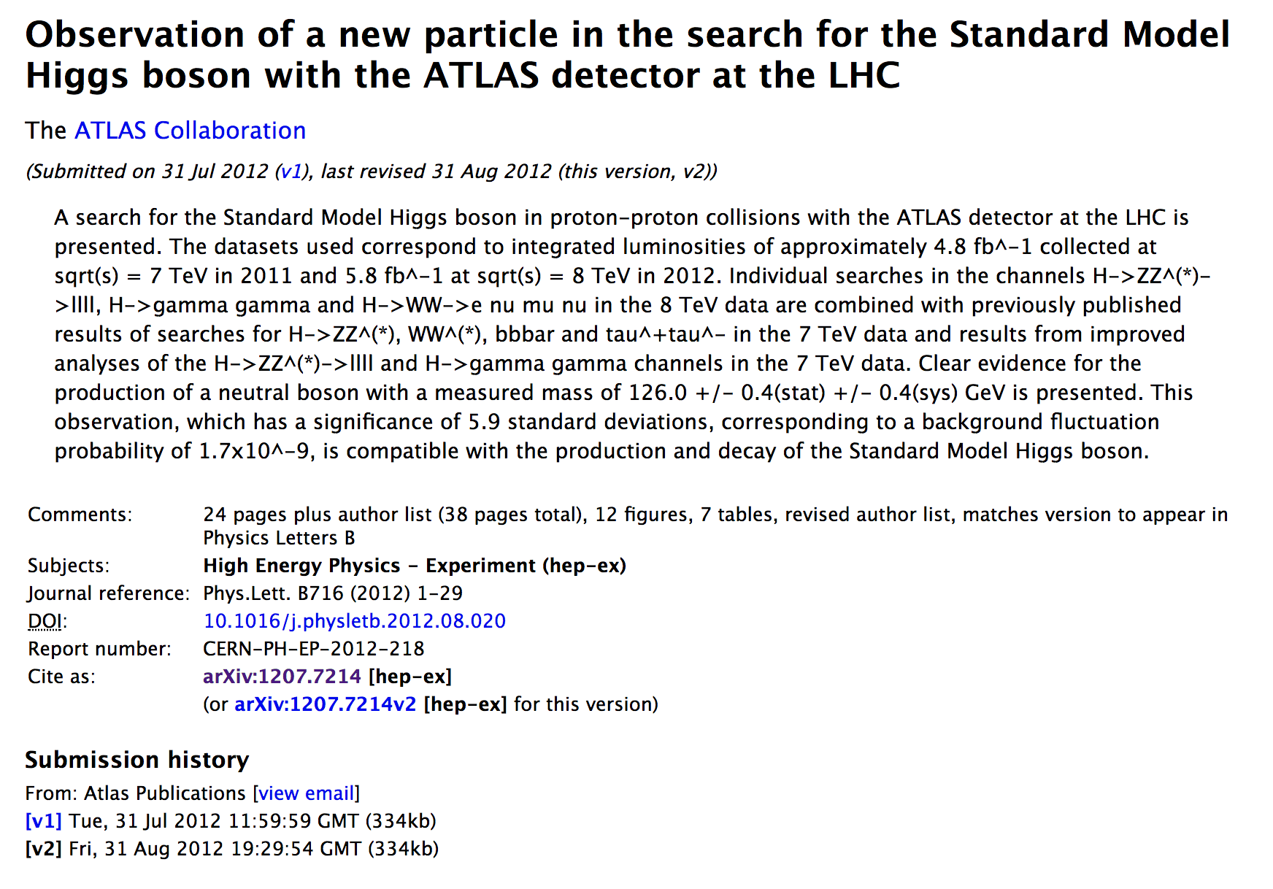

Slide 15
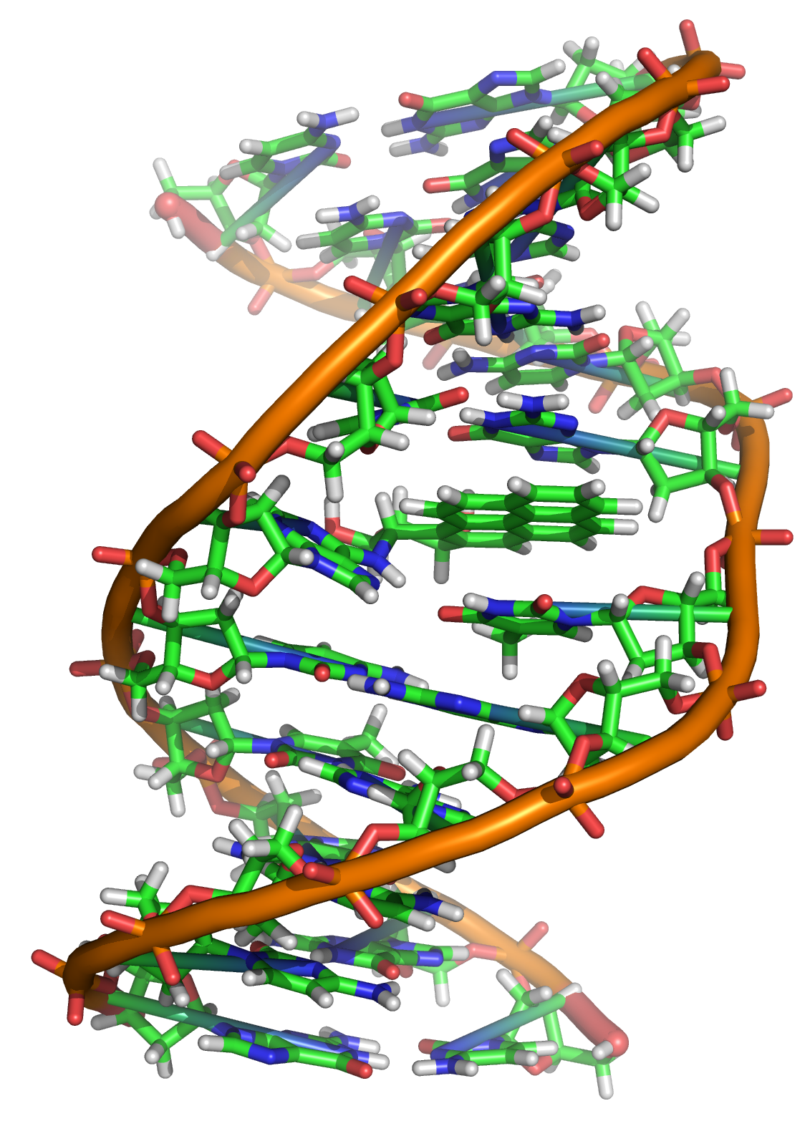
Source: Wikipedia (DNA)

Slide 16
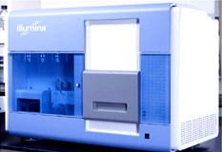
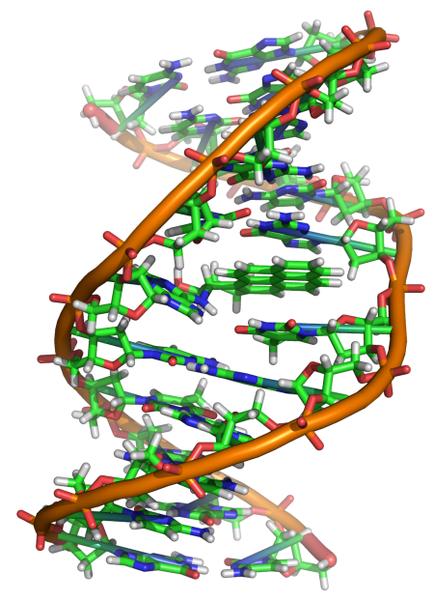
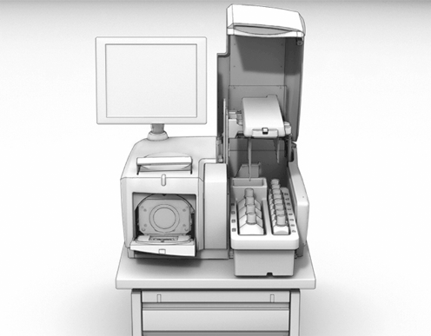
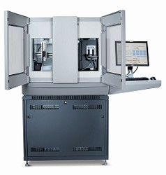
GATGCTTACTATGCGGGCCCC
CGGTCTAATGCTTACTATGC
GCTTACTATGCGGGCCCCTT
?
AATGCTTACTATGCGGGCCCCTT
TAATGCTTACTATGC
AATGCTTAGCTATGCGGGC
AATGCTTACTATGCGGGCCCCTT
AATGCTTACTATGCGGGCCCCTT
CGGTCTAGATGCTTACTATGC
AATGCTTACTATGCGGGCCCCTT
CGGTCTAATGCTTAGCTATGC
ATGCTTACTATGCGGGCCCCTT
Reads
Subject genome
Human genome: 3 gbp
A few billion short reads
(~100 GB compressed data)
Sequencer
Notes:
giga base pairs

Slide 17

Business
Data-driven decisions
Data-driven products
Source: Wikiedia (Shinjuku, Tokyo)

Slide 18
Business Intelligence
An organization should retain data that result from carrying out its mission and exploit those data to generate insights that benefit the organization, for example, market analysis, strategic planning, decision making, etc.
Duh!?

Slide 19
This is not a new idea!
In the 1990s, Wal-Mart found that customers tended to buy diapers and beer together. So they put them next to each other and increased sales of both.*
So what’s changed?
More compute and storage
Ability to gather behavioral data
* BTW, this is completely apocryphal. (But it makes a nice story.)

Slide 20
Virtuous Product Cycle
a useful service
$
(hopefully)
transform insights into action
analyze user behavior to extract insights
Google.
Facebook.
Twitter.
Amazon.
Uber.
data products
data science

Slide 21

Source: https://images.lookhuman.com/render/standard/8002245806006052/pillow14in-whi-z1-t-netflixing.png

Slide 22
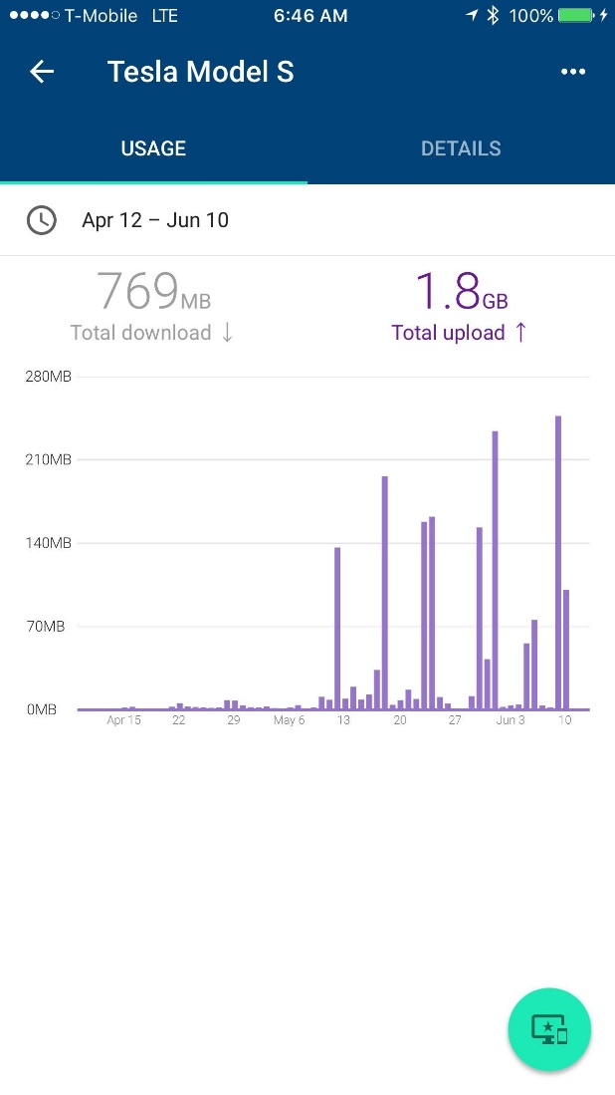
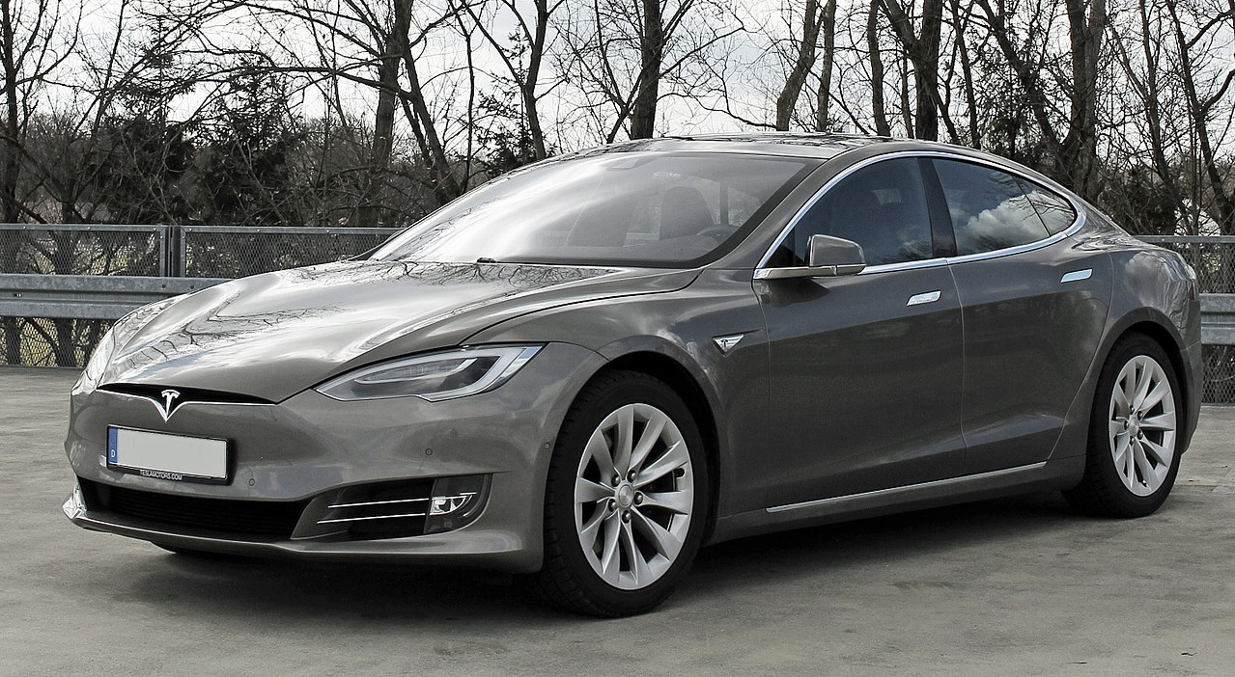
Source: https://www.reddit.com/r/teslamotors/comments/6gsc6v/i_think_the_neural_net_mining_is_just_starting/ (June 2017)

Slide 23
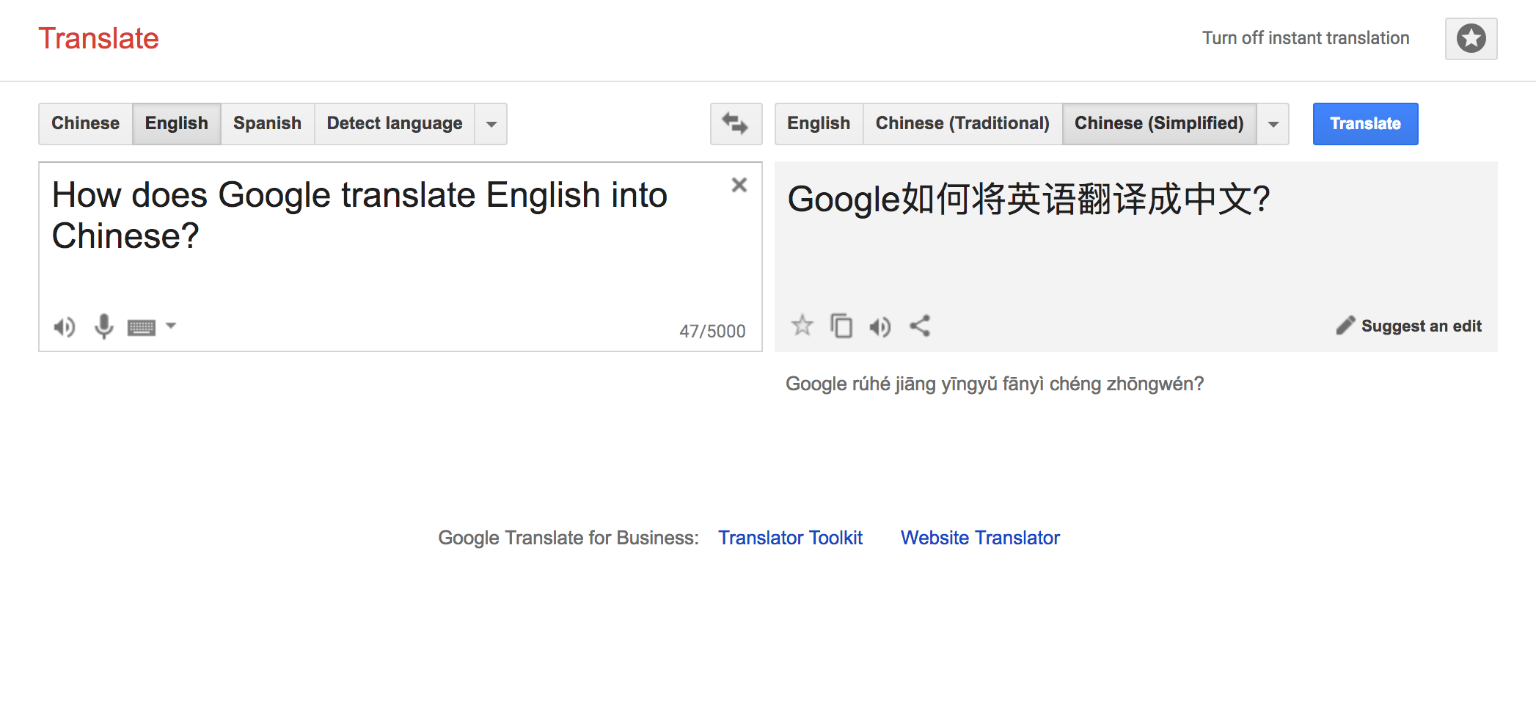

Slide 24
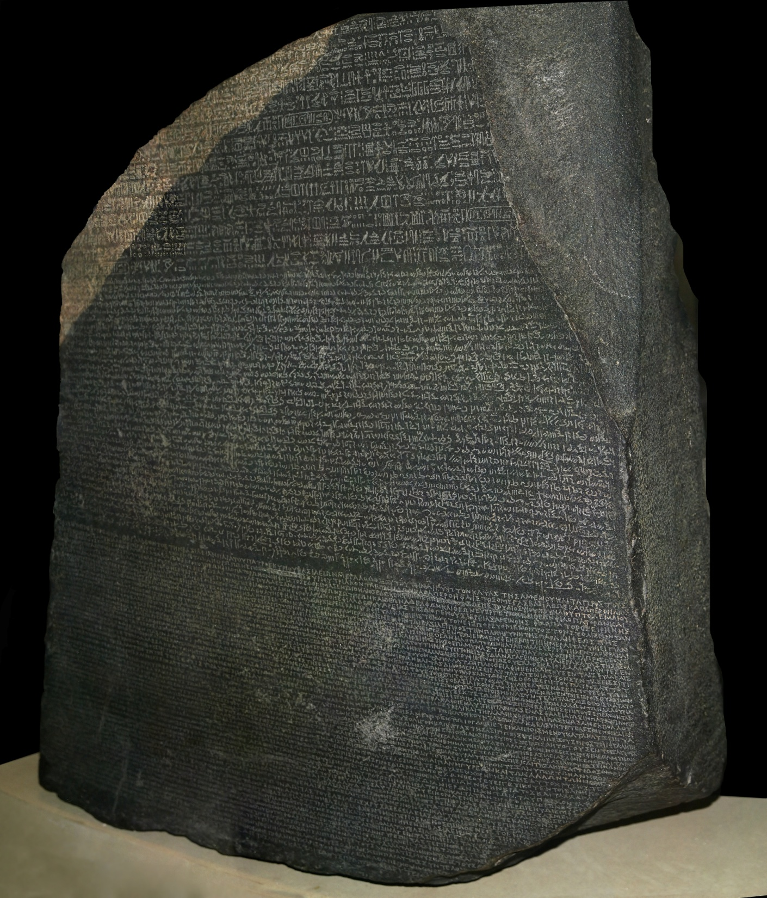
Source: Wikipedia (Rosetta Stone)

Slide 25
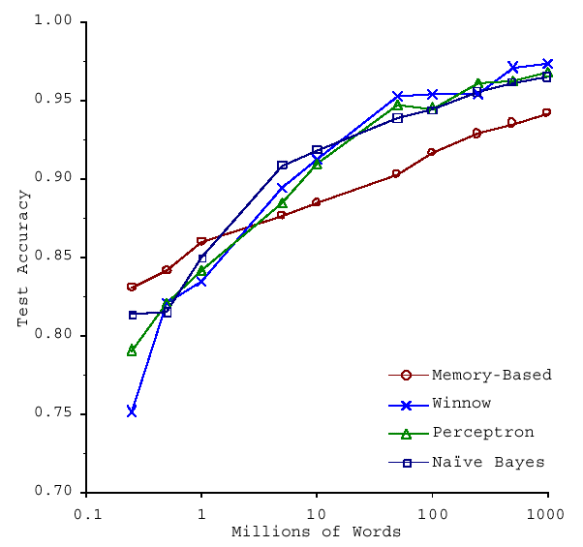
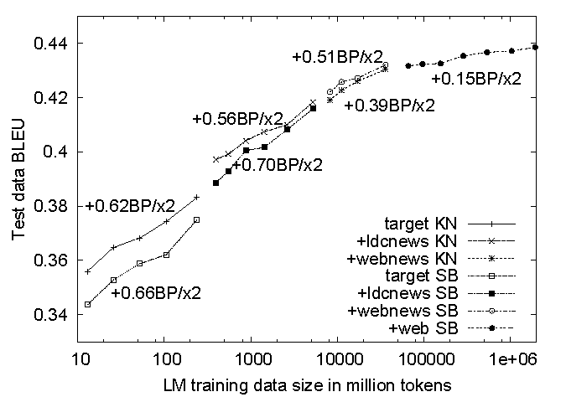
No data like more data!
(Banko and Brill, ACL 2001)
(Brants et al., EMNLP 2007)

Slide 26
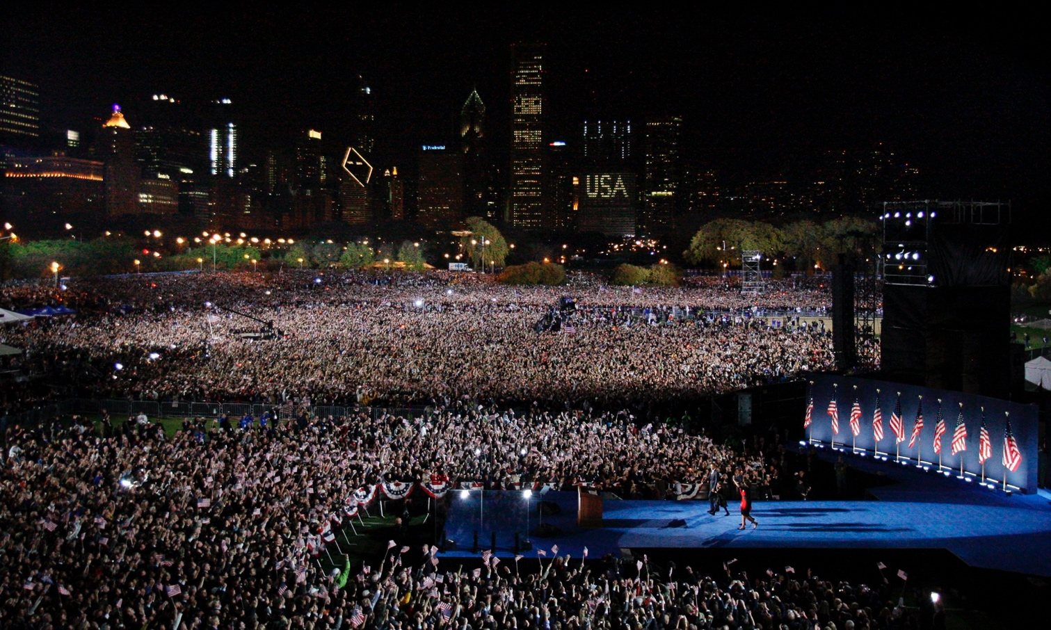
Society
Humans as social sensors
Computational social science
Source: Guardian

Slide 27
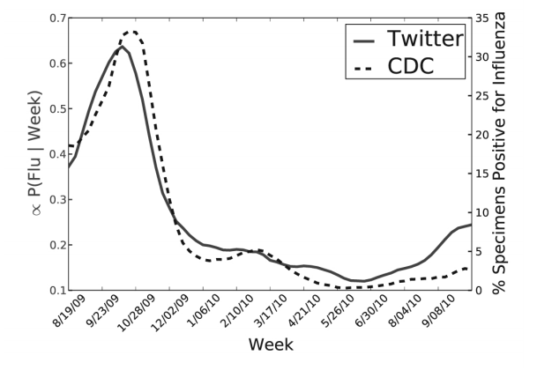
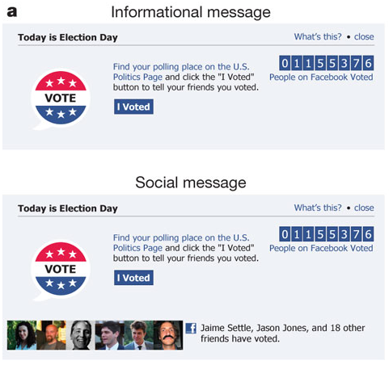
Predicting X with Twitter
2010 US Midterm Elections:
60m users shown “I Voted” Messages
Summary: increased turnout by 60k directly and 280k indirectly
Woah! You should feel unsettled about this!
Political Mobilization on Facebook
(Paul and Dredze, ICWSM 2011; Bond et al., Nature 2011)
Notes:
A fascinating piece in the FT this week posited that the effect of Facebook’s ‘voter megaphone’ (reminding users of polling day) and its “I voted” button could be significant.
A study in Nature in 2012 analysed the use of similar features during the 2010 congressional elections in the US.
60m US users saw the message “Today is Election Day” along with a link to polling place information and the “I voted” button (the button included a counter showing how many of your friends had also voted, and how many in total on the network). Crucially, a control group of 600,000 saw no notification.
When who voted was tallied with who got the Facebook reminder, the researchers saw it as responsible for 340,000 additional votes across the US.
Factoring in users whose Facebook names don’t match the electoral roll (nicknames etc.) and it’s possible that Facebook could have increased turnout by 0.6%.
That’s not small fry at all.

Slide 28
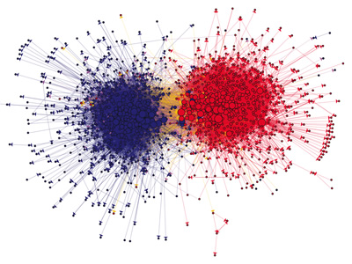
The Political Blogosphere and the 2004 U.S. Election

Slide 29

Source: Popular Internet Meme

Slide 30
What is this course about?
Data Science
Tools
This Course
Analytics Infrastructure
Execution
Infrastructure
“big data stack”

Slide 31
Buzzwords
Text: frequency estimation, language models, inverted indexes
Graphs: graph traversals, random walks (PageRank)
Relational data: SQL, joins, column stores
Data mining: hashing, clustering (k-means), classification, recommendations
Streams: probabilistic data structures (Bloom filters, CMS, HLL counters)
data science, data analytics, business intelligence, data warehouses and data lakes
Data Science
Tools
This Course
Analytics Infrastructure
MapReduce, Spark, Flink, Pig, Dryad, Hive, Dryad, noSQL, Pregel, Giraph, Storm/Heron
Execution
Infrastructure
“big data stack”
This course focuses on algorithm design and “thinking at scale”

Slide 32
Structure of the Course
Analyzing Text
Analyzing Relational Data
Analyzing Graphs
Data Mining and Machine Learning
What’s beyond batch processing?
“Core” framework features and algorithm design for batch processing

Slide 33
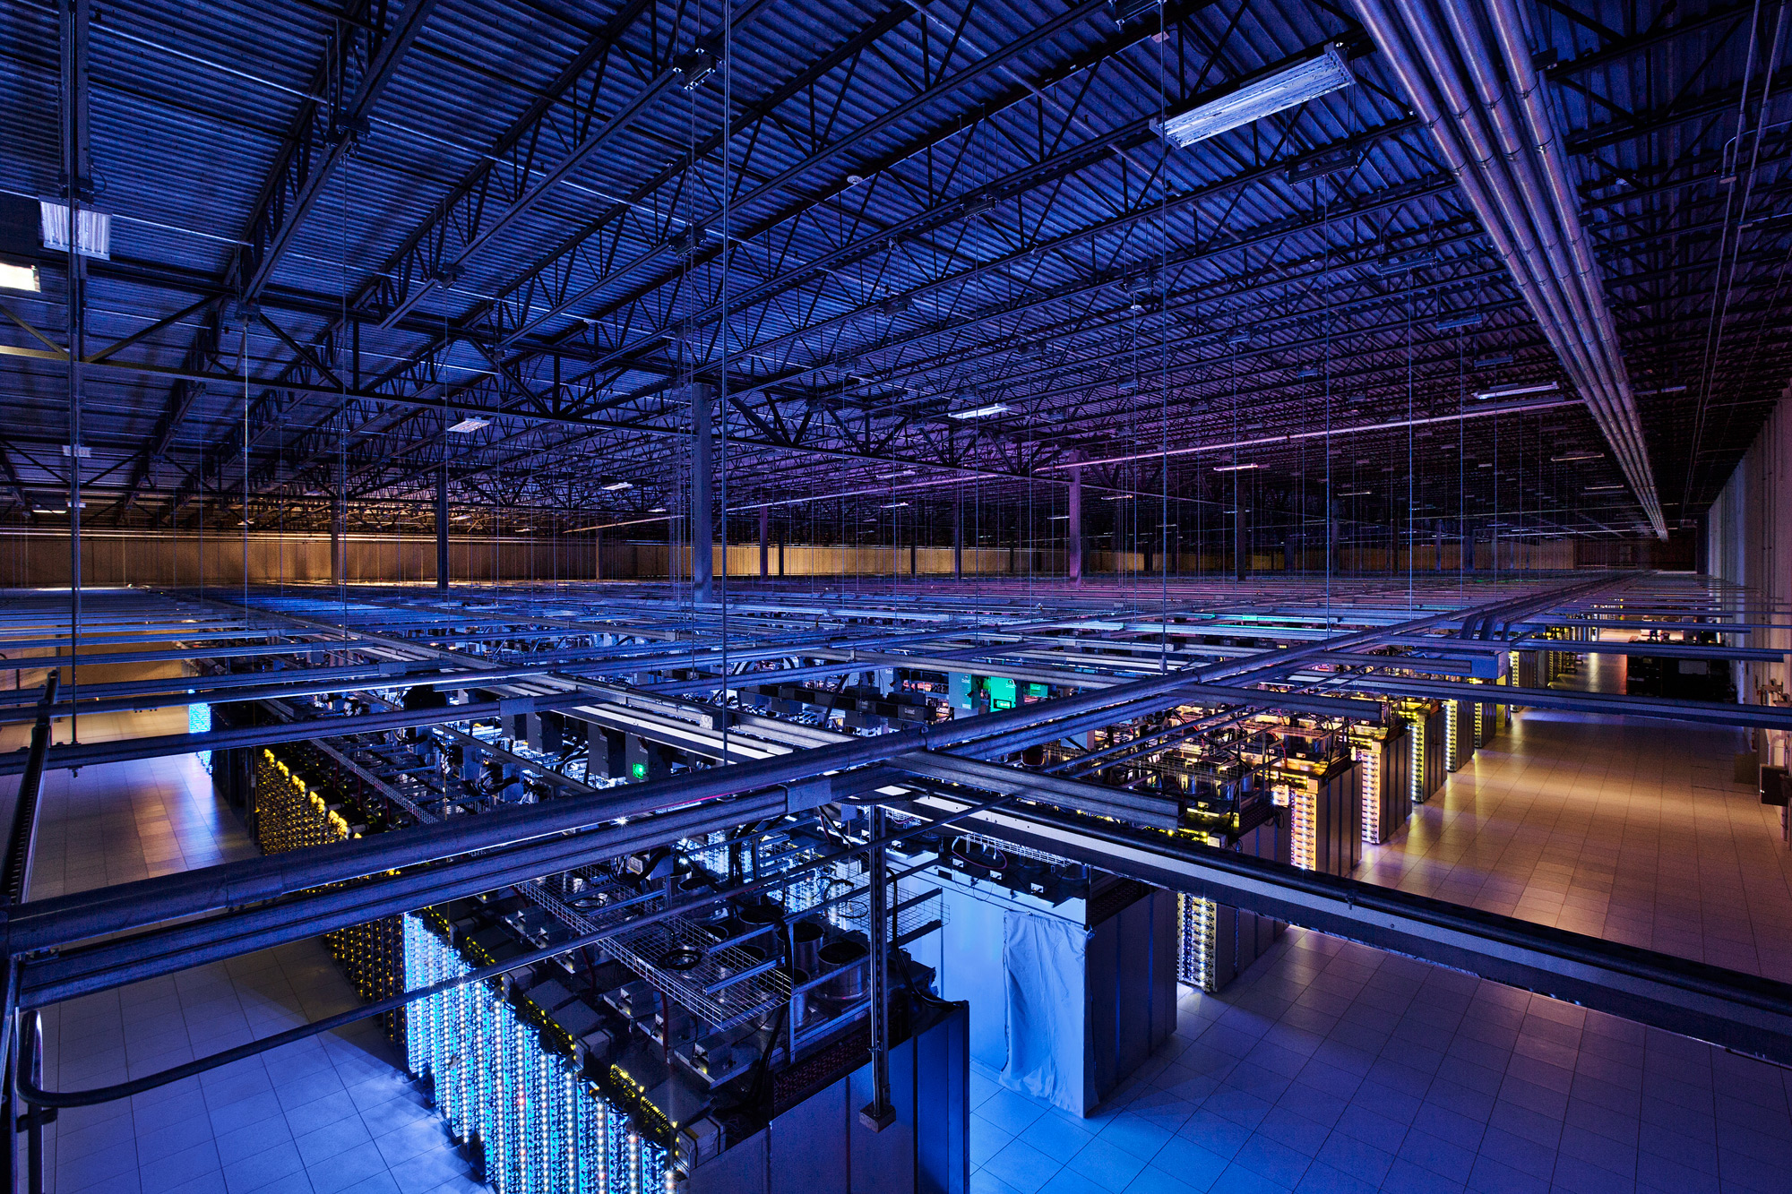
Tackling Big Data
Source: Google

Slide 34
Divide and Conquer
“Work”
Partition
w₁
w₂
w₃
worker
worker
worker
r₁
r₂
r₃
Aggregate
“Result”

Slide 35
Parallelization Challenges
How do we assign work units to workers?
What if we have more work units than workers?
What if workers need to communicate partial results?
What if workers need to access shared resources?
How do we know when a worker has finished? (Or is simply waiting?)
What if workers die?
Difficult because:
We don’t know the order in which workers run…
We don’t know when workers interrupt each other…
We don’t know when workers need to communicate partial results…
We don’t know the order in which workers access shared resources…
What’s the common theme of all of these challenges?

Slide 36
Common Theme?
Parallelization challenges arise from:
Need to communicate partial results
Need to access shared resources
(In other words, sharing state)
How do we tackle these challenges?

Slide 37
“Current” Tools
Basic primitives
Semaphores (lock, unlock)
Conditional variables (wait, notify, broadcast)
Barriers
Awareness of Common Problems
Deadlock, livelock, race conditions...
Dining philosophers, sleeping barbers, cigarette smokers...

Slide 38
“Current” Tools
Programming Models
Shared Memory
Message Passing
Memory
P₁
P₂
P₃
P₄
P₅
P₁
P₂
P₃
P₄
P₅
Design Patterns
producer
consumer
coordinator
work queue
workers
producer
consumer

Slide 39
When Theory Meets Practices
Concurrency is already difficult to reason about…
Now throw in:
The scale of clusters and (multiple) datacenters
The presence of hardware failures and software bugs
The presence of multiple interacting services
The reality:
Lots of one-off solutions, custom code
Write you own dedicated library, then program with it
Burden on the programmer to explicitly manage everything
Bottom line: it’s hard!

Slide 40
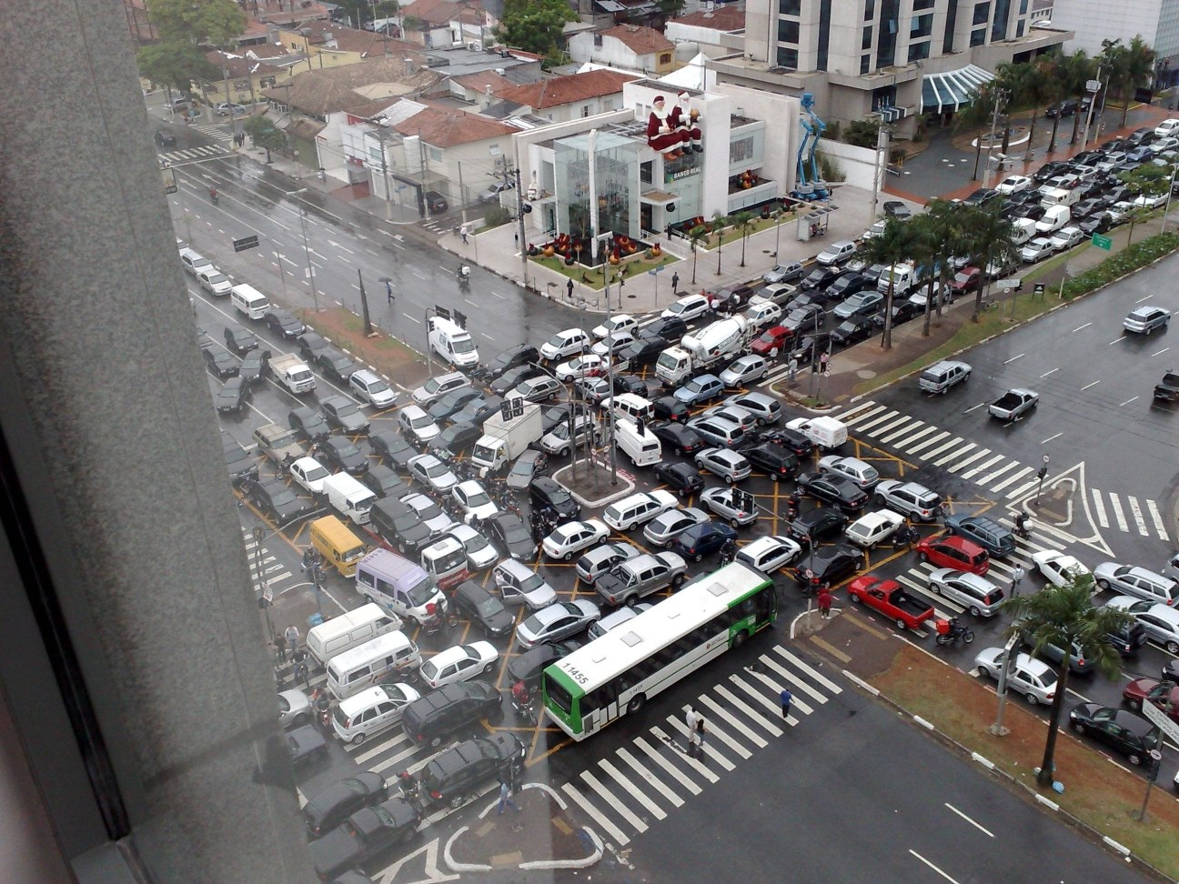
Source: Ricardo Guimarães Herrmann

Slide 41
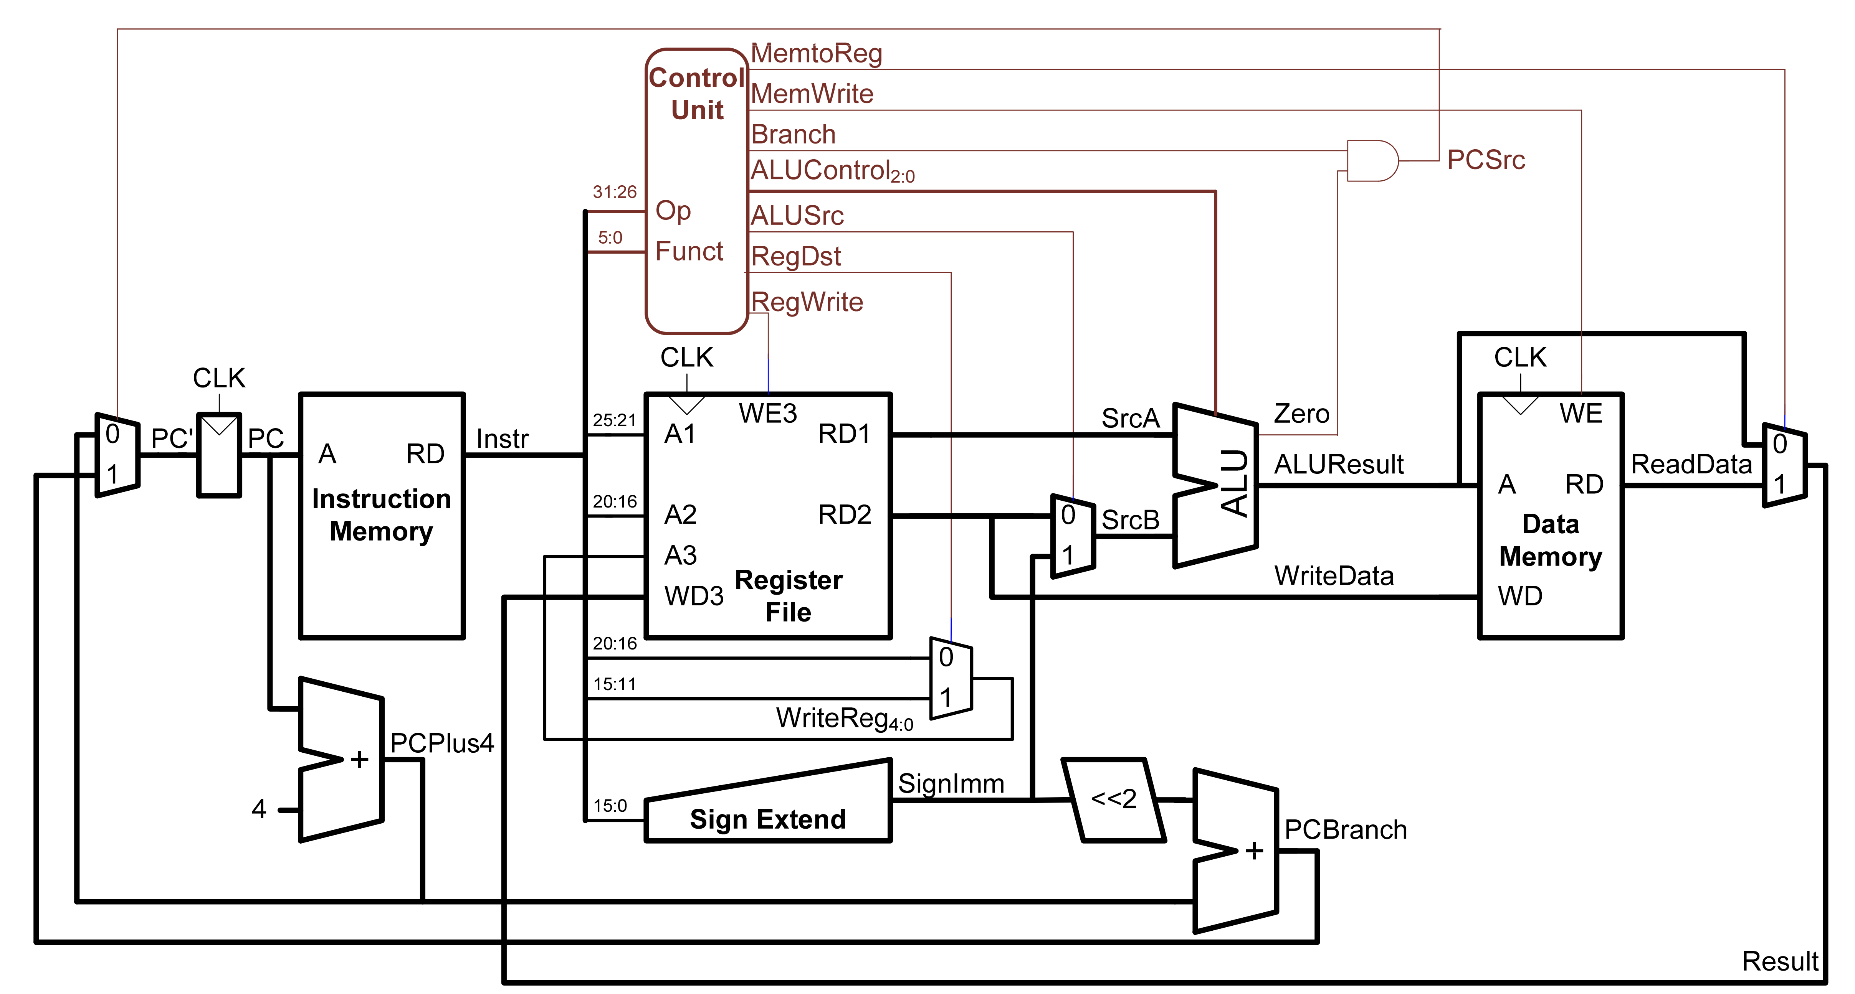
Source: CS 251
Notes:
von neumann

Slide 42
✗
Source: CS 251

Slide 43
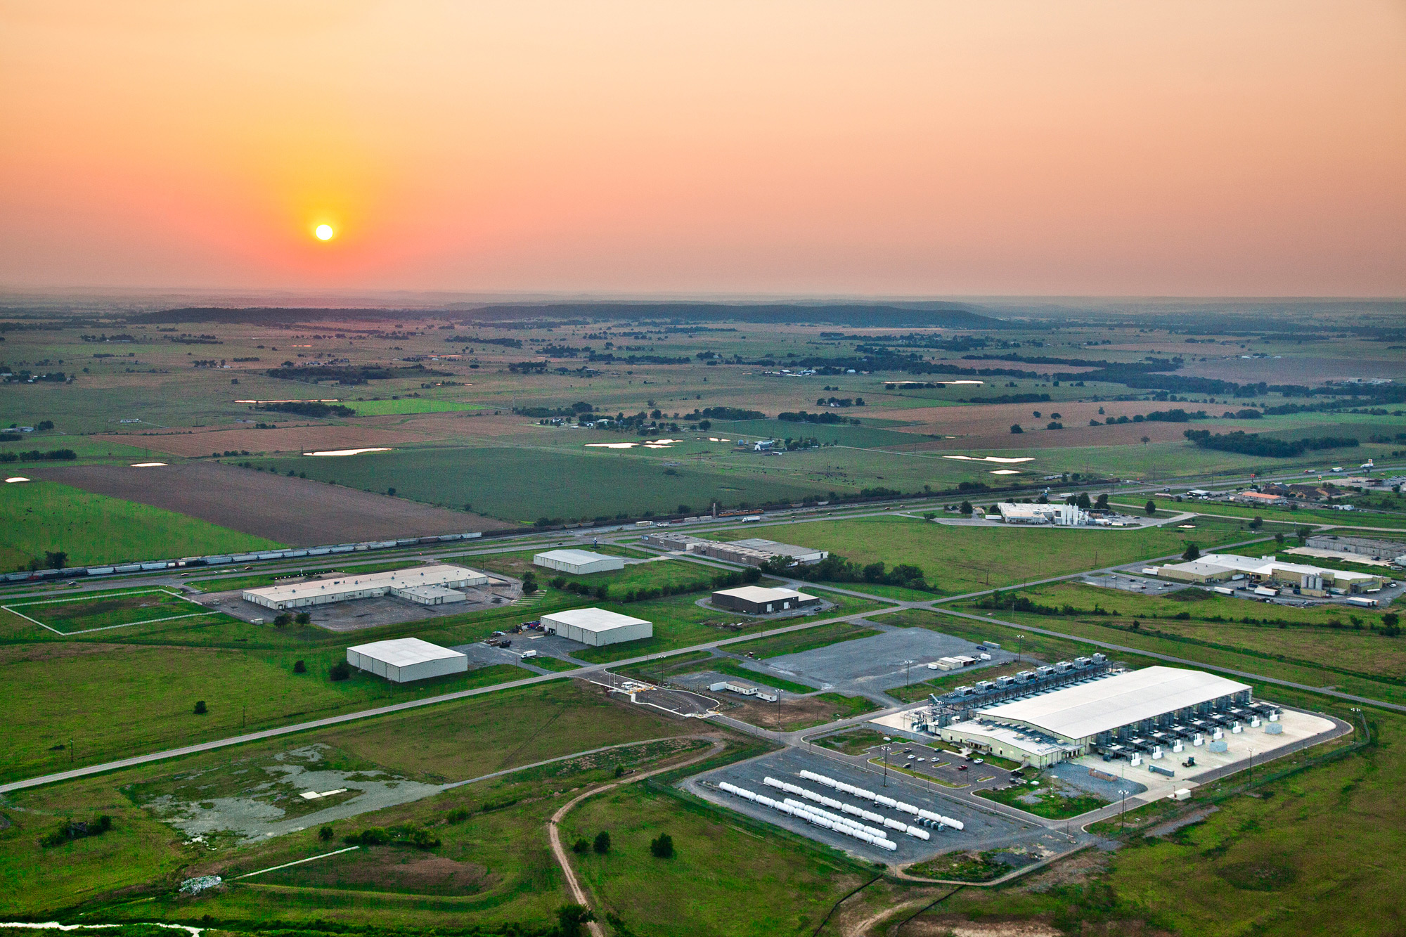
The datacenter is the computer!
Source: Google

Slide 44
The datacenter is the computer!
It’s all about the right level of abstraction
Moving beyond the von Neumann architecture
What’s the “instruction set” of the datacenter computer?
Hide system-level details from the developers
No more race conditions, lock contention, etc.
No need to explicitly worry about reliability, fault tolerance, etc.
Separating the what from the how
Developer specifies the computation that needs to be performed
Execution framework (“runtime”) handles actual execution
MapReduce is the first instantiation of this idea… but not the last!

Slide 45

Questions?
Source: Wikipedia (Japanese rock garden)

Slide 46

Course Administrivia
Source: http://www.flickr.com/photos/artmind_etcetera/6336693594/

Slide 47
✗
Four in One!
CS 451/651 431/631 all meet together
CS 451: version for CS ugrads (most students)
CS 651: version for CS grads
CS 431: version for non-CS ugrads
CS 631: version for non-CS grads

Slide 48
Two in One!
CS 451/651
CS 451: version for CS ugrads (most students)
CS 651: version for CS grads
CS 431/631
CS 431: version for non-CS ugrads
CS 631: version for non-CS grads
Course instructors
Ali Abedi: The guy talking right now
TAs: Ryan Clancy, Zheng Ma, Yuqing Xie, Wei Tu, Abdul Naik

Slide 49
Important Coordinates
Course website:
https://www.student.cs.uwaterloo.ca/~cs451/
Lots of info there, read it!
(“I didn’t see it” will not be accepted as an excuse)
Communicating with us:
Piazza for general/private questions (link on course homepage)
Bespin
http://bespin.io/

Slide 50
Course Design
This course focuses on algorithm design and “thinking at scale”
Not the “mechanics” (API, command-line invocations, et.)
You’re expected to pick up MapReduce/Spark with minimal help
Components of the final grade:
6 (CS 431/631) or 8 (CS 451/651) individual assignments
Final exam
Additional group final project (CS 631/651)

Slide 51
Expectations (CS 451)
Your background:
Pre-reqs: CS 341, CS 348, CS 350
Comfortable in Java and Scala (or be ready to pick it up quickly)
Know how to use Git
Reasonable “command-line”-fu skills
Experience in compiling, patching, and installing open source software
Good debugging skills
You are:
Genuinely interested in the topic
Be prepared to put in the time
Comfortable with rapidly-evolving software

Slide 52
MapReduce/Spark Environments (CS 451)
See “Software” page in course homepage for instructions
Single-Node Hadoop: Linux Student CS Environment
Everything is set up for you, just follow instructions
We’ll make sure everything works
Single-Node Hadoop: Local installations
Install all software components on your own machine
Requires at least 4GB RAM and plenty of disk space
Works fine on Mac and Linux, YMMV on Windows
Important: For your convenience only!
We’ll provide basic instructions, but not technical support
Distributed Hadoop: Datasci Cluster

Slide 53
Assignment Mechanics (CS 451)
We’ll be using private GitHub repos for assignments
Complete your assignments, push to GitHub
We’ll pull your repos at the deadline and grade
Note late policy (details on course homepage)
Late by up to 24 hours: 25% reduction in grade
Late 24-48 hours: 50% reduction in grade
Late by more the 48 hours: not accepted
By assumption, we’ll pull and mark at deadline:
If you want us to hold off, you must let us know!
Important: Register for (free) GitHub educational account!
https://education.github.com/discount_requests/new

Slide 54
Assignment Mechanics (CS 431)
Assignments will use Python and Jupyter
Everything you need to know is in the assignment itself
Assignments will generally be submitted using Git
Details are on the course website for the appropriate assignment

Slide 55
Assignment Mechanics (CS 431)
Note late policy (details on course homepage)
Late by up to 24 hours: 25% reduction in grade
Late 24-48 hours: 50% reduction in grade
Late by more the 48 hours: not accepted
By assumption, we’ll pull and mark at deadline:
If you want us to hold off, you must let us know!

Slide 56
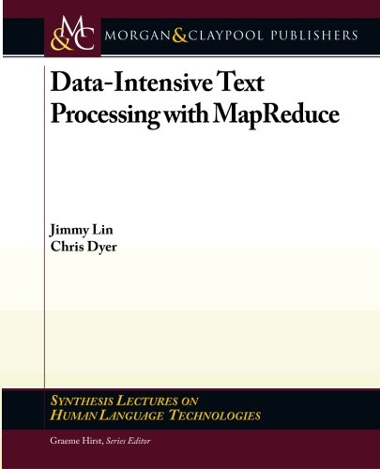

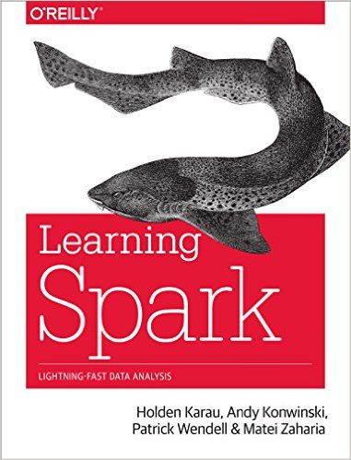

Course Materials
One (required) textbook +
Three (optional but recommended) books +
Additional readings from other sources as appropriate
(optional but recommended)
Note: 4th Edition

Slide 57
If you’re not (yet) registered:
Register for the wait list at:
By sending Ali an email at ali.abedi@uwaterloo.ca
Priority for unregistered students
CS students
Have all the pre-reqs
Final opportunity to take the course (e.g., 4B students)
Continue to attend class until final decision
Once the course is full, it is full
Note: late registration is not an excuse for late assignments

