Slide 1
Data-Intensive Distributed Computing
CS 431/631 451/651 (Fall 2019)
Part 2: From MapReduce to Spark (1/2)
September 19, 2019
Ali Abedi
These slides are available at http://roegiest.com/bigdata-2019w/
This work is licensed under a Creative Commons Attribution-Noncommercial-Share Alike 3.0 United States See http://creativecommons.org/licenses/by-nc-sa/3.0/us/ for details

Slide 2
The datacenter is the computer!
What’s the instruction set?
Source: Google

Slide 3
So you like programming in assembly?
Source: Wikipedia (ENIAC)

Slide 4
What’s the solution?
Design a higher-level language
Write a compiler

Slide 5
Hadoop is great, but it’s really waaaaay too low level!
What we really need is a scripting language!
What we really need is SQL!
Answer:
Answer:

Slide 6
SQL
Pig Scripts
Aside: Why not just use a database?
map
map
map
map
map
map
…
map
map
…
map
…
map
map
…
map
map
map
…
map
map
map
…
map
reduce
reduce
reduce
map
map
…
map
reduce
reduce
reduce
map
map
…
map
…
reduce
reduce
…
reduce
…
reduce
reduce
…
reduce
reduce
reduce
…
reduce
reduce
reduce
…
reduce
reduce
reduce
…
reduce
reduce
reduce
…
reduce
Both open-source projects today!

Slide 7
Hive
Pig
MapReduce
HDFS

Slide 8
Pig!
Source: Wikipedia (Pig)

Slide 9
Pig: Example
Task: Find the top 10 most visited pages in each category
Visits
URL Info
User | Url | Time
Amy | cnn.com | 8:00
Amy | bbc.com | 10:00
Amy | flickr.com | 10:05
Fred | cnn.com | 12:00
Url | Category | PageRank
cnn.com | News | 0.9
bbc.com | News | 0.8
flickr.com | Photos | 0.7
espn.com | Sports | 0.9
Pig Slides adapted from Olston et al. (SIGMOD 2008)

Slide 10
Pig: Example Script
visits = load ‘/data/visits’ as (user, url, time);
gVisits = group visits by url;
visitCounts = foreach gVisits generate url, count(visits);
urlInfo = load ‘/data/urlInfo’ as (url, category, pRank);
visitCounts = join visitCounts by url, urlInfo by url;
gCategories = group visitCounts by category;
topUrls = foreach gCategories generate top(visitCounts,10);
store topUrls into ‘/data/topUrls’;
Pig Slides adapted from Olston et al. (SIGMOD 2008)

Slide 11
Pig Query Plan
load visits
group by url
foreach url
generate count
load urlInfo
join on url
group by category
foreach category
generate top(urls, 10)
Pig Slides adapted from Olston et al. (SIGMOD 2008)

Slide 12
Pig: MapReduce Execution
load visits
Map₁
group by url
Reduce₁
Map₂
foreach url
generate count
load urlInfo
join on url
Reduce₂
group by category
Map₃
Reduce₃
foreach category
generate top(urls, 10)
Pig Slides adapted from Olston et al. (SIGMOD 2008)

Slide 13
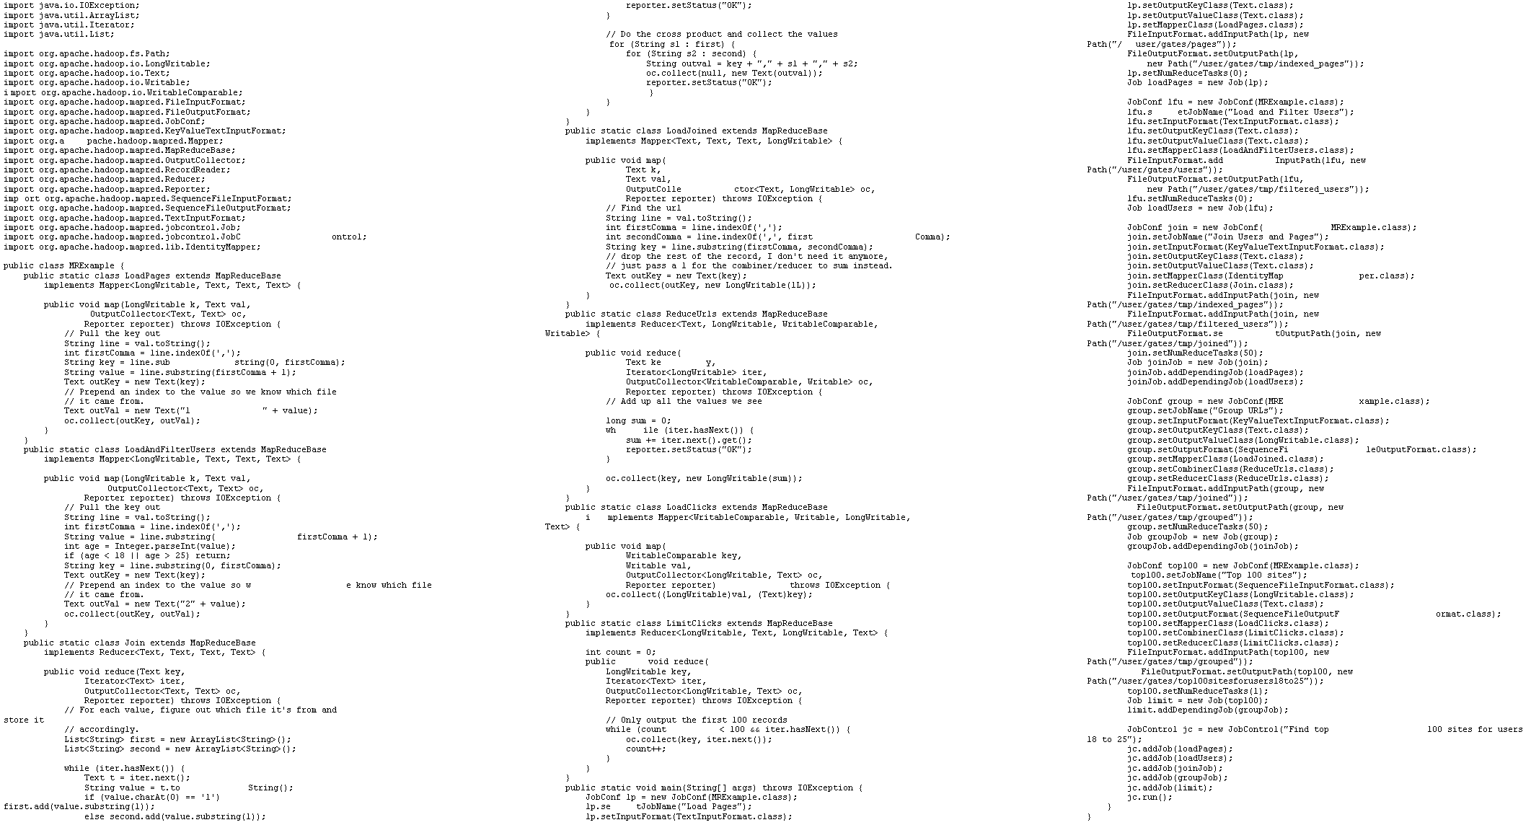
visits = load ‘/data/visits’ as (user, url, time);
gVisits = group visits by url;
visitCounts = foreach gVisits generate url, count(visits);
urlInfo = load ‘/data/urlInfo’ as (url, category, pRank);
visitCounts = join visitCounts by url, urlInfo by url;
gCategories = group visitCounts by category;
topUrls = foreach gCategories generate top(visitCounts,10);
store topUrls into ‘/data/topUrls’;
This?
Or this?

Slide 14
But isn’t Pig slower?
Sure, but c can be slower than assembly too…

Slide 15
Pig: Basics
Sequence of statements manipulating relations
Data model
atoms
tuples
bags
maps

Slide 16
Pig: Common Operations
LOAD: load data (from HDFS)
FOREACH … GENERATE: per tuple processing
“map”
FILTER: discard unwanted tuples
GROUP/COGROUP: group tuples
“reduce”
JOIN: relational join
STORE: store data (to HDFS)

Slide 17
Pig: GROUPing
A = LOAD 'myfile.txt’ AS (f1: int, f2: int, f3: int);
(1, 2, 3)
(4, 2, 1)
(8, 3, 4)
(4, 3, 3)
(7, 2, 5)
(8, 4, 3)
X = GROUP A BY f1;
(1, {(1, 2, 3)})
(4, {(4, 2, 1), (4, 3, 3)})
(7, {(7, 2, 5)})
(8, {(8, 3, 4), (8, 4, 3)})

Slide 18
Pig: COGROUPing
A:
(1, 2, 3)
(4, 2, 1)
(8, 3, 4)
(4, 3, 3)
(7, 2, 5)
(8, 4, 3)
B:
(2, 4)
(8, 9)
(1, 3)
(2, 7)
(2, 9)
(4, 6)
(4, 9)
X = COGROUP A BY $0, B BY $0;
(1, {(1, 2, 3)}, {(1, 3)})
(2, {}, {(2, 4), (2, 7), (2, 9)})
(4, {(4, 2, 1), (4, 3, 3)}, {(4, 6),(4, 9)})
(7, {(7, 2, 5)}, {})
(8, {(8, 3, 4), (8, 4, 3)}, {(8, 9)})

Slide 19
Pig: JOINing
A:
(1, 2, 3)
(4, 2, 1)
(8, 3, 4)
(4, 3, 3)
(7, 2, 5)
(8, 4, 3)
B:
(2, 4)
(8, 9)
(1, 3)
(2, 7)
(2, 9)
(4, 6)
(4, 9)
X = JOIN A BY $0, B BY $0;
(1,2,3,1,3)
(4,2,1,4,6)
(4,3,3,4,6)
(4,2,1,4,9)
(4,3,3,4,9)
(8,3,4,8,9)
(8,4,3,8,9)

Slide 20
Pig UDFs
User-defined functions:
Java
Python
JavaScript
Ruby
…
UDFs make Pig arbitrarily extensible
Express “core” computations in UDFs
Take advantage of Pig as glue code for scale-out plumbing

Slide 21
The datacenter is the computer!
What’s the instruction set?
Okay, let’s fix this!
Source: Google

Slide 22
MapReduce Workflows
HDFS
map
map
map
map
reduce
reduce
reduce
reduce
HDFS
HDFS
HDFS
HDFS
What’s wrong?

Slide 23
Want MM?
HDFS
HDFS
map
map
map
map
HDFS
HDFS
HDFS
✔
✗

Slide 24
Want MRR?
HDFS
HDFS
map
map
map
reduce
reduce
reduce
reduce
HDFS
HDFS
HDFS
✔
✗

Slide 25
The datacenter is the computer!
Let’s enrich the instruction set!
Source: Google

Slide 26
Spark
Answer to “What’s beyond MapReduce?”
Brief history:
Developed at UC Berkeley AMPLab in 2009
Open-sourced in 2010
Became top-level Apache project in February 2014

Slide 27
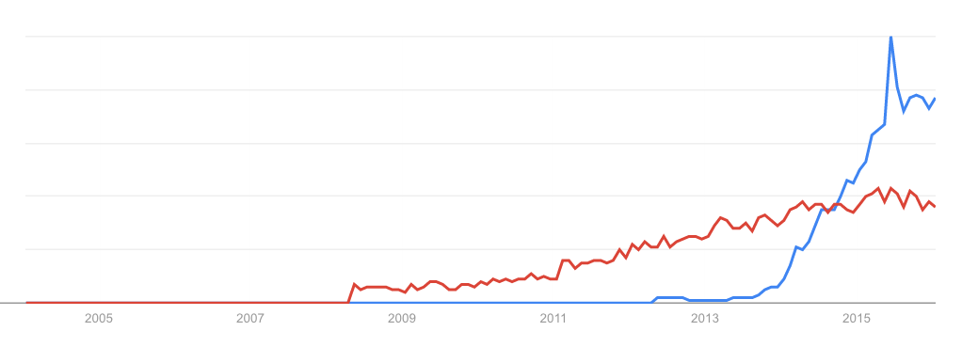
Spark vs. Hadoop
November 2014
Google Trends
Source: Datanami (2014): http://www.datanami.com/2014/11/21/spark-just-passed-hadoop-popularity-web-heres/

