Slide 1
Data-Intensive Distributed Computing
CS 431/461 451/651 (Fall 2019)
Part 2: From MapReduce to Spark (2/2)
Ali Abedi
These slides are available at http://roegiest.com/bigdata-2019w/
This work is licensed under a Creative Commons Attribution-Noncommercial-Share Alike 3.0 United States See http://creativecommons.org/licenses/by-nc-sa/3.0/us/ for details

Slide 2
YARN
Hadoop’s (original) limitations:
Can only run MapReduce
What if we want to run other distributed frameworks?
YARN = Yet-Another-Resource-Negotiator
Provides API to develop any generic distributed application
Handles scheduling and resource request
MapReduce (MR2) is one such application in YARN

Slide 3
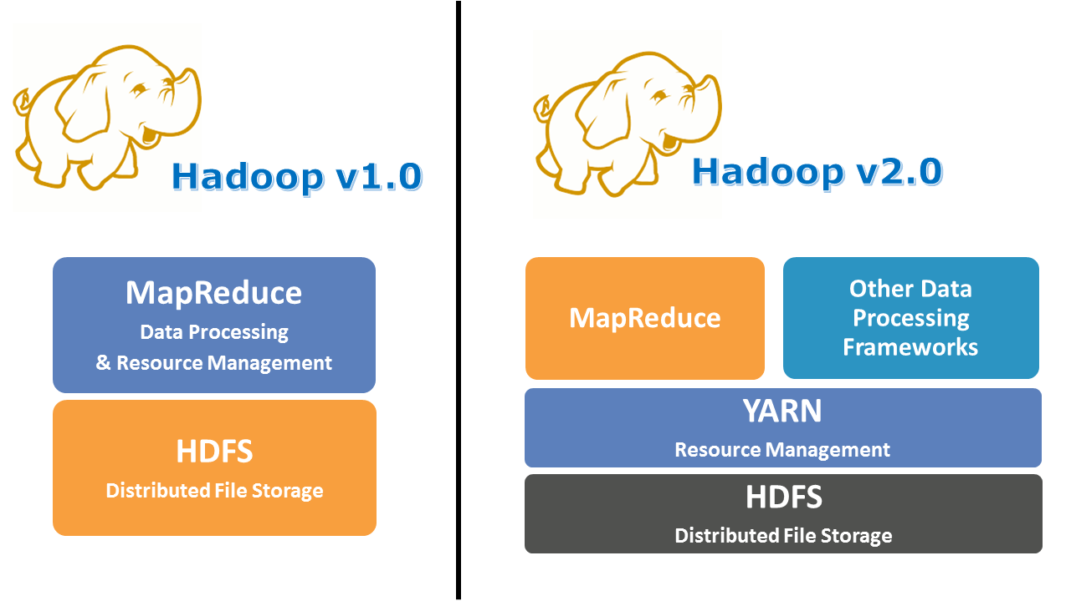

Slide 4
Hadoop MapReduce Architecture
namenode (NN)
jobtracker (JT)
namenode daemon
jobtracker daemon
tasktracker daemon
tasktracker daemon
tasktracker daemon
datanode daemon
datanode daemon
datanode daemon
Linux file system
Linux file system
Linux file system
…
…
…
worker node
worker node
worker node
Hadoop v1.0

Slide 5
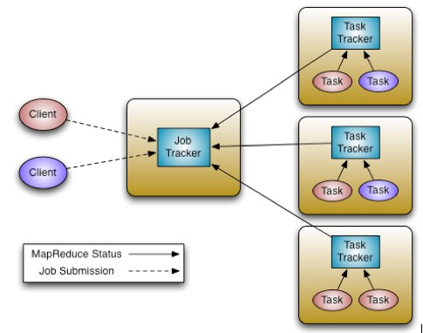
Hadoop v1.0

Slide 6
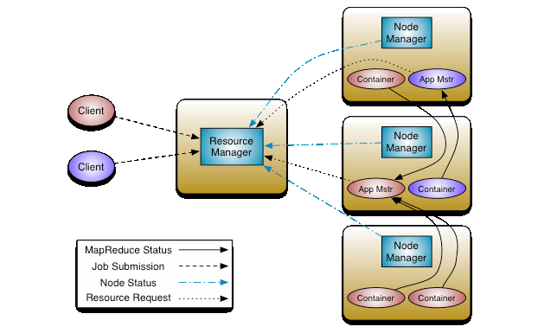
Hadoop v2.0

Slide 7
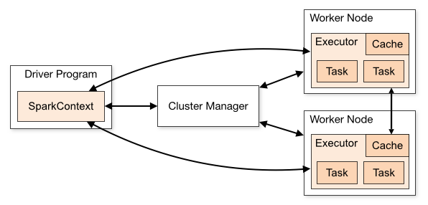
Spark Architecture

Slide 8
Algorithm Design

Slide 9
Closure
Takes type X and returns type X
3 + 4 = 7 (int + int = int)
5 / 2 = 2.5 (int + int != float)

Slide 10
Identity
“concept of nothing”
5 + 0 = 5
5 * 1 = 5
{3, 11, 9} + {} = {3, 11, 9}
Initializing a counter to zero

Slide 11
Associativity
Add parenthesis anywhere
1 + 2 + 3 = (1 + 2) + 3
10 / 2 / 5 != 10 / (2 / 5)
Huge jobs can become many small jobs

Slide 12
Commutativity
Reordering
1 + 2 + 3 = 2 + 3 + 1
10 / 2 != 2 /10

Slide 13
Monoid
Closure (int + int = int)
Identity (1 + 0 = 1)
Associativity (1 + 2 + 3 = (1 + 2) + 3)
Commutative Monoid

Slide 14
Commutative Monoid and MapReduce
( )
( )
( )
1 + 1 + 1 + 1 + 1 + 1 + 1 + 1 + 1 + 1 + 1 + 1 + 1 + 1
3
7
4
7
4
3
14

Slide 15
Two superpowers:
Associativity
Commutativity
(sorting)

Slide 16
Implications for distributed processing?
You don’t know when the tasks begin
You don’t know when the tasks end
You don’t know when the tasks interrupt each other
You don’t know when intermediate data arrive
…
It’s okay!

Slide 17
Word Count: Baseline
class Mapper {
def map(key: Long, value: String) = {
for (word <- tokenize(value)) {
emit(word, 1)
}
}
}
class Reducer {
def reduce(key: String, values: Iterable[Int]) = {
for (value <- values) {
sum += value
}
emit(key, sum)
}
}

Slide 18
Computing the Mean: Version 1
class Mapper {
def map(key: String, value: Int) = {
emit(key, value)
}
}
class Reducer {
def reduce(key: String, values: Iterable[Int]) {
for (value <- values) {
sum += value
cnt += 1
}
emit(key, sum/cnt)
}
}

Slide 19
Computing the Mean: Version 3
class Mapper {
def map(key: String, value: Int) =
emit(key, (value, 1))
}
class Combiner {
def reduce(key: String, values: Iterable[Pair]) = {
for ((s, c) <- values) {
sum += s
cnt += c
}
emit(key, (sum, cnt))
}
}
class Reducer {
def reduce(key: String, values: Iterable[Pair]) = {
for ((s, c) <- values) {
sum += s
cnt += c
}
emit(key, sum/cnt)
}
}

Slide 20
Co-occurrence Matrix: Stripes
class Mapper {
def map(key: Long, value: String) = {
for (u <- tokenize(value)) {
val map = new Map()
for (v <- neighbors(u)) {
map(v) += 1
}
emit(u, map)
}
}
}
class Reducer {
def reduce(key: String, values: Iterable[Map]) = {
val map = new Map()
for (value <- values) {
map += value
}
emit(key, map)
}
}

Slide 21
Synchronization: Pairs vs. Stripes
Approach 1: turn synchronization into an ordering problem
Sort keys into correct order of computation
Partition key space so each reducer receives appropriate set of partial results
Hold state in reducer across multiple key-value pairs to perform computation
Illustrated by the “pairs” approach
Approach 2: data structures that bring partial results together
Each reducer receives all the data it needs to complete the computation
Illustrated by the “stripes” approach
Commutative monoids!

Slide 22
Because you can’t avoid this…
…
…
But commutative monoids help

Slide 23
Synchronization: Pairs vs. Stripes
Approach 1: turn synchronization into an ordering problem
Sort keys into correct order of computation
Partition key space so each reducer receives appropriate set of partial results
Hold state in reducer across multiple key-value pairs to perform computation
Illustrated by the “pairs” approach
What about this?
Approach 2: data structures that bring partial results together
Each reducer receives all the data it needs to complete the computation
Illustrated by the “stripes” approach
Commutative monoids!

Slide 24
f(B|A): “Pairs”
(a, *) → 32
Reducer holds this value in memory
(a, b₁) → 3
(a, b₂) → 12
(a, b₃) → 7
(a, b₄) → 1
…
(a, b₁) → 3 / 32
(a, b₂) → 12 / 32
(a, b₃) → 7 / 32
(a, b₄) → 1 / 32
…
For this to work:
Emit extra (a, *) for every b_{n} in mapper
Make sure all a’s get sent to same reducer (use partitioner)
Make sure (a, *) comes first (define sort order)
Hold state in reducer across different key-value pairs

Slide 25
Two superpowers:
Associativity
Commutativity
(sorting)

Slide 26
When you can’t “monoidify”
…
…
Sequence your computations by sorting

Slide 27
Algorithm design in a nutshell…
Exploit associativity and commutativity via commutative monoids (if you can)
Exploit framework-based sorting to sequence computations (if you can’t)
Source: Wikipedia (Walnut)

