Slide 1

Data-Intensive Distributed Computing
CS 431/631 451/651 (Fall 2019)
Part 4: Analyzing Graphs (1/2)
October 3, 2019
Ali Abedi
These slides are available at https://www.student.cs.uwaterloo.ca/~cs451/
This work is licensed under a Creative Commons Attribution-Noncommercial-Share Alike 3.0 United States
See http://creativecommons.org/licenses/by-nc-sa/3.0/us/ for details

Slide 2
Structure of the Course
Analyzing Text
Analyzing Relational Data
Analyzing Graphs
Data Mining
“Core” framework features
and algorithm design

Slide 3
What’s a graph?
G = (V,E), where
V represents the set of vertices (nodes)
E represents the set of edges (links)
Edges may be directed or undirected
Both vertices and edges may contain additional information
outlinks
outgoing (outbound) edges
edges (links)
out-degree
vertex (node)
edges (links)
in-degree
incoming (inbound) edges
inlinks

Slide 4
Examples of Graphs
Hyperlink structure of the web
Physical structure of computers on the Internet
Interstate highway system
Social networks
We’re mostly interested in sparse graphs!

Slide 5
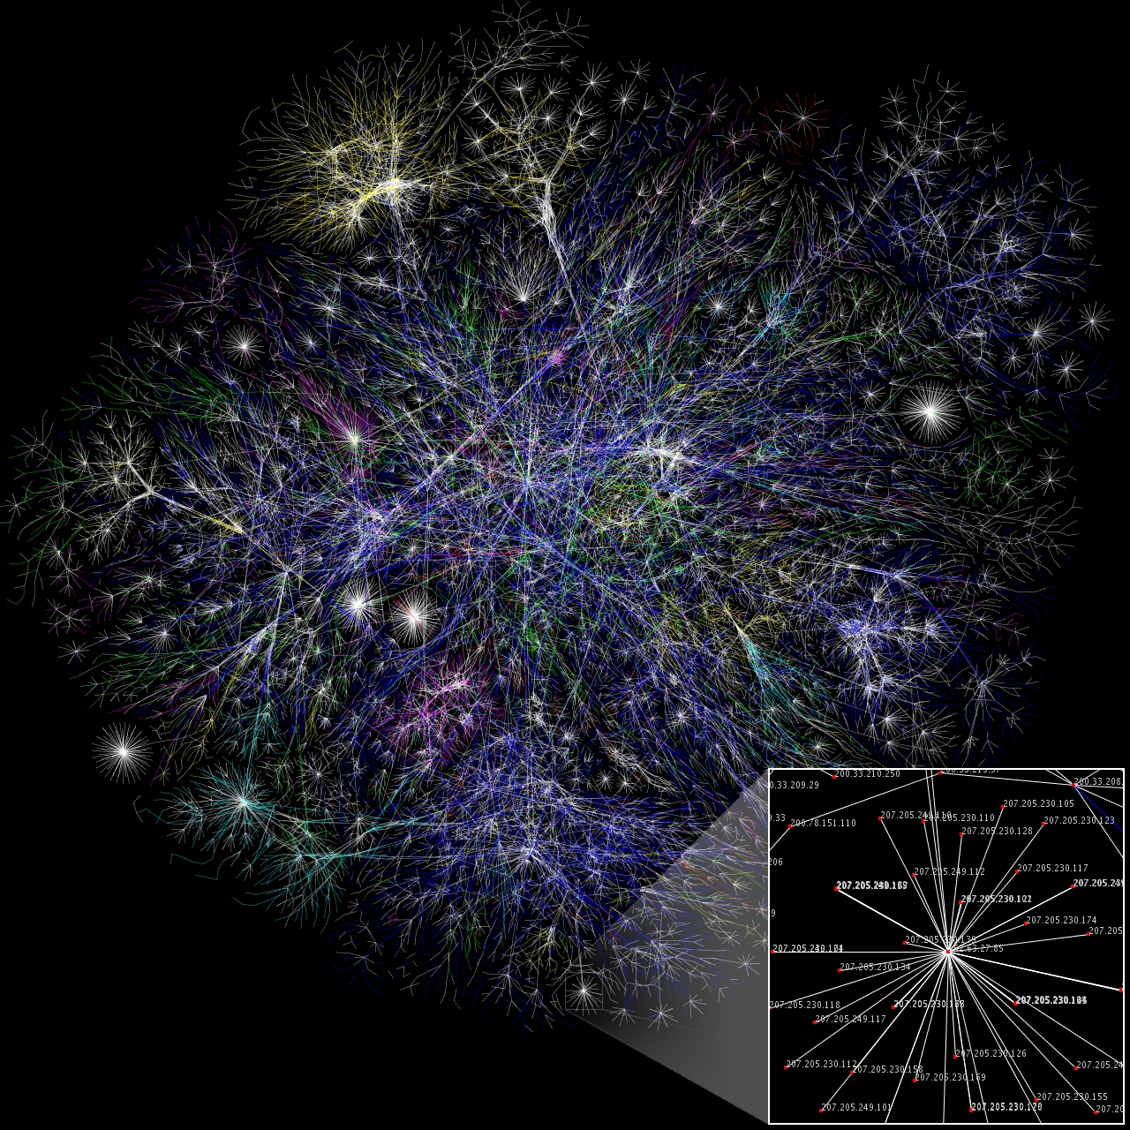
Partial map of the Internet based on the
January 15, 2005 data found on opte.org

Slide 6
Representing Graphs
Adjacency matrices
Adjacency lists
Edge lists

Slide 7
Adjacency Matrices
Represent a graph as an n x n square matrix M
n = |V|
M_{ij} = 1 iff an edge from vertex i to j
2
 | 1 | 2 | 3 | 4
1 | 0 | 1 | 0 | 1
2 | 1 | 0 | 1 | 1
3 | 1 | 0 | 0 | 0
4 | 1 | 0 | 1 | 0
1
3
4

Slide 8
Adjacency Matrices: Critique
Advantages
Amenable to mathematical manipulation
Intuitive iteration over rows and columns
Disadvantages
Lots of wasted space (for sparse matrices)

Slide 9
Adjacency Lists
Take adjacency matrix… and throw away all the zeros
2
1
 | 1 | 2 | 3 | 4
1 | 0 | 1 | 0 | 1
2 | 1 | 0 | 1 | 1
3 | 1 | 0 | 0 | 0
4 | 1 | 0 | 1 | 0
3
1: 2, 4
2: 1, 3, 4
3: 1
4: 1, 3
4
Wait, where have we
seen this before?

Slide 10
Adjacency Lists: Critique
Advantages
Much more compact representation (compress!)
Easy to compute over outlinks
Disadvantages
Difficult to compute over inlinks

Slide 11
Edge Lists
Explicitly enumerate all edges
(1, 2)
(1, 4)
(2, 1)
(2, 3)
(2, 4)
(3, 1)
(4, 1)
(4, 3)
 | 1 | 2 | 3 | 4
1 | 0 | 1 | 0 | 1
2 | 1 | 0 | 1 | 1
3 | 1 | 0 | 0 | 0
4 | 1 | 0 | 1 | 0

Slide 12
Edge Lists: Critique
Advantages
Easily support edge insertions
Disadvantages
Wastes spaces

Slide 13
Some Graph Problems
Finding shortest paths
Routing Internet traffic and UPS trucks
Finding minimum spanning trees
Telco laying down fiber
Finding max flow
Airline scheduling
Identify “special” nodes and communities
Halting the spread of avian flu
Bipartite matching
match.com
Web ranking
PageRank

Slide 14
What does the web look like?
Analysis of a large webgraph from the common crawl: 3.5 billion pages, 129 billion links
Meusel et al. Graph Structure in the Web — Revisited. WWW 2014.

Slide 15
Broder’s Bowtie (2000) – revisited
Notes:
2000- core 50M
largest strongly connected component (LSCC).

Slide 16
What does the web look like?
Very roughly, a scale-free network
Fraction of k nodes having k connections:
(i.e., degree distribution follows a power law)

Slide 19
How do we extract the webgraph?
The webgraph… is big?!
webgraph from the common crawl: 3.5 billion pages, 129 billion links
58 GB!
Meusel et al. Graph Structure in the Web — Revisited. WWW 2014.

Slide 20
Graphs and MapReduce (and Spark)
A large class of graph algorithms involve:
Local computations at each node
Propagating results: “traversing” the graph
Key questions:
How do you represent graph data in MapReduce (and Spark)?
How do you traverse a graph in MapReduce (and Spark)?

Slide 21
Single-Source Shortest Path
Problem: find shortest path from a
source node to one or more target nodes
Shortest might also mean lowest weight or cost
First, a refresher: Dijkstra’s Algorithm…

Slide 22
Dijkstra’s Algorithm Example
∞
1
∞
10
0
2
3
9
4
6
5
7
∞
∞
2
Example from CLR

Slide 23
Dijkstra’s Algorithm Example
10
1
∞
10
0
2
3
9
4
6
5
7
5
∞
2
Example from CLR

Slide 24
Dijkstra’s Algorithm Example
8
1
14
10
0
2
3
9
4
6
5
7
5
7
2
Example from CLR

Slide 25
Dijkstra’s Algorithm Example
8
1
13
10
0
2
3
9
4
6
5
7
5
7
2
Example from CLR

Slide 26
Dijkstra’s Algorithm Example
8
1
9
1
10
0
2
3
9
4
6
5
7
5
7
2
Example from CLR

Slide 27
Dijkstra’s Algorithm Example
8
1
9
10
0
2
3
9
4
6
5
7
5
7
2
Example from CLR

Slide 28
Single-Source Shortest Path
Problem: find shortest path from a
source node to one or more target nodes
Shortest might also mean lowest weight or cost
Single processor machine: Dijkstra’s Algorithm
MapReduce: parallel breadth-first search (BFS)

Slide 29
Finding the Shortest Path
Consider simple case of equal edge weights
Solution to the problem can be defined inductively:
  Define: b is reachable from a if b is on adjacency list of a
  DistanceTo(s) = 0
  For all nodes p reachable from s,
  DistanceTo(p) = 1
  For all nodes n reachable from some other set of nodes M,
  DistanceTo(n) = 1 + min(DistanceTo(m), m ∈ M)
d₁
m₁
…
d₂
s
…
n
m₂
…
d₃
m₃

Slide 30

Source: Wikipedia (Wave)

Slide 31
Visualizing Parallel BFS
n₇
n₀
n₁
n₃
n₂
n₆
n₅
n₄
n₈
n₉

Slide 32
From Intuition to Algorithm
Data representation:
Key: node n
Value: d (distance from start), adjacency list
Initialization: for all nodes except for start node, d = ∞
Mapper:
  ∀m ∈ adjacency list: emit (m, d + 1)
Sort/Shuffle:
  Groups distances by reachable nodes
Reducer:
  Selects minimum distance path for each reachable node
  Additional bookkeeping needed to keep track of actual path

Slide 33
Multiple Iterations Needed
Each MapReduce iteration advances the “frontier” by one hop
Subsequent iterations include more reachable nodes as frontier expands
Multiple iterations are needed to explore entire graph
Preserving graph structure:
Problem: Where did the adjacency list go?
Solution: mapper emits (n, adjacency list) as well
Ugh! This is ugly!

Slide 34
BFS Pseudo-Code
class Mapper {
def map(id: Long, n: Node) = {
emit(id, n) // emit graph structure
val d = n.distance
for (m <- n.adjacencyList) {
emit(m, d+1)
}
}
class Reducer {
def reduce(id: Long, objects: Iterable[Object]) = {
var min = infinity
var m = null
for (d <- objects) {
if (isNode(d)) m <- d
else if d < min min = d
}
m.distance = min
emit(id, m)
}
}

Slide 35
Stopping Criterion
(equal edge weight)
How many iterations are needed in parallel BFS?
Convince yourself: when a node is first “discovered”,
we’ve found the shortest path
What does it have to do with
six degrees of separation?
Practicalities of MapReduce implementation…

Slide 36
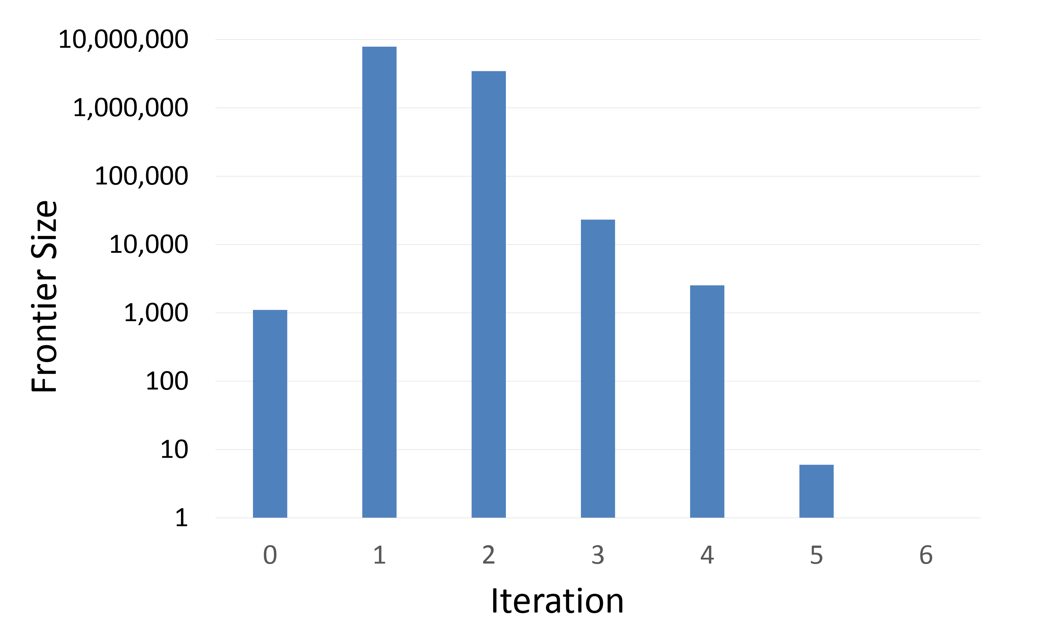
Frontier size during BFS traversal

Slide 37
Implementation Practicalities
HDFS
map
reduce
Convergence?
HDFS

Slide 38
Comparison to Dijkstra
Dijkstra’s algorithm is more efficient
At each step, only pursues edges from minimum-cost path inside frontier
MapReduce explores all paths in parallel
  Lots of “waste”
  Useful work is only done at the “frontier”
Why can’t we do better using MapReduce?

Slide 39
Single Source: Weighted Edges
Now add positive weights to the edges
Simple change: add weight w for each edge in adjacency list
Simple change: add weight w for each edge in adjacency list
  In mapper, emit (m, d + w_{p}) instead of (m, d + 1) for each node m
That’s it?

Slide 40
Stopping Criterion
(positive edge weight)
How many iterations are needed in parallel BFS?
Convince yourself: when a node is first “discovered”,
we’ve found the shortest path
Not true!

Slide 41
Additional Complexities
search frontier
1
n₆
1
n₇
1
n₈
r
10
1
n₅
n₉
n₁
s
1
1
p
q
n₄
1
n₂
1
n₃

