Slide 1

Data-Intensive Distributed Computing
CS 431/631 451/651 (Fall 2019)
Part 4: Analyzing Graphs (2/2)
October 8, 2019
Ali Abedi
Thanks to Jure Leskovec, Anand Rajaraman, Jeff Ullman (Stanford University)
These slides are available at https://www.student.cs.uwaterloo.ca/~cs451/

Slide 2
Structure of the Course
Analyzing Text
Analyzing Relational Data
Analyzing Graphs
Data Mining
“Core” framework features
and algorithm design

Slide 3
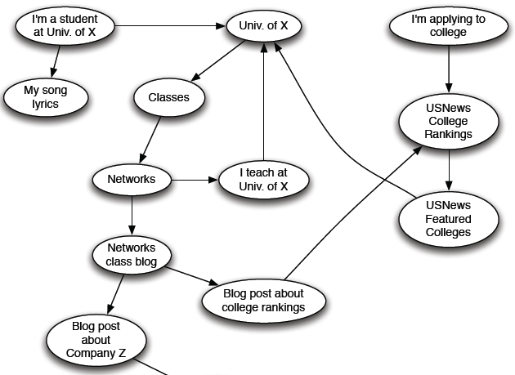
Web as a Directed Graph

Slide 4

Broad Question
How to organize the Web?
First try: Human curated
Web directories
  Yahoo, DMOZ, LookSmart
Second try: Web Search
  Information Retrieval investigates:
  Find relevant docs in a small
  and trusted set
    Newspaper articles, Patents, etc.
  But: Web is huge, full of untrusted documents, random things, web spam, etc.

Slide 5
Web Search: 2 Challenges
2 challenges of web search:
(1) Web contains many sources of information
Who to “trust”?
  Trick: Trustworthy pages may point to each other!
(2) What is the “best” answer to query “newspaper”?
  No single right answer
  Trick: Pages that actually know about newspapers might all be pointing to many newspapers

Slide 6
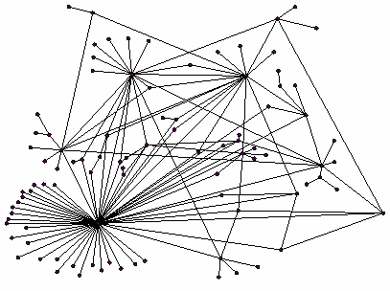
Ranking Nodes on the Graph
All web pages are not equally “important”
  www.joe-schmoe.com vs. www.stanford.edu
There is large diversity
in the web-graph
node connectivity.
Let’s rank the pages by
the link structure!

Slide 7
PageRank:
The “Flow” Formulation

Slide 8
Links as Votes
Idea: Links as votes
  Page is more important if it has more links
    In-coming links? Out-going links?
Think of in-links as votes:
  www.stanford.edu has 23,400 in-links
  www.joe-schmoe.com has 1 in-link
Are all in-links are equal?
  Links from important pages count more
  Recursive question!

Slide 9
Example: PageRank Scores
B
38.4
C
34.3
A
3.3
D
3.9
E
8.1
F
3.9
1.6
1.6
1.6
1.6
1.6

Slide 10
Simple Recursive Formulation
Each link’s vote is proportional to the importance of its source page
If page j with importance r_{j} has n out-links, each link gets r_{j} / n votes
Page j’s own importance is the sum of the votes on its in-links
i
k
r_{i}/3
r_{k}/4
j
r_{j}/3
r_{j} = r_{i}/3+r_{k}/4
r_{j}/3
r_{j}/3

Slide 11

PageRank: The “Flow” Model
A “vote” from an important page is worth more
A page is important if it is pointed to by other important pages
Define a “rank” r_{j} for page j
y/2
y
a/2
y/2
m
a
m
a/2
“Flow” equations:
  r_{y} = r_{y} /2 + r_{a} /2
  r_{a} = r_{y} /2 + r_{m}
  r_{m} = r_{a} /2
$d_{i}$ … out-degree of node $i$

Slide 12
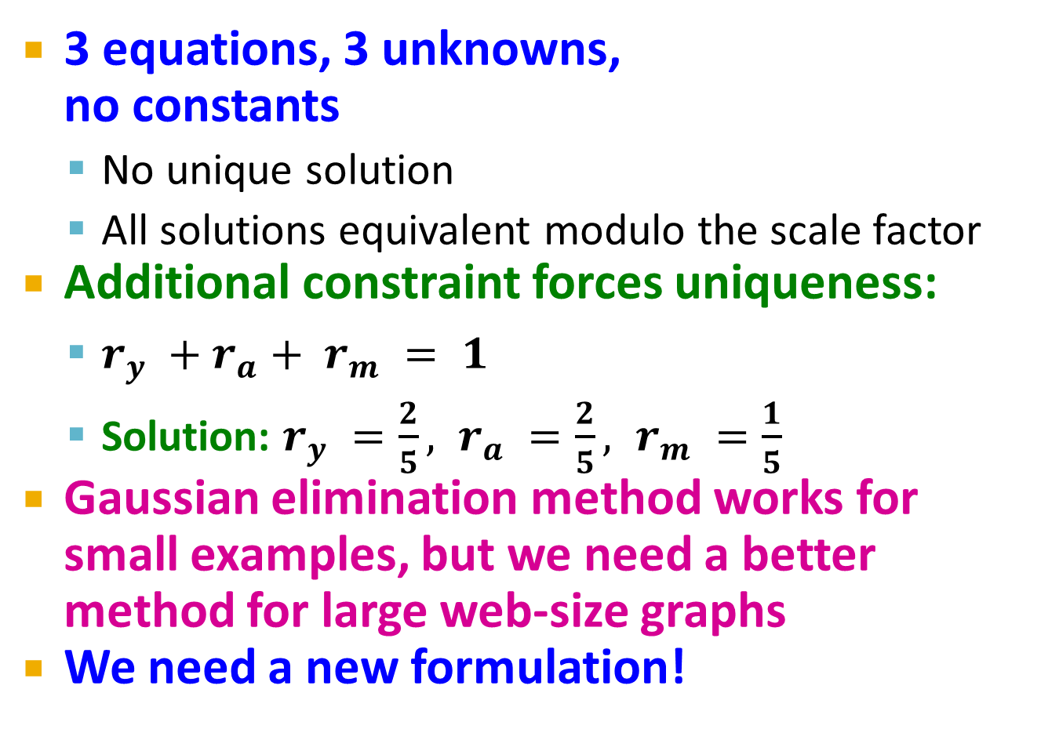
Solving the Flow Equations
Flow equations:
3 equations, 3 unknowns,
no constants
  No unique solution
  All solutions equivalent modulo the scale factor
Additional constraint forces uniqueness:
  $r_{y} +r_{a}+ r_{m} = 1$
  Solution: $r_{y} =\frac{2}{5}, r_{a} =\frac{2}{5}, r_{m} =\frac{1}{5}$
Gaussian elimination method works for
small examples, but we need a better method for large web-size graphs
We need a new formulation!
  r_{y} = r_{y} /2 + r_{a} /2
  r_{a} = r_{y} /2 + r_{m}
  r_{m} = r_{a} /2

Slide 13

PageRank: Matrix Formulation
Stochastic adjacency matrix $M$
  Let page $i$ has $di$ out-links
  If $i →j$, then $Mji =\frac{1}{di}$ else $Mji = 0$
    $M$ is a column stochastic matrix
      Columns sum to 1
y/2
y
 | y | a | m
y | ½ | ½ | 0
a | ½ | 0 | 1
m | 0 | ½ | 0
a/2
y/2
m
a
m
a/2

Slide 14
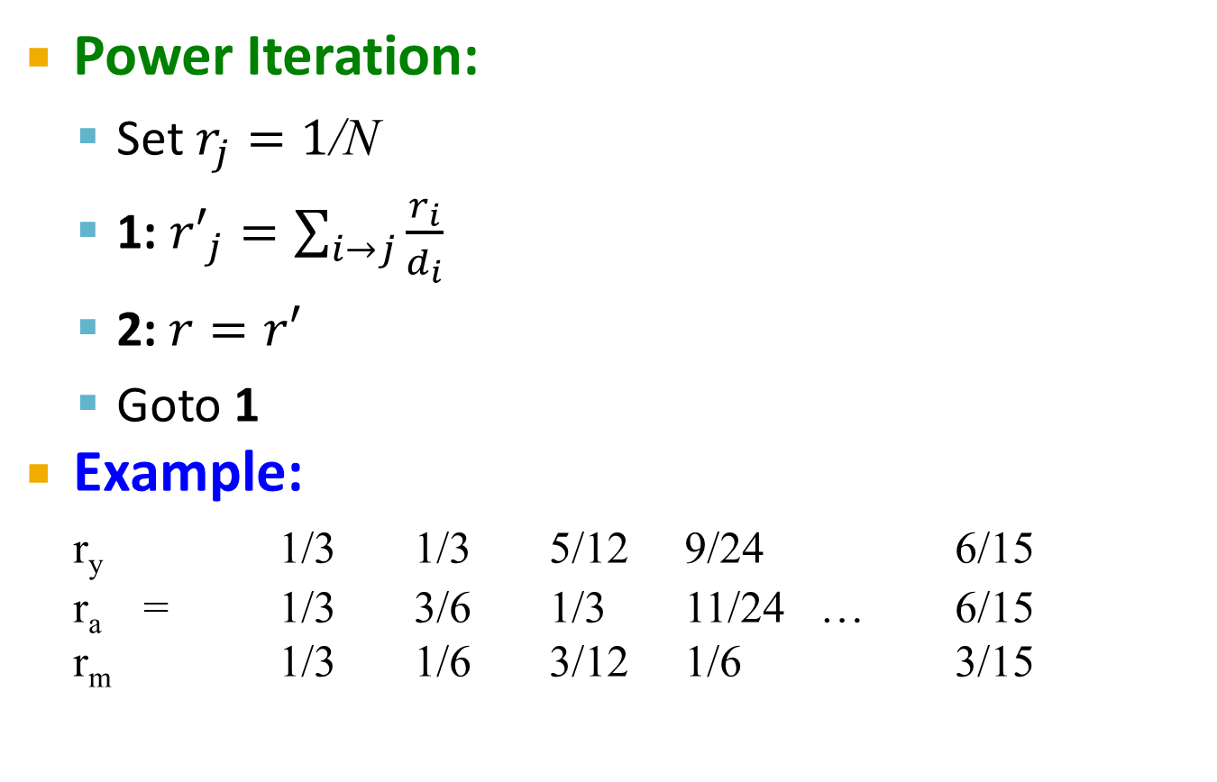
PageRank: How to solve?
Power Iteration:
  Set $r_{j}=1$/N
  1: ${r′}_{j}=\sum_{i→j}{\frac{r_{i}}{d_{i}}}$
  2:$r=r′$
  Goto 1
Example:
r_{y} 1/3 1/3 5/12 9/24 6/15
r_{a} = 1/3 3/6 1/3 11/24 … 6/15
r_{m} 1/3 1/6 3/12 1/6 3/15
y
 | y | a | m
y | ½ | ½ | 0
a | ½ | 0 | 1
m | 0 | ½ | 0
a
m
  r_{y} = r_{y} /2 + r_{a} /2
  r_{a} = r_{y} /2 + r_{m}
  r_{m} = r_{a} /2
Iteration 0, 1, 2, …

Slide 15
PageRank: How to solve?
Power Iteration:
  Set $r_{j}=1$/N
  1: ${r′}_{j}=\sum_{i→j}{\frac{r_{i}}{d_{i}}}$
  2:$r=r′$
  Goto 1
Example:
r_{y} 1/3 1/3 5/12 9/24 6/15
r_{a} = 1/3 3/6 1/3 11/24 … 6/15
r_{m} 1/3 1/6 3/12 1/6 3/15
y
 | y | a | m
y | ½ | ½ | 0
a | ½ | 0 | 1
m | 0 | ½ | 0
a
m
  r_{y} = r_{y} /2 + r_{a} /2
  r_{a} = r_{y} /2 + r_{m}
  r_{m} = r_{a} /2
Iteration 0, 1, 2, …

Slide 16
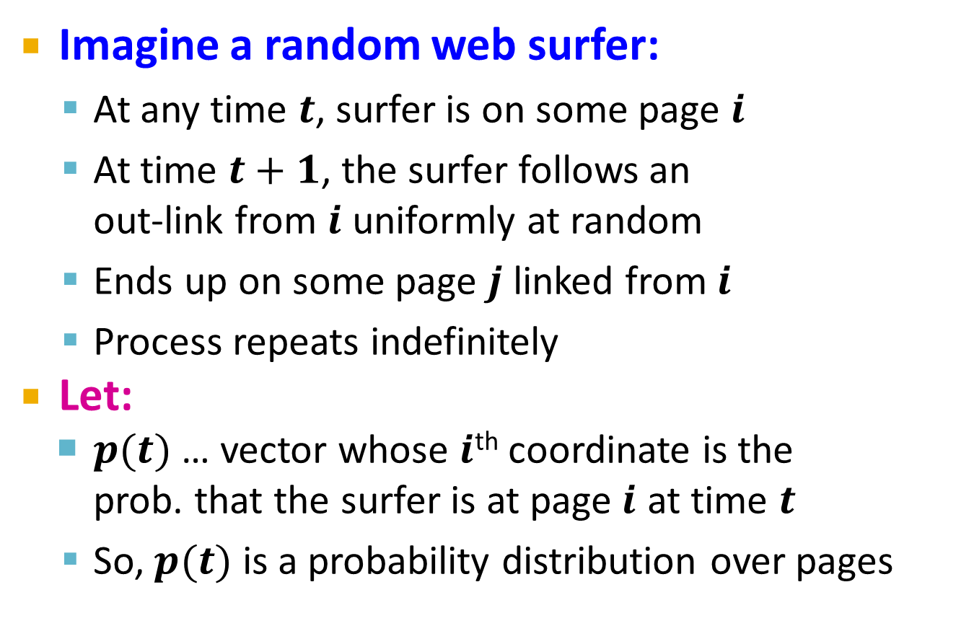
Random Walk Interpretation
Imagine a random web surfer:
  At any time $t$, surfer is on some page $i$
  At time $t+1$, the surfer follows an
  out-link from $i$ uniformly at random
  Ends up on some page $j$ linked from $i$
  Process repeats indefinitely
Let:
  $p(t)$ … vector whose $i$^{th} coordinate is the
  prob. that the surfer is at page $i$ at time $t$
  So, $p(t)$ is a probability distribution over pages
i₁
i₂
i₃
j

Slide 17
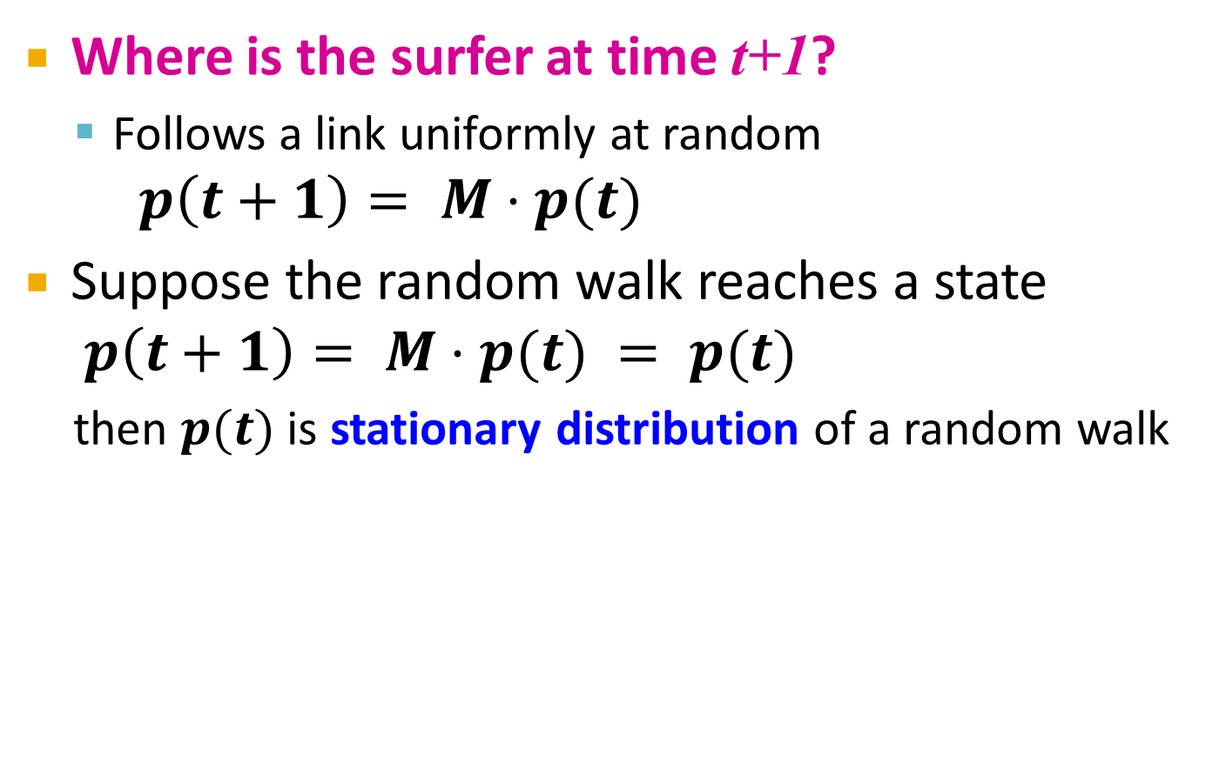
The Stationary Distribution
i₁
i₂
i₃
Where is the surfer at time t+1?
  Follows a link uniformly at random
$p\left(t+1\right)= M⋅p(t)$
Suppose the random walk reaches a state $p\left(t+1\right)= M⋅p(t) = p(t)$
  then $p(t)$ is stationary distribution of a random walk
j

Slide 18
Existence and Uniqueness
A central result from the theory of random walks (a.k.a. Markov processes):
For graphs that satisfy certain conditions,
the stationary distribution is unique and eventually will be reached no matter what the initial probability distribution at time t = 0

Slide 19
PageRank:
The Google Formulation

Slide 20
PageRank: Three Questions
Does this converge?
Does it converge to what we want?
Are results reasonable?

Slide 21
Does this converge?
Example:
r_{a} 1 0 1 0
r_{b} 0 1 0 1
a
b
=
Iteration 0, 1, 2, …

Slide 22
Does it converge to what we want?
Example:
r_{a} 1 0 0 0
r_{b} 0 1 0 0
a
b
=
Iteration 0, 1, 2, …

Slide 23
PageRank: Problems
Dead end
2 problems:
(1) Some pages are
dead ends (have no out-links)
  Random walk has “nowhere” to go to
  Such pages cause importance to “leak out”
(2) Spider traps:
(all out-links are within the group)
  Random walked gets “stuck” in a trap
  And eventually spider traps absorb all importance
Spider trap

Slide 24

Problem: Spider Traps
Power Iteration:
  Set $r_{j}=1$
  $r_{j}=\sum_{i→j}{\frac{r_{i}}{d_{i}}}$
    And iterate
Example:
r_{y} 1/3 2/6 3/12 5/24 0
r_{a} = 1/3 1/6 2/12 3/24 … 0
r_{m} 1/3 3/6 7/12 16/24 1
y
 | y | a | m
y | ½ | ½ | 0
a | ½ | 0 | 0
m | 0 | ½ | 1
a
m
m is a spider trap
  r_{y} = r_{y} /2 + r_{a} /2
  r_{a} = r_{y} /2
  r_{m} = r_{a} /2 + r_{m}
Iteration 0, 1, 2, …
All the PageRank score gets “trapped” in node m.

Slide 25
Solution: Teleports!
The Google solution for spider traps: At each time step, the random surfer has two options
  With prob. β, follow a link at random
  With prob. 1-β, jump to some random page
  Common values for β are in the range 0.8 to 0.9
Surfer will teleport out of spider trap
within a few time steps
y
y
a
m
a
m

Slide 26

Problem: Dead Ends
Power Iteration:
  Set $r_{j}=1$
  $r_{j}=\sum_{i→j}{\frac{r_{i}}{d_{i}}}$
    And iterate
Example:
r_{y} 1/3 2/6 3/12 5/24 0
r_{a} = 1/3 1/6 2/12 3/24 … 0
r_{m} 1/3 1/6 1/12 2/24 0
y
 | y | a | m
y | ½ | ½ | 0
a | ½ | 0 | 0
m | 0 | ½ | 0
a
m
  r_{y} = r_{y} /2 + r_{a} /2
  r_{a} = r_{y} /2
  r_{m} = r_{a} /2
Iteration 0, 1, 2, …
Here the PageRank “leaks” out since the matrix is not stochastic.

Slide 27
Solution: Always Teleport!
Teleports: Follow random teleport links with probability 1.0 from dead-ends
  Adjust matrix accordingly
y
y
a
m
a
m
 | y | a | m
y | ½ | ½ | 0
a | ½ | 0 | 0
m | 0 | ½ | 0
 | y | a | m
y | ½ | ½ | ⅓
a | ½ | 0 | ⅓
m | 0 | ½ | ⅓

Slide 28
Why Teleports Solve the Problem?
Why are dead-ends and spider traps a problem
and why do teleports solve the problem?
Spider-traps are not a problem, but with traps PageRank scores are not what we want
  Solution: Never get stuck in a spider trap by
  teleporting out of it in a finite number of steps
Dead-ends are a problem
  The matrix is not column stochastic, so our initial assumptions are not met
  Solution: Make matrix column stochastic by always teleporting when there is nowhere else to go

Slide 29
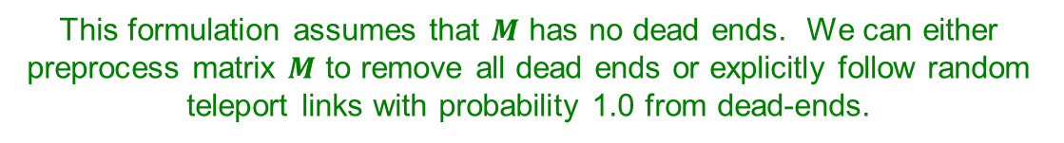
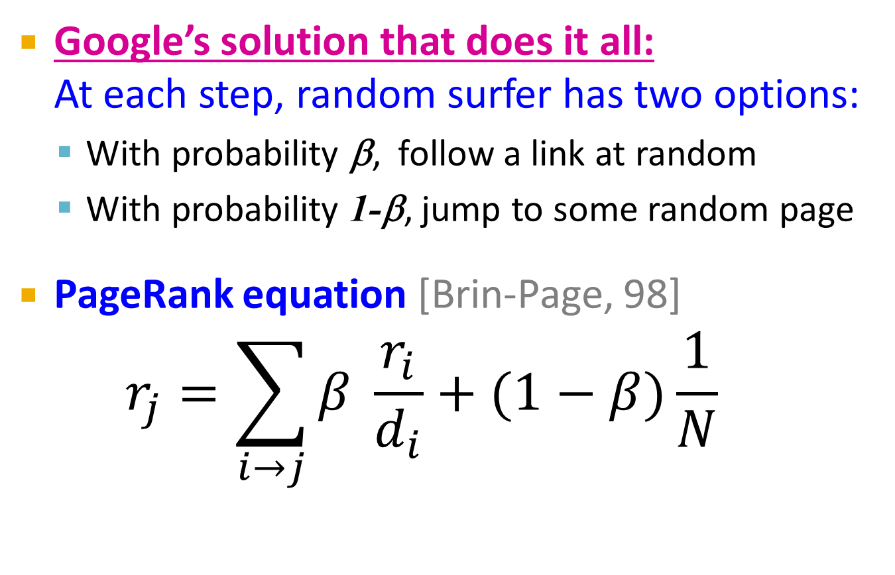
Solution: Random Teleports
Google’s solution that does it all:
At each step, random surfer has two options:
  With probability β, follow a link at random
  With probability 1-β, jump to some random page
PageRank equation [Brin-Page, 98]
$r_{j}=\sum_{i→j}{β \frac{r_{i}}{d_{i}}}+(1−β)\frac{1}{N}$
d_{i} … out-degree
of node i
This formulation assumes that $M$ has no dead ends. We can either preprocess matrix $M$ to remove all dead ends or explicitly follow random teleport links with probability 1.0 from dead-ends.

Slide 30
Random Teleports (β = 0.8)
M
  [1/N]_{NxN}
7/15
y
1/2 1/2 0
1/2 0 0
0 1/2 1
1/3 1/3 1/3
1/3 1/3 1/3
1/3 1/3 1/3
0.8
+ 0.2
7/15
1/15
7/15
1/15
y 7/15 7/15 1/15
a 7/15 1/15 1/15
m 1/15 7/15 13/15
13/15
a
7/15
m
1/15
1/15
A
y
a =
m
1/3
1/3
1/3
0.33
0.20
0.46
0.24
0.20
0.52
0.26
0.18
0.56
7/33
5/33
21/33
. . .

Slide 31
PageRank MapReduce Implementation

Slide 32
Simplified PageRank
First, tackle the simple case:
No random jump factor
No dangling (dead-end) nodes

Slide 33
Sample PageRank Iteration (1)
Iteration 1
n₂ (0.2)
n₂ (0.166)
n₁ (0.2)
0.1
0.1
0.1
n₁ (0.066)
0.1
0.066
0.066
0.066
n₅ (0.2)
n₃ (0.2)
n₅ (0.3)
n₃ (0.166)
0.2
0.2
n₄ (0.2)
n₄ (0.3)

Slide 34
Sample PageRank Iteration (2)
Iteration 2
n₂ (0.166)
n₂ (0.133)
n₁ (0.066)
0.033
0.083
0.083
n₁ (0.1)
0.033
0.1
0.1
0.1
n₅ (0.3)
n₃ (0.166)
n₅ (0.383)
n₃ (0.183)
0.3
0.166
n₄ (0.3)
n₄ (0.2)

Slide 35
PageRank in MapReduce
n₁ [n₂, n₄]
n₂ [n₃, n₅]
n₃ [n₄]
n₄ [n₅]
n₅ [n₁, n₂, n₃]
Map
n₂
n₄
n₃
n₅
n₄
n₅
n₁
n₂
n₃
n₁
n₂
n₂
n₃
n₃
n₄
n₄
n₅
n₅
Reduce
n₁ [n₂, n₄]
n₂ [n₃, n₅]
n₃ [n₄]
n₄ [n₅]
n₅ [n₁, n₂, n₃]

Slide 36
PageRank Pseudo-Code
class Mapper {
def map(id: Long, n: Node) = {
emit(id, n)
p = n.PageRank / n.adjacenyList.length
for (m <- n.adjacenyList) {
emit(m, p)
}
}
class Reducer {
def reduce(id: Long, objects: Iterable[Object]) = {
var s = 0
var n = null
for (p <- objects) {
if (isNode(p)) n = p
else s += p
}
n.PageRank = s
emit(id, n)
}
}

Slide 37
PageRank vs. BFS
PageRank
BFS
Map
PR/N
d+1
Reduce
sum
min
A large class of graph algorithms involve:
Local computations at each node
Propagating results: “traversing” the graph

Slide 38
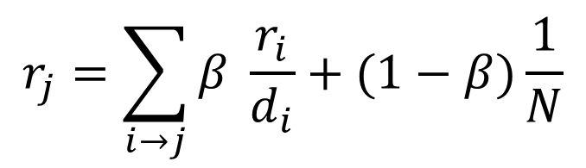
Complete PageRank
Two additional complexities
What is the proper treatment of dangling nodes?
How do we factor in the random jump factor?
Solution: second pass to redistribute “missing PageRank mass”
and account for random jumps
$$r_{j}=\sum_{i→j}{β \frac{r_{i}}{d_{i}}}+(1−β)\frac{1}{N}$$
One final optimization: fold into a single MR job

Slide 39
Implementation Practicalities
HDFS
map
map
Convergence?
reduce
HDFS
HDFS
What’s the optimization?

Slide 40
PageRank Convergence
Alternative convergence criteria
Iterate until PageRank values don’t change
Iterate until PageRank rankings don’t change
Fixed number of iterations

Slide 41
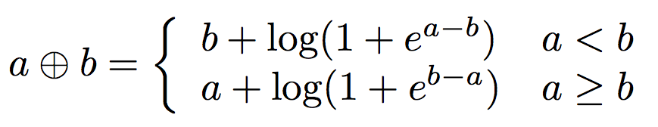
Log Probs
PageRank values are really small…
Solution?
Product of probabilities = Addition of log probs
Addition of probabilities?

Slide 42
Beyond PageRank
Variations of PageRank
Weighted edges
Personalized PageRank (A4 ☺)
Variants on graph random walks
Hubs and authorities (HITS)
SALSA

Slide 43
Implementation Practicalities
HDFS
map
map
Convergence?
reduce
HDFS
HDFS

Slide 44
MapReduce Sucks
Java verbosity
Hadoop task startup time
Stragglers
Needless graph shuffling
Checkpointing at each iteration
Spark to the rescue?

Slide 45
Let’s Spark!
HDFS
map
reduce
HDFS
map
reduce
HDFS
map
reduce
HDFS
…

Slide 46
HDFS
map
reduce
map
reduce
map
reduce
…

Slide 47
HDFS
map
Adjacency Lists
PageRank Mass
reduce
map
Adjacency Lists
PageRank Mass
reduce
map
Adjacency Lists
PageRank Mass
reduce
…

Slide 48
HDFS
map
Adjacency Lists
PageRank Mass
join
map
Adjacency Lists
PageRank Mass
join
map
Adjacency Lists
PageRank Mass
join
…

Slide 49
HDFS
HDFS
Adjacency Lists
PageRank vector
join
flatMap
reduceByKey
PageRank vector
join
flatMap
reduceByKey
PageRank vector
join
…

Slide 50
HDFS
HDFS
Adjacency Lists
PageRank vector
Cache!
join
flatMap
reduceByKey
PageRank vector
join
flatMap
reduceByKey
PageRank vector
join
…

Slide 51
MapReduce vs. Spark
Source: http://ampcamp.berkeley.edu/wp-content/uploads/2012/06/matei-zaharia-part-2-amp-camp-2012-standalone-programs.pdf

