Slide 1

Data-Intensive Distributed Computing
CS 431/631 451/651 (Fall 2019)
Part 5: Analyzing Relational Data (3/3)
October 24, 2019
Ali Abedi
These slides are available at https://www.student.cs.uwaterloo.ca/~cs451
This work is licensed under a Creative Commons Attribution-Noncommercial-Share Alike 3.0 United States
See http://creativecommons.org/licenses/by-nc-sa/3.0/us/ for details

Slide 2
MapReduce: A Major Step Backwards?
MapReduce is a step backward in database access
Schemas are good
Separation of the schema from the application is good
High-level access languages are good
MapReduce is poor implementation
Brute force and only brute force (no indexes, for example)
MapReduce is not novel
MapReduce is missing features
Bulk loader, indexing, updates, transactions…
MapReduce is incompatible with DBMS tools
Source: Blog post by DeWitt and Stonebraker

Slide 3
Hadoop vs. Databases: Grep
SELECT * FROM Data WHERE field LIKE ‘%XYZ%’;
Source: Pavlo et al. (2009) A Comparison of Approaches to Large-Scale Data Analysis. SIGMOD.

Slide 4
Hadoop vs. Databases: Select
SELECT pageURL, pageRank
FROM Rankings WHERE pageRank > X;
Source: Pavlo et al. (2009) A Comparison of Approaches to Large-Scale Data Analysis. SIGMOD.

Slide 5
Hadoop vs. Databases: Aggregation
SELECT sourceIP, SUM(adRevenue)
FROM UserVisits GROUP BY sourceIP;
Source: Pavlo et al. (2009) A Comparison of Approaches to Large-Scale Data Analysis. SIGMOD.

Slide 6
Hadoop vs. Databases: Join
SELECT INTO Temp sourceIP, AVG(pageRank) as avgPageRank, SUM(adRevenue) as totalRevenue
FROM Rankings AS R, UserVisits AS UV
WHERE R.pageURL = UV.destURL AND UV.visitDate BETWEEN Date('2000-01-15’) AND Date('2000-01-22’) GROUP BY UV.sourceIP;
SELECT sourceIP, totalRevenue, avgPageRank FROM Temp ORDER BY totalRevenue DESC LIMIT 1;
Source: Pavlo et al. (2009) A Comparison of Approaches to Large-Scale Data Analysis. SIGMOD.

Slide 7
Why was Hadoop slow?
Integer.parseInt
String.substring
String.split
Hadoop slow because string manipulation is slow?

Slide 8
Key Ideas
Binary representations are good
Binary representations need schemas
Schemas allow logical/physical separation
Logical/physical separation allows you to do cool things

Slide 9
Thrift
Originally developed by Facebook, now an Apache project
Provides a DDL with numerous language bindings
Compact binary encoding of typed structs
Fields can be marked as optional or required
Compiler automatically generates code for manipulating messages
Provides RPC mechanisms for service definitions
Don’t like Thrift? Alternatives include protobufs and Avro

Slide 10
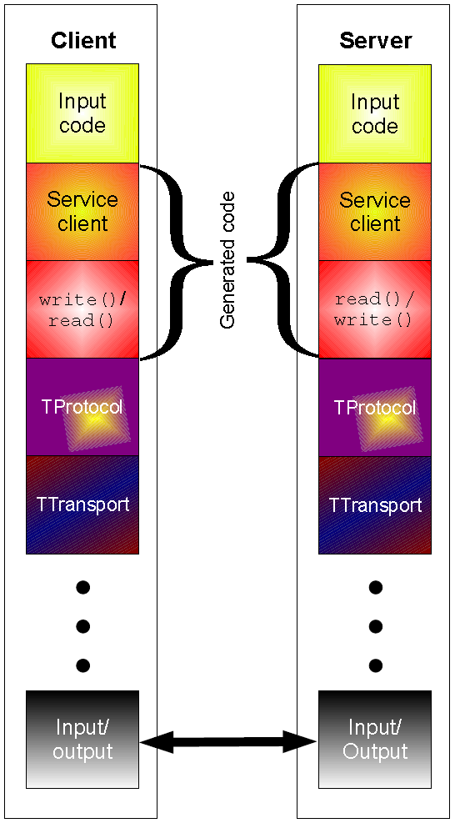
Thrift
struct Tweet {
1: required i32 userId;
2: required string userName;
3: required string text;
4: optional Location loc;
}
struct Location {
1: required double latitude;
2: required double longitude;
}

Slide 11
Why not…
XML or JSON?
REST?

Slide 12
Logical
R₁
R₂
R₃
Physical
How bytes are actually represented in storage…

Slide 13
Row vs. Column Stores
R₁
R₂
R₃
R₄
Row store
Column store

Slide 14
Row vs. Column Stores
Row stores
Easier to modify a record: in-place updates
Might read unnecessary data when processing
Column stores
Only read necessary data when processing
Tuple writes require multiple operations
Tuple updates are complex

Slide 15
external APIs
users
users
Frontend
Frontend
Frontend
Backend
Backend
Backend
OLTP
database
OLTP
database
OLTP
database
ETL
(Extract, Transform, and Load)
OLAP Data
Warehouse
BI tools
analysts

Slide 16
Advantages of Column Stores
Inherent advantages:
Better compression
Read efficiency
Works well with:
Vectorized Execution
Compiled Queries
These are well-known in traditional databases…

Slide 17
Row vs. Column Stores: Compression
R₁
R₂
R₃
R₄
Row store
Column store
This compresses better with
off-the-shelf tools, e.g., gzip.
Why?

Slide 18
Row vs. Column Stores: Compression
R₁
R₂
R₃
R₄
Row store
Column store
Additional opportunities for smarter compression…

Slide 19
Columns Stores: RLE
Column store
Run-length encoding example:
is a foreign key, relatively small cardinality
(even better, boolean)
In reality:
…
Encode:
3
2
1 …

Slide 20
Columns Stores: Integer Coding
Column store
Say you’re coding a bunch of integers…

Slide 21
Remember this?
VByte
(Part 3)
Simple idea: use only as many bytes as needed
Need to reserve one bit per byte as the “continuation bit”
Use remaining bits for encoding value
7 bits
0
14 bits
1
0
21 bits
1
1
0
Works okay, easy to implement…
Beware of branch mispredicts!

Slide 22
Remember this?
Simple-9
(Part 3)
How many different ways can we divide up 28 bits?
28 1-bit numbers
14 2-bit numbers
9 3-bit numbers
7 4-bit numbers
“selectors”
(9 total ways)
Efficient decompression with hard-coded decoders
Simple Family – general idea applies to 64-bit words, etc.
Beware of branch mispredicts?

Slide 23
Advantages of Column Stores
Inherent advantages:
Better compression
Read efficiency
Works well with:
Vectorized Execution
Compiled Queries

Slide 24
Putting Everything Together
SELECT big1.fx, big2.fy, small.fz
FROM big1
JOIN big2 ON big1.id1 = big2.id1
JOIN small ON big1.id2 = small.id2
WHERE big1.fx = 2015 AND
big2.f1 < 40 AND
big2.f2 > 2;
project
join
join
select
select
Build logical plan
project
project
Optimize logical plan
Select physical plan
big1
big2
small

Slide 25
val size = 100000000
var col = new Array[Int](size) // List of random ints
var selected = new Array[Boolean](size) // Matches a predicate?
for (i <- 0 until size) {
selected(i) = col(i) > 0
}
for (i <- 0 until size by 8) {
selected(i) = col(i) > 0
selected(i+1) = col(i+1) > 0
selected(i+2) = col(i+2) > 0
selected(i+3) = col(i+3) > 0
selected(i+4) = col(i+4) > 0
selected(i+5) = col(i+5) > 0
selected(i+6) = col(i+6) > 0
selected(i+7) = col(i+7) > 0
}
Which is faster?
Why?
On my laptop: 409ms
(avg over 10 trials)
On my laptop: 174ms
(avg over 10 trials)

Slide 26
val size = 100000000
var col = new Array[Int](size) // List of random ints
var selected = new Array[Boolean](size) // Matches a predicate?
for (i <- 0 until size) {
selected(i) = col(i) > 0
}
for (i <- 0 until size by 8) {
selected(i) = col(i) > 0
selected(i+1) = col(i+1) > 0
selected(i+2) = col(i+2) > 0
selected(i+3) = col(i+3) > 0
selected(i+4) = col(i+4) > 0
selected(i+5) = col(i+5) > 0
selected(i+6) = col(i+6) > 0
selected(i+7) = col(i+7) > 0
}
Why does it matter?
SELECT pageURL, pageRank
FROM Rankings WHERE pageRank > X;
On my laptop: 409ms
(avg over 10 trials)
On my laptop: 174ms
(avg over 10 trials)

Slide 27
Actually, it’s worse than that!
Each operator implements a common interface
open()
Initialize, reset internal state, etc.
next()
Advance and deliver next tuple
close()
Clean up, free resources, etc.
Execution driven by repeated calls
to top of operator tree

Slide 28
open() next() next()...
close()
pageURL, pageRank
open() next() next()...
close()
pageRank > X
open() next() next()...
close()
Read(Rankings)
SELECT pageURL, pageRank
FROM Rankings WHERE pageRank > X;
Very little actual computation is being done!

Slide 29
open() next() next()...
close()
pageURL, pageRank
open() next() next()...
close()
pageRank > X
open() next() next()...
close()
Read(Rankings)
SELECT pageURL, pageRank
FROM Rankings WHERE pageRank > X;
Solution?

Slide 30
val size = 100000000
var col = new Array[Int](size) // List of random ints
var selected = new Array[Boolean](size) // Matches a predicate?
✗
✓
for (i <- 0 until size) {
selected(i) = col(i) > 0
}
for (i <- 0 until size by 8) {
selected(i) = col(i) > 0
selected(i+1) = col(i+1) > 0
selected(i+2) = col(i+2) > 0
selected(i+3) = col(i+3) > 0
selected(i+4) = col(i+4) > 0
selected(i+5) = col(i+5) > 0
selected(i+6) = col(i+6) > 0
selected(i+7) = col(i+7) > 0
}
Vectorized Execution
next() returns a vector of tuples
All operators rewritten to work on vectors of tuples
Can we do even better?

Slide 31
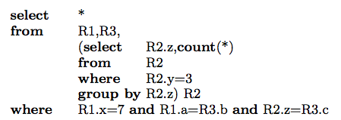
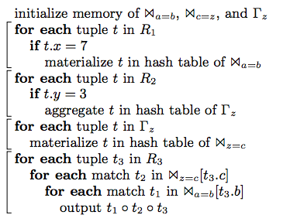
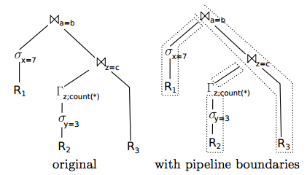
Compiled Queries
Source: Neumann (2011) Efficiently Compiling Efficient Query Plans for Modern Hardware. VLDB.

Slide 32
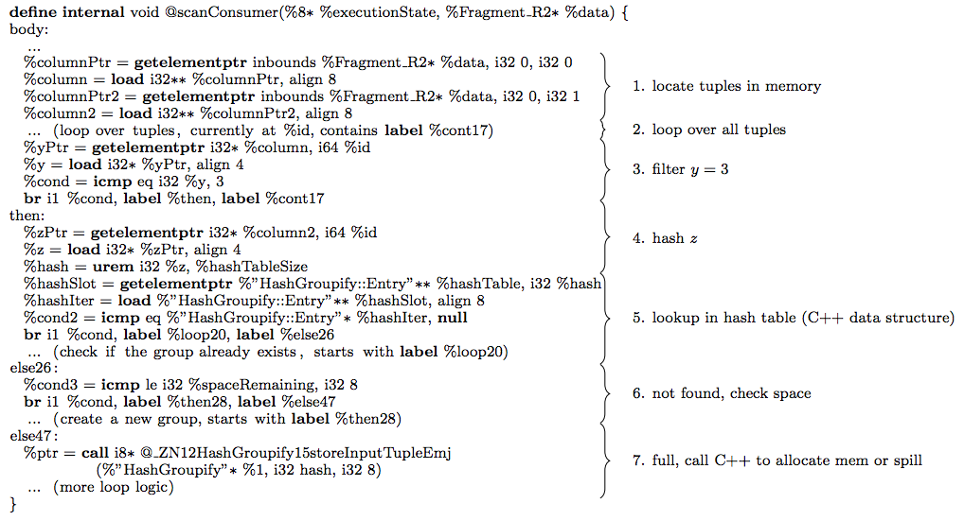
Compiled Queries
Example LLVM query template
Source: Neumann (2011) Efficiently Compiling Efficient Query Plans for Modern Hardware. VLDB.

Slide 33
Advantages of Column Stores
Inherent advantages:
Better compression
Read efficiency
Works well with:
Vectorized Execution
Compiled Queries
These are well-known in traditional databases…
Why not in Hadoop?

Slide 34
Why not in Hadoop?
No reason why not!
RCFile
Source: He et al. (2011) RCFile: A Fast and Space-Efficient Data Placement Structure in MapReduce-based Warehouse Systems. ICDE.

Slide 35

✓
Vectorized Execution?
set hive.vectorized.execution.enabled = true;
Batch of rows, organized as columns:
class VectorizedRowBatch {
boolean selectedInUse;
int[] selected;
int size;
ColumnVector[] columns;
}
class LongColumnVector extends ColumnVector {
long[] vector
}

Slide 36
✓
Vectorized Execution?
class LongColumnAddLongScalarExpression {
int inputColumn;
int outputColumn;
long scalar;
void evaluate(VectorizedRowBatch batch) {
long [] inVector = ((LongColumnVector)
batch.columns[inputColumn]).vector;
long [] outVector = ((LongColumnVector)
batch.columns[outputColumn]).vector;
if (batch.selectedInUse) {
for (int j = 0; j < batch.size; j++) {
int i = batch.selected[j];
outVector[i] = inVector[i] + scalar;
}
} else {
for (int i = 0; i < batch.size; i++) {
outVector[i] = inVector[i] + scalar;
}
}
}
}
Vectorized operator example

Slide 37

✓
Compiled Queries?
SELECT x, y
FROM z WHERE x * (1 – y)/100 < 434;
Predicate is “interpreted” as
LessThan(
Multiply(Attribute("x"),
Divide(Minus(Literal("1"), Attribute("y")), 100)),
434)
Slow!
Dynamic code generation
(feed AST into Scala compiler to generate bytecode):
row.get("x") * (1 – row.get("y"))/100 < 434
Much faster!

Slide 38
Advantages of Column Stores
Inherent advantages:
Better compression
Read efficiency
Works well with:
Vectorized Execution
Compiled Queries
Hadoop can adopt all of these optimizations!

Slide 39
Key Ideas
Binary representations are good
Binary representations need schemas
Schemas allow logical/physical separation
Logical/physical separation allows you to do cool things

Slide 40
MapReduce: A Major Step Backwards?
MapReduce is a step backward in database access
Schemas are good
Separation of the schema from the application is good
High-level access languages are good
MapReduce is poor implementation
Brute force and only brute force (no indexes, for example)
MapReduce is not novel
MapReduce is missing features
Bulk loader, indexing, updates, transactions…
MapReduce is incompatible with DMBS tools
Source: Blog post by DeWitt and Stonebraker

