Slide 1

Data-Intensive Distributed Computing
CS 431/631 451/651 (Fall 2019)
Part 7: Mutable State (2/2)
November 14, 2019
Ali Abedi

Slide 2
Motivating Scenarios
Money shouldn’t be created or destroyed:
Alice transfers $100 to Bob and $50 to Carol
The total amount of money after the transfer should be the same
Phantom shopping cart:
Bob removes an item from his shopping cart…
Item still remains in the shopping cart
Bob refreshes the page a couple of times… item finally gone

Slide 3
Motivating Scenarios
People you don’t want seeing your pictures:
Alice removes mom from list of people who can view photos
Alice posts embarrassing pictures from Spring Break
Can mom see Alice’s photo?
Why am I still getting messages?
Bob unsubscribes from mailing list and receives confirmation
Message sent to mailing list right after unsubscribe
Does Bob receive the message?

Slide 4
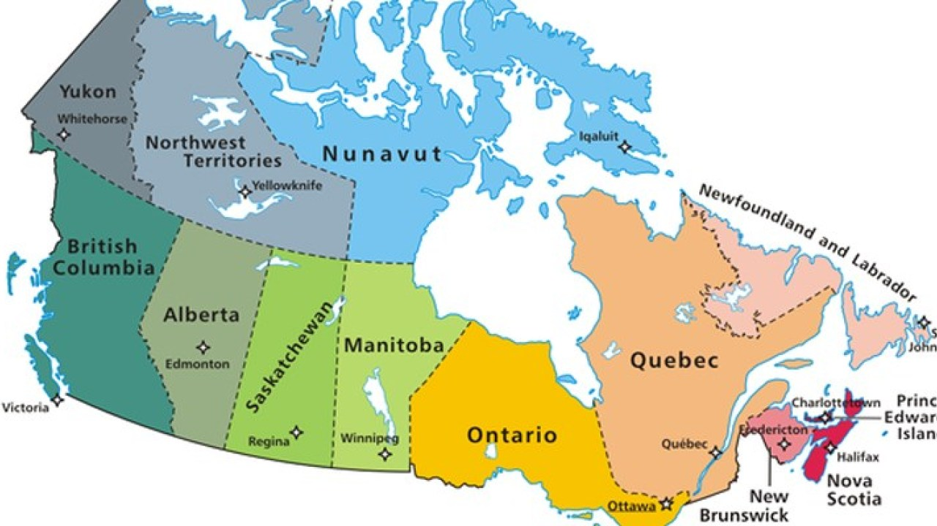

Consistency
All nodes should see the same data at the same time
Ali, $1,200
Ali, $1,200
Ali, $1,200
Ali, $1,200
Ali, $1,200
Ali, $1,200
read (“Ali”)

Slide 5
Availability
Node failures do not prevent survivors from continuing to operate
X
Ali, $1,200
Ali, $1,200
Ali, $1,200
Ali, $1,200
Ali, $1,200
Ali, $1,200

Slide 6
Partitioning-tolerance
The system continues to operate despite network partitions
X

Slide 7
CAP Theorem
Consistency:
  All nodes should see the same data at the same time
Availability:
  Node failures do not prevent survivors from continuing to operate
Partition-tolerance:
  The system continues to operate despite network partitions
A distributed system can satisfy any two of these guarantees at the same time but not all three

Slide 8
CAP Theorem
C
A
X
P
… pick two

Slide 9
CAP Theorem
This suggests there are three kinds of distributed systems:
CP: Big Table and Hbase
AP: DNS
CA → Impossible in distributed systems

Slide 11
CAP Theorem: Proof
A simple proof using two nodes:
A
B

Slide 12
CAP Theorem: Proof
A simple proof using two nodes:
Not Consistent!
A
B
Respond to client

Slide 13

CAP Theorem: Proof
A simple proof using two nodes:
Not Available!
A
B
Wait to be updated

Slide 14
CAP Theorem: Proof
A simple proof using two nodes:
Not Partition Tolerant!
A
B
A gets updated from B

Slide 15
Types of Consistency
Strong Consistency
  After the update completes, any subsequent access will return the same updated value.

Slide 16
2 Phase Commit: Sketch
Okay everyone, PREPARE!
YES
Good.
COMMIT!
ACK!
YES
DONE!
ACK!
Coordinator
YES
ACK!
subordinates

Slide 17
2 Phase Commit: Sketch
Okay everyone, PREPARE!
YES
ABORT!
YES
Coordinator
NO
subordinates

Slide 18
2PC: Assumptions and Limitations
Assumptions:
Persistent storage and write-ahead log at every node
WAL is never permanently lost
Limitations:
It’s blocking and slow
What if the coordinator dies?

Slide 19
Distributed Consensus
More general problem: addresses replication and partitioning
Hi everyone, let’s change the value of x.
Hi everyone, let’s execute a transaction t.
…
Paxos
Time

Slide 20
Types of Consistency
Strong Consistency
  After the update completes, any subsequent access will return the same updated value.
Weak Consistency
  It is not guaranteed that subsequent accesses will return the updated value.
Eventual Consistency
  Specific form of weak consistency
  It is guaranteed that if no new updates are made to object, eventually all accesses will return the last updated value (e.g., propagate updates to replicas in a lazy fashion)

Slide 21
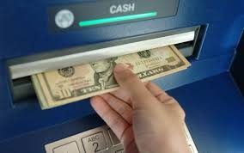
Eventual Consistency
- An ATM Example
In design of automated teller machine (ATM):
  Strong consistency appear to be a nature choice
  However, in practice, A beats C
  Higher availability means higher revenue
  ATM will allow you to withdraw money even if the machine is partitioned from the network
  However, it puts a limit on the amount of withdraw (e.g., $200)
  The bank might also charge you a fee when a overdraft happens

Slide 22



Eventual Consistency
- A Facebook Example
Bob finds an interesting story and shares with Alice by posting on her Facebook wall
Bob asks Alice to check it out
Alice logs in her account, checks her Facebook wall but finds:
- Nothing is there!
?

Slide 23

Eventual Consistency
- A Facebook Example
Bob tells Alice to wait a bit and check out later
Alice waits for a minute or so and checks back:
- She finds the story Bob shared with her!

Slide 24
Eventual Consistency
- A Facebook Example
Reason: it is possible because Facebook uses an eventual consistent model
Why Facebook chooses eventual consistent model over the strong consistent one?
  Facebook has more than 1 billion active users
  It is non-trivial to efficiently and reliably store the huge amount of data generated at any given time
  Eventual consistent model offers the option to reduce the load and improve availability

Slide 25
Facebook Architecture
memcached
MySQL
Read path:
Look in memcached
Look in MySQL
Populate in memcached
Write path:
Write in MySQL
Remove in memcached
Subsequent read:
Look in MySQL
Populate in memcached
Source: www.facebook.com/note.php?note_id=23844338919

Slide 26
Facebook Architecture: Multi-DC
memcached
memcached
MySQL
MySQL
Replication lag
California
Virginia
User updates first name from “Jason” to “Monkey”.
Write “Monkey” in master DB in CA, delete memcached entry in CA and VA.
Someone goes to profile in Virginia, read VA replica DB, get “Jason”.
Update VA memcache with first name as “Jason”.
Replication catches up. “Jason” stuck in memcached until another write!
Source: www.facebook.com/note.php?note_id=23844338919

Slide 27
Facebook Architecture: Multi-DC
memcached
memcached
MySQL
MySQL
Replication
= stream of SQL statements
California
Virginia
Solution: Piggyback on replication stream, tweak SQL
REPLACE INTO profile (`first_name`) VALUES ('Monkey’)
WHERE `user_id`='jsobel' MEMCACHE_DIRTY 'jsobel:first_name'
Source: www.facebook.com/note.php?note_id=23844338919

Slide 28
What if there are no partitions?
Tradeoff between Consistency and Latency:
Caused by the possibility of failure in distributed systems
  High availability -> replicate data -> consistency problem
Basic idea:
  Availability and latency are arguably the same thing: unavailable -> extreme high latency
  Achieving different levels of consistency/availability takes different amount of time

Slide 29
CAP -> PACELC
A more complete description of the space of potential tradeoffs for distributed system:
  If there is a partition (P), how does the system trade off availability and consistency (A and C); else (E), when the system is running normally in the absence of partitions, how does the system trade off latency (L) and consistency (C)?
Abadi, Daniel J. "Consistency tradeoffs in modern distributed database system design." Computer-IEEE Computer Magazine 45.2 (2012): 37.

Slide 30
PACELC
C
A
C
L
Normal
Partitioned

Slide 31
Examples
PA/EL Systems: Give up both Cs for availability and lower latency
  Dynamo, Cassandra, Riak
PC/EC Systems: Refuse to give up consistency and pay the cost of availability and latency
  BigTable, Hbase, VoltDB/H-Store
PA/EC Systems: Give up consistency when a partition happens and keep consistency in normal operations
  MongoDB
PC/EL System: Keep consistency if a partition occurs but gives up consistency for latency in normal operations
  Yahoo! PNUTS

