Slide 1

Data-Intensive Distributed Computing
CS 431/631 451/651 (Fall 2019)
Part 8: Analyzing Graphs, Redux (1/2)
November 19, 2019
Ali Abedi
These slides are available at https://www.student.cs.uwaterloo.ca/~cs451
This work is licensed under a Creative Commons Attribution-Noncommercial-Share Alike 3.0 United States
See http://creativecommons.org/licenses/by-nc-sa/3.0/us/ for details

Slide 2
Characteristics of Graph Algorithms
Parallel graph traversals
Local computations
Message passing along graph edges
Iterations
  Even faster?

Slide 3
Big Data Processing in a Nutshell
  Let’s be smarter about this!
Partition
Replicate
Reduce cross-partition communication

Slide 4
Simple Partitioning Techniques
Hash partitioning
Range partitioning on some underlying linearization
Web pages: lexicographic sort of domain-reversed URLs

Slide 5
How much difference does it make?
+18%
1.4b
674m
-15%
-60%
86m
PageRank over webgraph (40m vertices, 1.4b edges)
Lin and Schatz. (2010) Design Patterns for Efﬁcient Graph Algorithms in MapReduce.

Slide 6
Simple Partitioning Techniques
Hash partitioning
Range partitioning on some underlying linearization
Web pages: lexicographic sort of domain-reversed URLs
Web pages: lexicographic sort of domain-reversed URLs
Social networks: sort by demographic characteristics

Slide 7
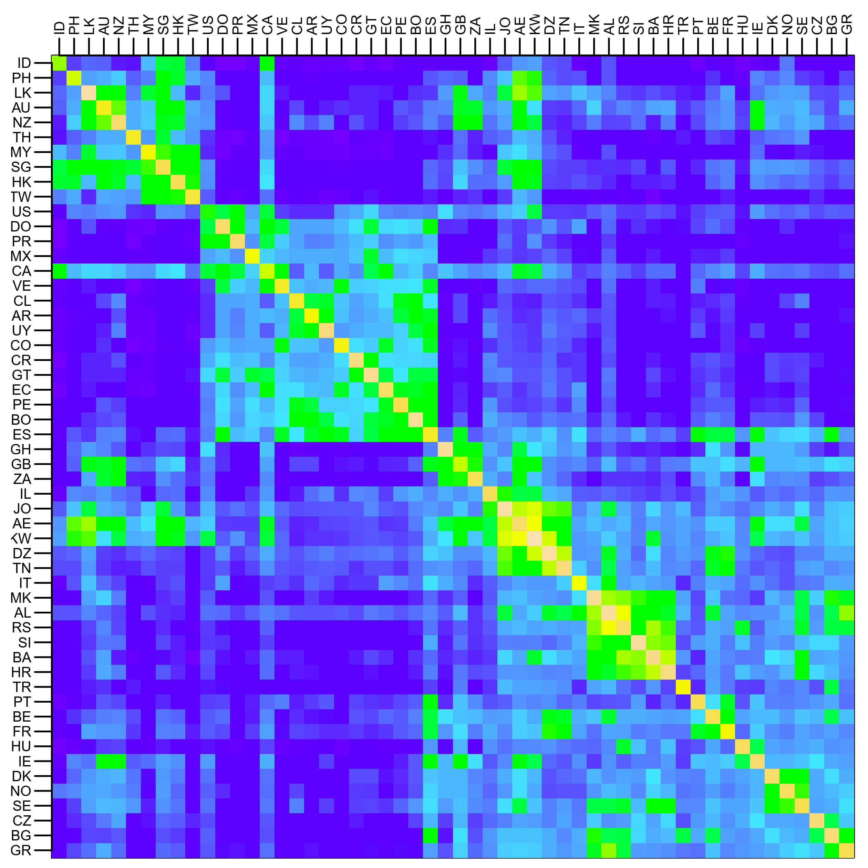
Country Structure in Facebook
Analysis of 721 million active users (May 2011)
54 countries w/ >1m active users, >50% penetration
Ugander et al. (2011) The Anatomy of the Facebook Social Graph.

Slide 8
Simple Partitioning Techniques
Hash partitioning
Range partitioning on some underlying linearization
Web pages: lexicographic sort of domain-reversed URLs
Social networks: sort by demographic characteristics
  But what about graphs in general?

Slide 9

Source: http://www.flickr.com/photos/fusedforces/4324320625/

Slide 10
Big Data Processing in a Nutshell
Partition
Replicate
Reduce cross-partition communication

Slide 11
Partition

Slide 12
Partition
What’s the fundamental issue?

Slide 13
Partition
Slow
Fast
Fast

Slide 14
State-of-the-Art Distributed Graph Algorithms
Periodic synchronization
Fast asynchronous iterations
Fast asynchronous iterations

Slide 15
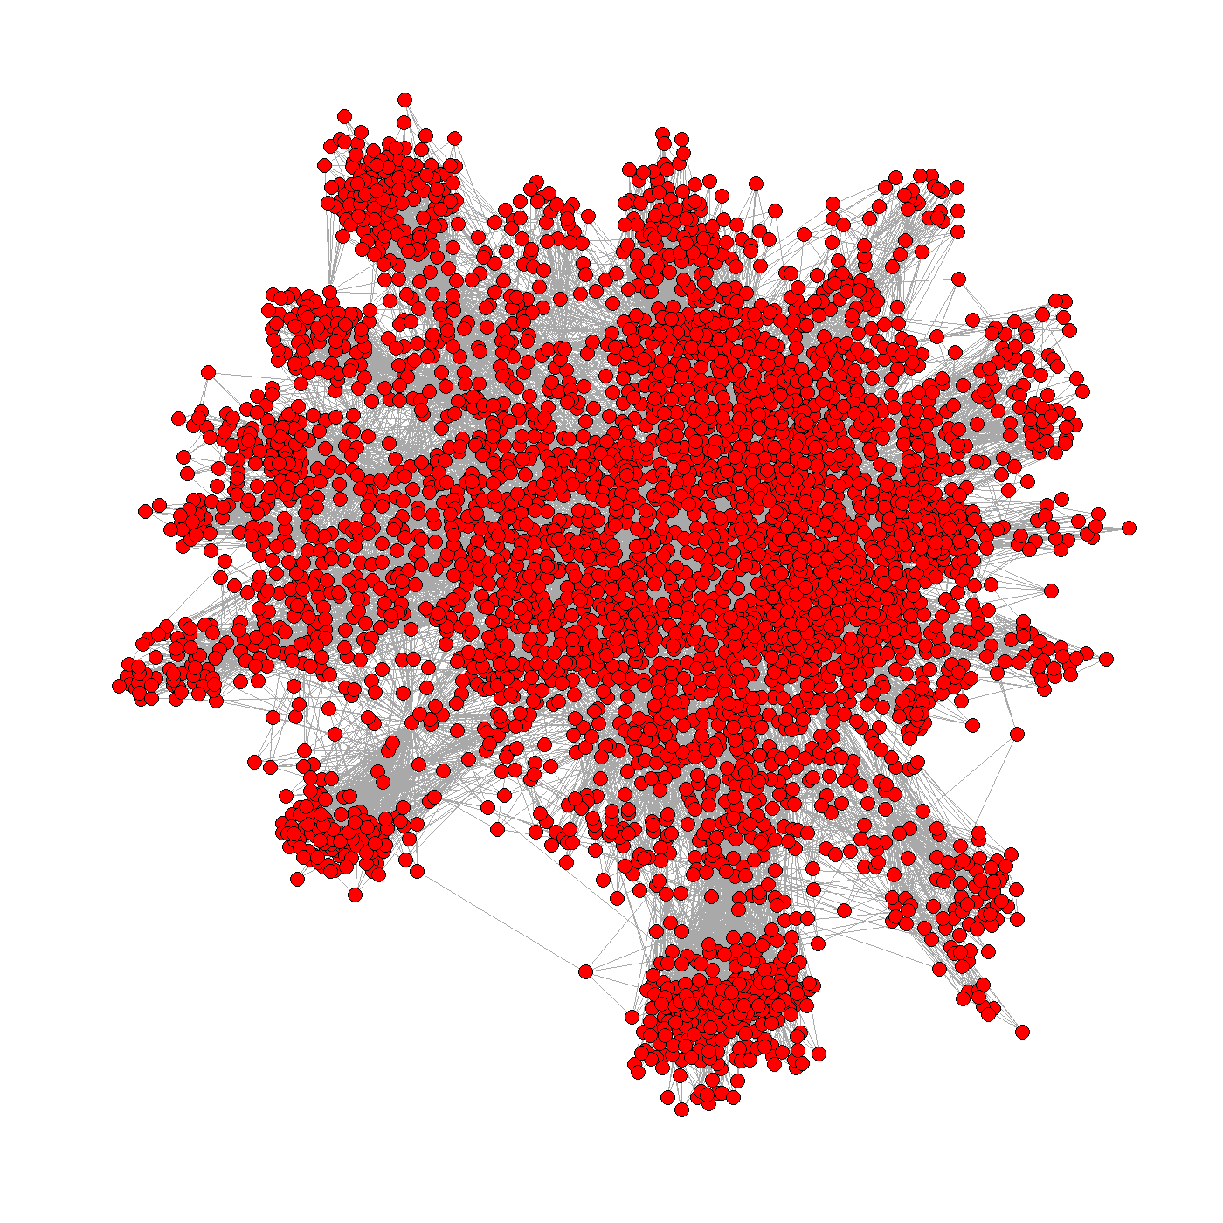
Graph Processing Frameworks
Graph Processing Frameworks

Slide 16

Graph Processing Frameworks
Pregel
  Google
Apache Giraph
  Based on Pregel
  On Hadoop
Spark GraphX

Slide 18
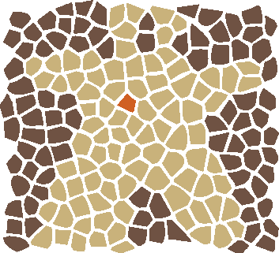


What is Apache Giraph
Giraph performs iterative calculation on top of an existing Hadoop cluster

Slide 19
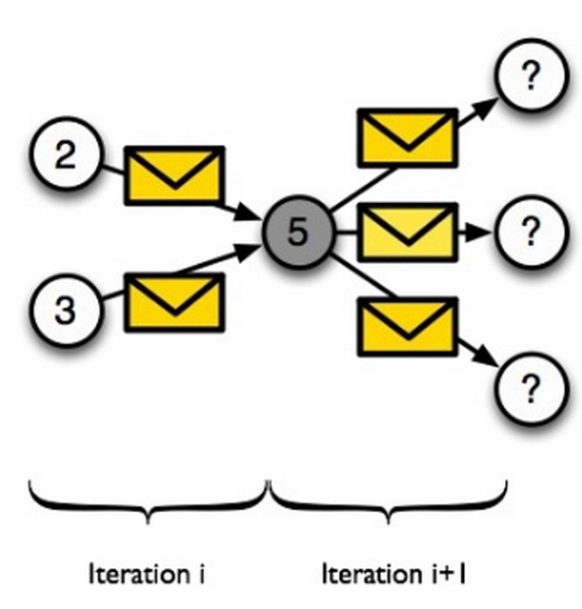
Bulk-Synchronous Parallel (BSP) Programming Model
Vertex-centric model

Slide 20
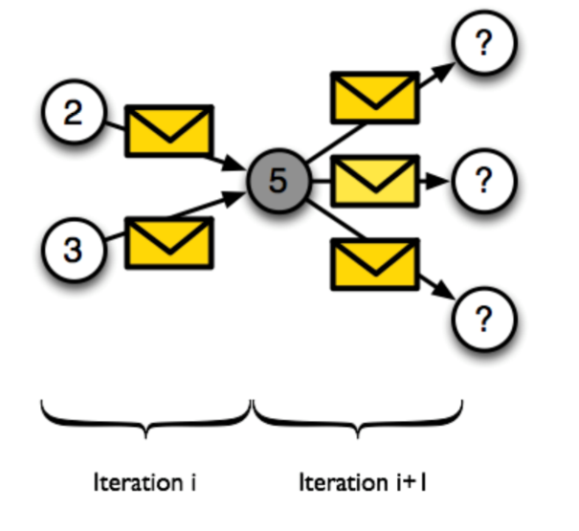
Vertex Centric Programming
Vertex Centric Programming Model
  ‣ Logic written from perspective on a single vertex.
  Executed on all vertices.
Vertices know about
  ‣ Their own value(s)
  ‣ Their outgoing edges

Slide 21
Bulk-Synchronous Parallel (BSP) Programming Model
P1
P2
P3
P4
Superstep 1
Computation
Communication
Barrier Synchronization
Superstep 2
Computation
“Often expensive and should be used as sparingly as possible”

Slide 22
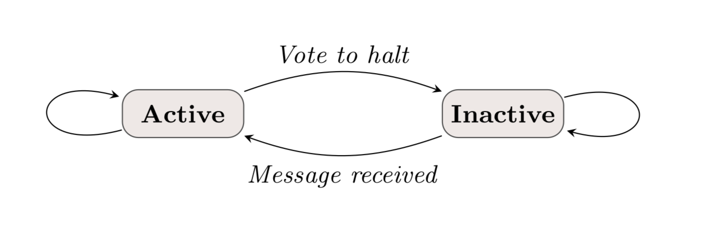
Vertex State Machine
In superstep 0, every vertex is in the active state.
A vertex deactivates itself by voting to halt.
It can be reactivated by receiving an (external) message.
Algorithm termination is based on every vertex voting to halt.

Slide 23
Finding Largest Value in a Graph
Superstep 0
3
6
2
1
Worker
Superstep 1
6
6
2
6
Edges
Superstep 2
6
6
6
6
Message
Active
Voted
to Halt
Superstep 3
6
6
6
6

Slide 24
Advantages
Makes distributed programming easy
‣ No locks, semaphores, race conditions
‣ Separates computing from communication phase
Vertex-level parallelization
‣ Bulk message passing for efficiency
Stateful (in-memory)
‣ Only messages & checkpoints hit disk

Slide 25
Giraph Architecture
Master – Application coordinator
  Synchronizes supersteps
  Assigns partitions to workers before superstep begins
Workers – Computation & messaging
  Handle I/O – reading and writing the graph
  Computation/messaging of assigned partitions
ZooKeeper
  Maintains global application state

Slide 26
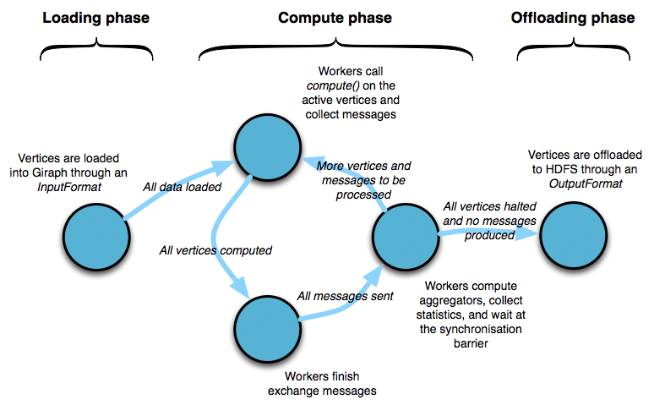
Lifecycle of a Pregel Program
Apache Giraph, Claudio Martella, Hadoop Summit, Amsterdam, April 2014

Slide 27
Applications

Slide 28
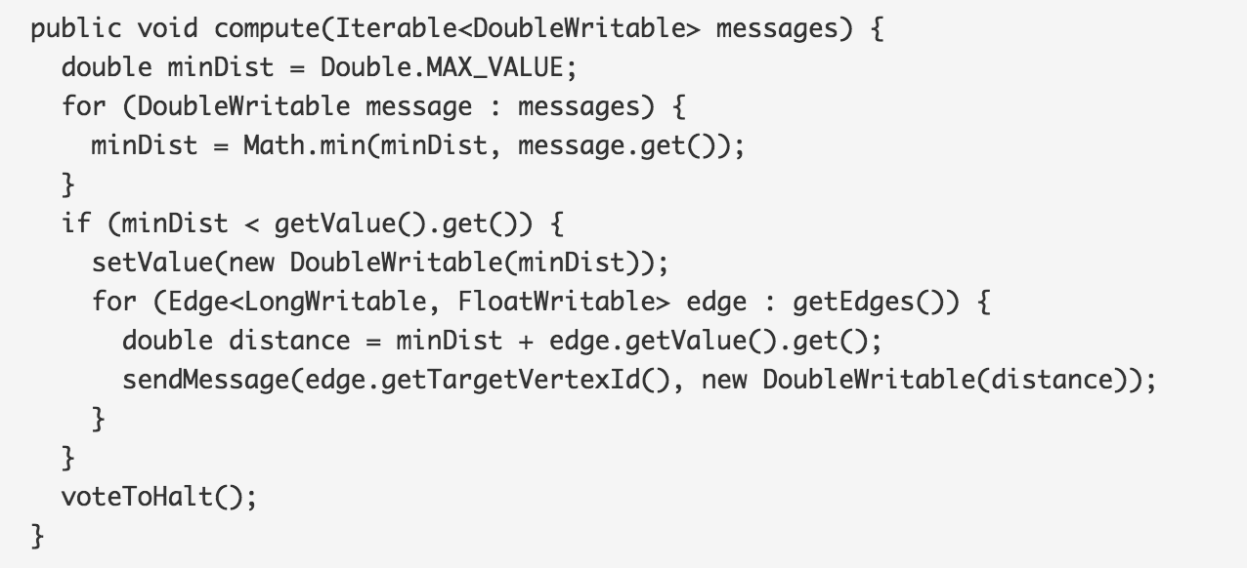
Shortest path
Example compute() method

Slide 29
SSSP (1/6)
D
Worker 2
5
Worker 4
2
G
B
1
2
3
E
A
2
Worker 1
2
4
H
C
1
F
1
Worker 3
Input Graph

Slide 30
SSSP (2/6)
∞
Worker 2
5
Worker 4
2
∞
∞
1
2
3
∞
0
2
Worker 1
2
4
∞
∞
1
∞
1
Worker 3
Superstep 0

Slide 31
SSSP (3/6)
∞
Worker 2
5
Worker 4
2
∞
1
1
2
3
∞
0
2
Worker 1
2
4
∞
2
1
∞
1
Worker 3
Superstep 1

Slide 32
SSSP (4/6)
3
Worker 2
5
Worker 4
2
∞
1
1
2
3
4
0
2
Worker 1
2
4
6
2
1
3
1
Worker 3
Superstep 2

Slide 33
SSSP (5/6)
3
Worker 2
5
Worker 4
2
6
1
1
2
3
4
0
2
Worker 1
2
4
4
2
1
3
1
Worker 3
Superstep 3

Slide 34
SSSP (6/6)
3
Worker 2
5
Worker 4
2
6
1
1
2
3
4
0
2
Worker 1
2
4
4
2
1
3
1
Worker 3
Algorithm has converged

Slide 35
Finding the Max

Slide 36
Execution Trace
Processor 1
5
5
5
5
Processor 2
1
1
5
5
5
2
2
2
5
5
Time

