Slide 1

Data-Intensive Distributed Computing
CS 431/631 451/651 (Fall 2019)
Part 8: Analyzing Graphs, Redux (2/2)
November 21, 2019
Ali Abedi
These slides are available at https://www.student.cs.uwaterloo.ca/~cs451
This work is licensed under a Creative Commons Attribution-Noncommercial-Share Alike 3.0 United States
See http://creativecommons.org/licenses/by-nc-sa/3.0/us/ for details

Slide 2
Theme for Today:
How things work in the real world
(forget everything you’ve been told…)
(these are the mostly true events of Jimmy Lin’s Twitter tenure)

Slide 3

From the Ivory Tower…
Source: Wikipedia (All Souls College, Oxford)

Slide 4
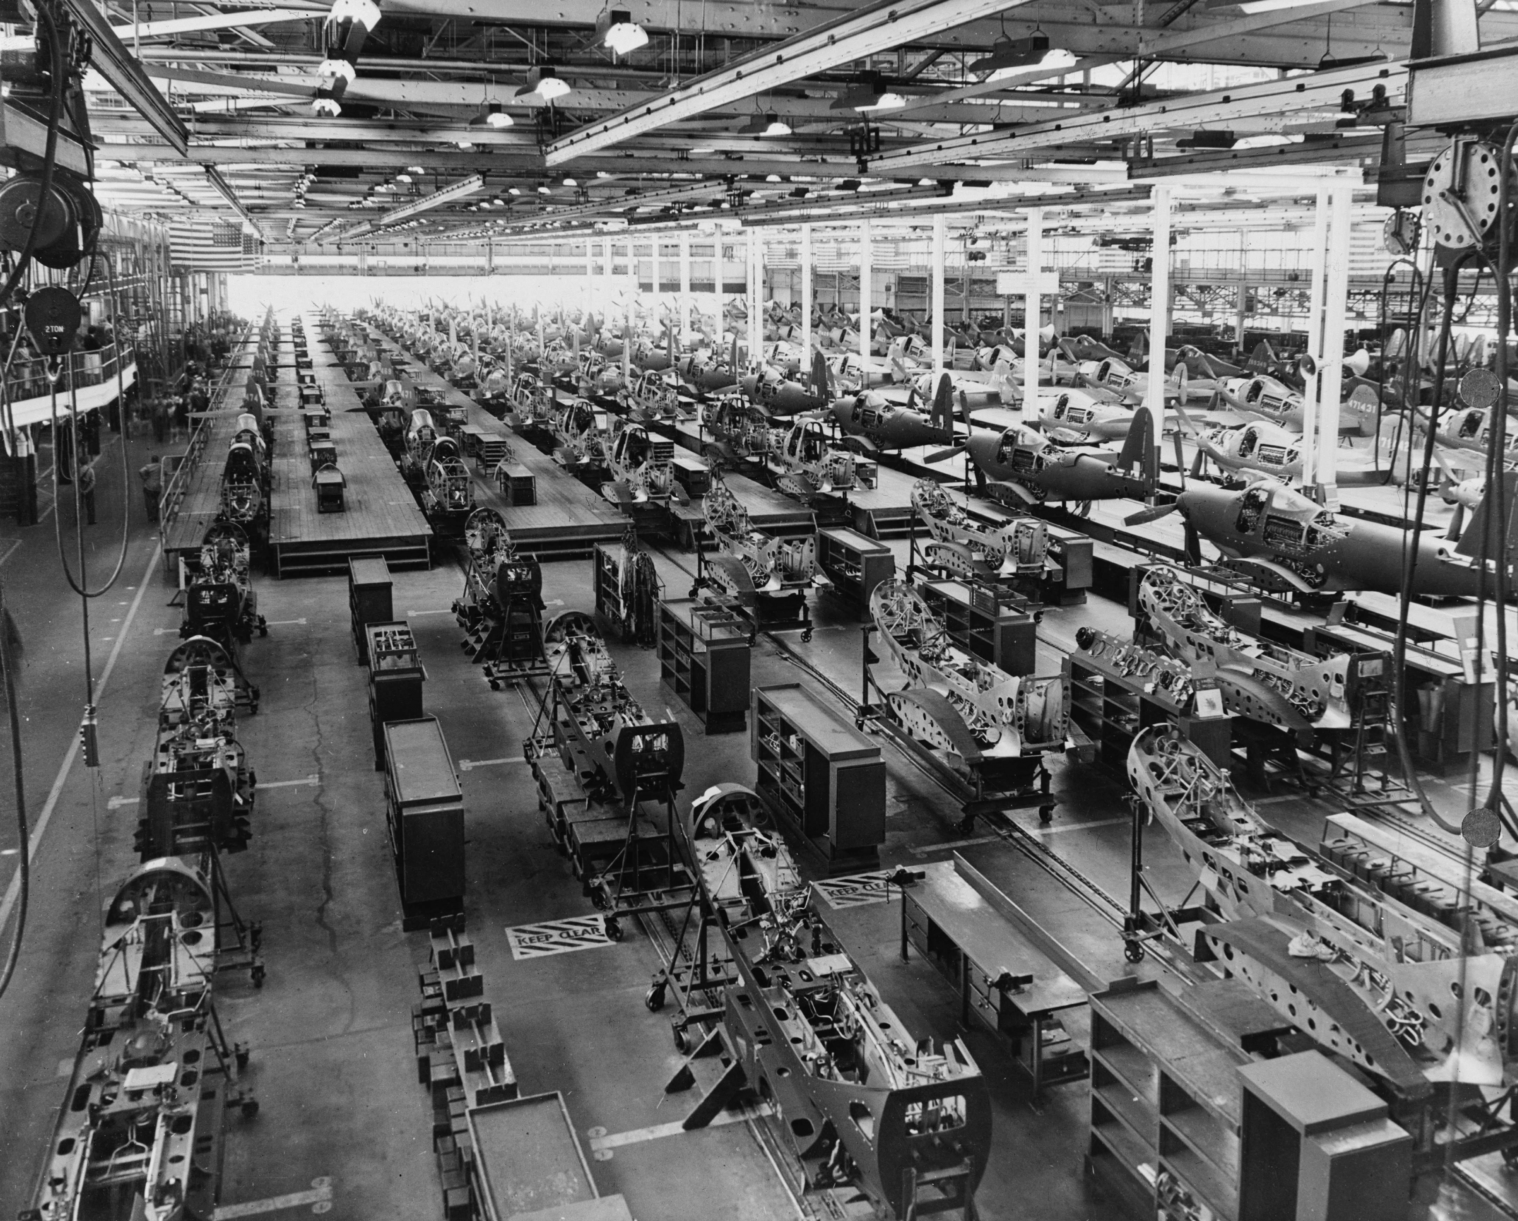
… to building sh*t that works
Source: Wikipedia (Factory)

Slide 5
What exactly might a data scientist do at Twitter?

Slide 6
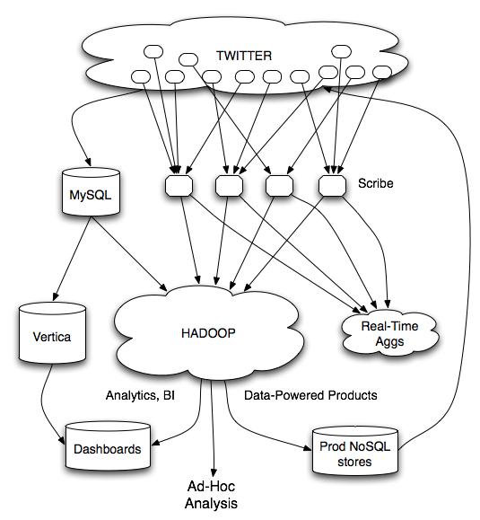
data products
data science
They might have worked on…
– analytics infrastructure to support data science
– data products to surface relevant content to users

Slide 7
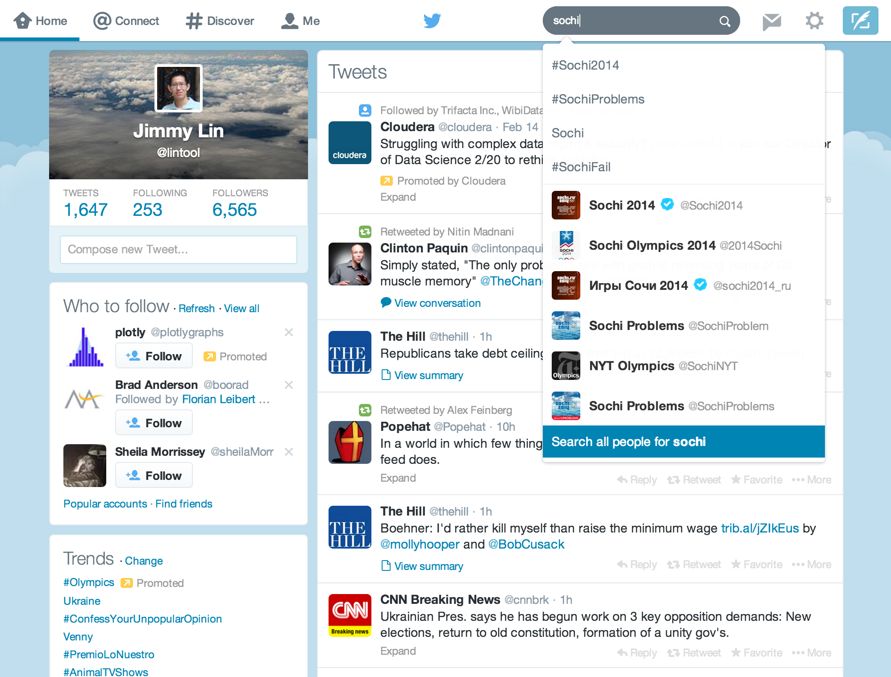
Busch et al. Earlybird: Real-Time Search at Twitter. ICDE 2012
Mishne et al. Fast Data in the Era of Big Data: Twitter's Real-Time Related Query Suggestion Architecture. SIGMOD 2013.
Leibert et al. Automatic Management of Partitioned, Replicated Search Services. SoCC 2011
Gupta et al. WTF: The Who to Follow Service at Twitter. WWW 2013
Lin and Kolcz. Large-Scale Machine Learning at Twitter. SIGMOD 2012
They might have worked on…
– analytics infrastructure to support data science
– data products to surface relevant content to users

Slide 8
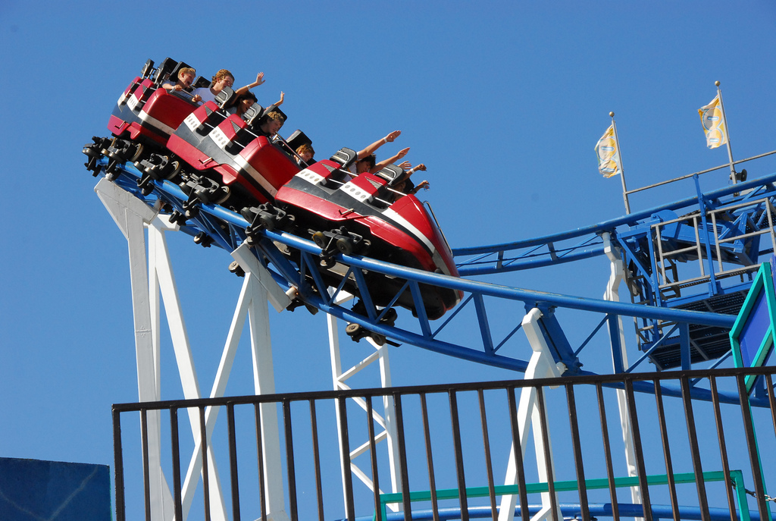
Source: https://www.flickr.com/photos/bongtongol/3491316758/

Slide 9
circa ~2010
~150 people total
~60 Hadoop nodes
~6 people use analytics stack daily
circa ~2012
~1400 people total
10s of Ks of Hadoop nodes, multiple DCs
10s of PBs total Hadoop DW capacity
~100 TB ingest daily
dozens of teams use Hadoop daily
10s of Ks of Hadoop jobs daily

Slide 10


WTF
(who to follow)
(whom to follow)

Slide 11
#numbers
(Second half of 2012)
~175 million active users
~20 billion edges
42% edges bidirectional
Avg shortest path length: 4.05
40% as many unfollows as follows daily
WTF responsible for ~1/8 of the edges
Myers, Sharma, Gupta, Lin. Information Network or Social Network?
The Structure of the Twitter Follow Graph. WWW 2014.

Slide 12
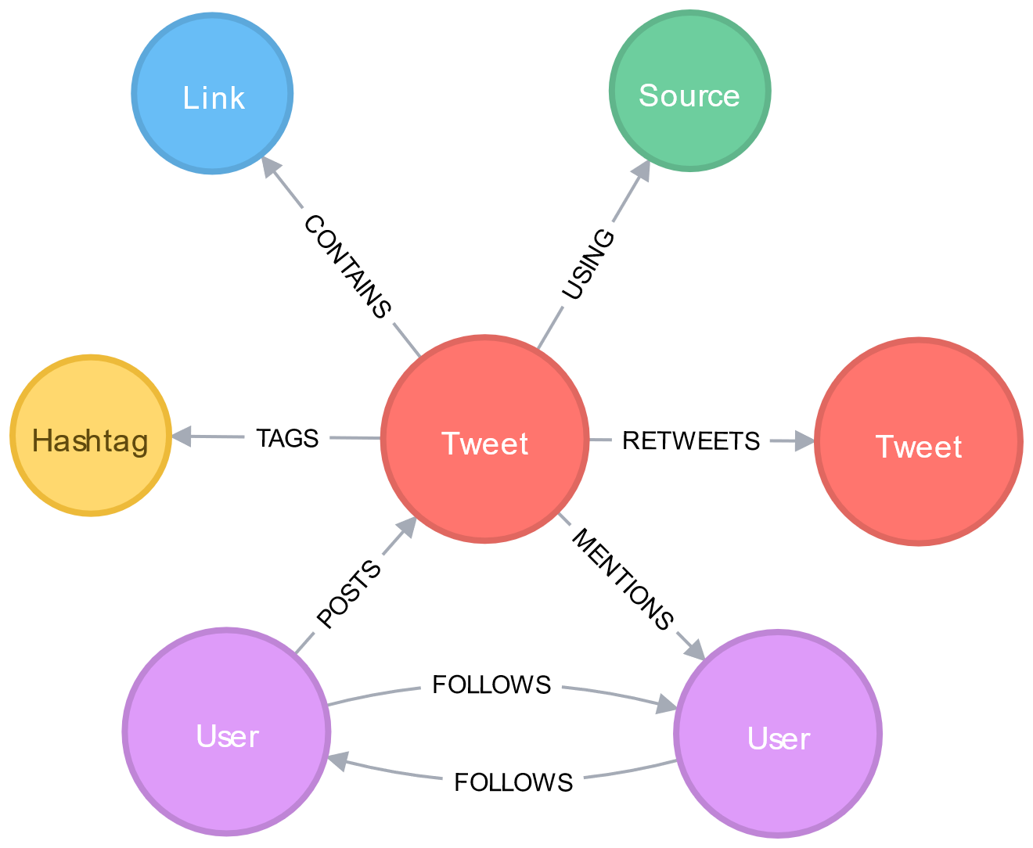
Graphs are core to Twitter
Graph-based recommendation systems
Why? Increase engagement!

Slide 13

The Journey
From the static follower graph for account recommendations…
… to the real-time interaction graph for content recommendations
In Four Acts...
Source: flickr (https://www.flickr.com/photos/39414578@N03/16042029002)

Slide 14
In the beginning… the void
Act I
WTF and Cassovary
(circa 2010)

Slide 15
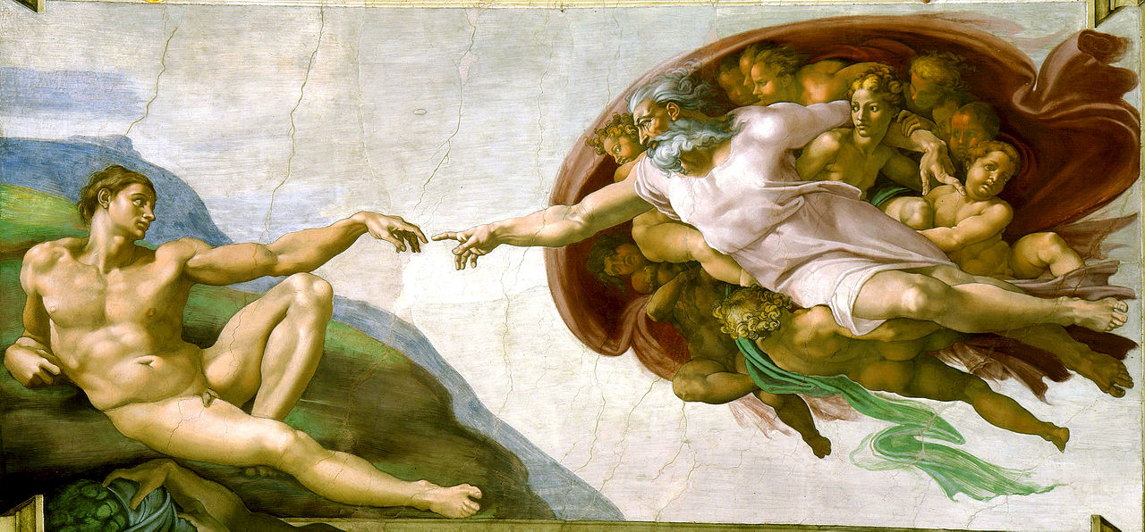
In the beginning… the void
Goal: build a recommendation service quickly
Act I
WTF and Cassovary
(circa 2010)

Slide 16
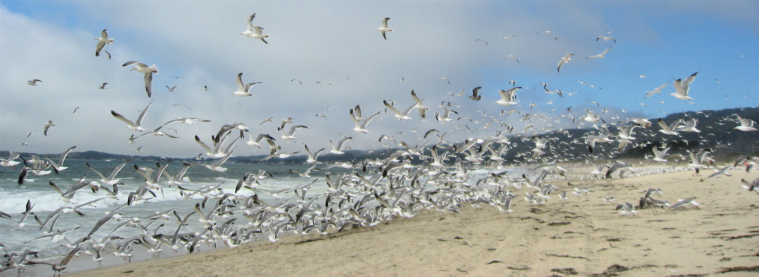
flockDB
(graph database)
Simple graph operations
Set intersection operations
Not appropriate for graph algorithms!

Slide 18
Okay, let’s use MapReduce!
But MapReduce sucks for graphs!

Slide 19
MapReduce sucks for graph algorithms…
Let’s build our own system!
Key design decision:
Keep entire graph in memory…
on a single machine!

Slide 20
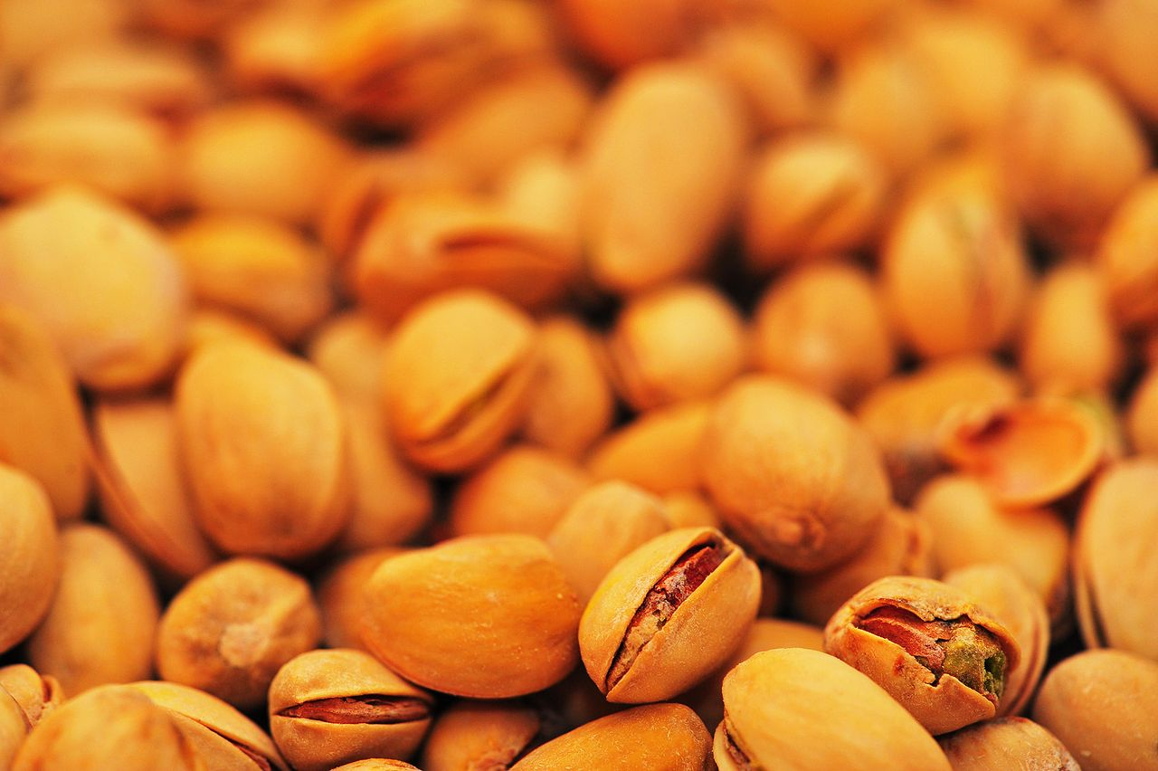
Nuts!
Why?
Because we can!
Graph partitioning is hard… so don’t do it
Simple architecture
Right choice at the time!
Source: Wikipedia (Pistachio)

Slide 21
Suppose: 10×10⁹ edges
(src, dest) pairs: ~80 GB
18 × 8 GB DIMMS = 144 GB
18 × 16 GB DIMMS = 288 GB
12 × 16 GB DIMMS = 192 GB
12 × 32 GB DIMMS = 384 GB

Slide 22
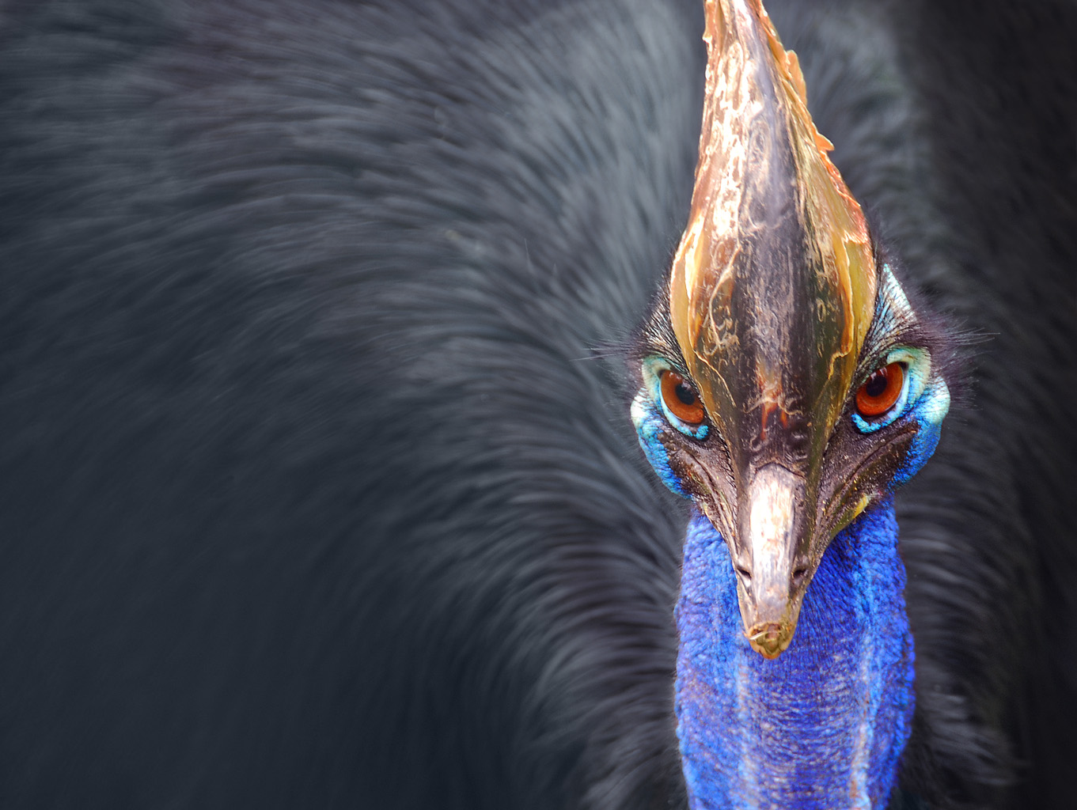
Cassovary
In-memory graph engine
  Implemented in Scala
  Compact in-memory representations
  But no compression
  Avoid JVM object overhead!
  Open-source
Source: Wikipedia (Cassowary)

Slide 23
PageRank
“Semi-streaming” algorithm
Keep vertex state in memory, stream over edges
Each pass = one PageRank iteration
Bottlenecked by memory bandwidth
Convergence?
  Don’t run from scratch… use previous values
  A few passes are sufficient

Slide 24
“Circle of Trust”
Ordered set of important neighbors for a user
Result of egocentric random walk: Personalized PageRank!
Computed online based on various input parameters
“circle of trust”
One of the features used in search

Slide 25
SALSA for Recommendations
“authorities”
“hubs”
hubs scores:
similarity scores to u
authority scores: recommendation scores for u
CoT of u
users LHS follow

Slide 26
Goel, Lin, Sharma, Wang, and Zadeh. WTF: The Who to Follow Service at Twitter. WWW 2013

Slide 27
Blender
Fetcher
WTF DB
FlockDB
HDFS
Cassovary

Slide 28
Blender
Fetcher
What about new users?
Cold start problem: they need recommendations the most!
WTF DB
FlockDB
HDFS
Cassovary

Slide 29
Blender
Fetcher
Fetcher
Real-time
Recommendations
WTF DB
FlockDB
HDFS
Cassovary

Slide 30
Spring 2010: no WTF
seriously, WTF?
Summer 2010: WTF launched

Slide 31

Act II
RealGraph
(circa 2012)
Goel et al. Discovering Similar Users on Twitter. MLG 2013.
Source: Facebook

Slide 32
Another “interesting” design choice:
We migrated from Cassovary back to Hadoop!
Source: Wikipedia (Pistachio)

Slide 33
Whaaaaaa?
Cassovary was a stopgap!
Hadoop provides:
  Richer graph structure
  Simplified production infrastructure
  Scaling and fault-tolerance “for free”
Right choice at the time!

Slide 34
Wait, didn’t you say MapReduce sucks?
What exactly is the issue?
  Random walks on egocentric 2-hop neighborhood
  Naïve approach: self-joins to materialize, then run algorithm
The shuffle is what kills you!

Slide 35
Graph algorithms in MapReduce
Tackle the shuffling problem!
Key insights:
  Batch and “stich together” partial random walks*
  Clever sampling to avoid full materialization
* Sarma et al. Estimating PageRank on Graph Streams. PODS 2008
Bahmani et al. Fast Personalized PageRank on MapReduce. SIGMOD 2011.

Slide 36
Throw in ML while we’re at it…
Follow graph
Retweet graph
Favorite graph
…
Candidate Generation
Trained Model
Candidates
Classification
Final Results
Lin and Kolcz. Large-Scale Machine Learning at Twitter. SIGMOD 2012.

Slide 37
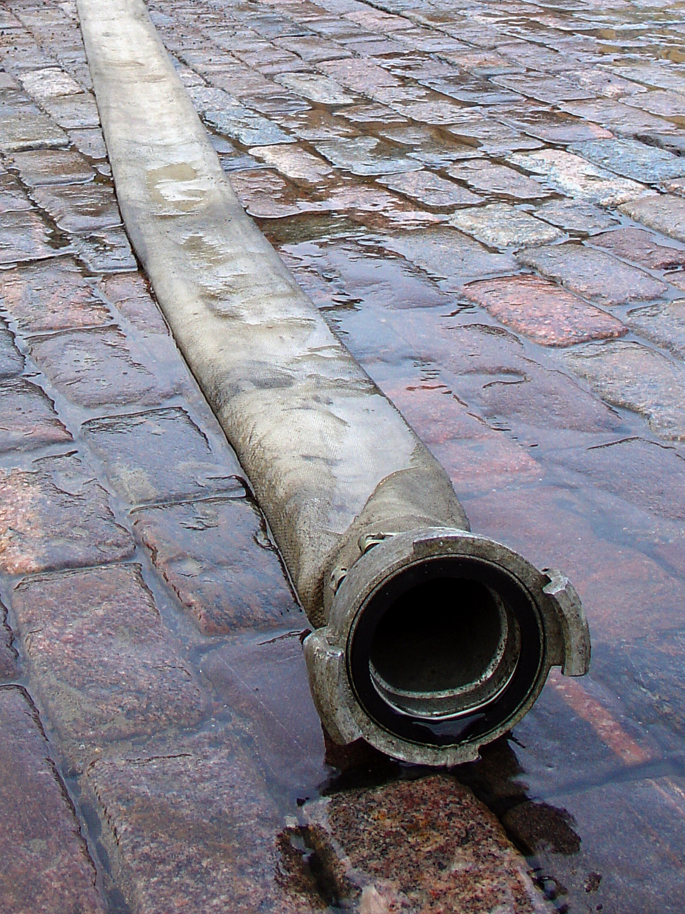
Act III
MagicRecs
(circa 2013)
Source: Wikipedia (Fire hose)

Slide 38

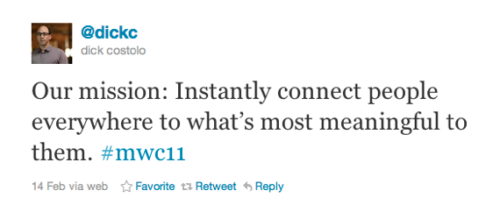
Isn’t the point of Twitter real-time?
So why is WTF still dominated by batch processing?
Source: Wikipedia (Motion Blur)

Slide 39
Observation: fresh recommendations get better engagement
Logical conclusion: generate recommendations in real time!
From batch to real-time recommendations:
Recommendations based on recent activity
“Trending in your network”
Inverts the WTF problem:
For this user, what recommendations to generate?
Given this new edge, which user to make recommendations to?

Slide 40
C₂
B₁
B₂
B₃
A
Why does this work?
A follows B’s because they’re interesting
B’s following C’s because “something’s happening”
(generalizes to any activity)
Gupta, Satuluri, Grewal, Gurumurthy, Zhabiuk, Li, and Lin. Real-Time Twitter Recommendation:
Online Motif Detection in Large Dynamic Graphs. VLDB 2014

Slide 41
Scale of the Problem
O(10⁸) vertices, O(10¹⁰) edges
Designed for O(10⁴) events per second
Naïve solutions:
Poll each vertex periodically
Materialize everyone’s two-hop neighborhood, intersect
Production solution:
Idea #1: Convert problem into adjacency list intersection
Idea #2: Partition graph to eliminate non-local intersections
Gupta, Satuluri, Grewal, Gurumurthy, Zhabiuk, Li, and Lin. Real-Time Twitter Recommendation:
Online Motif Detection in Large Dynamic Graphs. VLDB 2014

Slide 42
Single Node Solution
D “dynamic” structure:
stores inverted adjacency lists
Who we’re recommending
query C, return all B’s that link to it
C₂
“influencers”
B_{i}
C_{j}
B₁
B₂
B₃
B_{i}
C_{j}
B_{i}
C_{j}
A
S “static” structure:
stores inverted adjacency lists
Who we’re making the recommendations to
query B, return all A’s that link to it

Slide 43
Algorithm
D “dynamic” structure:
stores inverted adjacency lists
Who we’re recommending
query C, return all B’s that link to it
C₂
1. Receive B₃ to C₂
“influencers”
2. Query D for C₂, get B₁, B₂, B₃
B₁
B₂
B₃
3. For each B₁, B₂, B₃, query S
4. Intersect lists to compute A’s
A
S “static” structure:
stores inverted adjacency lists
Who we’re making the recommendations to
query B, return all A’s that link to it
Idea #1: Convert problem into adjacency list intersection

Slide 44
Distributed Solution
B_{i}
C_{j}
Who we’re recommending
Replicate on every node
C₂
1. Fan out new edge to every node
2. Run algorithm on each partition
3. Gather results from each partition
“influencers”
B₁
B₂
B₃
B₁
B₄
B₅
A
A₂
Partition by A
Who we’re making the recommendations to
Idea #2: Partition graph to eliminate non-local intersections

Slide 45
Production Status
Launched September 2013
Usage Statistics (Circa 2014)
  Push recommendations to Twitter mobile users
  Billions of raw candidates, millions of push notifications daily
Performance
  End-to-end latency (from edge creation to delivery):
  median 7s, p99 15s
Gupta, Satuluri, Grewal, Gurumurthy, Zhabiuk, Li, and Lin. Real-Time Twitter Recommendation:
Online Motif Detection in Large Dynamic Graphs. VLDB 2014

Slide 46

Act IV
GraphJet
(circa 2014)
Fully bought into the potential of real-time…
but needed something more general
Focused specifically on the interaction graph
Source: flickr (https://www.flickr.com/photos/martinsfoto/6432093025/)

Slide 47
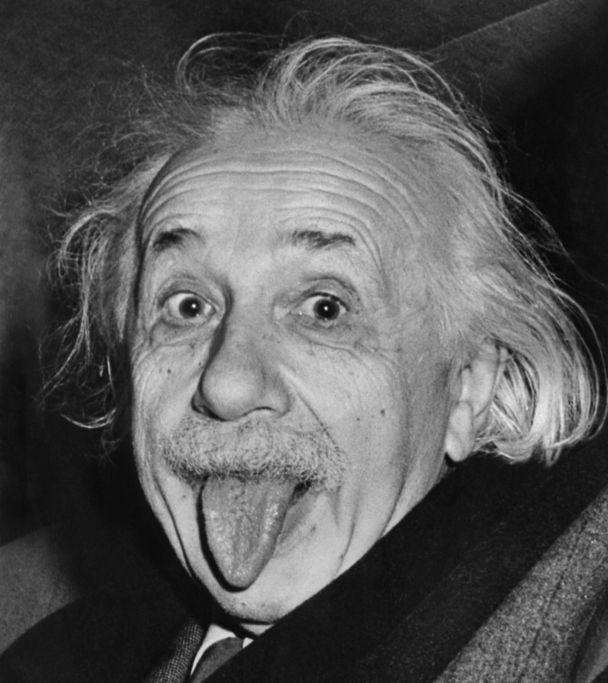
Takeaway lesson #01:
Make things as simple as possible, but not simpler.
With lots of data, algorithms don’t really matter that much
Why a complex architecture when a simple one suffices?

Slide 48

Takeaway lesson #10:
Constraints aren’t always technical.
Source: https://www.flickr.com/photos/43677780@N07/6240710770/

Slide 49

Takeaway lesson #11:
Visiting and revisiting design decisions
Source: https://www.flickr.com/photos/exmachina/8186754683/

Slide 50

Questions?
“In theory, there is no difference between theory and practice. But, in practice, there is.”
- Jan L.A. van de Snepscheut
Twittering Machine. Paul Klee (1922) watercolor and ink

