Slide 1

Data-Intensive Distributed Computing
CS 431/631 451/651 (Fall 2019)
Part 9: Real-Time Data Analytics (1/2)
November 26, 2019
Ali Abedi
These slides are available at https://www.student.cs.uwaterloo.ca/~cs451
This work is licensed under a Creative Commons Attribution-Noncommercial-Share Alike 3.0 United States
See http://creativecommons.org/licenses/by-nc-sa/3.0/us/ for details

Slide 2

users
Frontend
Backend
OLTP
database
ETL
(Extract, Transform, and Load)
Data
Warehouse
My data is a
day old…
BI tools
Meh.
analysts

Slide 3
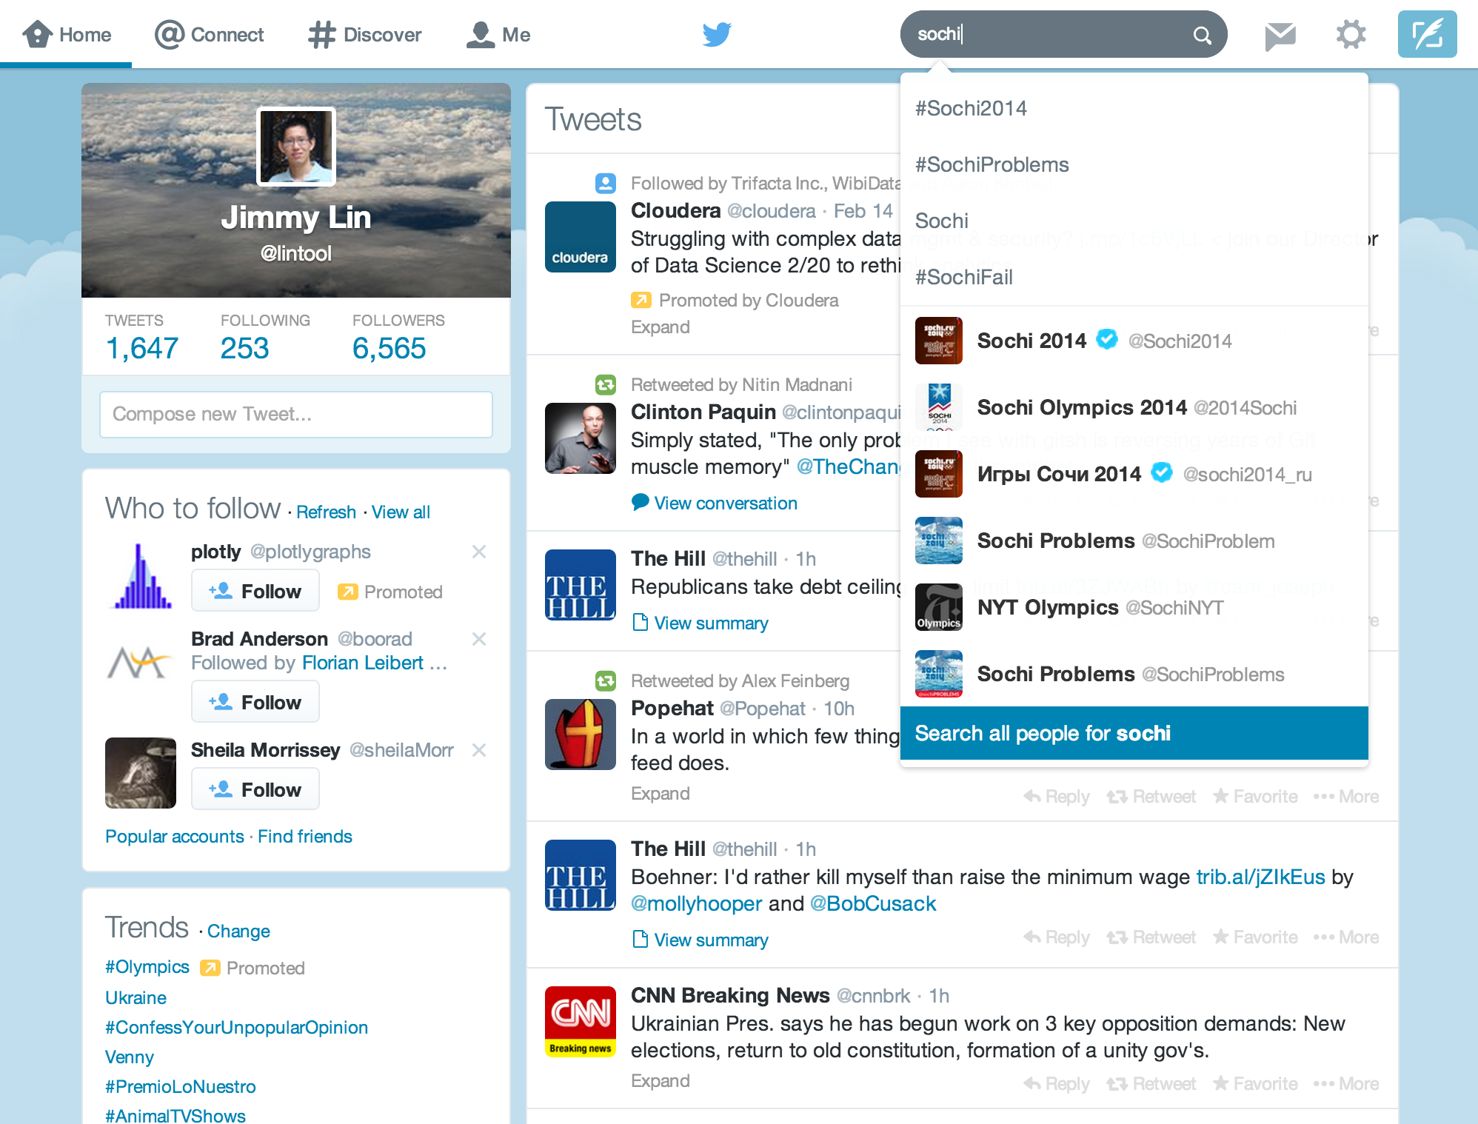
Mishne et al. Fast Data in the Era of Big Data: Twitter's Real-Time Related Query Suggestion Architecture. SIGMOD 2013.

Slide 4
Case Study: Steve Jobs passes away

Slide 5
Initial Implementation
Algorithm: Co-occurrences within query sessions
Implementation: Pig scripts over query logs on HDFS
Problem: Query suggestions were several hours old!
Why?
Log collection lag
Hadoop scheduling lag
Hadoop job latencies
We need real-time processing!

Slide 6
Solution?
Steve Jobs
Bill Gates
Can we do better than one-off custom systems?

Slide 7
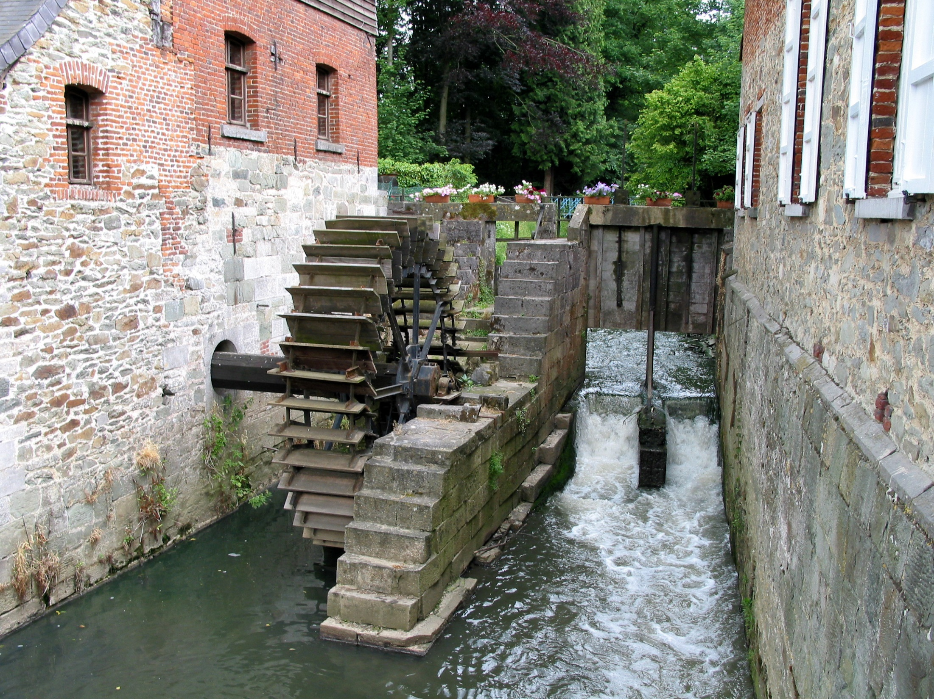
Stream Processing Frameworks
Source: Wikipedia (River)

Slide 8
Background Review -- Stream Processing
Batch processing | Stream processing
All the data | Continuously incoming data
Not real time | Latency critical (near real time)

Slide 9








Use Cases Across Industries
Credit
Transportation
Retail
Consumer Internet &
Mobile
Identify
fraudulent transactions as soon as they occur.
Dynamic
Re-routing
Of traffic or
Vehicle Fleet.
Dynamic
Inventory
Management
Real-time
In-store
Offers and recommendations
Optimize user
engagement based
on user’s current
behavior.
Healthcare
Manufacturing
Surveillance
Digital
Advertising
& Marketing
Continuously
monitor patient
vital stats and proactively identify
at-risk patients.
Identify
equipment
failures and
react instantly
Perform
Proactive
maintenance.
Identify
threats
and intrusions
In real-time
Optimize and personalize content based on real-time information.

Slide 10









Canonical Stream Processing Architecture
Data Sources
HDFS
HBase
Data Ingest
Kafka
Flume
App 1
Kafka
App 2
.
.
.

Slide 11
What is a data stream?
Sequence of items:
Structured (e.g., tuples)
Ordered (implicitly or timestamped)
Arriving continuously at high volumes
Sometimes not possible to store entirely
Sometimes not possible to even examine all items

Slide 12
What exactly do you do?
“Standard” relational operations:
Select
Project
Transform (i.e., apply custom UDF)
Group by
Join
Aggregations
What else do you need to make this “work”?

Slide 13
Issues of Semantics
Group by… aggregate
When do you stop grouping and start aggregating?
Joining a stream and a static source
Simple lookup
Joining two streams
How long do you wait for the join key in the other stream?
Joining two streams, group by and aggregation
When do you stop joining?
What’s the solution?

Slide 14
Windows
Windows restrict processing scope:
Windows based on ordering attributes (e.g., time)
Windows based on item (record) counts
Windows based on explicit markers (e.g., punctuations)

Slide 15
Windows on Ordering Attributes
Assumes the existence of an attribute that
defines the order of stream elements (e.g., time)
Let T be the window size in units of the ordering attribute
t₁
t₂
t₃
t₄
t₁'
t₂’
t₃’
t₄’
sliding window
t_{i}’ – t_{i} = T
t₁
t₂
t₃
tumbling window
t_{i+1} – t_{i} = T

Slide 16
Windows on Counts
Window of size N elements (sliding, tumbling) over the stream
t₁
t₂
t₁'
t₃
t₂’
t₃’
t₄’

Slide 17
Windows from “Punctuations”
Application-inserted “end-of-processing”
Example: stream of actions… “end of user session”
Properties
Advantage: application-controlled semantics
Disadvantage: unpredictable window size (too large or too small)

Slide 18
Streams Processing Challenges
Inherent challenges
Latency requirements
Space bounds
System challenges
Bursty behavior and load balancing
Out-of-order message delivery and non-determinism
Consistency semantics (at most once, exactly once, at least once)

Slide 19
Producer/Consumers
Producer
Consumer
How do consumers get data from producers?

Slide 20
Producer/Consumers
Producer
Consumer
Producer pushes
e.g., callback

Slide 21
Producer/Consumers
Producer
Consumer
Consumer pulls
e.g., poll, tail

Slide 22
Producer/Consumers
Consumer
Producer
Consumer
Producer
Consumer
Consumer

Slide 23
Producer/Consumers
Consumer
Producer
Kafka
Broker
Consumer
Producer
Consumer
Consumer
Queue, Pub/Sub

Slide 24
Producer/Consumers
Consumer
Producer
Kafka
Broker
Consumer
Producer
Consumer
Consumer

Slide 25


Slide 26
Topologies
Storm topologies = “job”
Once started, runs continuously until killed
A topology is a computation graph
Graph contains vertices and edges
Vertices hold processing logic
Directed edges indicate communication between vertices
Processing semantics
At most once: without acknowledgments
At least once: with acknowledgements

Slide 27
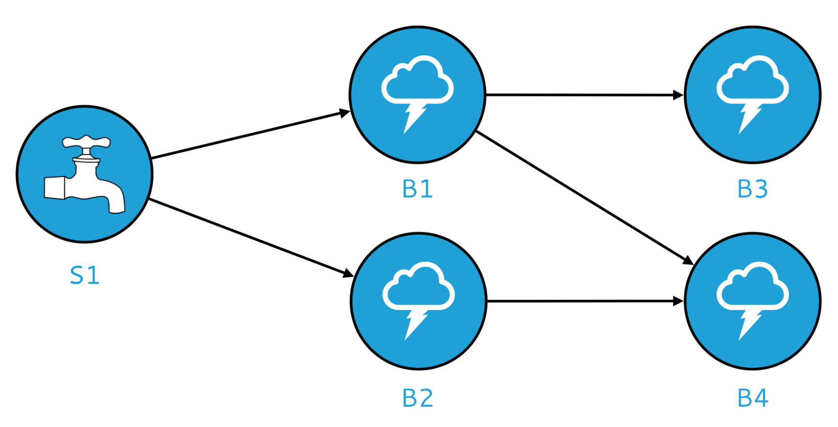
Spouts and Bolts: Logical Plan
Components
Tuples: data that flow through the topology
Spouts: responsible for emitting tuples
Bolts: responsible for processing tuples

Slide 28
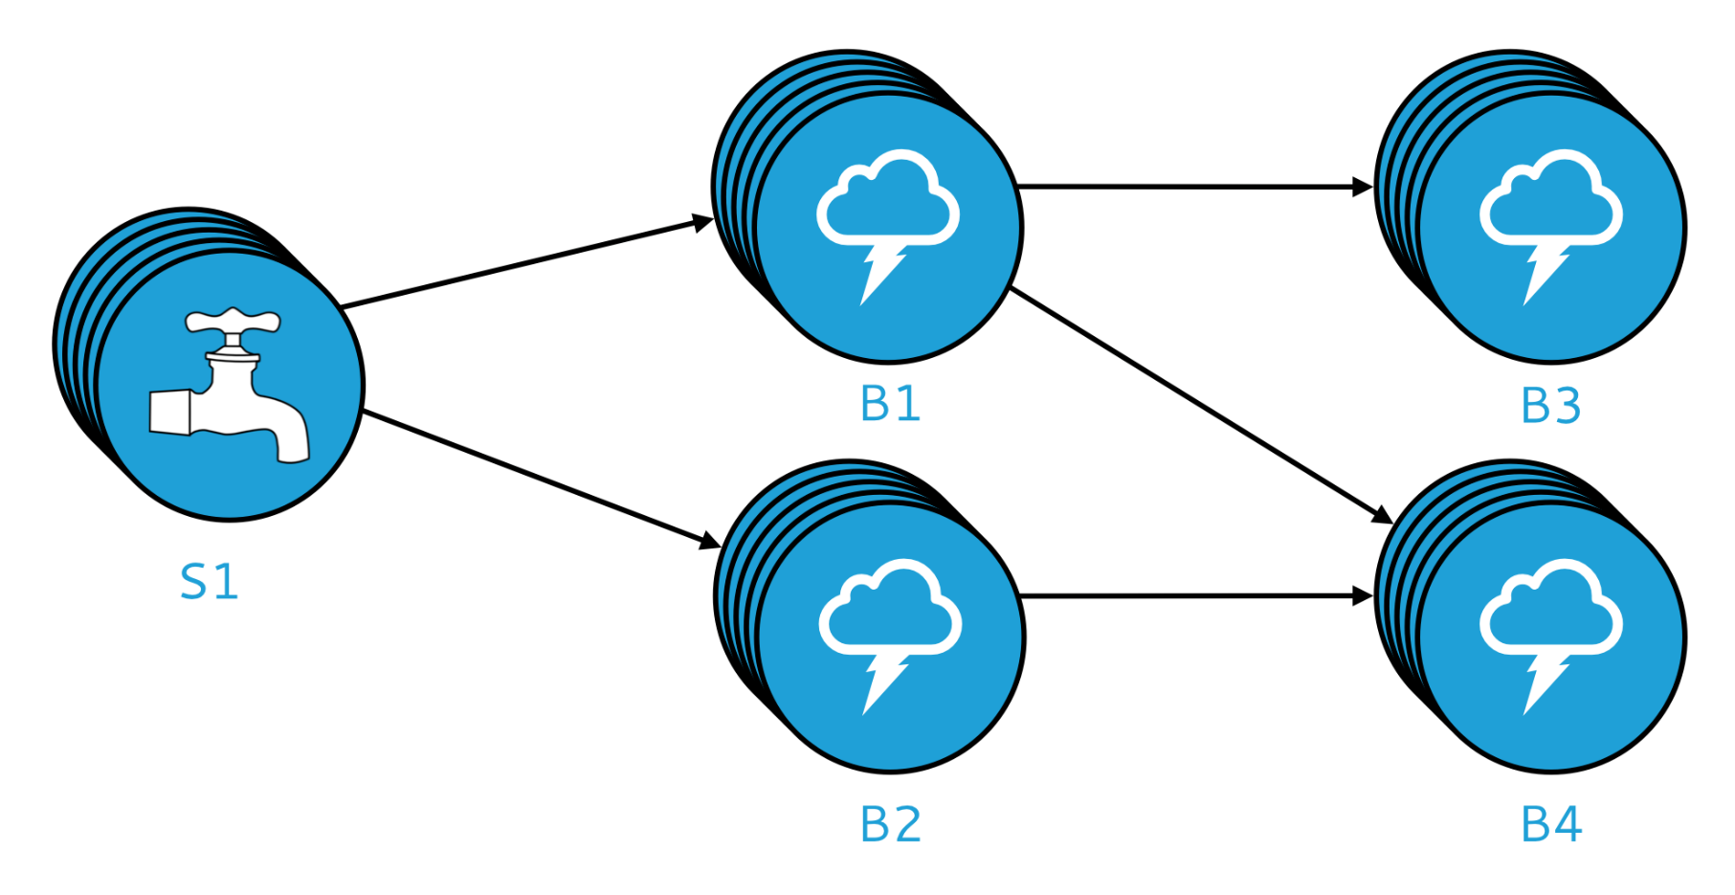
Spouts and Bolts: Physical Plan
Physical plan specifies execution details
Parallelism: how many instances of bolts and spouts to run
Placement of bolts/spouts on machines
…

Slide 29
Stream Groupings
Bolts are executed by multiple instances in parallel
User-specified as part of the topology
When a bolt emits a tuple, where should it go?
Answer: Grouping strategy
Shuffle grouping: randomly to different instances
Field grouping: based on a field in the tuple
Global grouping: to only a single instance
All grouping: to every instance

Slide 30


Slide 31
Spark Streaming: Discretized Streams
Run a streaming computation as a series
of very small, deterministic batch jobs
Chop up the stream into batches of X seconds
Process as RDDs!
Return results in batches
live data stream
Spark
Streaming
batches of X seconds
Spark
processed results
  Typical batch window ~1s
Source: All following Spark Streaming slides by Tathagata Das

Slide 32
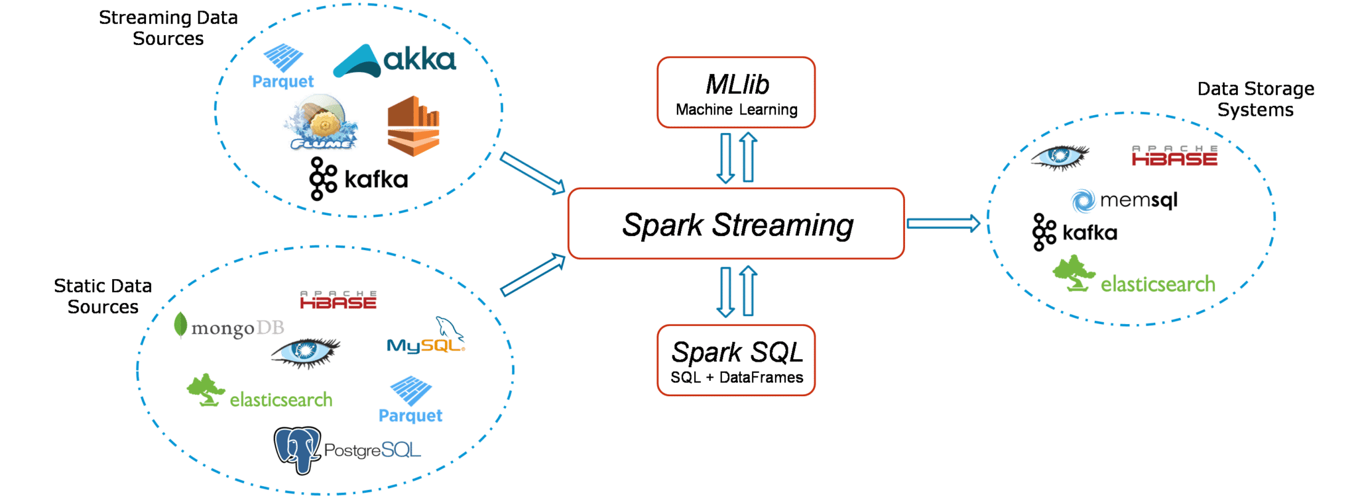

Slide 33

Example: Get hashtags from Twitter
val tweets = ssc.twitterStream(<Twitter username>, <Twitter password>)
DStream: a sequence of RDD representing a stream of data
Twitter Streaming API
batch @ t+1
batch @ t
batch @ t+2
tweets DStream
stored in memory as an RDD (immutable, distributed)

Slide 34
Example: Get hashtags from Twitter
val tweets = ssc.twitterStream(<Twitter username>, <Twitter password>)
val hashTags = tweets.flatMap (status => getTags(status))
new DStream
transformation: modify data in one
Dstream to create another DStream
batch @ t
batch @ t+1
batch @ t+2
tweets DStream
flatMap
flatMap
flatMap
hashTags Dstream
[#cat, #dog, … ]
…
new RDDs created for every batch

Slide 35
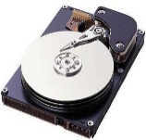
Example: Get hashtags from Twitter
val tweets = ssc.twitterStream(<Twitter username>, <Twitter password>)
val hashTags = tweets.flatMap (status => getTags(status))
hashTags.saveAsHadoopFiles("hdfs://...")
output operation: to push data to external storage
batch @ t
batch @ t+1
batch @ t+2
tweets DStream
flatMap
flatMap
flatMap
hashTags DStream
save
save
save
every batch saved to HDFS

Slide 36
Fault Tolerance
Bottom line: they’re just RDDs!

Slide 37


Fault Tolerance
Bottom line: they’re just RDDs!
tweets
RDD
input data replicated
in memory
flatMap
hashTags
RDD
lost partitions recomputed on other workers

Slide 38
Key Concepts
DStream – sequence of RDDs representing a stream of data
Twitter, HDFS, Kafka, Flume, TCP sockets
Transformations – modify data from on DStream to another
Standard RDD operations – map, countByValue, reduce, join, …
Stateful operations – window, countByValueAndWindow, …
Output Operations – send data to external entity
saveAsHadoopFiles – saves to HDFS
foreach – do anything with each batch of results

Slide 39
Example: Count the hashtags
val tweets = ssc.twitterStream(<Twitter username>, <Twitter password>)
val hashTags = tweets.flatMap (status => getTags(status))
val tagCounts = hashTags.countByValue()
batch @ t
batch @ t+1
batch @ t+2
tweets
flatMap
flatMap
flatMap
hashTags
map
map
…
map
tagCounts
[(#cat, 10), (#dog, 25), ... ]
reduceByKey
reduceByKey
reduceByKey

Slide 40
Example: Count the hashtags over last 10 mins
val tweets = ssc.twitterStream(<Twitter username>, <Twitter password>)
val hashTags = tweets.flatMap (status => getTags(status))
val tagCounts = hashTags.window(Minutes(10), Seconds(1)).countByValue()
sliding window operation
window length
sliding interval

Slide 41
Example: Count the hashtags over last 10 mins
val tagCounts = hashTags.window(Minutes(10), Seconds(1)).countByValue()
t-1
t
t+1
t+2
t+3
hashTags
sliding window
countByValue
count over all the data in the window
tagCounts

Slide 42
Smart window-based countByValue
val tagCounts = hashtags.countByValueAndWindow(Minutes(10), Seconds(1))
t-1
t
t+1
t+2
t+3
hashTags
countByValue
add the counts from the new batch in the window
subtract the counts from batch before the window
–
+
tagCounts
+
?

Slide 43
Smart window-based reduce
Incremental counting generalizes to many reduce operations
Need a function to “inverse reduce” (“subtract” for counting)
val tagCounts = hashtags
.countByValueAndWindow(Minutes(10), Seconds(1))
val tagCounts = hashtags
.reduceByKeyAndWindow(_ + _, _ - _, Minutes(10), Seconds(1))

Slide 44
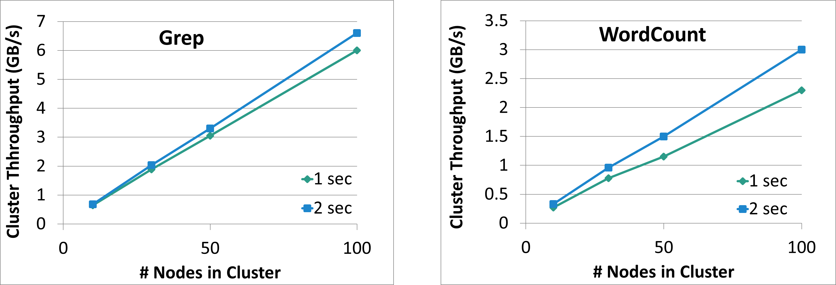
Performance
Can process 6 GB/sec (60M records/sec) of data on 100 nodes at sub-second latencyTested
with 100 streams of data on 100 EC2 instances with 4 cores each

Slide 45
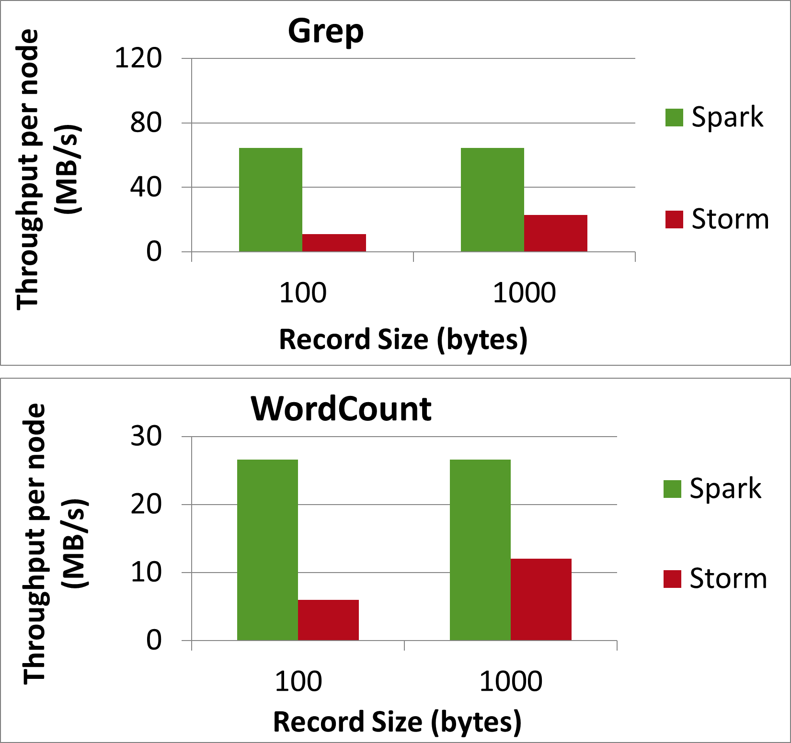
Comparison with Storm
Higher throughput than Storm
Spark Streaming: 670k records/second/node
Storm: 115k records/second/node

