Slide 1
Data-Intensive Distributed Computing
CS 431/631 451/651 (Fall 2019)
Part 9: Real-Time Data Analytics (2/2)
November 28, 2019
Ali Abedi
These slides are available at https://www.student.cs.uwaterloo.ca/~cs451
This work is licensed under a Creative Commons Attribution-Noncommercial-Share Alike 3.0 United States See http://creativecommons.org/licenses/by-nc-sa/3.0/us/ for details

Slide 2
Slides from Michael G. Noll, Verisign

Slide 3
Kafka?
http://kafka.apache.org/
Originated at LinkedIn, open sourced in early 2011
Implemented in Scala, some Java

Slide 4
Kafka adoption and use cases
LinkedIn: activity streams, operational metrics, data bus
400 nodes, 18k topics, 220B msg/day (peak 3.2M msg/s), May 2014
Netflix: real-time monitoring and event processing
Twitter: as part of their Storm real-time data pipelines
Spotify: log delivery (from 4h down to 10s), Hadoop
Loggly: log collection and processing
Mozilla: telemetry data
Airbnb, Cisco, Uber, …
https://cwiki.apache.org/confluence/display/KAFKA/Powered+By

Slide 5
How fast is Kafka?
“Up to 2 million writes/sec on 3 cheap machines”
Using 3 producers on 3 different machines, 3x async replication
Only 1 producer/machine because NIC already saturated

Slide 6
Why is Kafka so fast?
Fast writes:
While Kafka persists all data to disk, essentially all writes go to the page cache of OS, i.e. RAM.
Fast reads:
Very efficient to transfer data from page cache to a network socket
Linux: sendfile() system call
Combination of the two = fast Kafka!
Example (Operations): On a Kafka cluster where the consumers are mostly caught up you will see no read activity on the disks as they will be serving data entirely from cache.
http://kafka.apache.org/documentation.html#persistence

Slide 7
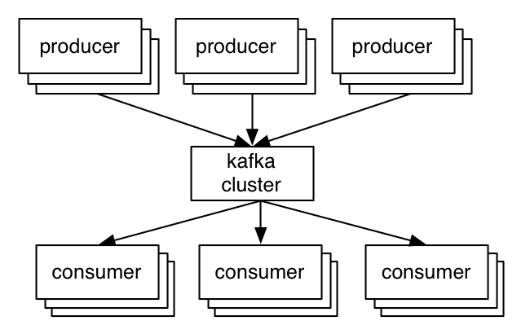
A first look
The who is who
Producers write data to brokers.
Consumers read data from brokers.
All this is distributed.
The data
Data is stored in topics.
Topics are split into partitions, which are replicated.

Slide 8
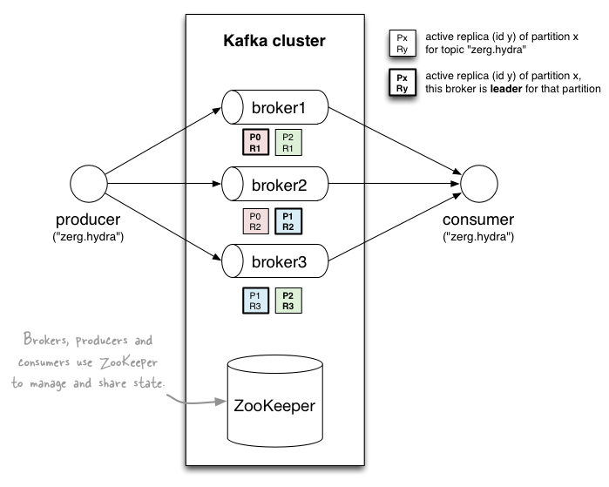
A first look
http://www.michael-noll.com/blog/2013/03/13/running-a-multi-broker-apache-kafka-cluster-on-a-single-node/

Slide 9
Topics
Topic: feed name to which messages are published
Example: “zerg.hydra”
Kafka prunes “head” based on age or max size or “key”
Producer A1
Kafka topic
Producer A2
…
…
new
Producer An
Older msgs
Newer msgs
Producers always append to “tail”
(think: append to a file)
Broker(s)

Slide 10
Topics
Consumer group C1
Consumers use an “offset pointer” to
track/control their read progress
(and decide the pace of consumption)
Consumer group C2
Producer A1
Producer A2
…
…
new
Producer An
Older msgs
Newer msgs
Producers always append to “tail”
(think: append to a file)
Broker(s)

Slide 11
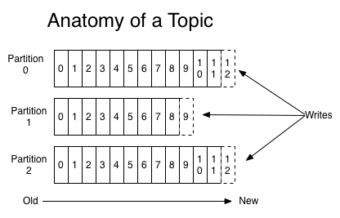
Partitions
A topic consists of partitions.
Partition: ordered + immutable sequence of messages that is continually appended to

Slide 12
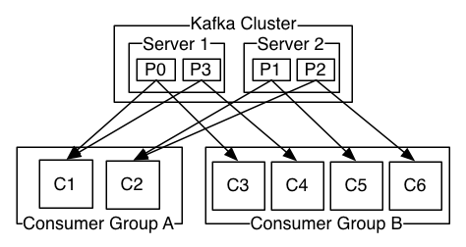
Partitions
#partitions of a topic is configurable
#partitions determines max consumer (group) parallelism
Consumer group A, with 2 consumers, reads from a 4-partition topic
Consumer group B, with 4 consumers, reads from the same topic

Slide 13
Partition offsets
Offset: messages in the partitions are each assigned a unique (per partition) and sequential id called the offset
Consumers track their pointers via (offset, partition, topic) tuples
Consumer group C1

Slide 14
Replicas of a partition
Replicas: “backups” of a partition
They exist solely to prevent data loss.
Replicas are never read from, never written to.
They do NOT help to increase producer or consumer parallelism!
Kafka tolerates (numReplicas - 1) dead brokers before losing data
LinkedIn: numReplicas == 2 → 1 broker can die

Slide 15
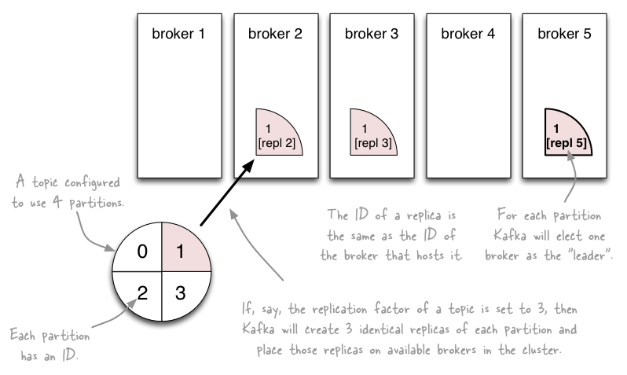
Topics vs. Partitions vs. Replicas
http://www.michael-noll.com/blog/2013/03/13/running-a-multi-broker-apache-kafka-cluster-on-a-single-node/

Slide 16
Writing data to Kafka

Slide 17
Writing data to Kafka
You use Kafka “producers” to write data to Kafka brokers.
Available for JVM (Java, Scala), C/C++, Python, Ruby, etc.
A simple example producer:

Slide 18
Producers
Two types of producers: “async” and “sync”
Same API and configuration, but slightly different semantics.
What applies to a sync producer almost always applies to async, too.
Async producer is preferred when you want higher throughput.

Slide 19
Producers
Two aspects worth mentioning because they significantly influence Kafka performance:
Message acking
Batching of messages

Slide 20
1) Message acking
Background:
In Kafka, a message is considered committed when “any required” replica for that partition have applied it to their data log.
Message acking is about conveying this “Yes, committed!” information back from the brokers to the producer client.
Exact meaning of “any required” is defined by request.required.acks.
Only producers must configure acking
Exact behavior is configured via request.required.acks, which determines when a produce request is considered completed.
Allows you to trade latency (speed) <-> durability (data safety).
Consumers: Acking and how you configured it on the side of producers do not matter to consumers because only committed messages are ever given out to consumers. They don’t need to worry about potentially seeing a message that could be lost if the leader fails.

Slide 21
1) Message acking
Typical values of request.required.acks
0: producer never waits for an ack from the broker.
Gives the lowest latency but the weakest durability guarantees.
1: producer gets an ack after the leader replica has received the data.
Gives better durability as the we wait until the lead broker acks the request. Only msgs that were written to the now-dead leader but not yet replicated will be lost.
-1: producer gets an ack after all replicas have received the data.
Gives the best durability as Kafka guarantees that no data will be lost as long as at least one replica remains.
better
latency
better
durability

Slide 22
2) Batching of messages
Batching improves throughput
Tradeoff is data loss if client dies before pending messages have been sent.
You have two options to “batch” messages:
Use send(listOfMessages).
Sync producer: will send this list (“batch”) of messages right now. Blocks!
Async producer: will send this list of messages in background “as usual”, i.e. according to batch-related configuration settings. Does not block!
Use send(singleMessage) with async producer.
For async the behavior is the same as send(listOfMessages).

Slide 23
Reading data from Kafka

Slide 24
Reading data from Kafka
You use Kafka “consumers” to write data to Kafka brokers.
Available for JVM (Java, Scala), C/C++, Python, Ruby, etc.

Slide 25
Reading data from Kafka
Consumers pull from Kafka (there’s no push)
Allows consumers to control their pace of consumption.
Allows to design downstream apps for average load, not peak load
Consumers are responsible to track their read positions aka “offsets”

Slide 26
Reading data from Kafka
Consumer “groups”
Allows multi-threaded and/or multi-machine consumption from Kafka topics.
Consumers “join” a group by using the same group.id
Kafka guarantees a message is only ever read by a single consumer in a group.
Kafka assigns the partitions of a topic to the consumers in a group so that each partition is consumed by exactly one consumer in the group.
Maximum parallelism of a consumer group: #consumers (in the group) <= #partitions

Slide 27
Guarantees when reading data from Kafka
A message is only ever read by a single consumer in a group.
A consumer sees messages in the order they were stored in the log.
The order of messages is only guaranteed within a partition.

Slide 28
Rebalancing: how consumers meet brokers
The assignment of brokers – via the partitions of a topic – to consumers is quite important, and it is dynamic at run-time.

Slide 29
probabilistic data structures for
Big data and streaming

Slide 30
Streams Processing Challenges
Inherent challenges
Latency requirements
Space bounds
System challenges
Bursty behavior and load balancing
Out-of-order message delivery and non-determinism
Consistency semantics (at most once, exactly once, at least once)

Slide 31
Algorithmic Solutions
Throw away data
Sampling
Accepting some approximations
Hashing

Slide 32
Reservoir Sampling
Task: select s elements from a stream of size N with uniform probability
N can be very very large
We might not even know what N is! (infinite stream)
Solution: Reservoir sampling
Store first s elements
For the k-th element thereafter, keep with probability s/k (randomly discard an existing element)
Example: s = 10
Keep first 10 elements
11th element: keep with 10/11
12th element: keep with 10/12
…

Slide 33
Reservoir Sampling: How does it work?
Example: s = 10
Keep first 10 elements
11th element: keep with 10/11
If we decide to keep it: sampled uniformly by definition
probability existing item is discarded: 10/11 × 1/10 = 1/11
probability existing item survives: 10/11
General case: at the (k + 1)th element
Probability of selecting each item up until now is s/k
Probability existing item is discarded: s/(k+1) × 1/s = 1/(k + 1)
Probability existing item survives: k/(k + 1)
Probability each item survives to (k + 1)th round: (s/k) × k/(k + 1) = s/(k + 1)

Slide 34
Hashing for Three Common Tasks
Cardinality estimation
What’s the cardinality of set S?
How many unique visitors to this page?
HashSet
HLL counter
Set membership
Is x a member of set S?
Has this user seen this ad before?
HashSet
Bloom Filter
Frequency estimation
How many times have we observed x?
How many queries has this user issued?
HashMap
CMS

Slide 35
HyperLogLog Counter
Task: cardinality estimation of set
size() → number of unique elements in the set
Observation: hash each item and examine the hash code
On expectation, 1/2 of the hash codes will start with 0
On expectation, 1/4 of the hash codes will start with 00
On expectation, 1/8 of the hash codes will start with 000
On expectation, 1/16 of the hash codes will start with 0000
…
How do we take advantage of this observation?

Slide 36
Bloom Filters
Task: keep track of set membership
put(x) → insert x into the set
contains(x) → yes if x is a member of the set
Components
m-bit bit vector
k hash functions: h₁ … h_{k}
0
0
0
0
0
0
0
0
0
0
0
0

Slide 37
Bloom Filters: put
put
x
h₁(x) = 2
h₂(x) = 5
h₃(x) = 11
0
0
0
0
0
0
0
0
0
0
0
0

Slide 38
Bloom Filters: put
put
x
0
1
0
0
1
0
0
0
0
0
1
0

Slide 39
Bloom Filters: contains
contains
x
h₁(x) = 2
h₂(x) = 5
h₃(x) = 11
0
1
0
0
1
0
0
0
0
0
1
0

Slide 40
Bloom Filters: contains
contains
x
h₁(x) = 2
h₂(x) = 5
h₃(x) = 11
A[h₁(x)]
A[h₂(x)]
AND = YES
A[h₃(x)]
0
1
0
0
1
0
0
0
0
0
1
0

Slide 41
Bloom Filters: contains
contains
y
h₁(y) = 2
h₂(y) = 6
h₃(y) = 9
0
1
0
0
1
0
0
0
0
0
1
0

Slide 42
Bloom Filters: contains
contains
y
h₁(y) = 2
h₂(y) = 6
h₃(y) = 9
A[h₁(y)]
A[h₂(y)]
AND = NO
A[h₃(y)]
0
1
0
0
1
0
0
0
0
0
1
0
What’s going on here?

Slide 43
Bloom Filters
Error properties: contains(x)
False positives possible
No false negatives
Usage
Constraints: capacity, error probability
Tunable parameters: size of bit vector m, number of hash functions k

Slide 44
Count-Min Sketches
Task: frequency estimation
put(x) → increment count of x by one
get(x) → returns the frequency of x
Components
m by k array of counters
k hash functions: h₁ … h_{k}
m
0
0
0
0
0
0
0
0
0
0
0
0
0
0
0
0
0
0
0
0
0
0
0
0
k
0
0
0
0
0
0
0
0
0
0
0
0
0
0
0
0
0
0
0
0
0
0
0
0

Slide 45
Count-Min Sketches: put
put
x
h₁(x) = 2
h₂(x) = 5
h₃(x) = 11
h₄(x) = 4
0
0
0
0
0
0
0
0
0
0
0
0
0
0
0
0
0
0
0
0
0
0
0
0
0
0
0
0
0
0
0
0
0
0
0
0
0
0
0
0
0
0
0
0
0
0
0
0

Slide 46
Count-Min Sketches: put
put
x
0
1
0
0
0
0
0
0
0
0
0
0
0
0
0
0
1
0
0
0
0
0
0
0
0
0
0
0
0
0
0
0
0
0
1
0
0
0
0
1
0
0
0
0
0
0
0
0

Slide 47
Count-Min Sketches: put
put
x
h₁(x) = 2
h₂(x) = 5
h₃(x) = 11
h₄(x) = 4
0
1
0
0
0
0
0
0
0
0
0
0
0
0
0
0
1
0
0
0
0
0
0
0
0
0
0
0
0
0
0
0
0
0
1
0
0
0
0
1
0
0
0
0
0
0
0
0

Slide 48
Count-Min Sketches: put
put
x
0
2
0
0
0
0
0
0
0
0
0
0
0
0
0
0
2
0
0
0
0
0
0
0
0
0
0
0
0
0
0
0
0
0
2
0
0
0
0
2
0
0
0
0
0
0
0
0

Slide 49
Count-Min Sketches: put
put
y
h₁(y) = 6
h₂(y) = 5
h₃(y) = 12
h₄(y) = 2
0
2
0
0
0
0
0
0
0
0
0
0
0
0
0
0
2
0
0
0
0
0
0
0
0
0
0
0
0
0
0
0
0
0
2
0
0
0
0
2
0
0
0
0
0
0
0
0

Slide 50
Count-Min Sketches: put
put
y
0
2
0
0
0
1
0
0
0
0
0
0
0
0
0
0
3
0
0
0
0
0
0
0
0
0
0
0
0
0
0
0
0
0
2
1
0
1
0
2
0
0
0
0
0
0
0
0

Slide 51
Count-Min Sketches: get
get
x
h₁(x) = 2
h₂(x) = 5
h₃(x) = 11
h₄(x) = 4
0
2
0
0
0
1
0
0
0
0
0
0
0
0
0
0
3
0
0
0
0
0
0
0
0
0
0
0
0
0
0
0
0
0
2
1
0
1
0
2
0
0
0
0
0
0
0
0

Slide 52
Count-Min Sketches: get
get
x
h₁(x) = 2
h₂(x) = 5
h₃(x) = 11
h₄(x) = 4
A[h₁(x)]
A[h₂(x)]
MIN = 2
A[h₃(x)]
A[h₄(x)]
0
2
0
0
0
1
0
0
0
0
0
0
0
0
0
0
3
0
0
0
0
0
0
0
0
0
0
0
0
0
0
0
0
0
2
1
0
1
0
2
0
0
0
0
0
0
0
0

Slide 53
Count-Min Sketches: get
get
y
h₁(y) = 6
h₂(y) = 5
h₃(y) = 12
h₄(y) = 2
0
2
0
0
0
1
0
0
0
0
0
0
0
0
0
0
3
0
0
0
0
0
0
0
0
0
0
0
0
0
0
0
0
0
2
1
0
1
0
2
0
0
0
0
0
0
0
0

Slide 54
Count-Min Sketches: get
get
y
h₁(y) = 6
h₂(y) = 5
h₃(y) = 12
h₄(y) = 2
A[h₁(y)]
A[h₂(y)]
MIN = 1
A[h₃(y)]
A[h₄(y)]
0
2
0
0
0
1
0
0
0
0
0
0
0
0
0
0
3
0
0
0
0
0
0
0
0
0
0
0
0
0
0
0
0
0
2
1
0
1
0
2
0
0
0
0
0
0
0
0

Slide 55
Count-Min Sketches
Error properties: get(x)
Reasonable estimation of heavy-hitters
Frequent over-estimation of tail
Usage
Constraints: number of distinct events, distribution of events, error bounds
Tunable parameters: number of counters m and hash functions k, size of counters

Slide 56
Hashing for Three Common Tasks
Cardinality estimation
What’s the cardinality of set S?
How many unique visitors to this page?
HashSet
HLL counter
Set membership
Is x a member of set S?
Has this user seen this ad before?
HashSet
Bloom Filter
Frequency estimation
How many times have we observed x?
How many queries has this user issued?
HashMap
CMS

